Slide 1

Please read this before using presentation
This presentation is based on content presented at the 2017 Dangerous Goods Rail Safety Forum.
Department of Mines, Industry Regulation and Safety (DMIRS) supports and encourages reuse of its information (including data), and endorses use of the Australian Governments Open Access and Licensing Framework (AusGOAL)
This material is licensed under Creative Commons Attribution 4.0 licence. We request that you observe and retain any copyright or related notices that may accompany this material as part of attribution. This is a requirement of Creative Commons Licences.
Please give attribution to Department of Mines, Industry Regulation and Safety, 2017.
For resources, information or clarification, please contact: RSDComms@dmirs.wa.gov.au or visit www.dmirs.wa.gov.au/ResourcesSafety

Slide 2
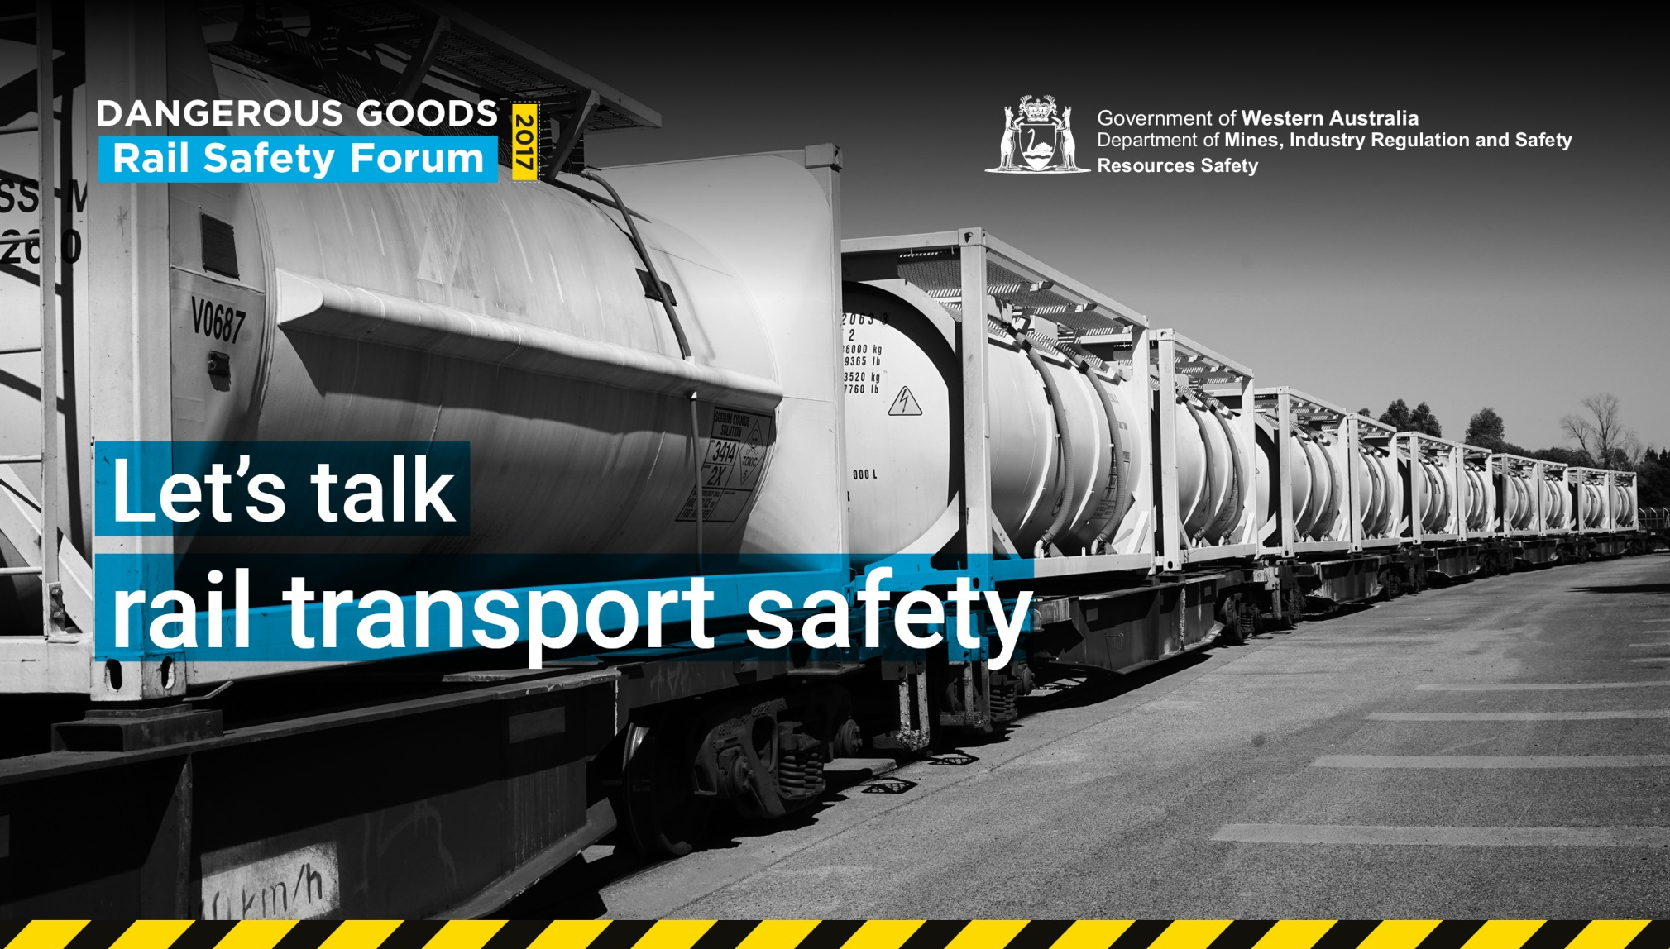

Slide 3
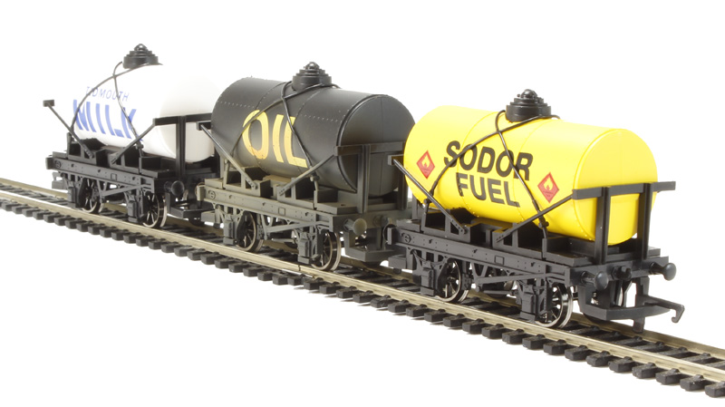
WA dangerous goods rail transfer observations and an overview of the Julia Creek incident

Slide 4
Overview of our rail journey
DG rail transport – getting started
Regulating – familiarise ourselves with rail practices
DG transport risk – focus on transfer
DG rail incidents – prevention and mitigation
Where to from here?

Slide 5
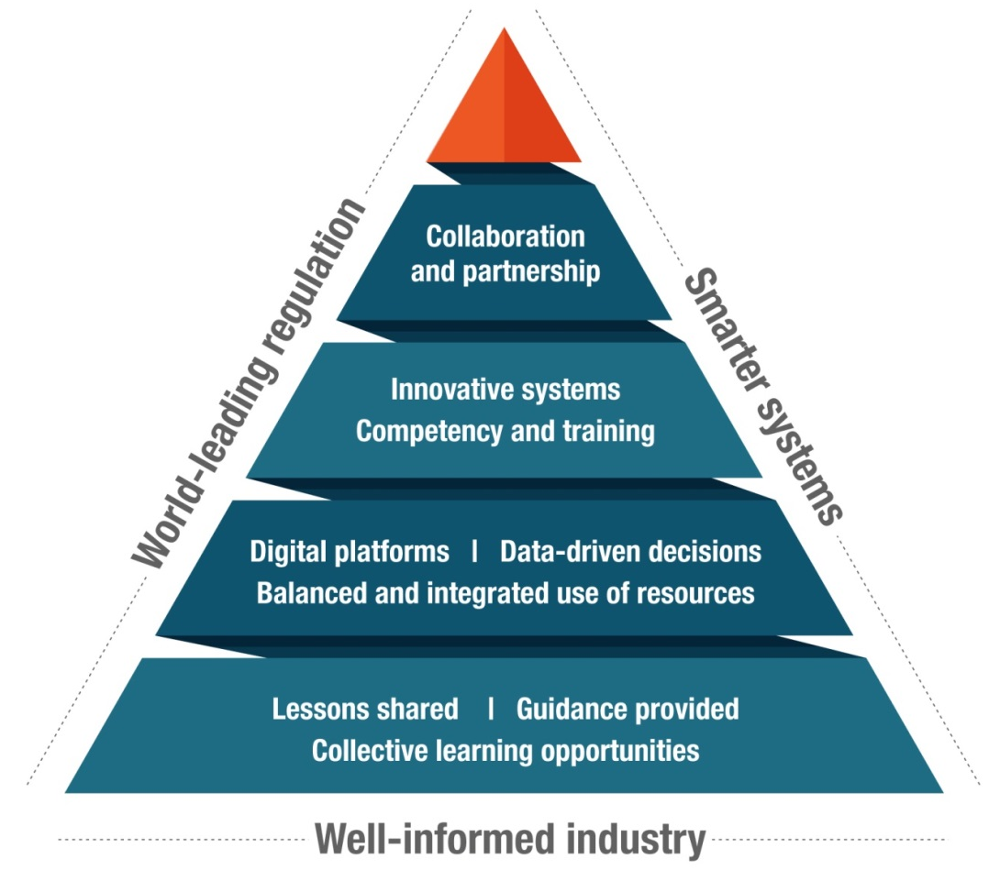
Why do we care? It’s our responsibility!
Dangerous Goods Safety (Road and Rail Transport of Non-explosives) Regulations 2007

Slide 6
What have we done recently?
Rail operator audits
MoU with other regulators
Rail transfer observations
Surveyed currency of Australian DG regulator’s involvement in rail transport

Slide 7
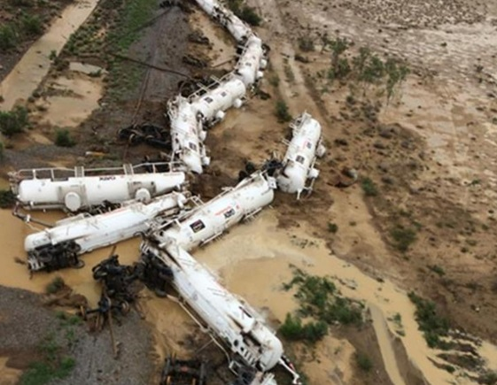
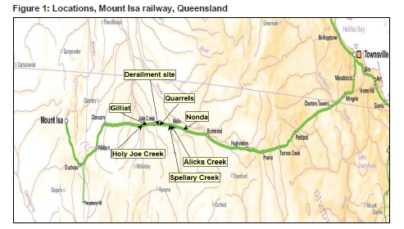
What about rail in Australia?
Derailment Dec 2015
820 kL H₂SO₄ in 26 tank wagons
Loss of Containment - 61 kL
20km East of Julia Creek

Slide 8
Julia Creek Logs
Train crew saw a washout about 45 m ahead & called out a warning
The driver immediately emergency braked
Locomotive entered the washout
Crew felt the locomotive bounce and saw water splash on the windscreen before it derailed and began to tip over

Slide 9
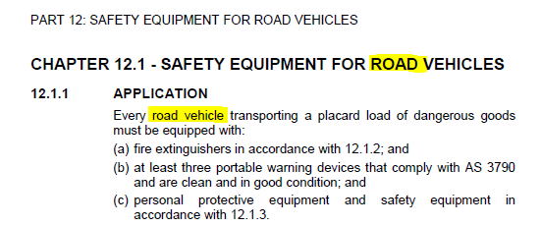
Australian Dangerous Goods Code (ADG7.5)

Slide 10
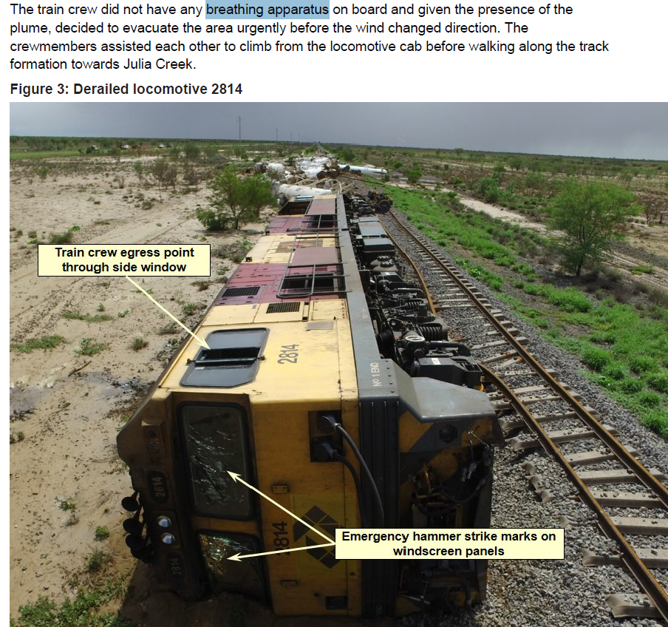
No specific PPE requirements

Slide 11
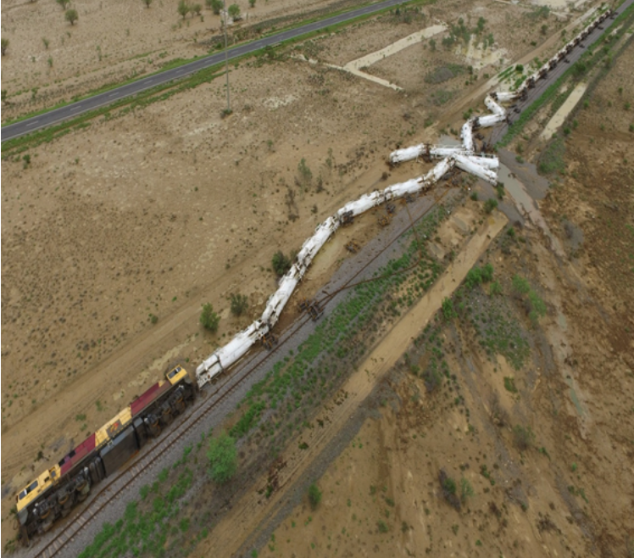

Approved Emergency Responders (AERs) apply to rail (WA Law)

Slide 12
DMIRS awakens – getting into rail
DG Rail Working Group convened August 2015 to examine DG rail regulation and how to establish a compliance program
Dangerous goods officers (DGOs) conducted rail familiarisation at Aurizon depots mid-2016
“Force Field Analysis” of our rail regulation performed and Working Group conducted a SWOT Analysis
Identified 15 rail transfer sites in WA and adopted a list of the criteria to be addressed and interrogated in 2016-17 period

Slide 13
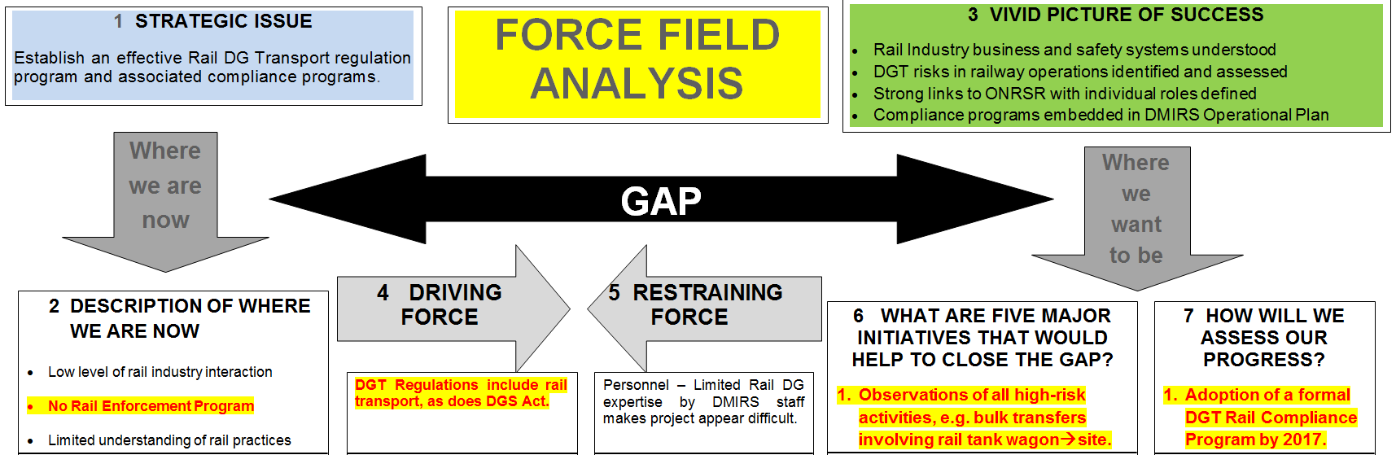
Scoping DG rail compliance in WA

Slide 14
Opportunities from SWOT analysis
Joint inspection and training with rail agencies
Examine and report upon risks observed in industry
Conduct “Rail-blocks” analogous to “Road-blocks” conducted in on-road enforcement (ORE) of road dangerous goods transport (DGT)
Educate Rail Operators on DGT requirements, e.g. PPE, Segregation
Involve agencies and stakeholders in a 2017 DG Rail Forum.
Notes:
LIAISON WITH ONRSR
INDIVIDUAL RAIL OPERATORS
BULK TRANSFER
DGT COMPLIANCE PROGRAM
OTHER

Slide 15
Survey of Australian DGT regulators
Element | Questions
Jurisdiction | Which state agency has primary responsibility for rail transport of dangerous goods?
Regulation | What type of interactions does your agency have with rail operators? Do you conduct system audits of rail operators against relevant criteria of Dangerous Goods Transport Regulations? Is a DGT Rail Compliance Program in force? Do you conduct inspections of rail terminals, rail depots or rail gantries at DG sites? Are observations of bulk transfer at the rail wagon / consignee interface conducted?

Slide 16
Survey of Australian DGT regulators
Element | Questions
Approvals | Does your agency grant approvals for rail tank wagon design?
HAZMAT | What requirements are there of rail operators in your state for Transport Emergency Response Planning (T.E.R.P.)? Which agency or company fulfils role of Incident Controller in a DG rail incident? Are DG rail incidents reported to your agency?
Route Planning | What are the requirements for route planning, i.e. are there regulatory approval processes, risk assessment by operator, etc. in place? Are Environmental Conditions placed upon toxic goods, e.g. sodium cyanide, anhydrous ammonia or chlorine gas transported by rail?

Slide 17
State responses to 4 key questions
System audits against DG Transport Regs?
  Not undertaken – except in QLD who conduct risk-based audits
Inspections of rail terminals, depots or gantries?
  VIC and WA some involvement – QLD focus on specific activities
Requirements for Transport Emergency Response Plan (TERP)?
  All regulators require TERP under DGT regulations and ADG Code
Requirements for route planning & risk assessment?
  Unanimously viewed as operator responsibility – no approvals

Slide 18
Getting on-board with rail operations
Examine consignment systems for DGT by rail
Discuss liaison with DG manufacturer and consignee
Understand system for assuring tank wagon safety
Scrutinise TERP including communications and Approved Emergency Responder (AER)
Review specific training packages incl. bulk transfer procedures
Learn about rail operations and discuss safety implications.

Slide 19
Focus on bulk transfer of DG
Developed generic template for bulk DG transfer
  Procedures
  Hardware
  Controls
  Maintenance
  Risk Management
Scheduled observations for live loading and active unloading
Typically spent 4 hours at site
  Reviewing operator responsibilities
  Observing mechanics and controls of transfer
  Interviewing key personnel to understand risk management
Notes:
LP GAS – Rail wagon → Depot storage tank
AMMONIA – Manuf. → Rail → Road Tanker → Mine-site
SODIUM CYANIDE – Manuf. → Rail ISO → Kalg. → Semi → Mine
CAUSTIC SODA – Port → Rail → Process Site → Rail → Next site
SULPHURIC ACID – Manuf. → Rail → Kwinana storage tank
SULPHUR – Port Storage → Bulk container → Siding → Semi → Mine
PETROL – Terminal → Rail Tank → Kalg. depot

Slide 20
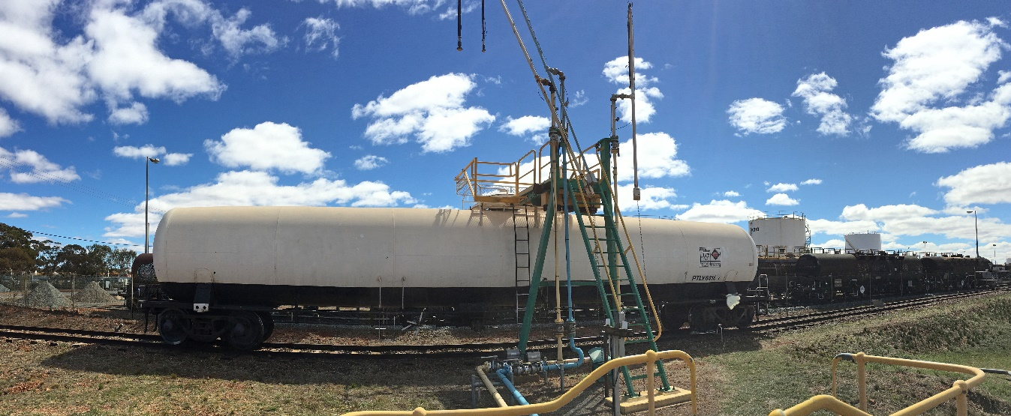
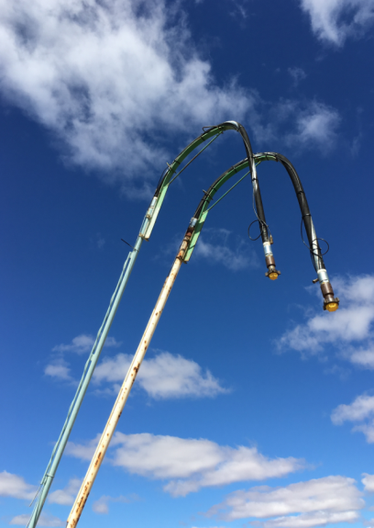
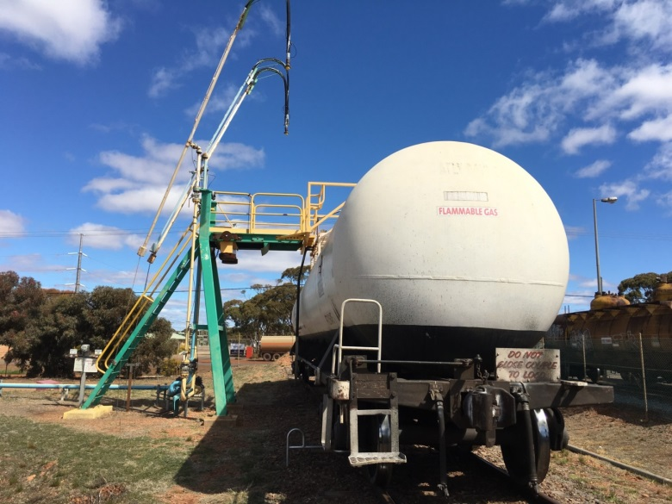
LP gas (Div. 2.1)
Rail wagon → Depot storage tank

Slide 21
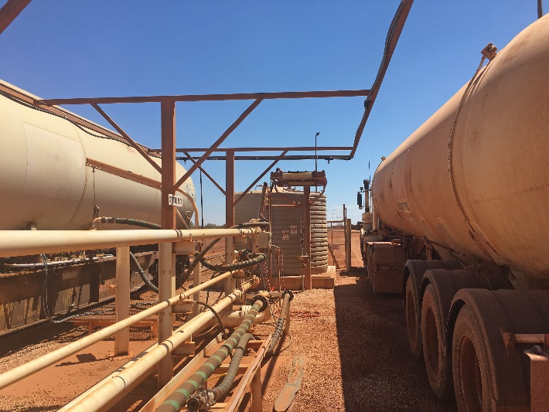
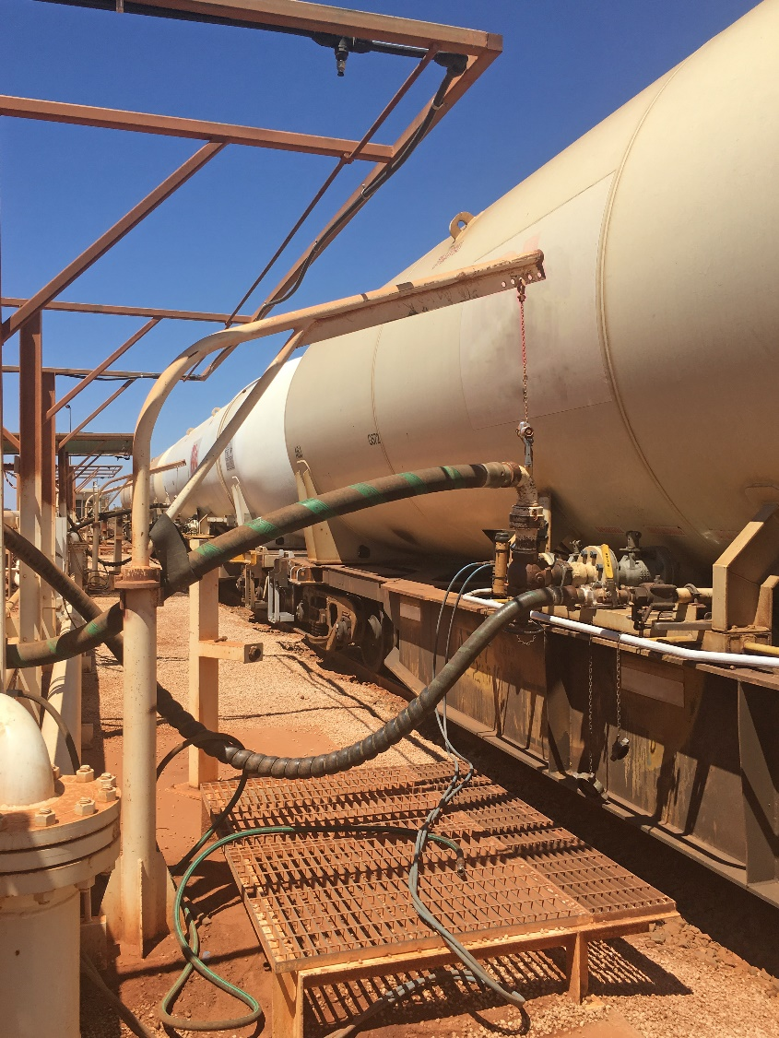
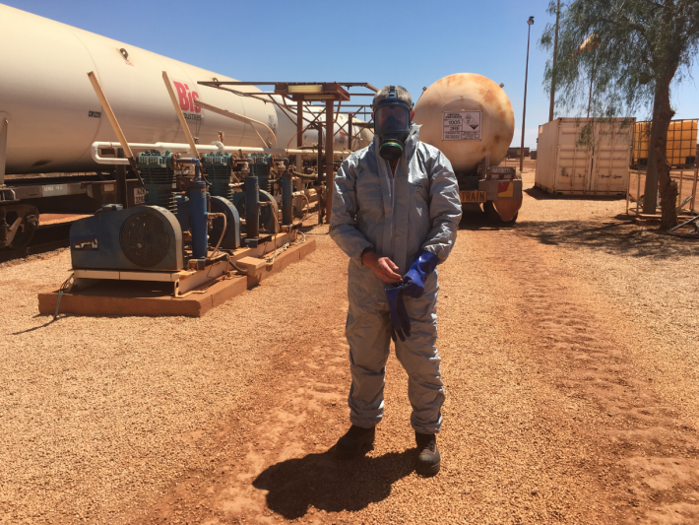
Anhydrous ammonia (div. 2.3 sub-risk 8)
Manufacturer → Rail → Road tanker → Mine site

Slide 22
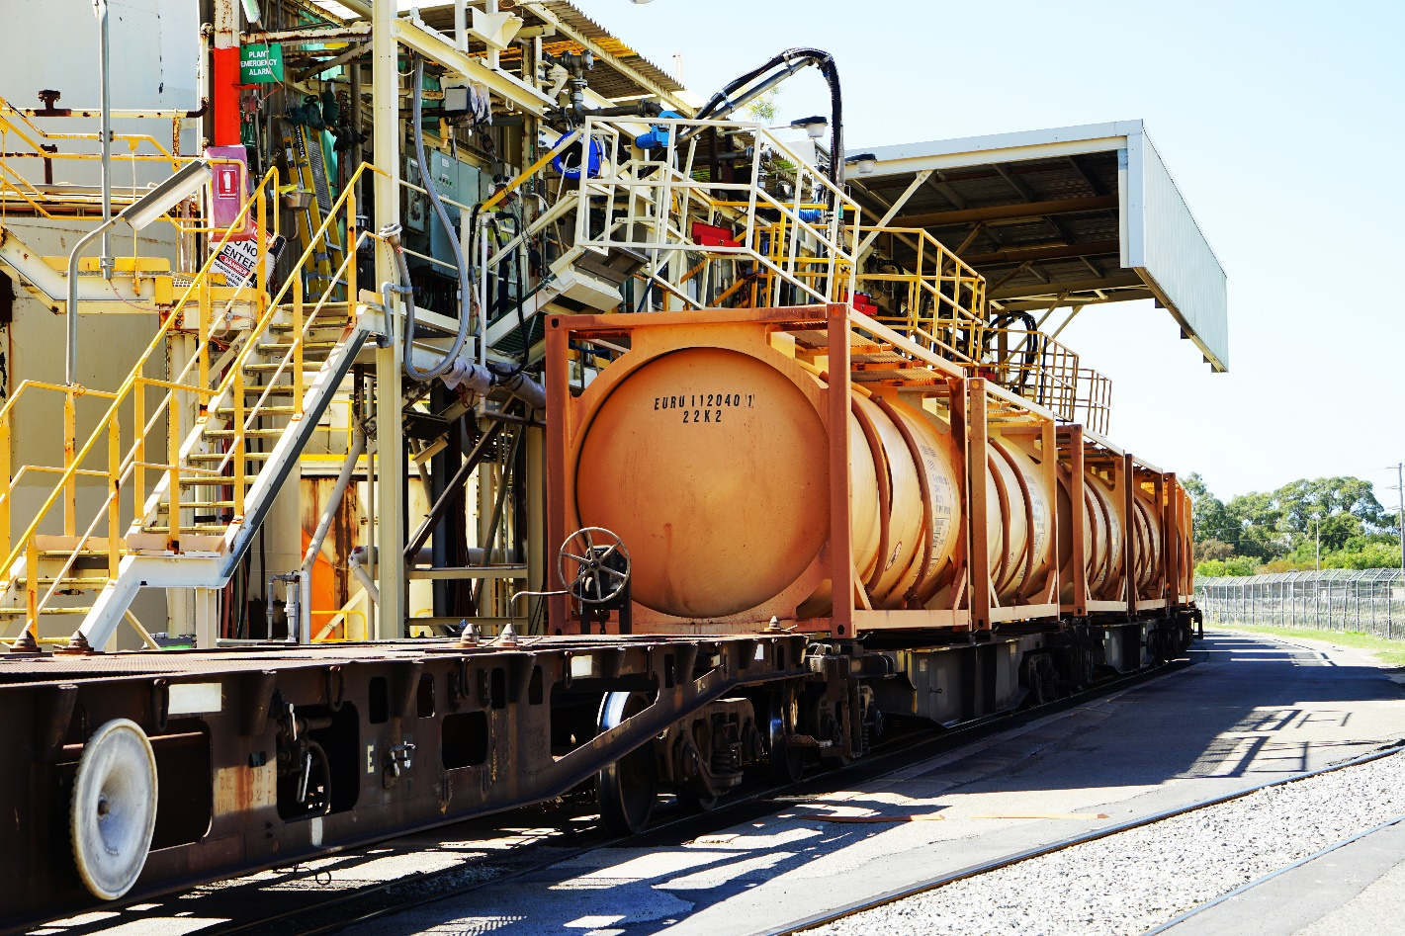
Sodium cyanide solution (div. 6.1)
Manufacturer → Rail ISO → Kalgoorlie → Semi → Mine

Slide 23
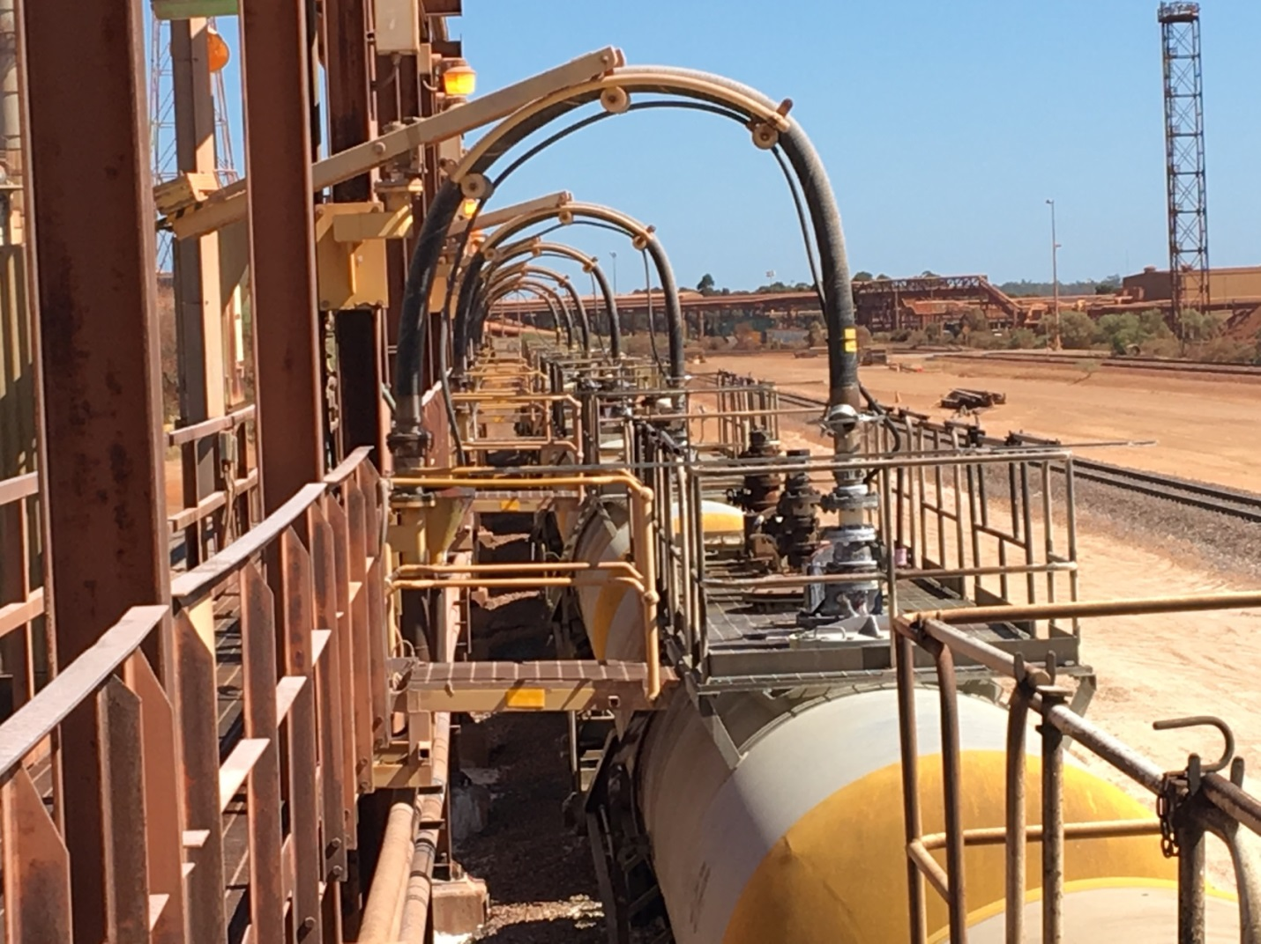
Caustic soda (Class 8)
Port → Rail → Process site → Rail → Next site

Slide 24
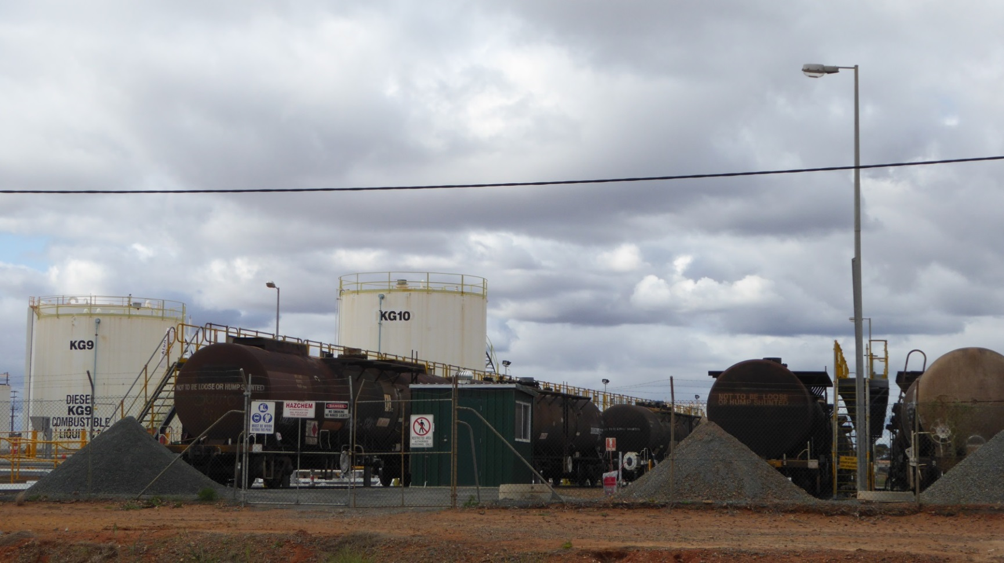
Petrol (Class 3) and Diesel (CL)
Metro terminal → Rail tank → Kalgoorlie depot

Slide 25
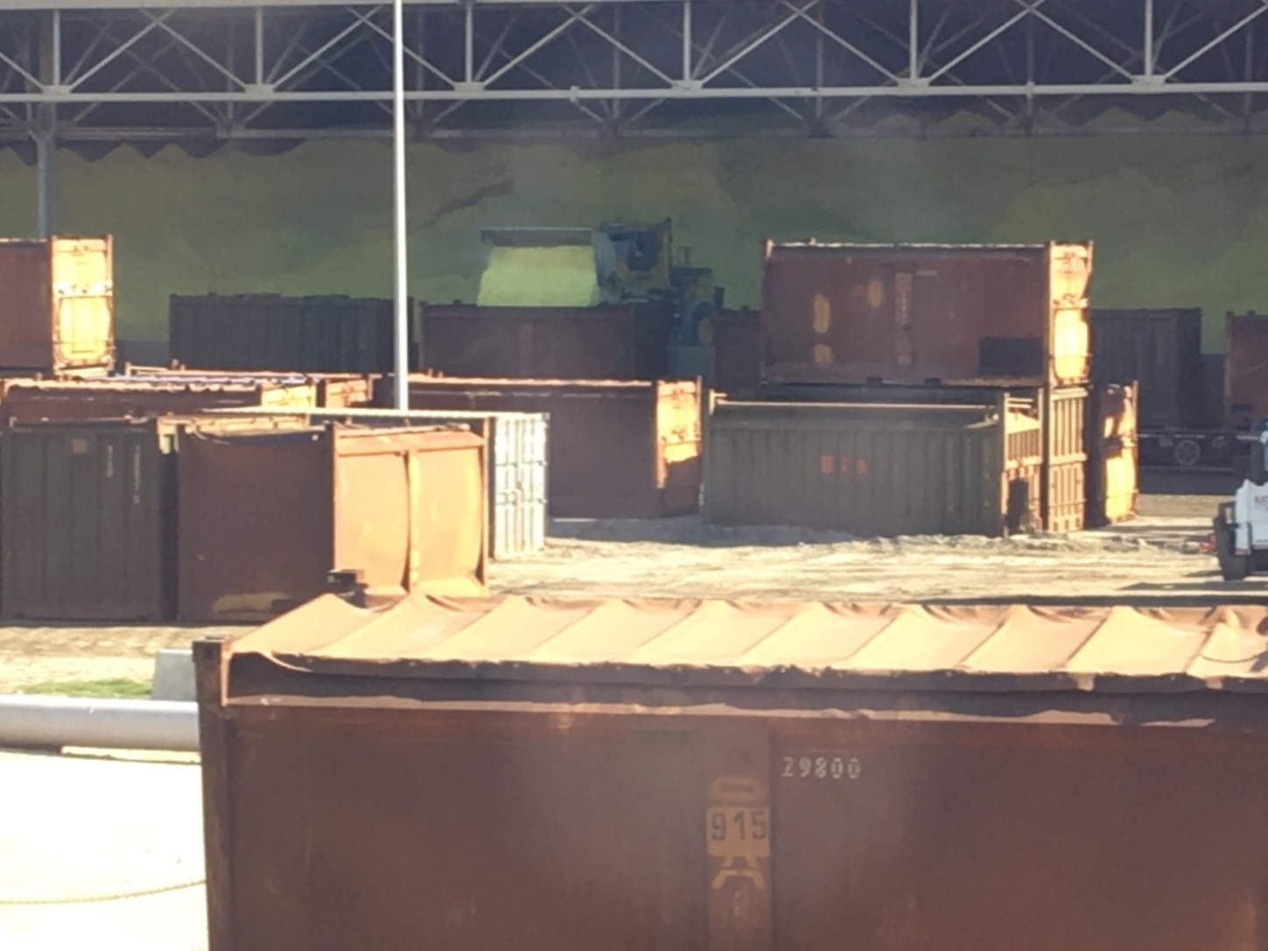
Sulphur (div. 4.1)
Port storage → Bulk container → Siding → Semi → Mine

Slide 26
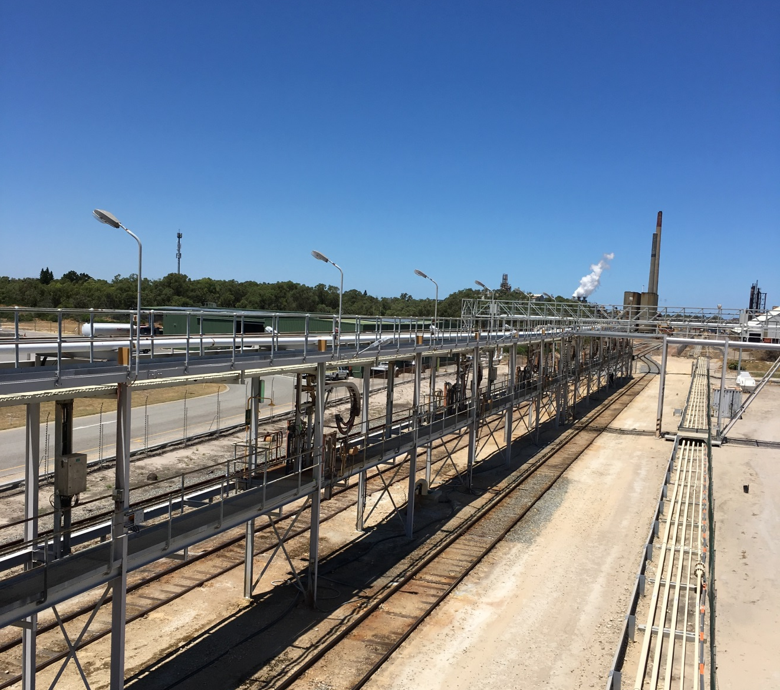
Sulphuric acid (Class 8)
Manufacturer → Rail → Kwinana storage tank

Slide 27


Summary of findings – DG transfers
POSITIVE FINDINGS | OPPORTUNITY FOR IMPROVEMENT
Manufacturers’ infrastructure aligns with risk minimisation principles | Remote sidings need some improvement w.r.t transfer controls
Cyanide solution transfer protocols positively influencing transport and mine-site safety | Concern for caustic soda unloading is control of air pressure
Positive interactions between manufacturers/ consignors and rail operators | Emergency planning requires attention– - response capability - mobilising resources to remote areas

Slide 28
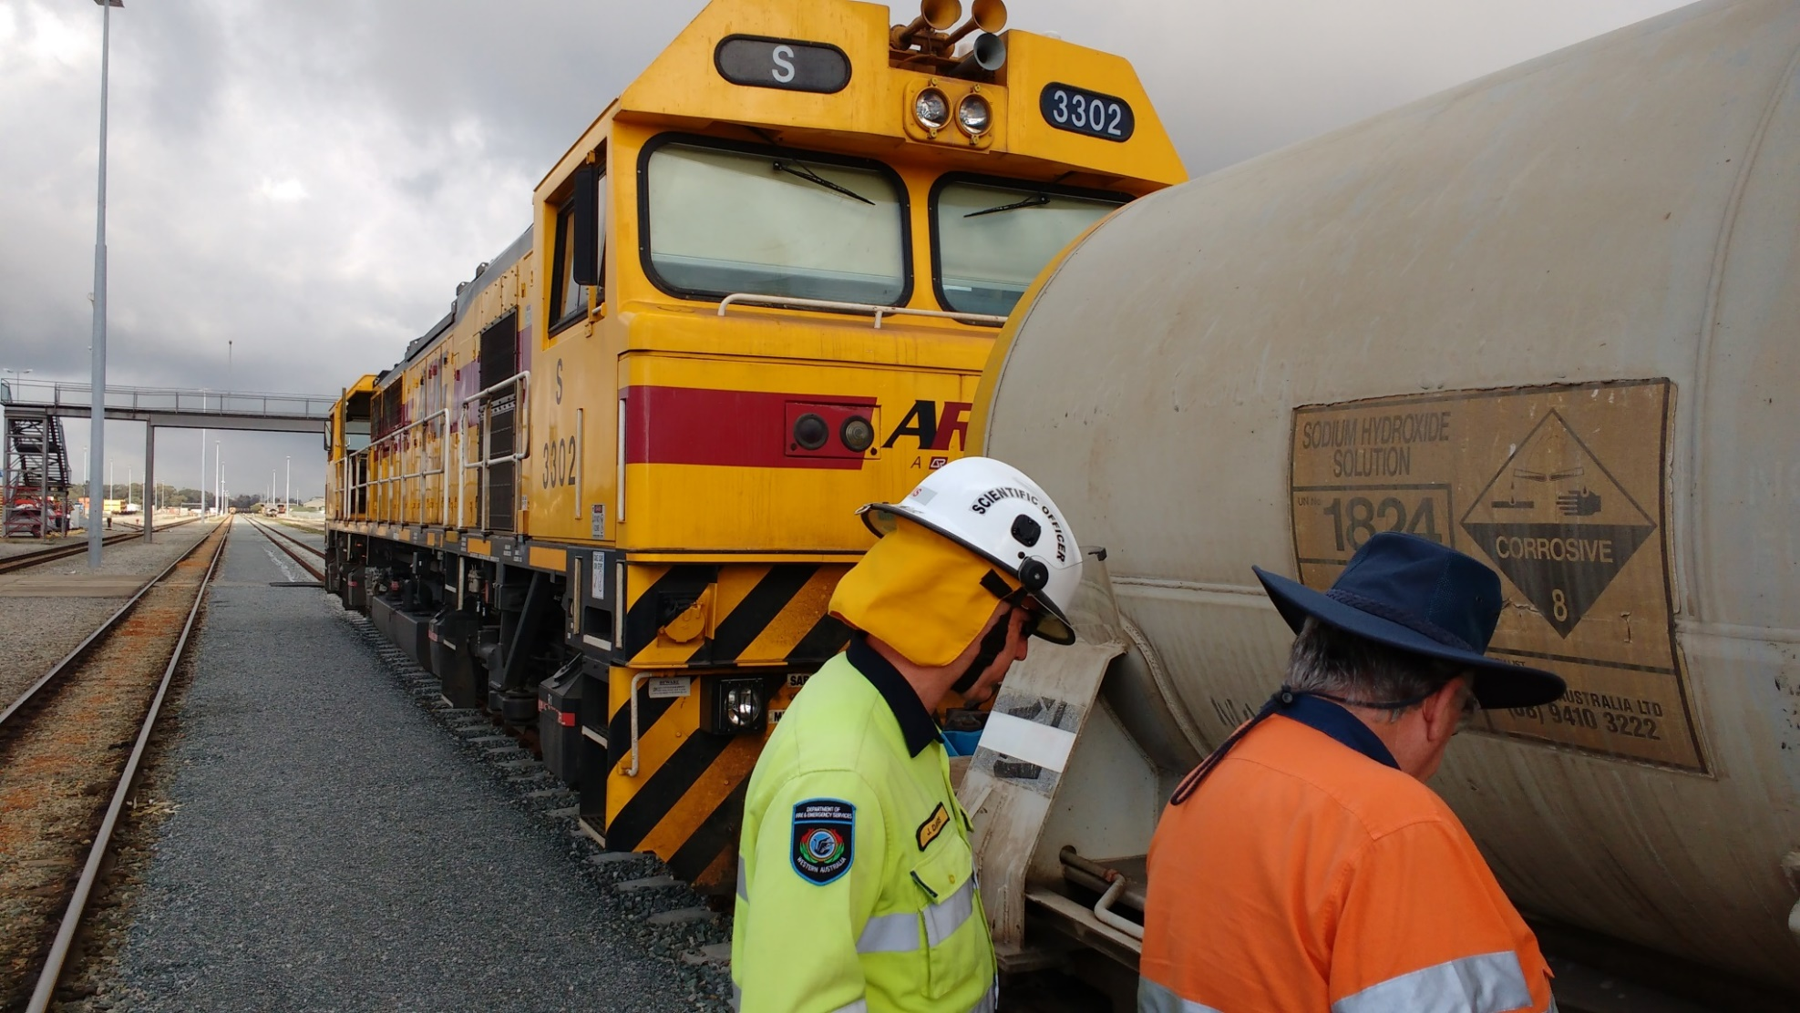
What have we found?

Slide 29
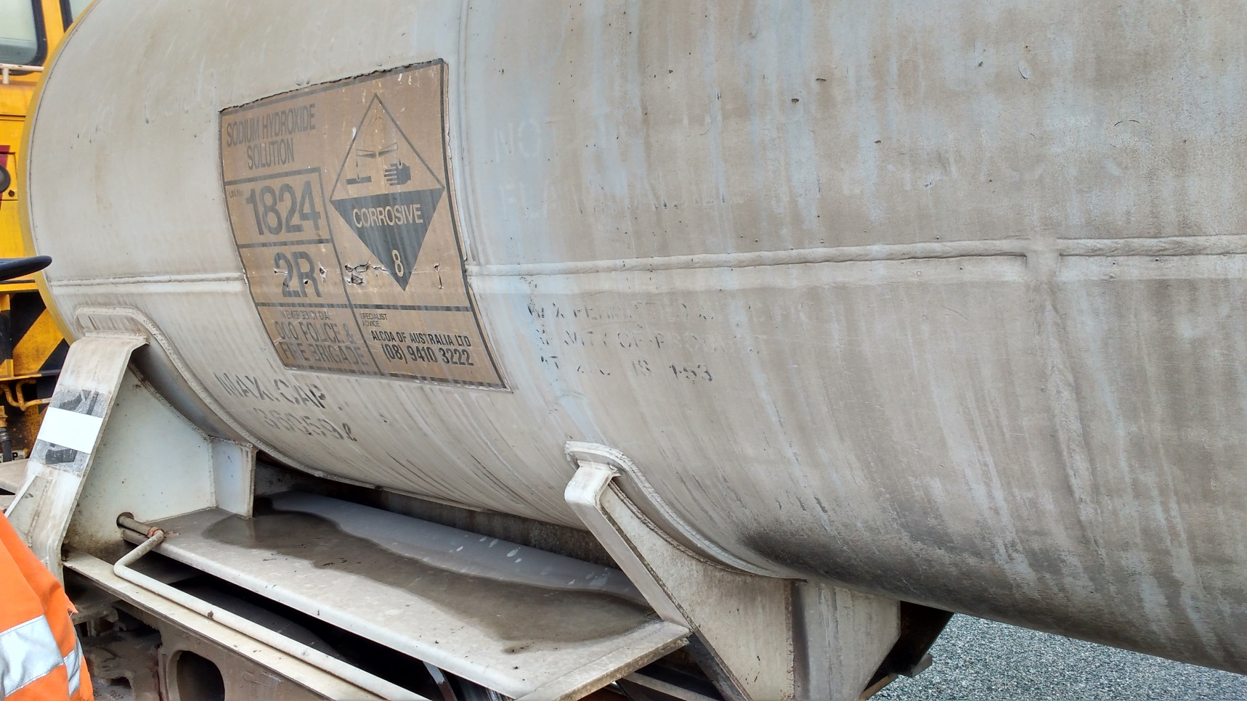
Placarding

Slide 30
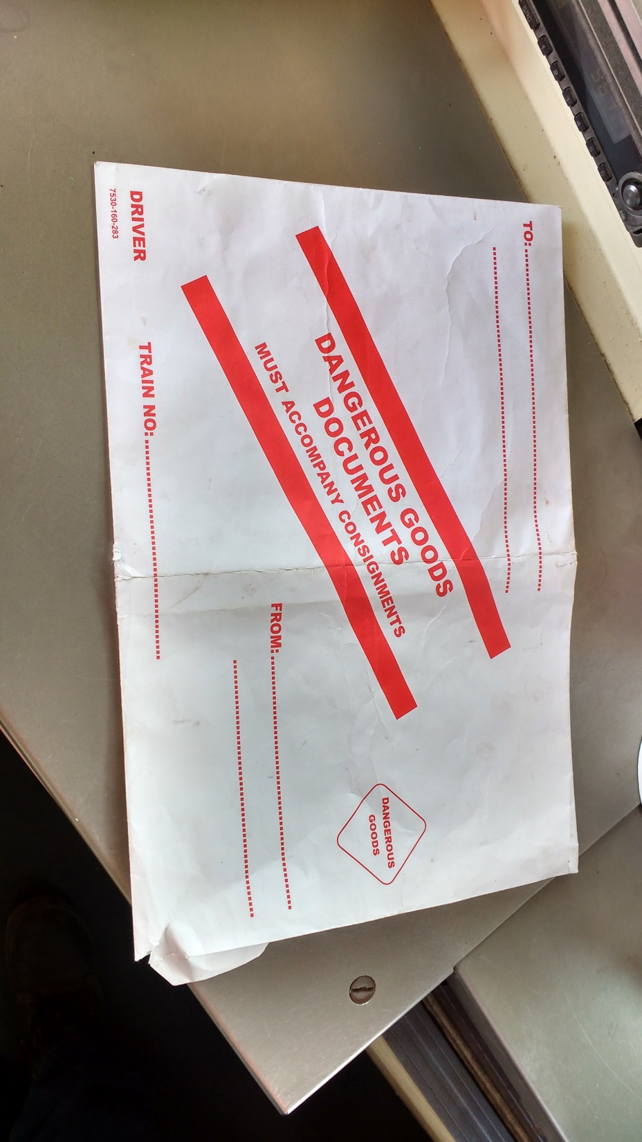
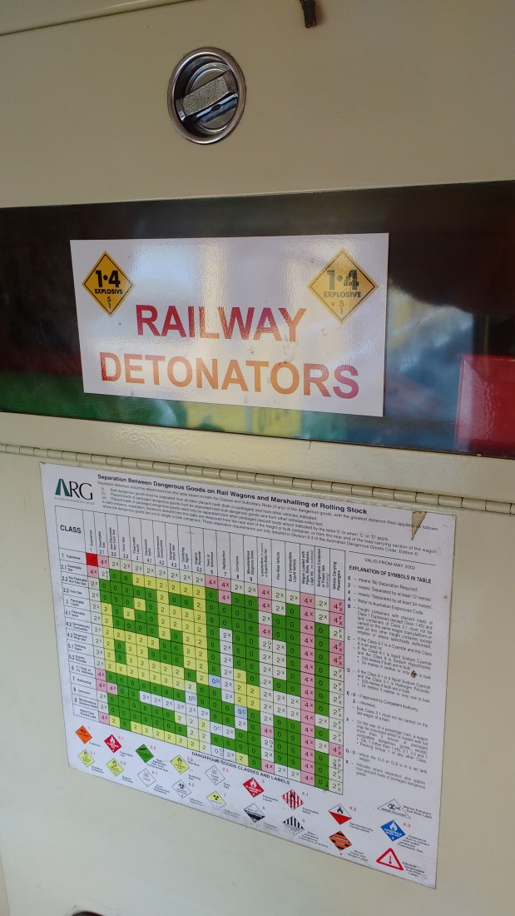
Inside the locomotive

Slide 31
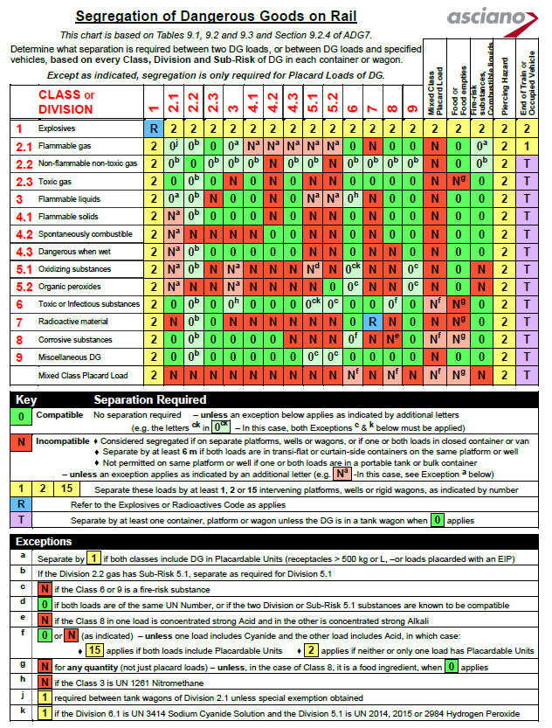
Segregation chart for rail
Source: rissb.com.au

Slide 32
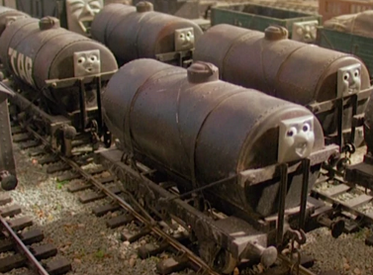

Overflow of liquid DG
400 kL corrosives in rail tank wagons
150kL holding tank with “automatic” pumping at high level to larger tank. Overflow to bund.
150kL Bund
You do the maths!

Slide 33
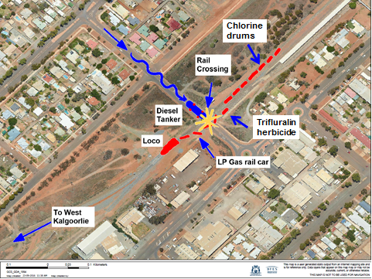
State risk project – Hazmat rail scenario
40 kL diesel tanker - travelling south on Chapple St Kalgoorlie
Collides with locomotive
carrying LP Gas rail car
(77 kL, 32 t on board)

Slide 34
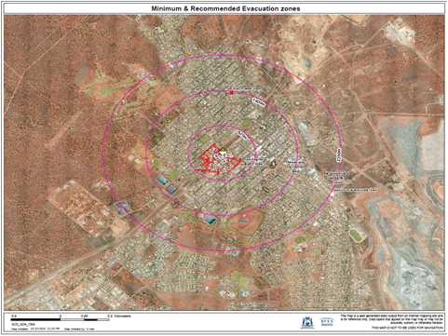
Consequences

Slide 35
State risk project – Hazmat Rail
Key findings:
Preparedness – planning and capabilities
Health system would be placed under stress
Impact on business – rail through many suburbs, cities and towns
Notes:
The largest impacts of the LP Gas rail car scenario were:
towards the health system,
disruption to trade (East-West) and the resources industry.
Communities would also be displaced as homes would be lost from the fire/explosion of the rail car.

Slide 36

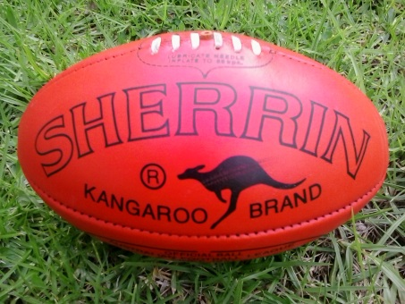
Has your depot taken its eye off the ball?
No emergency plans and site extremely reliant on emergency services
No breathing apparatus on site or trains
No dangerous goods training for staff
No spill containment on site

Slide 37
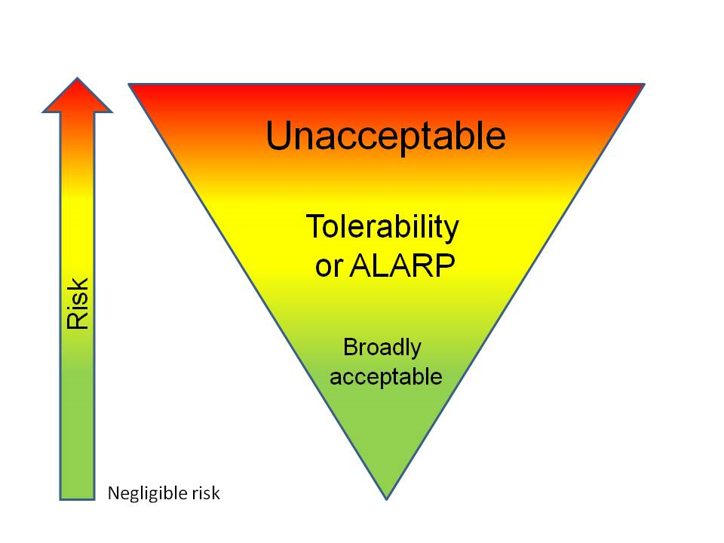
What does ALARP look like from a DG perspective?
Developed under Section 8 (Duty to minimise risk from DGs)
Chain of custody and responsibility for DG
Address DG transfer risks
Emergency preparedness
Notes:
8. Duty to minimise risk from dangerous goods
(1) A person who is involved directly or indirectly in storing, handling or transporting dangerous goods must take all
reasonably practicable measures to minimise the risk to people, property and the environment from the goods.
ALARP Inverted Triangle
What criteria does your company use to assess risk?
Has your rail company assessed the risks as tolerable?
What practices are driving your overall risk towards broadly acceptable?

Slide 38
DG transport incidents – exposure to hazards in rail
Three prominent US rail incidents highlight hazards inherent in rail transport systems:
maintenance of track
human intervention in track switching
bulk transfer of dangerous and hazardous goods.
Notes:
Incidents:
Minot ammonia tanker derailment, 2002
Graniteville chlorine tanker rupture, 2005
Michigan mercaptan release during transfer, 2001

Slide 39
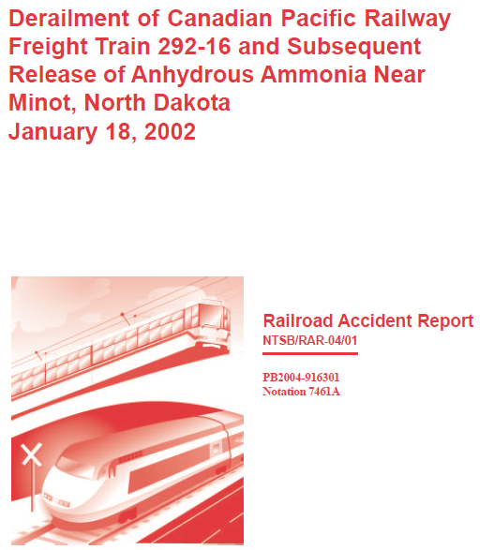
Minot ammonia rail wagon incident 18/1/2002
Occurred west of Minot, when a CPR freight train derailed in Harrison, spilling hazardous materials.

Slide 40
Summary of events
At 1.37 a.m., 31 cars of CPR train derailed 6.5km west of Minot
Five tanker cars carrying anhydrous ammonia ruptured, releasing a cloud of toxic corrosive gas over city
Large area around the derailed train evacuated, and residents in the remainder of the city were told to stay indoors
Accident killed one person, caused serious injuries to 11 people (incl. 2 train crew), and caused minor injuries to 322 others

Slide 41
Consequence severity due to liquid flashing
Catastrophic failure of 5 tank cars and ammonia vaporised
Plume rose an estimated 100 metres and gradually expanded 8 km downwind of accident over population of 11,600 people
554 kL
Liquefied NH₃
X 850
470 000 kL Gas

Slide 42
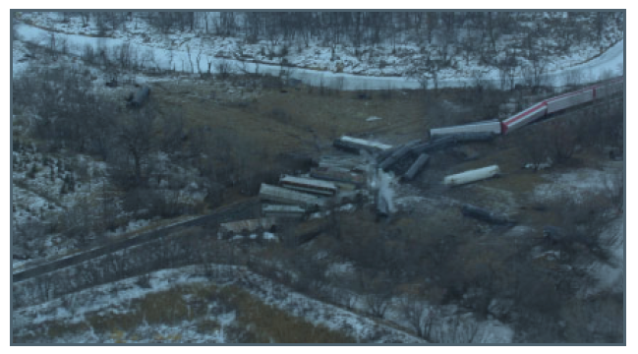
Derailment scene
Freight cars 8 →17 formed wall that blocked 15 NH₃ tank cars
Notes:
Damage to the anhydrous ammonia tank cars categorized as ranging from severe to light,
generally decreasing amounts of damage with increased distance from the front of the train

Slide 43
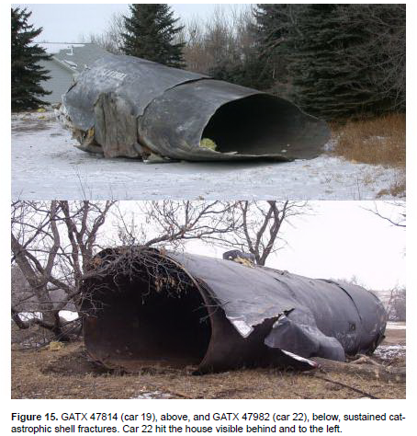
Ammonia tank catastrophic rupture
Notes:
Tank Car Damage
During the derailment, the first seven of the derailed anhydrous ammonia tank cars rotated laterally and separated from their couplers and came to rest aligned perpendicular to the tracks.
Five of these tank cars received sidewall impacts to their shells, and the shells structurally failed.
Four of these tank car shells sustained fractures that propagated completely around their circumferences.
The fifth tank car sustained a fracture that resulted in separation of the tank head from the tank car.

Slide 44
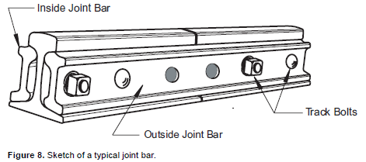
Historical repair of track using track joint bars
Numerous joints where defective sections of rail had been cut out and replaced with pieces of matching 19 rail called “plugs”
Notes:
Main track in tangent areas was laid with 100-pound18 continuous welded rail (CWR) & curves were 115-pound CWR
Each end of the plug was spliced into the CWR with two 36-inch joint bars, which fit against the inside & outside of rail and are fastened with bolts, sandwiching the rail between the bars.

Slide 45
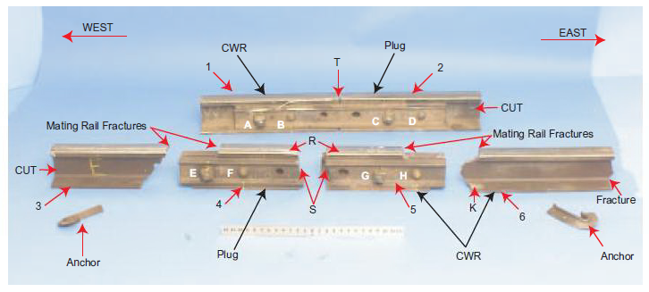
Derailment conclusions – rail maintenance and wagon shells
Cause was ineffective inspection and maintenance program that did not identify and replace cracked joint bars
Low fracture toughness of non-normalized steels in tank shells in this accident contributed to complete fracture and separation
Fracture of joint bars contributed to derailment
Notes:
Joint bars at the east end of the plug rail fractured as accident train passed over, rail itself also fracturing and breaking away.
Inspection procedures were inadequate to properly inspect and maintain joints within continuous welded rail.
Inadequate procedures allowed undetected cracking in the joint bars at the accident location to grow to a critical size.
Materials standard needed to define minimum level of dynamic fracture toughness for the material in all Class 2 tank cars

Slide 46
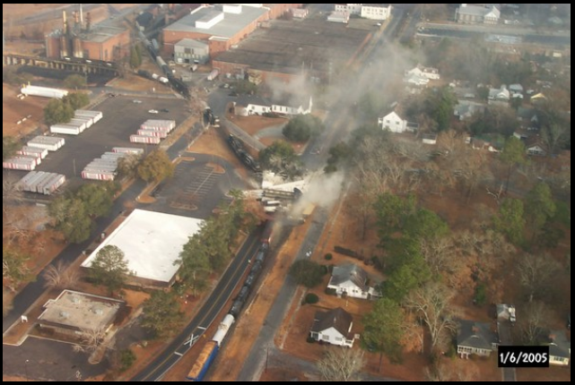
Graniteville chlorine incident 6 Jan 2005
Notes:
NTSB Railroad Accident Report - 05/04

Slide 47
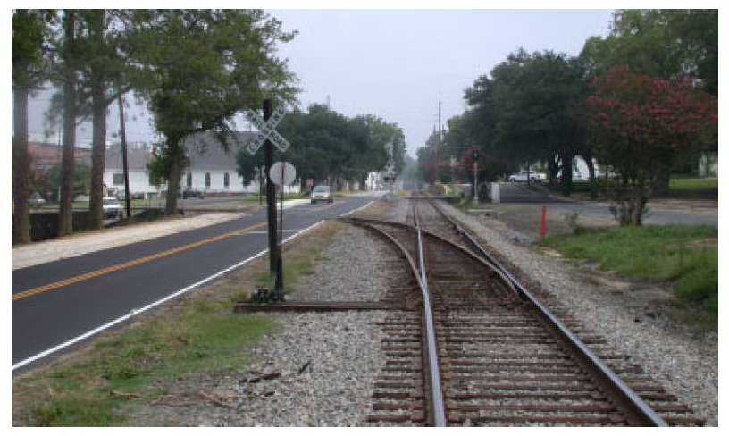
View down the main railway line
Notes:
Figure 4. Looking north at the switch and turnout from the NSR main line onto the Avondale Mills industry track at Graniteville.
The switch banner, or target, shows white, indicating that the switch is in the normal position, i.e., aligned for movement along the main line track.
(The banner shows red when the switch is set for the industry track into the mill.)

Slide 48
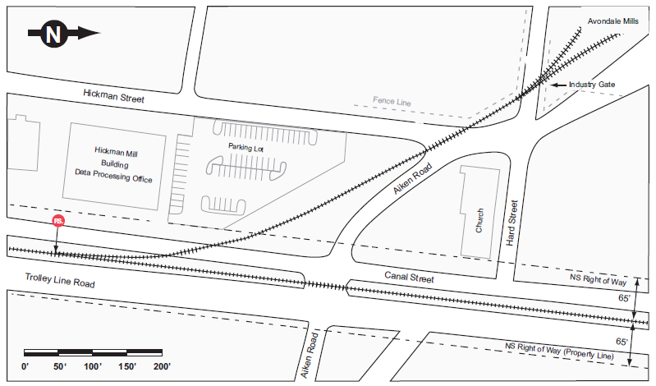
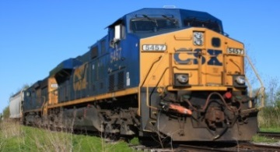
Switch point from Main Line to Avondale Mills
77 km/h
Notes:
Events leading to collision
Switch point locked into position for diverting into mill
Train P22 parked on spur overnight - loco + 2 freight containers
Positioned on spur~ 6 car lengths from main line switch
Train 192 approached on main line at 77 km/h at 2:39 AM
Train 192 carrying 42 cars - 14 cars had hazardous load
Chlorine, sodium hydroxide and cresol tankers
6/7/9th cars - 90 tonne tank wagons of liquefied chlorine gas

Slide 49
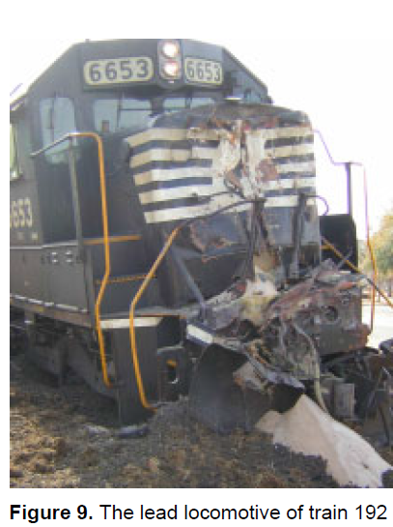
Collision and derailment
Both locomotives and the first 16 cars derailed
Punctured 9th car released 60 tonnes chlorine (rupture froze)
Chlorine vapour cloud settled in low-lying valley along tracks
Cloud extended at least:
  800 meters to the North
  300 metres to the East, South and West
Notes:
Rail Wagon & Locomotive damage
6th car (Cl₂) - severe dent right of centre in B-end head
7th car (Cl₂) - severe dent left midline
8th car (NaOH) - sustained major jacket damage, torn from almost 1/3 of tank
9th car (Cl₂) - puncture and tear on the right side middle of tank
Opening 950mm long X 125mm wide

Slide 50
Consequences
9th car – puncture and tear on RHS tank middle – opening 950mm long X 125mm wide
Nine people died (eight at the time of the accident, one resident later as a result of chlorine inhalation)
At least 250 people were treated for chlorine exposure
5,400 residents within 1.6 km of crash site forced to evacuate for 2 weeks while HAZMAT and clean-up crews decontaminated

Slide 51
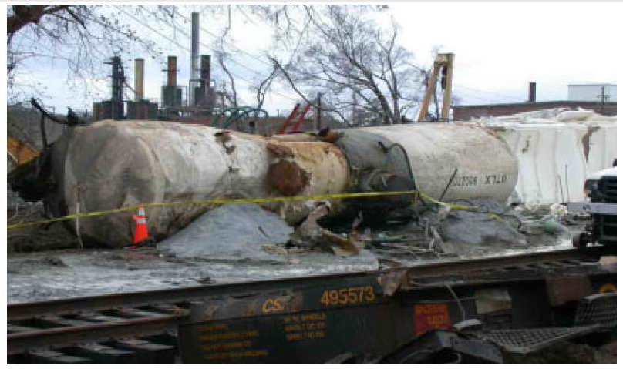
Decanting and neutralisation complete 20 Jan 2005
Notes:
Figure 8. Ruptured chlorine tank car during unloading.
The tank has been rotated so that the patched puncture is at the top.
Hoses attached to the patch are drawing off chlorine vapors that are then bubbled
through a sodium hydroxide solution to reduce their hazard.

Slide 52
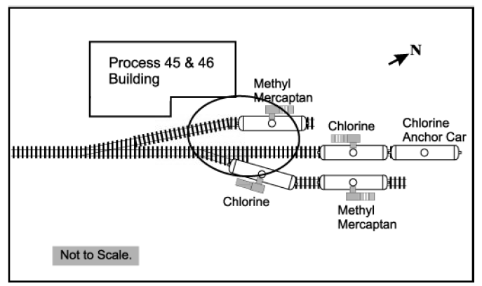
Methyl Mercaptan release during transfer
Toxic and Flammable Gas
Boiling Point 6˚C, Flash Point -18˚C
Flammability Limits 4 – 22%

Slide 53
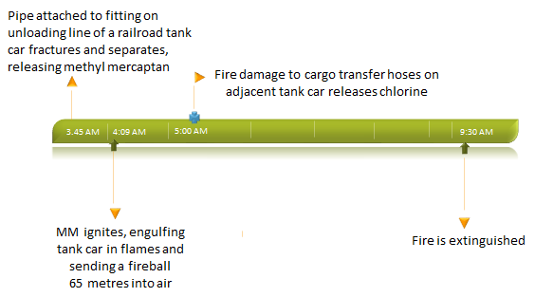
Incident timeline

Slide 54
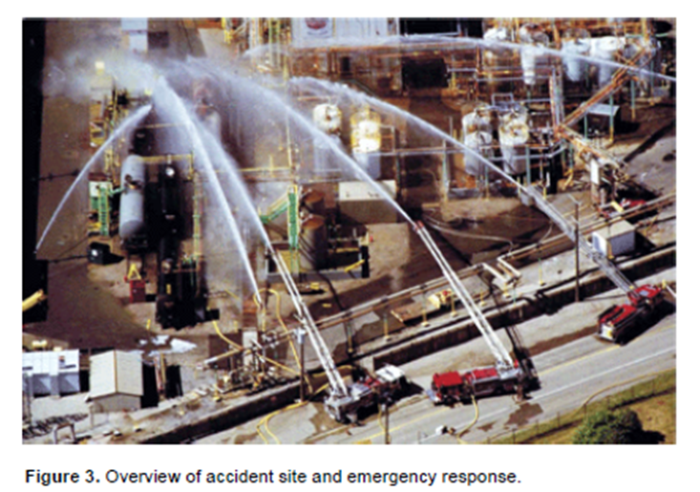
Aerial view of response
Notes:
Consequences
Three plant employees were killed in the accident.
About 2,000 residents were evacuated from their homes for about 10 hours.
Two tank cars, railroad track, and plant equipment (including hoses and fittings) were damaged in the fire.

Slide 55
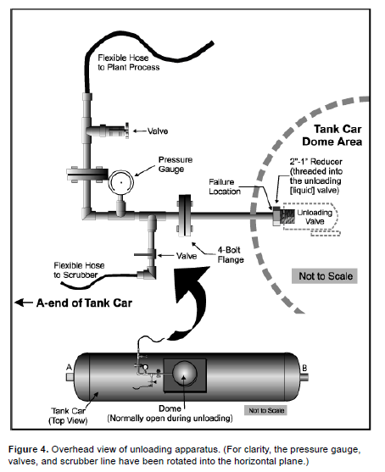
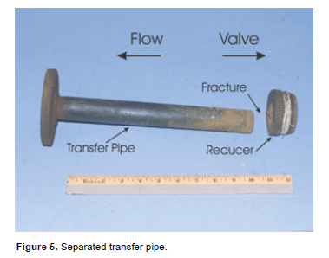
Transfer pipe failed

Slide 56
NTSB investigation conclusions
Cargo transfer pipe fracture resulted from:
  failure of company to adequately inspect and maintain it’s equipment
  inadequate federal oversight of unloading operations involving hazardous materials
Contributing to accident were:
  reliance on tank car excess flow valve to close in leak event
  company’s failure to require appropriate safety equipment for employees involved in loading and unloading operations.

Slide 57
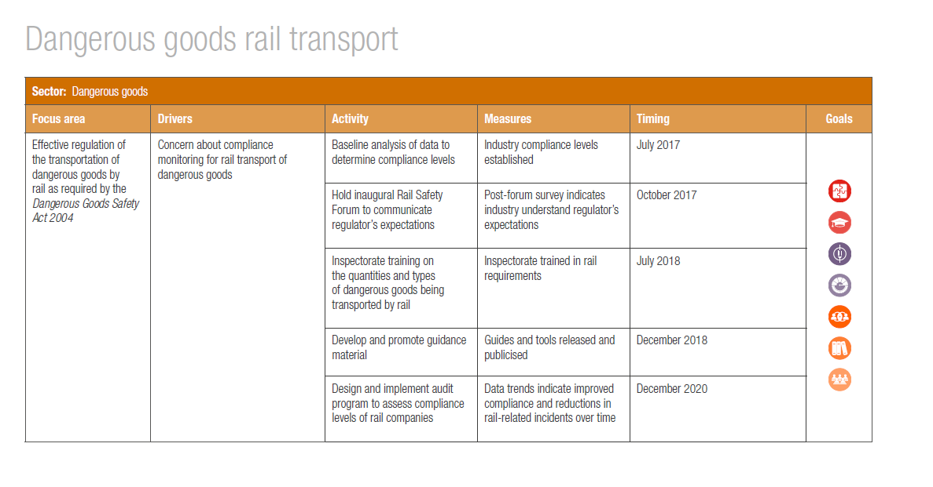
Regulating effectively

Slide 58
What do we still need to do?
Rail consignment and business systems
Protecting dangerous goods from impact during derailment
Route planning – minimise risk
Security SSAN
DG package consignment systems
Load consolidation
Use of freight containers

