Slide 1
Please read this before using presentation
This presentation is based on content presented at the Six Pillars of Dangerous Goods Transport information sessions held in October 2014
It is made available for non-commercial use (e.g. toolbox meetings, safety discussions) subject to the condition that the PowerPoint file is not altered without permission from Resources Safety
Supporting resources, such as brochures and posters, are available from Resources Safety
For resources, information or clarification, please contact:
  RSDComms@dmp.wa.gov.au
  or visit
  www.dmp.wa.gov.au/ResourcesSafety

Slide 2
Vehicle
Your vehicle is one of the most important factors in
preventing dangerous goods incidents

Slide 3
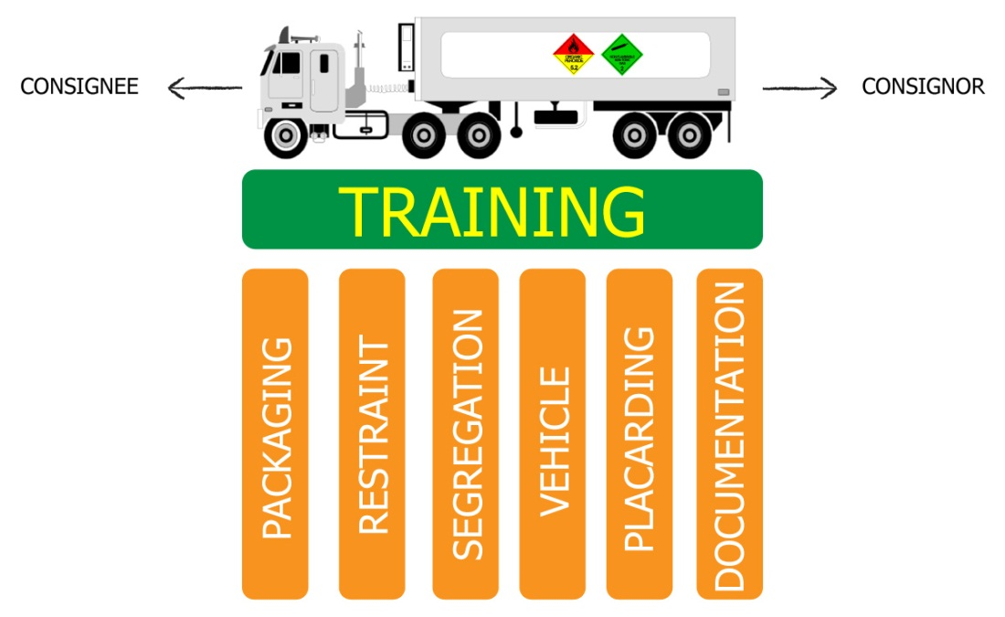
Six pillars of dangerous goods transport
Notes:
This presentation focuses on the vehicle, one of the Six Pillars of Dangerous Goods Transport. What are the six visible elements of your transport system for dangerous goods? [LISTED IN GRAPHIC]
The Department of Mines and Petroleum views training as the platform that holds these elements or pillars together.
Packaged dangerous goods transport has often been afforded a low priority in organisations that cart general freight- the poor cousin of bulk tanker transport. However, when you consider that dangerous goods freight movement currently constitutes 8% of road transport activity, the safe movement of multitudes of placard and sub-placard loads is important in terms of road networks and the exposure of the public.
The risk to personnel in your transport activity is determined by the integrity of the packaging. Pause and consider the effects of a single 32 kg chlorine cylinder releasing its contents while your driver is checking the pallet restraints and tyre pressures after a rest break.
This information presented here is a snapshot of the common considerations applied to the transport of packaged dangerous goods. Each business will have some unique challenges for carting mixed loads and a range of container types. Nevertheless, applying the safe transport principles stipulated in the Australian Dangerous Goods Code will guide you toward minimising risk.
There are five other toolbox presentations in the Six Pillars series available at www.dmp.wa.gov.au/14788.aspx. They related directly to the self-audit template for prime contractors available on the Resources Safety website at www.dmp.wa.gov.au/17148.aspx.
The audit can be used to conduct a “health check” of your dangerous goods transport system.

Slide 5
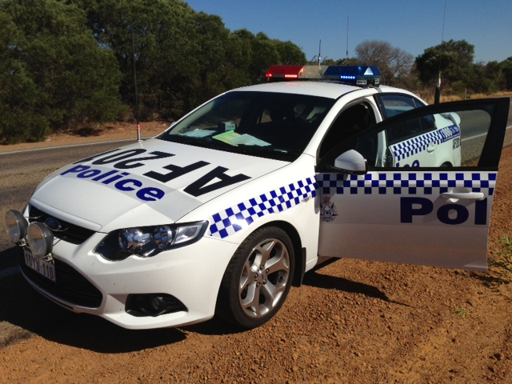
Roadworthy?
Notes:
You don’t want to attract unwanted attention!
Your dangerous goods vehicle must be in a roadworthy condition and free from any defects. The vehicle is obviously an important component when transporting dangerous goods safely.

Slide 6









Vehicle equipment
Transport document holder (driver’s door)
Breakdown triangles
Torch (hazardous zone rated for flammable materials)
Eyewash
Class label/s and/or EIPs
Fire extinguisher/s
Emergency equipment (gloves, boots, face shield, coveralls, escape breathing apparatus)
Notes:
Make sure you have all the necessary emergency equipment on board your dangerous goods vehicle.
It could save your life one day.

Slide 7
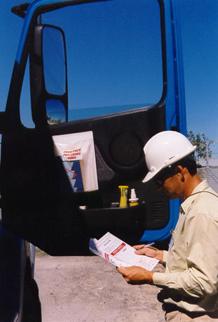
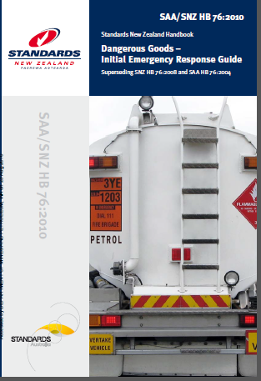
Documentation and emergency information
Located by driver’s door in holder:
Transport document
Emergency procedure guide for product and vehicle fires (or HB 76)
Notes:
Having these documents is a legal requirement and helps the Department of Fire and Emergency Services (DFES) and WA Police in emergencies. They will know what they are dealing with.

Slide 8
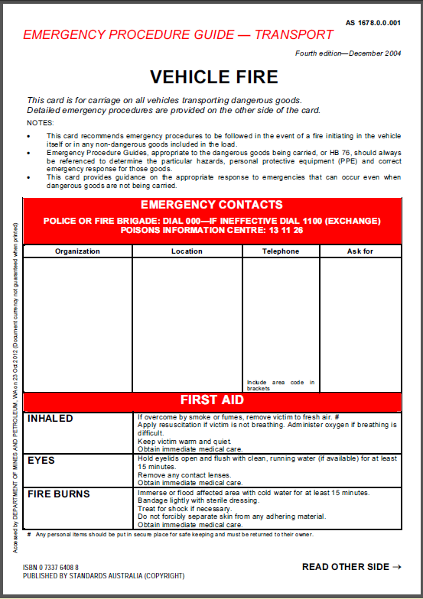
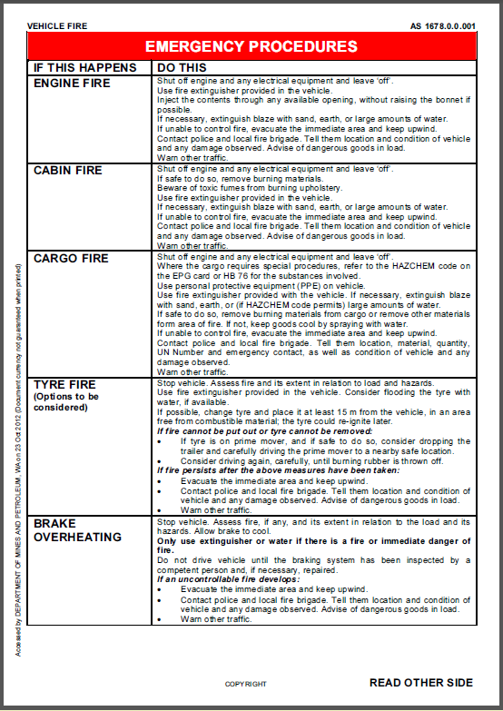
EPGs – emergency procedure guides
Notes:
This is an example EPG for vehicle fire.

Slide 9
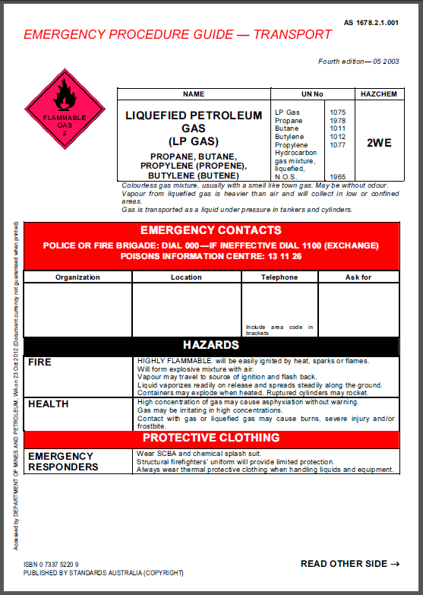
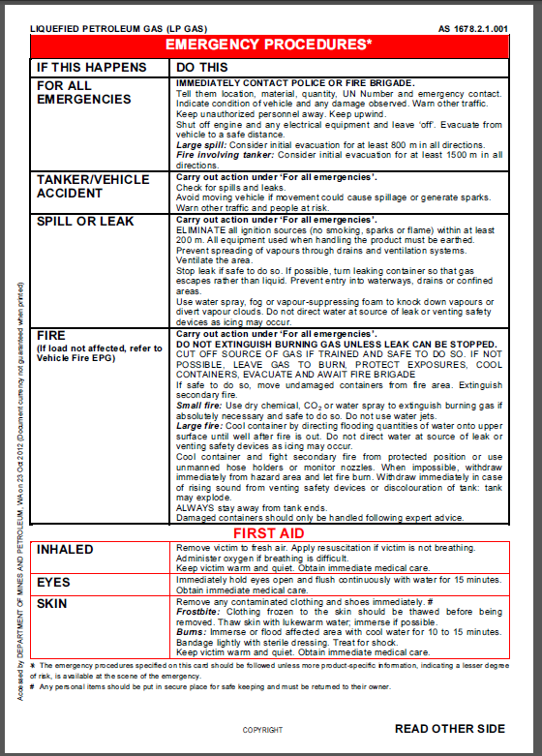
EPGs
Notes:
This is an example EPG for LP Gas.

Slide 10
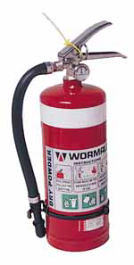
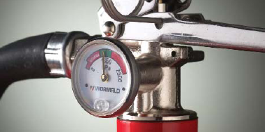
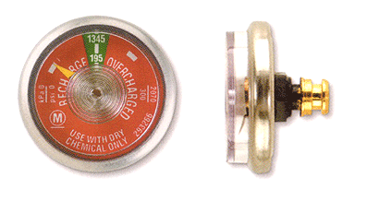
FFE for placard load ADG 7.3 Table 12.1
What fire-fighting equipment is required for vehicle carrying packaged goods?
Each vehicle – rigid traytop, trailer – requires minimum of 30 B DCP
Stamped with service date within 6 months, gauge in green zone
DCP = dry chemical powder
Notes:
Fire fighting equipment (FFE) requirements for a vehicle containing packaged dangerous goods.
ADG7 = The Australian Dangerous Goods Code, Edition 7.3
General information available at www.infrastructure.gov.au/transport/australia/dangerous/dg_code_7e.aspx
Code available at www.ntc.gov.au/heavy-vehicles/safety/australian-dangerous-goods-code

Slide 11
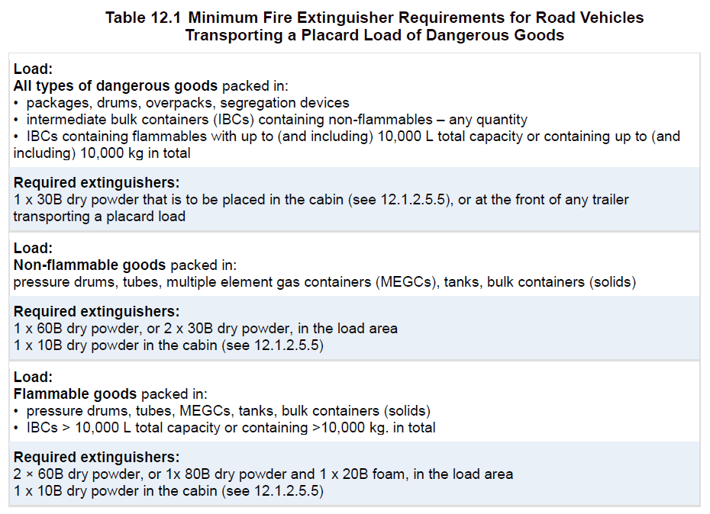
Australian Dangerous Goods Code
Notes:
This table is from ADG7.3

Slide 12
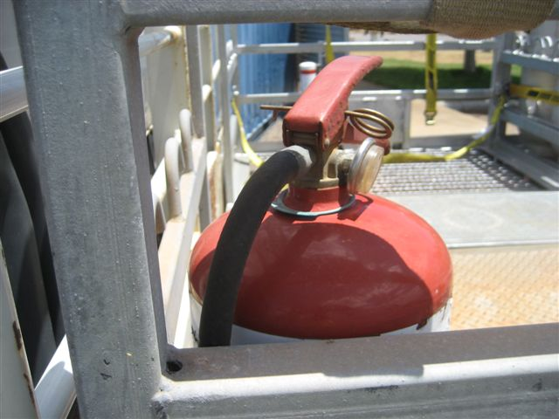
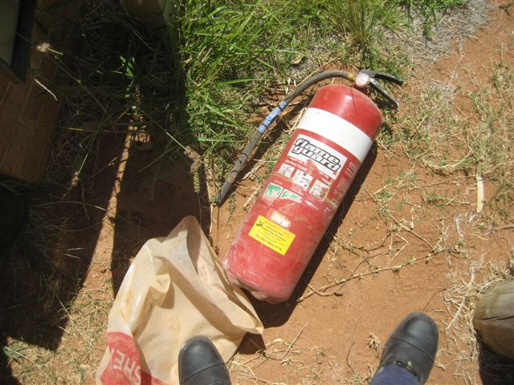
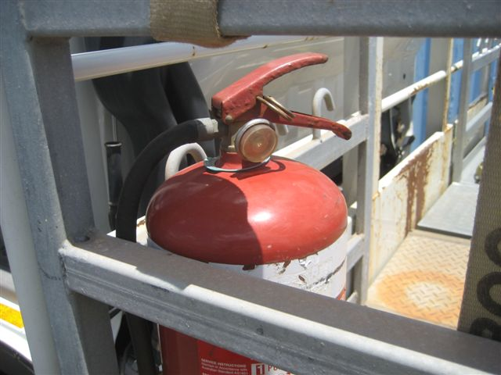
FFE must be serviceable
Notes:
Don’t get caught with a fire extinguisher that is out of service.
Not only might it not work when you need it, but the prime contractor could be fined $3,000.

Slide 13
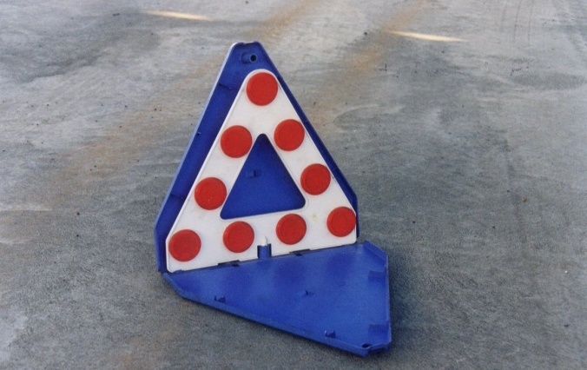
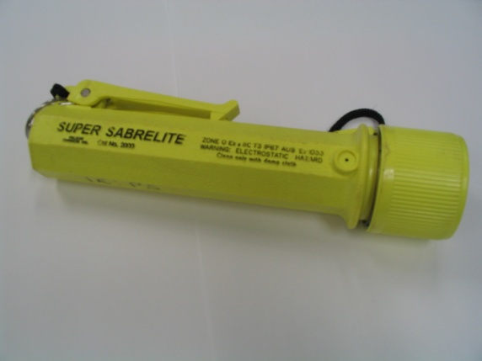
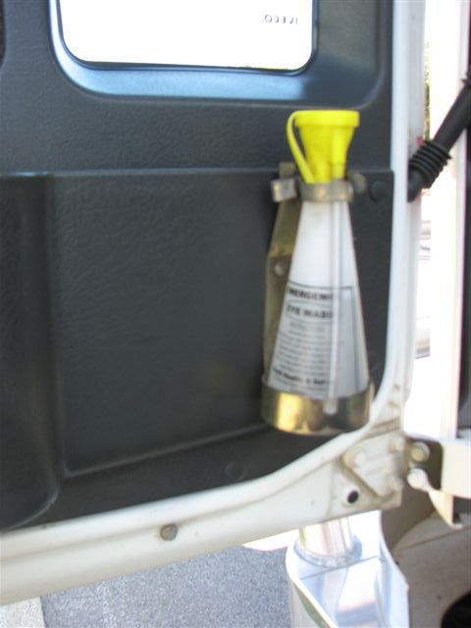
Emergency equipment (ADG 7.3, Chapter 12)
Breakdown triangles Torch Eyewash (250 mL)
What else is required?
PPE in accordance with ADG7.3 Table 12.2 also needs to be carried.

Slide 14
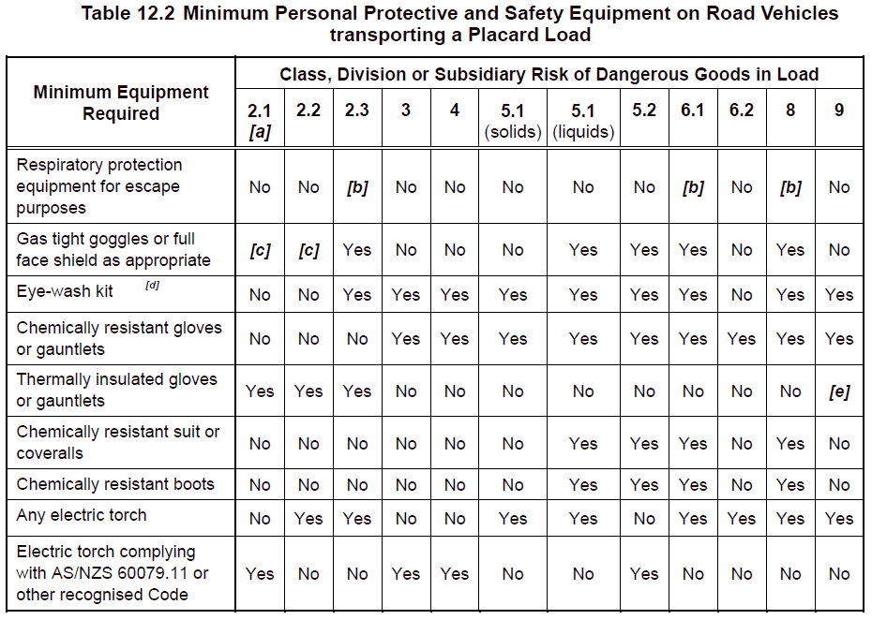
Notes:
Table from ADG7.3 lists requirements when transporting placard load.

Slide 15
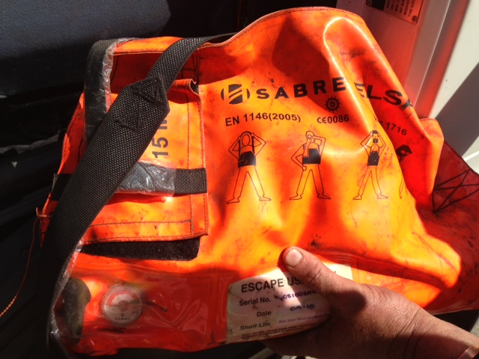
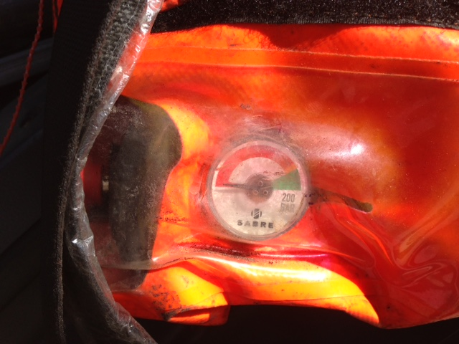
Emergency equipment must be serviceable
Notes:
Check that your breathing apparatus (BA) and respirators are in date.

Slide 16
Any questions…
Email packages@dmp.wa.gov.au
Email punit@dmp.wa.gov.au
Notes:
For further information on Dangerous Goods Transport, send an email to these addresses

Slide 17


Don’t forget – Stay informed!
Visit www.dmp.wa.gov.au/ResourcesSafety
to sign up for our weekly news alerts

