Slide 1

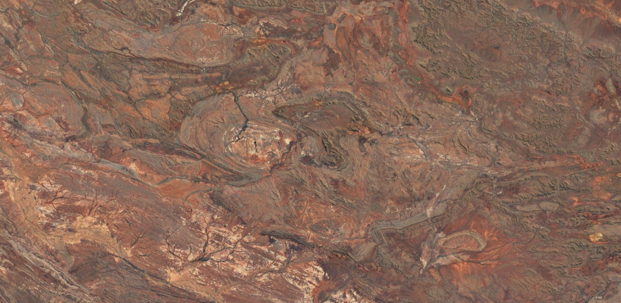





Loop 3D geological modelling: speeding up the workflow
Mark Jessell¹, Vitaliy Ogarko², Mark Lindsay¹, Ranee Joshi¹, Lachlan Grose³, Laurent Ailleres³, Miguel de la Varga⁴, Guillaume Pirot¹
¹ Mineral Exploration Cooperative Research Centre, School of Earth Sciences, UWA, Perth, Australia
² International Centre for Radio Astronomy Research, UWA, Perth, Australia
³ School of Earth, Atmosphere and Environment, Monash University
⁴Computational Geoscience and Reservoir Engineering, RWTH Aachen, Germany
mark.jessell@uwa.edu.au
GSWA 21/02/2020

Slide 2
3D Geological Modelling Challenges
  Speeding up the workflow Loop WP2
  Building reproducible Models Loop WP2
  Managing complex geology Loop WP3
  Integrating geophysical constraints Loop WP4
  Quantifying Uncertainty Loop WP5

Slide 3
MinEx CRC Project 6: Automated 3D geological modelling
Reduce to one week the time taken from receiving data to
constructing probabilistic models.

Slide 4
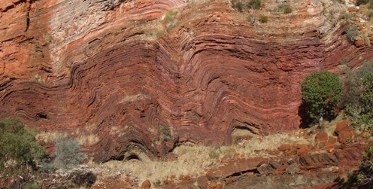
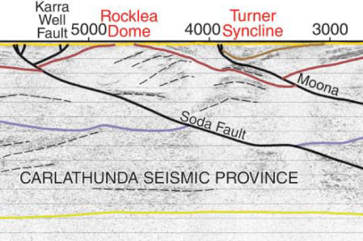
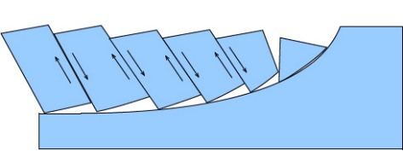
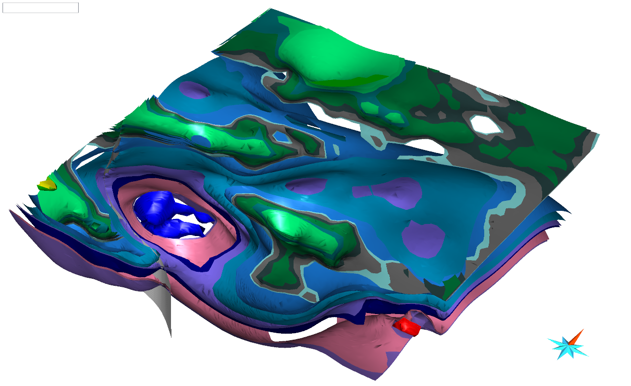
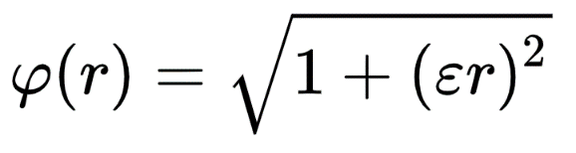
Ingredients of a 3D geological model (and sources of uncertainty)
Observations
Interpretations
Concepts
Algorithms

Slide 5
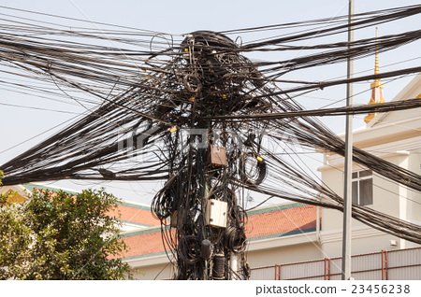
Current 3D Modelling Workflow
Observations
Concepts
Interpretations
Algorithms

Slide 6
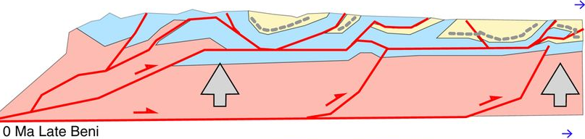
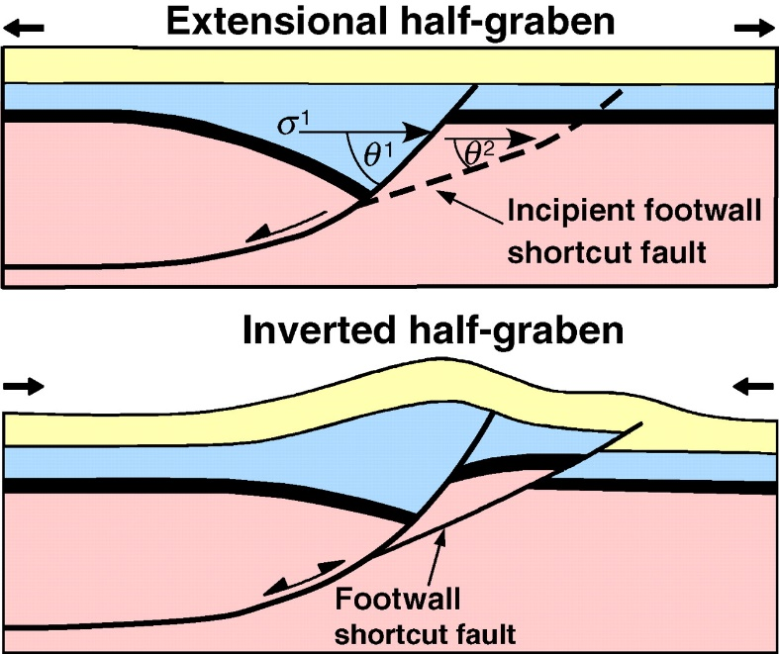

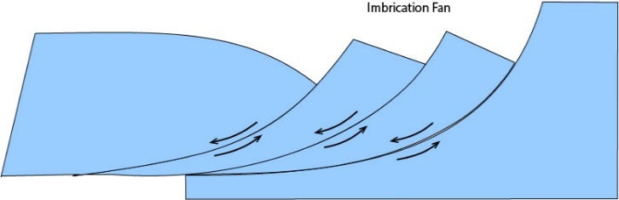
Prior concepts about region (faults)
Without limited geophysical constraints, the sub-surface geometry of faults is often ‘solved’ by applying a pre-conceived notion based on vertical, listric, flower or negative flow, fold & thrust geometries.

Slide 7
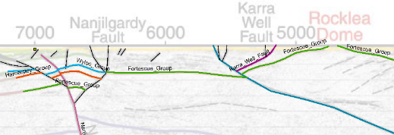
Prior concepts about region (faults)

Slide 8
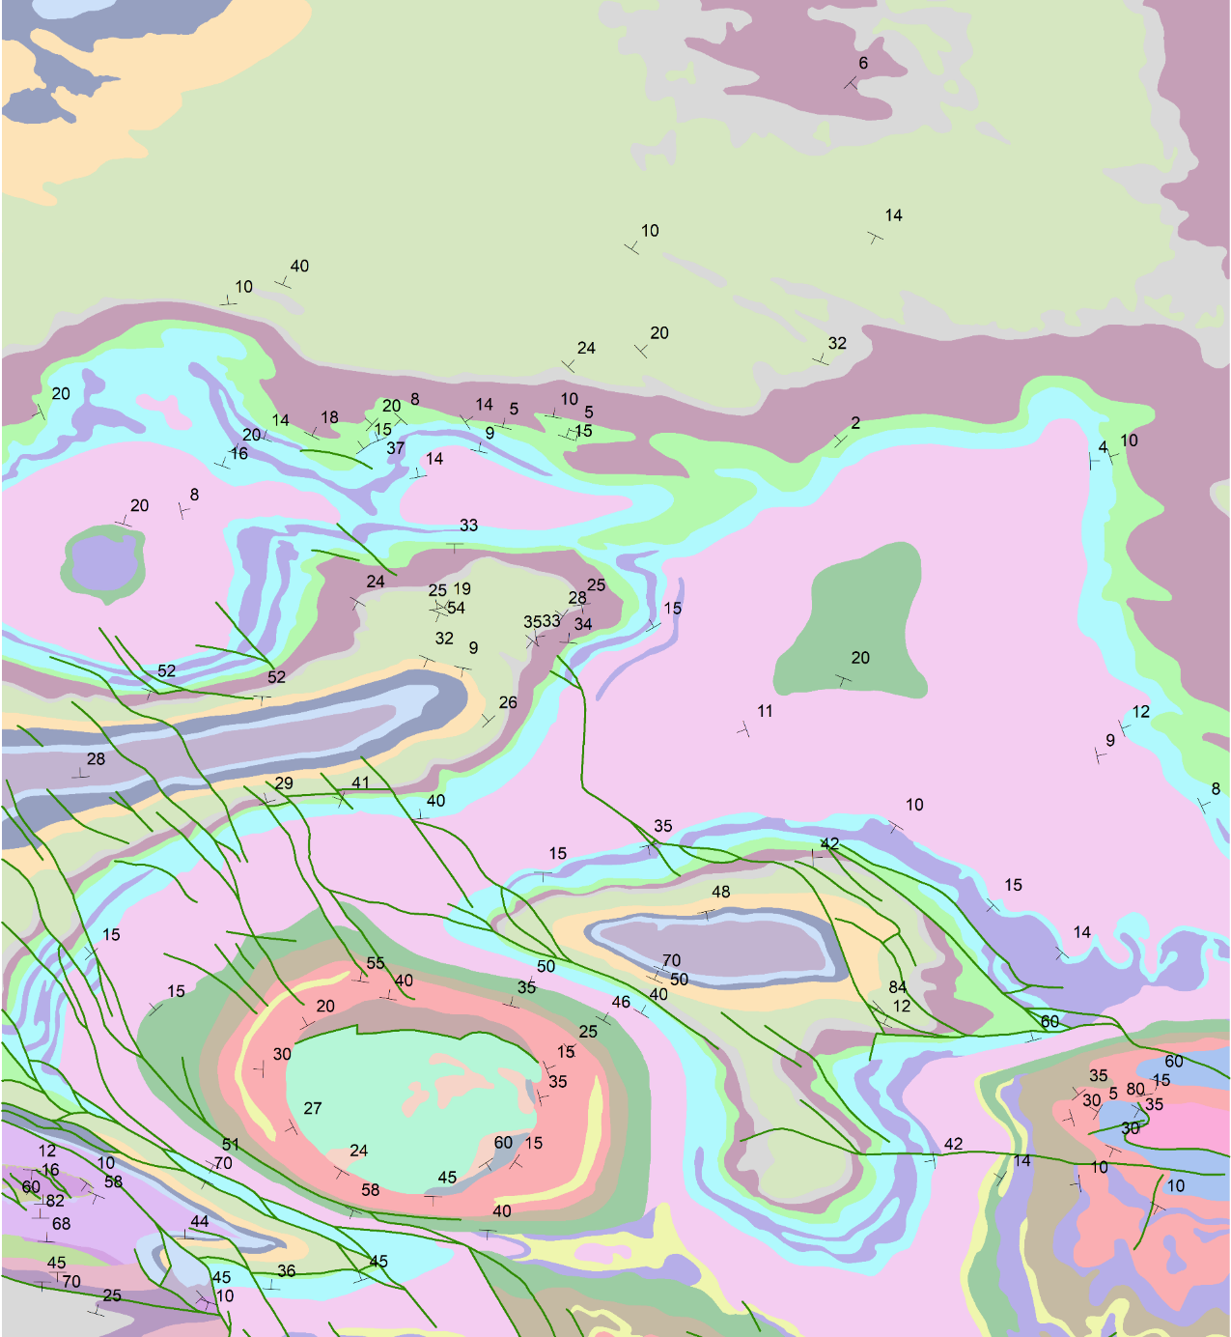
Start notebook
Two end-member regional 3D modelling scenarios:
  Geological constraints come FIRST
GSWA 500K IBG

Slide 9
Start notebook
Two end-member regional 3D modelling scenarios:
  Geological constraints come FIRST
  Under cover, so geophysics is FIRST constraint
Qs
GSWA 500K IBG

Slide 10
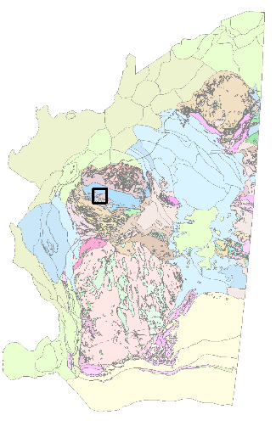
Loop Information Manager
map2loop
3 layers available via WFS
at geo.loop-gis.org/geoserver
Geology polygons (GSWA 500k IGB,state)
Fault polylines (surface trace, state)
Structural points (bedding, local area)
DTM online from GA

Slide 11
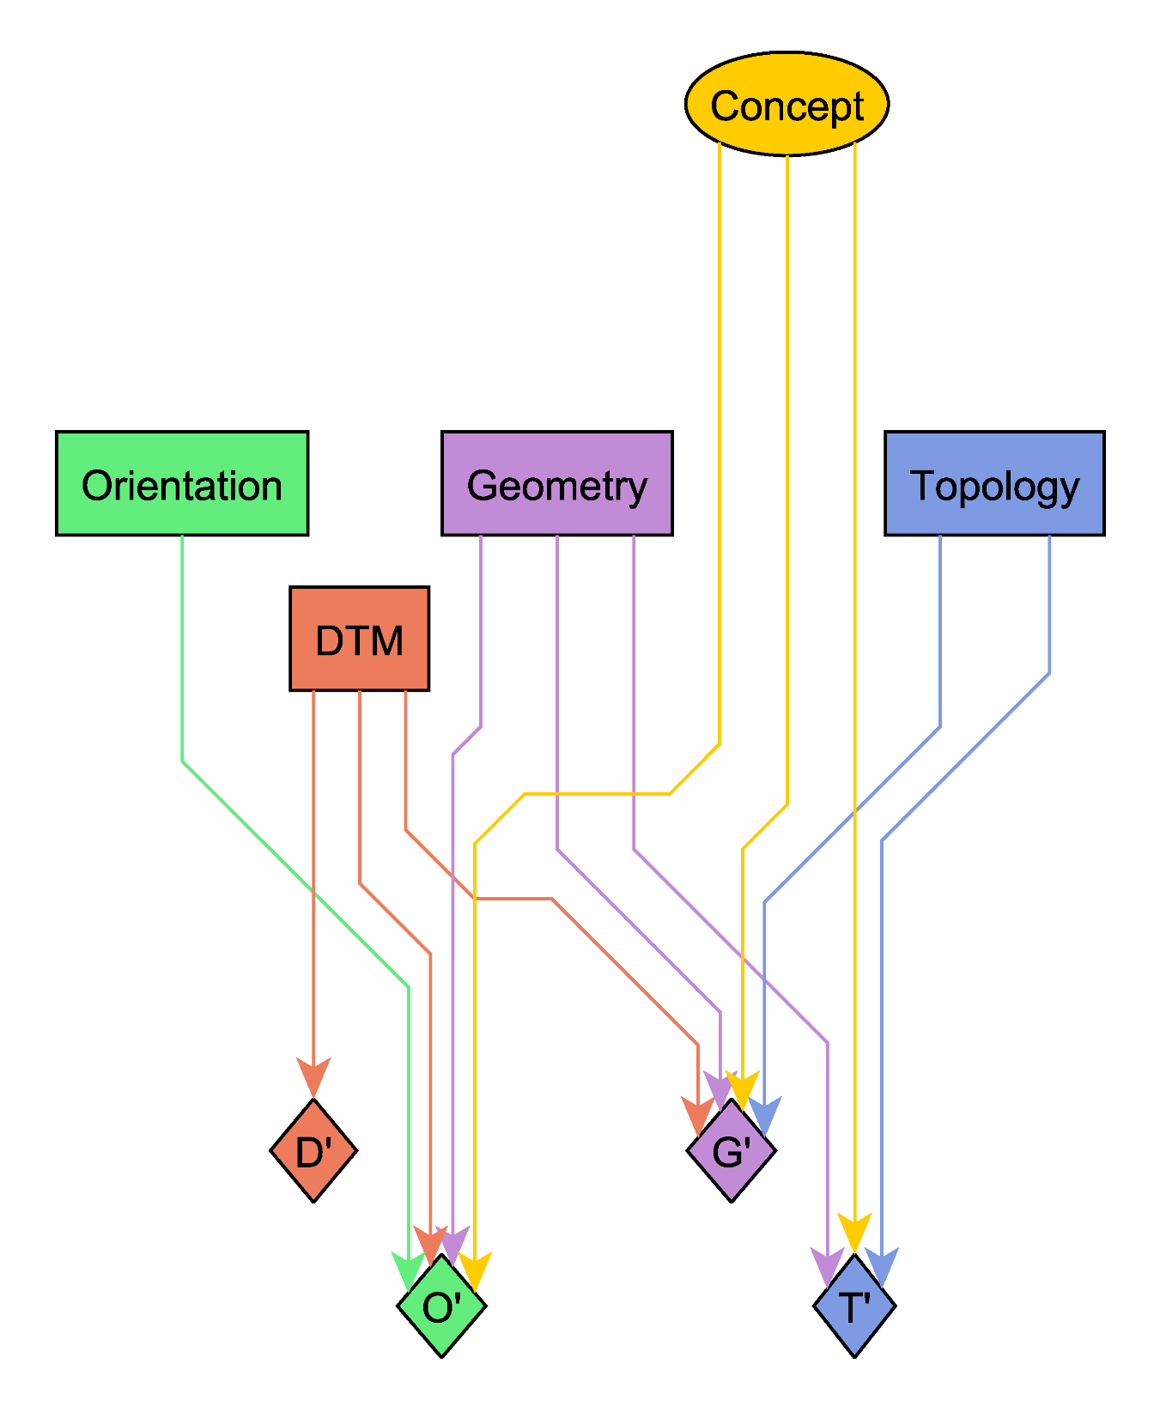
Concepts:
What is the geological framework in this region?
Observations:
Gradient
Position
Topology
DTM
Outputs:
Selected Observations
Subsampled Observations
Derived measurements
Gradient
Position
D’
P’
G’
T’

Slide 12
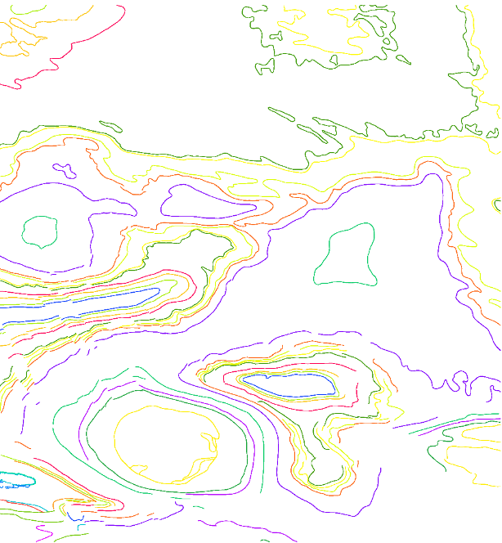
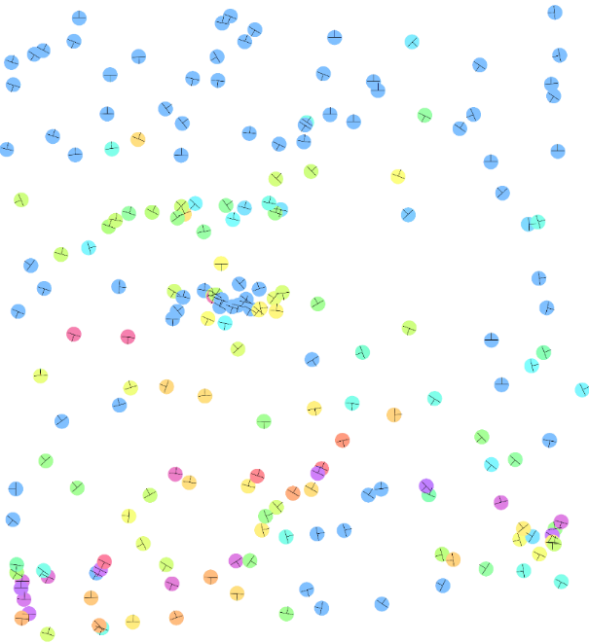
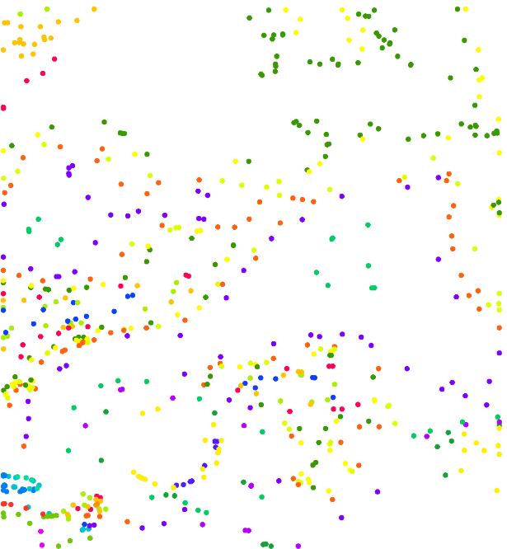
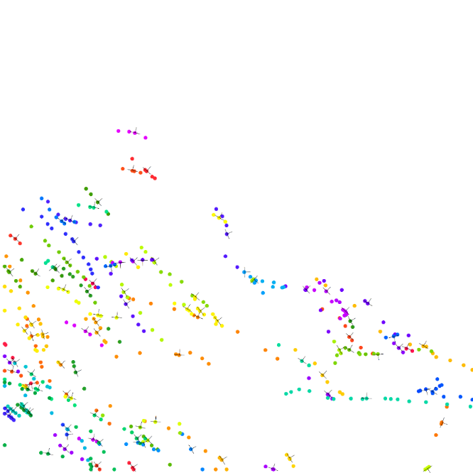
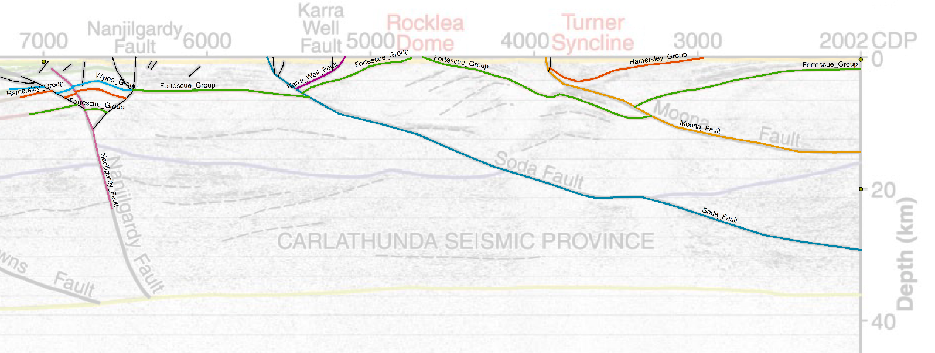
Automated Geometry
Structures
Contacts
Faults
Seismic Interpretation
(10GA-CP1)

Slide 13
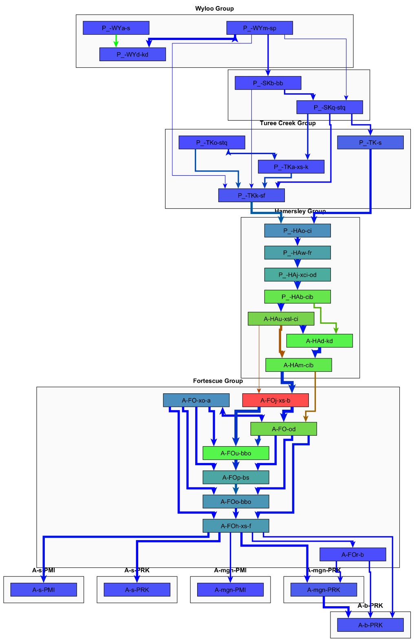
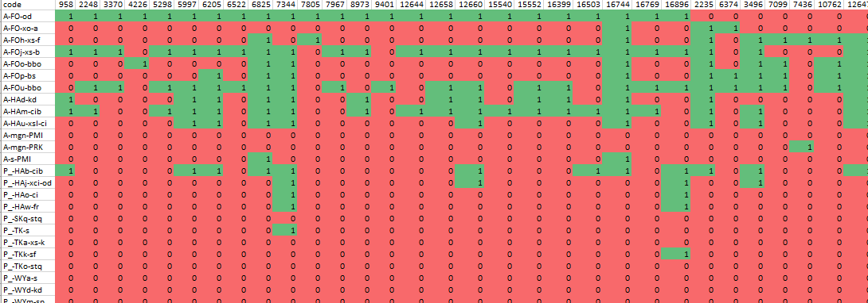
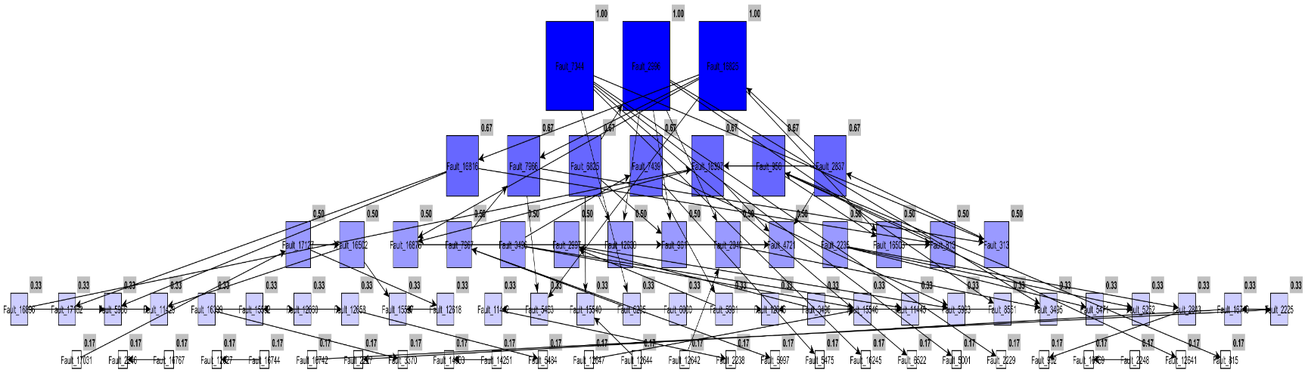
Automated Topology
Stratigraphic
relationships
Fault/Stratigraphy Relationships
Fault/fault
relationships

Slide 14
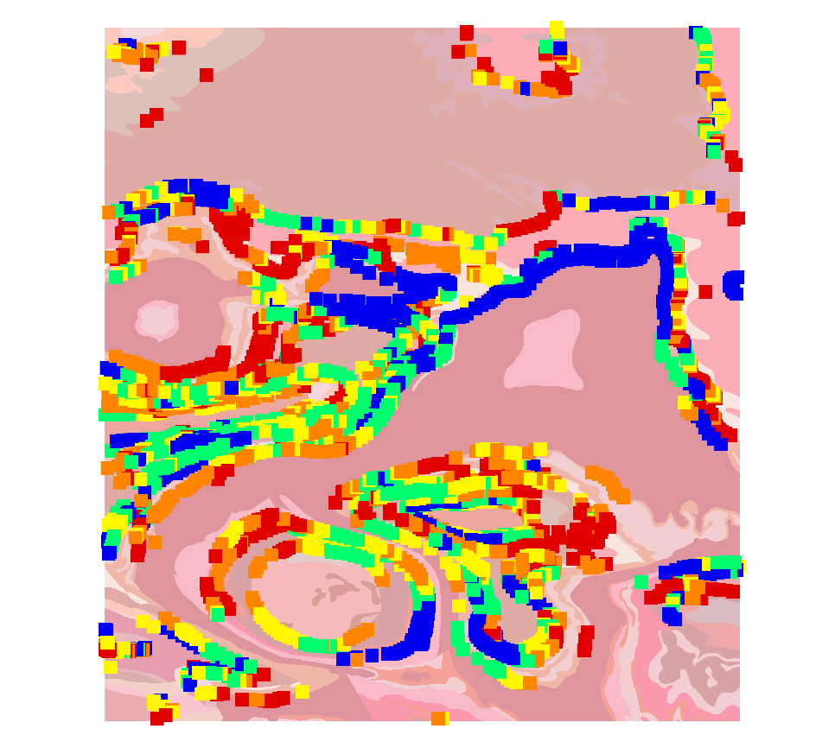
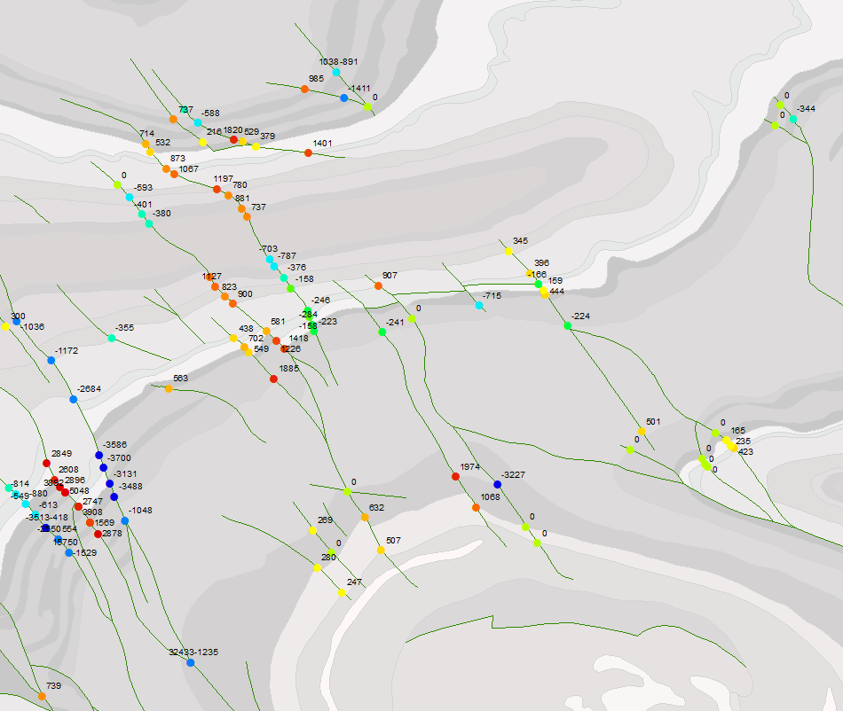
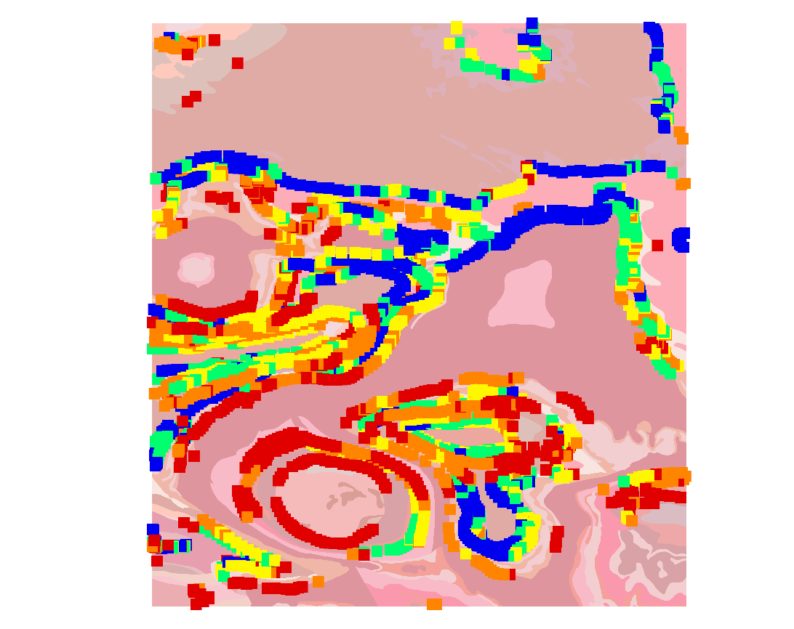
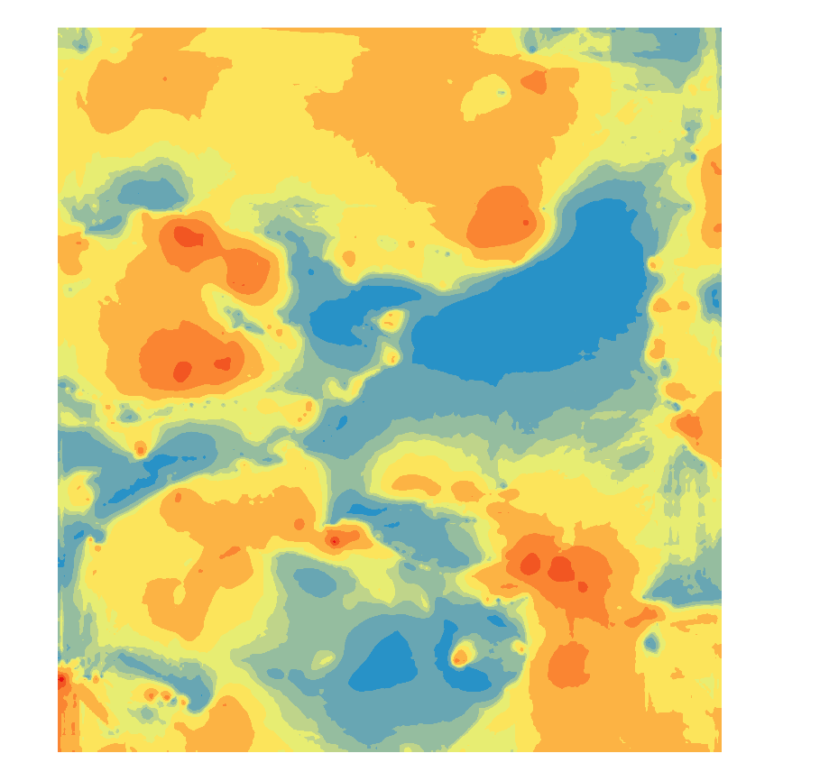
Automated Analysis
Apparent fault throw
Estimated Unit Thickness

Slide 15
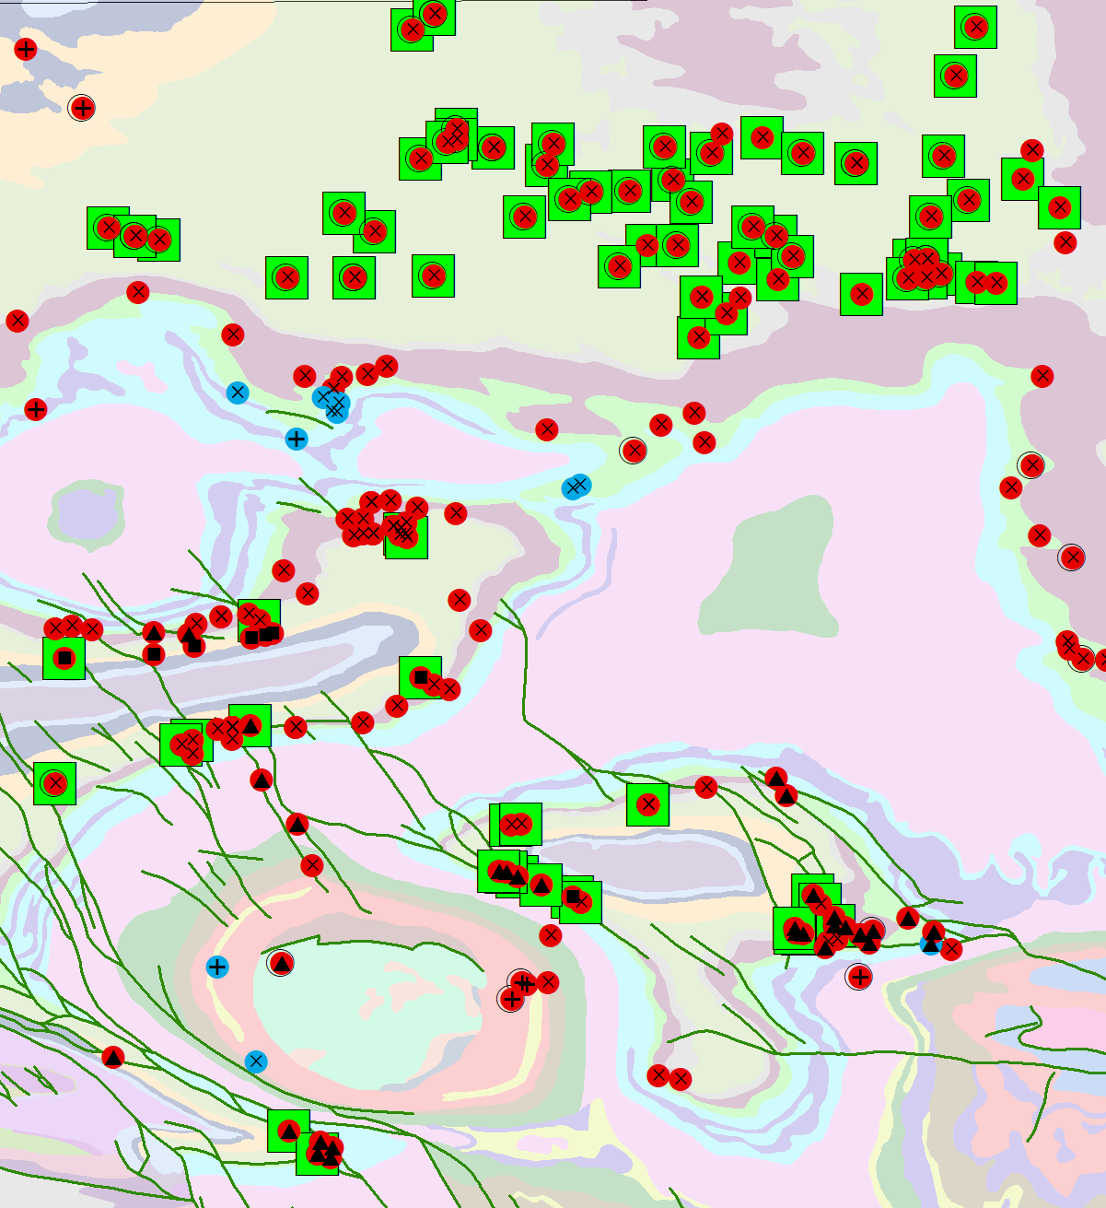
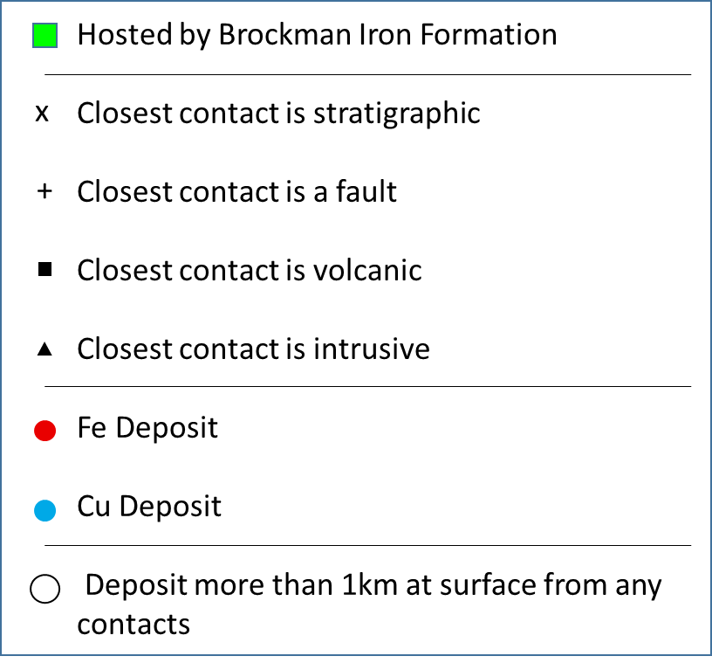
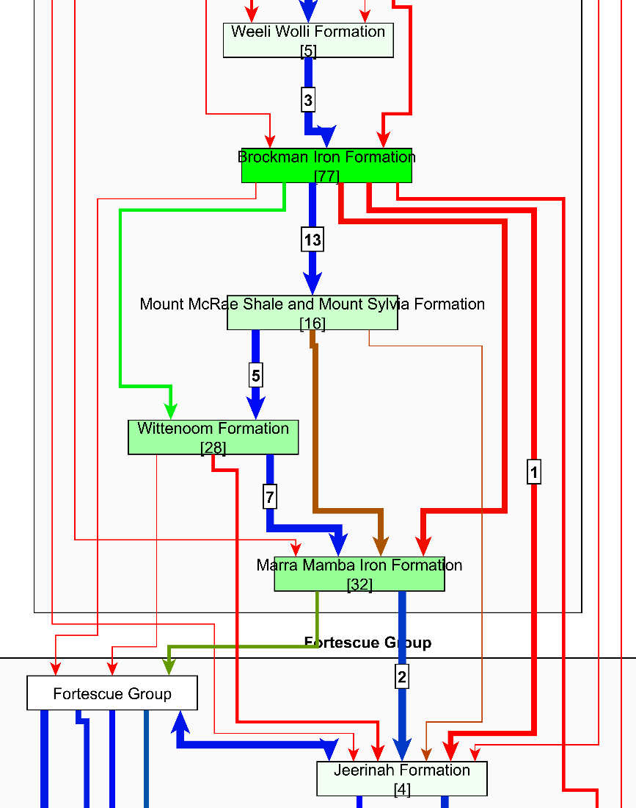
Litho-structural mineralisation context
12
Deposits on/near contact
[7]
Deposits hosted by formation
Formation
Fault Contact
Strat Contact

Slide 16
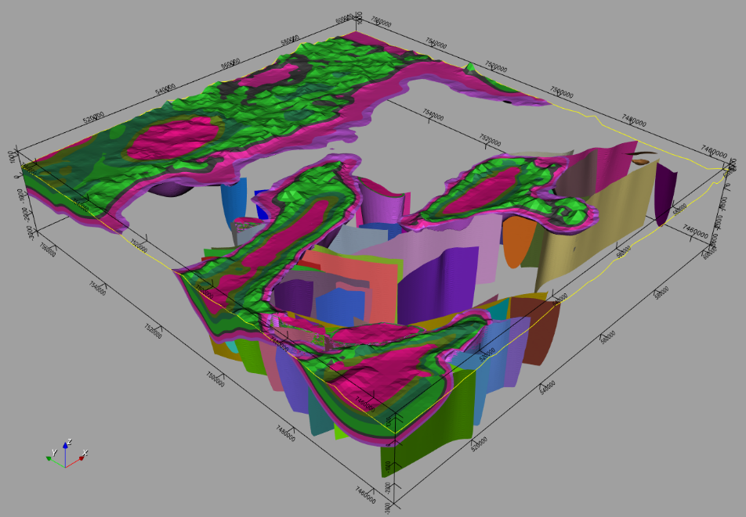
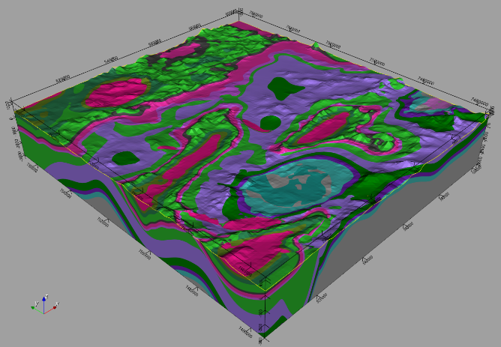


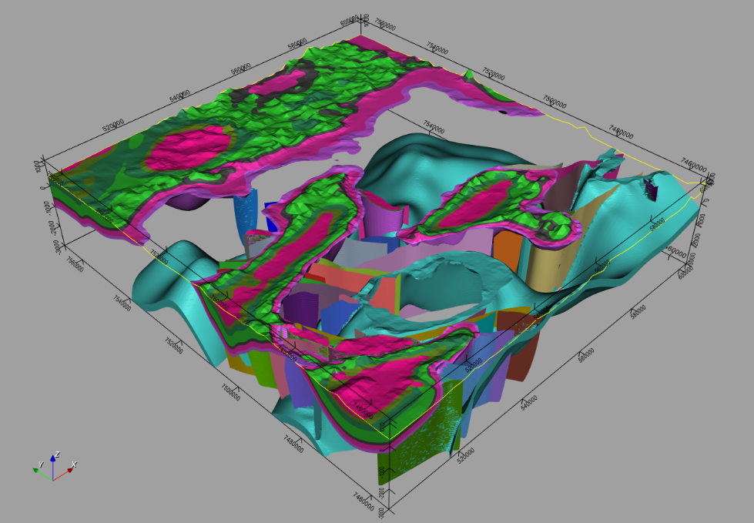
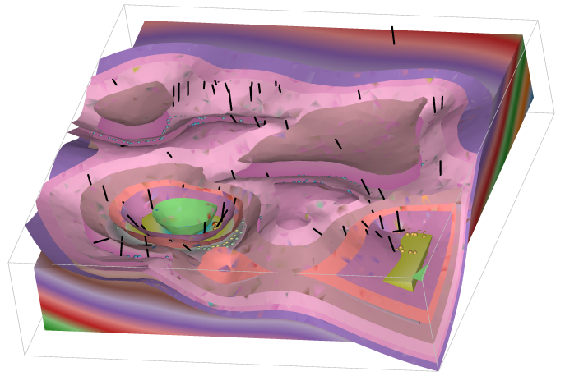
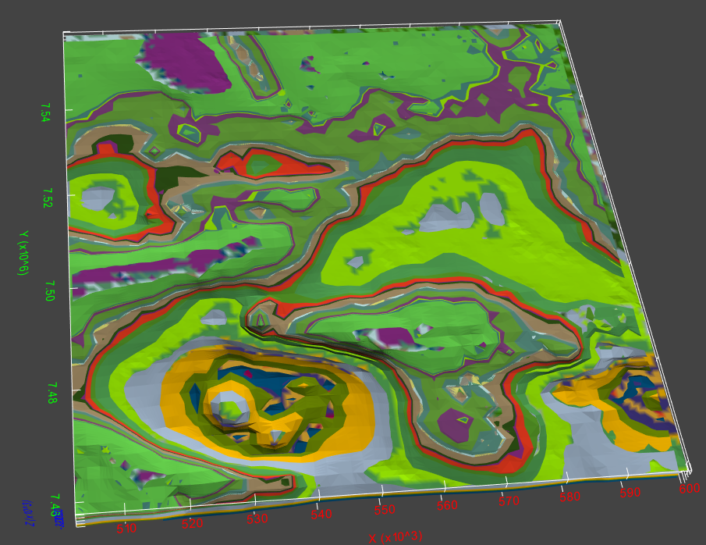
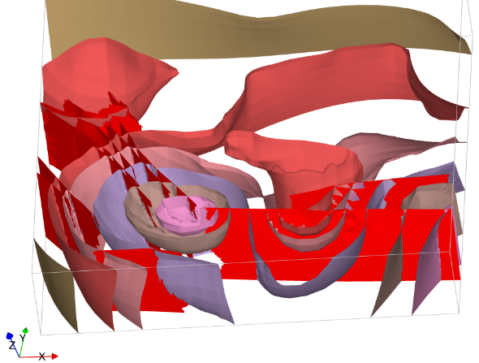
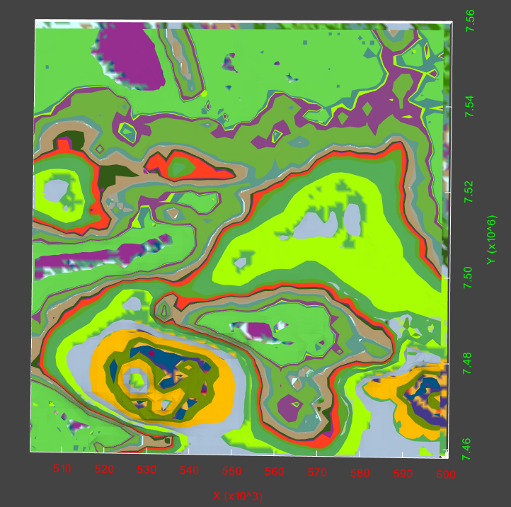
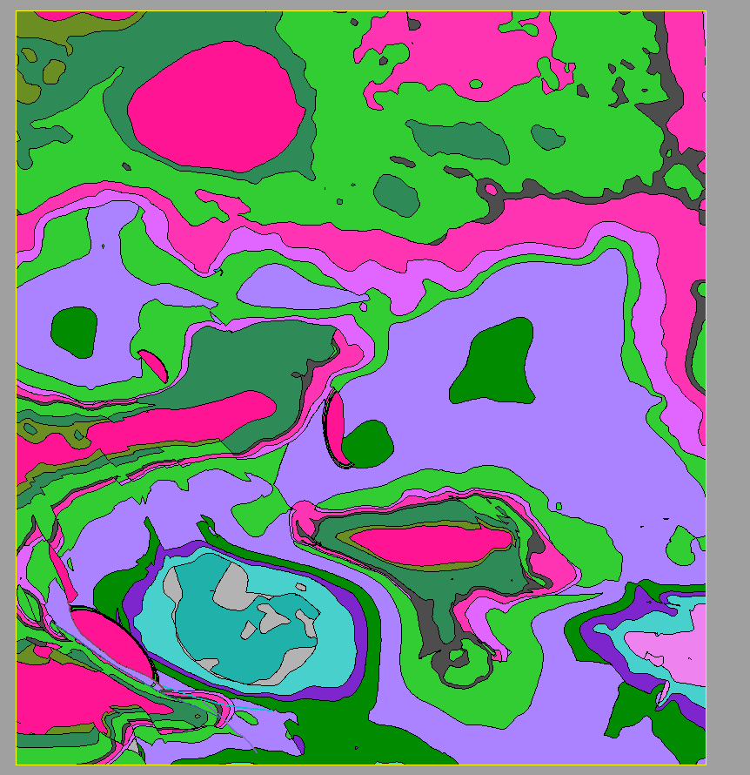
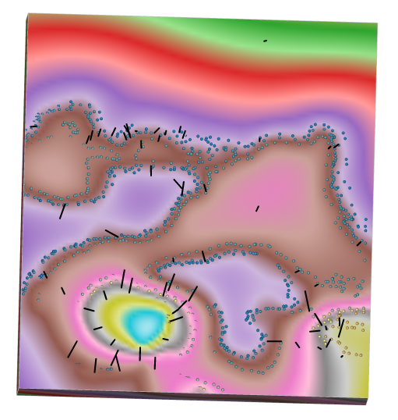

geomodeller
Structural

Slide 17

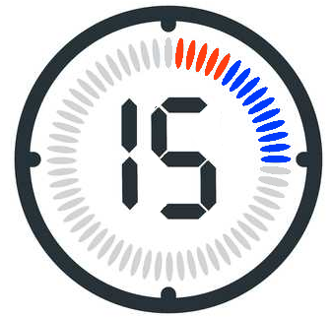
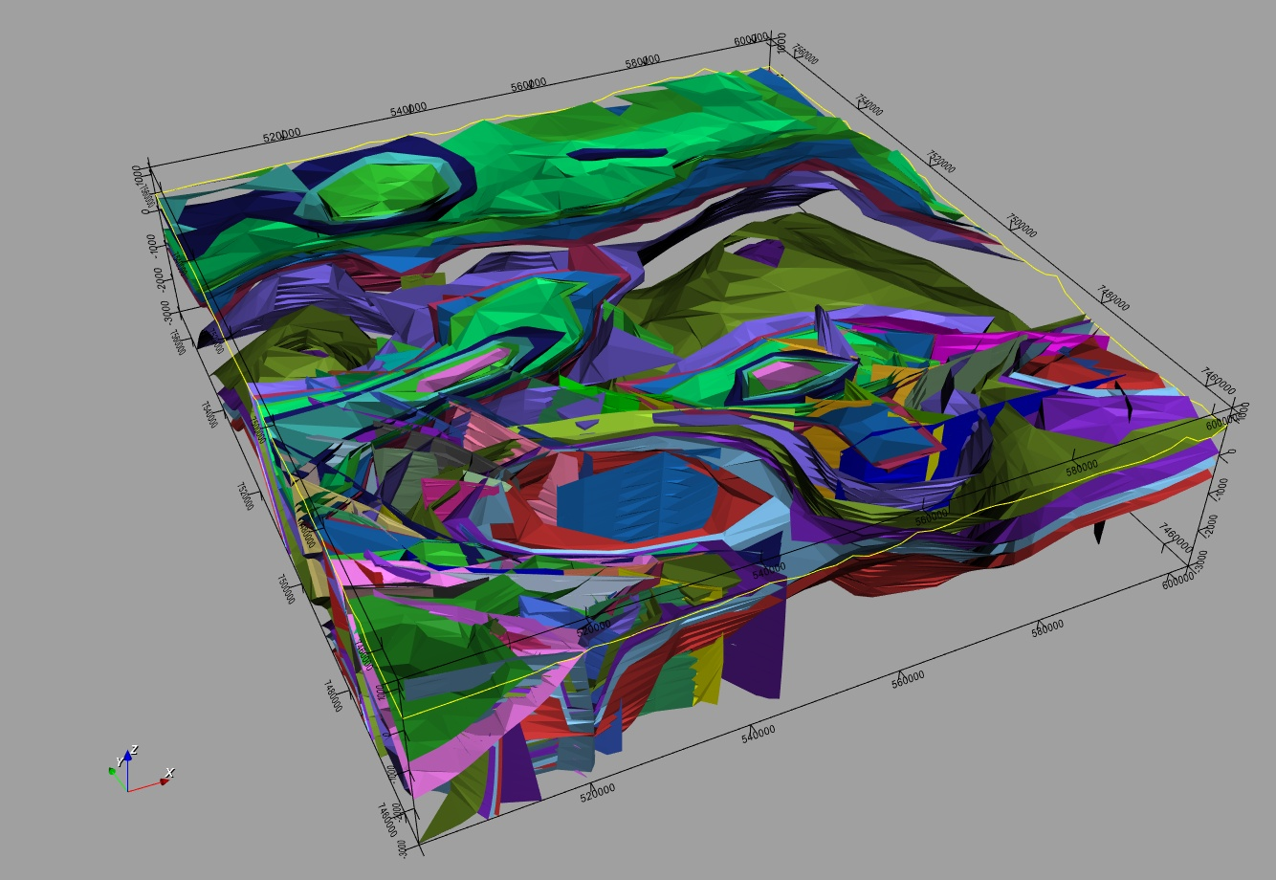
map2loop
Geomodeller
minutes

Slide 18
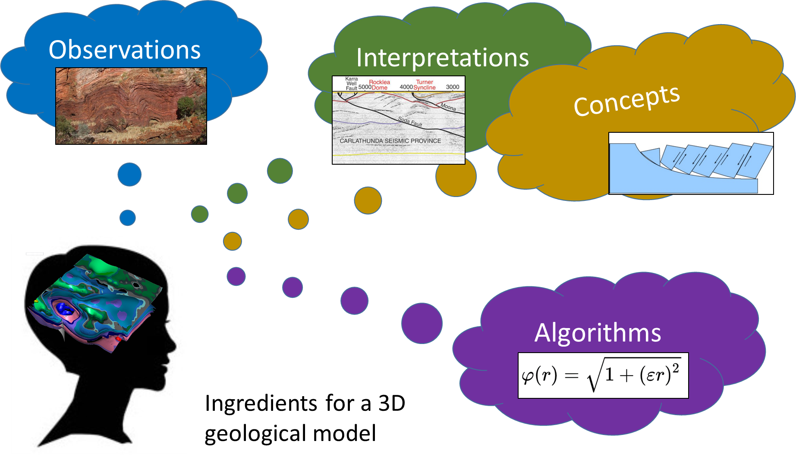
Uncertainty Quantification?
a
r
Elicitation?
r
Concept parameterisation?
a

Slide 19
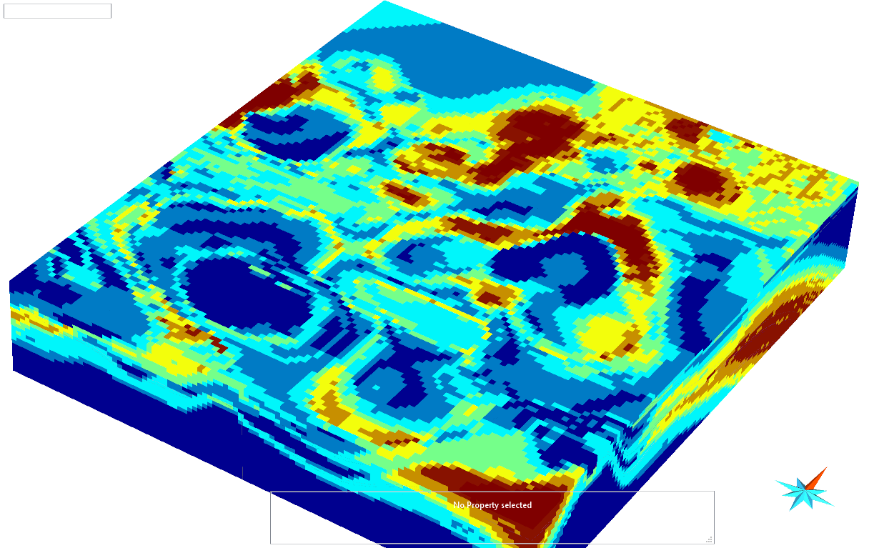
3D model data uncertainty quantification
WP 5 Guillaume Pirot
Multiple realisations
of the same model with
confidence acknowledged
Multiple realisations
of the same fault
Multiple realisations
of the same contact
65
75
85
Uncertainty voxet
With new workflow, uncertainty propagation from source data, not just from sampled data and provides pathway for conceptual uncertainty
Uncertainty analysis
Jessell +2010, Wellmann + 2010,2011,. Lindsay + 2013,2014, Pakyuz-Charrier + 2018,2019

Slide 20
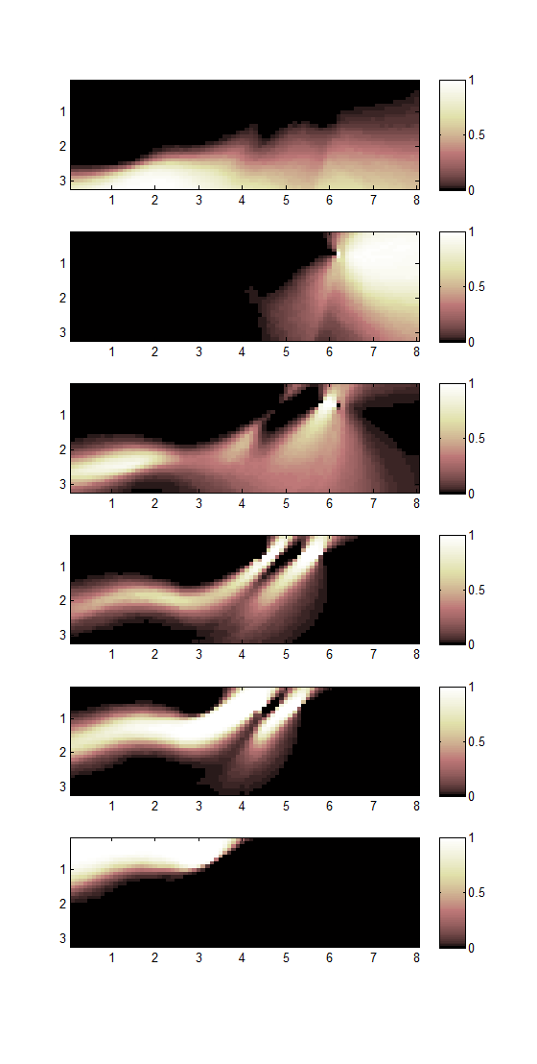
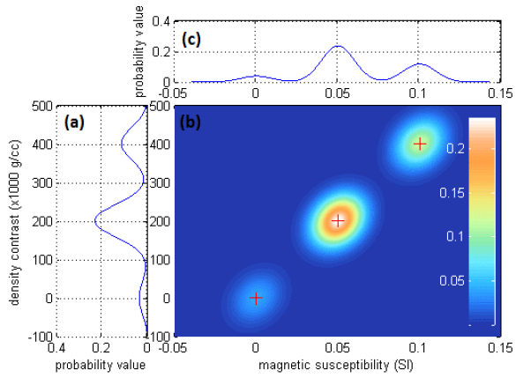
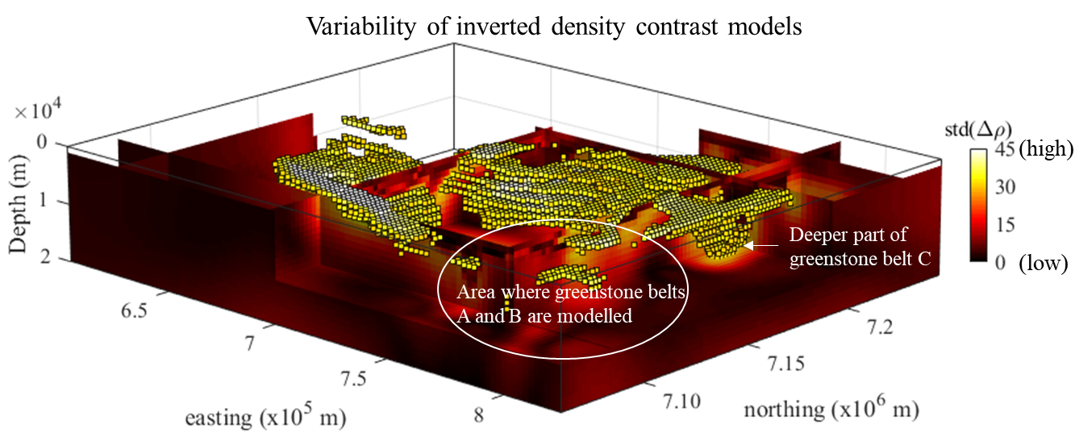
From geological uncertainty to geophysical inversions (and back again)
1= certain
0=uncertain
Voxel-level petrophysical uncertainty
Geophysical inversion with geological & petrophysical constraints
Voxel-level lithological uncertainty
Giraud + 2017,2018,2019
Lithological recovery with topological constraints
WP 4 Jeremie Giraud

Slide 21
map2loop automation provides significant advantages, since it:
  Significantly reduces the time to first prototype models;
  Clearly separates the primary observations, interpretations, derived data and conceptual priors during the data reduction steps and
  Provides a homogenous pathway to Sensitivity Analysis, Uncertainty Quantification, Multiscale Modelling and Value of Information studies.

Slide 22
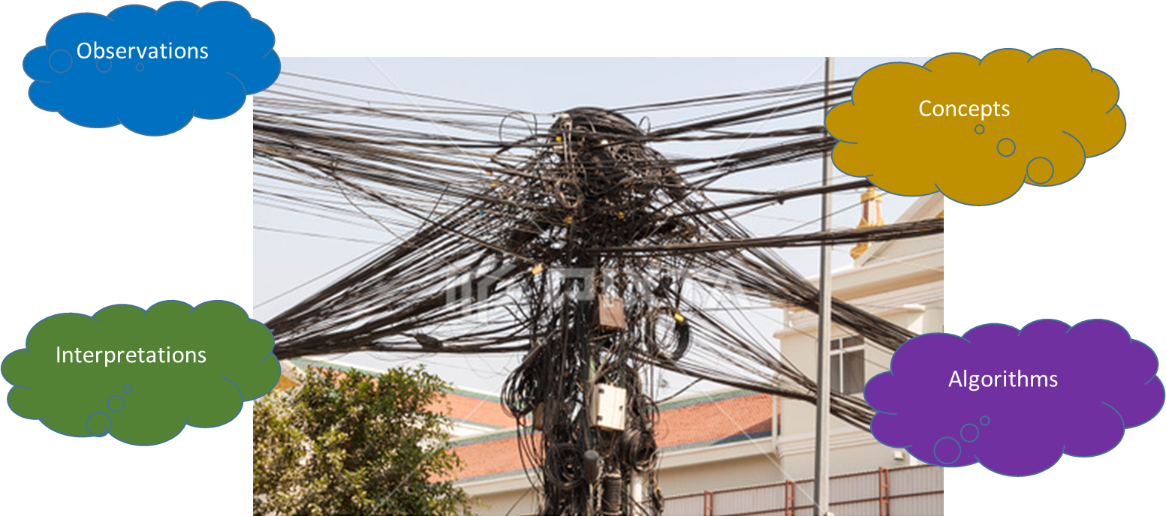
Concepts
Observations
Interpretations
Algorithms

Slide 23

Proof of concept, use at your own risk!

