Slide 1
Please read this before using presentation
This presentation is based on the content presented at the 2019 Exploration Safety Forum in May 2019.
Department of Mines, Industry Regulation and Safety (DMIRS) supports and encourages reuse of its information (including data), and endorses use of the Australian Governments Open Access and Licensing Framework (AusGOAL)
This material is licensed under Creative Commons Attribution 4.0 licence. We request that you observe and retain any copyright or related notices that may accompany this material as part of attribution. This is a requirement of Creative Commons Licences.
Please give attribution to Department of Mines, Industry Regulation and Safety, 2019.
For resources, information or clarification, please contact: SafetyComms@dmirs.wa.gov.au or visit www.dmirs.wa.gov.au/ResourcesSafety

Slide 2
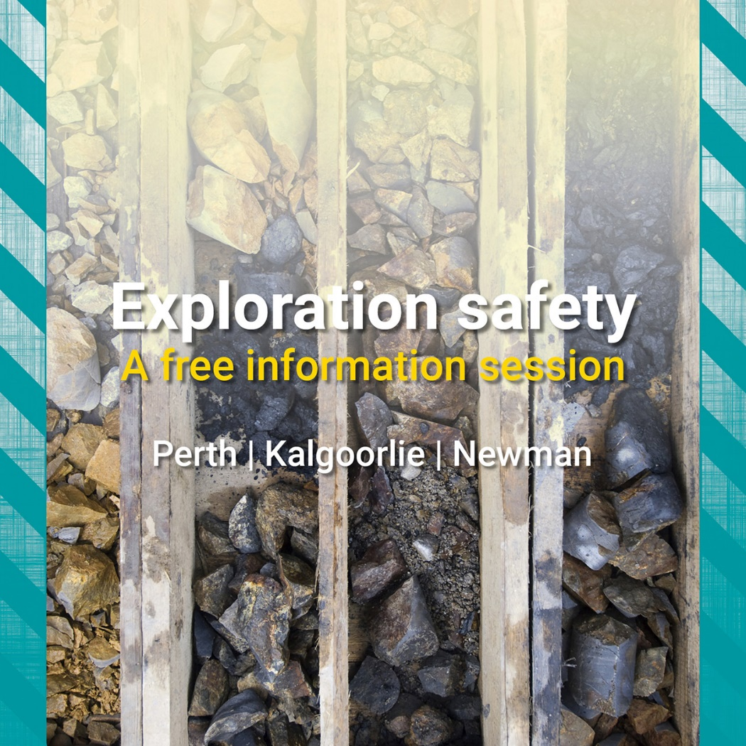
2019 Exploration Safety Forum

Slide 3
Best practice: drilling safety basics – an industry perspective

Slide 4
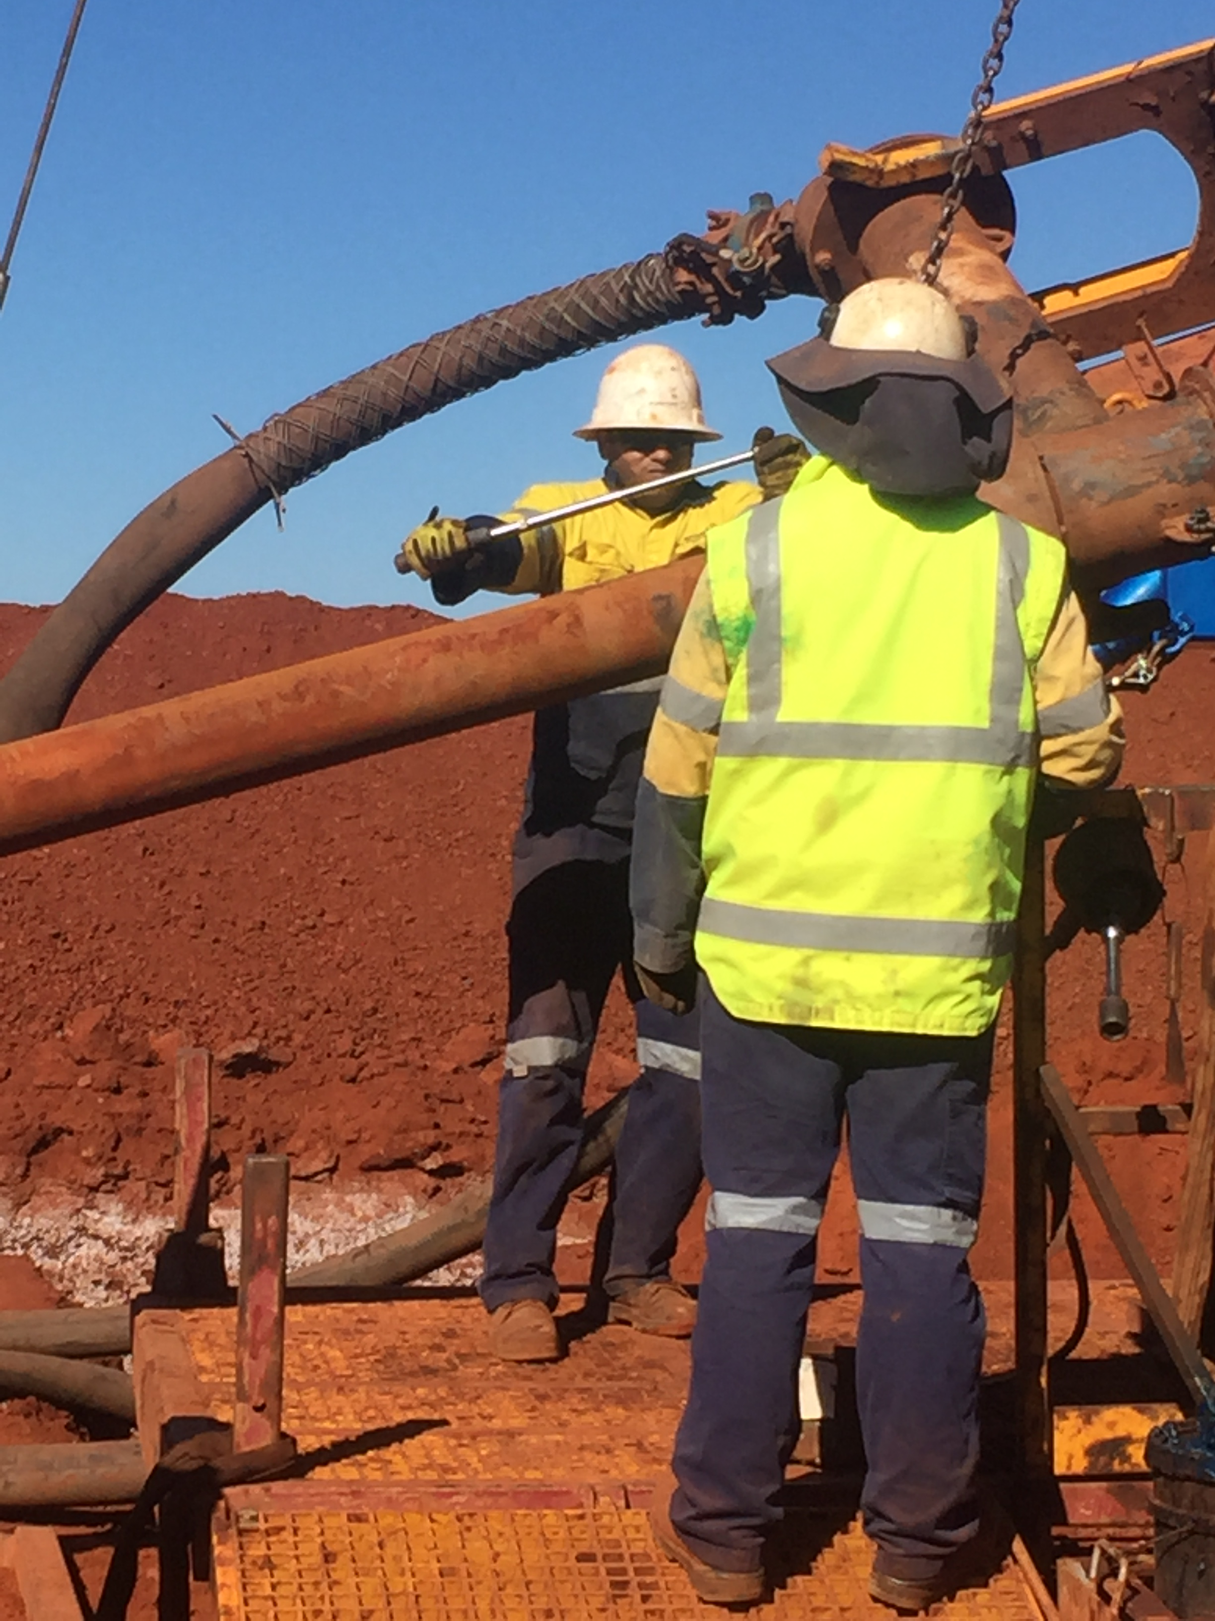
Safety and getting the basics right!
(image courtesy of Easternwell)
Presented by: Peter Hall, CEO

Slide 5
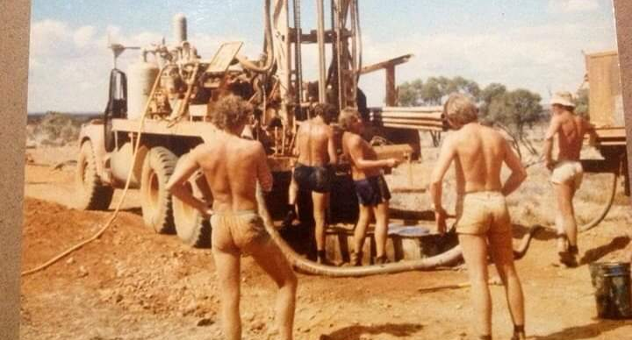
Where have we come from – 1970’s

Slide 6
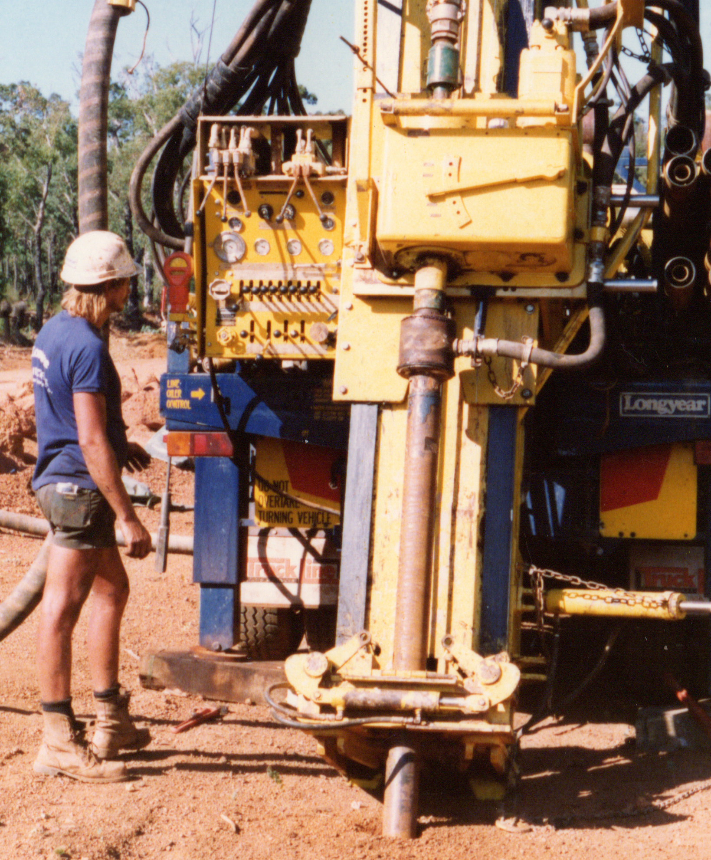
Early 1990’s!

Slide 7
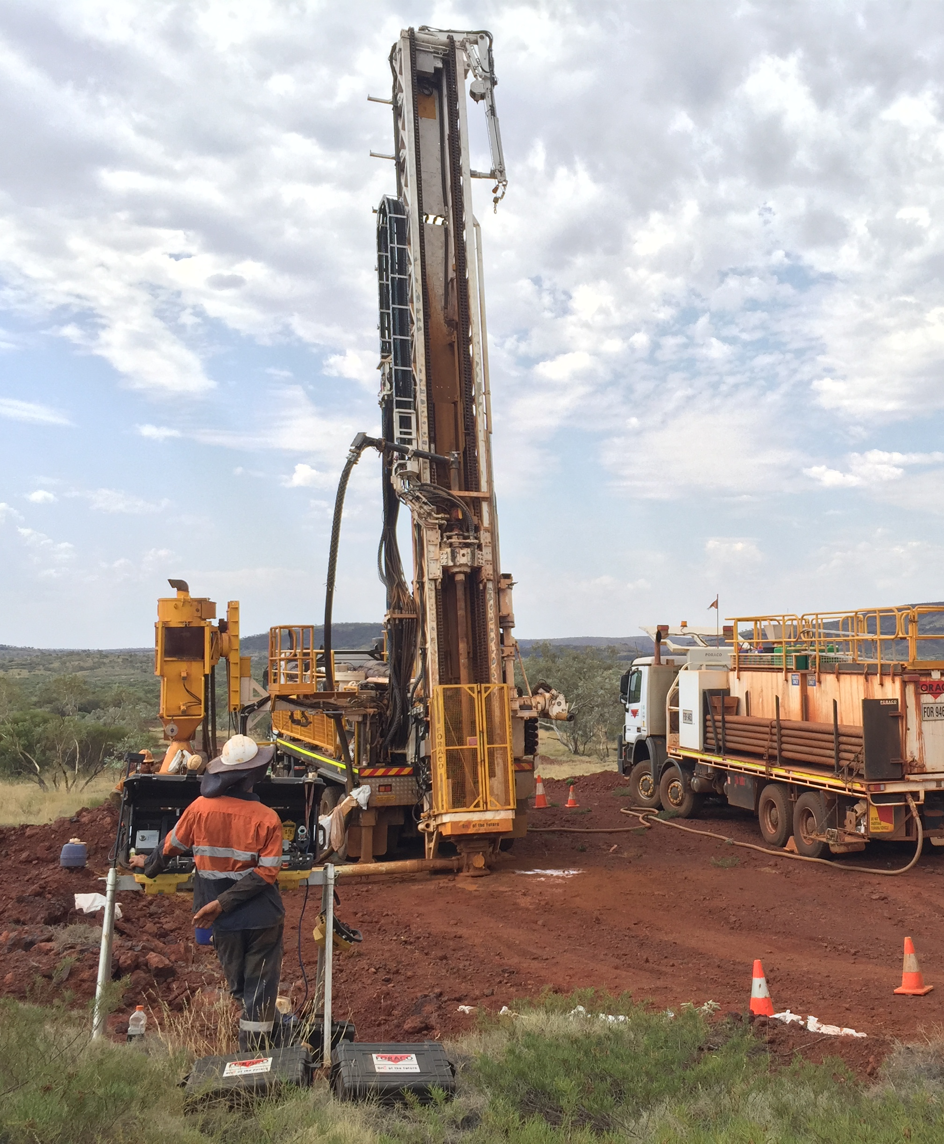
Current Day - 2019
(image courtesy of Foraco)

Slide 8
What changes have we seen since the 1970’s
Then
NOW
Almost zero body protection
No equipment guarding
Operator at the rig
Hook/Clamshell for rod handling
Basic foot-clamp arrangements
Stilson wrenches
No exclusion zones
No safety systems
Full PPE
Rod guard with interlocks
Remote control panel
Remote control rod handler
Rod spinners/clamps
Rod breakers
Designated work zones
Crew working to an embedded standard

Slide 9
Collaboration has driven change in the drilling industry!
Regulators
Standards to improve workplace health and safety
Miners and Explorers
Need to report to shareholders their EH&S statistics.
Development of targets to reduce risk throughout the business.
Drilling Contractors
Embrace technological advancements in the workplace
Development of safety systems to comply with client requirements.
Community expectations that people come home from work safe and uninjured.
Standards filter down to the smaller companies
Strong client relationship allows for reinvestment in the business.

Slide 10
Safety has to start at the top
Senior Management must be 100% committed and provide the resources
Operations Management must live and breathe the standards and “walk the talk”.
The drill crews need to have clarity and support on an ongoing basis and a safety culture they can identify with. They must be encouraged to feedback unsafe situations.
Standards and Expectations
Operational Feedback

Slide 11
Employees expectations are different than they were one and two generations ago
First preference is for transferrable Qualifications
Good work/life balance
Salary is important but 3rd on the list.
Many low level injuries in the workplace are with employees with less than 2 years experience. Select the right employees in the first instance and then give them the necessary training and opportunity.

Slide 12
Culture and Implementation
Companies who are serious about best practice on safety will have an embedded “way of doing things”. These will vary company to company but they will generally run across similar lines:
Driving.
Operations.
Weather.
Working at heights
Lifting and carrying
Stored Energy
Materials handling
Numerous others
ADIA has recently produced a set of 4 posters covering some of these themes.

Slide 13
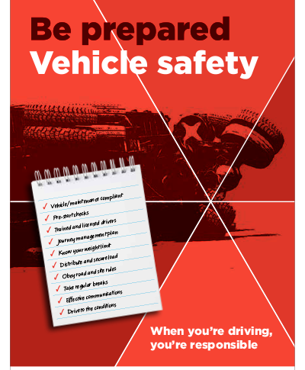
Driving is acknowledged as the riskiest activity and most likely to result in a serious injury or fatality.

Slide 14
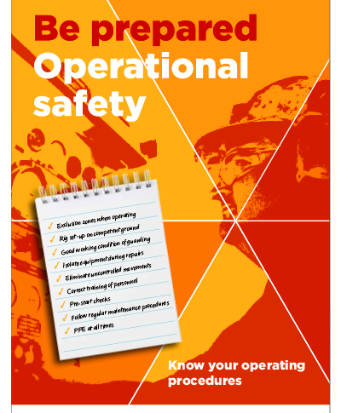
This is everything around the drill rig and is not hard to get right! Drilling contractors need to develop a safety system that all employees will engage with.

Slide 15
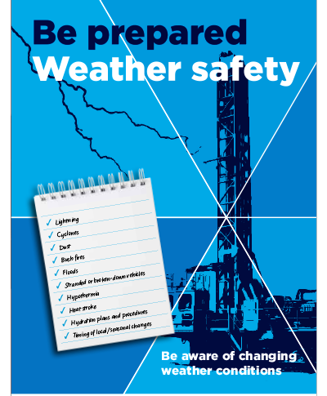
Climate conditions can change dramatically over a short time. Not being prepared or not having mitigating systems in place can seriously expose employees to high risk!

Slide 16
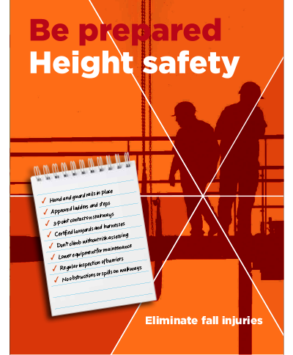
There are times when it is necessary to undertake work above ground level. Systems and training need to be in place to mitigate risk!

Slide 17
Early Client – Contractor Relationship
Contractor
Qualifications
Training
Inductions
Rig audit
Engineering
Maintenance
Client
Reporting
Culture
Communication
Meetings
Responsibilities
Expectations
The contractor is engaged to drill, therefore the majority of the work to comply with safety expectations needs to be signed-off before arriving at site.
The client will have their own expectations and protocols and these need to be clear and defined from the outset.
How well will these mesh with the contractor needs to be determined early.

Slide 18
Onsite Client – Contractor Relationship
Contractor
Communication
Respect
Empathy
Mentoring
Management interaction
Demonstrate support.
Client
Communication
Respect
Sensibility
Learn
Engage after-hours
Not sure, ask!
2018-19 has been a busy period for drillers, meaning a lot of new recruits starting in the industry.
How do we ensure we look after them?
More drilling is an outcome of more investment into exploration and expansion. This has resulted in a lot of “green” personnel on the client side also.

Slide 19
Client – Contractor Relationship When things go wrong!
Contractor
Communication
Investigate
Management support
Identify cause and rectification
Employee welfare
Client
Communication
Investigate
Independent review
Consistency in approach
Unfortunately incidents are still occurring. Investigations need to be completed before cause and blame are attributed.
Shut-down of operations needs to be commensurate with incident magnitude and not seen as penalisation.

Slide 20
The type of comments that won’t belong in a company with a strong and effective safety culture.
Training is only a “tick and flick exercise”
Don’t report it as the rig may get shut down.
I’ll be right, I’ve only had a couple of beers
Bridge it out and fix it later!
Put your glasses on as the geo is coming
Harden up princess!

Slide 21
Well known quotation and very applicable to leaders in the drilling industry!
The standard that you walk past, is the standard that you accept!

Slide 22
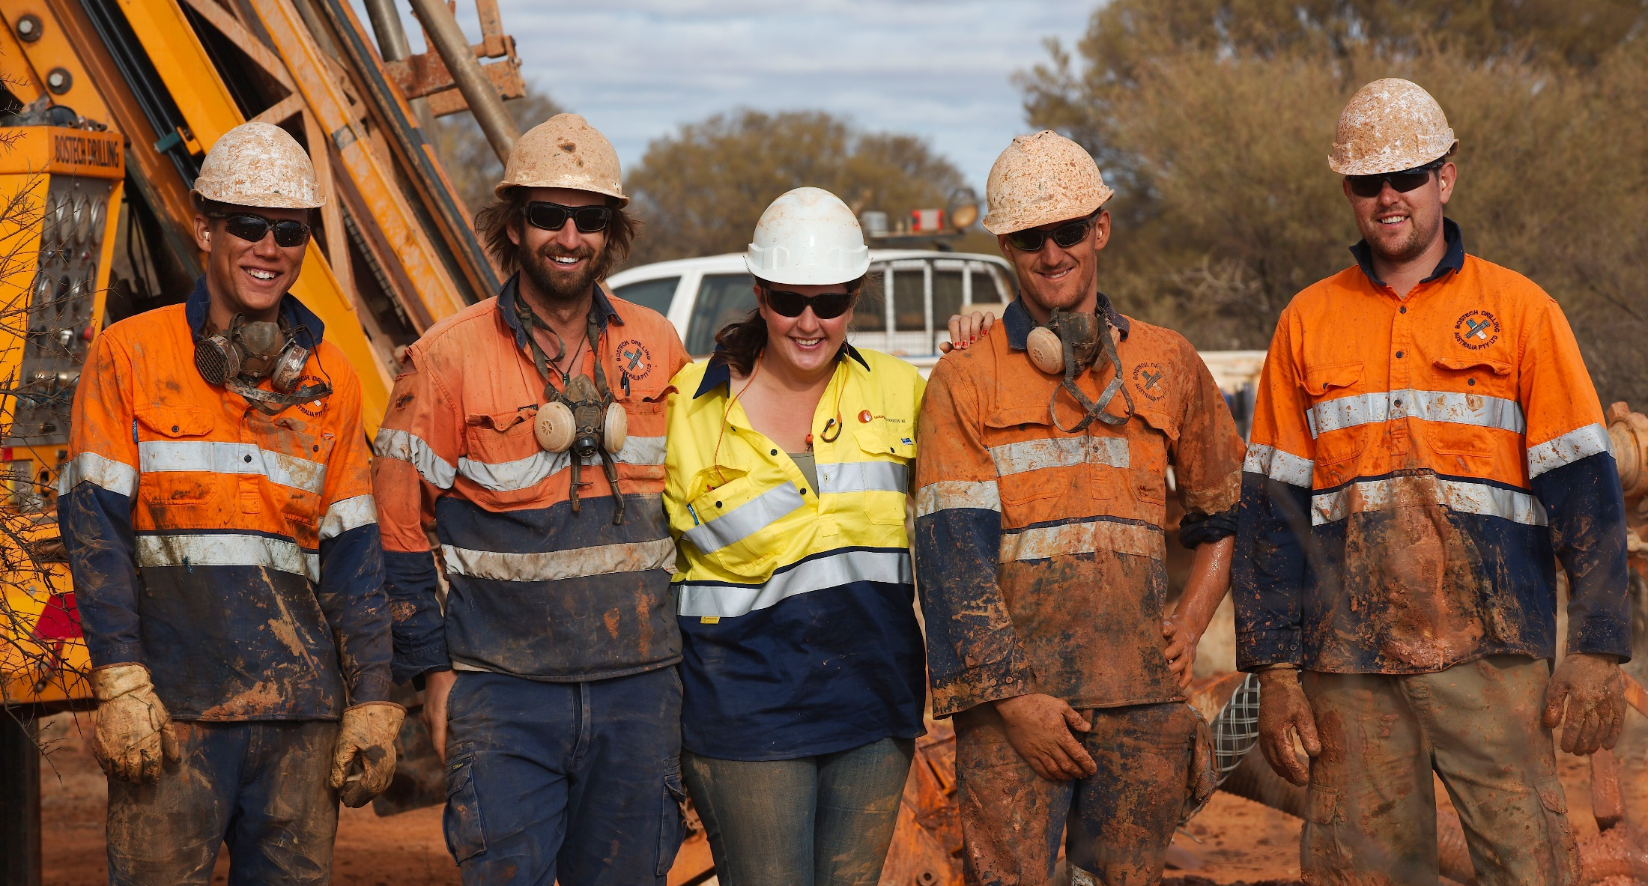
Thank you and enjoy the remainder of the session!
(image courtesy of Bostech)

