Slide 1

Please read this before using presentation
This presentation is based on content presented at the 2017 Emergency Management information session in November 2017.
Department of Mines, Industry Regulation and Safety(DMIRS) supports and encourages reuse of its information (including data), and endorses use of the Australian Governments Open Access and Licensing Framework (AusGOAL)
This material is licensed under Creative Commons Attribution 4.0 licence. We request that you observe and retain any copyright or related notices that may accompany this material as part of attribution. This is a requirement of Creative Commons Licences.
Please give attribution to Department of Mines, Industry Regulation and Safety, 2018.
For resources, information or clarification, please contact: SafetyComms@dmirs.wa.gov.au or visit www.dmirs.wa.gov.au/ResourcesSafety

Slide 2


Slide 3
Emergency management for Western Australian mines
– code of practice and emergency preparedness audit

Slide 4
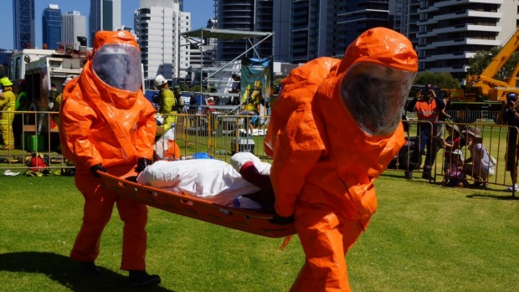
What am I going to cover?
Historical guidance
Code of practice development
Public comment
Emergency preparedness audit
Where to from here

Slide 5
History
Current guidance is out of date (DMP/CME)
  Emergency preparedness for underground fires
  Fitness for mine rescue personnel (1997)
  CME guidelines for mine emergency response in WA (1999)
Various attempts made to review guidance
Safe Work Australia – code of practice (still in draft)

Slide 6
Code development
Working group established May 2016, 4 workshops conducted in 2016
Working group reviewed and update document
Document submitted to MIAC for review and endorsement
Document released for public comment 25 November 2016 to 3 February 2017
Document finalised and signed off by State Mining Engineer
Public comment addressed

Slide 7
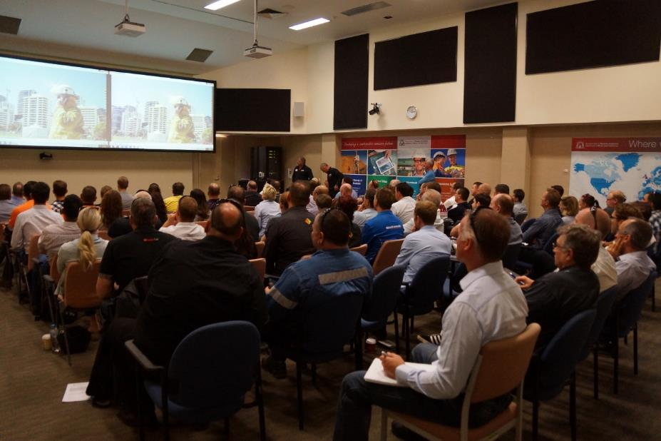
Public comment
Title
Risk management
Terminology
Volunteers
Training
State Emergency Management
Application to small operations

Slide 8
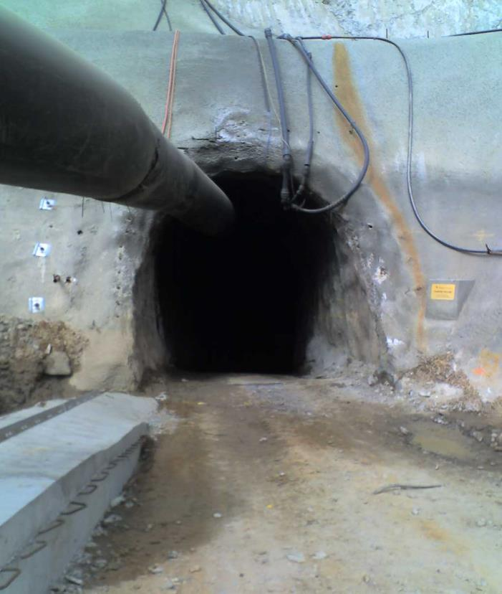
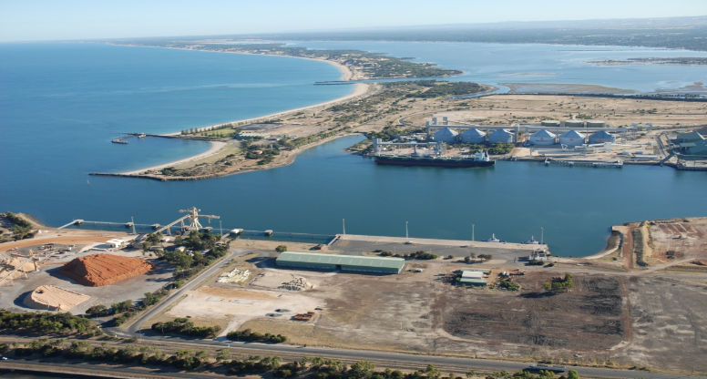

One size does not fit all

Slide 9
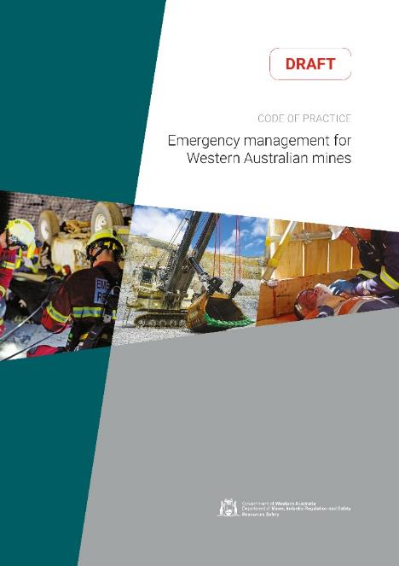
Code of practice – contents
Stakeholder responsibility
Risk based approach
Identification of foreseeable scenarios
Emergency management planning
Emergency resources and equipment
Emergency response personnel
Training and competency requirements
Incident management
Supporting reference material
Example templates
Notes:
Chapter 2:
variables/factors to be considered when
emergency response activities are
undertaken, including hazard identification and risk management
Chapter 3:
assistance with establishing an emergency plan as part of the site’s safety management system, including incident management systems
Chapters 4, 5, 6, 7
broader occupational health and safety requirements for undertaking emergency response in accordance with the legislation

Slide 10

Aims of the code of practice
Describe the key factors to consider when emergency response activities are undertaken, including hazard identification and risk management
Assist with establishing an emergency plan as part of the site’s safety management system
Broader occupational health and safety requirements for undertaking emergency response in accordance with the legislation

Slide 11
To assist the development of learning materials for the new legislation, including Emergency Management, Mines Safety Roadshow 2017 564 participants completed a questionnaire
Role | Percentage
Employees | 37%
Supervisors / Team leaders | 15%
Superintendents | 17%
OHS / Safety Representatives | 26%
Other (including Emergency) | 5%
Experience
30% < 3 years 21% 3-5 years 21% 6-8 years 10% 9-11 years 18% 11+ years
Qualifications
35% Safety Representative 23% Certificate IV 22% Diploma 13% Bachelor degree 7% Grad Cert/Dip 5% Higher degree
Notes:
564 participants over X sites across Western Australia

Slide 12
Facilities
65% of respondents reported an incident in the last month
42% of sites were between 50 and 200 km away from medical services
On site | Up to 10km | 11-50 | 51-100 | 101-150 | More than 200km | 151-200
10% | 24% | 36% | 16% | 14% | 6% | 6%
On site services reported were:
7% Doctor
16% Paramedic
23% Medic
18% Nurse
36% First Aid Station
22% Medical Station
9% Nursing Station
Notes:
65% of respondents reported incidents in the last 6 months
42% of sites were between 50 and 200 Kms away from medical services.
Significant differences in knowledge of on site services between individuals

Slide 13
Emergency Management
Less than 15% rated their organisation as extremely effective in Emergency Management
Topic | % Companies rated as poor | Individual training need strongly identified
Emergency Management | 38% | 72%
Fatality Prevention | 27% | 68%
Preventing Emergencies | 28% | 69%
Preparing for Emergencies | 35% | 74%
Responding to Emergencies | 33% | 70%
Recovering from Emergencies | 42% | 74%
Notes:
Less than 15% rated their organisation as extremely effective
30-35 % intended to study further in OHS / Leadership

Slide 14
Emergency preparedness audit experience
Emergency plan available
Desktop exercises and simple evacuations conducted
Volunteer emergency response personnel and equipment generally available
Full exercises rarely conducted
Mutual aid have not attended site / exercises
Fluctuations in the skills and experience of volunteers
A range of equipment not maintained to OEM recommendations

Slide 15
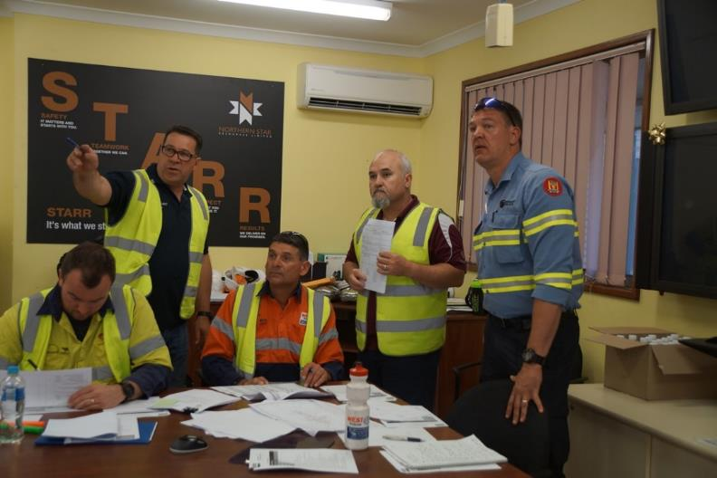
Emergency preparedness audit
Reviewed and aligned the audit to code of practice
Discussed and workshopped audit with inspectors
Audit will be made available for trial

Slide 16
Where to from here
Emergency preparedness audit available for trial
Document recommended to Minister for Mines and Petroleum for approval
Code of practice submitted to MIAC for review and endorsement

