Slide 1
Please read this before using presentation
This presentation is based on content presented at the Mines Safety Roadshow held in October 2013
It is made available for non-commercial use (e.g. toolbox meetings, OHS discussions) subject to the condition that the PowerPoint file is not altered without permission from Resources Safety
Supporting resources, such as brochures and posters, are available from Resources Safety
For resources, information or clarification, please contact:
  RSDComms@dmp.wa.gov.au
  or visit
  www.dmp.wa.gov.au/ResourcesSafety

Slide 2
Why is design so important to safety?

Slide 3
What is safety in design?
Safety in design is aimed at preventing injuries and disease by considering hazards as early as possible in the planning and design process.
Notes:
What is safety in design and why is it so important?
Safety in design is aimed at preventing injuries and disease by considering hazards as early as possible in the planning and design process.
A simple example of safety in design is the advancements that can be seen in cars.

Slide 4
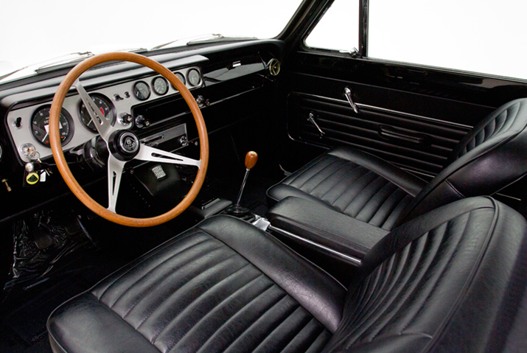
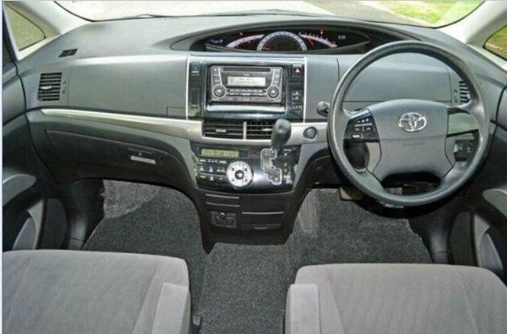
Design improvements over time
Notes:
Think of a car built in the 1960s. What do you see?
unforgiving surfaces
sharp edges on the dash
a thin-rimmed steering wheel with a decorative metal bar for the horn
drivers seat is flat and unsupportive with no head restraint or seat belts
roof pillars are thin and unpadded on the inside
the windscreen will probably be unlaminated
Compare that to the cars of today. You’ll see:
airbags
seat belts
ABS brakes
laminated windscreens
a car body made to crush on impact.
These built-in safety features are great examples of what safety in design aims to achieve.
Safety in design is about understanding the potential hazard that your product introduces – so for a car it’s the fact that we are travelling down a road at 100 km/hr – and finding a way to minimise potential loss of control or collisions, and mitigate the consequences (i.e. crash).
Designers and manufactures in the car industry are preventing injuries by considering the hazard of the car crashing early in the design process.
Now, thinking about how this can be applied to mine sites.
A safe design approach considers the safety of those people who:
construct
operate
clean
repair
demolish an asset.
These assets could be a:
building
structure
plant
equipment
as well as those who work in or with it.
In order to be able to design-out these hazards, however, very specific assumptions are made on how the product is intended to be used.
For example, car designs often assume that children will not be seated in the front seat. Once you start using a product outside of these limits you are likely introducing another hazard. In the case of a car, this new hazard is that the air bags deploy with such a force that they can cause severe head and neck injuries to a child.

Slide 5
How big is your window of opportunity?
Concept selected
Concept evaluation
Conceptual design
Final investment decision (FID)
Front-end engineering design (FEED)
Detailed design
Field activities
Construction
Cost to change
Field construct and install
Production or operation
Source: NOPSEMA
Notes:
Slide modified from NOPSEMA
This image illustrates how the cost, time and complexity of reducing a hazard can increase exponentially as you progress through the design cycle This leads to a shrinking window of opportunity to make cost-effective changes.
Retrofitting a safety system to a product once it is in production, is almost always far more expensive and logistically difficult. It typically results in a product that is not as safe as compared to one where that safety system was integrated in during the design phase.

Slide 6
Concept development
Detailed design
Shop fabrication / manufacture
Site construction and installation
Production operation
Maintenance, refurbishment and repair
Modification or expansion
Demolition or relocation
See code of practice on safe design
Safety in design
life cycle
Notes:
This figure shows a typical lifecycle for a design where the safety in design approach begins at the conceptual and planning phase, and continues right through to the final disposal.
Safety in design emphasises the choices made about the design, materials and methods of manufacture or construction required to enhance safety.
For example:
Obviously a designer should think twice about manufacturing an item using carcinogenic materials, because of the hazards they can present to the users.
A structure is designed to contain a single large piece of steel weighing 60 tonnes. As a designer, you’ve now introduced a very complex lift for those involved in constructing the structure.
[Safe design of buildings and structures – code of practice available on DMP website at www.dmp.wa.gov.au/15551.aspx]

Slide 7
What responsibilities do you have?
Mines Safety and Inspection Act 1994, section 14
(1) A person who designs, manufactures, imports or supplies any plant for use at a mine must, so far as is practicable –
  (a) ensure that the design and construction of the plant is such that persons who properly install, maintain or use the plant are not, in doing so, exposed to hazards
Notes:
What responsibilities do you have?
Section 14 (1)(a) of the Mines Safety and Inspection Act 1994 states that
A person who designs, manufactures, imports or supplies any plant for use at a mine must, so far as is practicable –
(a) ensure that the design and construction of the plant is such that persons who properly install, maintain or use the plant are not, in doing so, exposed to hazards
There are also duties for people to properly install, maintain and use the plant. You have a responsibility to follow the original equipment manufacturer (OEMs) or designer’s instructions.
By modifying a design you become a designer and can introduce a suite of new hazards that need to be considered.

Slide 8
Reasonably practicable
Quantum of risk severity and likelihood of event
Sacrifice in time, money and trouble
Notes:
Safe design will always be part of a wider set of design objectives though, including:
practicability
cost
functionality of the product
Safe design is the process of successfully achieving a balance of these sometimes competing objectives – without compromising the health and safety of those potentially affected by the product over its life.
This is the most common level of duty in OSH law and was defined in UK by Judge Asquith in Edwards versus the National Coal Board in 1949.
Time, money and trouble must grossly outweigh, not balance, the risk.

Slide 9
What are the consequences of poor design?
Risk of injury or loss of life
Environmental or equipment damage
Loss of income
Low productivity
Higher operating costs
Higher maintenance costs
Reduced asset life
Higher employment and workers’ compensation expenses
Notes:
What are some of the consequences of poor design?
Risk of injury or loss of life
Environmental or equipment damage
Loss of income
Low productivity
Higher operating costs
Higher maintenance costs
Reduced asset life
Higher employment and workers’ compensation expenses
Consider the example of a poorly designed piece of equipment that excessively vibrates. What do you imagine you could see over its life cycle?
an increased risk of causing harm to the operator
which may lead to them having to take time off work
which then could affect productivity leading to higher operating costs
The equipment itself will have to be maintained more frequently due to the damage this vibration does, damage which will ultimately reduce the assets life.

Slide 10
Hierarchy of control – start at the top
Elimination
Substitution
Engineering
Isolation
Modify tools or equipment to minimise exposure to hazard
Administrative control
Modify work practices (e.g. procedure, training) to minimise exposure to hazard
PPE
Last resort when other controls not practicable
Isolate or separate the hazard or hazardous work practice from people
Replace the hazard or hazardous work practice with a less hazardous one
Remove the hazard or hazardous work practice
Increasing effectiveness
What works?
10
Notes:
When considering risk controls, the hierarchy of controls is a useful framework for considering their effectiveness. This approach has been adopted by many regulators.
Elimination – removing the hazard from the building or structure design by “designing it out”.
Substitution – substituting or replacing a hazard or hazardous design component with a less hazardous one, through a process of redesign
Isolation – isolating or separating the hazard or hazardous work from people
Engineering controls – if the hazard cannot be eliminated, substituted or isolated, an engineering control is the next preferred measure and should be specified in the design notes
Administrative controls – those include noting in the design those work practices needed to reduce risk
Personal protective equipment only considered when other control measures are not practicable
As you are likely aware, the effectiveness of the controls decreases as you move further down the list

Slide 11

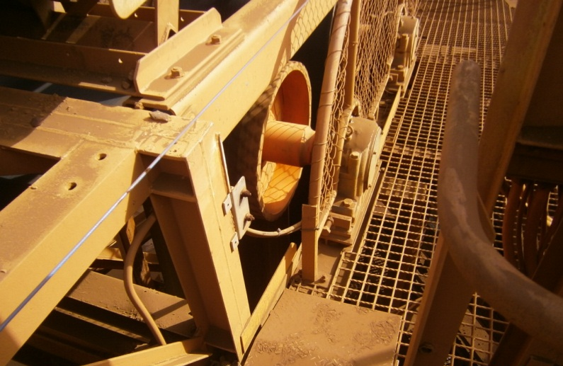
What is wrong with this?
Access way next to conveyor take-up pulley
Notes:
In this scenario we have a conveyor take-up pulley in close proximity to a walk way. Notice how narrow the walkway is.
What potential hazards do you see with this scenario?
How will this asset interact with its environment?
Will people be walking near it?
What type of work could be done around it?
(Clues: walkway width, proximity of the pulley, opening, guard position, pull wire)
Hazard?
Answer: Entanglement, crush injury etc
How can this be prevented by better design?
Answer:
greater width for walkway
move take up away from the narrow area
guard the opening
What do you see?
(Clues; walkway width, proximity of pulley, opening, guard position, pull wire)
How can this this be prevented by better design?
Answer:
more width
moving take up away from narrow area
How can it be managed?
Answer:
signs
training

Slide 12
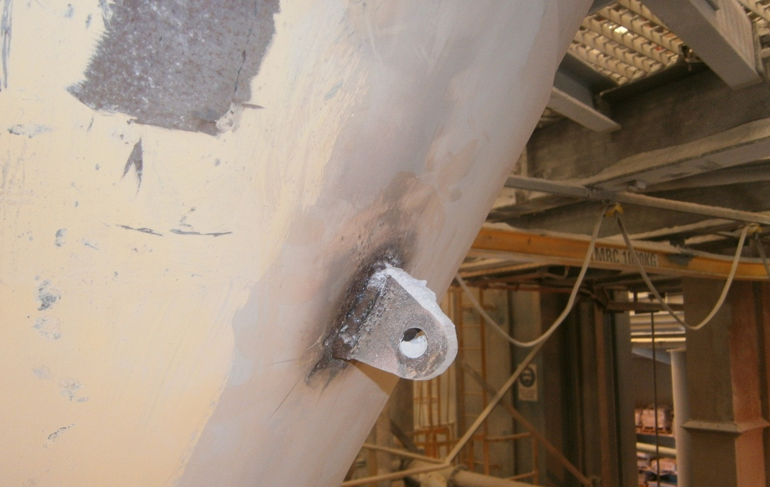
What is wrong with this?
Lifting lug welded to outside of conical bottom on powder-handling bin
Notes:
In this scenario a lifting lug has been welded to a bin as a modification (or after thought).
What potential hazards do you see with this scenario?
Is the item appropriate or adequate for its intended use?
Is it strong enough? How do you know?
Are there any Australian Standards and/or codes of practice it should comply with?
(Clues: what is the design capacity of the lug? Surface the lug was welded to? Bolt hole edge distance? Weld strong enough? Is the weld compatible with the material of the bin (bi-metallic corrosion?)
Hazard?
Answer: Load could be dropped. The weld could have affected the structural integrity of the bin initiating cracks.
How can this be prevented by better design?
Answer: Designed to Australian Standards by a competent person assessing all load paths. It should be inspected and tested to ensure it’s strong enough to lift the bin.
Now this slide highlights a very important point. One of the biggest threats to safety in design that we see everywhere results from people modifying designs. Removing bracing, adding lifting lugs, adding and/or removing counterweights.
Using a product for a purpose it was not initially designed for can really affect how safe it is for the user.

Slide 13
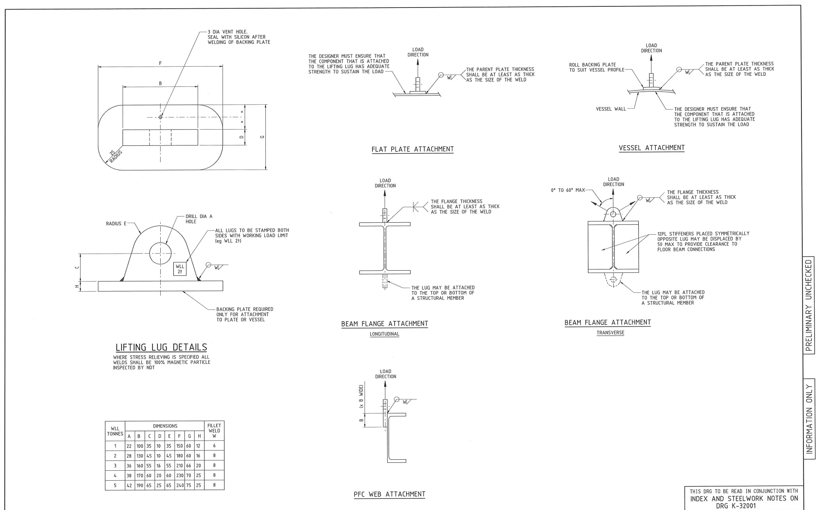
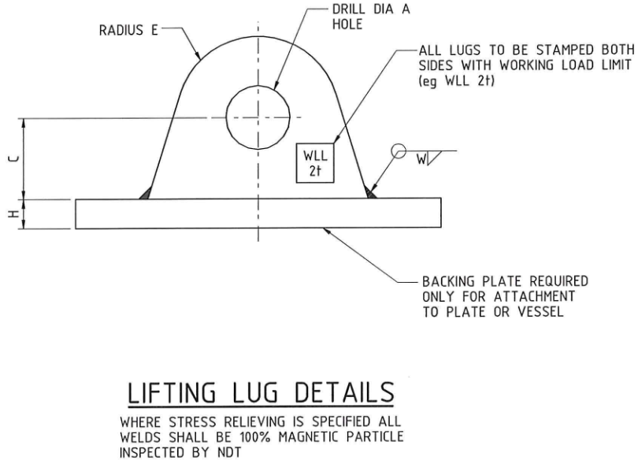
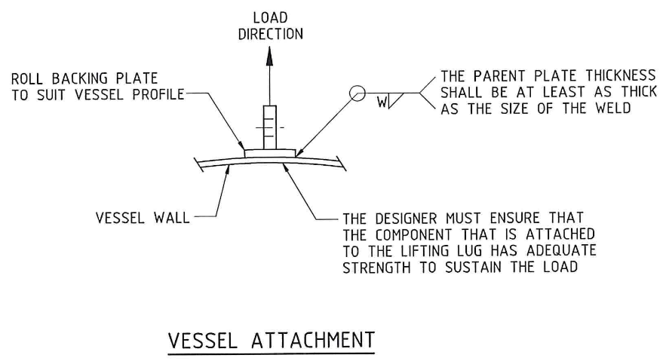
Standard drawings – lifting lug example
Notes:
Here are some examples of what a designer should consider when someone has asked for a lug to be added to a vessel.
Click: enlarged lifting lug details diagram appears
Click: enlarged vessel attachment diagram appears

Slide 14
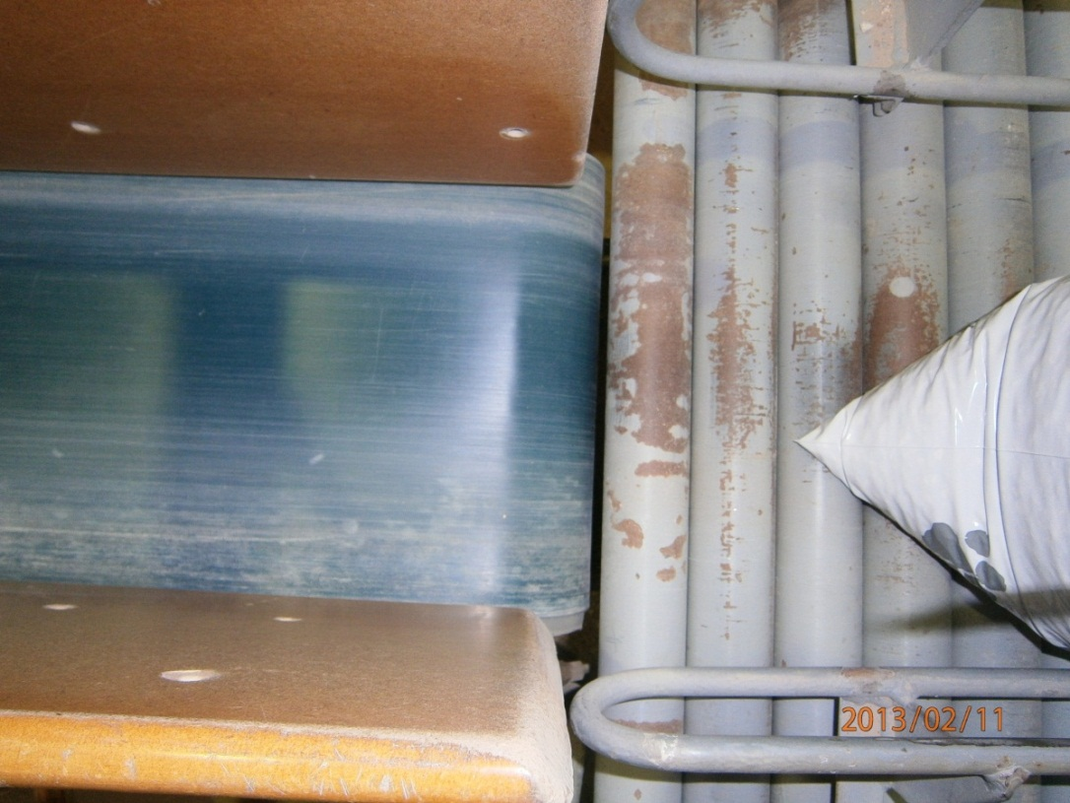
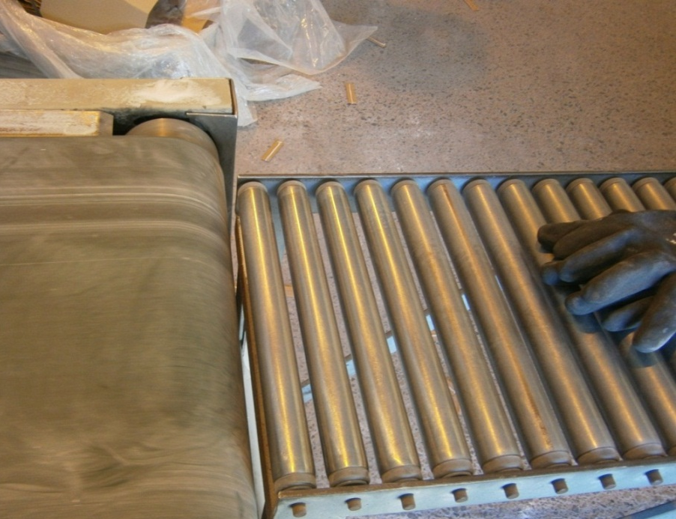
What is wrong with this?
Bag filling station – flat belt conveyor with roller bed lead-off conveyor
Notes:
In this scenario we have a flat belt conveyor leading onto a roller bed lead-off conveyor
What potential hazards do you see with this scenario?
How will the asset interact with its environment?
Will people be working near it?
What type of work will be done around it?
(Clues: Narrow gap between the conveyor and first lead off roller of the idler bed conveyor)
Hazard?
Answer: Pinch point, entanglement, crush injury
How can this be prevented by better design?
Answer:
maximise the gap to make it much larger
the first one or two idlers could pop-out rather than stay fixed
guard the pinch point

Slide 15
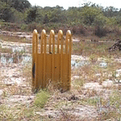
What’s wrong with this?
Tyre inflation cage
“Homemade” truck tyre cage modified with additional steel plating
Source: http://www.alberthaviation.com/TireCageVideos.htm
Notes:
This is a tyre cage that was put together without going through a proper design process (in terms of assessing its required strength)
What potential hazards do you see with this scenario?
Is the item appropriate or adequate for its intended use?
Is it strong enough? How do you know?
(Clues: Cage was not designed or tested by a competent person. The steel plate was added for extra protection)
Hazard?
Answer: Added more shrapnel if tyre over pressurises and explodes. In this particular case the metal plate travelled over 90 metres.
How can this be prevented by better design?
Answer: Designed and tested to be able to sustain that pressure. Rated to a certain capacity and clearing marked.

Slide 16
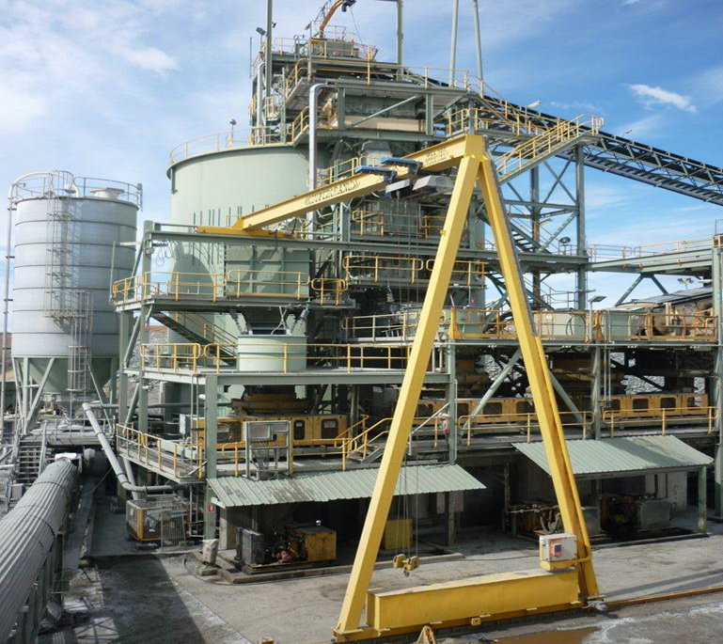
What is wrong with this?
Notes:
This is a good example of what can occur when you don’t address hazards in the design phase.
Some design problems are not easy to detect, especially if the item, in this case a semi-portal crane, has been in use for a number of years. People accept that it is safe simply because it has never failed. The next slide shows what can happen.

Slide 17
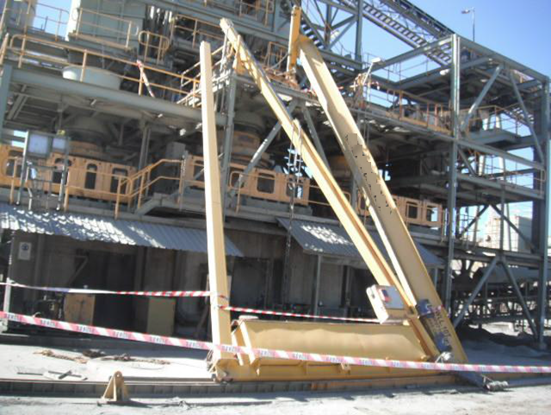
Flaws in the design
Notes:
In this particular case derailment led to the total collapse of the crane. An operator was standing right next to the crane as this happened.
How could this have been prevented by better design? Let’s have a look at some more photos.

Slide 18
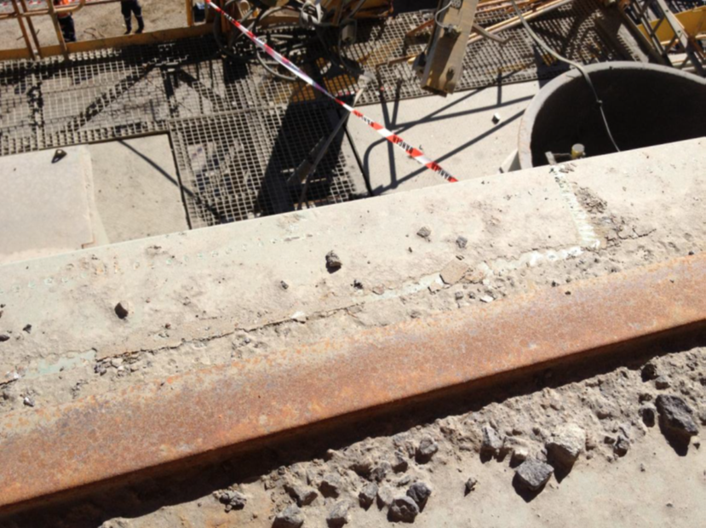
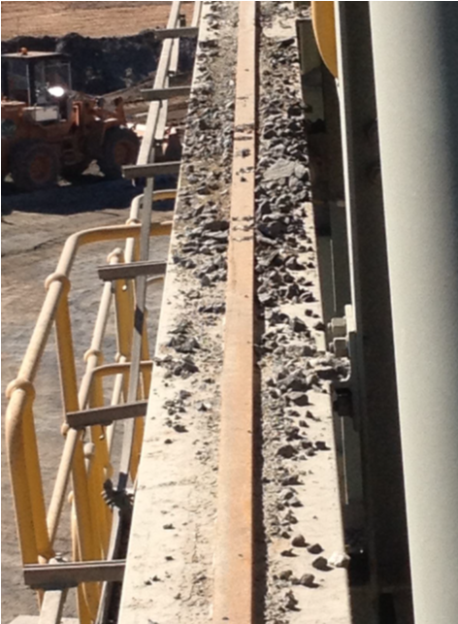
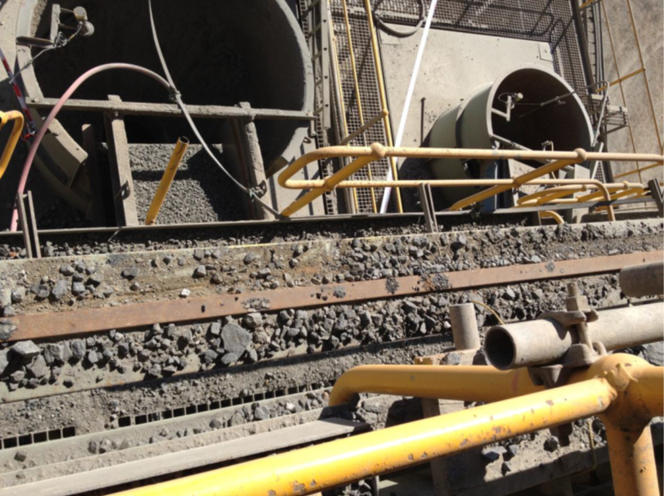
Top rail
Notes:
The upper runway of this crane was subject to substantial spillage from above activity. Rocks and debris on the crane runways pose serious risk to cranes and can cause derailment.

Slide 19
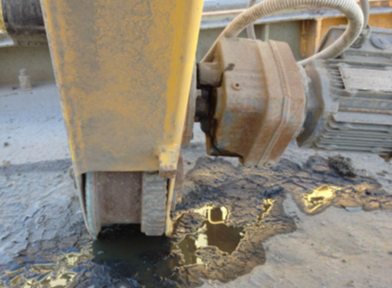
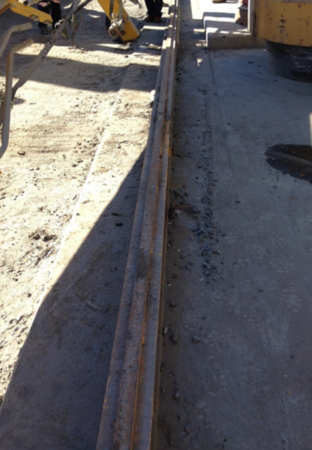
Top drive gear
Bottom rail
Notes:
How could this have been prevented by better design?
Answer: A designer should have:
assessed the environment for which this crane would be operating
adopted anti-derailment devices
have something in place to shield the runways from the spillage
It is about not just looking at your product or process in isolation, but addressing how it will behave and/or interact with its environment as a whole.
What could have been done once it was in place?
Answer:
a risk assessment looking at the critical control required to prevent the crane from derailing.
a simple pre-start (again) requiring critical aspects to be checked. There was no evidence of pre-start on the crane. Evidence indicate that the crane was already derailed by the time it was used.
regular cleaning of the material build up on and around the rails. Rocks had been crushed by the carriage wheels driving over them.

Slide 20
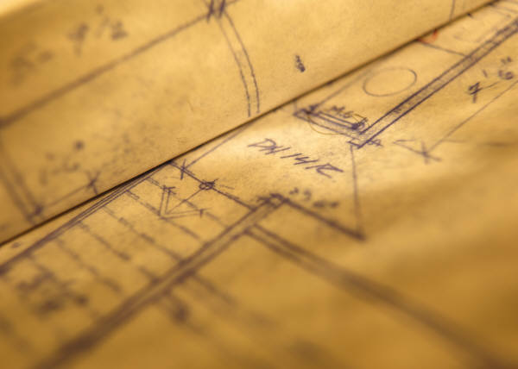
    Consider not the cost of fixing a problem in the design stage, but the cost of not fixing a problem in the design stage!

