Slide 1
Please read this before using presentation
This presentation is based on the content presented at the 2018 Mines Safety Roadshow in October 2018.
Department of Mines, Industry Regulation and Safety (DMIRS) supports and encourages reuse of its information (including data), and endorses use of the Australian Governments Open Access and Licensing Framework (AusGOAL)
This material is licensed under Creative Commons Attribution 4.0 licence. We request that you observe and retain any copyright or related notices that may accompany this material as part of attribution. This is a requirement of Creative Commons Licences.
Please give attribution to Department of Mines, Industry Regulation and Safety, 2018.
For resources, information or clarification, please contact: SafetyComms@dmirs.wa.gov.au or visit www.dmirs.wa.gov.au/ResourcesSafety

Slide 2
2018 Mines Safety Roadshow

Slide 3
Emergency management of WA mines – Code of practice

Slide 4
Notes:
Available at:
http://www.dmp.wa.gov.au/Documents/Safety/MSH_COP_EmergencyManagement.pdf

Slide 5
MSIR 4.30 Preparation of an emergency plan
The principal employer at, and the manager of, a mine must ensure that a plan for dealing with emergencies at the mine is prepared to:
identify hazards that might cause an emergency at a mine
minimise the level of risk to life, property and the environment as a result of an emergency situation
Notes:
The emergency plan is a document prepared to address the requirements of regulation 4.30 of the Mines Safety and Inspection Regulations 1995. The plan covers the matters to be managed during an emergency at site level, and should reflect size and nature of the operation, nature of the risks, and availability of external resources.
Emergency management involves:
risk assessment – identifying the hazards and analysing the risks associated with potential emergency scenarios and mines emergency response training exercises
prevention – determining appropriate control measures to eliminate or reduce the impact of the identified risks
preparedness – developing a safety management system, which includes preparation and training for emergencies
response – implementing the emergency plan
recovery – returning to normal operations and conducting a post-emergency review of the effectiveness of the emergency plan and emergency response activities so they can be revised as necessary.

Slide 6
Purpose of the emergency plan
Identify resources (e.g. people, equipment, information, knowledge) necessary to minimise risk
Provide training and guidance for all employees on what to do in emergencies, including evacuation
Provide information for dealing with external authorities and stakeholders
Notes:
Identify the resources necessary to minimise the risk.
Provide training and guidance for all employees on what to do in emergencies, including evacuation.
Provide information for dealing with external authorities and stakeholders (e.g. Department of Mines, Industry Regulation and Safety; WA Police Force; Environmental Protection Authority; media).
The development and implementation of the emergency plan should be undertaken in consultation with the workforce.

Slide 7
Why Plan? - The Deflector Mine Experience
Owned by Deflector Mining Ltd (Doray)
Copper/gold mine
240 employees
Initial production open pit
Underground mine started June 2016
Emergency audit Aug 2017
Notes:
New process plant started May 2016
Inspections Jul 2015 (s42), Dec 2015 (construction), Jul 2016 (u/g & o/p)
Location 430km NW Perth

Slide 8
DMIRS audit findings from the Deflector Mine
Audit conducted August 2017:
Emergency Management Plan (EMP) in place based on site risk assessment
Emergency Response Team (ERT) capabilities and skills reflecting change from open pit to underground mining
DMIRS audit identified opportunities for further improvement in:
Emergency drill frequency and monitoring of ERT numbers
ERT training and qualifications assessment based on foreseeable events

Slide 9
Serious potential incident - Underground Mine
Serious potential incident – Underground Mine
Underground loader fire 8 August 2018
Fire on R1700 teleremote loader in 1120 level drive, 12.10am
Aqueous film forming foam (AFFF) activated but did not extinguish fire; operator raised alarm over radio
11 underground workers evacuated to 12 man refuge chamber; all personnel accounted by 12.35am
Refuge chamber in decline,
not threatened by fire with mains air and radio communications
Decision to keep workers in known safe location (refuge chamber) longer
rather than rush immediate rescue via hostile environment

Slide 10
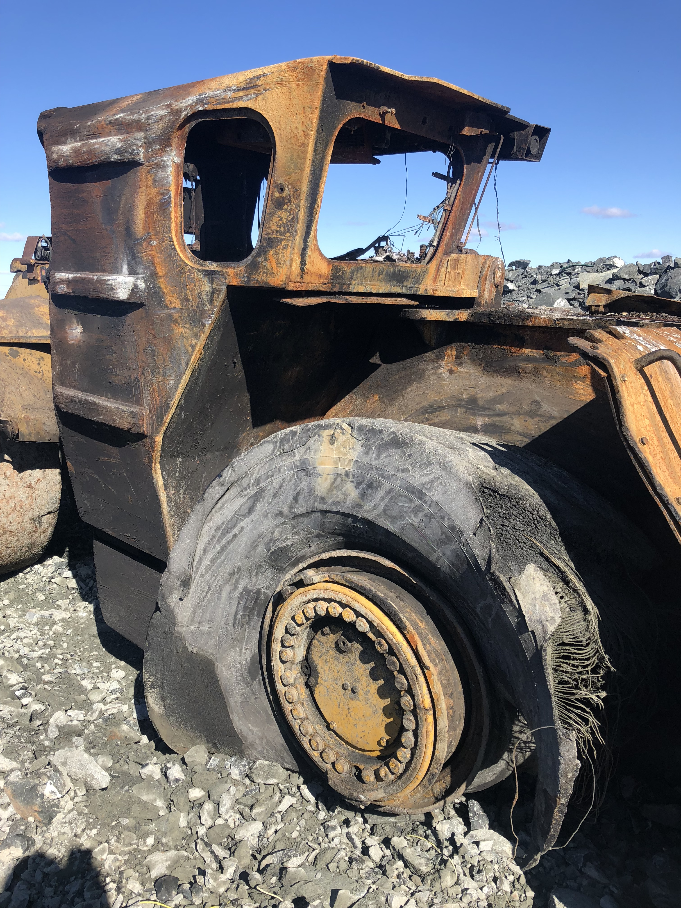
Underground loader in 1120 drive
Rear wheel mudguard likely blown off by tyre explosion

Slide 11
Loader fire – emergency response
High profile incident, media reports, miners trapped
Emergency Management Plan /Crisis Management Plan (CMP) activated and rescue plan implemented
Mutual Aid Agreement - Golden Grove on stand-by
ERT underground around 11am
All on surface by 2pm (approx. 14 hours)
Notes:
Underground fire serious incident
High profile prolonged incident, media reports, miners trapped
EMP/CMP activated
Wait for additional ERT resources fly-in D/S
Golden Grove on stand-bye (1.5 hours)
Detailed rescue plan based on risk assessment
ERT underground around 11am
Escort workers down decline to escapeway in fresh air
All on surface by 2pm (approx. 14 hours)
Medical resources mobilized including counselling

Slide 12
Comparison to South African Event
Copper mine – conveyor fire 15th July 2018
Refuge chamber:
only one for 1400 metres
unable to supply a life sustaining atmosphere
some services not fire resistant or fire protected
Routine inspections failed to identify issues with refuge chamber
Six mine workers dies as a result of the accident.
Ref: Queensland Dept. of Natural Resources, Mines and Energy Mines Safety Alert no. 357

Slide 13
Deflector Underground Fire: Conclusion
DMIRS emergency audit identified further opportunities for site emergency preparedness
Recommend early scheduling of emergency management audit particularly for underground mines
Fire initiated in a low voltage electrical circuit – not “normal” source of high risk
Doray management very pleased with the site response, successful extrication and lessons learnt from pro-active DMIRS involvement
Notes:
DMIRS emergency audit identified shortcomings in site emergency preparedness – improvement notice regarding ERT.
Actions taken better equipped mine to respond to fire incident 12 months later.
Also confirmed existence of important elements that were crucial in dealing with the fire incident.
Audit notification may have prompted site to identify ERT shortfall and need for training (reinforced by improvement notice).
Recommend early scheduling of emergency management audit particularly for UG mines.
Highlights importance of proactive audit program.

Slide 14
Concerns: Emergency preparedness audits
52% employees are not retrained in the emergency plan accordingly
47% of the resources required in an emergency are not regularly reviewed
36% can not account for the number of personnel on site at all times
36% of personnel are not trained in the use of fire extinguishers
Notes:
19 Emergency preparedness audit conducted
10 non-compliance: Element 2.9 – After a revision of the emergency plan key staff and the necessary employees are retrained accordingly
9 non-compliance: 5.1 – The resources required in the event of an emergency are regularly reviewed
7 non-compliance: 2.2 – The emergency plan details the method for identifying and accounting for the number of persons on site at all times
7 non-compliance: 4.3 – The Emergency Control Centre (ECC) has the most recent version of the site layout and location maps
7 non-compliance: Site personnel are trained in the use of fixed location fire fighting equipment.

Slide 15
Concerns: Emergency preparedness audits
86% of the emergency plan does not consider other relevant legislation
71% of employees are not informed and retrained after a review of the plan
57% of each foreseeable scenario has not been assessed with intent of prevention
57% of personnel have not been notified of their role in an emergency situation
Notes:
7 Emergency management audit conduct
6 non-compliant: 2.5 – The emergency plan documentation considers other relevant legislation
5 non-complaint: 2.11 – After a revision of the emergency plan employees are informed and retrained accordingly
5 non-compliant: 2.2 – The emergency plan documentation details the method for identifying and accounting for persons on site at all times
4 non-compliant: 1.4 – Each foreseeable scenario is assessed with regard to prevention
4 non-compliant: 2.10 – The emergency plan documentation is regularly reviewed, and updated as required, and at least annually
4 non-compliance: 2.8 – The emergency plan is communicated to all personnel who have role in enacting the plan.

Slide 16
DMIRS Recommendations
Identify resources (e.g. people, equipment, information, knowledge) necessary to minimise risk
Provide training and guidance for all employees on what to do in emergencies, including evacuation
Audit your capabilities and preparedness frequently:
Use the DMIRS audit template;
Use the Code of Practice as a reference point.

