Slide 1
Please read this before using presentation
This presentation is based on the content presented at the 2019 Health and Hygiene Forum in June 2019.
Department of Mines, Industry Regulation and Safety (DMIRS) supports and encourages reuse of its information (including data), and endorses use of the Australian Governments Open Access and Licensing Framework (AusGOAL)
This material is licensed under Creative Commons Attribution 4.0 licence. We request that you observe and retain any copyright or related notices that may accompany this material as part of attribution. This is a requirement of Creative Commons Licences.
Please give attribution to Department of Mines, Industry Regulation and Safety, 2019.
For resources, information or clarification, please contact: SafetyComms@dmirs.wa.gov.au or visit www.dmirs.wa.gov.au/ResourcesSafety

Slide 2
2019 Health and hygiene
forum

Slide 3
History of health surveillance and monitoring

Slide 4
This presentation will cover
Brief history of mining in Western Australia
Health and sanitation conditions of mine workers during the Gold Rush
History of health monitoring from:
gold rush days from late 1800s to mid 1930s
fluctuating fortunes to late 1960s
expansion and evolution of the industry
Brief overview of MineHealth findings
Introduction of risk-based health surveillance in 2010
Update of legislation and application of health surveillance in HHMPs

Slide 5
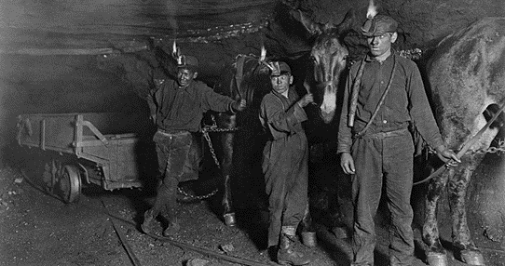
Hygiene and sanitation during the WA gold rush (1892 – 1930s)
imagine
Source: lithub.com/a-day-in-the-life-of-a-west-virginia-coal-miner/
Notes:
Imagine that you are working in one of the underground gold mines, several hundred feet below ground.
It is dark, but for the faint flicker of the candle on your helmet, that produces just enough light so you can be seen. You are relying almost entirely on your night vision and other senses to move through sometimes small and cramped space.
It is hot and humid.
In the rush to find and remove the minerals as quickly as possible, some underground mines relied solely on natural ventilation. Early reports describe such low airflow that the anemometer were unable to detect them. So airflow was determined by observing the flicker and brilliance of a burning candle.
Horses and mules were often used to assist carting ore to the surface.
Clean or fresh water was scarce. Eating and abluting usually happened within the mine to maximise working time an increased output.
Herbert Hoover, who was one of the earlier mine superintendents at Gwalia Mine in Leonora was renowned for cost cutting and exploited migrant workers by paying them reduced wages.
Imagine how it must have smelled.
Candle GIF: https://ayearofchristmas.tumblr.com/post/70306024856

Slide 6
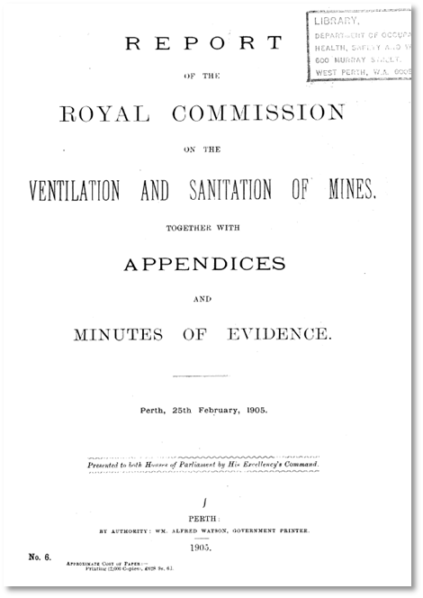
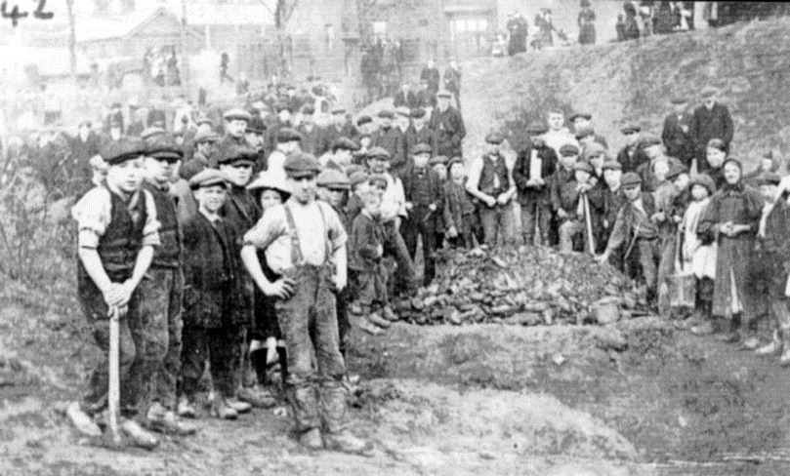
Four Royal Commissions – health, hygiene and ventilation
Photo: https://i.pinimg.com/originals/9f/27/20/9f27206da3817823c10986b8f2e227b9.jpg
1905 Ventilation and Sanitation of Mines
1910 Pulmonary Diseases Amongst Miners
1911 Miners’ Lung Diseases
1925 Mining Industry
6
Notes:
Because of these poor conditions many miners suffered from disabling respiratory diseases.
There were four royal commissions between 1905 and 1925 into the conditions miners faced. Many gold miners were suffering and dying from lung diseases that became known as “miners’ phthisis”.
The first Royal Condition in 1905 explored new ventilation technology being used in the coal mines in Cornwall and elsewhere to improve the conditions for miners. It also focussed on sanitation with descriptions of many ablution and crib facilities as downright filthy with only a few being described as satisfactory.
And of course it was very dusty.
The 1905 royal commission reported on hospital reports of 25 hospitals and attempted to summarise patterns of disease. A high prevalence of gastroenteritis (typhoid fever), gun shot wounds, falling and crushing injuries accompanied reports of “miners’ phthisis”.
In short periods of working underground miners developed severe productive coughs, experienced breathlessness that over time became disabling preventing sick workers from working.

Slide 7
“Miners and ex-miners experienced a reduced life expectancy compared with non-mining working populations”
1911 Royal Commission – Miner’ Lung Diseases – Findings by Dr JHL Cumpston (from McNulty, 1968)
Notes:
Tuberculosis was also rife amongst miners. This highly infectious bacterial infection seemed to be worse amongst miners who were also exposed to dusty environments. Dr Cumpston reported at the 1911 Royal Commission that there were miners suffered from either:
Pure tubercular infections,
Pure fibrosis,
or mixed tuberculosis and fibrosis.
Dr Cumpston reported symptoms of early, intermediate and late fibrosis with an emphasis on winter coughs and colds. This table summarises death rates from the various pulmonary diseases between 1900 and 1909.
The markedly high rates in miners compared with non-miners are obvious for all respiratory diseases.
According to McNulty (1968), at this time there were no routine chest x-rays to support diagnosis and no established screening had yet occurred at the time of the 1911 Commission.

Slide 8
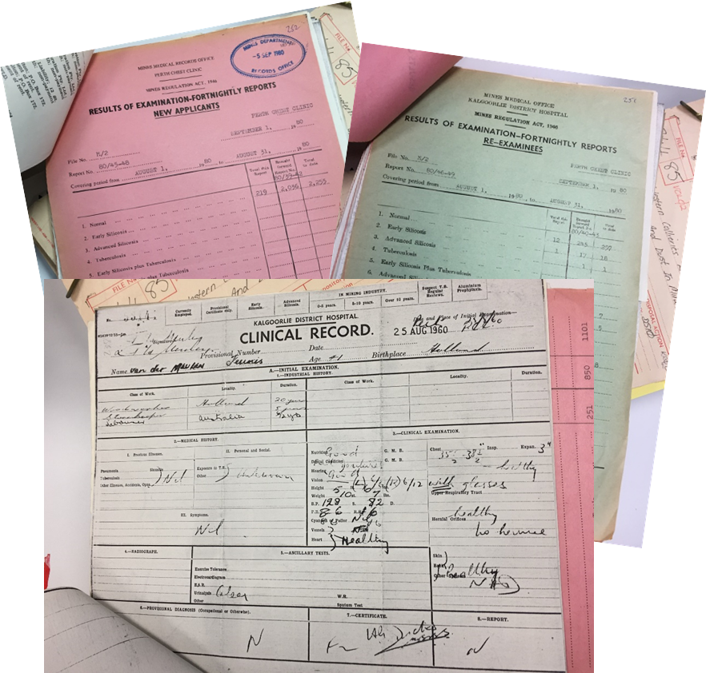
Miners Phthisis Act, 1922 and Miners Phthisis Act Regulations, 1925
1. Certificate of appointment
2. Notice requiring person to be tested
3. Certificate of good health
4. Report to Minister
5. Notice to person with tuberculosis
6. Notice to person with miners’ phthisis
7. Service of notices
8. Payment of compensation
9. Scale of compensation (s. 9)
Notes:
The term Miners’ Phthisis was used to describe the heavy burden of respiratory diseases that miners experienced compared with the population who did other work.
The first Mine Workers’ Health Certificate started as a result of the
Miners’ Phthisis Act, 1922 and Regulations 1925.
The text on the left is a copy and paste from the contents page of the 1925 regulations.
1. Certificate of appointment – refers to appointment of medical examiner
2. Notice requiring person to be tested – every new miner (or new applicant) was examined with a compulsory chest x-ray, that was repeated every year while the miner remained in the industry.
Initially these tests were carried out by the Commonwealth government at a local laboratory in Kalgoorlie until the state Health Department took over in 1954.
The image on the right shows an example of a clinical record, that were summarised monthly in the pink and green forms behind.
Miners without a diagnosis of tuberculosis or miners’ phthisis were given a
3. Certificate of good health and were permitted to work in the industry.
For those who were not provided with a certificate of good health, were prohibited to from working in the mines.
The prohibition was reported to the minister and a notice given to the person directing them to obtain compensation payments. The scale of payment were scheduled in the Regulations.
4. Report to Minister
5. Notice to person with tuberculosis
6. Notice to person with miners’ phthisis
7. Service of notices
8. Payment of compensation
9. Scale of compensation (s. 9)
Schedule of Forms Notes
Compilation table 12

Slide 9
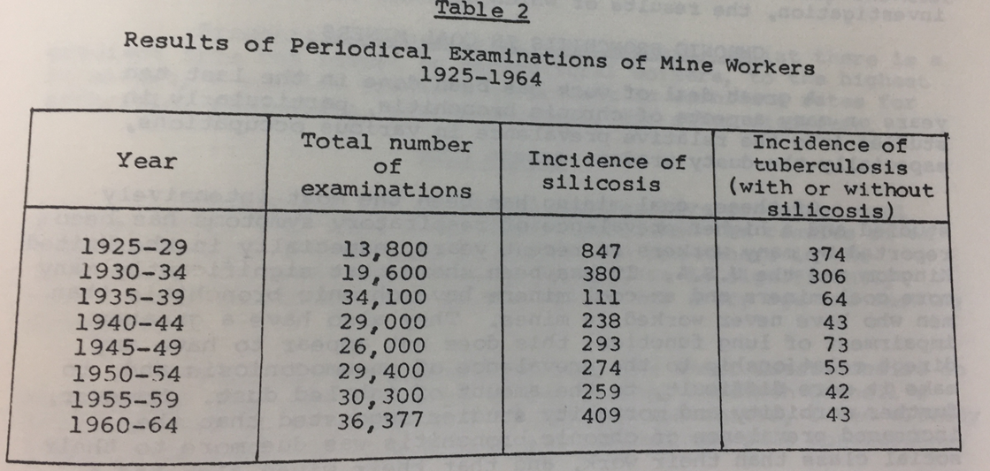
Source: McNulty (1968)
Notes:
This table summarises the results of those periodic examinations of mine workers in five year periods from 1925 to 1964. Dr Jim McNulty the chief medical officer in WA, reported to the First Australian Pneumoconiosis Conference – a conference on airborne dust in industry, its measurement, control and effects on health at Sydney University in February 1968.
In his paper he remarks, that in Western Australia, approximately 1000 cases of silicosis were reported in a ten year period, in contrast to only 120 cases of silicosis being reported by his equivalents in Queensland over a seven year period.
If we take a look at this table, there is significant fluctuations to 1964 in the silicosis cases, accompanied by a dramatic reduction in incidence of tuberculosis.
He raises the point that diagnosis of silicosis is highly variable and sensitive to which medical practitioner is reviewing a case. He states that one doctor may diagnose chronic bronchitis based on symptoms, while another may diagnose silicosis if the chest x-ray shows small nodules.

Slide 10
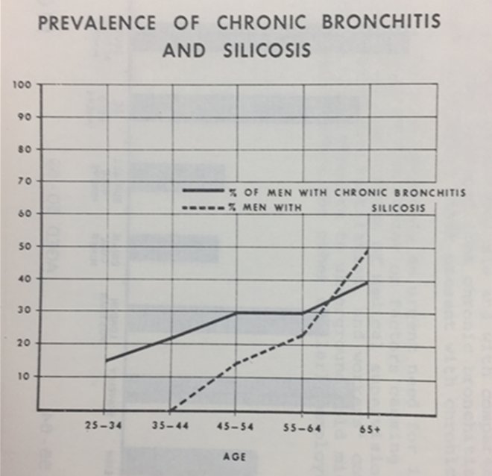
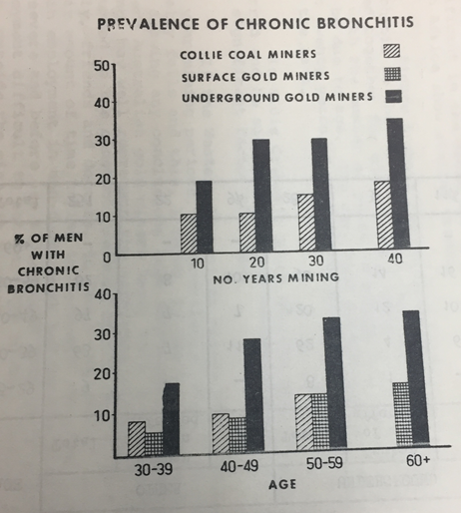
50%
1968 First Australian Conference of Pneumoconiosis
Dr Jim McNulty (1968) The prevalence of respiratory symptoms in Western Australian gold miners compared with coal miners.
Notes:
I have included these graphs from McNulty’s paper, as he compares the prevalence of chronic bronchitis with silicosis in the one on the left.
This shows that as many as 50% of all miners experienced silicosis prior to 1965. And that the symptoms of chronic bronchitis preceded this diagnosis.
McNulty acknowledged that by the time a diagnosis silicosis could be made miners were usually suffering from severe and disabling diseases – characteristically they suffered from severe breathlessness, continuous productive bronchitis (they had to cough up frequently throughout the day so they could take a decent breath).
He noticed high rates of chronic bronchitis that often appeared before silicosis diagnosed.
Rates of silicosis increased as miners aged, however he confirmed that some younger miners, who started working when they were boys, developed silicosis in a pattern suggesting there was a relationship with years in mining, not necessarily age.
When he compared coal and gold miners, with reference to whether they were surface or underground miners, Underground Gold Miners bore a greater burden of respiratory disease than Collie coal miners and surface gold miners.
He wondered if chronic bronchitis could be used as an early indicator of health impacts that lead to more serious diseases, for medical practitioners to advise against working underground to prevent silicosis. He also notes that the non-bronchitic silicotic is not seriously disabled and can continue to work.
He concludes that Chronic bronchitis (productive cough in morning & night for at least three months for at least three years) is associated with length of mining but of the majority of miners suffering chronic bronchitis, there was a strong association with smoking as well.
He postulated that smoking and working underground led to earlier development of more severe respiratory conditions.
For a scientific manuscript, it is unusual compared to the dry technical wording used today – he reflected that he regularly encouraged susceptible workers to leave mining and find a different industry to work in while they were younger and still fit to work.

Slide 11
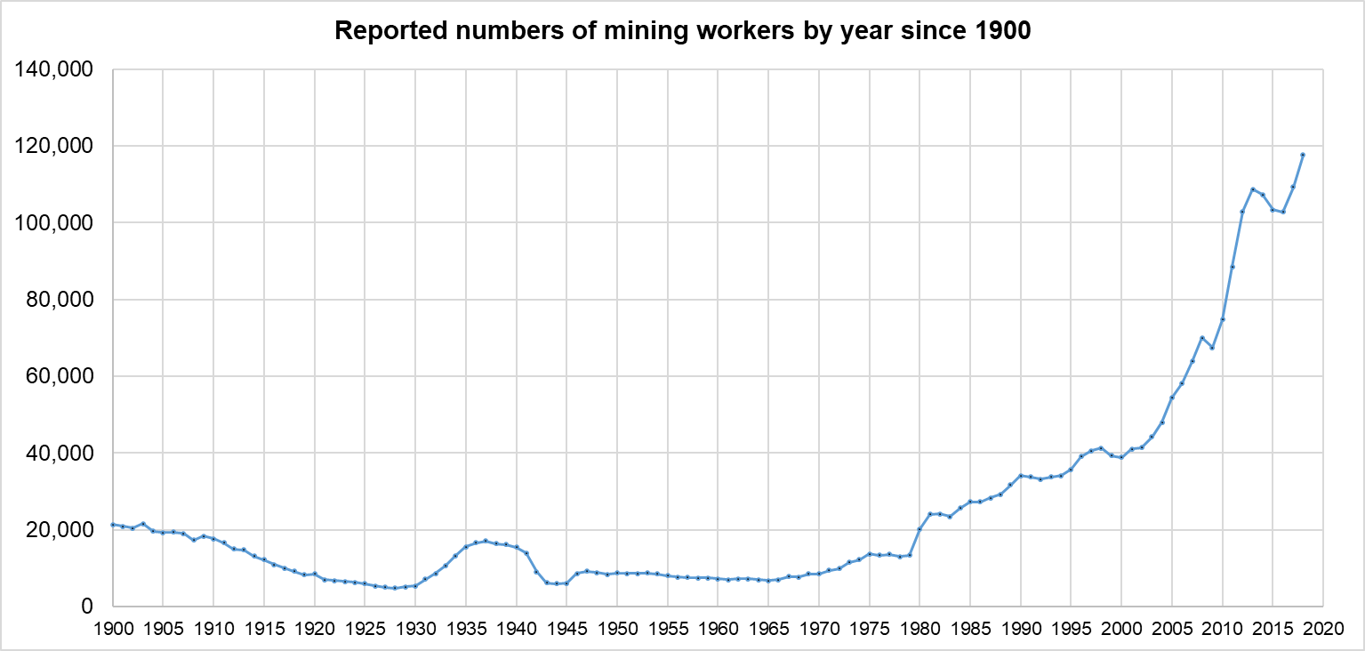
Endless cycles of fluctuating fortunes
Burgeoning commodities with increased complexity of operations
Iron Ore 1957 Mt Whaleback – 1938 -1960 iron ore embargo lifted
Bauxite / Alumina – 1963 – Jarrahdale / Kwinana Refinery
Nickel – 1970s - peak price during Vietnam War
Lead – 1990s - Magellan
Collie coal since 1846
Lead - Northampton (1838-1938)
Asbestos (1939 -1966)
WW1
1987 stock market crash
GFC
WW2
Notes:
At this stage it is necessary to step back and take a look at what else was happening in the WA mining industry.
This slides shows numbers of mine employees reported to the department since 1900. It shows a steady decline from the gold-rush days to WW1. Then a renewed increase in the 1930s until WW2 took many miners to fight abroad.
Blue asbestos was mined around Wittenoom from 1939-1966. It ceased due to “unprofitability” and recognition of the health concerns. Mines Inspector Adams reported on the dust menace blowing onto the town noting health concerns. However it wasn’t until 1946, that the first case of asbestosis occurred, however it wasn’t diagnosed for a long time. Dr Eric Saint is reported to have warned that workers exposed to this dust would contract chest disease within six months.
Although extensive exploration had identified the scale of iron ore in the Pilbara there was small scale mining in the Yampi Sound because the Federal Government had imposed an embargo that prevented export of iron ore between 1938 and 1960. This was based on fear of supporting Japan who had moved into China. Shortly after it was lifted the Utah Development Company started mining at Goldsworthy in 1965, with the first shipment a year later. Since then, iron ore has continued to increase the volume mined and shipped so that today it represents approximately 54% of the national export sales value.
Bauxite and Alumina – around 1963 Jarrahdale and the Kwinana Refinery started operations.
Nickel – has been subject an extremely fickle market, with fluctuating fortunes, since early 1960s, with a price peak at the time of the Vietnam War and booming exploration from the 1970s till the global stock market crash.
This graph shows how the industry plateaued in population size while the components changed and many diversified with building more complex processing facilities.

Slide 12
Mines Regulations Act Regulations, 1976 (Metalliferous mines)
From the Phthisis Act, 1925 “Certificate of Good Health” to:
Mine Workers’ Health Certificate (1976 -1995)
Physical examination and a screening Chest X-ray (CXR) was required for every miner in:
Class-A mine, every two years
All underground, lead, manganese, vanadium, talc, micor or with radioactive materials
Class-B mine, every five years
Most quarries, surface mining and treatment plants
Commonwealth Laboratory and later Perth Chest Clinic (WA Dept. of Health) examined and read CXRs
Notes:
In early 1991, the Mine Workers’ Health Certificate was modified, to include hearing tests.

Slide 13
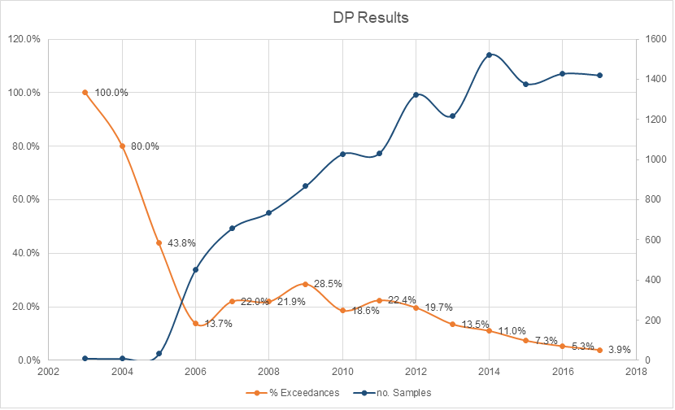
History of dust monitoring
Ventilation Board came into effect in 1976 for metalliferous mines
Established guidelines and procedures for monitoring dust concentrations
The Mines Inspectorate vetted results and required improvements “whenever poor results were noted”
CONTAM database created in late 1980s and redeveloped in 2000
Expansion of contaminants to reflect all exposures
Linkage of exposure to MineHealth assessments
Health and Hygiene module in SRS – May 2017
Notes:
Around the same time as the Mines Regulation Act and Regulation being gazette, in 1976, the Ventilation Board was established.
It prepared guidelines and procedures for standardised monitoring of airborne dust concentrations to monitor how developed purity .
Results were vetted by inspectors and where there were elevated, mines were directed to improve control.
Under Part 8 of these regulations (that are similar to Part 9 of the MSIR, 1995), it was necessary to monitor and submit all results to the inspectorate every three months. In addition, it was necessary to suppress or control any chemical that could impact the health of miners to conform with the standards of purity, set out in the regulations. These were published by NH&MRC by permission of ACGIH (USA).
The first version of CONTAM was released in the mid 1980s. The earliest, most reliable historical exposure results from these early days were transferred in to the upgraded CONTAM in 2000. This newer version was linked to the MineHealth system by linking to the Health Surveillance Number, which was the unique identifier of every miner who participated in the MineHealth program.
In 2017, all of these exposure monitoring data were transferred into the Health and Hygiene module of SRS.
The graph compares the number of diesel particulate matter (DPM) samples (the blue line) taken each year and compares against the number of exceedances of the adopted guideline value of 0.1mg/m3 measured as elemental carbon. It is clear to see that the hazard was identified, then with some inspectorate focus and ongoing monitoring, the industry adopted a range of controls that have ultimately resulted in a significant reduction of annual exceedances. This graph is similar to inhalable and respirable dusts, and silica since 1976, when the inspectorate caused the industry to reduce exposures.

Slide 14
MineHealth objectives
Assess the health status of all mining industry employees on a regular basis
Analyse collected data to detect adverse health effects at the earliest opportunity
Enable appropriate and timely corrective action to be taken in order to safeguard the health and well being of mining industry employees
Provide data which may be useful for future epidemiological studies.
Notes:
The MineHealth system provided a standardised or generic health assessment that could be conducted by any medical practitioner (without any specific training or guidance of a planned epidemiological analysis) or by an Approved Person – who passed a half day training course to perform spirometry and deliver the questionnaire and to conduct hearing tests to comply with WorkCover Baseline audiometric standards.
In total contrast to the Mine Workers’ Health Certificate, that originated from the 1925 Mines’ Phthisis Act & Regulation, the MineHealth was not in any way a FITNESS for WORK assessment. There was no PASS or FAIL. However not everyone who participated in the program understood that – particularly those workers who had been in the industry prior to 1995.
Officers from the Department coded the occupational work history from the form prior to being entered into the database and a qualified scientific officer scanned the spirometry results and questionnaires for any abnormalities or unusual results. These were then reviewed by the mines occupational physician who would assess and liaise with individuals. For those who were assessed as requiring further medical examination a letter was sent to the individual suggesting they contact their own doctor to follow-up. In the process, the team would look for a pattern in distinct mining operations or commodity groups, in order to identify where the regulator should focus their efforts.
This is an optimistic list of objectives and unfortunately. Many mining companies did this well yet unfortunately some companies failed to monitor the health of their own employees and didn’t make necessary changes based on the results and they considered the Department was able to identify health changes based on the results of the epidemiological study.
Some these objectives were achieved. However in retrospect, the size of the industry and the rapid rate of expansion of the industry from 40,000 in 1995 to 105,000 in 2013 hampered the success of achieving all of the goals.
Since 2009, there were two internal reviews of the MineHealth data. One was presented to the AIOH Conference in 2009 as a paper and poster, and also the Queensland Department of Mines. A second review was undertaken in 2012 immediately prior to cessation of the program. The Mines Occupational Physicians also reviewed the functionality of the program and raised concerns that changes to individuals were best identified by a medical practitioner over the Approved Persons, employed to conduct most of the health assessments.
The MineHealth database has been provided to University of Western Australia and Curtin academics for independent investigations.
2017 – Data linkage with hospital information has been analysed, and a slight, yet statistically significant increase for lung cancers in underground gold miners was reported. All other occupations and commodity groupings were assessed, yet no statistical findings were reported.
The “healthy worker syndrome” was observed, which is understandable from the perspective that unhealthy applicants generally do not pass pre-employment medicals at selection and in some cases, many workers will self-select themselves out of work if the work impacts their health and well-being.

Slide 15
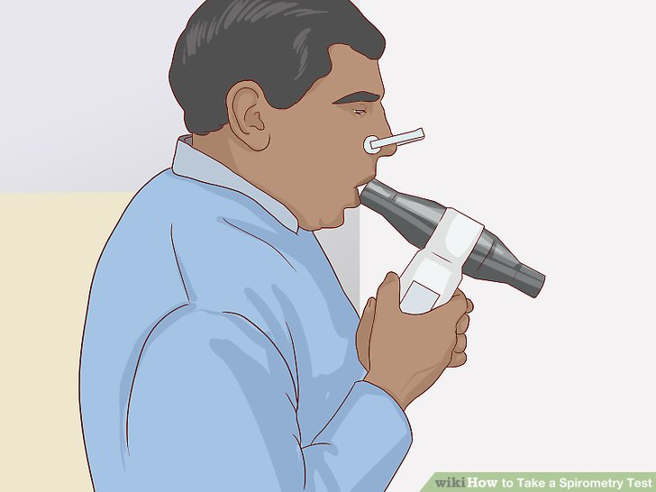
Mine Employees’ Health Surveillance Program (MineHealth) 1996 – 2013 Generic Health Surveillance
What was monitored?
Work history
Respiratory questionnaire
symptoms of cough,
breathlessness,
wheeze,
smoking status
Spirometry (lung function)
Chest X-rays for designated occupations
Audiometry (hearing)
Section 75 MSI Act, 1994 &
MSI Regulations, 1995; Part 3, Division 4
R 3.25 – Initial health assessment and
R 3.26 – Periodic health assessment
R 3.27 – Other health assessment
(2009 on - Risk-based health assessment)
r3.28 – Biological monitoring
www.wikihow.com/images/thumb/5/50/Take-a-Spirometry-Test-Step-5-Version-2.jpg/aid687905-v4-728px-Take-a-Spirometry-Test-Step-5-Version-2.jpg
Notes:
The MineHealth system provided a standardised or generic health assessment that focussed on respiratory function, diseases of the lungs including: asthma, chronic bronchitis, and signs of pneumoconioses or other lung diseases.
Chest X-rays for designated occupations:
Designated occupations include:
Underground miners; blast hole drilling, charging & blasting; exploration activities; open-cut service occupations; sample preparation; samplers (exploration – processing); crushing/screening operators
Non-mining occupations at risk included: sandblasting; tunnelling/road construction; foundry work; any occupation with significant exposure to asbestos (including ACM removalists)
Who was monitored?
All new and existing mineworkers
Except
Non-mining occupations (administration etc)
Work in industry <three months /year
1996 Radiological Council recommended screening CXR’s only for:
Designated occupations after 10 years of working in any mining or non-mining occupations
Frequency of monitoring?
Not less than three years, on average about five years (periodic rates varied from 3-13.3)

Slide 16
MineHealth assessments
Years | Initial | Second | Third | Fourth | Average No. Employees
1995 - 2000 | 58,417¹ | 565 | 0 | 0 | 40,497
2001 - 2005 | 47,969 | 25,639 | 843 | 0 | 44,796
2006 - 2010 | 81,145 | 22,622 | 14,360 | 533 | 98,350
2011 - 2013² | 29,830 | 7,586 | 2,589 | 1,633 | 105,000
Total number of assessments | 217,361 | 56,412 | 17,792 | 2,186 | 293,751
¹ Existing and new entrants in 1996
² Two-year period only
Notes:
This is pretty self-explanatory – yet notice that a lot of initial or new health assessments were being conducted in each five year period in surplus to the average number of employees in that period. This suggests a significant turnover or a lot of prospective employees who did not stay in the industry for the second or third assessment.

Slide 17
Chest X-rays (CXR) submitted for MineHealth
4,704 (2.5%) CXRs taken from 186,047 assessments at the 2010 Data Review
Only 102 (2.2%) of all CXRs showed any change, hence 98% of all CXRs had no radiological abnormality
Readings based on ILO classification of pneumoconiosis (1980)
3 readers (between reader issues noted)
4 CXRs (~0.1% of all CXRs taken) with ILO classification of 1/0 or higher
Heavy smoking history confounding epidemiology
Difficult to diagnose as silicosis purely from the radiology. Further medical assessment required for diagnosis.
Notes:
In 1996, the Radiological Council highlighted the increased risk from radiation exposures for employees undergoing frequent x-ray screening. This coupled with the dramatic reduction in the number of people being diagnosed with compensable pneumoconioses, like silicosis and asbestosis.
As a result of this only high risk employees were designated and required regular chest x-rays after ten years of working in the WA industry.
This meant that at the 2010 data review, only 4,704 chest x-rays were taken of the 186,000 health assessments conducted. Of those only 102 or 2.2% showed any changes at all. And these people were referred to their own doctors, as smoking histories or other comments from the assessors, implied that the conditions were not work related.
Interestingly, an internal review highlighted significant differences between findings between three different chest x-ray readers, despite using a standard protocol. This reflects what Dr McNulty suggested from his 1968 paper of chronic bronchitis and silicosis diagnosis.
All chest x-rays were read by an A-class reader employing the ILO classification system. Only four peopled showed nodules of a size suggestive of radiological diagnosis of silicosis. Closer scrutiny of these cases identified a confounding heavy smoking history that may also have caused these nodules. These people were therefore referred to their own doctors for medical follow-up and treatment if necessary.
Unfortunately, if these people had left the industry when or if they did get sick, if is entirely up to the worker to inform the Department. This is one of the biggest challenges of occupational health systems administered by a government regulator. The MSIR has no jurisdiction requiring medical practitioners to report occupational diseases to the Department. It is the responsibility of the employer currently.

Slide 18
Comparison of rates respiratory disease
Years | Prevalence of Chronic Bronchitis (% miners) | Incidence of silicosis (radiological evidence) (per 10,000 miners)
1925 -1929 |  | 614
1960-1964 (McNulty 1968) | 10% surface 27% underground | 112
1986 (Holman et al., 1986) | 13% surface 29% underground | 100
2012 (Goh, et al., 2012, unpublished) | 15% surface, smokers¹ 4% surface, non-smokers¹ 15% underground, smokers¹ 2% underground, non-smokers¹ | *9 (*4 people)
¹ Ten years after initial (second periodic)
Notes:
In 1968 McNulty noted that 73% underground miners and 64% surface miners were current smokers and that this seriously confounded any interpretations of impacts of dusts alone causing chronic bronchitis.
Chronic cough or chronic bronchitis continues to be a problem in mining – especially for current smokers.

Slide 19
Generic MineHealth - Hearing loss
Average percentage hearing loss - occupation versus age-group
Occupations | <25yrs | 25-35yrs | 35-45yrs | 45-55yrs | 55-65yrs | > 65yrs | Totals
Metalwork Trades | 1.0% | 1.3% | 2.4% | 5.3% | 10.8% | 16.7% | 3.8%
Ore Treatment/Processing | 0.9% | 1.1% | 1.8% | 4.1% | 8.5% | 15.6% | 3.5%
Miscellaneous Trades/Utilities | 1.0% | 1.3% | 2.6% | 4.4% | 9.1% | 14.5% | 3.4%
Underground Production/Development | 0.7% | 1.2% | 2.2% | 5.3% | 12.2% | 13.9% | 3.1%
Railways | 0.5% | 1.1% | 1.4% | 5.1% | 9.3% | 13.6% | 4.7%
Material Handling | 1.0% | 1.2% | 2.2% | 4.8% | 9.1% | 13.6% | 3.4%
Management and Supervisory | 0.6% | 1.0% | 1.9% | 4.0% | 8.1% | 12.1% | 3.1%
Mining Production and services | 1.1% | 1.3% | 2.3% | 4.8% | 9.8% | 11.7% | 3.8%
Electrical Trades | 0.8% | 1.1% | 2.0% | 3.7% | 7.5% | 9.1% | 2.7%
Totals | 0.9% | 1.2% | 2.1% | 4.5% | 9.1% | 13.1% | 3.4%
Notes:
This is a busy slide – but what jumps out for you? …… The highlighted columns!
People with more than 10% hearing loss (calculated at both ears) have compensable hearing loss. Compensation payments though are barely enough to contribute to hearing aids. People with this level of hearing loss struggle to hear conversations in rooms with background noise.
For people over 55, the average level of hearing loss is near or more than the compensable level for all occupations. At 55, there is still a lot living and communication to share. This is an important health issue for mining employees.

Slide 20
Risk-based health surveillance and biological monitoring (Introduced 2008 & regulated from 2013 - now)
Relevant for workplaces where:
Employees may be exposed to hazards at unacceptable levels,
Personal protective equipment is the main form of control, or
Exposure to hazardous substances that may be absorbed through routes other than respiratory tract;
Specific for each similar exposure group (SEG)
State mining engineer may request this information
Notes:
Refer to MSI Regulations 3.27 & 7.30
Relevant for workplaces where:
Employees may be exposed to hazards at unacceptable levels,
Personal protective equipment is the main form of control, or
Exposure to hazardous substances that may be absorbed through routes other than respiratory tract;
skin,
eyes,
needle-stick
Specific for each similar exposure group (SEG)
The State mining engineer may request this information
MSIR 3.27 Health assessment (Modified July 2009 & January 2013)
(1) The principal employer and each employer at a mine must ensure that health assessments are carried out in respect of an employee who engages in specified occupational exposure work at the mine, if —
(a) an identifiable disease or other adverse effect on the health of the employee may be related to the exposure; and
(b) there is a reasonable likelihood that the disease or adverse effect may occur under the particular conditions of work; and
(c) there are recognised techniques for detecting indications of the disease or adverse effect.
(2) The State mining engineer may direct that a health assessment be carried out in respect of specified employees at a mine.
(3) The principal employer and each employer at the mine must ensure that a direction given under subregulation (2) is complied with as soon as is practicable.
(4) The State mining engineer may require the results of any health assessment carried out in respect of employees at a mine to be given to the State mining engineer.
(5) The principal employer and each employer at a mine must ensure that a requirement made under subregulation (4) is complied with as soon as is practicable.
MSIR Part 3, Div 4. Health surveillance (1996 - current)
3.39. Notice of occupational disease
If an employer at a mine receives advice from an employee or a person on behalf of an employee that the employee has an occupational disease, the employer must, as soon as is practicable, notify the Mines occupational physician in a form approved for that purpose by the State mining engineer that the employee has the disease.
3.40. Remedial action
If any health assessment or biological monitoring under this Division indicates the need for remedial action to be taken to protect the health of an employee at a mine, the employer must ensure that the action is taken as soon as is practicable.
The State mining engineer may, on the advice of the Mines occupational physician, direct in a particular case that specified remedial action be taken by an employer to protect the health of employees at a mine.
An employer must ensure that a direction given under subregulation (2) is complied with as soon as is practicable.

Slide 21
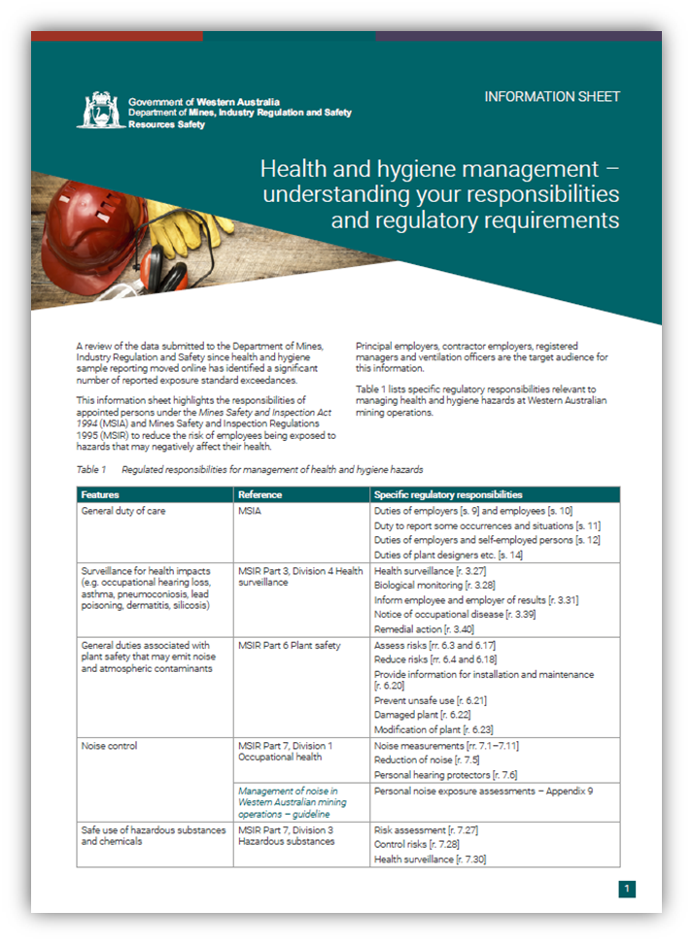
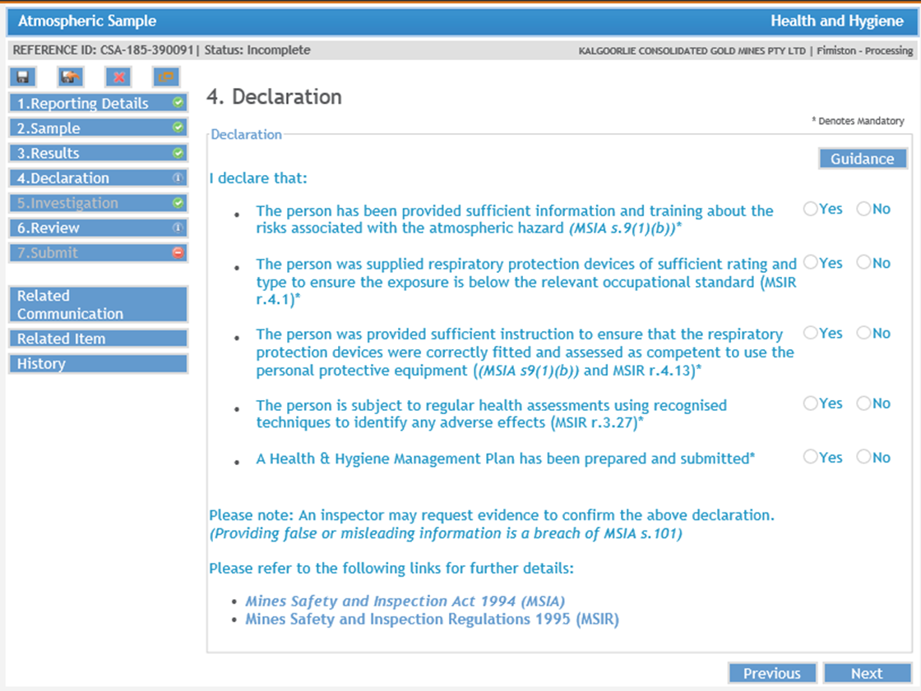
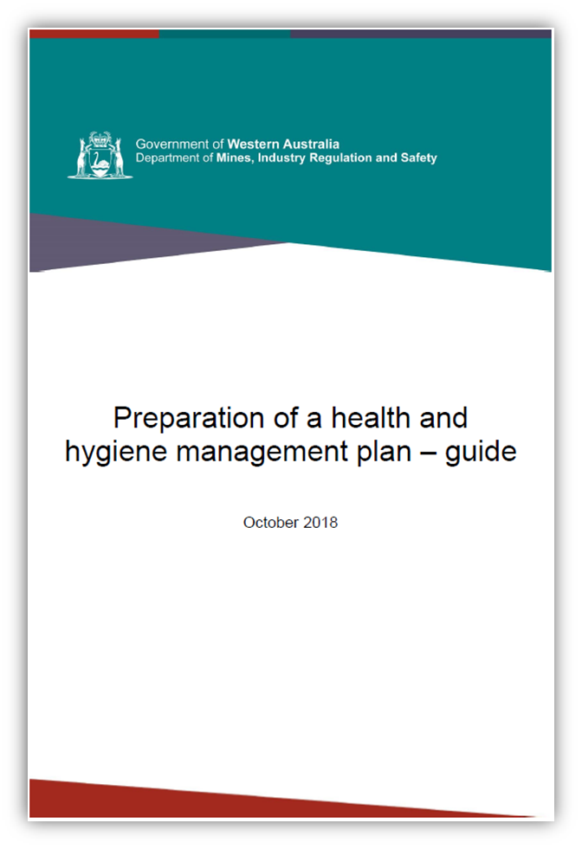
Reminder of responsibilities to control and monitor health hazards (December 2017)
Notes:
Industry was reminded of their responsibilities regarding risk-based health surveillance in December 2017, with release of this fact sheet and then introduction of the declaration questions in SRS.
Further documentation and planning will be covered through health and hygiene management plans (HHMPs).

Slide 22
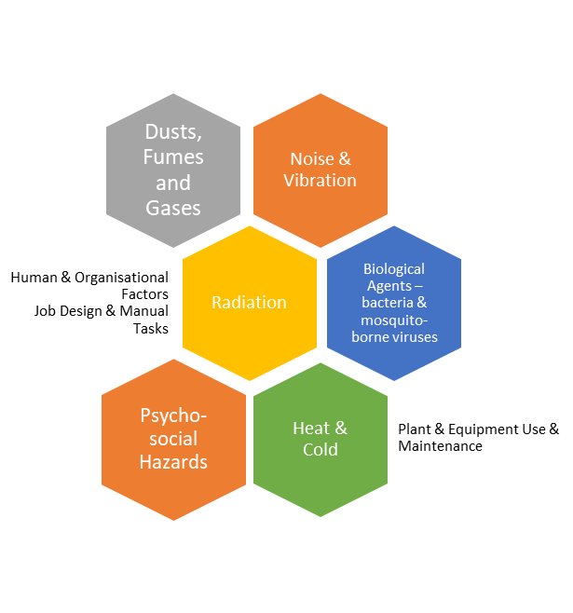
Role of the occupational health and hygiene professional
Risk management
Hazard identification (qualitative)
Assessment of risk (qualitative & quantitative)
Recommending effective controls
Review and verify efficiency of controls
Notes:
Hazard Identification (qualitative)
What? Who? When? How?
Assessment of risk (qualitative & quantitative)
How much? How often? How serious?
Is it acceptable risk?
Can it be managed?
Recommending effective controls
Reducing exposures to:
as low as reasonably practicable or
to accepted levels (legislated or corporate standards)
Review and verify efficiency of controls
Advise on SEGS requiring health monitoring

Slide 23
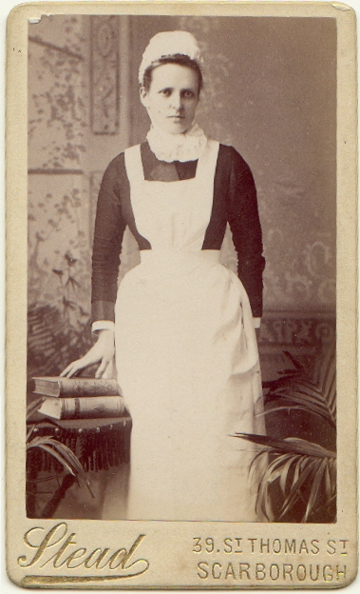
Role of consulting medical practitioner in risk-based health surveillance
Make a clinical assessment on health of the worker based on workplace exposure information
Ensure worker understands the examination purpose and what the results mean
Notify the employer of diagnosis of an occupational disease and any remedial action that may be necessary.
https://summertime75.files.wordpress.com/2010/01/scarbrough-maid-nurse-1880s.jpg
Notes:
Make a clinical assessment on health of the worker based on workplace exposure information.
HHMP, exposure monitoring summaries for individual & relevant SEGs
Health surveillance history; biological monitoring etc
Ensure worker understands the examination purpose and what the results mean.
Notify the employer of diagnosis of an occupational disease and any remedial action that may be necessary
Referrals to specialists or for further assessment or treatment, removal from tasks, initiate compensation processes, if necessary
Provide advice on recovery periods or reduction of exposures

Slide 24
Context of health surveillance, monitoring and screening
Monitoring exposures at the mine
Atmospheric (airborne concentration/risk)
Biological monitoring (agent in breath, urine, blood)
Health monitoring / medical screening of mining employees to identify early, reversible toxic effects
Questionnaires, physical examination
Spirometry, CXR, CT scan
Audiometry and audiology
Effects testing – blood tests and biochemical analyses
Mental health/resilience
Health surveillance
Notification of diseases to the regulator
Tracking trends in disease incidence and for epidemiology
Identifying new hazards, risk factors, at risk populations.
Notes:
This slide emphasizes how monitoring exposure fits in with assessing health risks and how, in conjunction with health monitoring (the term used by Safe Work Australia) and pre-employment medicals benefits individuals. Health surveillance, in contrast is more of an epidemiological study and in WA, notification of conditions or early changes in health can be tracked for the industry population.

Slide 25
Types of health assessments for risk-based health monitoring
Fit, healthy worker
Exposure risk management
Medical screening
Health monitoring
Early signs of health impacts
Health surveillance Epidemiology
Injury / Disease
Diagnosis (Referral?)
Pre-Employment medical
Fitness for work
Treatment / Rehabilitation
(Compensation) (Return to work)
Respiratory fitness & predisposition
Musculoskeletal fitness
FIFO CoP – mental health resilience
Notify the Regulator of outcomes
Regular reporting of trends
Lead, mercury, cobalt, isocyanates etc.
Explain results to worker
Inform employer of outcome
Undertake remedial actions
Medical examination for diagnosis, referral or treatment as required
Notes:
There are many purposes of undertaking health assessments. They include:
Pre-employment assessments to ensure fit and healthy workers are selected for employment who are mentally and physically capable of doing the job. This may involve lung function testing if the worker must wear a negative pressure respiratory (P2 dust mask).
A baseline assessment of any hazards the worker may be exposed to should be undertaken at this stage – for example, baseline hearing levels, inherent levels of lead in blood are important for future process workers in lead mines, laboratories using lead litharge, or working in gold rooms.
Exposure risk management involves identification/assessment/control/ validation and verification of controls. If there is a chance that exposure to an atmospheric contaminant can cause an occupational disease, there is a a validated test to screen changes (the earliest signs are preferable), then that health screening is appropriate. This is informed by exposure monitoring.
Biological monitoring, say for lead, is appropriate for everyone in the SEG with more than 50% of the Exposure Standard.

Slide 26
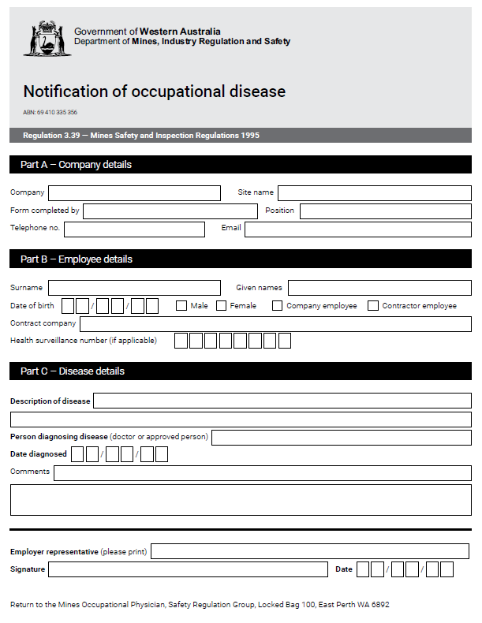
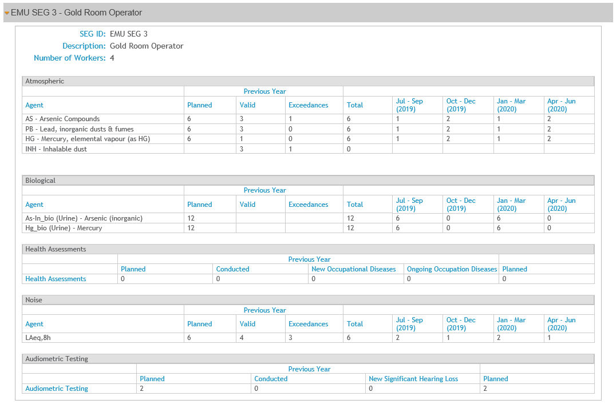
Health surveillance in SRS
Notes:
Regulation 3.39 requires any employer who becomes aware of a mine worker being diagnosed with an occupational disease to report it to the Mines Occupational Physician. The current approved notification method is this form.
More details of numbers of people involved in Health Surveillance programs are required to be reported in SRS in the sampling plan and then subsequently at the time of the annual review. More information will be provided in guidance materials from the homepage.

Slide 27
DMIRS contacts
1 800 SAFE MINE (1 800 7233 646)
Email: MinesSafety@dmirs.wa.gov.au

Slide 28
Follow us on social media
Twitter
@DMIRS_WA
@AndrewChaplyn
LinkedIn at Department of
Mines, Industry Regulation and Safety
Notes:
Add slide about awards

