Slide 1
Please read this before using presentation
This presentation is based on the content presented at the 2018 Mines Safety Roadshow in October 2018.
Department of Mines, Industry Regulation and Safety (DMIRS) supports and encourages reuse of its information (including data), and endorses use of the Australian Governments Open Access and Licensing Framework (AusGOAL)
This material is licensed under Creative Commons Attribution 4.0 licence. We request that you observe and retain any copyright or related notices that may accompany this material as part of attribution. This is a requirement of Creative Commons Licences.
Please give attribution to Department of Mines, Industry Regulation and Safety, 2018.
For resources, information or clarification, please contact: SafetyComms@dmirs.wa.gov.au or visit www.dmirs.wa.gov.au/ResourcesSafety

Slide 2
2018 Mines Safety Roadshow

Slide 3
Setting the scene
Developing mentally healthy and safe workplaces

Slide 4
This presentation is about…
What is mental health?
What is a mentally healthy workplace?
Why we are investing in this area?
How can we make a positive difference?
Common concerns and misunderstandings
What stigma is and how it impacts?

Slide 5
Mental health: a state of wellbeing
Mental health is as a state of well-being in which an individual realizes their potential, can cope with the normal stresses of life, can work productively and fruitfully, and is able to make a contribution to their community.
-World Health Organisation, 2014
Notes:
Mental health is: ‘a state of well-being in which every individual realises his or her own potential, can cope with the normal stresses of life, can work productively and fruitfully, and is able to make a contribution to her or his community.‘
Facts:
Mental health exists along a continuum/spectrum
It is dynamic
Applies to everybody – nobody is immune
Changes over the life time – can get better or worse so needs constant investment*
Impacted by external and internal factors – list some examples
*even if you are resilience you will still experience movement on this continuum
If we want to improve the mental health of the population then there are loads of people who need to contribute. Everybody has a unique contribution to make, so does industry. You need to identify your unique contribution and be careful not to get side tracked by other stuff. Industry’s unique contribution is to create mentally healthy workplaces because nobody else in the community can do this, and if you can manage to do this then you will have a positive impact on a really large number of people for a significant chunk of their life.

Slide 6
What is a mentally health and safe workplace?
A mentally healthy workplace is one in which workers and management collaborate to protect and promote the health, safety and wellbeing of all…
…by considering and addressing health, safety and wellbeing concerns due to the work environment, including the organisation of work and workplace culture as well as the physical environment and facilities provided.

Slide 7
Legislation
Section 9(1) An employer must, so far as is practicable, provide and maintain at a mine a working environment in which that employer’s employees are not exposed to hazards
Section 10(1) An employee at a mine must take reasonable care —
(a) to ensure his or her own safety and health at work; and
(b) to avoid adversely affecting the safety or health of any
other person through any act or omission at work.

Slide 8
Why is a mentally healthy workplace important?
↑ productivity
↑ engagement and job satisfaction
↑ attraction of talent
↓ absenteeism
↓ occupational injuries and illnesses
↓ workers compensation claims
↓ turnover and selection costs
Return on investment is $2.30 for every $1 invested
Notes:
Benefits of a mentally healthy workplace, your motivation:
Decreased presentism
Improved focus
Thriving workers
Increased productivity
Decreased absenteeism
Decreased occupational injuries and illnesses
Decreased workers compensation claims
Increased engagement and job satisfaction
Decreased turnover and selection costs
Increased attraction of talent
Return on investment is $2.30 for every $1 invested

Slide 9
What’s the difference?
Mentally healthy workplace
Mental health at work
Notes:
Understanding the difference between these gets in the way of making progress.
We are aiming to focus on your skills and strengths to create a mentally healthy workplace, not to become experts in managing individuals mental health- you have people employed to do that. MOST people need to focus on the whole workplace – your unique contribution.

Slide 10
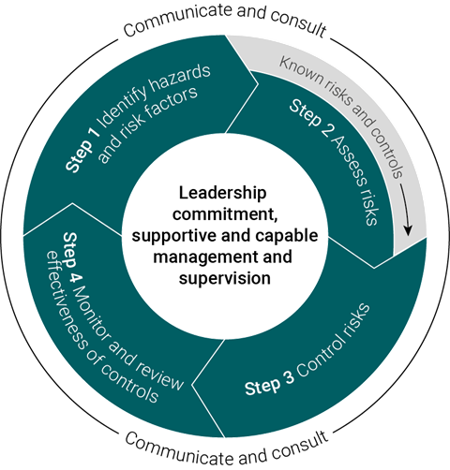
Risk management process
Notes:
Thinking we need to develop an entirely new system to manage psychosocial hazards and risks gets in the way of making progress – we don’t need to design a new system, use the one you have got – you are good at this, it is your unique contribution.
Use your risk management process.

Slide 11
Step 1: Identification
Notes:
In line with good risk management approaches, the first step is to identify the hazards.
Can you think of any psychosocial hazards in your work place?

Slide 12
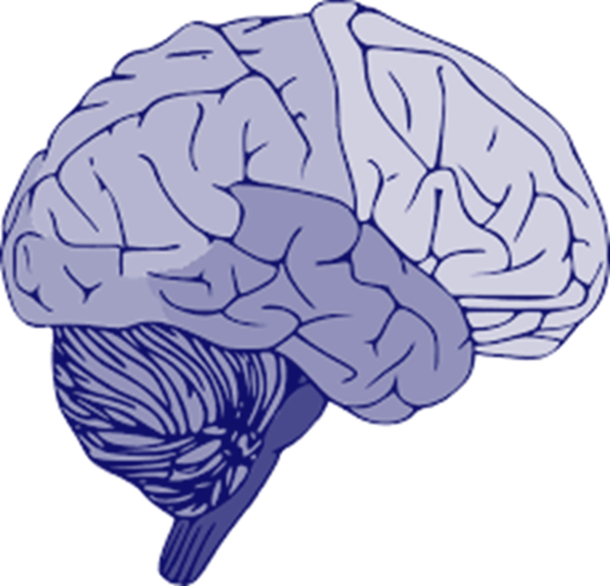
Psychosocial hazards and factors are…
anything in the design or management of work that increases the risk of work related stress
a stress response is the physical, mental and emotional reactions that occur when the perceived situational demands exceed a person’s ability or resources to cope
chronic or acute work-related stress can cause psychological and/or physical harm.
Stress itself does not
constitute a physical
or psychological injury
Notes:
Psychosocial hazards are anything in the design or management of work that increases the risk of work-related stress. A stress response is the physical, mental and emotional reactions that occur when a worker perceives the demands of their work exceed their ability or resources to cope. Work-related stress if prolonged and/or severe can cause both psychological and physical harm.
Example Psychosocial Hazards
High job demands
Low job demands
Low job control
Poor job design
Poor support
Poor workplace relationships
Low role clarity
Poor organisational change management
Low recognition and reward
Poor organisational Justice
Poor environmental conditions
Remote work
Isolated work
Violent of traumatic events
Workers are likely to be exposed to a combination of psychosocial hazards; some may always be present, while others only occasionally.
Stress does not constitute and injury, however it is a condition that can increase the likelihood of injury

Slide 13
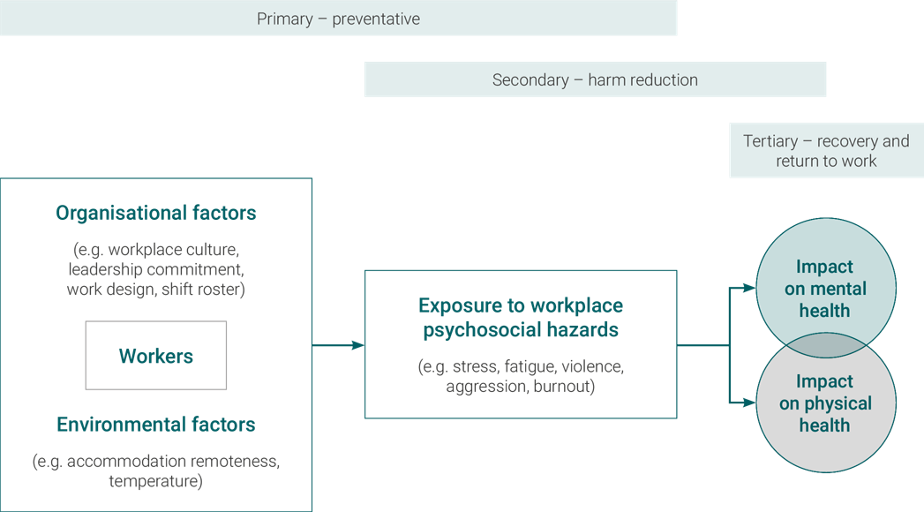
Notes:
How risks increase likelihood of hazards and how exposure to risks and hazards impact mental and physical health outcomes.
We need to have interventions at each phase with most energy focused on prevention at the organisational risk factors phase.

Slide 14
Step 2: Risk analysis & assessment

Slide 15
Organisational risk factors
Change
External and internal
Work Organisation
Job demands and control
Organisational Culture
Structures, systems and relationships
Leadership
Style and skill
Notes:
Four types of antecedents (risk factors) appear: (1) changing in general and changing nature of work, (2) work organisation, (3) organisational culture and climate, and (4) leadership.
Change – Any internal or external changes where the relationships between employees are likely to be affected. For instance, organisational restructuring has been found to act as a risk factor of bullying in several studies and this risk may grow if managers adopt more autocratic practices to bring about change (McCarthy, et al. 1995, Sheehan 1999). Changes can occur at three levels: personal (i.e. changes to position and responsibilities), management (i.e. new supervisors or processes and procedures), and organisational (i.e. takeover, restructure or redundancies)
External
Labour market
Global events i.e. GFC
Internal
Restructure
Budget
Technology
Change in manager
Duties
Work organisation – negative and stressful work environment (Leymann 1996b) are associated with workplace bullying. This relationship can be explained as various environmental work factors are considered to produce or elicit occupational stress, which again may increase the risk of conflict and bullying. The characteristics of the negative and stressful environment are, for example, work pressure, unclear and unpredictable job situations, enforced team working, unclear roles, lack of control, as well as various job related physical aspects (noise, heat and coldness) (Hoel & Salin 2003).
High job demands
Low job control
Role ambiguity
Rights
Duties
Responsibilities
Role conflict
Environment : temp, noise, layout etc.
Organisational Culture- organisational culture may play a decisive role (Dejours 1993, 1998). According to Hoel and Salin (2003: 211), “As new members enter the organisation they will gradually adapt to the shared norms of the organisation and their work group by means of socialisation processes”. Given this, a highly homogenous work group is a risk factor for bullying. In some organisations, bullying may not be an integral part of the culture, but it is still indirectly ‘permitted’. For example if it is tolerated by management or perceived to be rewarded through promotions etc. If there is no policy against bullying, no monitoring policy and no punishment for those who engage in bullying, it could be interpreted that the organisation accepts the behaviour as normal and legitimate and to some extent indirectly rewards the behaviour (Hoel & Salin 2003). Brodsky (1976: 83) argues that, “For harassment to occur, the harassment elements must exist within a culture that permits and rewards harassment.”. Other factors include- high internal competition.
Structures & systems
Non-existent
Ineffective
Reward a negative culture
Lack of rewards & recognition
Organisation injustice
Resource distribution
Processes and decision making
Personal interaction
Unhealthy work relationships
Lack of support from colleagues
Homogenous group
Leadership- Two styles of leadership have been found to be associated with bullying: an authoritarian style (dictatorship) and a laissez-faire style (abdication of leadership-→ employees experience high degrees of role conflict and ambiguity, with increased conflict between employees). In contrast, people who had neither been bullied, nor had observed bullying taking place, reported that disagreements at their workplace tended to be solved by negotiation (Vartia 1996). Moreover, a laissez-faire style of leadership may also provide a fertile ground for bullying between peers or colleagues. A manager’s ignorance and failure to recognise and intervene in bullying cases may indirectly contribute to bullying by conveying the message that bullying is acceptable. Similarly, dissatisfaction with the amount and quality of guidance, instructions and given feedback has been shown to be associated with higher levels of bullying (Hoel & Salin 2003).

Slide 16
Stigma
Ignorance
Discrimination
Prejudice
Problems with behaviour
Problems with knowledge
Problems with attitudes
Notes:
Stigma gets in the way of everything. If there is stigma around mental health then nobody will put effort into addressing it or improving the workplace or even using the resources available – it wont get prioritised.
Address stigma by targeting its three components – Knowledge, attitude and behaviour

Slide 17
Step 3: Control the risk
Notes:
Relying on resilience is not an effective control. ‘– if that is all we rely on it is not a very strong control and it perpetuates stigma.
Employee Assistance Program (EAP) is not sufficient control either – this is first aid and is only relevant after people have been exposed to the hazard. There is a place for EAP and they can add value BUT they are intervention, not prevention.
Apply the hierarchy of controls that you are familiar with

Slide 18
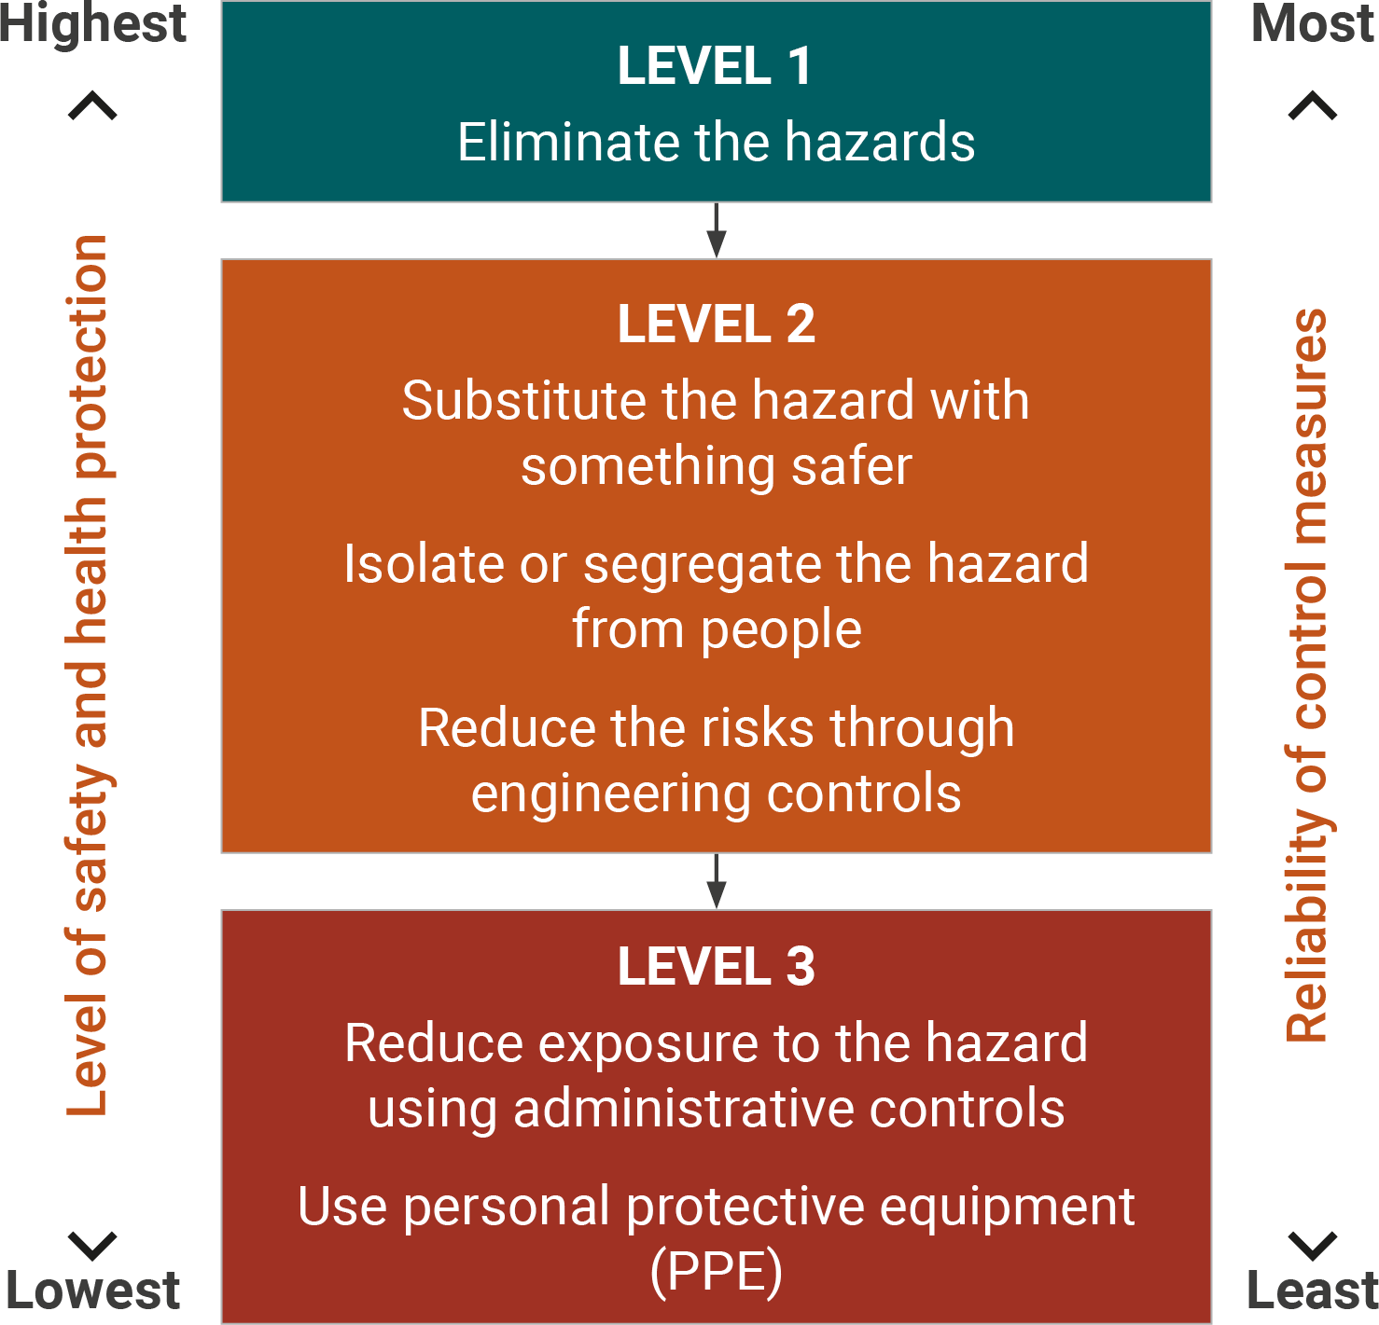
Risk management - Hierarchy of control
Notes:
Apply the Hierarchy of control (HoC) as you would with any other type of safety.
This is the hierarchy of control. Controls: are anything that is practicable for an employer that reduces the risk of injury or harm to health from employees being exposed to a hazard. Whilst you not always have the decision making authority when consulting to organisations , it is important to consider when recommending controls or interventions that you are using the hierarchy of control as a guide for your recommendations .
Eliminate - if it is possible, the hazard should be removed completely. For example, get rid of dangerous machines.
Substitute - replace something that produces the hazard with something that does not produce a hazard. For example, replacing solvent based paint with water based paint. Risk assessment on the substitution must be conducted to ensure that it will not pose another hazard.
Engineering control - isolate a person from the hazard by creating physical barrier or making changes to process, equipment or plant to reduce the hazard. For example, install ventilation systems.
Administrative control - change the way a person works by establishing policies and procedures to minimise the risks. For example, job scheduling to limit exposure and posting hazard signs.
Use personal protective equipment (PPE) - protect a person from the hazard by wearing PPE. For example, wearing gloves, safety glasses, hard hats and high-visibility clothing. PPE must be correctly fitted, used and maintained to provide protection.

Slide 19
Examples of risk controls
Elimination | Substitution | Engineering | Administrative | PPE
Cultural change | Coaching | Separation of parties | Workplace behaviour policy/ code of conduct | Stress management training
Job design & redesign | Leadership development | Job redesign | Reporting procedures | Resilience training
Recruitment & selection | Mgt/ supervisor training |  | Performance management | Employee assistance program
 | Transfer |  | Clear job descriptions | Peer supporter program
 |  |  | Conflict mgt system | Health and wellbeing programs
Notes:
Here are some HoC ideas

Slide 20
Step 4: Communicate & consult
Notes:
Consultation involves sharing information and giving workers a reasonable opportunity to express their views on safety and health matters that may affect them. These views should be considered when decisions are made.
Consultation with workers and their representatives is important at each step of the risk management process. By drawing on workers’ experience, knowledge and ideas, it is more likely that the psychosocial hazards and risk factors will be identified and effective controls selected. Worker ownership throughout the process should also lead to increased support and understanding when strategies are implemented.
Examples of strategies to encourage communication and reporting include:
role modelling of desired behaviours and values by managers and supervisors
actively encouraging workers to provide feedback
consulting workers about workplace updates and changes
being responsive to worker reports
empowering a safe, supportive and learning culture
checking in regularly with workers
maintaining confidentiality.
Examples of activities to support effective communication and consultation include:
using focus groups
having a standing agenda or discussion item at
safety and health committee meetings
team meetings
toolbox meetings
regular updates to the workforce (e.g. email broadcasts, newsletters).

Slide 21
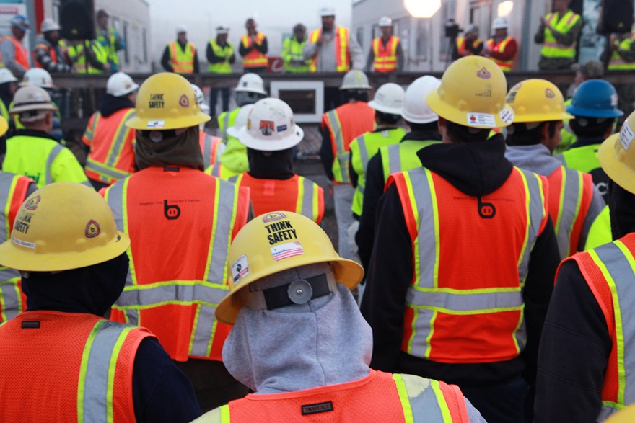
Safety meetings
Toolbox
Prestart
Hazard reports
Conversations
Non verbal communication
Secondary impact of other safety hazards
Notes:
Data collection opportunities

Slide 22
Step 5:
Monitoring & review
Notes:
The results of monitoring for psychosocial hazards and risk factors are used:
for verification and validation of controls
to identify learning opportunities for the purpose of continuous improvement
to trigger corrective measures, including early intervention if necessary.
Mechanisms for the recognition and early detection of harm to mental health in the workplace include analysing workplace data from:
hazard, incident and investigation reports
complaints
worker surveys
consultation with safety and health representatives and work teams
alcohol and other drug test results
direct observations (e.g. workers displaying the early signs and symptoms of psychological or physical harm).

Slide 23
Analysing workplace data
Records of leave
Absenteeism records
Workers’ compensation claims
Complaints
Incidents and injury records
Employee assistance program data
Industrial relations records
Minutes of meetings
Work schedule records
Medic information
Organisation’s policies and procedures
Notes:
There are numerous sources of information that can shine light on the nature and extent of mental health issues in the workplace. These are a few examples …

