Slide 1
Please read this before using presentation
This presentation is based on content presented at the 2015 Exploration Industry Forum in June 2015
The Department of Mines and Petroleum (DMP) supports and encourages reuse of its information (including data), and endorses use of the Australian Governments Open Access and Licensing Framework (AusGOAL)
This material is licensed under Creative Commons Attribution 4.0 licence. We request that you observe and retain any copyright or related notices that may accompany this material as part of attribution. This is a requirement of Creative Commons Licences.
Please give attribution to Department of Mines and Petroleum, 2015.
For resources, information or clarification, please contact: RSDComms@dmp.wa.gov.au or visit ww.dmp.wa.gov.au/ResourcesSafety

Slide 2
Management plans for occupational health and hygiene during mineral exploration

Slide 3
Hazard identification
Baseline survey – Identify the hazard and occupational exposure limits (OEL)
Induction and training – Understand the risks
Where potential for exposure or risk is identified
Personal risk assessment
JHA or JSA or similar
Consider the health hazards that you may be exposed to
Document the hazard and route of exposure
Consider the potential health effects from exposure

Slide 4
Hazard identification
Consider controls for reduction in exposure
Engineering controls
Procedure development and training
Personal protection equipment (PPE)
Occupational hygiene monitoring program
Where exposure cannot be eliminated or reduced, specific ongoing monitoring may be required to validate that level of control is acceptable

Slide 5
ALARP principle
If a measure is practicable and it cannot be shown that cost of measure (in money, time and effort) is grossly disproportionate to the benefit gained – then the measure is considered reasonably practicable and should be implemented
Criterion is reasonably practicable not reasonably affordable – justifiable cost and effort is not determined by the budget constraints or viability of a project

Slide 6
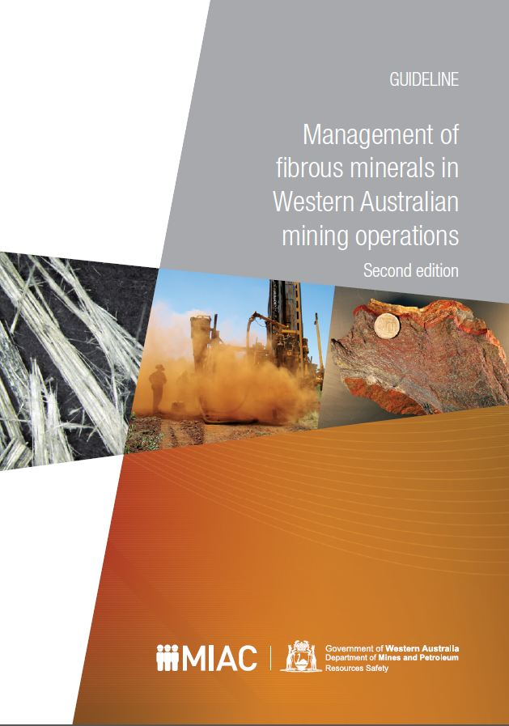
Typical exploration health and hygiene hazards
Dust
Fibrous minerals
Noise
Manual handling
Radioactive mineralisation
Visit www.dmp.wa.gov.au/15569.aspx

Slide 7
When would RSD ask for a management plan?
When there is a foreseeable risk of injury or adverse health effects to worker from hazards associated with mining activities
To fulfill duty of care to workers
Principal employer (MSIA s.13)
Registered manager (MSIA s.9)
Employee (MSIA s.10)
Person conducting a business or undertaking (PCBU)

Slide 8
What is reasonable and practicable?
AS LOW AS REASONABLY PRACTICABLE (ALARP)
What is considered ‘reasonable’ or ‘foreseeable’
Dust vs. meteors
What is considered sufficient detail?
Brief statement vs. opus

Slide 9
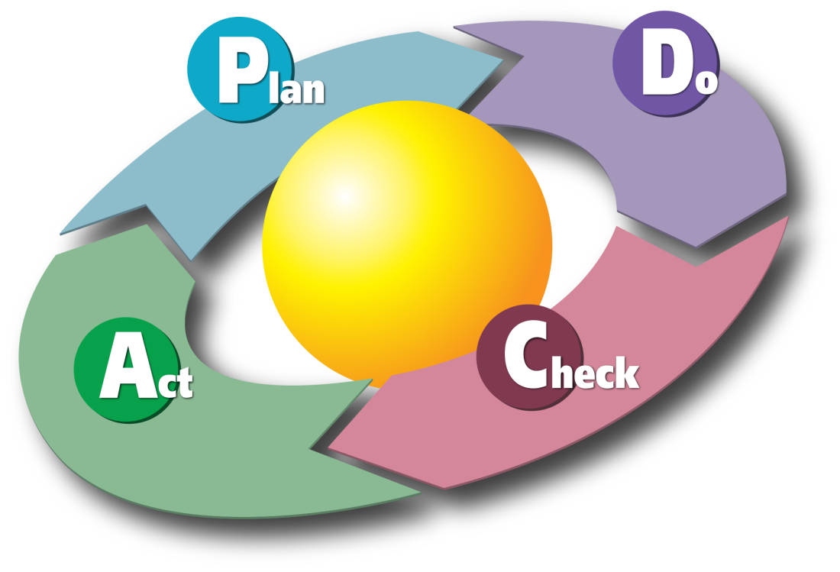
How to implement a management plan
Training
Competencies – Surface vent tech/officer
Policy – Procedure – Work instructions
Reporting (internal and external)
Review
Action plan

Slide 10
Risk-based hygiene management planning
Not a requirement but it is recommended
CONTAM/RBHMP guidelines are a helpful resource
Visit www.dmp.wa.gov.au/15567.aspx

Slide 11
Role of safety and health representatives in management plans
Do SHReps role work in exploration industry?
“How a drill crew can request and/or be involved in development of a management plan from a principal employer of an exploration project”

Slide 12
Stay informed!
Subscribe to our email alert service
and receive weekly news about:
recent publications
latest safety alerts
what’s happening at Resources Safety.
Visit www.dmp.wa.gov.au/ResourcesSafety
to sign up

