Slide 1
Please read this before using presentation
This presentation is based on content presented at the industry information session on risk-based hygiene management planning held in May 2015
It is made available for non-commercial use (e.g. toolbox meetings, OHS discussions) subject to the condition that the PowerPoint file is not altered without permission from Resources Safety
Supporting resources, such as brochures and posters, are available from Resources Safety
For resources, information or clarification, please contact:
RSDComms@dmp.wa.gov.au
or visit
www.dmp.wa.gov.au/ResourcesSafety

Slide 2
Our commitment
To work with industry to reduce serious accidents and incidents, and provide tangible support in achieving a positive cultural change.

Slide 3
Resources Safety’s focus

Slide 4
Managing noise in Western Australian mines

Slide 5
Legislative framework
General
Duty of care requirements under s. 9 of the Mines Safety and Inspection Act 1994 (MSIA)
General duties for workers under s. 10 of the MSIA that require workers to protect themselves from occupational hazards
Employers and self-employed persons have a duty of care under s. 12 of the MSIA to take reasonable care to ensure their own safety and health at work

Slide 6
Legislative framework
Specific
Part 7, division 1 of the Mines Safety and Inspection Regulations 1995 (MSIR)
Schedule 7 of the Workers Compensation and Injury Management Act 1981

Slide 7
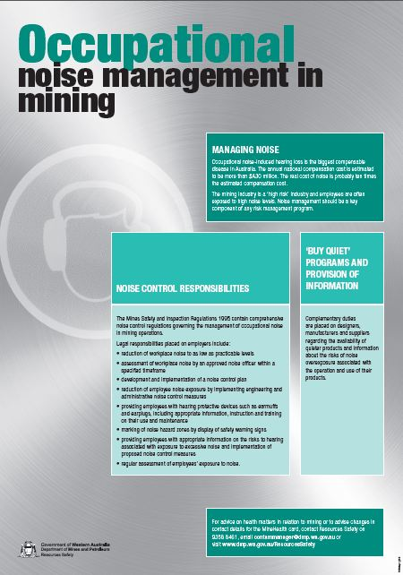
Noise exposure
Measurement
Action levels
Adjustment for extended work shifts

Slide 8
Noise report
Purpose
Additional reports
Report preparation
Action summary
Workplace description
Activities since last report and comparison to
Results tabulated in approved formats
General noise control advice and comments
Full name and signature of noise officer
Measurement method; equipment used; and calibration certificates
Notification requirements

Slide 9
Noise control plan
Purpose
Contents
Description of mine
Noise objectives
Hierarchy of hazard control and concept of “as low as reasonable practicable” (ALARP)
Expected reduction in noise levels
Method used to determine effectiveness
Monitor and review

Slide 10
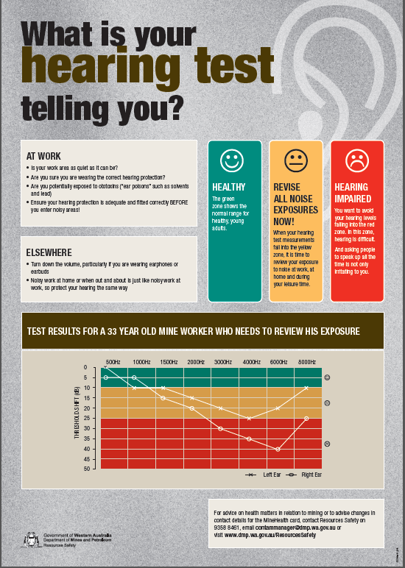
Noise control policy
Goals for noise exposure
Design goals for new plant
Selection and purchase of quiet plant
Noise control in temporary work areas
Agreements with contractors
Audiometric testing
Funding for noise control programs

Slide 11
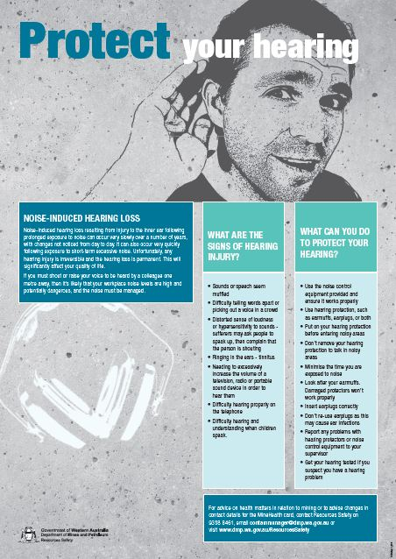
Hearing conservation program
Must be linked to the risk-based hygiene management plan (RBHMP) and overarching safety management system (SMS)
Information and training
Personal hearing protectors – selection, use and fit-testing
Exclusion zones and signage
Role of workers
Dosimetry

Slide 12
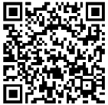
Stay informed!
Subscribe to our email alert service
and receive weekly news about:
recent publications
latest safety alerts
events
what’s happening at Resources Safety.
Visit www.dmp.wa.gov.au/ResourcesSafety
to sign up

