Slide 1
Please read this before using presentation
This presentation is based on content presented at the 2015 Exploration Industry Forum in June 2015
The Department of Mines and Petroleum (DMP) supports and encourages reuse of its information (including data), and endorses use of the Australian Governments Open Access and Licensing Framework (AusGOAL)
This material is licensed under Creative Commons Attribution 4.0 licence. We request that you observe and retain any copyright or related notices that may accompany this material as part of attribution. This is a requirement of Creative Commons Licences.
Please give attribution to Department of Mines and Petroleum, 2015.
For resources, information or clarification, please contact: RSDComms@dmp.wa.gov.au or visit ww.dmp.wa.gov.au/ResourcesSafety

Slide 2
Mining rehabilitation fund

Slide 3
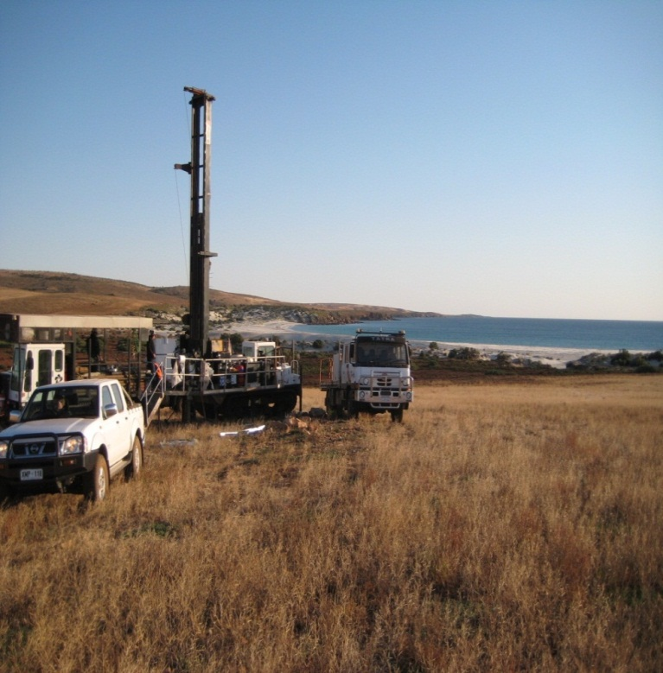
Mining rehabilitation fund
Mining rehabilitation fund (MRF)
All Mining Act 1978 tenements
New securities model-replacing unconditional performance bonds (UPBs) in most cases
Successful first reporting period-2014
30 June deadline for 2015 period

Slide 4
Mining rehabilitation fund
Unconditional performance bonds (UPBs)
UPBs can be retained, or reapplied by the Minister (Mining Act 1978)
Administration of mining securities guideline (new bond policy)
Risk of the rehabilitation liability reverting to the state
Environment enforcement panel process

Slide 5
Mining rehabilitation fund
Tenements in WA in 2014
Type | Total
Exploration | 5,854
Prospecting | 6,785
Mining | 5,937
Miscellaneous | 2,145
General | 512
Retention | 28
Total | 21,261

Slide 6
Mining rehabilitation fund
Exploration tenements by region
Region | Numbers of tenement
Northern region | 2,521
South-west region | 887
Mid-west/Northern goldfields region | 1,180
Goldfields region | 1,266
Total | 5,854

Slide 7
Mining rehabilitation fund
Exploration tenement activities in the MRF 2014
In hectares – to minimum of two decimal places
Regions | Disturbance | Land under rehabilitation
Goldfields region | 1695.3253 | 32.304
Mid-west/Northern goldfields region | 1105.7451 | 26.317
Northern region | 6085.6717 | 53.2104
South-west region | 232.9798 | 14.3456
Total | 9119.7219 | 126.177

Slide 8
Mining rehabilitation fund
MRF levy and UPBs on exploration leases: retired 2014
93 UPB’s retired through the MRF with a value of $3,988,500.00
 | Levy | No levy | Total
Total | 147 | 5,707 | 5,854
 | Amount $
Total levy | $255,681.30
Average per tenement | $1740

Slide 9
Mining rehabilitation fund
Exploration activities reported on Mining leases 2014
In hectares – to a minimum of two decimal places
Mining activity type in mining lease | Disturbed land(Ha) | Land under rehabilitation
Land (other than land under rehabilitation or rehabilitated land) that has been disturbed by exploration operations | 7345.7362 | 0
Total | 7345.7362 | 0

Slide 10
Mining rehabilitation fund
MRF Reporting for exploration activities
Category D ‘land that has been disturbed by exploration operations’
Consistent with approval
Rehabilitation – evidence
Activity review – activities that should not be on exploration tenements (e.g. TSFs)

Slide 11
Mining rehabilitation fund
MRF audits and results
178 audits of 2014 reports (groups not individual tenements)
44 audits were conducted on MRF reports focusing on exploration tenements
All audits have now been closed out or resolved

Slide 12
Mining rehabilitation fund
MRF audits and results
Of the 44 audits completed
6 required amendments to the reports which increased the RLE
12 reports were completed under a DMP initiated assessment on behalf of tenement holders due to a failure to report or a failure to respond to requests further information
2 requested reassessments and the RLE decreased as a result
2 had reported correctly in the MRF however are being reviewed to confirm compliance with the Mining Act 1978 (potential activities without the necessary approvals)
22 audits found no discrepancies and required no amendments

Slide 13
Mining rehabilitation fund
Thank you
www.dmp.wa.gov.au/19344.aspx
mrfenquiry@dmp.wa.gov.au (08) 9222 3162
Sarah Bellamy: 9222 3604
sarah.bellamy@dmp.wa.gov.au

Slide 14
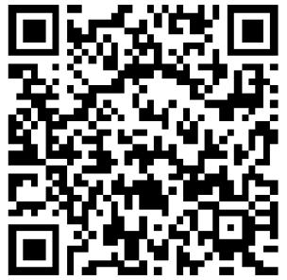
Stay informed!
Subscribe to our email alert service
and receive weekly news about:
recent publications
latest safety alerts
what’s happening at Resources Safety.
Visit www.dmp.wa.gov.au/ResourcesSafety
to sign up

