Slide 1
Please read this before using presentation
The Department of Mines and Petroleum (DMP) supports and encourages reuse of its information (including data), and endorses use of the Australian Governments Open Access and Licensing Framework (AusGOAL)
This material is licensed under Creative Commons Attribution 4.0 licence. We request that you observe and retain any copyright or related notices that may accompany this material as part of attribution. This is a requirement of Creative Commons Licences.
Please give attribution to Department of Mines and Petroleum, 2015.
For resources, information or clarification, please contact:
RSDComms@dmp.wa.gov.au or visit
www.dmp.wa.gov.au/ResourcesSafety

Slide 2
Safe drilling: The journey (part 3)
The future

Slide 3
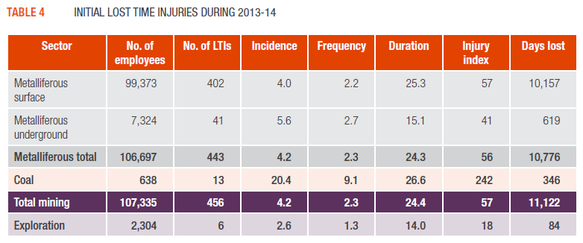
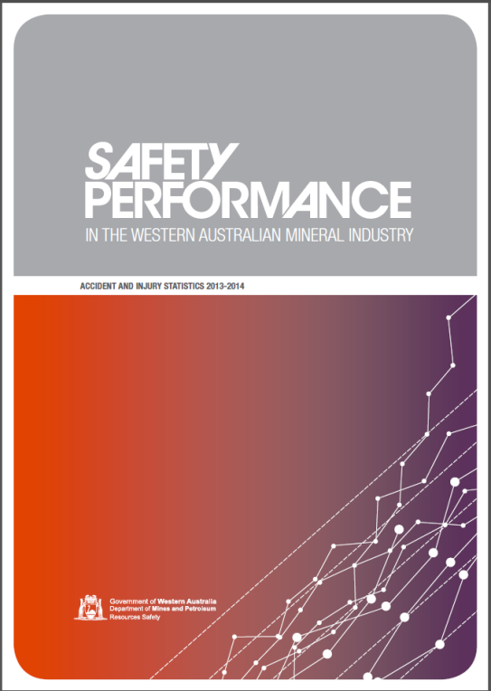
Notification statistics
Notes:
The exploration sector is under-reporting compared to mining and mineral processing.
Note: All exploration activities for metalliferous and mineral resources is subject to Mines Safety and Inspection and Mines Safety and Inspection Levy. More information is available in the ‘’Frequently asked questions’ section of the Mines Safety and Inspection Levy information sheet. Download from the Department of Mines and Petroleum’s website www.dmp.wa.gov.au/Safety/Information-sheets-and-16176.aspx

Slide 4
Why do you need to report?
MSIA s. 4
Exploration operations
means any exploration activity which is undertaken on a mining tenement, whether offshore or on land,
Notes:
Exploration activities are subject to the Mines Safety and Inspection Act 1994 . This is based on activity and resource, not if the activity is on a mining lease or permit.

Slide 5
MSIA s. 76
76. Accidents involving disabling injury to be notified
(1) Where a person suffers injury in an accident at a mine and is disabled by that accident from performing his or her duties of employment as they were being performed at the time the accident occurred, the manager must cause notice of the accident to be given —
Notes:
Report all injuries to the Department of Mines and Petroleum. The more serious the injury, the earlier it must be reported. Report as soon as possible with whatever initial information is available. Do not delay reporting until all the facts are available.
The Reporting an accident or incident poster is a “cheat sheet” that will help with who and when to report.

Slide 6
MSIA s. 78
78. Some occurrences at mines to be notified and recorded
(1) The manager must immediately give notice to the district inspector for the region in which the mine is situated of an occurrence to which this section applies, whether or not any bodily injury to any person or damage to property has resulted from the occurrence, and must give to the district inspector such particulars in respect of the occurrence as the inspector may require.
Notes:
Other incidents that may not involve injuries to workers also needs to be reported.
(a) any extensive subsidence, settlement or fall of ground or any major collapse of any part of the operations of a mine, or any earth movement caused by a seismic event; or
(b) any outbreak of fire above or below ground in any mine; or
(c) any breakage of a rope, cable, chain or other gear by which persons are raised or lowered; or
(d) any inrush of water from old underground operations or other source; or
(e) any accidental ignition of dust below ground or the discovery of the presence of potentially harmful or asphyxiant gas or an outburst of such gas in any part of a mine; or
(f) any accidental ignition or detonation of explosives, or any delayed or fast ignition of explosives; or
(g) any explosion or bursting of compressed air receivers, boilers, or pressure vessels; or
(h) every electric shock or burn to a person and every dangerous occurrence involving electricity; or
(i) any incidence of a person being affected by poisoning or exposure to toxic gas or fumes; or
(j) any loss of control of heavy earth moving equipment, including failure of braking or steering.

Slide 7
MSIA s. 79
79. Some potentially serious occurrences to be notified
The manager must inform the district inspector for the region in which the mine is situated of any occurrence at the mine which in the manager’s opinion had the potential to cause serious injury or harm to health (other than an occurrence referred to in section 78) although no injury or harm in fact happened.
The manager must inform the district inspector as required by subsection (1) as soon as practicable after the manager has ascertained the facts and circumstances of the occurrence and, if required by the district inspector, must provide a written report on that occurrence.
Notes:
A manager must make a decision what constitutes a POTENTIALLY significant and/or serious occurrence.
If in doubt, call the District Inspector or other inspector from the Mines Safety Branch of the Department of Mines and Petroleum.

Slide 8
What to report
Names
Roles
Date and time
Location
Equipment used
Description of unplanned event
Employers/ contracting company
Any other details relevant to event

Slide 9
What to report “cheat sheet”
Notes:
The Reporting an accident or incident poster is available from the Department of Mines and Petroleum www.dmp.wa.gov.au/Safety/Posters-16197.aspx

Slide 10
How do we accept injury reporting from industry?
With exception of initial contact with District Inspector, we no longer accept injury reporting via telephone
Safety Regulation System (SRS) is the online system used for reporting to Resources Safety
Notes:
All notifications, where not required to be made immediately, are to be done via the Department of Mines and Petroleum’s online Safety Regulations System (SRS).
Please contact the Department of Mines and Petroleum, Resources Safety Division for further information.
Note. To access SRS visit the Department of Mines and Petroleum’s website www.dmp.wa.gov.au/Safety-Regulation-System-SRS-1486.aspx

Slide 11
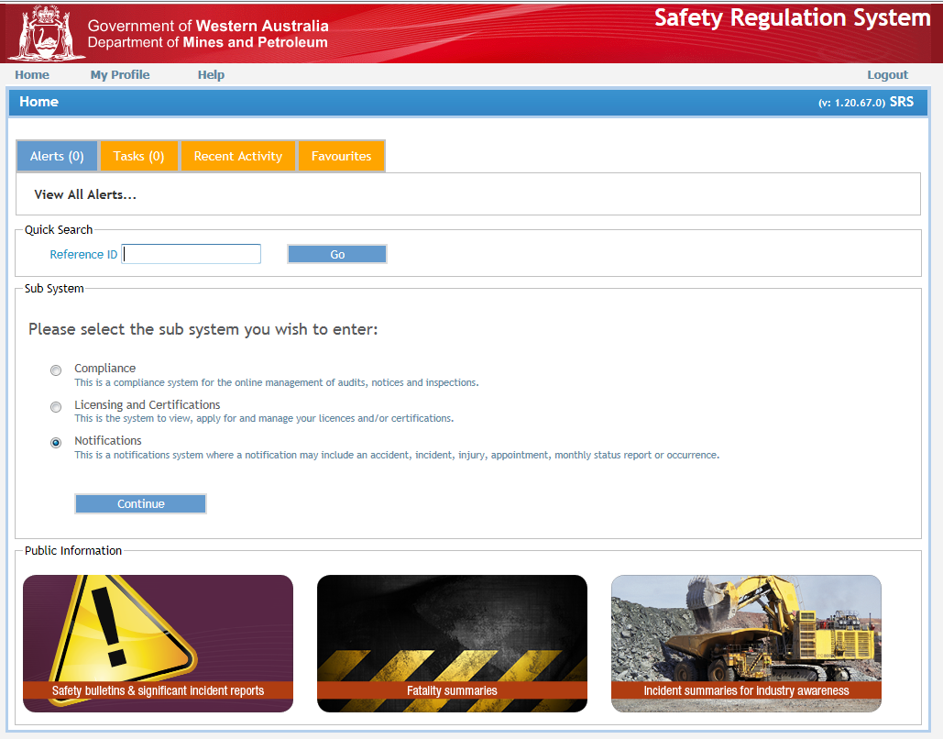
Safety Regulation System (SRS) notification

Slide 12
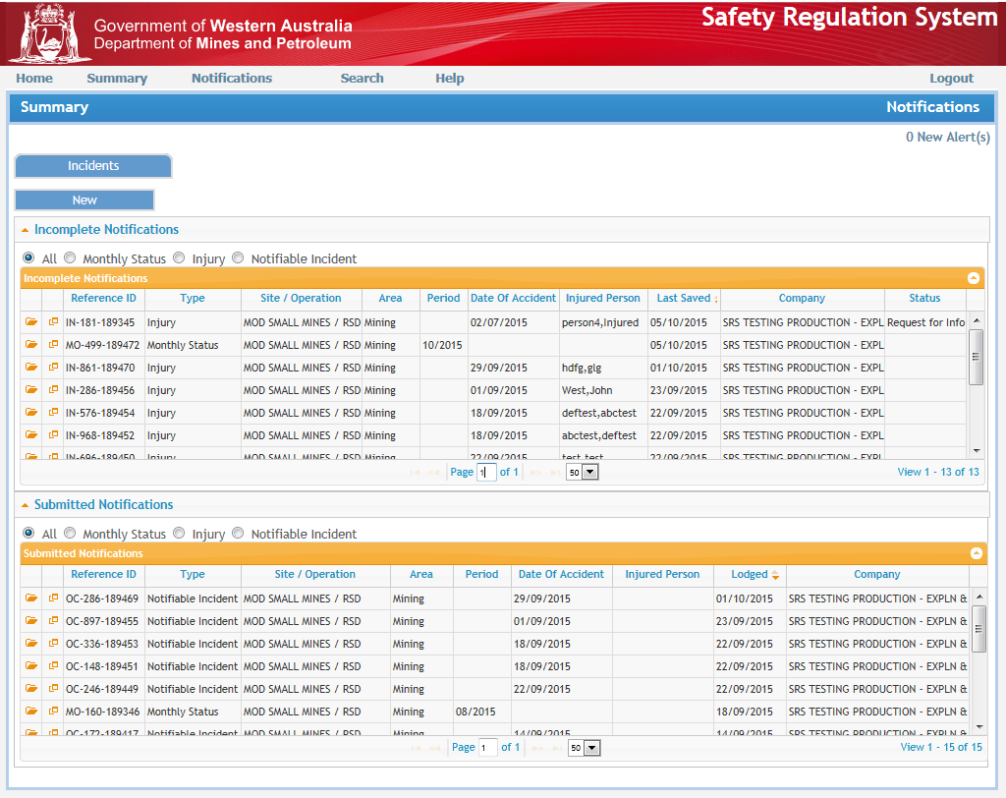
SRS notification

Slide 13
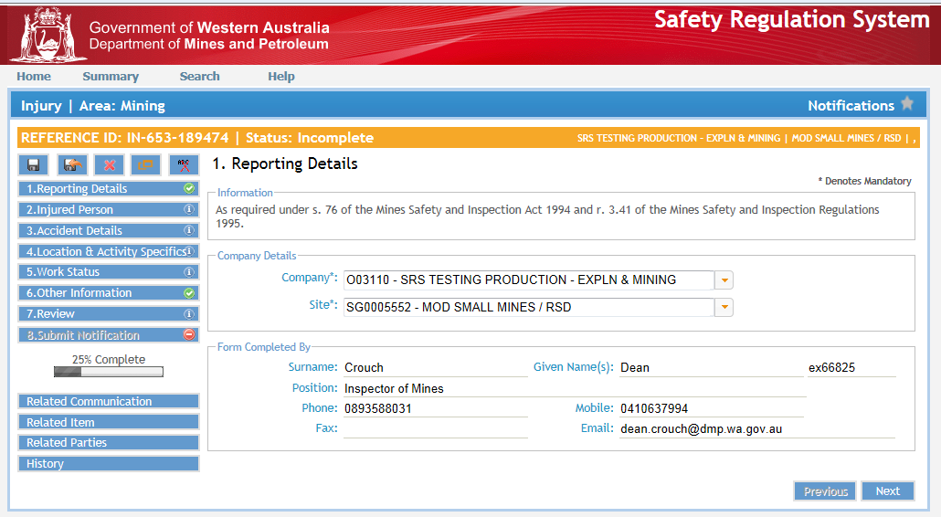
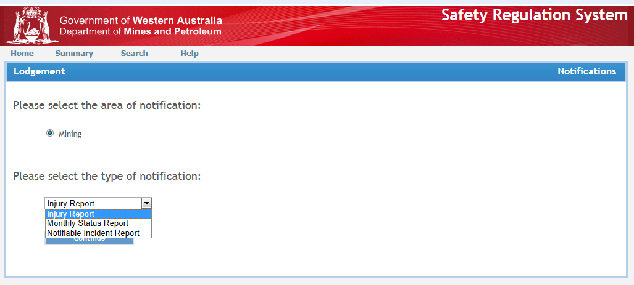
SRS notification

Slide 14
What follows after reporting to DMP?
Expected that any reportable injury or incident is internally investigated
Implement adequate controls appropriate to prevent recurrence
Apply hierarchy of controls
If mines inspectors investigate, primarily look for root causes and whether preventative actions are adequate (no injuries)
Notes:
The Safety Regulation System (SRS) allows a person who has reported an injury and/or incident to track who has been made responsible for the notification and contact them directly.

Slide 15
Safety culture spectrum
Vulnerable | Rule followers | Robust | Enlightened | Resilient
In denial Messengers ‘shot’ Whistleblowers dismissed or discredited Protection of the powerful Information hoarded Responsibility shirked Failure punished or covered up New ideas crushed | Deal ‘by the book’ Conform to rules Target = ‘zero’ Reactive Repair not reform Information neglected Responsibility compartmentalised New ideas = ‘problems’ | Develop risk management capacity Enhance systems Improve suite of performance measures Develop action plans Monitor and review progress Clarify/refine objectives | Active leadership Safety management plan widely known Competent people with experience Accountabilities understood Advanced performance measures Regular reviews Range of emergency responses catered for | Strive for resilience of systems Reform rather than repair Responsibility shared Actively seek new ideas Messengers rewarded Proactive as well as reactive Failures prompt far-reaching inquiries Flexibility of operation Consistent mindset is ‘wariness’
‘in disarray’ pathological | ‘organised’ reactive | ‘credible’ calculative | ‘trusting’ proactive | ‘disciplined’ generative
Sanction | Direct | Encourage | Partner | Champion
Notes:
The safety reform spectrum, available from the Department’s website, lists the attributes of different organisations – with the most prone to failure on the left, and moving across in increasing levels of trust and system development. The row across the bottom shows the ways in which regulators tend to vary their strategies to deal with each organisational type.
All operations should aspire to be RESILIENT. This is the goal of the inspector under the Reform and Development at Resources Safety (RADARS) program.
To strive for resilience of systems you must be able to take a hit and recover (e.g. receive negative feedback and react proactively).
Reform rather than repair. If something goes wrong, or there is a near miss, take the opportunity to really address the issues using the hierarchy of control rather than do a “quick fix”.
Responsibility shared. Every employee on the mine is responsible for safety not just safety representatives, safety advisors and management.
Seek new ideas. Is there a better way of doing what we are doing?
Messengers rewarded with positive feedback and recognition.
Proactive as well as reactive. Use audit findings and consult with the workforce to proactively deal with hazards prior to an event.
Failures prompt far reaching inquiries and do not just blame the operator. What can we do as an organisation?
Flexibility of operation to overcome and resolve issues and deal with change.
Consistent mindset, maintain a state of awareness. Celebrate success and do not rest on your achievements.

Slide 16
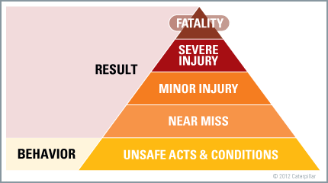
Reporting triangle
Reference: safetycultureworld.blogspot.com.au/
Notes:
The reason for reporting of all injuries and incidents (including a near miss/hit) is to allow the Department of Mines and Petroleum to determine where industry as a whole is demonstrating uncontrolled hazards.
Identifying trends in low consequence events may help prevent recurrences and escalation in consequences.

Slide 17
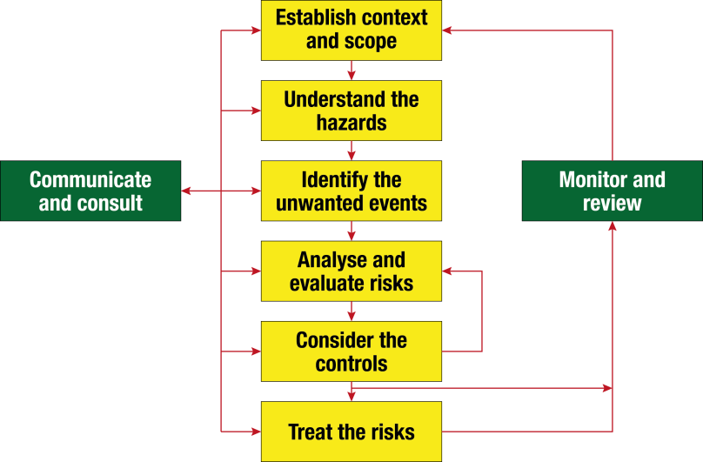
How do we manage risk?
AS/NZS ISO 31000
NSW MDG 1010
Notes:
These steps can be seen on a common job hazard analysis (JHA) or a site risk assessment:
Establish context and scope “Task to be done”.
Understand the hazards “Hazards and sources of energy”.
Identify the unwanted event “Consequence on risk matrix”.
Analyse and evaluate the risks “Likelihood on risk matrix”.
Consider the controls “Controls on JHA”.
Treat the risk “Residual risk on risk matrix”.

Slide 18
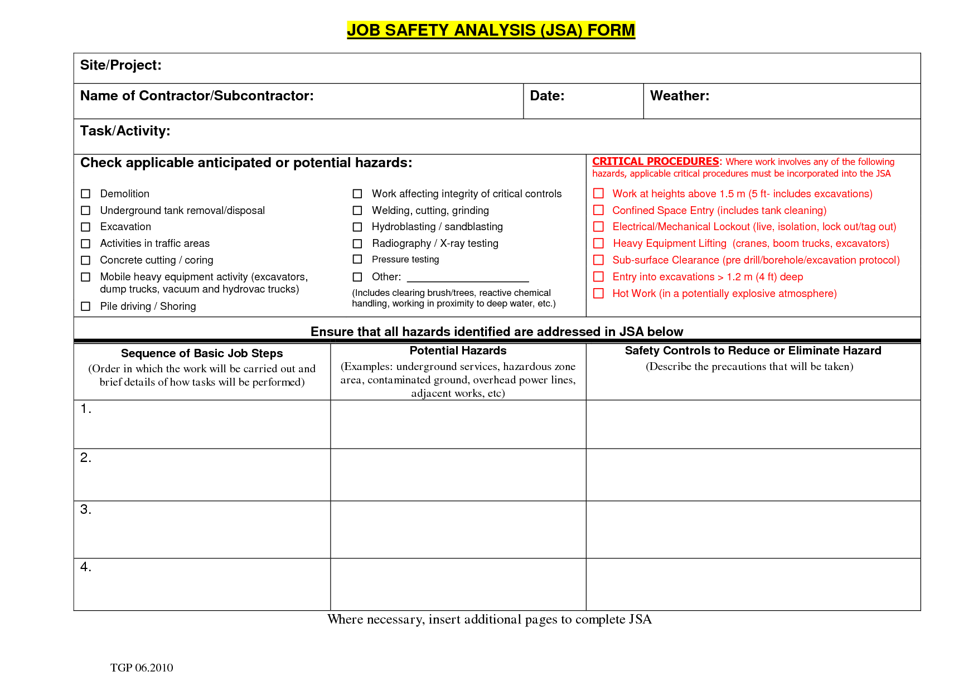
SAMPLE

Slide 19
Reasonably practical
A duty-holder can gain this knowledge in various ways, for example by:
consulting their workers and others in the industry
undertaking risk assessments
analysing previous incidents
considering relevant Regulations and Codes of Practice and other sources of information such as:
the regulator and its inspectors
reputable technical standards, such as those published by Standards Australia
industry publications, and
published scientific and technical literature.
Reference: http://www.safeworkaustralia.gov.au/

Slide 20
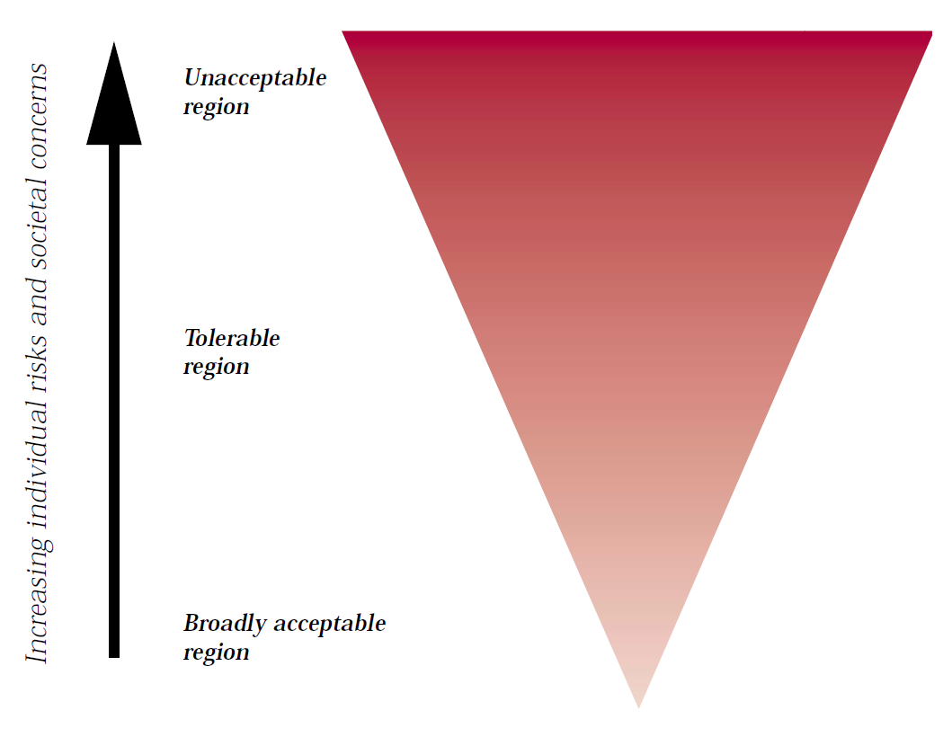
Tolerability of risk
Reference: Health & Safety Executive: Reducing risks, protecting people
Notes:
Unacceptable region – Not permissible under any conditions (e.g. smoking in confined space next to source of flammable gas).
Broadly acceptable region – Risk not considered significant or risk considered negligible (e.g. crossing the road).
Tolerable region – action has benefit but risk.
Risk assessment to be considered to reduce risk and verify that management are aware of the risk, that the benefit justifies the risk, and all persons involve accept the risk and controls.

Slide 21
What you should take away from today
Use code of practice – we are still hurting people as we did in 1990s
Develop realistic and effective controls moving away from administrative and PPE controls
Be aware of legal responsibility and become fluent with legislation – it is not optional
Regulators role is to develop a safety culture horizontally across businesses, not just vertically from management down to field workers in one business.
Learn from each other’s experience – report incidents and read others

