Slide 1
Please read this before using presentation
This presentation is based on the content presented at the 2018 Mines Safety Roadshow in October 2018.
Department of Mines, Industry Regulation and Safety (DMIRS) supports and encourages reuse of its information (including data), and endorses use of the Australian Governments Open Access and Licensing Framework (AusGOAL)
This material is licensed under Creative Commons Attribution 4.0 licence. We request that you observe and retain any copyright or related notices that may accompany this material as part of attribution. This is a requirement of Creative Commons Licences.
Please give attribution to Department of Mines, Industry Regulation and Safety, 2018.
For resources, information or clarification, please contact: SafetyComms@dmirs.wa.gov.au or visit www.dmirs.wa.gov.au/ResourcesSafety

Slide 2
2018 Mines Safety Roadshow

Slide 3
Shaping and sharing the future

Slide 4
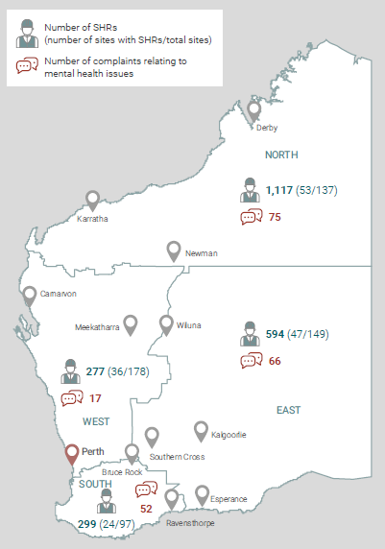
What Do We Know?
Notes:
The September 2018 Monthly Safety and Health Snapshot was purposefully designed to align with the Roadshow theme, and to provide an insight into the number of mental health related incidents reported to the Inspectorate.
The graphic presented on the slide formed the back page of the September Snapshot. It illustrates the number of SHReps per Region in the bold Green number and in the brackets are the number of mines with at least one SHRep out of the total number of mines in the Region. It can be seen that most SHReps (1117) are in the North Region, but only 53 of the 137 mines have a SHRep.
The West Region has the least number of SHReps’ (277) and has the lowest proportion of mining operations (36 out of 178) with SHReps. This data helps the Inspectorate identify opportunities for increasing the number or SHReps, therefore improving engagement with workers on safety and health matters. The data support the findings from Sara’s presentation (the Role of the Supervisor) on the identified areas where worker representation can be increased.
The other key piece of information from the graphic is the number of complaints received by region (the value in red) that had mental health as the main reason for the complaint being made.
117 complaints were directly related to mental health, with 65 of them arsing from bullying and abuse. The Snapshot covered nearly 3 years of data, and in that time 237 complaints were received. The 65 bullying and abuse complaints represent 27% of the complaints received by the Inspectorate – equivalent to one in every four complaints being related to bullying and abuse.

Slide 5
Last years “shaping and sharing”: Overview
ECU were asked to collect and analyse information from Roadshow participants:
to help define training material contents
how best to provide them.
So far we have collected data from:
649 delegates in 2016
634 delegates in 2017
A very powerful data set!
Notes:
In 2016 and 2017 Roadshow audience members contributed to a project designed to assist the Inspectorate develop training materials to support the implementation of the new risk-based WHS Act.
Over the 2 years, 1283 Roadshow delegates have provided feedback. In turn, the Inspectorate has passed the feedback to Edith Cowan University to compile insights into what this data is telling us.

Slide 6
Last year’s roadshow: Recap of 2016 data
Personal training needs in priority order:
Legislation
Developing culture
Emergency management
Risk management
Incident prevention
Measuring performance
Leadership
Organisational training needs in priority order:
Developing culture
Leadership
Emergency management
Risk management
Safety measurement
Incident prevention
Legislation
Notes:
In 2016 the survey asked what training was required across the mining sector at both the organizational and personal level.
The Department reported these findings in the 2017 Roadshow, and reminded the audience of the feedback that had been provided. It was evident that personal training needs were very different to the organizational needs, and therefore different approaches (and training courses) were needed.

Slide 7
Last year’s roadshow: So far…
Content requirements vary between role groups
Employees and team leaders/supervisors
Managers and OHS professionals
Everyone wants:
Compliance with legislation
Risk Management
The trial online materials were well received and participants remembered the contents.
including exercises, videos and case studies
New training materials should be available online with trainer support materials for class room teaching.
Notes:
The key data on this slide is the need to develop 2 distinctly different courses, and that the materials that were reviewed prior to the roadshow presentation were fit-for-purpose.

Slide 8
Last year’s roadshow: So far…
Roadshow delegates are well qualified and want to study more:
Half have a qualification which includes OHS; and
More than half were either studying or intend to.
The trial online materials were well received and participants remembered the contents.
including exercises, videos and case studies
New training materials should be available online with trainer support materials for class room teaching.
Notes:
The key take away is that the learning materials (which had largely been developed for delivery on-line) needed to be available for delivery in a face-to-face format.

Slide 9
Consultation questionnaire
Voluntary - Please only take part if you want.
Anonymous – please do not include any personal contact details.
More information – email researchers or call:
Marcus Cattani 0439 955 367
Dr Marcus Please complete the questionnaire
Thank You
Notes:
Short presentation to engage with you about the development of a training course for some parts of the new legislation.
The material we propose to use has been developed by Marcus Cattani, who has worked in the WA mining industry for over 15 years. Marcus is a Senior Lecturer and Researcher at ECU.
We have already seen some of Marcus’s work, and think it could be useful to you.
Our aim is to find out what you would like in the training materials, and then he will update his materials to reflect this.

Slide 10
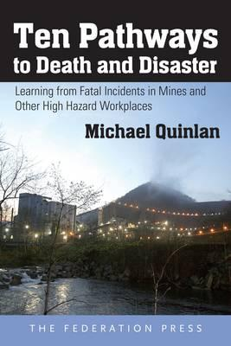
Last year’s roadshow
Mining accident data since 1992 in 5 countries:
Australia, Britain, Canada, New Zealand and USA
46 fatal or multiple fatality accidents
Engineering, design and maintenance flaws
Failure to heed warning signs
Flaws in risk assessments
Flaws in management systems
Flaws in system auditing
Economic and reward pressures compromising safety
Failures in regulatory oversight
Worker or supervisor concerns that were ignored
Poor worker-management communication and trust
Deficiencies in emergency and rescue procedures
M. Quinlan (2014), Ten Pathways to Death and Disaster: Learning from fatal incidents
in mines and other high hazard workplaces, Federation Press, Sydney
Notes:
In 2017, as a response to the number of fatal accidents in the industry the presenter had investigated who around the world had conducted research into the factors that contributed to fatal accidents in mining operations.
It eventuated that the leading research had been compiled by Professor Michael Quinlan from the University of New South Wales, and published in his book, 10 Pathways to Death and Disaster. Quinlan had identified 10 recurring themes from 46 accidents that eventuated in fatalities (the themes are listed on the slide).
In 2017 the audience members were asked a series of questions about how their workplace was “performing” against each of the 10 factors identified in Quinlan’s research. The audience were asked to rank from 0 (poor) to 10 (excellent) for each factor. This data has also been provided to ECU for analysis.

Slide 11
Last year’s roadshow: Pathways to disaster
703 of you filled in a questionnaire concerning these pathways in your own organisation.
Score from 0 (poor) to 10 (excellent)
13 Roadshow locations
Mean scores were between 6 and 8 (out of 10)
Mine sites had less variety than town locations;
Likely due to people from different organisations.
Best scores concerned with:
Effectiveness of risk assessments (mean = 7.5); and
Safety before production (mean = 7.3)
Notes:
The best mean scores were found to be effectiveness of risk assessments (an interesting result seeing as the personal training questionnaire indicated that more training on risk assessment was required) and that audience members felt very confident that they could stop work on a safety issue and would be supported by their immediate manager.
The audience was asked, via a show of hands whether the stop work sentiment had continued into 2018. Overwhelmingly, audiences in all Roadshow events agreed that they felt confident to stop work, therefore validating the 2017 findings.

Slide 12
Last year’s roadshow: Pathways to disaster
Equal 2nd lowest score from Design and Maintenance
Mean = 6.1
Equipment designed and maintained to remove hazards;
Indicates latent risk.
Lowest score was Auditing Management Systems
Mean = 5.8
Checking system design & effectiveness to control risk;
Indicates complacency.
Notes:
The worst scores were associated with Design and Maintenance of Plant and Equipment. The ECU researchers have indicated that this is means latent risk is building in the industry, increasing the possibility of catastrophic failure of plant and equipment.
The lowest score was for Auditing Management Systems, with the ECU researchers (well before the Roadshow and Registered Manager’s forums) concluding that this represents a build up of complacency.
Interestingly, this is precisely what the audience members had fed back to the forums via the Word Cloud exercise in the morning session (refer to Presentation #1).

Slide 13
DMIRS findings
DMIRS analysis of fatal incidents has been summarised on our hazard register.
“Precautions and preventative measures” include similar findings to Quinlan.
The analysis and last year’s survey results shows weaknesses in the design and implementation of safety management systems.
DMIRS legal team have:
Detected similar weaknesses; and
Suggested a small bank of questions to be asked of registered managers and responsible persons.
Notes:
The Departments’ Investigations team were asked to review the Quinlan survey findings from the 2017 Roadshow events. The Investigations team (who are often involved in accidents that end in Court) had found very similar contributing factors to those in the 2017 survey.
The Investigations team advocated taking a proactive response to the 2 sets of findings – to advise those in decision making roles of the findings, and in order to start a conversation about their risk management approach, proposed a series of questions that industry should be asking of those in decision making capacity.

Slide 14
DMIRS recommended questions: Audit and monitoring
What safety monitoring is conducted at your mining operation?
Does the monitoring include safety system audits?
How often are they conducted?
Where are they documented?
Are the persons that conduct the audits competent?
How do you know?
What personal measures do you take to monitor compliance:
With the legislation and
With the safety management plan?
Where are the measures documented?
Could you validate your safety monitoring activities to a court?
Notes:
There are 3 critical questions that get asked of every senior decision maker who is required to give evidence to the DMIRS Investigation team. The second and third questions have follow-up questions.
It is strongly recommended that SHReps take these questions to a Committee meeting and that in turn the be asked of Senior Decision Makers so that they can lead the safety performance improvement initiatives at their mining operations.

