Slide 1
Please read this before using presentation
This presentation is based on the content presented at the 2019 Health and Hygiene Forum in June 2019.
Department of Mines, Industry Regulation and Safety (DMIRS) supports and encourages reuse of its information (including data), and endorses use of the Australian Governments Open Access and Licensing Framework (AusGOAL)
This material is licensed under Creative Commons Attribution 4.0 licence. We request that you observe and retain any copyright or related notices that may accompany this material as part of attribution. This is a requirement of Creative Commons Licences.
Please give attribution to Department of Mines, Industry Regulation and Safety, 2019.
For resources, information or clarification, please contact: SafetyComms@dmirs.wa.gov.au or visit www.dmirs.wa.gov.au/ResourcesSafety

Slide 2
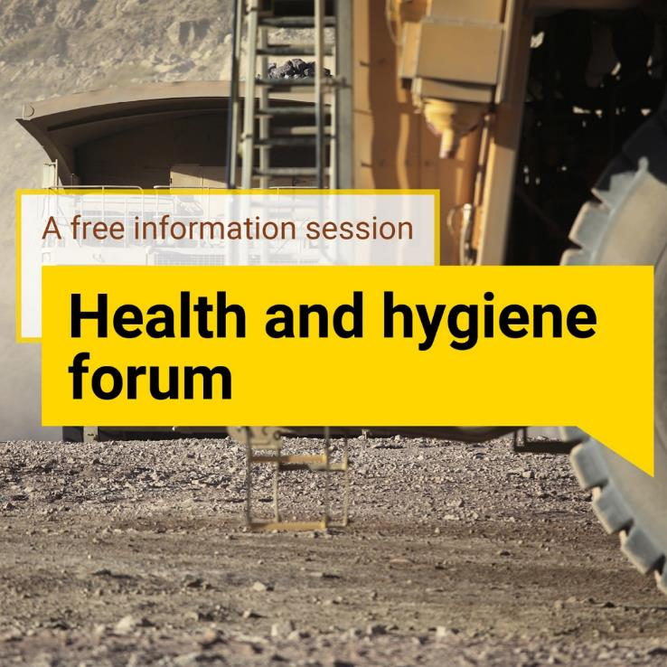
2019 Health and hygiene
forum

Slide 3
What the data tells us about silica

Slide 4
Silicosis in mining
Lung disease characterised by inflammation and fibrosis of the lungs
Caused by exposure to respirable crystalline silica
Development of silicosis in miners usually takes 10-20 years from the first exposure
Clinical Types
Chronic – long latency – 10 - 20 years of exposure at >0.5mg/m³, often accompanied with chronic bronchitis
Accelerated – after two to 10 years – rapid clinical signs – radiological progression to PMF
Acute – within weeks to two years from high exposures to dusts with high silica concentrations
Silicosis can be prevented BUT there is no cure!

Slide 5
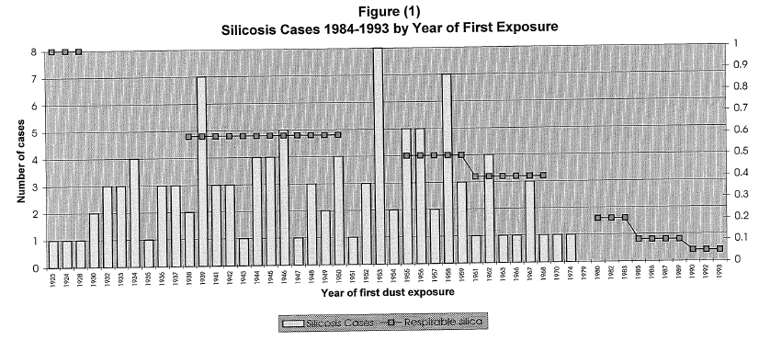
Year of first dust exposure
Silicosis cases Respirable silica concentrations
Source: Wan & Lee (1996) Silicosis in Western Australia from 1984 to 1993. Poster presented at Australian National Scientific Forum on Crystalline Silica, 9 November 1993.
Notes:
In 1996, Drs Wan and Lee reviewed all 110 cases of silicosis that had been certified for workers’ compensation by the WA Pneumoconiosis Medical Panel during the ten year period of 1984 and 1993 to see if there was any relationship with their exposures to airborne respirable crystalline silica. They identified that previously cases were reported by the year of their diagnosis, rather than considering when the affected people would have first been exposed to respirable silica at work.
They found that there had not been any compensable cases of silicosis in mineworkers who started working after 1974. They attributed this finding to reduced exposure levels reported after 1976, corresponding to establishment of the Ventilation Board that required improved controls and regular standardised monitoring of atmospheric dusts and increased vigilance and direction from the mining inspectorate. They wrote “No miner has developed silicosis since the advent of the Ventilation Board in 1974.” Further they emphasised that the incidence of silicosis in the WA shows a progressively declining trend. ….”New cases still arising as a legacy of the past have all been accounted for, new incidences of the disease will have been virtually eradicated.

Slide 6
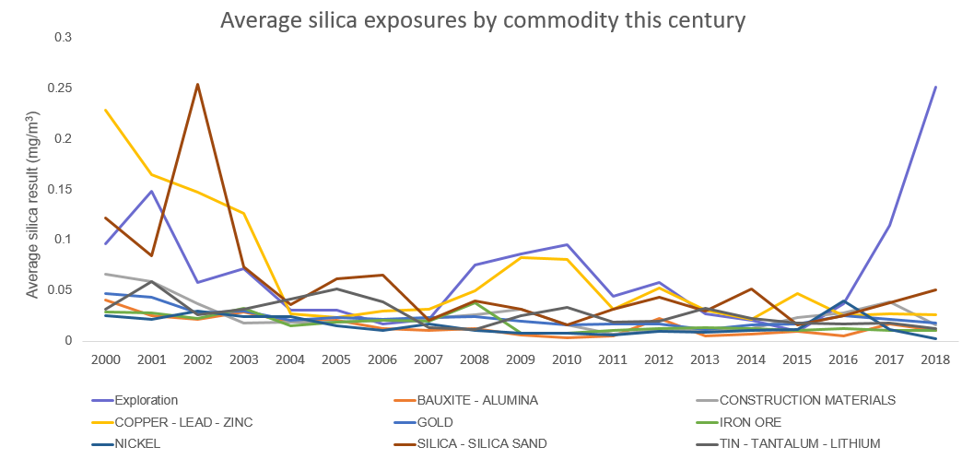
Notes:
This graph shows average respirable crystalline exposure levels for commodities exploited by several companies and sites.
The exploration line peaks at 2017 and 2018 jumped out to me as well, and when I explored this I noticed that there are only four exploration samples submitted in these years. The reason I didn’t delete the line, is because I have been asked to provide advice to exploration companies on what I know about exploration ores – clearly not very much, apart from the fact that exposure levels fluctuate from year to year.
This is pretty much the same for all sites and commodities, which is why we need to take some measurements.
The other interesting line in this graph is the yellow line. We can see from this graph that there has been a reduction in the average exposures. From scrutinizing these results that means that there are fewer incidences of very high exposures to silica. However, the frequency of exposures above the exposure standard are interesting.

Slide 7
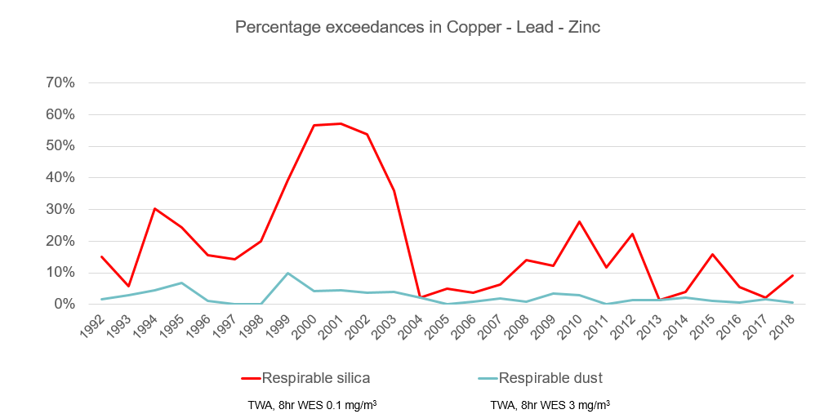
Notes:
If we focus more on the percentage of exceedances, rather than average exposures over the years (note this graph projects back to 1992), we see that there have been improvements, but the proportion of samples that exceed the exposure standard each year are often greater the 5%. This is the arbitrary acceptable level of exceedances.
Also I want to point out that this graph indicates that exposures to respirable crystalline silica do occur at significant levels even when respirable dust levels appear to be well controlled and are less than the respirable dust exposure standard.

Slide 8
Some commodities are more likely to exceed the SIL ES (since 1999)
COMMODITIES | No. >ES | No. samples | % >ES
COPPER - LEAD – ZINC | 443 | 2,572 | 17.2%
DIATOMITE – SPONGOLITE | 6 | 36 | 16.7%
EXPLORATION | 234 | 1,588 | 14.7%
SILICA - SILICA SAND | 124 | 1,040 | 11.9%
MANGANESE ORE | 36 | 431 | 8.4%
GOLD | 2,742 | 34,722 | 7.9%
CONSTRUCTION MATERIALS | 303 | 3,915 | 7.7%
TIN - TANTALUM – LITHIUM | 128 | 2,083 | 6.1%
GRAND TOTAL | 4,802 | 81,900 | 5.9%
Only commodities with more than 5% exceedance of exposure standards (WES) or regular sampling, are included in this table.
Notes:
This table shows the commodities that have the highest frequencies of exceedances to the current silica exposure standard. Data extracted for 1999 onwards

Slide 9
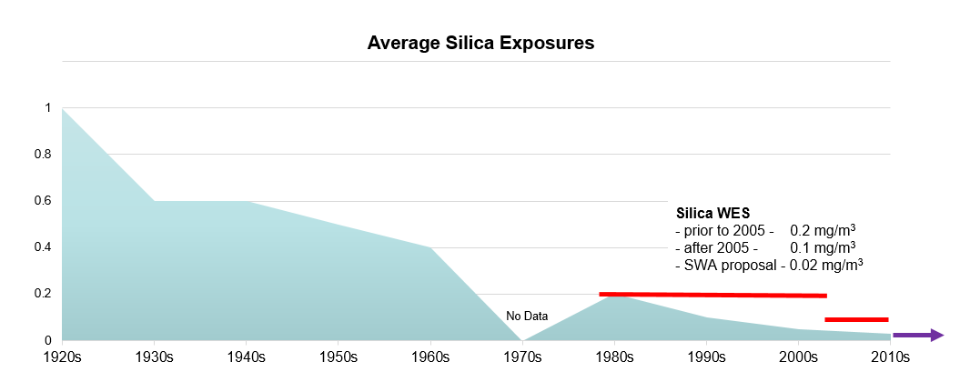
Historical exposures to respirable crystalline silica
url:ourdocs:Central/005301.Resources.Safety
Notes:
From what we have discussed already, average industry exposures, smoothens out the very high results with the multitude of samples that come in below the limit of detection.
Since 1993, the WES of 0.2mg/m3 RCS was reduced in 2005 to 0.1mg/m3.
No further cases of silicosis were certified by workers’ compensation, and despite four individuals being identified with characteristic silicosis nodules from chest x-ray, they were either asymptomatic, worked in mines outside of Western Australia some 20-25 years before the identifying chest x-ray or had significant smoking history (the youngest at 45 had a smoking history of 65 pack years) with only 7 years in mining. Therefore direct diagnosis was not attributable to working in mining.

Slide 10
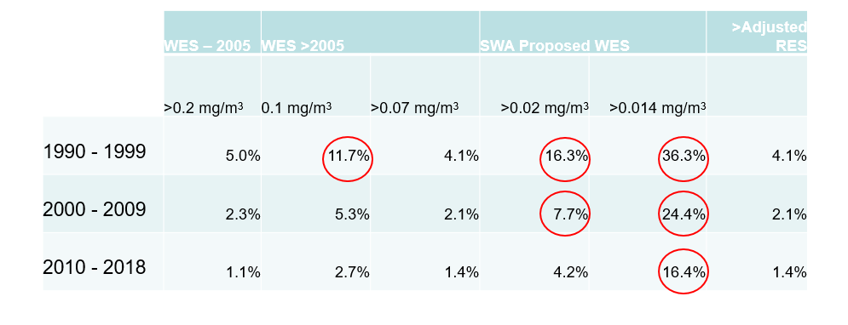
Percentage of all silica measurements since 1990
Notes:
What does the data tell us here?
5% of all silica samples in the 1990s exceeded the exposure standard of the day. If we assume that the standard proportionally outlines risk of developing disease, then we could extrapolate that we would expect an increase in incidence of disease in miners …. But we don’t!
We still have some higher risk commodities and higher risk work, but better atmospheric sampling and verification with health surveillance of these groups is necessary before we can be sure of this.
So keep sampling and follow up on your health surveillance programs to confirm that your controls are working.

Slide 11
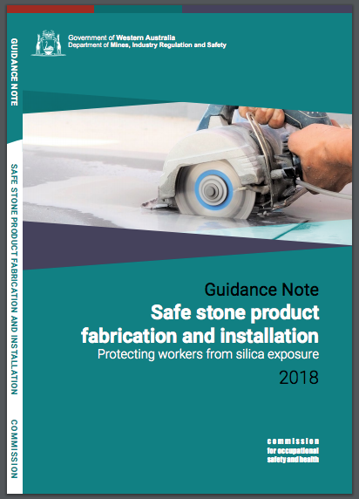
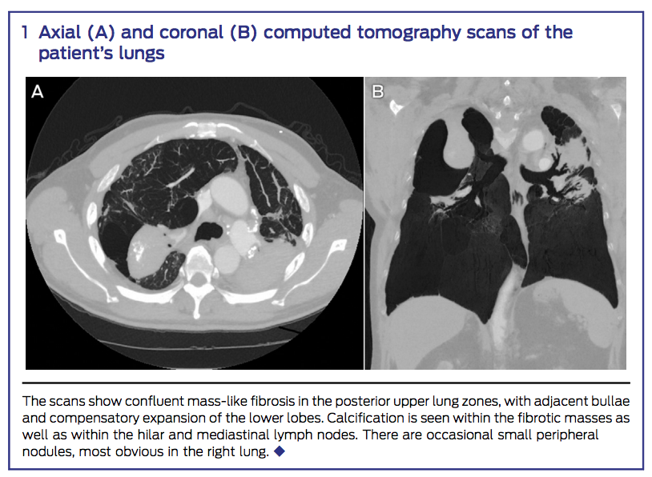
Stone benchtops and silicosis
Matar et al. (2017) Complicated silicosis resulting from occupational exposure to engineered stone products. Medical Journal of Australia.206:9:385-386.
Notes:
There is more to the story.
Silicosis has reappeared in WA. At this stage mainly amongst people who have been working in construction, building stone benchtops comprised of between 85-95% silica.
WorkSafe have produced the guidance note that we recommend you make sure all your friends and family know about – particularly if they are building, renovating, or have family in the construction business.

Slide 12
DMIRS contacts
1 800 SAFE MINE (1 800 7233 646)
Email: MinesSafety@dmirs.wa.gov.au

Slide 13
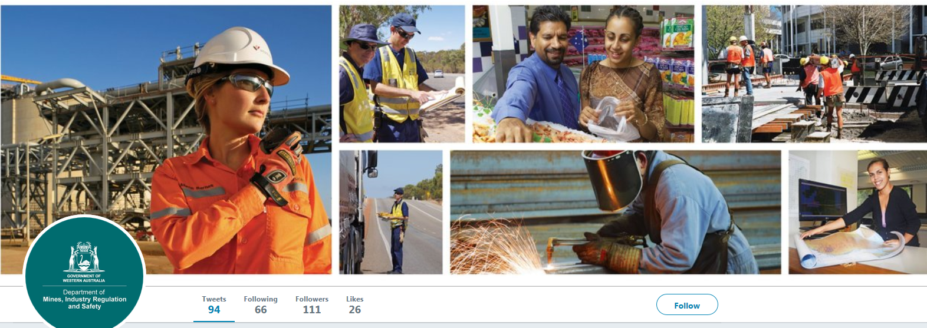
Follow us on social media
Twitter
@DMIRS_WA
@AndrewChaplyn
LinkedIn at Department of
Mines, Industry Regulation and Safety
Notes:
Add slide about awards

