Slide 1
Please read this before using presentation
This presentation is based on content presented at the 2015 Mines Safety Roadshow in October 2015
The Department of Mines and Petroleum (DMP) supports and encourages reuse of its information (including data), and endorses use of the Australian Governments Open Access and Licensing Framework (AusGOAL)
This material is licensed under Creative Commons Attribution 4.0 licence. We request that you observe and retain any copyright or related notices that may accompany this material as part of attribution. This is a requirement of Creative Commons Licences.
Please give attribution to Department of Mines and Petroleum, 2015.
For resources, information or clarification, please contact:
RSDComms@dmp.wa.gov.au or visit
www.dmp.wa.gov.au/ResourcesSafety

Slide 2
Why is falling from height a problem?
A global perspective (be thinking controls)
Notes:
The purpose of this presentation is to share information about how common falling from height is.

Slide 3
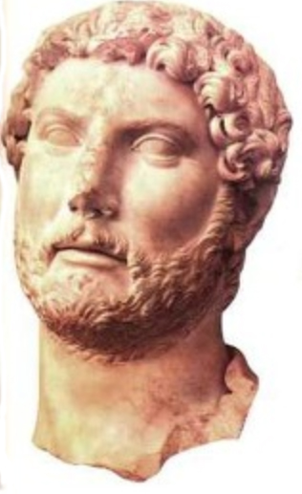
Quote
The wise man corrects his own errors by observing those of others.
Publilius Syrus
Notes:
This quote comes from about 50 BC. The applicability of this quote remains unchanged. We need to learn!

Slide 4
What are we talking about today?
How does the rest of the world compare
Australian statistics
Heights for fatalities
Probability of death
Videos
Technical
Personal stories
A workshop where you will be providing your ideas on what YOU think we can do different

Slide 5
What do I know about mines?
Notes:
This slide was sourced from another presentation – the original presenter is from this region in the United States (US).
For the purpose of comparison to Western Australia, each red dot is a mine – primarily underground.
The presenter shared how in one event, 91 miners died at the Sunshine Mine. In another accident at the Bunker Hill complex, 17 died in a single event from a rock fall.
The number of fatalities in the US mining industry is far greater than the Western Australian mining industry.

Slide 6
United States numbers
1978 – 288,165 employees with 136 deaths
2013 – 251,263 employees with 21 deaths
approximately 2 x Western Australia
Reference: msha.gov
Notes:
Here we are comparing number of employees in mining.
Note: These are metalliferous mining statistics (i.e. does not include coal mining).

Slide 7
Comparison of fatality rates
Notes:
Both countries have improved, however there is room for continued improvement.

Slide 8
World Health Organisation
Each year an estimated 424,000 individuals die from falls
37.3 million falls are severe enough to require medical attention
Non-fatality falls are responsible for over 17 million disability-adjusted life years lost
Note: Data set is for all people worldwide, not limited to occupational
Reference: WHO Fact Sheet No 344, October 2012
Notes:
This data is on falls worldwide, from all population.

Slide 9
Some Australian statistics
Australian companies lose over 108,000 recordable days per annum and the average days lost time due to a fall is 93 days (2009-2010 statistics)
Over 32% result in a serious injury
Fire and Safety Australia
Notes:
Data us on all Australian industry. Emphasis is on lost time rate.

Slide 10
How high?
Nearly half of falls that resulted in a fatality involved distances of three metres or less in the eight years 2003 to 2011
Of 232 fatalities in Australia from falls:
1 m or less 11 (5%)
>1 to 2 m 52 (22%)
>2 to 3 m 39 (17%)
>3 to 4 m 22 (9%)
>4 m 109 (47%)
Safe Work Australia October 2013

Slide 11
How high? (continued)
Safe Work Australia October 2013

Slide 12
Probability of death (from height)
Number of mining fatalities from 2008 to 2011 was 5 (5th in all industries)
Fatality rate for mining was 0.72 deaths per 100,000 workers (3rd in all industries)
WA fatality rate is 0.53 deaths per 100,000 workers, highest in Australia (national average is 0.25)
Safe Work Australia October 2013
Notes:
How likely a person is to die from falling in the mining industry.

Slide 13
Why are we still getting it wrong?

Slide 14
Hazard awareness videos – Falling from height
Notes:
The Falling from height video, is the first of two in the Know your hazards: Down to earth series.
The first video explains why falls from height – whether a stumble of a few centimetres or a fall of metres – can have serious outcomes. The perception of what heights are ‘safe’ is challenged and the effect on the human body is explained.
www.dmp.wa.gov.au/Safety/Hazard-awareness-videos-16435.aspx
Note: Videos may be shared or downloaded from vimeo.com and distributed for educational purposes.

Slide 15
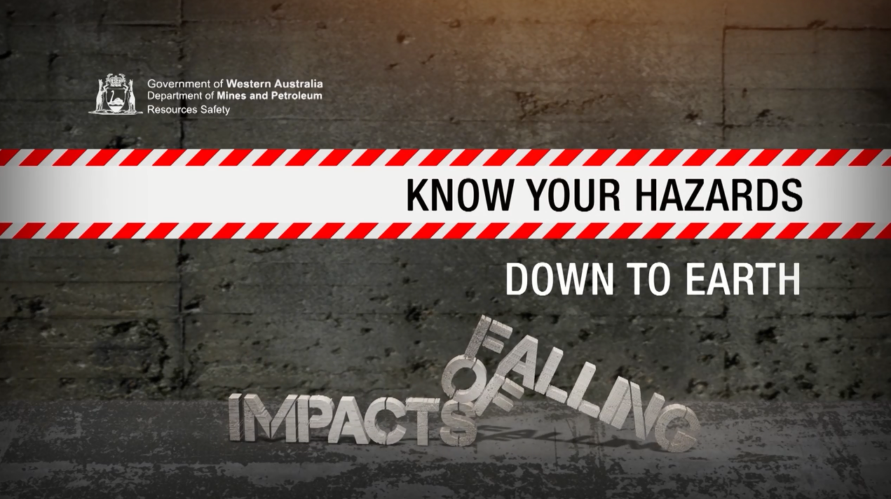
Hazard awareness videos – Impacts of falling
Notes:
The Impacts of falling video, is the second of two in the Know your hazards: Down to earth series.
The second video explores the potential social ramifications of a fall from height on a person’s career, relationships, hobbies and mental health, as well as their family and friends. Three people affected by the consequences of a fall from height at work generously share their stories to raise awareness of the impact of workplace accidents.
www.dmp.wa.gov.au/Safety/Hazard-awareness-videos-16435.aspx
Note: Videos may be shared or downloaded from vimeo.com and distributed for educational purposes.

Slide 16
Summary
We looked at some statistics
We are in an industry that has proven that you have a higher chance for death if you fall
Given you a chance to ponder why we are still getting it wrong

