Slide 1
Please read this before using presentation
This presentation is based on the content presented at the 2019 Exploration Safety Forum in May 2019.
Department of Mines, Industry Regulation and Safety (DMIRS) supports and encourages reuse of its information (including data), and endorses use of the Australian Governments Open Access and Licensing Framework (AusGOAL)
This material is licensed under Creative Commons Attribution 4.0 licence. We request that you observe and retain any copyright or related notices that may accompany this material as part of attribution. This is a requirement of Creative Commons Licences.
Please give attribution to Department of Mines, Industry Regulation and Safety, 2019.
For resources, information or clarification, please contact: SafetyComms@dmirs.wa.gov.au or visit www.dmirs.wa.gov.au/ResourcesSafety

Slide 2
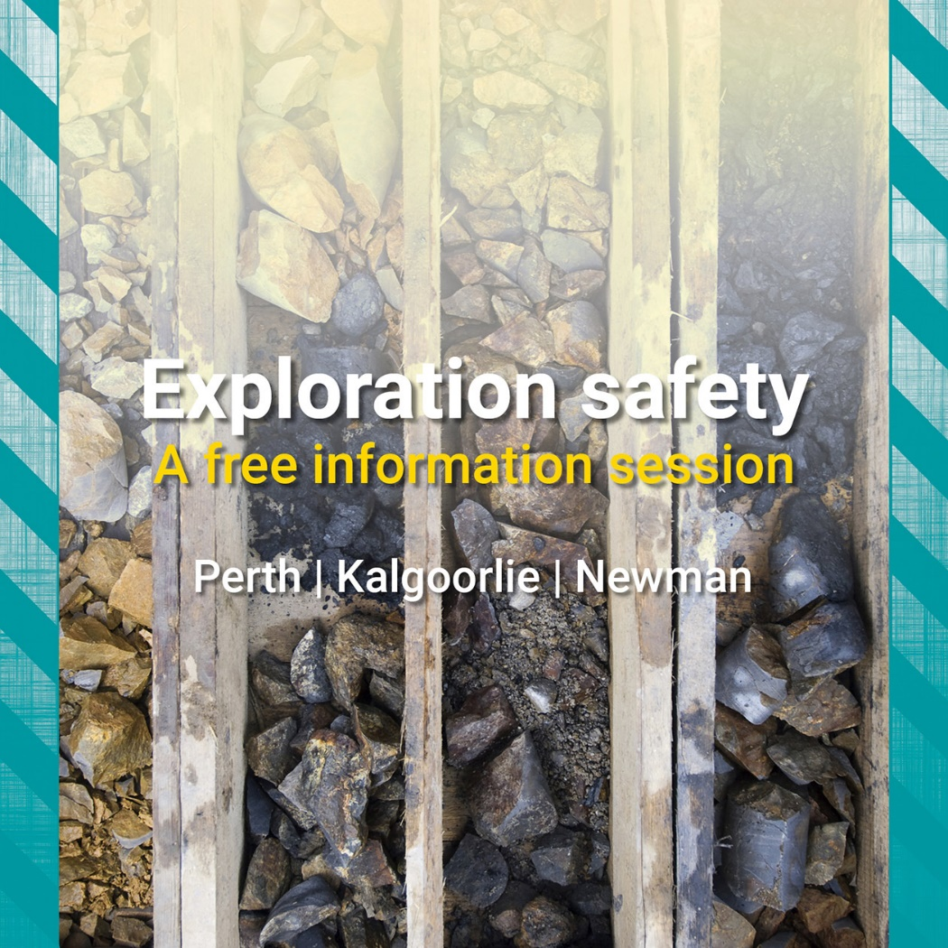
2019 Exploration Safety Forum

Slide 3
Mineral exploration drilling – Code of practice
Significant incident report case study and workshop
Notes:
Welcome to the workshop today we will be using a case study to work our way through the Mineral Exploration Drilling – Code of Practice

Slide 4
Code of practice
This workshop is a learning tool on how an exploration site can use the Mineral Exploration Drilling – Code of Practice to identify the hazard’s, assess the risk’s and risk controls that can be put in place.
http://www.dmp.wa.gov.au/Safety/Codes-of-practice-16145.aspx
Part 1: Risk Management Approach
Part 2: Drilling Hazards
Part 3: Emergency Preparedness
Notes:
The Mineral Exploration Drilling – Code of Practice comprises of three parts
1.Risk Management Approach,
2. Drilling Hazards
3. Emergency Preparedness.
In this workshop we will be exploring Part 2 Drilling Hazards of the Code of Practice as a practical guide in the workplace to mitigate hazards .
The workshop will be using a current Significant Incident Report (SIR) that is available on the DMIRS website as a case study.

Slide 5
Code of practice - Part 2 Drilling hazards
What is the hazard?
What is the risk?
What controls can be put in place?
Notes:
There are three parts to the workshop using the SIR what was the hazard , what are the risks and what controls could be put in place.

Slide 6
Significant Incident Report 257
Note: The Department of Mines, Industry Regulation and Safety’s investigation is ongoing. The information contained in this significant incident report is based on materials received, knowledge and understanding at the time of writing.
Subject Field technician collapses during exploration activities - fatal accident
Date 28th February 2018
In October 2017, two field technicians, based in off-site accommodation, were conducting remote reconnaissance mapping on an exploration tenement in the Pilbara.
Notes:
Read directly
Note: The Department of Mines, Industry Regulation and Safety’s investigation is ongoing. The information contained in this significant incident report is based on materials received, knowledge and understanding at the time of writing.
Subject Field technician collapses during exploration activities - fatal accident
Date 28th February 2018
In October 2017, two field technicians, based in off-site accommodation, were conducting remote reconnaissance mapping on an exploration tenement in the Pilbara.

Slide 7
Significant Incident Report 257
On their first day in the field, after driving over an hour to the tenement, the two technicians parked the vehicle and walked about 16 km in temperatures reaching 36°C.
They returned the next day, parked up, and walked about 18 km in around 7 hours, with the temperature peaking at 37°C.
While returning to their vehicle, one of the field technicians collapsed and became unconscious.
His colleague contacted emergency services and provided treatment but, within a short time, the unconscious field technician stopped breathing and could not be resuscitated.
Notes:
On their first day in the field, after driving over an hour to the tenement, the two technicians parked the vehicle and walked about 16 km in temperatures reaching 36°C.
They returned the next day, parked up, and walked about 18 km in around 7 hours, with the temperature peaking at 37°C.
While returning to their vehicle, one of the field technicians collapsed and became unconscious.
His colleague contacted emergency services and provided treatment but, within a short time, the unconscious field technician stopped breathing and could not be resuscitated.
Please Note: Although this death was reported to the Department of Mines, Industry Regulation and Safety as being non-work related, it was treated as a possible work-related fatality and investigated. In January 2018, it was established that it was a work-related fatality, and the cause of death was associated with dehydration and renal failure.

Slide 8
What is the major hazard?
Notes:
After reading the SIR 257 our first step through this case study is to demonstrate how you could apply it in your operation
From the list of drilling hazards from the COP What is the hazard from the SIR?
Answer: Working in hot environments

Slide 9
Workshop – Case Study
Two discussions
Calling upon table for your group feedback
Using the your own knowledge and expertise…..
Notes:
Now we have identified our hazard our next step is to assess the risks
We’re going to have 2 discussions,
These will be discuss at your tables, you have been allocated 10 minutes to discuss, I will give you a 2 minute warning when your time is almost up and I’ll be calling upon tables to share some feedback with the group

Slide 10
Workshop – Case Study
What risk (direct and contributing) factors can you identify?
Notes:
The first discussion point is using your own knowledge and expertise what risk (direct and contributing) factors can you identify?

Slide 11
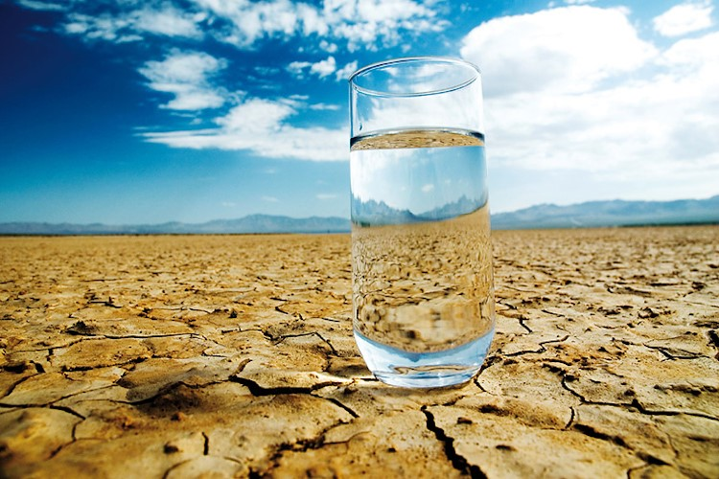
Direct risk factors
Temperature
Radiant heat
Humidity
Wind velocity
Notes:
All of the information is directly from the Code Of Practice part 2 page 26 Working in hot environments.
if you had any of these you are on the right track
Temperature
Radiant heat
Humidity
Wind velocity
Did people have any other direct risk factors please discuss

Slide 12
Contributing risk factors
Extended frequency and duration of exposure
Lack of acclimatisation
Frequency, duration and intensity of physical activity
Certain medical conditions and medications
Lack of physical fitness
Drug and alcohol use
Dehydration
Type and amount of clothing
Notes:
What contributing risk factors did you all come up with (Discuss)
All of the information is directly from the Code Of Practice part 2 page 26 Working in hot environments.
Extended frequency and duration of exposure
Lack of acclimatisation
Frequency, duration and intensity of physical activity
Certain medical conditions and medications
Lack of physical fitness
Drug and alcohol use
Dehydration
Type and amount of clothing

Slide 13
Workshop – Case Study
The second discussion
Discussion 2 – 10 minutes
Using the identified risk factors what are some controls you could implement?
Notes:
Now that you’ve done a great job identifying your risk factors, we can move onto our second discussion identifying the controls
Using the identified risk factors what are some controls you could implement?
Please discuss at your tables again, you have been allocated 10 minutes to discuss, I will give you a 2 minute warning when your time is almost up and I’ll be calling upon tables to share some feedback with the group

Slide 14
Risk controls
Ensure workers are aware of the underlying causes of heat strain, recognise its symptoms and know how to respond.
Personnel at risk from heat stress (e.g. workers with pre-existing medical conditions such as cardiovascular disease or febrile illnesses such as influenza, and workers not acclimatised to site conditions) must be monitored at the workplace:
for signs of heat strain
to ensure that they follow work–rest and hydration regimes.
Provide weather protection (e.g. tents, shade) and cool rest and recovery areas.
Notes:
Again all of this information is from the COP and is only a minimum guide each operation should tailor the controls for them.
Ensure workers are aware of the underlying causes of heat strain, recognise its symptoms and know how to respond.
Personnel at risk from heat stress (e.g. workers with pre-existing medical conditions such as cardiovascular disease or febrile illnesses such as influenza, and workers not acclimatised to site conditions) must be monitored at the workplace:
for signs of heat strain
to ensure that they follow work–rest and hydration regimes.
Provide weather protection (e.g. tents, shade) and cool rest and recovery areas.

Slide 15
Risk controls
Implement acclimatisation policies covering new employees and those returning to work after a break.
Adjust hours of work so that physically demanding work is done in cooler periods of the day, and schedule regular breaks and task rotation.
Where practicable, workers should wear clothing suitable for the environment (e.g. cotton drill fabric).
Notes:
Implement acclimatisation policies covering new employees and those returning to work after a break.
Adjust hours of work so that physically demanding work is done in cooler periods of the day, and schedule regular breaks and task rotation.
Where practicable, workers should wear clothing suitable for the environment (e.g. cotton drill fabric).

Slide 16
Notes:
This is the published SIR 257

Slide 17
Direct causes:
Inadequate hydration and management of heat exposure during field work on both days.
Notes:
The findings from the investigation were
Direct causes:
Inadequate hydration and management of heat exposure during field work on both days.

Slide 18
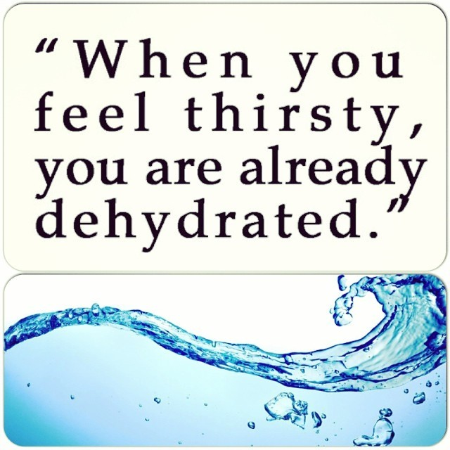
Contributory causes:
Neither the heat stress management plan or procedures were adequate.
There was no system to train or assess workers supervising or conducting reconnaissance.
Work in remote locations (e.g. extreme temperature conditions).
Notes:
Contributory causes:
Neither the heat stress management plan or procedures were adequate.
There was no system to train or assess workers supervising or conducting reconnaissance.
Work in remote locations (e.g. extreme temperature conditions).

Slide 19
Contributory causes:
The fitness-for-work assessment process did not adequately address the capacity of Individual workers to undertake field work.
Hydration testing was not conducted prior to undertaking field work.
A task-based risk assessment (e.g. job hazard analysis, JHA), was not performed before starting field work.
The field technicians were unable to access a suitable cool-down area during field work (e.g. an air-conditioned vehicle).
Notes:
Contributory causes:
The fitness-for-work assessment process did not adequately address the capacity of Individual workers to undertake field work.
Hydration testing was not conducted prior to undertaking field work.
A task-based risk assessment (e.g. job hazard analysis, JHA), was not performed before starting field work.
The field technicians were unable to access a suitable cool-down area during field work (e.g. an air-conditioned vehicle).

Slide 20
Actions required:
Review heat stress management plans and procedures to confirm they address risk factors such as frequency and duration of exposure, acclimatisation, frequency and duration and intensity of physical activity, and medical conditions and medications.
Notes:
Actions required:
Resulting from this SIR there was around 6 recommended actions these included to operations to reduce the potential for incidents involving heat stress.
Review heat stress management plans and procedures to confirm they address risk factors such as frequency and duration of exposure, acclimatisation, frequency and duration and intensity of physical activity, and medical conditions and medications.

Slide 21
Actions required:
When planning field work, establish appropriate work–rest, acclimatisation and hydration regimes to address the risks posed by the environment (e.g. temperature extremes, terrain).
Confirm that supervisors and workers are aware of the underlying causes of heat strain, recognise its symptoms and how to respond.
Supervisors to review the risk-based field work plan before work commences.
Notes:
Actions required:
Resulting from this SIR there was around 6 recommended actions these included to operations to reduce the potential for incidents involving heat stress.
When planning field work, establish appropriate work–rest, acclimatisation and hydration regimes to address the risks posed by the environment (e.g. temperature extremes, terrain).
Confirm that supervisors and workers are aware of the underlying causes of heat strain, recognise its symptoms and how to respond.
Supervisors to review the risk-based field work plan before work commences.
Supervisors to regularly monitor workers in the field and environmental conditions, and review the work plan if there are changes.
Workers to undertake a risk assessment for daily task before commencing work, and review if conditions change.

Slide 22
Actions required:
Supervisors to regularly monitor workers in the field and environmental conditions, and review the work plan if there are changes.
Workers to undertake a risk assessment for daily task before commencing work, and review if conditions change.
Notes:
Actions required:
Supervisors to regularly monitor workers in the field and environmental conditions, and review the work plan if there are changes.
Workers to undertake a risk assessment for daily task before commencing work, and review if conditions change.

Slide 23
Summary
Anticipate and recognise hazards
Assess the probability and severity of harm that may arise and
Identify and implement appropriate controls.
Guidance about heat and thermal stress management:
www.dmp.wa.gov.au/Safety/Guidance-about-heat-and-thermal-6968.aspx
Notes:
That is the end of the workshops today I hope it gave you some clarity on how easy it is to identify the hazards, assess the risk and identify and implement appropriate controls for your organisation.
The Mineral Exploration Drilling Code of Practice is a practical guide of 20 hazards that are found in exploration drilling sites. The COP that can be used as a starting place for sites to expand from.

Slide 24
Useful resources
Webpages
Guidance about working in remote areas
Guidance about travelling for work
Guidance about exploration hazards
Guidance about working alone
Guidance about heat and thermal stress management
Risk management approach to emergency preparedness
Developing emergency response plans
Guidance for mine sites, exploration camps and construction villages
Notes:
Some useful resources

Slide 25
DMIRS contacts
1 800 SAFE MINE (1 800 7233 646)
Email: MinesSafety@dmirs.wa.gov.au
Notes:
DMIRS contacts

Slide 26
Follow us on social media
Twitter
@DMIRS_WA
@AndrewChaplyn
LinkedIn at Department of
Mines, Industry Regulation and Safety
26
Notes:
Add slide about awards

