Slide 1
Health and Hygiene Sampling
Safety Regulation System (SRS)
Industry Awareness session May 2017
www.dmp.wa.gov.au/ResourcesSafety

Slide 2
Session objectives
An overview of Health and Hygiene Sampling
Sampler registration requirements
SRS security role requirements
The process of submission of samples
Case scenarios - atmospheric sample submissions
Contributory factors and how to action them
Health Management Regime (HMR) for a mine site / exploration company
Notes:
Information referred to in the PowerPoint applies to mining and exploration companies

Slide 3
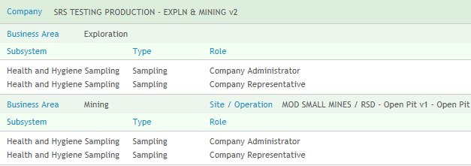
SRS security roles
Business areas: Mining / Exploration
Company Administrator or Company Representative security roles for Individual Samples and Bulk Lodgement
Notes:
To submit a sample in SRS the mine site / exploration company must have the appropriate security roles (i.e. business area / type of submission)

Slide 4
Guideline - atmospheric monitoring
Notes:
http://www.dmp.wa.gov.au/Documents/Safety/MSH_G_RiskbasedHygieneMgmtPlanning.pdf

Slide 5
Guideline - biological monitoring
Notes:
http://www.dmp.wa.gov.au/Documents/Safety/MSH_G_RiskBasedHealthSurveillanceAndBiologicalMonitoring.pdf

Slide 6
Guideline – noise monitoring
Notes:
http://www.dmp.wa.gov.au/Documents/Safety/MSH_G_ManagementNoiseWAMiningOperations.pdf

Slide 7
Bulk lodgement
Notes:
Refer DMP website

Slide 8
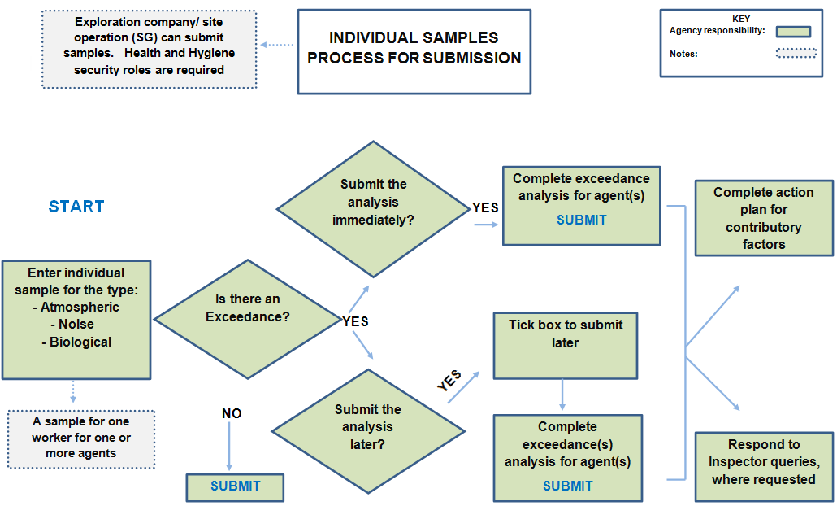
Notes:
The process map for individual sample submissions.

Slide 9
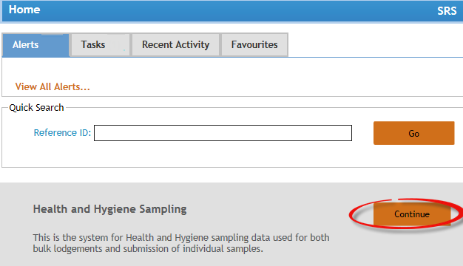
SRS home page

Slide 10
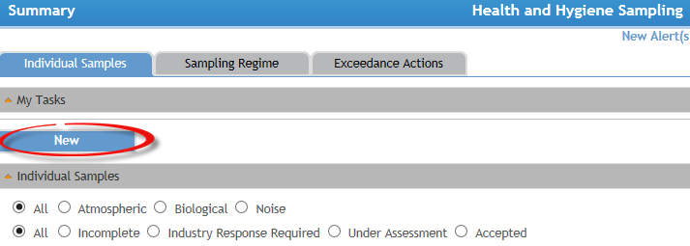
Individual sample lodgement
Notes:
Click New - this takes you to lodgement page
Choose type of sample and Mining or Exploration
Note: Security roles required to lodge a sample.

Slide 11
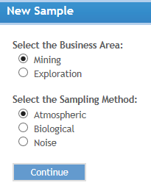
Lodgement
Notes:
Choose Mining or exploration select the sampling method

Slide 12
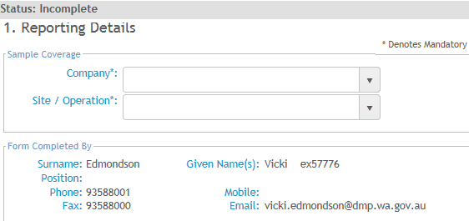
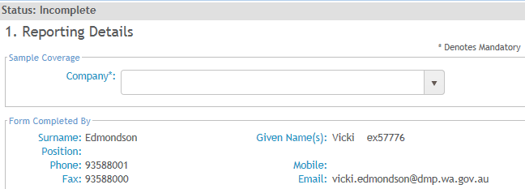
Reporting details
Mining
Exploration
Notes:
Reporting details for Atmospheric
For Mining Add company and site / operation details. The form completed by will be auto populated
For Exploration: Only company name is required

Slide 13
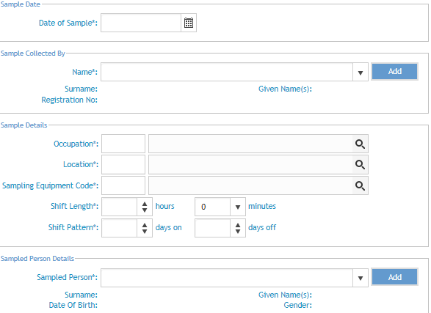
Sample
Notes:
Sample step for Atmospheric
Requires the sample date, name of person who took the sample (sampler), sample details and the sampled person details.
Add date sample was taken.

Slide 14
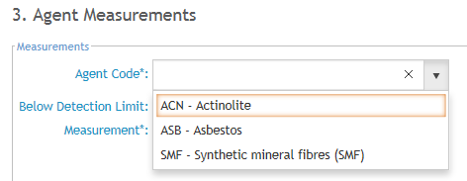
Sampling equipment
Notes:
Sample step for Atmospheric
The sampling equipment code must be added for the type of sample being taken.
Use the search icon to choose.
The sampling equipment chosen will restrict what type of sample to choose from in the agent measurements.
Some equipment can be used for multiple agents
Note: if the sampling equipment is not listed in the drop down contact data services

Slide 15
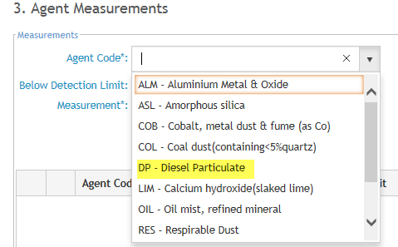
Atmospheric – multiple agents
Notes:
Sample step for Atmospheric
Some sampling equipment in Step 2 (Sample) may be used for multiple agent codes.

Slide 16
Sampled person
Notes:
Sample step for Atmospheric
If a sampled person has been previously sampled for this site they will appear in the drop down.
If not, click Add to add the details on the sampled person – A person added via the ‘ADD’ can be edited.
Note: a person picked from the drop down is not editable.

Slide 17
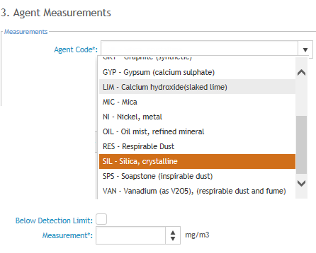
Agent measurements - 1
Notes:
Agent Measurements step for Atmospheric
Choose the agent code from the drop down. This will be related to the sampling equipment code.
Click ‘Below Detection Limit’ box to auto populate the minimum limit in the measurement box.

Slide 18
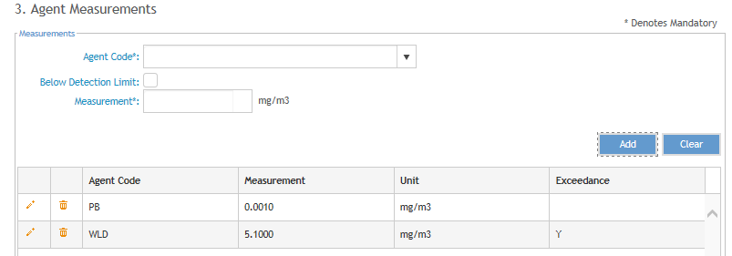
Agent measurements - 2
Notes:
Agent Measurements step for Atmospheric
An agent with measurement below detection limit and an agent with an exceedance

Slide 19
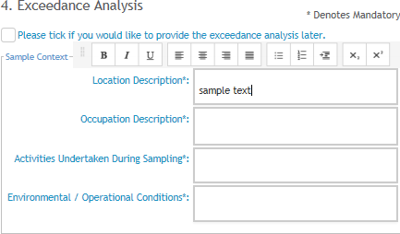
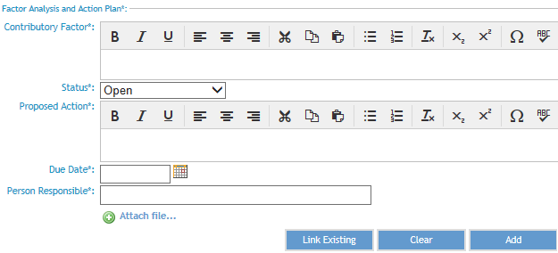
Atmospheric - exceedance analysis
Notes:
Exceedance Analysis step for Atmospheric
Complete mandatory fields – Sample Context, Personal Protective Equipment and Factor Analysis and Action Plan
Note - Tick box to provide the analysis later. The status will change to ‘Industry response required’ which will require completion of this step and submit
Biological Exceedance Analysis
Complete steps as Atmospheric
Personal Protective Equipment will drop down related to biological
Noise Exceedance Analysis
Complete steps as Atmospheric
Personal Protective Equipment will drop down related to Noise

Slide 20
Exceedance analysis - Link Existing
Notes:
Exceedance Analysis step for Atmospheric
‘Link existing’ enables you to add an already existing Contributory factor in the similar exposure group (SEG)

Slide 21
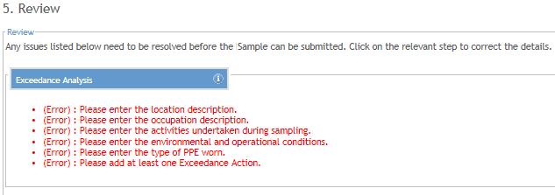
Review
Step with errors
Step with no errors
Notes:
Review step for Atmospheric
If any required information has not been provided this will show under Review step. Click the step to add the information
If any required information has been provided the submission will be flagged as no errors or warnings

Slide 22
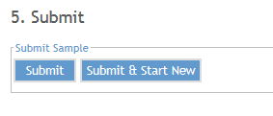
Submit
Notes:
Submit step for Atmospheric
Click submit if only one submission or for the last submission.
‘Submit’ button will only add the one sample.
By using ‘submit and start new’ will create a new sample and will populate the Sample collected by

Slide 23
Exceedance Analysis – Task /Alert
Notes:
Exceedance Analysis for Atmospheric to be completed later
An Alert and Task is generated for a sample submission with an exceedance to be submitted later.
For samples submitted immediately no alert/task is generated.

Slide 24
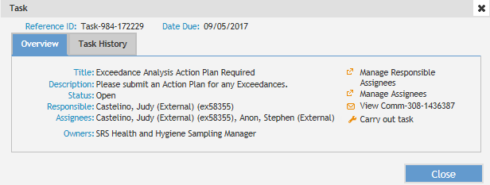
Carry out task
Notes:
Exceedance Analysis for Atmospheric to be completed later
Opening task from the Home page takes you to the task box. Click Carry out task to open up the wizard and complete Exceedance Analysis step.
Submit.

Slide 25
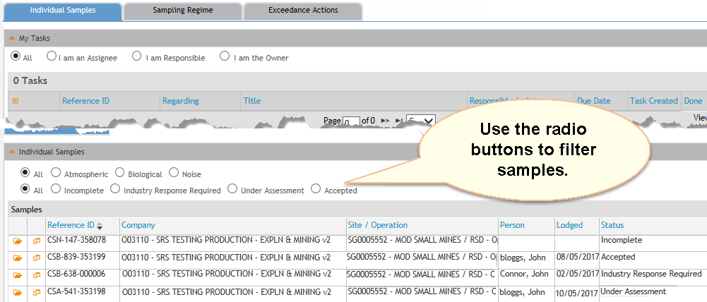
Summary - individual samples
Notes:
Individual Samples summary page
The Summary page shows Individual samples, Sampling regime and Exceedance Actions tabs for the entire company (exploration) / mine site operation (SG)
My Tasks – this shows the exceedance tasks created as a result of sample with an exceedance. Click the spanner icon to action the task. Tasks can be filtered using the radio buttons
From here you can open the sample by clicking open the open folder icon, view the submission using the summary icon and view details of samples in the grid.

Slide 26
Contributory factor (CF)
A Contributory Factor provides an explanation for the cause of an exceedance and is a mandatory entry
Status: Open / Closed / No Action Required
Proposed/completed action plan is required
Contributory Factors can be linked to existing in similar exposure groups (SEGs)
Contributory Factors can be updated only where the sample it is related to, is not in the status of ‘Under Assessment’
Notes:
What are Contributory factors linked to an exceedance?

Slide 27
Status - open
Notes:
Contributory Factor for Atmospheric
Contributory factor fields available in an Open status

Slide 28
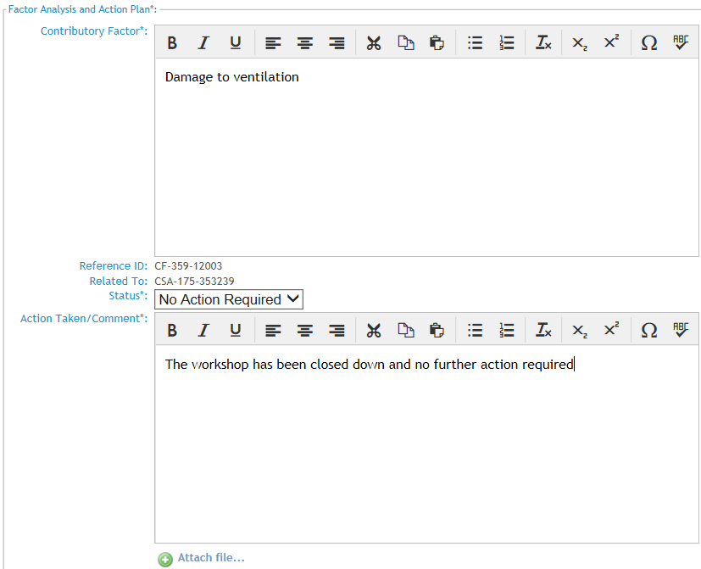
Status – no action required
Notes:
Contributory Factor for Atmospheric
Contributory factor fields available in an No action Required status.

Slide 29
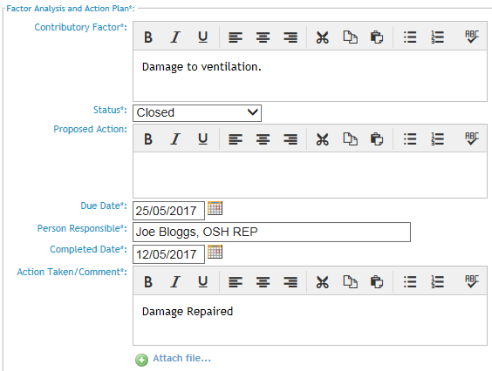
Status - closed
Notes:
Contributory Factor for Atmospheric
Contributory factor fields available in a Closed status.

Slide 30
Edit exceedance actions – 1
Notes:
Exceedance Analysis Action Plan for Atmospheric
Update a contributory factor from the Home Page TASK, for a sample in the status of Industry Response Required.

Slide 31
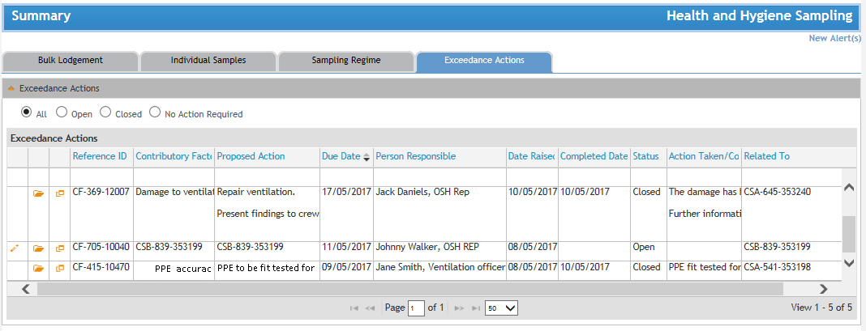
Edit exceedance actions– 2
Notes:
Exceedance Analysis Action Plan for Atmospheric
Update a contributory factor from the Exceedance Actions tab, which is in the status of Open / Accepted or Industry Response Required.

Slide 32
Edit exceedance action - 3
Notes:
Edit Exceedance Action for Atmospheric

Slide 33
Noise - agent measurement
Notes:
Agent Measurements for a Noise Sample
Step 3 – wizard view and fields for a Noise sample submission

Slide 34
Biological - agent measurements
Notes:
Agent Measurements for a Biological Sample
Step 3 – wizard view and fields for a Biological sample submission
Biological: Agent Measurements for the agent Arsenic requires the field ‘Roster Timing’

Slide 35
Further help
Notes:
Agent Measurements for a Biological Sample
Biological: Agent Measurements for the agent Arsenic - Roster Timing

Slide 36
Q&A
Notes:
Agent Measurements for a Biological Sample
Biological: Agent Measurements for the agent Arsenic - Roster Timing

Slide 37
Notes

