Slide 1
International regulatory trends Presentation to WA Petroleum Day 2019
Stuart Smith, CEO
13 September 2019
Notes:
Today I will be providing an overview of issues and trends affecting the Australian offshore energy sector and looking at how these compare internationally.

Slide 2
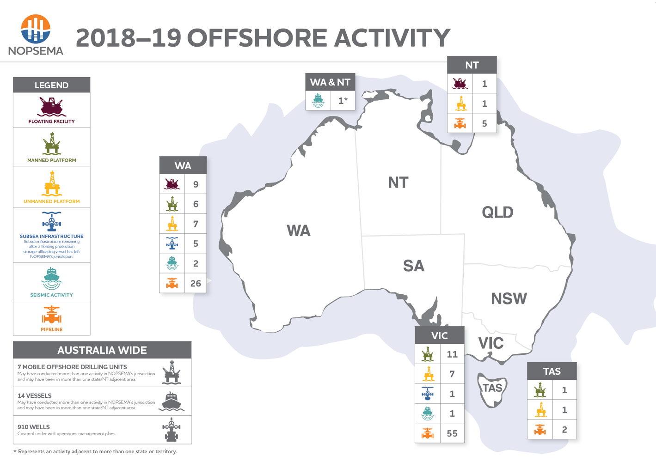
2
Notes:
NOPSEMA is the independent body for regulating Australia’s offshore energy operations with responsibility for protecting worker safety, well integrity and environmental management aspects of individual petroleum activities.
Our goal is to prevent major accident events and ensure the safety of the workforce and protection of the environment
No offshore petroleum activity is without impact but we are committed to applying appropriate measures and controls to reduce impacts to an acceptable level, in accordance with Commonwealth regulations.
In doing so, NOPSEMA makes expert, independent decisions based on science and facts
As you can see the majority of offshore activity occurs off the coast of Western Australia (in the North West Shelf) and off the coast of Victoria (in the Bass Straight)

Slide 3
Industry performance 2018/19
Safety performance generally sound with continued improvement
13.3 million hours worked offshore
386 reports of occupational health and safety incidents
Notes:
In Australia, the offshore industry hasn’t recorded any fatalities in the past six years, however eight serious injuries occurred in 2018
These have been reviewed and there is no suggestion of systematic failures that could result in a Major Accident Event
NOPSEMA remains vigilant in watching for signals of potential Major Accident Events
We are committed to:
-Preventing major accident events
-preventing and managing loss of well control
-improving incident response and source control and;
-improving oil spill response arrangements

Slide 4
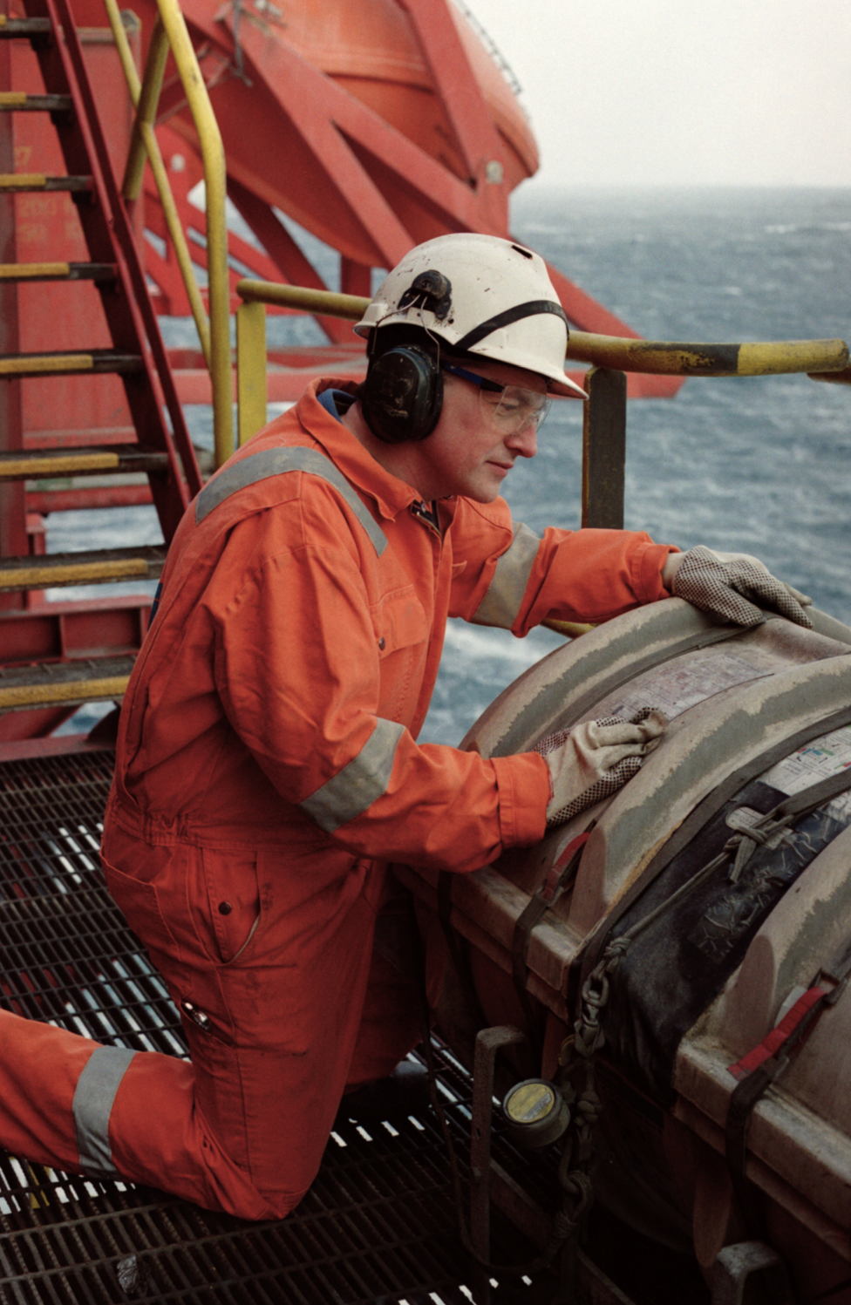
Industry performance 2018/19
529 investigations
180 inspections, up almost 20% on previous year
Issued 29 enforcement actions to address breaches of the legislation
Late life assets a key focus
Notes:
In Australia, the offshore industry hasn’t recorded any fatalities in the past six years, however eight serious injuries occurred in 2018
These have been reviewed and there is no suggestion of systemic failures that could result in a Major Accident Event
NOPSEMA remains vigilant in watching for signals of potential Major Accident Events
We are committed to:
preventing Major Accident Events
preventing and managing loss of well control
improving incident response and source control and
improving oil spill response arrangements

Slide 5
International membership
NOPSEMA represents Australia in the:
International Regulators Forum (and Management Committee)
International Offshore Petroleum Environmental Regulators Group
International Upstream Forum (with NOPTA)
Global Offshore Wind Regulators Forum (GOWRF)
5
Notes:
NOPSEMA participates in leading regulatory forums including:
The international regulators forum (and Management Committee)
The international Offshore Petroleum Environmental Regulators Group
The International Upstream Forum

Slide 6
International engagement
NOPSEMA also:
Presents at international forums that will support regulatory outcomes in Australia
Shares information with fellow regulatory bodies
Undertakes exchanges/secondments with other regulators globally
Cooperates with other regulators on international actions where appropriate
Supports developing nations
Intelligence gathered from international interaction is shared with industry and others
6
Notes:
NOPSEMA also
Presents at international forums that will support regulatory outcomes in Australia
Shares information with fellow regulatory bodies
Undertakes exchanges/secondments with other regulators globally
Cooperates with other regulators on international actions where appropriate
Intelligence gathered from international interaction is shared with industry and others in Australia, including identification of similarities and differences with local experience.

Slide 7
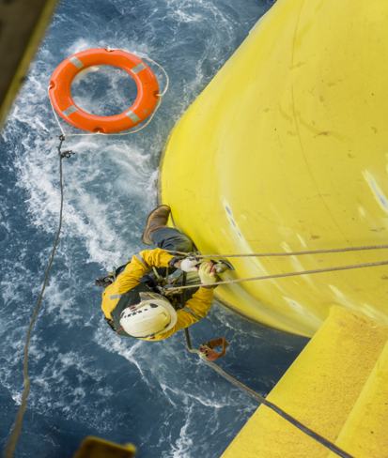
International similarities
Changing risks with scale of late life assets to smaller operators (issues often related to transition)
Important role for international standards in safety outcomes
Trend towards increasing hydrocarbon releases
7
Notes:
-From our interaction with international stakeholders, we have an appreciation of how issues and trends affecting the Australian industry are playing out overseas.
There are key similarities:
Important role for international standards in facilitating safety outcomes
Risks with the scale of late life assets by super majors to smaller operators
Pressure on the industry social licence to operate
Pressure on regulators to take more punitive enforcement actions
Rising community expectations for transparency and consultation
Hydrocarbon releases
Opposition to marine noises (eg seismic)
Offshore wells
Notes of late life assets
When we refer to late life assets, we’re referring to the age of registered offshore facilities
More than half of these are older than 20 years and some exceed 50 years
We are concerned about the growing trend in late life assets being sold of by large, established companies into the hands of much smaller organisations
It’s a concern because many of these smaller organisations don’t have financial capacity for ongoing operations and decommissioning commitments
It’s a concern shared by stakeholders, such as the Department of Industry, innovation and science, with whom we are working to identify potential solutions
Notes on seismic
Marine seismic surveys are another area attracting significant interest from the community, fishers and environmental non-government organisations
Marine seismic surveys are used to determine where there are potential oil and gas deposits
They involve the use of airgun arrays that are towed behind vessels and produce low frequency sounds at regular intervals
These sounds are using to piece together images of the underlying geological formations
In assessing proposals for marine seismic activity, NOPSEMA incorporates latest science to inform understanding while acknowledging that science is ever-evolving
NOPSEMA recognises that seismic surveys can impact the environment and that assessments must be based on a precautionary apporach

Slide 8
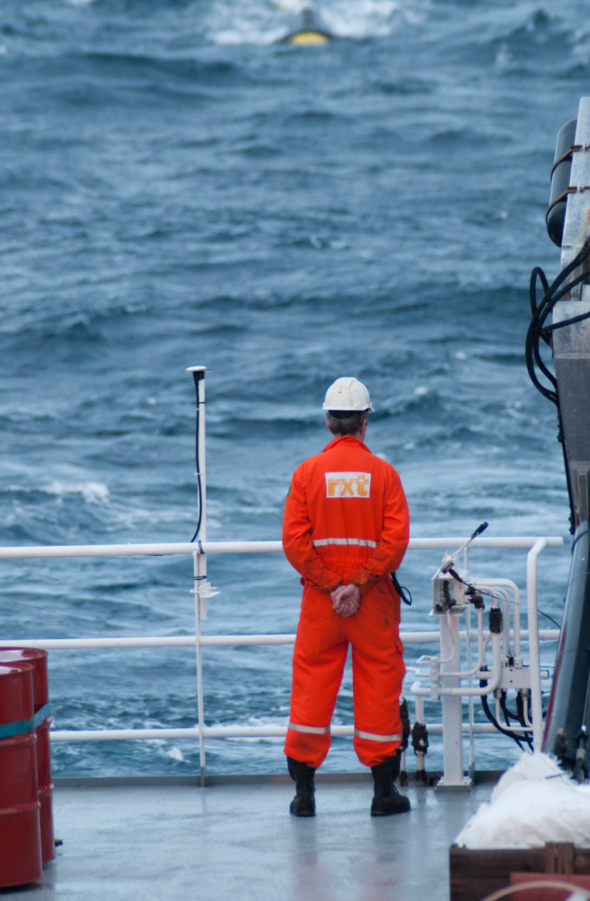
International similarities
Pressure on the industry social licence to operate
Rising community expectations for transparency, consultation and scrutiny
Opposition from fishers and environmental NGOs to seismic activity
Incidents involving contractors
8
Notes:
- From our interaction with international stakeholders, we have an appreciation of how issues and trends affecting the Australian industry are playing out overseas.
- There are key similarities:
Important role for international standards in facilitating safety outcomes
Risks with the sale of late life assets by super majors to smaller operators
Pressure on the industry social licence to operate
Pressure on regulators to take more punitive enforcement actions
Rising community expectations for transparency and consultation
Hydrocarbon releases
Opposition to marine noise (eg seismic)
Offshore wells
Notes of late life assets:
When we refer to late life assets, we’re referring to the age of registered offshore facilities
More than half of these are older than 20 years and some exceed 50 years
We are concerned about the growing trend in late life assets being sold off by large, established companies into the hands of much smaller organisations
It’s a concern because many of these smaller organisations don’t have financial capacity for ongoing operations and decommissioning commitments
It’s a concern shared by stakeholders, such as the Department of Industry Innovation and Science, with whom we are working to identify potential solutions
Notes on seismic:
- Marine seismic surveys are another area attracting significant interest from the community, fisheries and environmental non-government organisations
- Marine seismic surveys are used to determine where there are potential oil and gas deposits.
- They involve the use of airgun arrays that are towed behind vessels and produce low frequency sounds at regular intervals.
- These sounds are used to piece together images of the underlying geological formations.
- In assessing proposals for marine seismic activity, NOPSEMA incorporates latest science to inform understanding while acknowledging that science is ever-evolving
- NOPSEMA recognises that seismic surveys can impact the environment and that assessments must be based on a precautionary approach

Slide 9
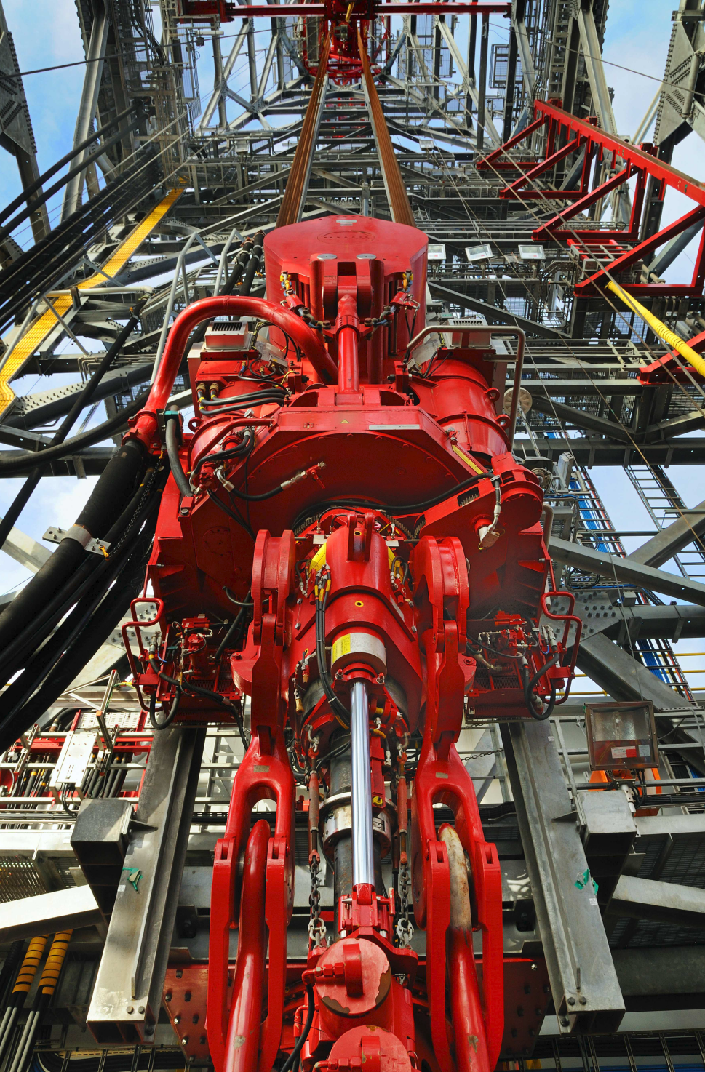
International differences
Industry capacity expansion in Australia
Little improvement internationally on fatalities during recent years
Perpetual liability for offshore facilities
9
Notes:
There are also some key differences:
Little improvement internationally on fatalities during recent years
Offshore wind developments commonplace in overseas jurisdictions
Decommissioning liabilities cannot be transferred
Industry capacity has expanded in Australia with an increase in hours worked in the last year
Notes on offshore wells:
- There are approximately 900 registered wells in Commonwealth Waters and of these, 600 are operational and approximately 300 have been shut-in or suspended
- Many are older than 20 years old and constructed with materials no longer used in the industry
- The majority are found in the Bass Strait and the North West Shelf
- NOPSEMA is working with industry to ensure appropriate plugging and abandonment of these wells is undertaken.

Slide 10
International differences
No time limit in Australia for offshore wells to be plugged and abandoned
Offshore wind regulation and developments often established
10
Notes:
There are also some key differences:
Little improvement internationally on fatalities during recent years
Offshore wind developments commonplace in overseas jurisdictions
Decommissioning liabilities cannot be transferred
Industry capacity has expanded in Australia with an increase in hours worked in the last year
Notes on offshore wells:
- There are approximately 900 registered wells in Commonwealth Waters and of these, 600 are operational and approximately 300 have been shut-in or suspended
- Many are older than 20 years old and constructed with materials no longer used in the industry
- The majority are found in the Bass Strait and the North West Shelf
- NOPSEMA is working with industry to ensure appropriate plugging and abandonment of these wells is undertaken.

