Slide 1
Please read this before using presentation
This presentation is based on content presented at the Industry Forum on Reducing Approval Times: What is “Reasonably Practicable”?, held on 14 November 2014
It is made available for non-commercial use (e.g. toolbox meetings, safety discussions) subject to the condition that the PowerPoint file is not altered without permission from Resources Safety or Graham Bower-White
For information about this presentation, please contact the author
  Graham Bower-White, gbw@tsrhorizons.com
For other information, please contact:
  RSDComms@dmp.wa.gov.au
  or visit
  www.dmp.wa.gov.au/ResourcesSafety

Slide 2
What is “reasonably practicable”?
Graham Bower-White
Executive Director Operations
TSRhorizons Consulting

Slide 3
ALARP – What is reasonably practicable?
Graham Bower-White

Slide 4
Overview
A Reminder
Core Concepts
ALARP – How it works
2-Step Process

Slide 5
A Reminder
MONTARA - 2009
failure to follow good oilfield practice
failure to follow internal procedures
lack of understanding of controls in place
failure to realise that only one effective barrier was in place and that the integrity of that barrier was compromised

Slide 6
A Reminder
MACONDO - 2010
failure to recognise that primary barrier integrity was compromised
failure to conduct appropriate tests on controls in place
poor design of the blowout preventer
failure of the blowout preventer
lack of control of ignition sources

Slide 7
Risk Management
Establishing context
Risk assessment
Risk identification
Risk analysis
Risk evaluation
Communication and consultation
Monitoring and review
Risk treatment
REF: ISO 31000: Risk Management

Slide 8
ALARP Background
‘Reasonably practicable’ is a narrower term than ‘physically possible’ … a computation must be made by the owner in which the quantum of risk is placed on one scale and the sacrifice involved in the measures necessary for averting the risk (whether in money, time or trouble) is placed in the other, and that, if it be shown that there is a gross disproportion between them – the risk being insignificant in relation to the sacrifice – the defendants discharge the onus on them.
UK Court of Appeal (Edwards v. National Coal Board [1949])

Slide 9
ALARP Principle
If a measure is practicable and it cannot be shown that the cost of the measure (in money, time and effort) is grossly disproportionate to the benefit gained; then the measure is considered reasonably practicable and should be implemented.
The criterion is reasonably practicable not reasonably affordable: justifiable cost and effort is not determined by the budget constraints/viability of a project.

Slide 10
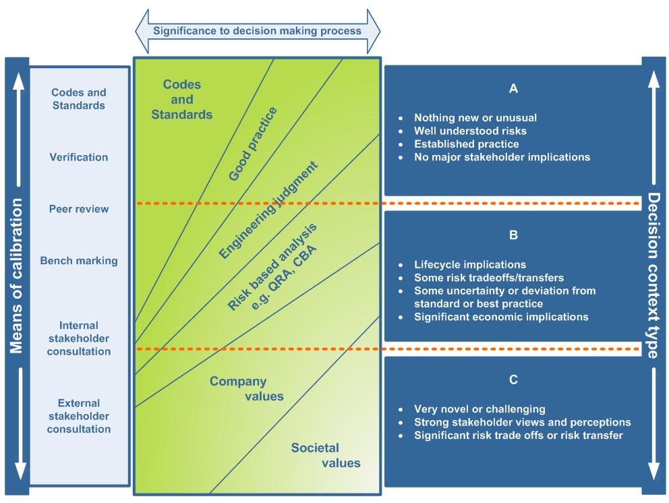
Risk-based Decision Making
REF: NOPSEMA, N-04300-GN0166, ALARP

Slide 11
Safety Case Lifecycle
REF: NOPSEMA, N-04300-GN0166, ALARP

Slide 12
Quantitative Risk Analysis
REF: NOPSEMA, N-04300-GN0166, ALARP

Slide 13
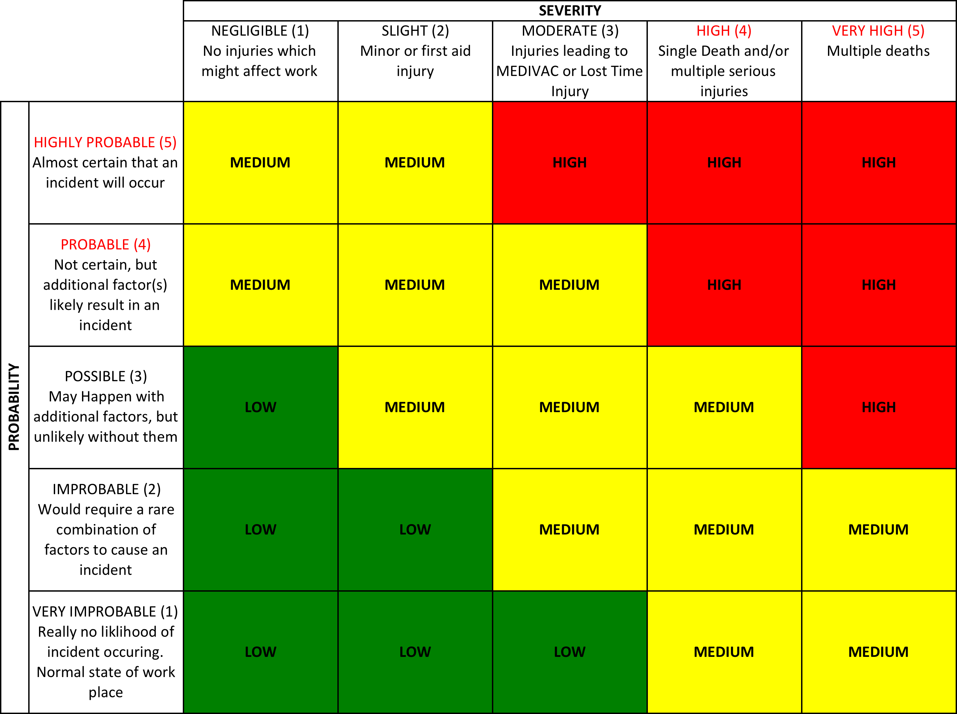
Qualitative Risk Assessment
NOTE: Example only

Slide 14
Qualitative Risk Assessment
REF: NOPSEMA, N-04300-GN0271, Control Measures and Performance Standards

Slide 15
Bow-Ties
Fault Tree
Event Tree
NOTE: Example only

Slide 16
ALARP Demonstration
So…
  We’ve assessed our risk using Qualitative and/or Quantitative risk assessment.
Does that mean that risks are demonstrably ALARP?

Slide 17
2-Step Process
Step 1
  Demonstrate that risks are tolerable/acceptable
Step 2
  Demonstrate that all practicable risk reduction measures have been implemented
  Justifying what HASN’T been implemented is as important

Slide 18
How to get over that 2nd Step!
Identify all further risk reduction measures
Assess the potential risk benefit
Assess the potential cost ($, risk, schedule)
Is cost grossly disproportionate to benefit?
  If yes, REJECT measure and document
  If no, measure should be implemented

Slide 19
Gross Disproportionality
ICAF (Implied Cost of Averting a Fatality)
*PLL = Probability of Loss of life
REF: Safe Work Australia, Guide for Major Hazard Facilities: Safety Case: Demonstrating The Adequacy of Safety Management and Control Measures

Slide 20
Case Study: Qualitative
Small pipelay barge
~75m in length
SOLAS / IMO / Class Compliant
Life-rafts only – NO LIFEBOATS
Case 1: Littoral waters, no live HC present
Is Evacuation risk ALARP?
Case 2: Pipelay in vicinity of HC-producing asset
Is Evacuation risk still ALARP?

Slide 21
Case Study: Quantitative
QRA sensitivity analysis shows risk reduction measure would achieve 0.005 reduction in PLL
Therefore:
Justifiable Spend = Reduction in PLL x ICAF
= 5.0E-03 x 100,000,000
= $500,000
So: if the measure costs less $500,000 or less it should be implemented

