Slide 1
Please read this before using presentation
This presentation is based on the content presented at the 2019 Exploration Safety Forum in May 2019.
Department of Mines, Industry Regulation and Safety (DMIRS) supports and encourages reuse of its information (including data), and endorses use of the Australian Governments Open Access and Licensing Framework (AusGOAL)
This material is licensed under Creative Commons Attribution 4.0 licence. We request that you observe and retain any copyright or related notices that may accompany this material as part of attribution. This is a requirement of Creative Commons Licences.
Please give attribution to Department of Mines, Industry Regulation and Safety, 2019.
For resources, information or clarification, please contact: SafetyComms@dmirs.wa.gov.au or visit www.dmirs.wa.gov.au/ResourcesSafety

Slide 2
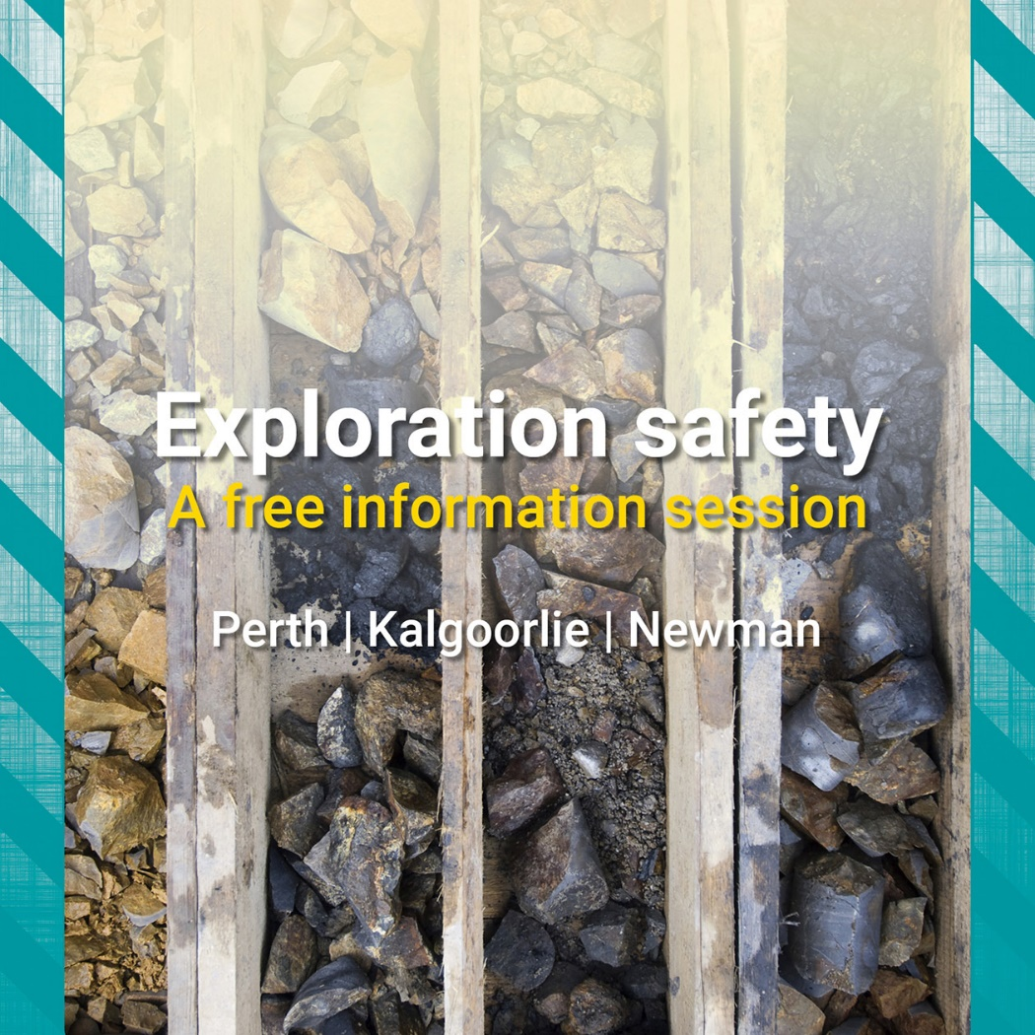
2019 Exploration Safety Forum

Slide 3
Setting the scene: Duties of care and expectations from the inspectorate

Slide 4
What are we going to cover?
Quick look at some industry data
Talk about the basics:
risk management
hazards
emergency preparedness
Notes:
What are we going to cover today? We will be exploring duties of care and expectations from the inspectorate
During my presentation we are going to:
Take a quick look at some industry data and talk about the hazard registers available on our website and how you can use this information in your own operations
Talk about the basics of exploration. These basics can be found in the Code of Practice and I strongly encourage each of you to make yourself familiar with the code. The code is divided into 3 areas
Risk Management
Hazards
Emergency Preparedness

Slide 5
Why back to basics?
Feedback
Data
Notes:
Why is the theme of this years exploration forum “back to basics”?
There are a few reasons the most compelling reasons for this theme are:
FEEDBACK - The feedback from those who attended last years exploration forum had some common themes, the most prominent being what are the basic expectations of the regulator and requests for guidance on how to handle the fundamentals, and
DATA - The data from our hazard registers which detail the fatalities and serious injuries from 2000 to 2018, and recent industry incident reporting data which illustrates that recurring hazards remain uncontrolled

Slide 6
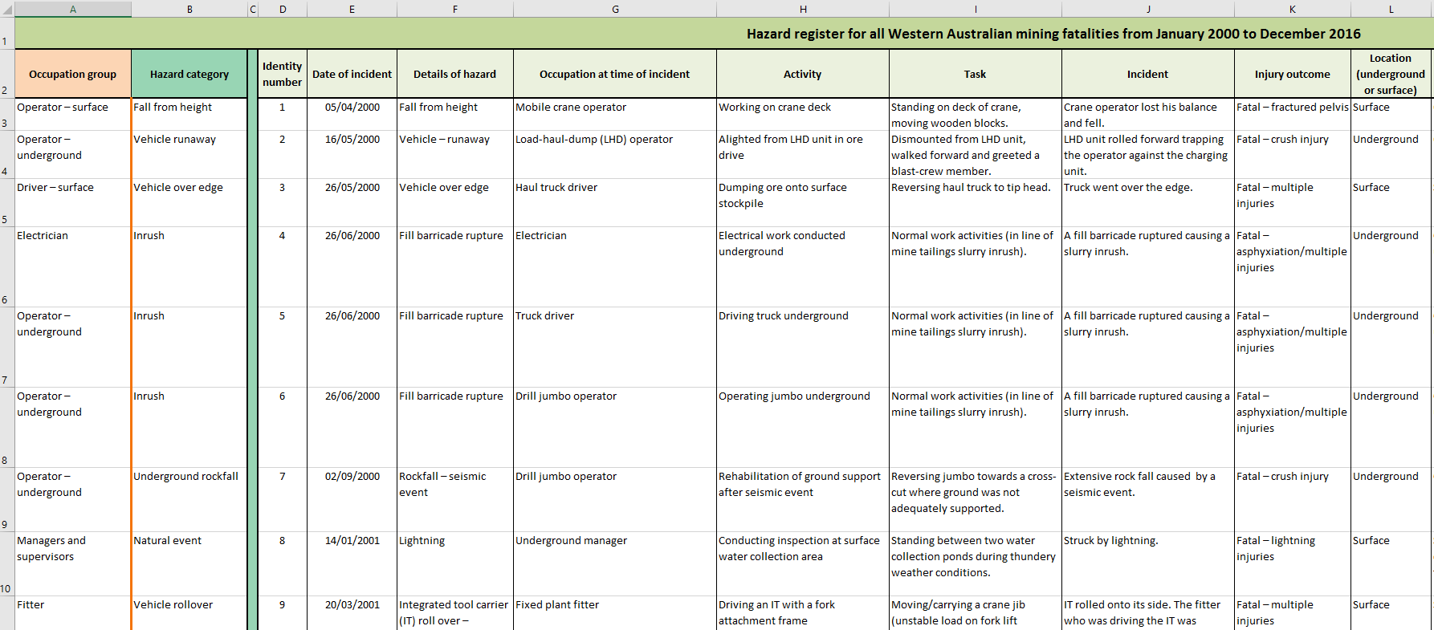
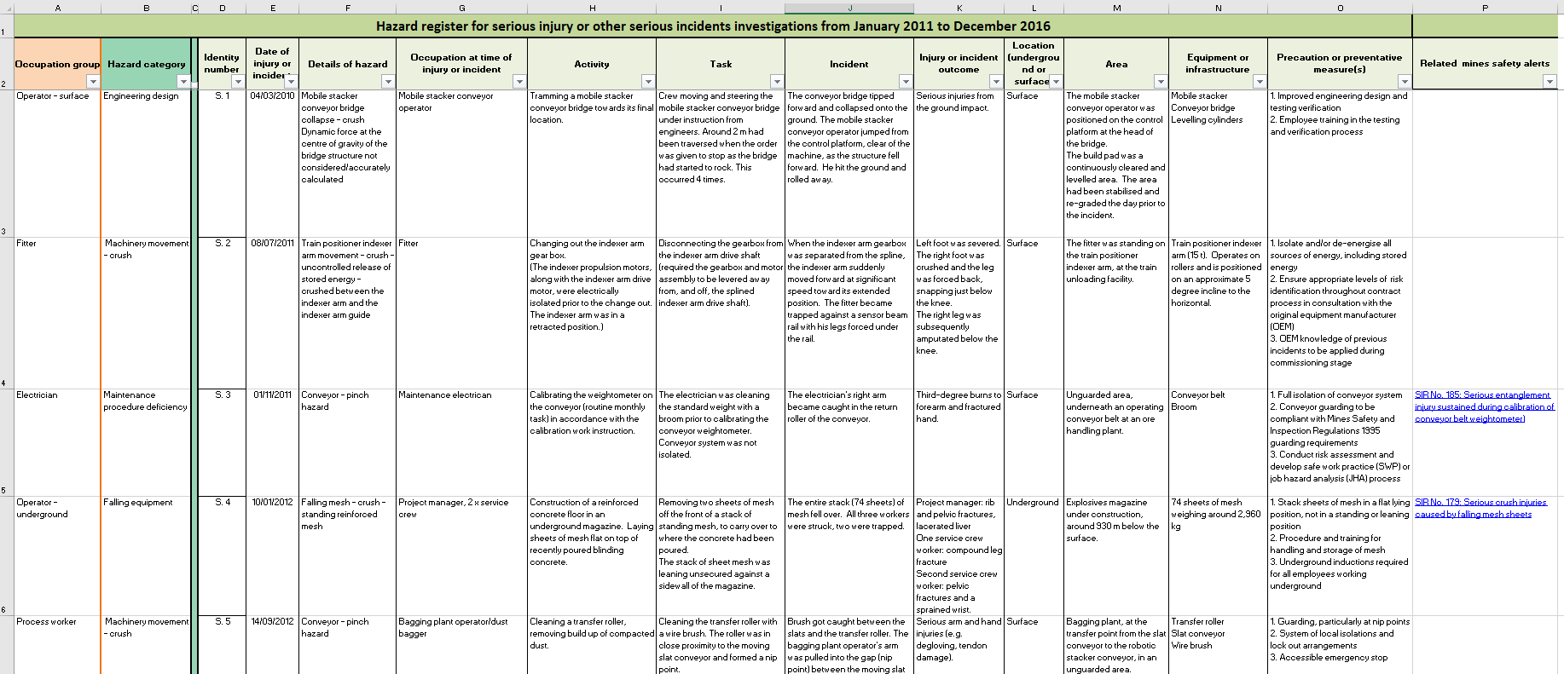
Hazard registers – fatal and serious injury
Available at www.dmirs.wa.gov.au
Notes:
DMIRS hazard registers.
If you are not aware of these incredibly valuable tools, the hazard registers enable users to:
identify hazards with the potential to cause fatalities or serious injuries
demonstrate how hazards can impact different occupation groups
identify the activities and tasks being undertaken at the time a fatality, serious injury or other serious incident
identify potential precautions or preventative measures.
Operators should use the hazard registers to identify and review hazards relevant to their site that are associated with fatalities, serious injuries or other serious incidents in Western Australia.
This information can then be used in site-specific hazard registers and incorporated into the site’s safe systems of work. This process can assist operations to focus on these hazards and how to address them.
Workers can also consult the hazard registers to raise individual awareness around hazard identification, incidents associated with their occupation, and tasks they may undertake that potentially expose them to risk.

Slide 7
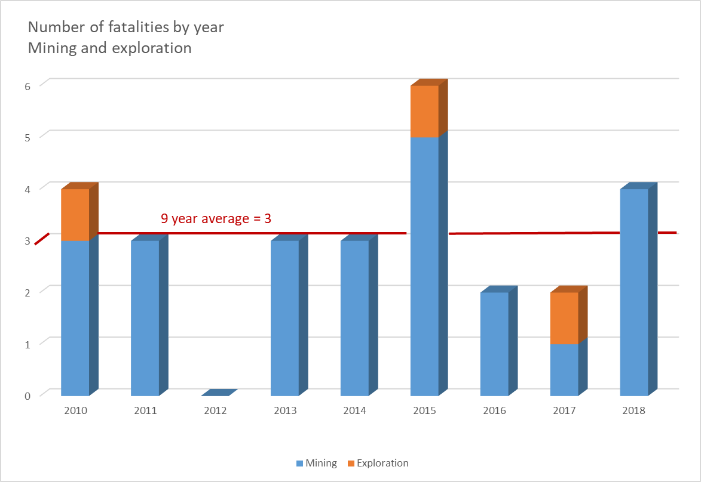
Fatalities: What is the data telling us?
Why are we not improving?
Notes:
Why are we still having fatalities in our industry? I’ll give you a minute to reflect on that question, if anyone feels comfortable sharing their thoughts with us I encourage you share with us……..

Slide 8
Why are we not improving?

Slide 9
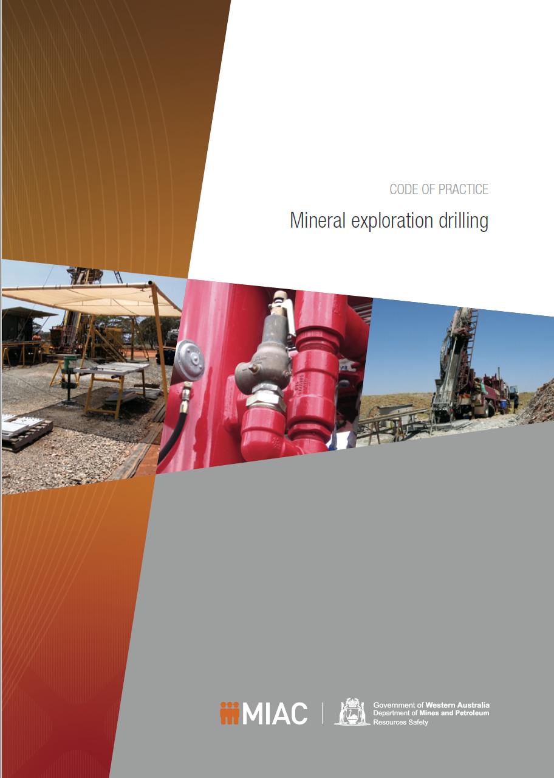
Back to basics
A practical guide to assist those involved in mineral exploration to develop and implement safe systems of work for drilling operations, particularly in remote areas.
Used to increase the understanding of hazards and risks associated with exploration drilling.
Remember:
Legally enforceable
Must vs. Should
Complexity will determine the detail
Describes minimum requirements
Notes:
This is the Mineral Exploration Drilling code of practice. The code is a legally enforceable and practical guide to assist those involved in mineral exploration to develop and implement safe systems of work for drilling operations, particularly in remote areas.
You should use this code if you have functions and responsibilities for managing risk on drilling operations for mineral exploration. The code may also be used by workers and safety and health representatives who need to understand the hazards and risks associated with exploration drilling.
REMEMBER:
The code is enforceable
The code includes references to both mandatory and non-mandatory actions. Just a reminder for everyone, the words “must” or “requires” indicate that legal requirements exist, which must be complied with. The word “should” indicates a recommended course of action, while “may” indicates an optional course of action.
Each drilling operation will have its own complexity and specific requirements, the complexity of your operation will determine the detail that you go into - this allows operators to develop site-specific solutions
The code describes minimum requirements that provide an acceptable level of risk, it is up to you to determine whether you are going to go further beyond the minimum requirements

Slide 10
Back to basics
CODE OF PRACTICE
Risk management
Hazards
Emergency preparedness
Notes:
The code is comprised of 3 topics
Risk Management
Hazards
And Emergency Preparedness

Slide 11
Risk management approach
There are numerous incidents where personnel have died or been seriously injured through inadequate recognition of exploration hazards and risks.
Exploration in any environment is potentially hazardous but exploration in remote locations, such as those encountered in Western Australia, presents additional risk factors.
Notes:
Firstly, a Risk Management Approach
Given the data included in the previously mentioned hazard registers and the earlier graph illustrating the fatalities from 2010 to 2018, this highlights that there have been numerous incidents where personnel have died or been seriously injured through inadequate recognition of exploration hazards and risks.
And we know that exploration in any environment is potentially hazardous but exploration in remote locations, such as those encountered in Western Australia, presents additional risk factors.

Slide 12
The risks faced in exploration work need to be managed with the same rigour as for any other mining activity.
Notes:
The risks faced in exploration work need to be managed with the same rigour as for any other mining activity.

Slide 13
Risk management approach
Plan and Prepare
Provide:
instruction
information
training
supervision
Critical for effective hazard management
Essential components of risk control strategy
Notes:
Thorough planning and preparation are critical elements for effective management of the hazards associated with these activities.
The provision of instruction, information, training and supervision are critical to risk management and they are an essential component of any risk control strategy.

Slide 14
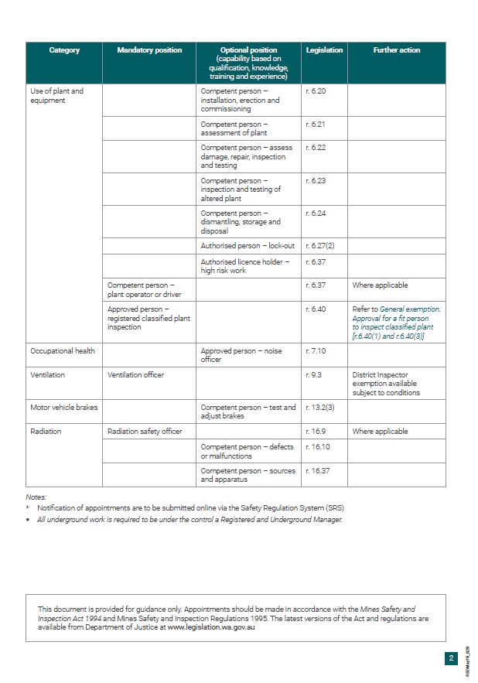
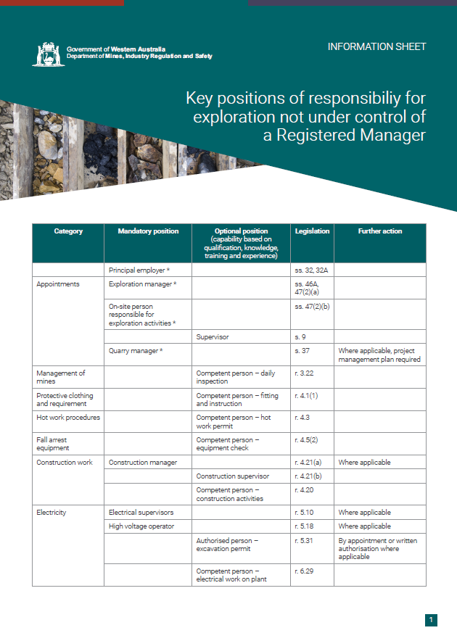
Notes:
WAEEL – we will update this once the revised info sheet is complete and approved
As a demonstration of some of the resources you can draw upon, perhaps as a checklist to make sure you are delivering on the basics for supervision here is a resource available on our website, it outlines the key positions of responsibility for exploration not under the control of a registered manager
http://www.dmp.wa.gov.au/Documents/Safety/MSH_IS_KeyResponsibilitiesExploration.pdf

Slide 15
Break out exercise
Spend 5 minutes looking at this handout.
Circle any of the areas where you believe there is a gap at your operation
Notes:
Break out exercise
Spend 5 minutes looking at this handout, circle any of the areas where you believe there is a gap at your operation
NOTE (set timer for 3 minutes) after the exercise suggest that they use this list of items circled as something to take away with them to follow up at their operations

Slide 16
Risk management approach
Supervisors have an important role in developing and checking work plans, as well as monitoring and responding to changes in work and the environment.
Notes:
Supervisors have an important role in developing and checking work plans, as well as monitoring and responding to changes in work and the environment.

Slide 17
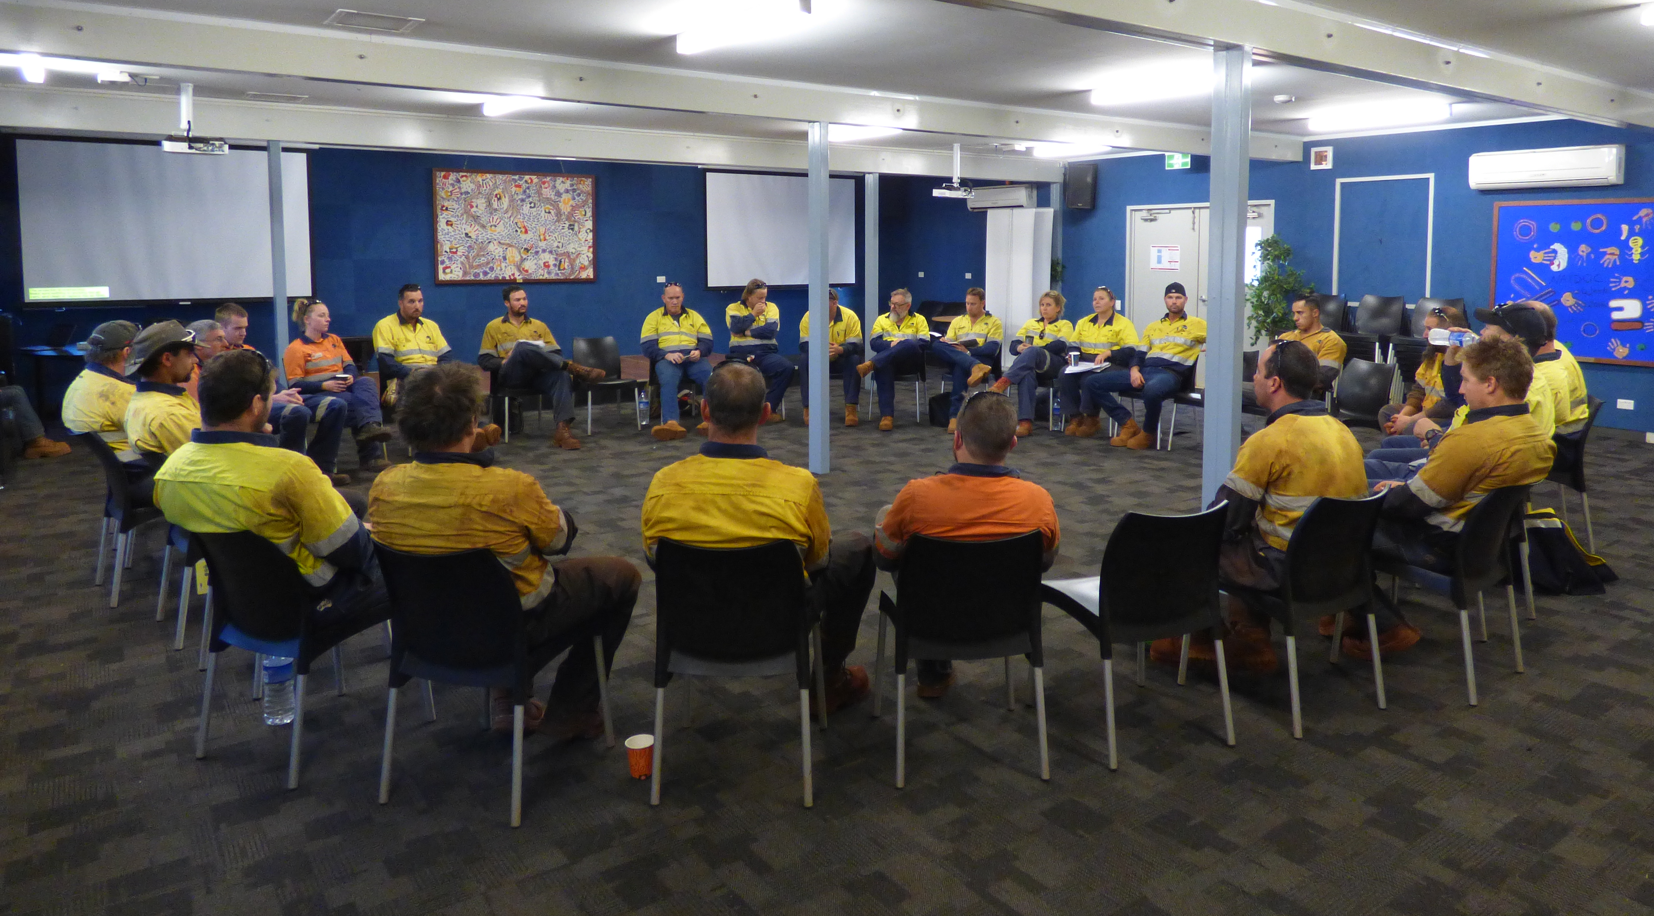
Supervisor focus
Having insufficient or inexperienced supervisors can lead to situations that increases safety and health risks to workers.
Notes:
Having insufficient or inexperienced supervisors can lead to situations that increases safety and health risks to workers.

Slide 18
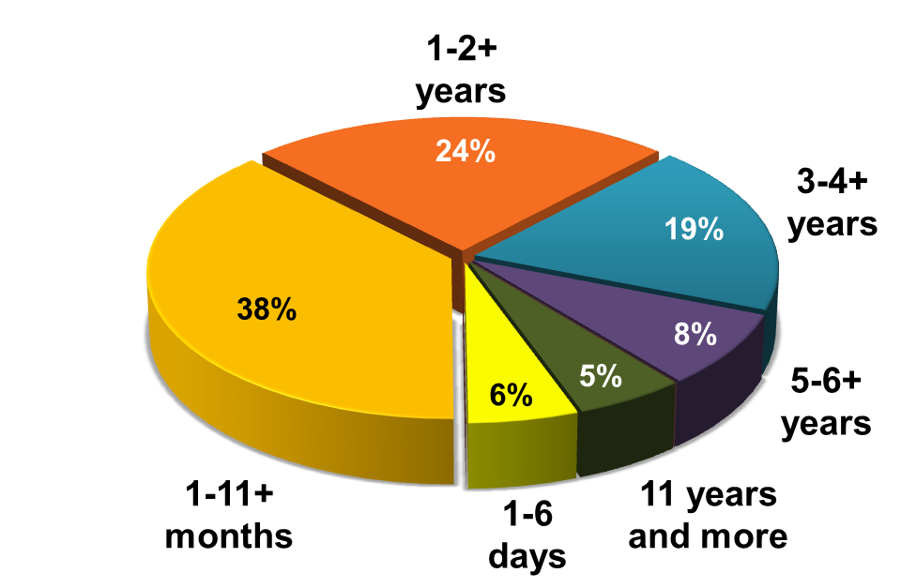
Supervisor focus
44% of fatalities occurred under supervision of supervisors who had been in role for less than one year
Notes:
In case you aren’t already aware of this statistic, 44% of fatalities occurred under supervision of supervisors who had been in role for less than one year –please note this is industry as a whole and not broken into exploration
Retrospective study
Source: http://www.dmp.wa.gov.au/Documents/Safety/MSH_R_FatalAccidents200012.pdf

Slide 19
Risk management approach
Minimum requirements will encourage personnel to:
Anticipate and recognise hazards
Assess the probability and severity of harm that may arise and
Identify and implement appropriate controls.
Most effective when:
Hazards are addressed at the design or planning stages
The workforce is consulted throughout the process and
Control measures are regularly monitored and reviewed for effectiveness.
Notes:
The minimum requirements of a risk management approach will encourage all personnel to:
Anticipate and recognise hazards
Assess the probability and severity of harm that may arise and
Identify and implement appropriate controls.
The risk management approach is most effective when:
Hazards are addressed at the design or planning stages
The workforce is consulted throughout the process and
Control measures are regularly monitored and reviewed for effectiveness.

Slide 20
Risk management tools
5 x 5 Risk Matrix
HAZID’s
Take 5’s
Checklists
Team based risk assessments
Bow Tie
HAZOP’s
Nertney’s wheel
Notes:
There are a variety of tools available for risk management:
Take 5’s
Checklists
Team based risk assessments
Bow Tie
5 x 5 Risk Matrix
HAZOP’s
HAZID’s
Nertney’s Wheel

Slide 21
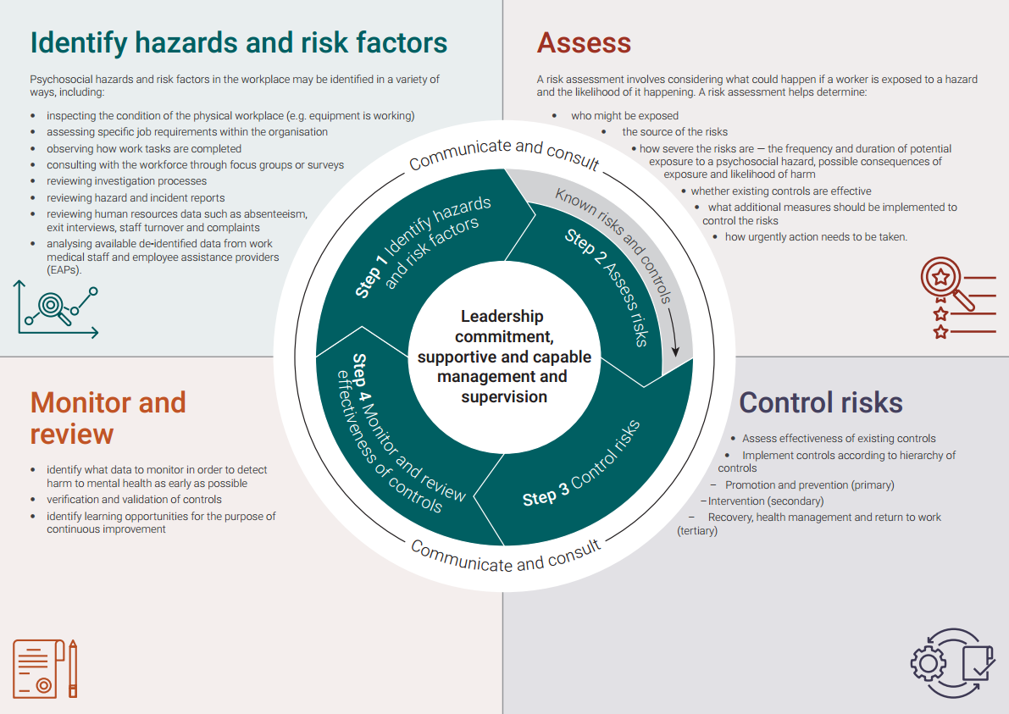
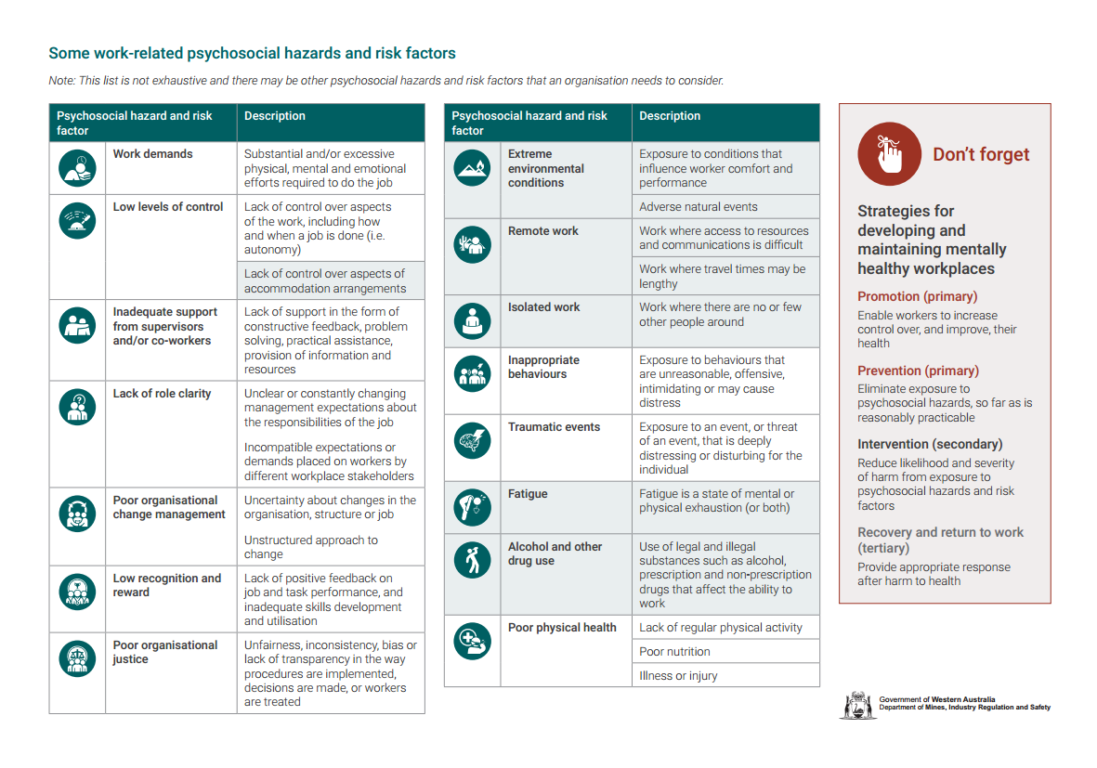
Notes:
There is also some simple guidance available on our website which you may find useful
Whatever tool you choose to apply, its critical to remember that it must be appropriate to the complexity of your operation

Slide 22
Hazard summary
Risk factors
Risk controls
More info
Notes:
Part 2 of the code comprises the major hazard categories identified for the exploration environment.
For each of these hazards there is
A summary of the hazard and examples of the types of equipment, activity or environment that may give rise to it. This hazard summary may assist in identifying the sources of the risk.
The direct and contributing factors to consider when assessing the risk of injury or harm to health from the hazard. This allows operators to develop site-specific solutions – each operation will have its own complexity and specific requirements.
Examples of control measures to assist in risk mitigation. Rather than being overly prescriptive, the content aims to provide a basis for considering how best to manage the risk. Use the hierarchy of control when implementing controls to eliminate the hazard or reduce the risk. Low-level controls such as providing personal protective equipment (PPE) or administrative measures should only be used as a last resort or to support other control measures.
And further information, including incident summaries that highlight what can go wrong.

Slide 23
Know your hazards
Notes:
If we apply the basics that I’ve shared so far today….
By using the data from the DMIRS fatality and serous injury hazard registers and the list of major exploration hazards outlined in the code, this offers a good starting place.
Then add the hazards relevant to your own operation that you have identified, this forms a basic hazard register for you to assess.
Don’t forget that the code already has a list of identified controls – don’t reinvent the wheel!

Slide 24
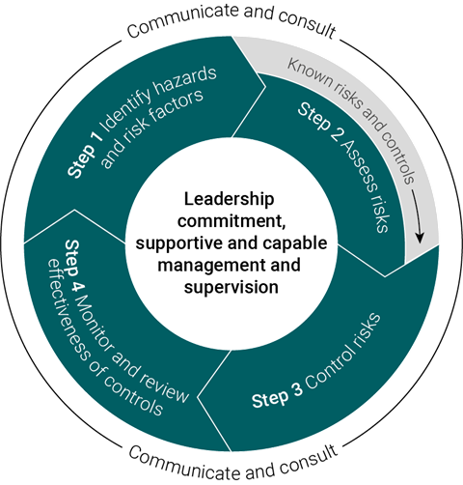
What is a mentally healthy workplace?
Where workers and managers address wellbeing concerns due to:
work environment
organisation of work
workplace culture
physical environment and facilities.
Notes:
Mental Wellbeing is identified in the code as a major hazard and encourage you to place the appropriate amount of energy into minimising the exposure to hazards surrounding mental health at your operations.
Best way to think of it: mental health hazards are to be treated like any other hazards.
Use the risk management process to identify the hazards, and to put in suitable controls
Do not only rely on EAPs. EAPs are important & have their role, but that’s more outcome based (dealing with a potential mental health issue that’s already occurred).

Slide 25
Mentally healthy workplaces
Available resources
Code of Practice
DMIRS webpage resources (coming soon)
Notes:
...the FIFO code of practice which has been published. You can get a hard copy or go online to DMIRS, google it etc.
https://www.commerce.wa.gov.au/sites/default/files/atoms/files/fifocode_of_practice.pdf
DMIRS will also be releasing supporting material online soon.

Slide 26
Health and hygiene
Increased attention on chronic exposure to agents that lead to adverse impacts upon health.
Requirement for a health and hygiene management plan (HHMP)
Ask yourself:
What hazards can harm your health?
What safe guards can you put in place?
Let’s look at dust…
Notes:
As part of the Departments vision for a safe and healthy resources sector, there has been increased attention on chronic exposure to agents that lead to adverse impacts upon health.
A health and hygiene management plan (HHMP) provides a structured means of creating a register of agents that may impact upon the health of exposed workers. It documents the risk from those agents, the controls that are used, and details the verification and validation methods used to confirm the effectiveness of those controls. The HHMP complements other management plans, registers and reports that are currently submitted to the Department.
Dust – the silent killer! Just because its not causing harm today, doesn’t mean it won’t harm you in the future.

Slide 27
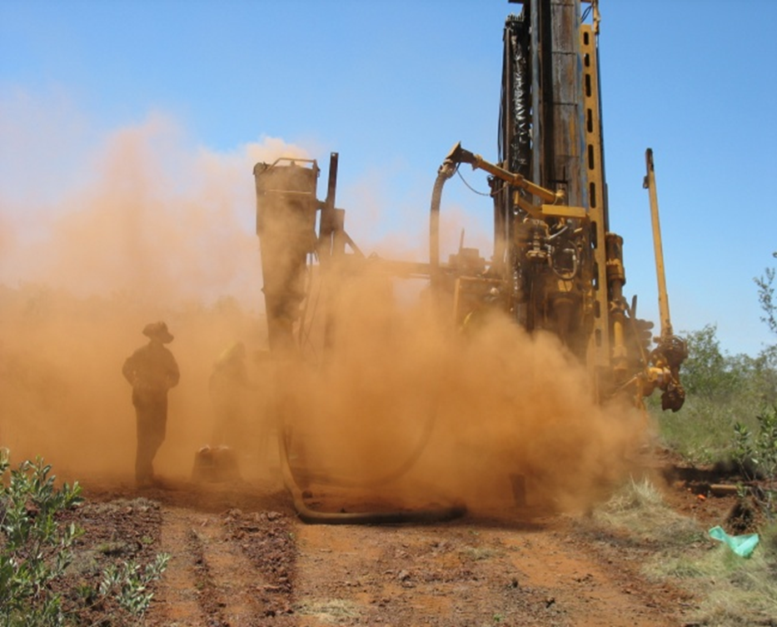
Manage the risks
What’s in the dust?
asbestos?
silica?
lead?
arsenic?
solvents?
Need to manage the risks
Identify the risks
Reduce them as much as possible
Assume the worst if you don’t know
Include in your site’s Health and Hygiene Management Plan
Notes:
What’s in the dust?
asbestos?
silica?
lead?
arsenic?
solvents?
Noise?
Do you need to yell?
Heat or cold stress?
Repetitive awkward movements?
Need to manage the risks
Identify the risks
Reduce them as much as possible
Assume the worst if you don’t know
Include in your site’s Health and Hygiene Management Plan
I’m now going to hand over to Narelle McMahon who will take us through some examples of significant incidents involving known major hazards as identified in the code. Please join me in welcoming Narelle

Slide 28
Know your hazards
Working in hot environment
Remoteness of exploration
Rotating and moving parts
Hydraulic systems
Working at heights
Falling objects
Heavy vehicle movement
Notes:
There are 21 of these hazards listed in the CODE. The following specifics will be discussed.
1. Rotating and moving parts
2. Hydraulic systems
3. Working at height
4. Falling objects
5. Working in hot environments
6. Heavy vehicle movement
7. Remoteness of exploration

Slide 29
Serious and fatal incidents involving known hazards
Rotating and moving parts: two fatal and four serious injuries
Hydraulic systems: two fatal and one serious injuries
Working at height: one serious injury
Falling objects: two serious injuries
Notes:
Firstly Rotating and moving parts has had serval SIR’s published: The first SIR was published in 1991 and the last in 2018.
SIR No. 36 Injuries sustained whilst working on drilling mast. (there is 3 separate injuries in this report)
The first injury occurred in 1991 where the IP was working up the mast of a drill rig, he received serious injuries.
The second injury occurred also in 1991 the IP lost three toes plus receiving severe lacerations to a foot.
The third in 1992 a offsider lost his arm when he jacket was caught and he was dragged between the rods and the mast. In this case he had climbed up the mast to carry out maintenance. (working with no guarding on rotating equipment)
SIR No. 47 Injuries sustained while working on a drill mast.
The IP’s hair was caught in the rotating drill rods whilst he was painting the bottom of the drill mast. The IP received multiple injuries including hair pulled from the scalp, friction burns, lacerations and several soft tissue injuries. (working with no guarding on rotating equipment)
SIR No. 61 Caught in a rotating drill rod – fatal accident
The IP was found caught between the drill rod and the mast of a diamond drill. The IP sustained serious head and internal injuries and later died from them. (Guarding was also a factor)
SIR No. 247 Drill fitter crushed between drill head and rod centraliser arm – Fatal (ties with 243)
Two drill fitters were working on the deck of a blast-hole drill rig. The drill had not been isolated and the centraliser arm closed unexpectedly and one of the fitters was caught between the centraliser arm and the drill, his head the injuries were fatal.
As you can see we have not eliminated the risks associated with rotating and moving parts.
Some of the common factor here is working on energised and unguarded equipment.
Hydraulic systems is another hazard that has not been eliminated there has been three SIR’s written that indicates this hazard is still a major factor in fatalities and injuries
Hydraulic systems
SIR No. 3 Compressed Air Hose Connection Fatal Accident
An offsider was struck in the head by a large compressed air hose. He received serious head injuries which were fatal. (the contributing factors were failure to secure the hose that was being worked on)
SIR No. 92 RC Drill Rig 3 inch sample hose connection – serious accident
The IP was struck on the right side of his body when the hose blew off its fitting above the drillers operating platform. The IP received serious injuries to his ribs and lungs as well as severely crushed right arm this was later amputated. (the contributing factors were incorrect fittings where supplied and the hose clamps the wrong size)
SIR No. 145 Drillers offsider struck by dust deflector box (or wear bend) Fatal
The IP was struck by the wear bend that had become detached from the cyclone and the sample hose. It weight around 40kg he suffered fatal head and other injuries. ( The contributing factors in this case were No safe work procedures, insufficient number of bolts to hold the wear bend)
All of the hazards on this slide and the next slide show that as an industry our hazards are not changing. This is a serious issue and in my opinion needs to be addressed.
Working at Height
SIR No. 246 Fall from height during helicopter lifting operations
Two offsiders where attaching slings to a drill rig base that was being lifted by a helicopter when one of the offsiders leg became entangled in a tag line. The helicopter lifted the rig but was unaware of the situation when the pilot became aware he reduced altitude but the offsider still fell 5 to 10 meters injuring his back (No high risk work licences for dogging or rigging and no risk assessment).
SIR No. 87 Drill rod handling – serious incident
The offsider was attempting to attach the winching attachments onto the rod, the thread suddenly parted and the rod fell onto the drill table, balancing for a few seconds and then falling forward. It struck the offsider he received serious spinal injuries.
SIR No. 109 Fitting of tile boxes on drilling rigs
The tile box fell from the drill rig hitting the driller from a distance of 6 to 8 meters he received severe head and other injuries.

Slide 30
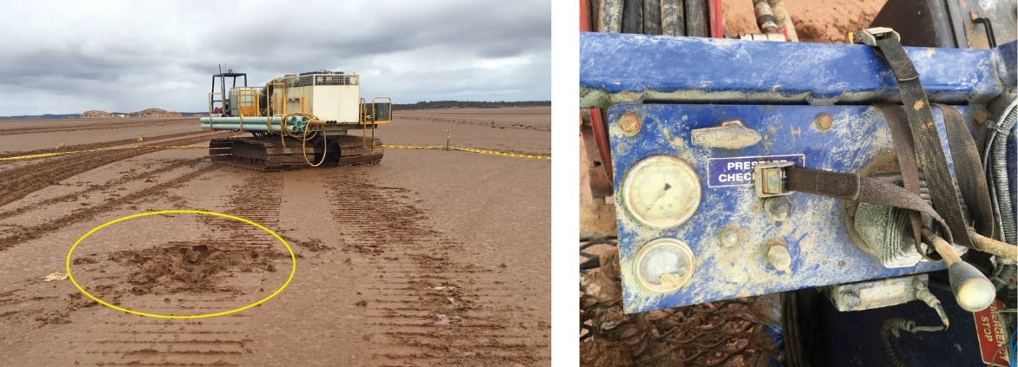
Serious and fatal incidents involving known hazards
Working in hot environments: two fatal injuries and serious incident
Heavy vehicle movement: one serious incident
Remoteness of exploration: one serious incident
Notes:
Working in hot environments
SIR No. 095 Death of exploration worker A young geology student newly employed with little field experience. The first day he spent working then at camp exhibited gastric symptoms and vomited. He worked the next day still sick around mid morning he was unable to continue making his way to the vehicle to rest he never arrived his body was found 2.5hrs later. He had no water with him at the time
SIR No. 257 Field technician collapses during exploration activities – fatal accident this case we will be discussing in the workshop.
SIR No. 163 Exploration employee lost in remote bush
A contract driller attempted to walk through scrub to retrieve a support vehicle 6 kilometres away from the camp site. He became dehydrated and disorientated he was found 30 hours later 10 kilometres from the camp.
Heavy vehicle movement
SIR No. 249 Drill offsider run over by tracked vehicle A drillers offsider was ran over by the tracked vehicle he was tramming. The controls had been overridden. Injuries to the head and face plus a fractured hand.
Remoteness of exploration
SIR No. 253 Injured worker not discovered and treated for extended period
is where driver of a service vehicle lost control of the vehicle on a remote part of a site and it rolled onto its roof. Because of his injuries the driver was unable to walk and he could not raise and emergency call. He was discovered by a passing worker 2 hours later his own work colleagues had not noticed he was missing. There was a delay in emergency responders due to unfamiliarity of the area plus no one missed him from his own work team
All of these are available on the website.
I will now pass you back to WI for emergency preparedness

Slide 31
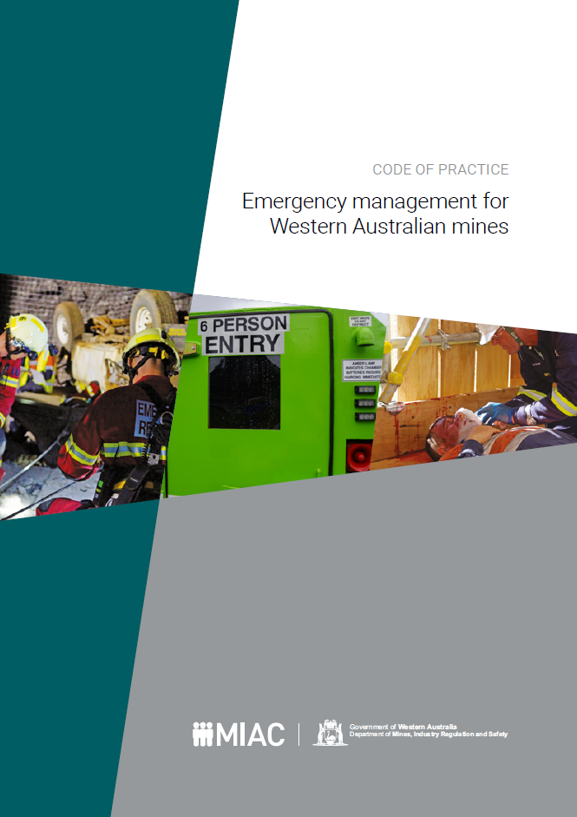
Emergency preparedness
Workers in remote areas are faced with many challenges if something goes wrong.
Changing conditions (e.g. bushfire, flash floods) can affect access.
The onset of an illness requiring medical treatment can require the evacuation of a worker.
Notes:
Part 3 of the code provides guidance on the management and planning for emergency situations, there is also a separate code of practice for emergency management is WA mines
The potentially hazardous nature of exploration operations, and the often remote locations where they are carried out, mean that emergency management and emergency response planning are critical to the health and safety of personnel. In particular, effective communication and appropriate medical care during an emergency can be difficult to establish and sustain in remote areas.
Workers in remote areas are faced with many challenges if something goes wrong.
Changing conditions (e.g. bushfire, flash floods) can affect access.
The onset of an illness requiring medical treatment can require the evacuation of a worker.

Slide 32
Emergency preparedness
When developing an emergency plan, determine the following:
Emergency facilities are available in the area
Their feasibility for use (e.g. nearest air strip for the Royal Flying Doctor Service).
Who will assist with search and rescue, provide information, and lead the operation on the ground and in the office.
It can be beneficial to establish third-party arrangements with nearby mines, local residents and landowners.
Notes:
Planning for general medical emergencies, evacuation and rescue needs should be considered and, where appropriate, advice sought on the most appropriate responses.
When developing an emergency plan, determine the following:
Emergency facilities are available in the area
Their feasibility for use (e.g. nearest air strip for the Royal Flying Doctor Service).
Who will assist with search and rescue, provide information, and lead the operation on the ground and in the office.
It can be beneficial to establish third-party arrangements with nearby mines, local residents and landowners.

Slide 33
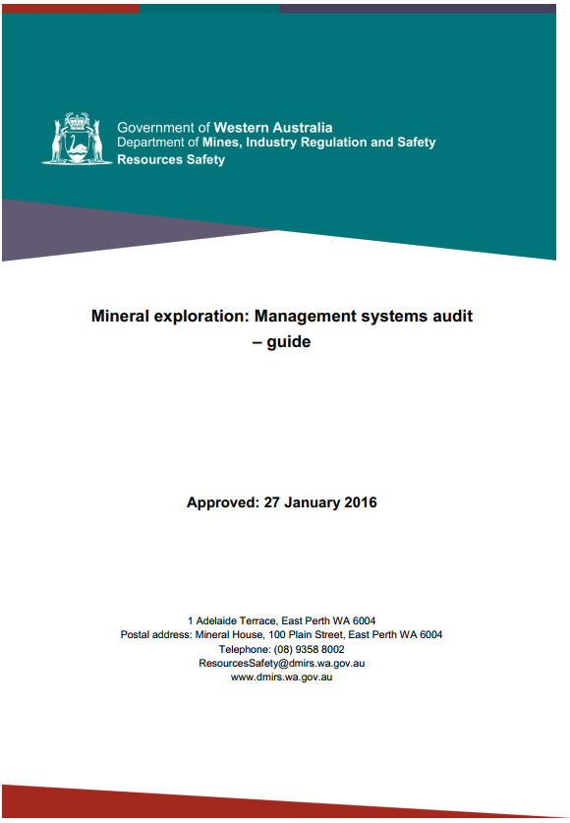
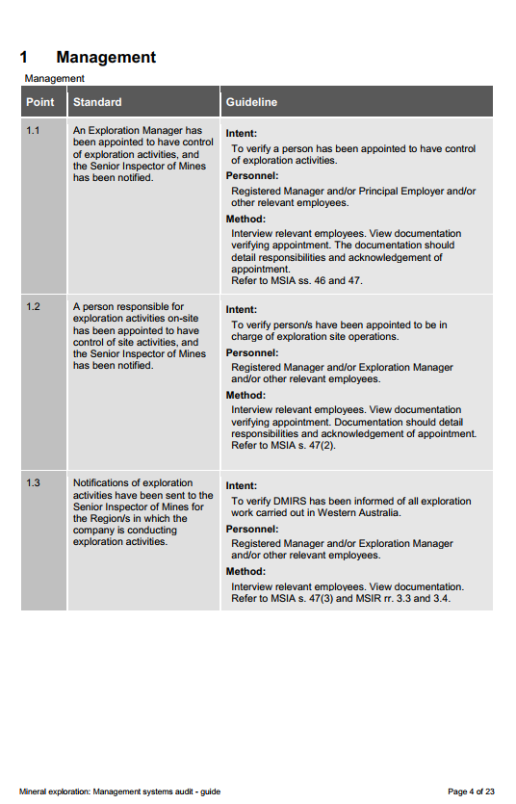
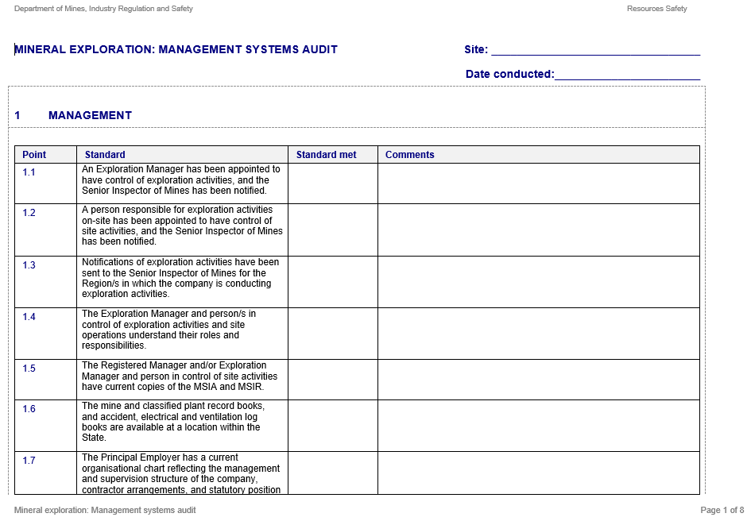
What guidance is available?
Audit template
Guide
Available on DMIRS website
Notes:
Mineral Exploration Audit – use it to be proactive & self-audit.
Three audit guides and templates available:
Mineral exploration management systems
Mineral exploration site operations
Mineral exploration drilling and other field activities
Can also use the “Small Mines Audit” – goes into the next level of detail…

Slide 34
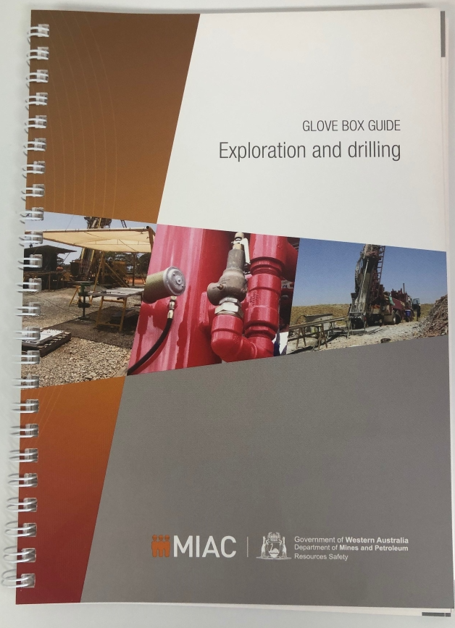
Exploration safety guide
Glove box guide (Guidance about exploration hazards)
Notes:
Useful reference material. Hard copies available for your disposal.

Slide 35
Summary
Exploration sites are varied in nature with unique characteristics.
Risk Management process is to be used to identify and treat hazards as appropriate in the workplace.
Use our hazard registers in aiding you to identify your own workplace hazards
For safe exploration to occur, a mentally healthy and controlled work environment must be maintained.
Notes:
In summary
Exploration sites are varied in nature with unique characteristics.
Risk Management process is to be used to identify and treat hazards as appropriate in the workplace.
Use our hazard registers in aiding you to identify your own workplace hazards
For safe exploration to occur, a mentally healthy and controlled work environment must be maintained.

Slide 36
DMIRS contacts
1 800 SAFE MINE (1 800 7233 646)
Email: MinesSafety@dmirs.wa.gov.au

Slide 37
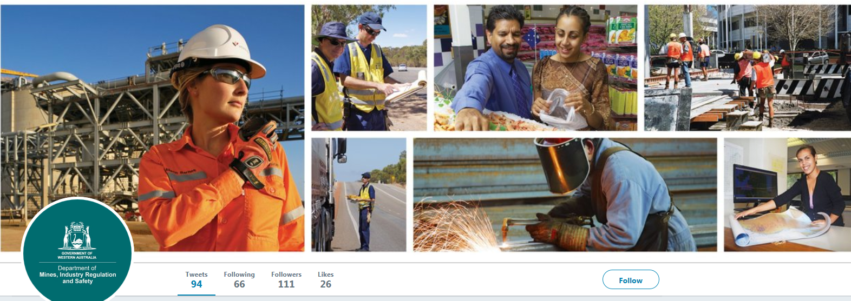
Follow us on social media
Twitter
@DMIRS_WA
@AndrewChaplyn
LinkedIn at Department of
Mines, Industry Regulation and Safety
37
Notes:
Add slide about awards

