Slide 1
Please read this before using presentation
This presentation is based on the content presented at the 2018 Mines Safety Roadshow in October 2018.
Department of Mines, Industry Regulation and Safety (DMIRS) supports and encourages reuse of its information (including data), and endorses use of the Australian Governments Open Access and Licensing Framework (AusGOAL)
This material is licensed under Creative Commons Attribution 4.0 licence. We request that you observe and retain any copyright or related notices that may accompany this material as part of attribution. This is a requirement of Creative Commons Licences.
Please give attribution to Department of Mines, Industry Regulation and Safety, 2018.
For resources, information or clarification, please contact: SafetyComms@dmirs.wa.gov.au or visit www.dmirs.wa.gov.au/ResourcesSafety

Slide 2
2018 Mines Safety Roadshow

Slide 3
Setting the scene
What is the state-of-play for safety performance in WA?

Slide 4
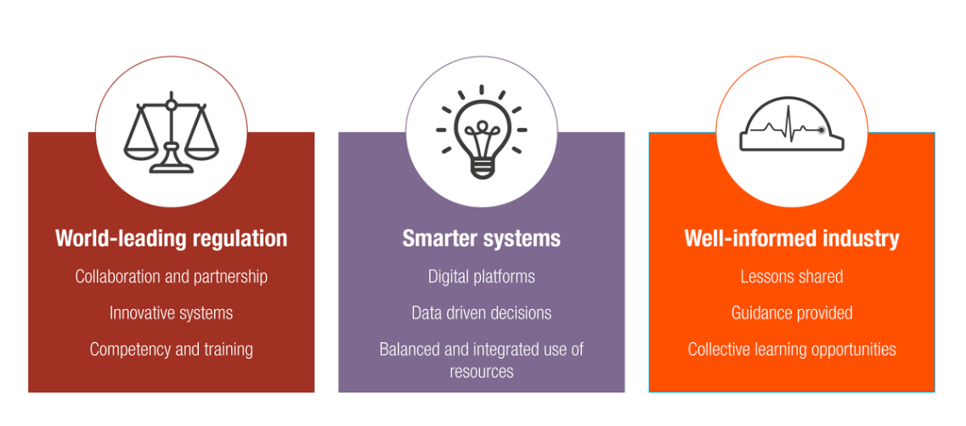
Towards 2020 – goals
Notes:
The Towards 2020 goals are integral to the Strategic Plan for the Mines Safety inspectorate, and align with the inspectorate’s commitment statement “To work with industry to reduce serious accidents and incidents, and provide tangible support in achieving a positive cultural change”.
The Department’s focus over the past few years in relation to Smarter Systems has been the advancement of the web-enabled Safety Regulation System (SRS) which has had several major releases through 2018. Importantly for SHReps, one of the releases has been the capacity for SHReps to enter their details into SRS in order that the Inspectorates electronic communications are able to be delivered effectively. DMIRS encourages SHReps to make advantage of this capability by ensuring that they are granted access to SRS via their workplaces.
Mines Safety’s focus in relation to a well informed industry is to ensure that the website is readily accessible and up-to-date; to maintain weekly updates, and to ensure that they are circulated as broadly as possible; to publish monthly safety snapshots to support workplace-hosted toolbox or safety committee meetings; and to host forums for specific parts of the industry. In 2018 Mines Safety hosted forums for the Exploration Industry; Lithium sector and Registered Managers, as well as increasing the scope for the Roadshow series of events.
The Department’s approach to world-leading regulation is dealt with in the next few slides.

Slide 5
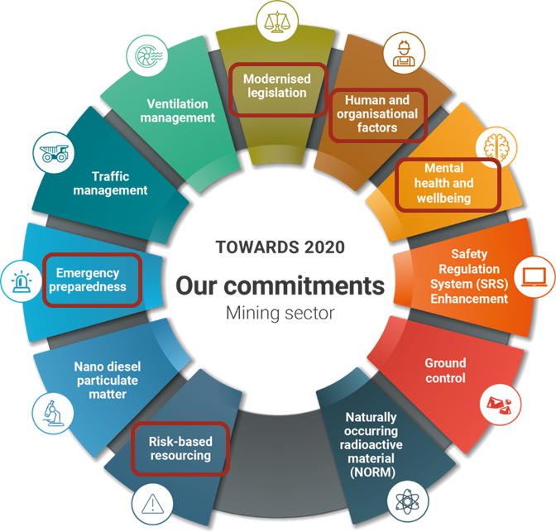
Towards 2020 – our commitments
Notes:
Towards 2020 commitments details the goals, focus areas and measures of success for safety and health initiatives undertaken by the regulator.
Progress on these commitments will be reported annually. Examples of progress reporting include online news items, magazine articles, publications, web pages or case studies.
Completed commitments will be archived and be made available to industry online.
(Commitments summary - clockwise)
Modernised legislation – Modernised, consolidated legislation covering mining, petroleum, MHF and geothermal energy;
Human and organisational factors - Routine application of human and organisational factors principles to safety and health management
Mental health and wellbeing - Improved workplace mental health and wellbeing in the resources sector
Safety regulation system (SRS) enhancements - Fully integrated online systems that streamline administration and regulatory functions
Ground control - Improved ground control management
NORM - Improved radiation safety management of naturally occurring radioactive material (NORM)
Risk-based resourcing - Appropriate targeting of compliance and enforcement efforts (right tool, right place, right time)
Nano diesel particulate matter - Increased understanding and control of health impacts of diesel particulate matter (DPM), particularly nano diesel particulate matter (nDPM)
Emergency preparedness - Improved emergency preparedness and safe systems for those working away from readily accessible infrastructure and support services
Traffic management - Improved traffic management practices
Ventilation management - Improved ventilation practices and compliance

Slide 6
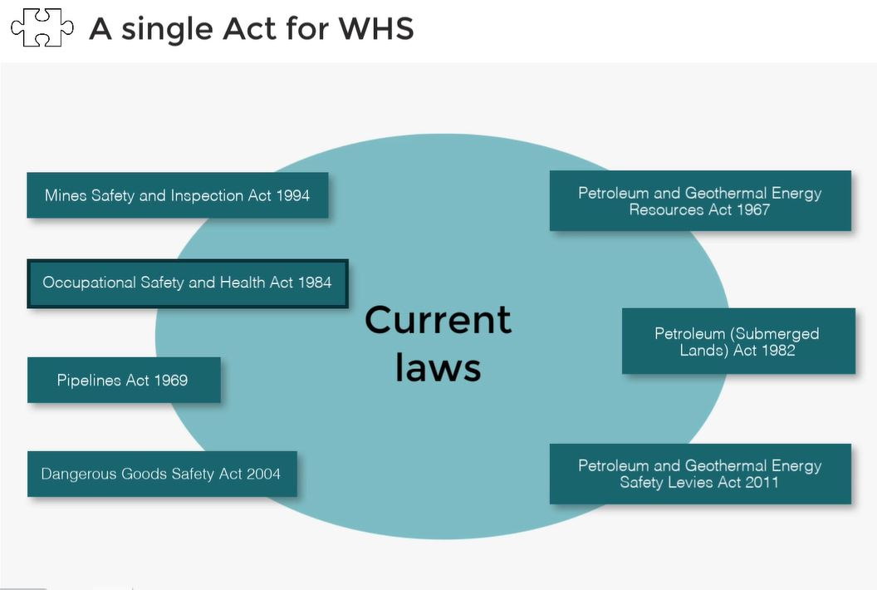
The (new) WHS Act
Notes:
The aim of the modernised legislation (called the WHS Act) was to merge all of the State’s workplace safety laws into a single, unified Act that aligned with the (Federal) model WHS act that has been embraced by all of the other States and Territories (except Victoria).
The important first step is to align the Mines Safety and Inspection Act with the Occupational Safety and Health Act, and this process is well under way.

Slide 7
The (new) WHS Act
The Ministerial Advisory Panel (MAP) has completed its review of the Model WHS Act, and provided its recommendations to Minister Johnston:
44 recommendations were made.
The Department has run a series of information sessions and is collating the public comments in relation to the proposed legislation.
The next stage of the process will be a submission to the Minister shortly advising of the public comments:
The Minister may choose to implement any, or all, of the 44 recommendations.
Notes:
All other jurisdictions across the country made alterations to the model Act to ensure that their specific requirements were met by their State’s workplace safety laws.
Western Australia is no different, with Minister Johnston forming a group of specialist stakeholders to review the model Act and to make recommendations on changes required to make sure the WHS act reflected WA’s requirements. The group of specialist stakeholders was called the Ministerial Advisory Panel (MAP). After an extensive consultation process, MAP made 44 recommendations to the Minister for alterations to the model Act to suit WA’s needs.
The recommendations are currently with the Minister’s office for a final decision to be made. The recommendations are not binding, and the Minister may choose to embrace all of them, some of them or none of them.

Slide 8
The (new) WHS Act: highly recommended
www.dmirs.wa.gov.au
Notes:
In order to ensure that the recommendations from MAP were broadcast to as large an audience as possible, DMIRS has produced a 38 minute video that outlines the process of developing the WHS Act, and outlines the basis for the 44 recommendations.
The video can be found at: https://vimeo.com/user9322862/review/280294023/95ff6441cf
In particular, pay attention to Recommendation #8 which provides for a positive duty of care to be placed on providers of safety advice and equipment. If implemented, this will be the first time in the State’s history that providers of safety advice have been the subject of a special legislative focus. Recommendation #8 is featured at the 30 minute mark of the video.
DMIRS takes this opportunity to remind SHReps that whilst they are acting in the role of the SHRep, they are deemed as volunteers, and not providers of safety advice, and therefore will not be subject to the requirements of Recommendation #8 (if it is implemented).
Can we insert a Q code for this please?

Slide 9
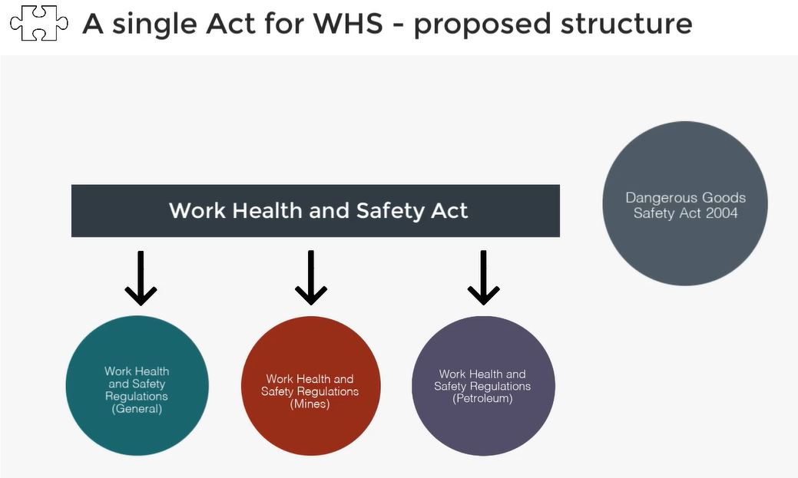
The (new) WHS Act and Regulations
Notes:
The single WHS Act will be supported by Regulations for all industry sectors (the WHS Regulations).
Many of the important components of the current Mines Safety legislation (for example appointment of Registered Managers or Quarry Managers) will be dealt with under specific Regulations for the mining industry. Therefore, it is likely that mining operations will be subject to the Act, and 2 sets of supporting regulations.

Slide 10
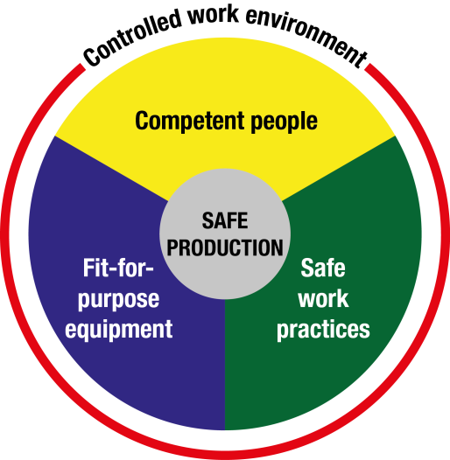
Safety regulator expectations of industry
Notes:
Employers should implement safe systems of work that are thorough and up-to-date, and ensure employees receive information and training on procedures (and put them into practice).
Ultimately to eliminate hazards or reduce risk, there must be effective controls in conjunction with adequate training and safety procedures. Supervisors and workers must remain vigilant.
Mines Safety will continue to work with industry to ensure resilient safety cultures and best practice standards are adopted and maintained as we work together towards safe production.

Slide 11
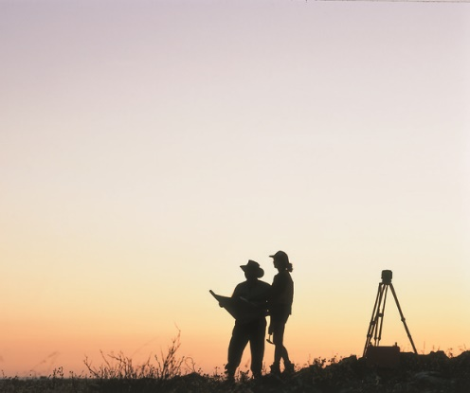
Well-informed industry
To work with industry to reduce serious accidents and incidents, and to provide tangible support in achieving a positive cultural change.
Risk-based approach that places the onus on operators to demonstrate:
an understanding of the hazards and risks of their workplace
they are operating as safely as possible.
Notes:
As part of the inspectorate’s commitment statement we wish to ensure that industry is well informed, and that the information we provide is used as the basis of good risk management decision making.
We believe that the better the industry is informed, the better mining operations will understand the hazards and risks in their workplaces, and therefore the level of safety afforded to the workforce will increase.
However, we have not always been successful in getting our message out – as witnessed by the following example.

Slide 12
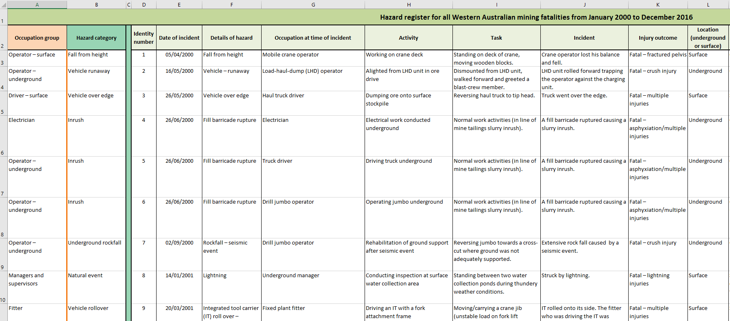
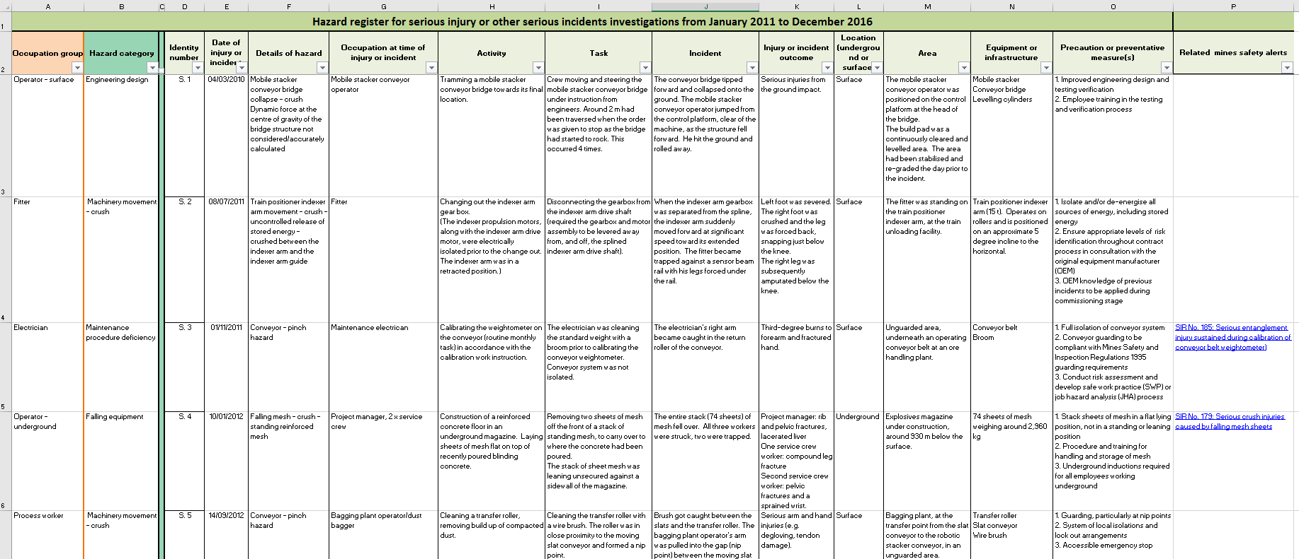
Well-informed industry: Hazard registers
Available at www.dmirs.wa.gov.au
Notes:
DMIRS publishes “Hazard Registers” available at: http://www.dmp.wa.gov.au/Safety/What-accident-and-incident-19287.asp
The Registers outline the mining industry’s reported serious and fatal accidents, including details as to the factors that contributed to the accident, it’s location and the task being conducted at the time of the accident.
In effect, the Registers provide an ideal learning experience for mining operations – and the Department encourage sites to review the accidents that appear on the Registers, and assess the possibilities of a similar accident occurring at their operations. This as a very powerful tool for safety committees to elevate their conversations on managing the risks in their operations.
SHReps should note the availability of the Hazard Registers, and bring them to the attention of their colleagues, and site management.

Slide 13
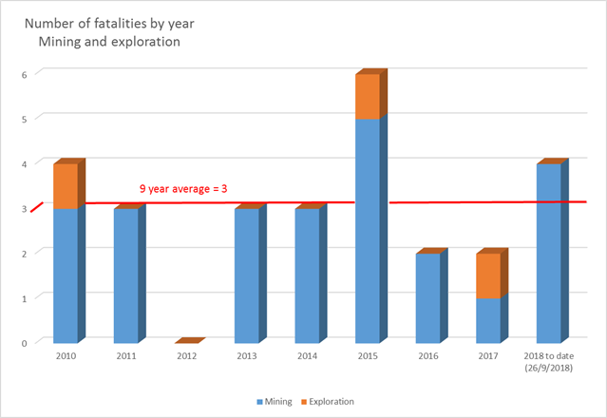
Fatalities: What is the data telling us?
Notes:
Sadly, the story of the recent history of fatal accidents in the mining sector illustrates that an average of 3 fatal accidents have occurred across the sector per year since a fatality free 2012.
There were 4 fatal accidents in the 2018 financial year, and to 26 September 2018, 1 fatality had occurred in the 2019 year.

Slide 14
Serious injuries: What is the data telling us?
Why are we not improving?
Notes:
The fatal accident data only tells a small part of the story of the State’s safety performance.
This chart summarises the frequency rate (per million hours) of serious injuries reported to the Inspectorate (the red line), and the subset of serious injuries that resulted in amputations, fractures or crush injuries (AFC - the green line).
It is evident that over the past 8 years, little has changed in either of these performance indicators, with AFC performance decreasing over the past 2 years, and serious injuries increasing by approximately 10% between 2016 and 2017.

Slide 15
Serious injuries: A closer look
Why are we not improving?
In fact – why are we getting worse?
Notes:
This slide follows from the previous, but talks in terms of total number of injuries, as opposed to a frequency rate. The trend for AFC injuries over the past 2 years is a concern, and indicates that in 2017 about 210 workers suffered serious amputation, fracture or crush injuries.
Presenters on the 2018 Roadshow were surprised by the overwhelming trend that the audience feedback indicated. It aligned almost perfectly with the answers provided to this question on the 2018 Registered Managers forum held about a month prior to the beginning of the 2018 Roadshow series of events …

Slide 16
What the 2018 Registered Managers Forum told us
Why aren’t we improving?
Notes:
This was the word cloud that arose form the audience members feedback on the 2018 Registered Managers forum.
The more central the word (or phrase) and the larger it is, the more times it was supplied by the members of the audience (each audience member only had one vote).
Complacency (of the workforce) was seen as the major contributor to the deterioration in the State’s safety performance. When pushed for an explanation of what “complacency” meant we were advised by the audience that “safety efforts have become ‘more of the same’ and often repetitive or boring”.

Slide 17
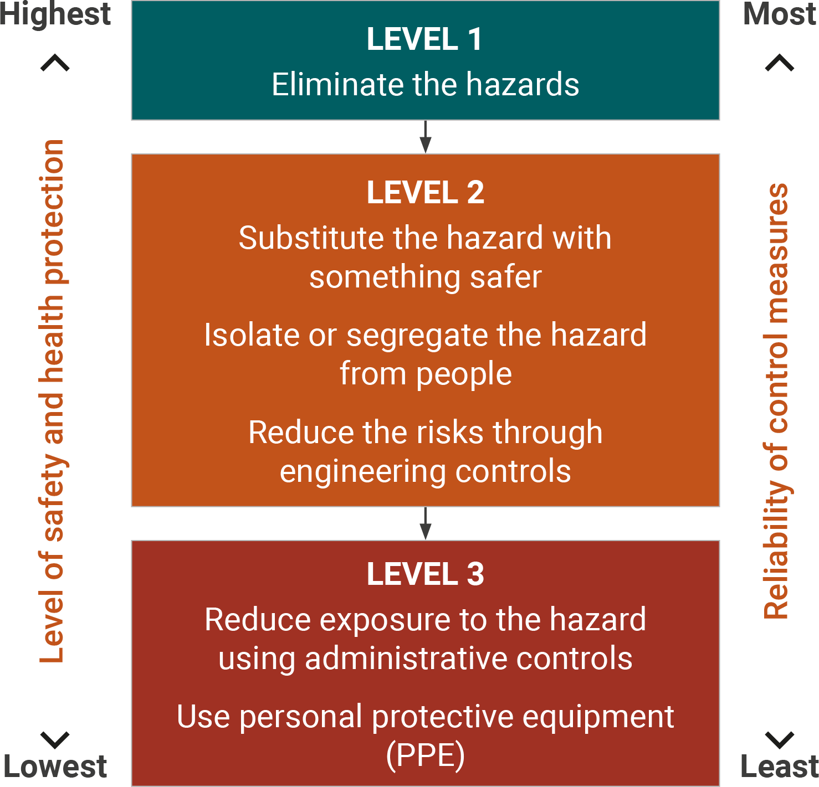
Risk management – Hierarchy of control
Notes:
Mines Safety contend that the risk management “discussion” across the broader industry appears to start at the bottom tier of the hierarchy of control.
Industry are reminded (many would be familiar with the hierarchy of control concept) that the tier-3 controls are usually straightforward to implement, but are the least effective, and should be viewed, in most instances as short-term fixes to long term issues.
Importantly, for the discussion that follows, when implementing a tier-3 control, a conscious decision is made to not address the hazard, rather to control the potential exposure to the hazard. This does not align with the modern safety philosophy of making the workplace suitable for the worker, and not making the worker suitable for the workplace …

Slide 18
Noise management – How far have we come?
Average LAeq8 results for occupational groups over time
Average result (dBA)
Notes:
By way of providing an example of why the Department believes the risk management conversation commences on the Tier 3 controls, the following slides is a summary of noise exposures across the Industry.
There is a big range in different people’s susceptibility to hearing loss from noise, however research shows that 8-hour average daily noise exposure levels below 75 dB(A) or instantaneous peak noise levels below 130 dB(C) are unlikely to cause hearing loss. With progressively increasing levels, the risk becomes greater*. The exposure standard for noise at an LAeq,8h of 85 dB(A) and a peak noise level at 140 dB(C), which protects most but not all people. Therefore, workplace noise should be kept lower than the exposure standard for noise if reasonably practicable.
*SWA Managing Noise and preventing hearing loss at work, September 2015 Page 10
Essentially, a worker who is exposed to 85 dB(A) for 8 hours receives the same noise energy as someone exposed to 88 dB(A) for 4 hours, with the balance of the day in a very quiet environment. In both cases the exposure standard is not being exceeded. However, being exposed to 88 dB(A) for more than 4 hours would mean that the standard is exceeded. Similarly, if a worker is using a machine that generates 121 dB(A) then the exposure standard would be exceeded after only 7.2 seconds.
The Department has selected 4 categories of workers (another 6 categories are available, and all show similar trends) to illustrate the point that over the past 15 years (from data supplied by the industry) noise exposures have scarcely changed, with the non-management and supervisory categories being consistently exposed above the exposure standard.

Slide 19
“But everyone wears hearing protection”
44%
LAeq8h (dBA) ranges (upper limits included)
Notes:
Mines Safety has had several discussions with industry leaders that have had a recurring theme that ‘noise is difficult to manage’, and therefore the industry actively promotes the use of hearing protection as a first line of protection. Feedback is that compliance with the use of hearing protection is very high.
Data submitted does not support the industry view of compliance. When industry submits data on noise exposures to the Department, the user is asked whether hearing protection was worn during the sampling period.
The grey bars in the graph illustrate the number of samples submitted that reported noise exposures within a 5dBA band. As can be seen from the graph, there are a great deal of samples submitted (>3000) and only 44% of the samples returned exposure readings less than the exposure standard.
Therefore over half of the mining workforce are exposed to levels of noise that may lead to noise induced hearing loss.
Almost half of the samples collected on workers that returned results above the 85dB Action Level reported that the workers did not wear hearing protection.

Slide 20
Risk management – Hierarchy of control
Notes:
A reminder of the structure of the Hierarchy of Control, and have conversations with team members on risk management and the need to start with Tier 1 and then Tier 2 controls.

