Slide 1
Please read this before using presentation
This presentation is based on content presented at the 2015 Exploration Industry Forum in June 2015
The Department of Mines and Petroleum (DMP) supports and encourages reuse of its information (including data), and endorses use of the Australian Governments Open Access and Licensing Framework (AusGOAL)
This material is licensed under Creative Commons Attribution 4.0 licence. We request that you observe and retain any copyright or related notices that may accompany this material as part of attribution. This is a requirement of Creative Commons Licences.
Please give attribution to Department of Mines and Petroleum, 2015.
For resources, information or clarification, please contact: RSDComms@dmp.wa.gov.au or visit ww.dmp.wa.gov.au/ResourcesSafety

Slide 2
The approvals process: Reducing red tape Information Session

Slide 3
Our economy relies on the resources sector

Slide 4
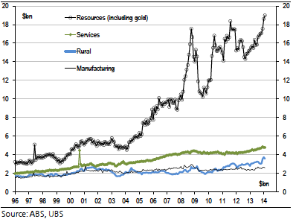
Australia’s transformation

Slide 5
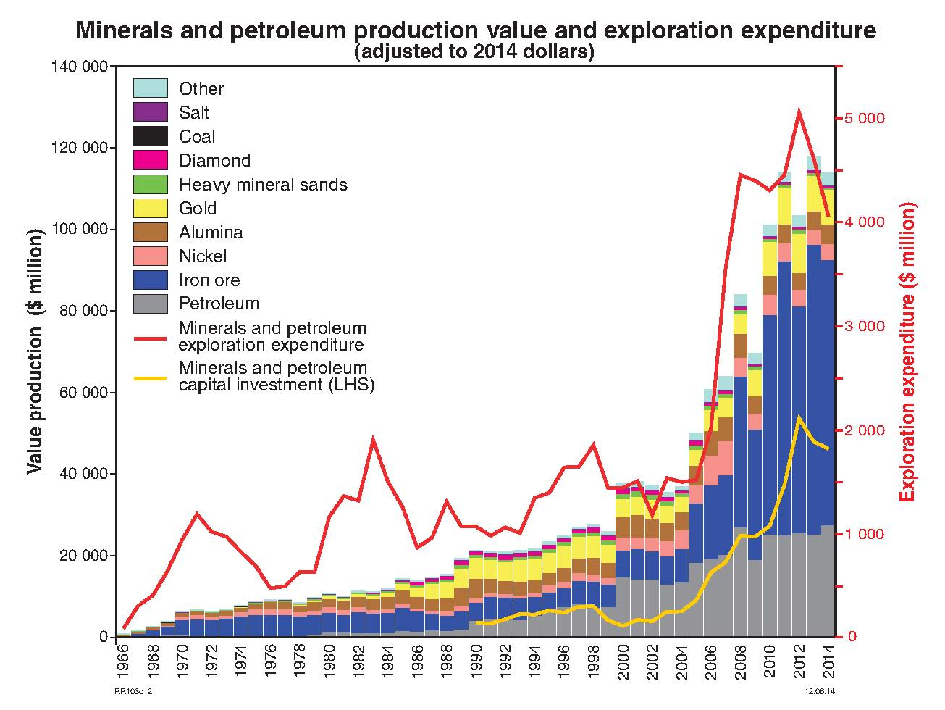
Western Australia world class resource sector
Notes:
Three cycles operating in the resources sector — exploration, capital investment into production facilities, and lastly, resource production ARE all shown in this graph.
Like the rest of the world, Western Australia has seen a downturn in two of these cycles -- exploration expenditure and investment into resource production facilities. Nevertheless these downturns have come after enormous rises in these cycles over the last eight years.
The drop in the rate of investment may not be such a bad thing if it reduces wage demands and the general cost of construction.
However, the production cycle, which reached a new record of $121.6 billion in 2013-14, shows no sign of a downturn on the back of higher physical production despite lower commodity prices.

Slide 6
Royalties
In 2014 Western Australia collected $6.8b in royalties
Iron ore and petroleum contributed 76% and 16% respectively
Royalties are payable on all minerals and hydrocarbon production
Royalties are government revenue used for education, health, roads, law enforcement, community development programs, etc.

Slide 7
Resource projects in WA in 2015
1046 operating
mines
294 mineral
projects
*48 operating oil
and gas fields
*32 in Commonwealth waters

Slide 8
Administering the resources sector
Approvals and compliance for minerals and energy resources projects – critical part of a successful and sustainable sector
Proponents want:
secure title to the resources they discover and develop
Clear and consistent regulatory requirements – including the royalty/tax regime
Government wants:
ensures workers and community are safe
ensures the community gets value through rent/royalties
provides policy settings that promote economic activity – transparent and consistent
ensures environment, cultural, and community values are protected

Slide 9
Lead agency – resources sector
Notes:
As part of the Lead Agency Framework, DMP has responsibility for coordinating resource sector approvals across State Government agencies. In many cases we have interagency agreements.
DMP also tracks other agencies’ approvals performance.
One agency takes the lead and works to address issues across Government, with set timeframes for each stage
Assist proponents with project approval scoping, coordination and problem solving
Scoping the proposal determines approvals required, identifies all agencies involved, including Commonwealth
Projects assigned levels based on importance and complexity
System of MOUs and agreements between agencies
Agency responsibility reflects the relevant legislation:
DMP is lead agency for mining, petroleum, geothermal and carbon capture and storage
Department of State Development (DSD) is lead agency for large, complex and strategically important projects

Slide 10
Our organisation

Slide 11
Key mining regulatory groups in DMP
Mineral Titles
Resources Safety Division
Environment Division
Petroleum Division
Legal, Royalties
Investigations and prosecutions
Communications
Ministerial unit
Focus on:
– equity, consistency, transparency and improvement

Slide 12
Why reform approvals?
Approval processes have become complex and
difficult to understand
Impacting on risk profile and State’s reputation in
attracting investment
Delay adds costs and complexity to project
Improving approvals and compliance is a key
part of government policy

Slide 13
Fundamental principles
Equality
Consistency
Transparency
Continuous improvement
Efficiency
The web is key – delivers easy access to information, for timely interaction and online transactions 24/7

Slide 14
Reform agenda
Reduce red tape – eliminate overlap of information requested
Set target timeframes for major approvals – report quarterly on the web
Set up lead agency project system with DSD – focus on large and complex projects
Set up all processes for the start of uranium mining in WA
Automatic notification of application for mining with other government agencies – Departments of Aboriginal Affairs, Parks and Wildlife, Water, Health, Office of the Environmental Protection Authority
Administrative agreements with these agencies

Slide 15
Reform agenda (continued)
Introduction of a mining rehabilitation fund (MRF) to address abandoned mine rehabilitation
Introduction of a mine safety levy (based on the number of employees) – to address failures of safety procedures at mine sites
RADARS – Reform and Development at Resources Safety
Attraction retention incentive (ARI) to attract and retain high calibre, technical staff in a very competitive employment environment
Continually improving guidelines mining proposals, tailings storage facilities (TSFs)
Amendments to legislation and regulations to facilitate responsible development

Slide 16
Risk
All reforms are the outcome of very extensive and sometimes protracted stakeholder engagement
Very strong focus on outcome-based and risk-based approach to reforms
Proponent carries ultimate responsibility to identify and address risks
DMP provides guidance and encourage best practice

Slide 17
New opportunities
Carbon capture and storage (CCS) – largest project in the world at Gorgon
Use of remotely controlled machinery
Use of driverless equipment – dump trucks, drilling and sampling, trains
Remote mine management from Perth – integrated mining, railway and port operation
Shale and tight gas – current focus on domestic gas supplies
Floating liquefied natural gas (FLNG) – the first in the world at Prelude

Slide 18
Smart ICT systems
Major shift to online applications and compliance reporting – all transactions online by July 2016
Revamp internal processes in DMP to phase-out paper files
Provides accurate tracking and reporting on performance
Improved capacity to analyse and understand weaknesses in our business
Online payment of rents and fees
Seamless transition from exploration approvals and reporting to mining approvals and reporting
Integrated systems – information to pre-fill forms online, and shared databases and information with other regulators, one billing and payment system

Slide 19
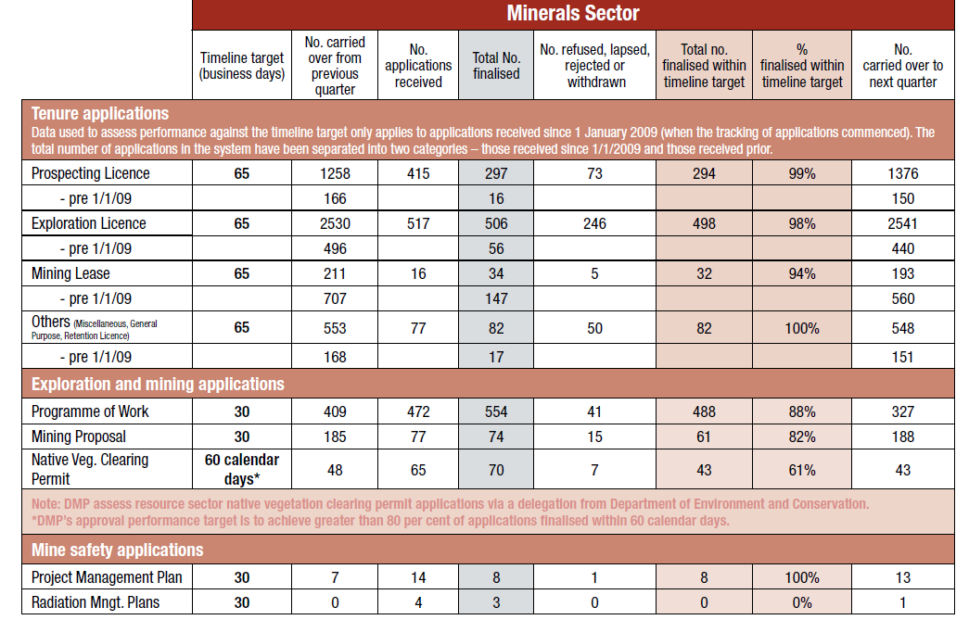
Performance reporting
Set target timelines for all key approvals and publish approvals performance quarterly
In 2014 DMP processed:
6,790 mineral, petroleum and geothermal applications
2,021 Programmes of Work – of these, 97% were within 30 business days timeline target
Notes:
DMP publishes quarterly approval performance reports for all key approval processes against target timelines. For example, the target timeline for the assessment of a mining proposal application is 30 business days. DMP reports its performance as a % of applications that were assessed within the target period. On average, DMP assess greater than 80% of standard applications within target timelines. During the 2012 calendar year, DMP processed over 7,048 mineral, petroleum and geothermal applications.
Growing community awareness of resource projects has highlighted the importance of ensuring that the departments approvals processes are transparent and openly communicated.

Slide 20
Attracting investment
Convince investors there is a high chance of making a discovery in WA – Geological Survey of Western Australia
Security of title – exploration to mining
Predictable and consistent government processes with specified timeframes – leads to low sovereign risk
Clear and efficient processes – reducing red tape
Continuous improvement
Are we succeeding?
Fraser Institute report assess the performance of jurisdictions around the world

Slide 21
WA ranking by Fraser Institute

Slide 22
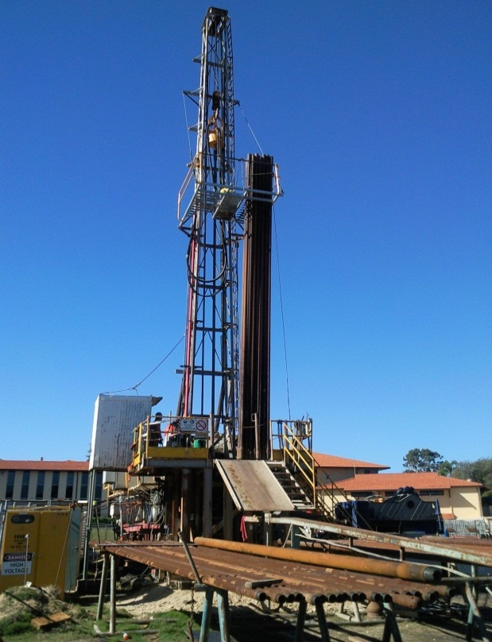
Community engagement
A major focus for DMP – Government must be regarded as a qualified, experienced and trusted regulator
Industry has been slow to play its critical role in explaining its activities to local communities and the wider community
Need to address misinformation
A big challenge to explain how risk is managed
Multiple land use framework (MLUF) – an approach to avoid moratoriums by promoting multiple and/or sequential land use because resource projects do not last for ever

Slide 23
Summary
Long term success of WA’s resources industry is fundamental to Australia’s economy into the future
DMP’s vision is for WA to continue to be the destination of choice for responsible resource exploration and development
Department is undergoing the most significant reform programs to occur in a generation
We are working in consultation with stakeholders to deliver more efficient and transparent approvals processes, with online systems as a key component
We know our business, treat people well and deliver on commitments

Slide 24
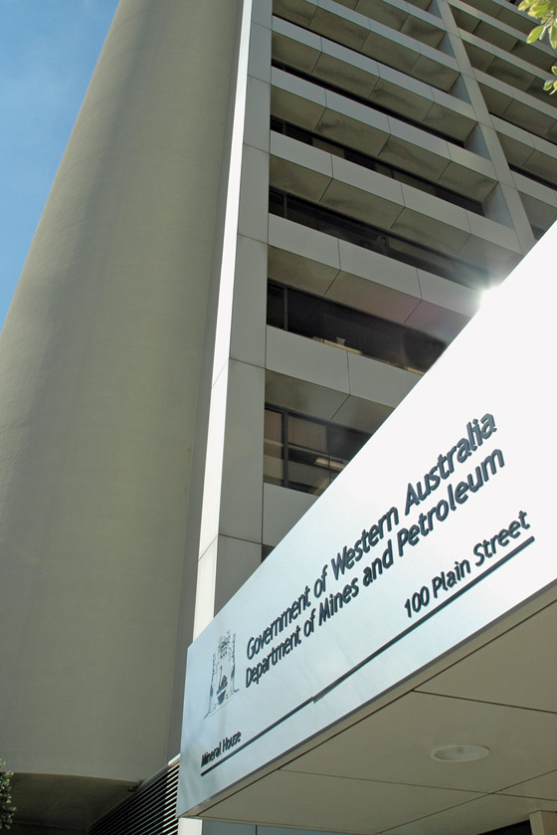
We aim to keep getting better
OUR VISION
Western Australia is the destination of choice for responsible resource development
We will continue to find new ways to cut red tape while maintaining a reputation as an responsible and trusted regulator
Our overriding role is to ensure the public and industry workers are safe, and the impact of resource projects on the environment is minimised

Slide 25
Stay informed!
Subscribe to our email alert service
and receive weekly news about:
recent publications
latest safety alerts
what’s happening at Resources Safety.
Visit www.dmp.wa.gov.au/ResourcesSafety
to sign up

