Slide 1
Please read this before using presentation
Department of Mines, Industry Regulation and Safety (DMIRS) supports and encourages reuse of its information (including data), and endorses use of the Australian Governments Open Access and Licensing Framework (AusGOAL)
This material is licensed under Creative Commons Attribution 4.0 licence. We request that you observe and retain any copyright or related notices that may accompany this material as part of attribution. This is a requirement of Creative Commons Licences
Please give attribution to Department of Mines, Industry Regulation and Safety, 2019
For resources, information or clarification, please contact: SafetyComms@dmirs.wa.gov.au or visit www.dmirs.wa.gov.au

Slide 2
Asbestos in the built environment

Slide 3
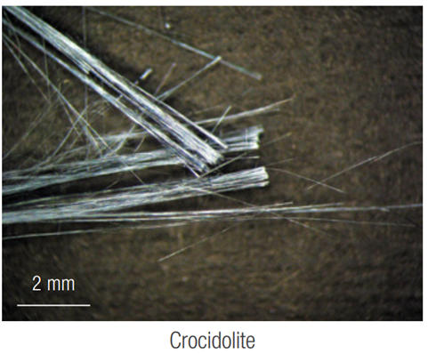
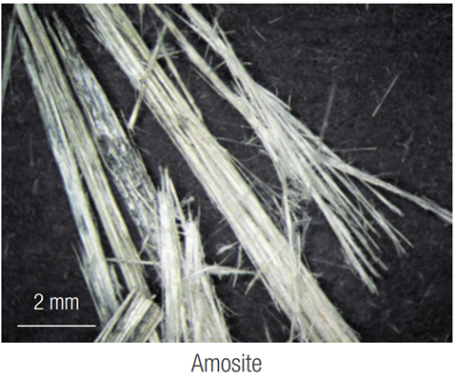
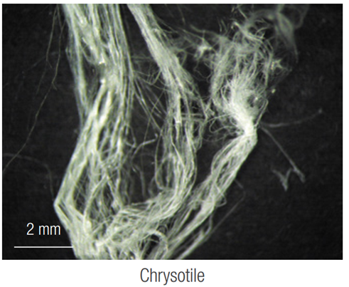
Asbestos in the built environment
The use of asbestos containing materials (ACM) at work sites is prohibited (with limited exceptions).
Historically ACMs were most commonly manufactured with these types of asbestos:
(blue asbestos)
(brown asbestos)
(white asbestos)
Notes:
Asbestos means any of the following fibrous forms of mineral silicates belonging to the serpentine or amphibole groups of rock forming minerals:
(a) actinolite asbestos;
(b) amosite (brown asbestos);
(c) anthophyllite asbestos;
(d) chrysotile (white asbestos);
(e) crocidolite (blue asbestos);
(f) tremolite asbestos.
Regulation 9.32A of the Mines Safety and Inspection Regulations 1995 prohibits use of asbestos except where exempted or removal and disposal by a competent person is required.

Slide 4
Asbestos in the built environment
Asbestos containing materials may be present in buildings, structures, plant, equipment and vehicles if:
constructed or renovated prior to 2004
imported materials using asbestos are used
Notes:
ACMs were used extensively in Australian buildings, structures, plant, equipment and motor vehicles.
Buildings and structures constructed or renovated between 1945 and the late 1980s may contain asbestos in areas such as ceilings, internal walls, roofs, eaves, external cladding, wet areas and vinyl floor tiles. Asbestos may also be present in brake pads, gaskets and seals, pipes and pipe lagging.
From 1985 the manufacture, importation and installation of products containing crocidolite and amosite was banned. This was followed in the late 1980s by the ban of their use in building products. On 31 December 2003, a national ban on all uses of chrysotile asbestos came into effect.

Slide 5
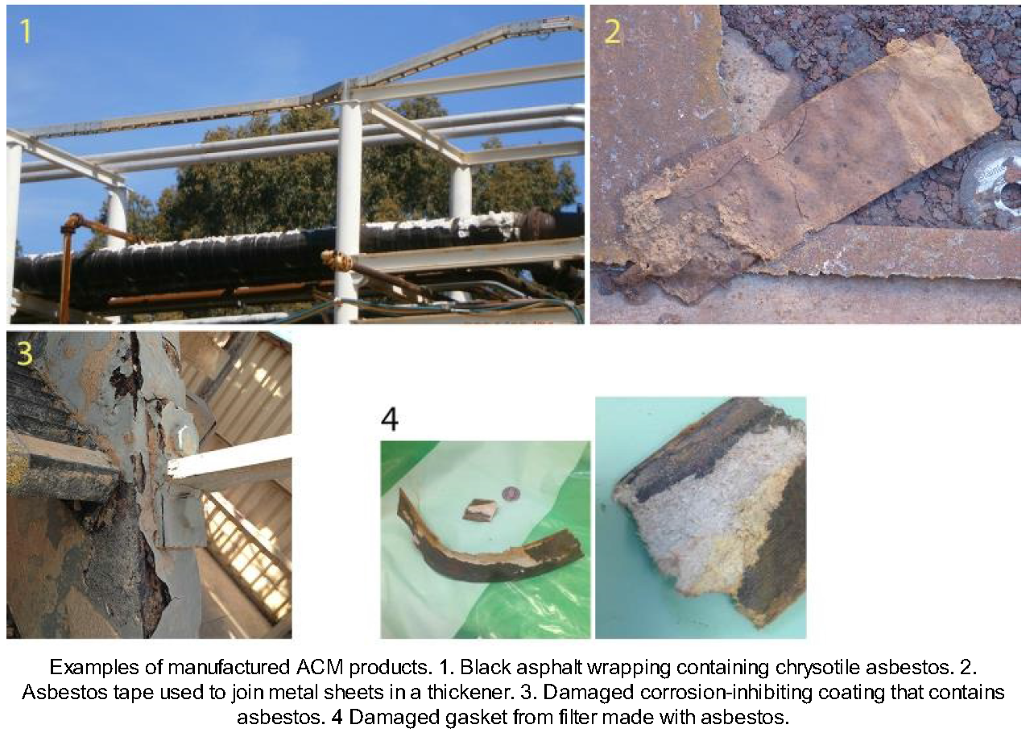
Examples of manufactured ACM products

Slide 6
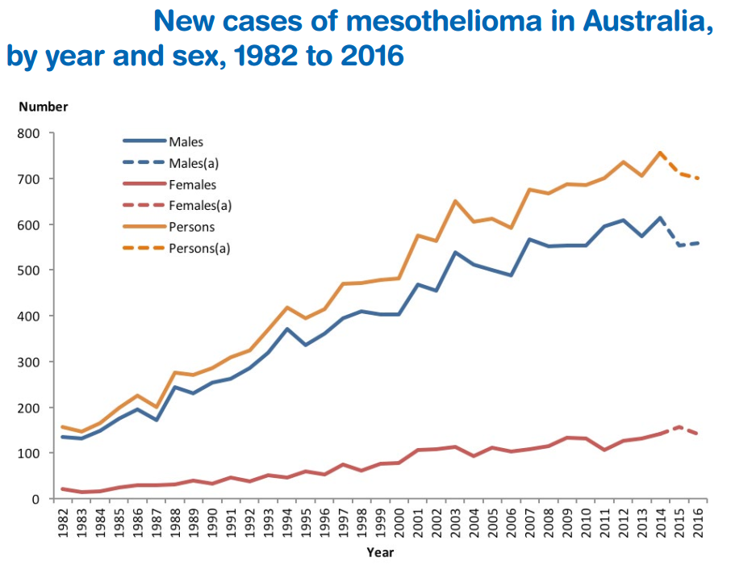
Impacts on health
Asbestos fibres can be released if ACM is disturbed, deteriorated or abraded
Risk to health when fibres are inhaled
Lag period for asbestos
related diseases
Asbestosis (5 -15 years)
Lung cancer (>20 years)
Mesothelioma (20 - 40 years) – no cure
Pleural plaques
Notes:
Asbestosis is a thickening of the lung tissue due to the breakdown of the macrophages which attempt to dissolve the fibres. This results in fibrosis causing breathing difficulty.
Lung cancer results when the breakdown of the macrophages and the irritation of the lung tissue results in the mutation of a cell, which then becomes cancer.
Mesothelioma is a particular type of cancer with a very short life (typically 18 months); from which people rarely survive. There is currently no cure for the disease.
Pleural plaques are another form of thickening of the lung tissue, resulting from the breakdown of the lubricating fluid located in the pleural cavity. It causes rigidity in the lung tissue, making breathing difficult.
Graph Source: Australian Mesothelioma Registry – Mesothelioma in Australia 2016 – 6th Annual report

Slide 7
Impacts on health
Western Australia has the highest mesothelioma rate in Australia
(4.9 cases per 100,000 population)
710 people were diagnosed with mesothelioma in 2017
(Australia wide)
Australia has one of the highest incident rates in the world.
651 Australians died from the disease in 2016
Notes:
Source:
Australian Mesothelioma Registry – Mesothelioma in Australia – November 2018
Note: These are preliminary figures and are expected to rise as more information becomes available.

Slide 8
Incidents involving asbestos exposure
SIR 263 Asbestos disturbed in power transformer
MSB 129 Management of ACM at mines sites and accommodation
MSB 080 imported gaskets containing asbestos
Safety alert 12/2018 High pressure water cleaning of asbestos cement
Safety alert 06/2016 Exposure to asbestos during renovation works
Safety alert 02/2017 Asbestos found in imported friction wear plates in rail carriages
Safety alert 13/2012 Asbestos gaskets in vehicles
Safety alert 01/2017 Asbestos in imported building products

Slide 9
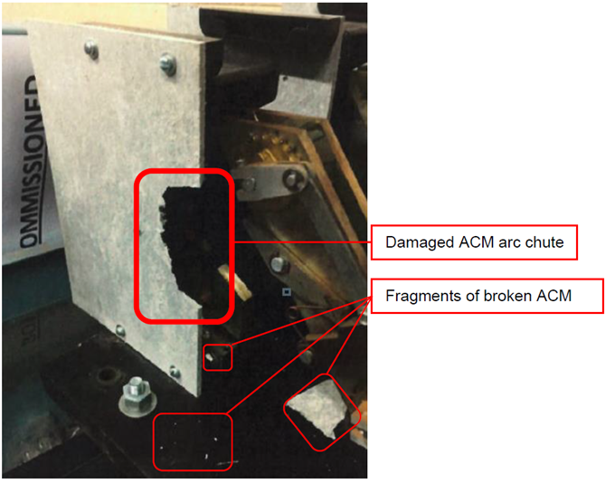
Common investigation findings
Sites not aware of where asbestos is present in their workplace
Asbestos on site allowed to become disturbed, deteriorated or abraded
Workers not aware of asbestos present in their work area
Workers not wearing adequate respirators/PPE

Slide 10
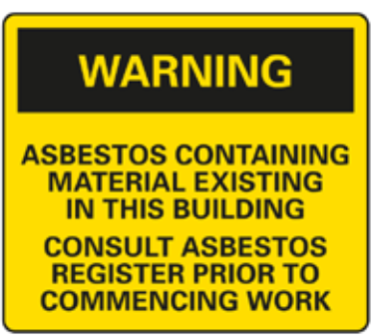
Common investigation findings
Principal employers not ensuring workers are provided adequate induction, training and supervision to prevent exposure
Workers not provided direct access to the asbestos register for the site
Competent persons are not being used to do the task (e.g. Licensed asbestos removalist)
Asbestos not being sign-posted or labelled.

Slide 11
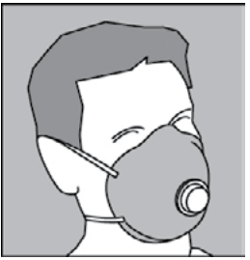
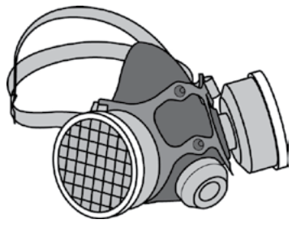
Preventing exposure to asbestos fibres
Persons are unlikely to be wearing adequate PPE if they do not know where the asbestos is in their work environment.
Before working, ensure that there is no asbestos in the work area.
check the site asbestos register, and/or
have a competent person verify asbestos is not present
Notes:
Prior to any work:
A competent person should have already conducted a survey for asbestos in the workplace (reviewed 5 yearly)
An Asbestos Register and Asbestos Management Plan should have been developed

Slide 12
Preventing exposure to asbestos fibres
If asbestos is suspected stop work until it can be confirmed by a competent person and/or a laboratory sample that the material is not asbestos.
Ensure only competent persons conduct any removal work, clean up and disposal.
Notes:
A competent person means a person possessing adequate qualifications, such as suitable training and sufficient knowledge, experience and skill, for the safe performance of the specific work.
In most WA workplaces, removal of any amount of friable asbestos, or more than 10 m2 of non-friable asbestos, must be done by a licenced asbestos removalist, or a person engaged by a licenced removalist.
Information on finding and selecting a licensed asbestos removalist is available here http://www.commerce.wa.gov.au/worksafe/finding-and-selecting-asbestos-licence-holder
If a material is presumed or suspected to contain asbestos, you can either treat it in the same way as asbestos, or have it tested for asbestos.

Slide 13
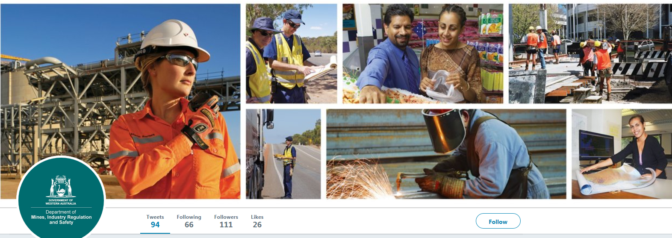
Follow us on social media
Twitter
@DMIRS_WA
@AndrewChaplyn
LinkedIn at Department of
Mines, Industry Regulation and Safety
13

