Slide 1
Please read this before using presentation
This presentation is based on content presented at the Mines Safety Roadshow in October and November 2016
The Department of Mines and Petroleum (DMP) supports and encourages reuse of its information (including data), and endorses use of the Australian Governments Open Access and Licensing Framework (AusGOAL)
This material is licensed under Creative Commons Attribution 4.0 licence. We request that you observe and retain any copyright or related notices that may accompany this material as part of attribution. This is a requirement of Creative Commons Licences
Please give attribution to Department of Mines and Petroleum, 2016
For resources, information or clarification, please contact:
RSDComms@dmp.wa.gov.au or visit
www.dmp.wa.gov.au/ResourcesSafety

Slide 2
What are the consequences of getting caught, trapped or crushed?

Slide 3
Good morning
What does the Investigation Branch do?
We ask questions… lots of questions
What was the most awkward conversation of your life?
Notes:
The DMP Investigations Branch is in the business of bad news. When the Investigations Branch go to a site it normally means something has gone horribly wrong.
The branch investigates fatal accidents, severe serious injuries and high risk near misses.
What was the most awkward conversation of your life?
Imagine you are a supervisor, and someone on you’re your crew is killed in an accident, and someone from DMP Investigations branch comes to site to interview you… How awkward would that be?
None of these interviews are pleasant, but one example was where the supervisor was the brother of the person who was fatally injured.

Slide 4
Pop quiz
Who here has worked on a mine (in WA)?
Who here has any information relating to anything to do with work carried out on a mine (in WA)?
Who here is familiar with Section 21, of the Mines Safety Inspection Act (1994)?
A mines inspector can compel
Any person who is or was at any time during the preceding 3 years – an employee working at a mine
Any person who may otherwise be able to provide information relevant to a matter the inspector is inquiring
to answer questions
Notes:
This is a statement you could hear if an accident happens at your site, and DMP come and interview you:
“Under MSIA I will now ask you some questions which I REQUIRE you to answer. IF you object to answering any of these questions you should say so, BUT you MUST still answer. Any answer you give will Not be admissible in evidence in a prosecution against you EXCEPT a prosecution for failing to provide information which I require or for making a false or misleading statement to me.”

Slide 5
What is safety?
What is safe?
What is ‘unsafe’?
Where is safety?
How did you get here?
Notes:
(Note to presenter: Click through each question)
How did you get here?
How did you get from your bed (at home or possibly your donga) to this presentation? From the moment you got up and your feet hit the ground, up until now… Did you take zero risks?
(Note to presenter: interactive section)
Please rate how much risk you accepted in getting from your bed to here.
For absolutely zero risk, point your right hand directly to the ceiling,
If you arrived here in an extremely risky manner, point your right hand directly at the floor
Maybe you had to cross the road, go down stairs, drive or was driven
Look around Maybe some people may think they take no risks - but WE ALL TAKE RISKS

Slide 6
Speaking of safety
What is the first thing you think of…
When you hear the phrase ‘as safe as possible’?
“minimise the risk, and do it as safe as possible”
REALLY?!?
Notes:
The Video is from Leg straps Incident – YouTube and the full version contains language that may not be suitable for work.
The point of this video is to emphasis the importance of awareness, supervision and the importance of ensuring the controls for risks are in place and effective.
In a report published in 2007, Soreide et al studied the results of 20,850 BASE jumps between 1995 to 2005 at the Kjerag Massif in Norway. During the 11-year period, they found there had been 82 nonfatal accidents (1 in every 254 jumps) and 9 fatal accidents (1 in every 2,317 jumps).
In comparison, traditional skydiving carries a death rate of one in every 101,083 jumps, according to data compiled by the United States Parachute Association.
Other extreme or adventure sports carry markedly lower risks, such as scuba diving (one death in every 200,000 dives), rock climbing (one in every 320,000 climbs) and skiing (one in every 1,556,757 visits).

Slide 7
Why aren’t we making better decisions?
Why aren’t we learning?
Who here has learnt to count?
It’s not the most complicated thing in the world
Who here has made a mistake counting?
It’s not that simple
It’s never that simple
Never say never
Notes:
We all make mistakes You don’t know the mistake you or your co-worker might make, even with seemingly simple tasks.

Slide 8
Caught, trapped or crushed videos
Warning:
video does contain and enactment of an accident including fake blood and bad acting
Notes:
Why aren’t we learning, These hazards aren’t exactly new. But before we get to our DMP videos, this video is from the 1980 film ‘Shake Hands with Danger’ made for Caterpillar.

Slide 9
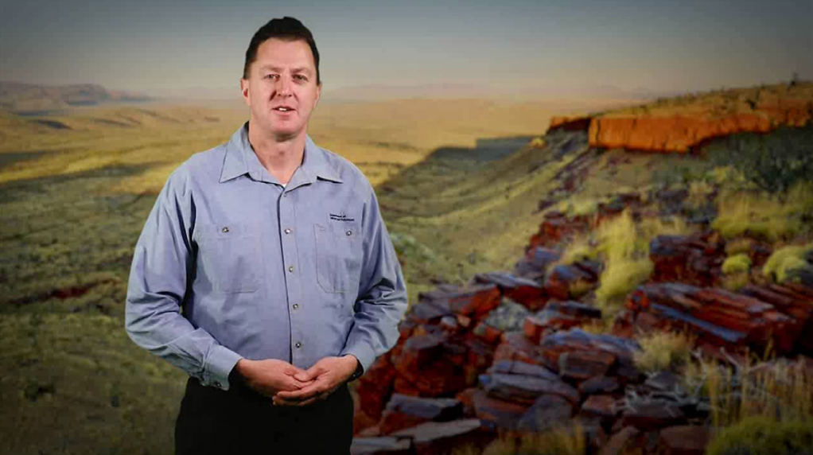
Know your hazard video: caught
The following video is about a real accident with real consequences and may show images of injuries which some viewers may find disturbing
Do not try this at work or home
Notes:
Video link https://vimeo.com/190053434
This video is one in a set focusing on the hazards surrounding machinery and plant on mine sites. When things go wrong, and part of your body is trapped, caught or crushed by moving objects, you could be seriously hurt or killed.
In this video, we’re exploring how rotating or moving machinery can snare limbs, loose hair, jewellery and clothing to rapidly catch and entangle workers, as well as the personal consequences of this kind of event.
The act of being caught and entangled in rotating or moving machinery usually relies on a combination of gaps, projections, friction and speed, compounded by a lack of awareness or suitable safeguards. Workers must approach with caution any exposed high-speed rotating shaft or parts.

Slide 10
Why aren’t we making better decisions?
When have you done something really stupid?
At work?
At home?
Or abroad?
Why did you make that decision?
Notes:
(Note to presenter: interactive section) (each question is animated)
Possible group discussion or ask an individual to volunteer a story depending on time
Emphasis on why they made the decision,
What was there focus at the time?
Where they aware of all the hazards?
Was there a trade-off? Where they conscious of it?

Slide 11
Investigation insights: Top 3
Hazard awareness
Hazard awareness
Hazard awareness
Know your caught hazards
Know your trapped hazards
Know your crush hazards
Notes:
Time after time there are some things that often keep popping up in investigations. The one thing that happens in almost every investigation is lack of awareness of the hazard - Looking without seeing It’s rare that after a hazard is identified front and centre it isn’t dealt with, If it isn’t in the procedure or SWI, it isn’t in the JHA, if it isn’t in the Take 5….

Slide 12
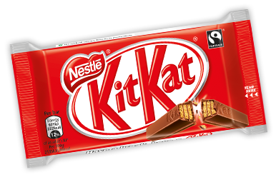
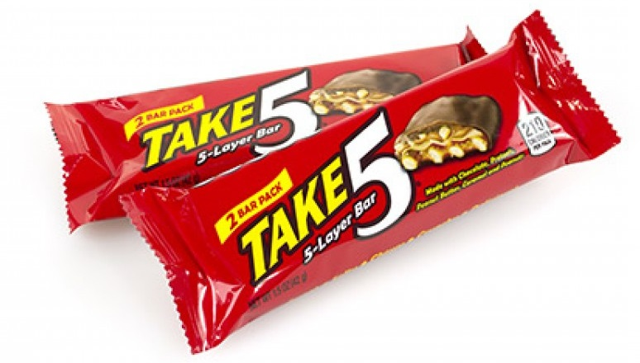
Step back and Take 5
Have you done a Take 5? Did they do a Take 5?
What is the point? What is the purpose?
How about JSA/JHA/JSEA/TBRA? (different flavours)
Take 5’s & JSA’s hazard awareness and human error
VS
Notes:
It is common for supervisors or managers to ask if you have done the paperwork, it’s easy to check, and yes Investigations Branch will ask if a Take 5/JSA has been done after an accident. Unfortunately when DMP visits after an accident, if a take5 or JSA has been done, it either:
didn’t identify the hazard
did identify the hazard but there was no sufficient control in place
What does it say about your safety system,
If the people at the pointy end aren’t told about a hazard in training, procedure or instructions and they are expected to pick it up themselves Are we expecting every worker, everyday to remember and identify every hazard?
How is that safety system protecting people from their errors?
Everyone has trade-offs, some people pay the price.

Slide 13
Investigation insights: common patterns
Before or after breaks
Why is that?
Helping someone else do their task
Why is that?
What normally works or is supposed to work didn’t
What do you do?
Scope creep or something changed…?
Poor procedures or poor planning
Notes:
(Note to presenter: click through each question)
Time after time there are some things that often keep popping up in investigations. These are other common patterns that pop up in investigations,
(Note to presenter: Interactive section)
Ask audience why these are associated with accidents

Slide 14
Know your hazard video: trapped
The following video is about a real accident with real consequences and may show images of injuries which some viewers may find disturbing
Do not try this at work or home
Notes:
Video link: https://vimeo.com/190053660
This video is one in a set focusing on the hazards surrounding machinery and plant on mine sites. When things go wrong, and part of your body is trapped, caught or crushed by moving objects, you could be seriously hurt or killed.
In this video, we’re exploring how dangerous nip points can trap workers in equipment, as well as the personal consequences of this kind of incident.
Nip points in machinery potentially have enough energy to trap a worker, making it hard to escape. Getting your clothing or part of your body caught in a nip point could lead to severe crush injuries, amputation or a fatality.

Slide 15
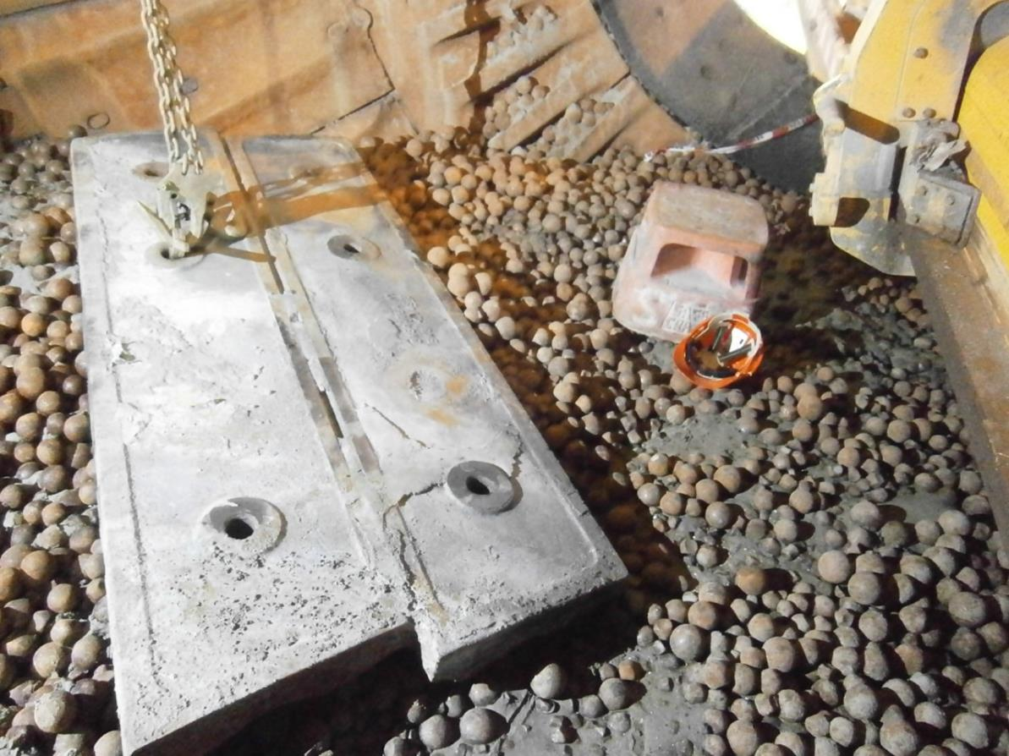
In 2012
Safety step and hard hat for scale
Zero fatalities
How did we do it?
Were we making better decisions?
Were we safer?
1.5 tonne mill liner
Notes:
In 2012-2013 the mining industry had a 700 day stretch fatality-free
How did we do it?
Had we learnt?
Were we making better decisions?
Were we safer?
There are around a dozen accidents like the one in this photo, which with a difference of an inch or a foot either way, could have been fatal.
Mines Safety Significant Incident Report No. 187
www.dmp.wa.gov.au/Documents/Safety/MSH_SIR_187.pdf
Serious crush injuries caused by falling ball-mill liner plate
Summary of incident
A worker was seriously injured during a ball-mill relining operation when he was struck by a large liner plate weighing about 1.5 tonnes. The worker had been preparing to remove two unsecured liner plates still in place inside the ball mill when the top liner plate was dislodged and fell, pinning him to the ground. A mechanical lifting device was required to lift the liner plate from the worker. He sustained extensive injuries, including compound leg fractures, fractured vertebra, and crush injuries to his chest.

Slide 16
Also 2012: three tonnes of mesh
Notes:
Mines Safety Significant Incident Report No. 179
www.dmp.wa.gov.au/Documents/Safety/MSH_SIR_179.pdf
Serious crush injuries caused by falling mesh sheets
Summary of incident
Three workers were seriously injured at an underground mine when an upright stack of more than 70 sheets of construction re-enforcing mesh fell onto them. The mesh became unstable and fell onto the workers when two sheets were being manually removed. Two of the injured workers were trapped under the mesh and suffered fractured pelvises. The third worker was struck by the falling mesh and pushed out of the way. He suffered a compound fracture of the leg. The mesh was being used for the construction of a floor. The sheets were 6.0 m long by 2.4 m wide and weighed about 40 kg each.

Slide 17
Three tonnes and three people
Notes:
Something to keep in mind The offsider, who had been resting in an air-conditioned cab to recover from exhaustion after a long shift in a warm area with poor ventilation, and the additional heat generated by the fast setting concrete.
He was a concrete worker, who was exhausted, which was why he was resting in the air-conditioned vehicle. The person he was assisting would also have been under the influence of heat and exhaustion, when he made the decision at the end of shift to try and move the sheets.
What quality of decisions do people who are exhausted and influenced by heat stress make?

Slide 18
Know your hazard video: crushed
The following video is about a real accident with real consequences and may show images of injuries which some viewers may find disturbing
Do not try this at work or home
Notes:
https://vimeo.com/190053219
This video is one in a set focusing on the hazards surrounding machinery and plant on mine sites. When things go wrong, and part of your body is trapped, caught or crushed by moving objects, you could be seriously hurt or killed.
In this video, we’re exploring how heavy-duty equipment has the potential to contribute to crushing incidents, as well as the personal consequences of this kind of event.
Some machines are specially designed for crushing tasks. It’s easy to identify the hazards for staff working with, or around, this type of equipment. But other machines can also produce crushing hazards. All crushing injuries can be prevented through awareness and by applying adequate control measures.

Slide 19
Crushed
Notes:
Something changed: The original plan was to use a crane to remove bulk bags from inside the building, but some of the loops on the bags were broken. What was supposed to work didn’t.
New plan to use forklift, as the bags were on pallets, BUT the forklift got stuck trying to reverse into building.
Significant Incident Report No. 203
www.dmp.wa.gov.au/Documents/Safety/MSH_SIR_203.pdf
Subject: Operator crushed by mast of forklift truck - fatal accident
Date: 21 July 2014
Summary of incident
A worker was fatally injured when he was trapped between the mast and frame of a forklift truck. The forklift had bottomed-out and was stuck on the crest of a ramp that provided pedestrian access into a process building. The worker, who had a high risk work licence for operating a forklift truck, planned to lift the front of the forklift with a mobile crane to release it. He had positioned himself between the mast and frame of the forklift truck to attach a lifting sling to the mast. He was not using the marked slinging points. It appears that the control level for the mast’s tilt cylinder was inadvertently activated, causing the mast to close and crush him.

Slide 20
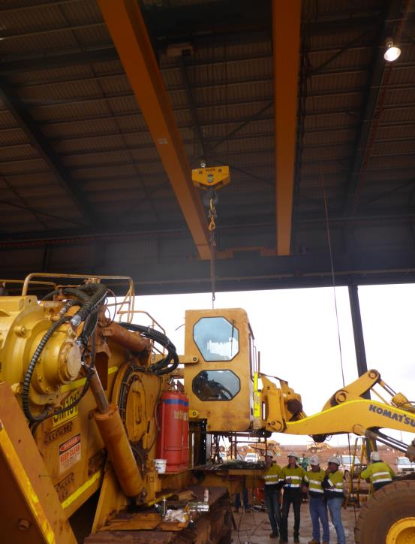
Load cell display
Overhead crane SWL 50 tonne
100 tonne surface miner
Rigging connecting crane to cab SWL 5.5 tonne
2.2 tonne cab
Cab arms connecting cab to surface miner
Machine used only in rescue after incident
Location of workers
Notes:
(Note to presenter: interactive section)
Before clicking through slide ask the audience: Q: are there any dogmen, riggers or crane drivers here? Q: what information do you need to know before selecting lifting equipment? (weight of load) In this accident they did not know the weight.
(Note to presenter: Start click through to ‘cab arms connecting cab to surface liner’)
Q: what might be happening if the crane load cell is showing a load above the expected weight of the load?
(Note to presenter: click through remaining text bubbles)
NOTE: at the time the SIR was published the investigation was not complete
The rigging was overloaded, though it had sufficient capacity to lift the cab (If they were just lifting the cab)
Significant Incident Report No. 194
www.dmp.wa.gov.au/Documents/Safety/MSH_SIR_194.pdf
Subject: Crush injuries sustained from working with a suspended load - fatal accident
Date: 16 January 2014
Summary of incident
A worker was fatally injured, and another seriously injured, in an accident at a heavy equipment maintenance workshop. Two workers were completing the installation of the operator’s cab for a surface miner after a rebuild. The cab weighed about 2.5 tonnes and was suspended from an overhead crane.
The pins that connected the four lifting arms to the cab had been fitted by the day shift workers. The day shift had then lowered the cab onto the machine and left it in the resting position against the bump stops. There was slack in the chains connecting the cab to the overhead crane. When the job was handed to the night shift workers, one pin had to be shimmed and the retaining bolts fitted to all four pins. The accident happened about one hour into the night shift after the cab had been lifted from its resting

Slide 21
Caught, Trapped, Crushed Summary
Hazard awareness
Know your hazards
We all make trade-offs
We all make mistakes
Decisions have consequences – some people pay
Notes:
Hazard awareness
Know your hazards
We all make trade-offs
We all make mistakes
Decisions have consequences – some people pay

Slide 22
Stay informed
Remember: Subscribe to our weekly email alert service to receive the latest news about what’s happening at Resources Safety
@ www.dmp.wa.gov.au/subscriptions
Follow us on social media:
Twitter
@DMP_WA
LinkedIn at Department of
Mines and Petroleum
Notes:
Subscribe to Resources Safety’s email alert service to receive invitations to provide input as well as the latest news about publications, safety alerts, events and safety reform progress. Safety news alerts are typically sent each Tuesday.
Follow us on LinkedIn to receive the latest resources safety news alerts and job opportunities at DMP.
Follow us on Twitter to stay up-to-date on a variety of the latest department news and information - from major project milestones and upcoming events, to updates regarding industry policies and guidelines.

