Slide 1
Please read this before using presentation
This presentation is based on the content presented at the 2018 Mines Safety Roadshow in October 2018.
Department of Mines, Industry Regulation and Safety (DMIRS) supports and encourages reuse of its information (including data), and endorses use of the Australian Governments Open Access and Licensing Framework (AusGOAL)
This material is licensed under Creative Commons Attribution 4.0 licence. We request that you observe and retain any copyright or related notices that may accompany this material as part of attribution. This is a requirement of Creative Commons Licences.
Please give attribution to Department of Mines, Industry Regulation and Safety, 2018.
For resources, information or clarification, please contact: SafetyComms@dmirs.wa.gov.au or visit www.dmirs.wa.gov.au/ResourcesSafety

Slide 2
2018 Mines Safety Roadshow

Slide 3
Investigations in serious and fatal accidents
Notes:
In the past, isolation processes in the mining industry were not given adequate emphasis. It was common practice to use tags only to identify that a circuit or item of plant was deactivated or de-energised and that personnel may be working on or around it. In many instances, the potential sources of hazardous energies were not recognised and isolation was not understood or properly applied.

Slide 4
Guideline published
Hazardous energy is any form of energy with the potential to cause harm.
Hazardous energies exist in all mining operations.
Exposure to the hazardous energies associated with plant continues to be a significant cause of fatal and serious injuries in the WA minerals sector.
Notes:
Guidance about the isolation of hazardous energies - Isolation of hazardous energies associated with plant in Western Australian mining operations
Structure of guideline
This guideline will assist mining operations to develop safe systems of work for fixed and mobile plant. It is structured to support a risk management approach to the isolation of hazardous energies where protection is required from:
movement or operation of plant
movement of materials handled by plant
contact with energy used to operate plant
contact with energy used to carry out processes associated with plant
contact with energy produced or carried by plant
contact with energy stored within plant.
A guideline on isolation of hazardous energies associated with plant in Western Australian mining operations is available for industry use.
The guideline provides information on the development of safe systems of work associated with the isolation of hazardous energies, where protection is required from:
the movement or operation of plant
the movement of materials handled by plant
contact with energy
used to operate plant
used to carry out processes associated with plant
produced or carried by plant
stored within plant.

Slide 5
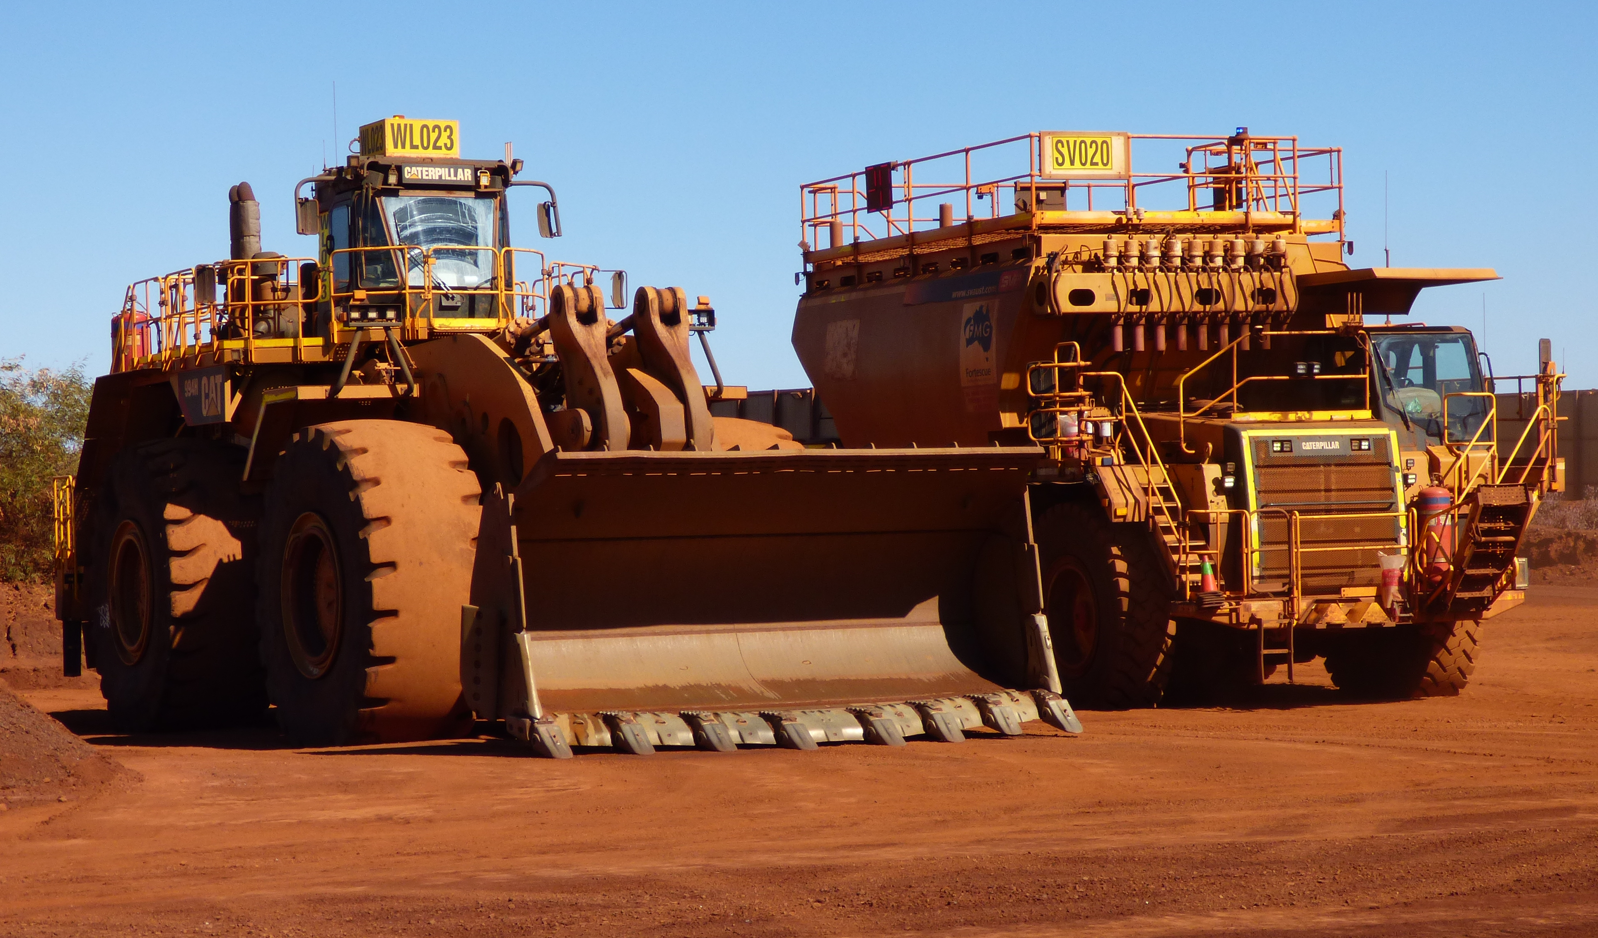
Hazardous energies
Some forms of hazardous energies to consider are:
Electrical
Chemical
Mechanical (or kinetic)
Stored (or potential)
Thermal
Radiation energy.
Notes:
Why is the isolation of hazardous energies associated with plant important?
A range of hazardous energies exists in mobile and fixed plant in mining operations, such as stored, electrical, and mechanical energies. During normal operating conditions, workers are generally protected from these energies by controls such as the plant’s design and guarding.
Controlling exposures to hazardous energies:
Hazardous energy is any form of energy with the potential to cause harm. Hazardous energies exist in all mining operations. Exposure to the hazardous energies associated with plant continues to be a significant cause of fatal and serious injuries in the Western Australian minerals sector.
Hazardous energies:
Some forms of hazardous energies to consider are listed below.
Electrical energy – energy made available by the flow of electric charge through a conductor. It can be encountered live through power lines, transformers, switchgear, local controls and distributors; or it can be stored in batteries or capacitors. Workers may be harmed through electric shock, exposure to an electric arc, or induced electrical currents in adjacent cables.
Note: This guideline does not cover high voltage (HV) installations and their isolation.
Chemical energy – energy that is stored in chemicals and that is released and converted into other forms when a substance undergoes a chemical reaction. For example, when explosives go off, stored chemical energy is transferred to the surroundings as thermal, sound and kinetic energies.
Mechanical (or kinetic) energy – the energy an object, component or material possesses due to its motion. Setting an object into motion requires that the object be accelerated to attain motion, and this energy, if hazardous, must be dissipated and isolated. Examples include flywheels, conveyor systems, and fans that can be moved or energised by physical means.
Stored (or potential) energy – the energy stored within a physical system, including gravitational potential, and pneumatic and hydraulic pressure energies. Mine site examples include hydraulic systems, vacuum systems, power presses, blocked pipework and vessels, inflated tyres, accumulators and other pressure vessels, power washers, conveyor counterweights, pneumatic valves with fail-safe spring mechanisms, stockpile faces and storage dams.
Thermal energy – the internal energy present in a system or substance by virtue of its temperature. Experienced as either heat or cold, thermal energy is commonly produced by mechanical devices (combustion or friction), electrical resistance, and chemical reactions or change of state (e.g. melting, evaporation, sublimation).
Radiation energy – energy from electromagnetic sources such as lasers, microwave transmitters, equipment that generates infra-red or ultraviolet light, and X-ray machines. Workers may be harmed through exposure to laser beams and ultraviolet light (e.g. skin and eye damage), and X-rays (e.g. cancer).
Potential radiation energy sources used at mining operations include downhole or well logging tools, portable XRF analysers, nuclear moisture or density gauges, and material-grading devices.
Note: Isolation of ionising radiation devices is only to be conducted by a competent and authorised radiation safety officer, as required under the mining operation’s radiation management plan.

Slide 6
Significant Incident Report (SIR) events
Information contained in the SIRs used today is based on knowledge and understanding at the time of writing.
Some of the Department of Mines, Industry Regulation and Safety’s investigations are ongoing.

Slide 7
Mines Safety Bulletin No. 101
Subject: Trucks moving off while fitters working underneath Date: 6 December 2012
Summary of hazard
Over the past 18 months, three open-pit incidents have been reported where a truck has been driven off while a fitter was carrying out work beneath it.
Although the fitters were not injured, there was significant potential for serious or fatal injuries.
Notes:
Work requiring partial or complete energisation
Some tasks require plant to be either partially or completely energised. Examples include the inching of mills during relining, and assessing the source of a fault or damage where information can only be obtained during plant operation.
Using a risk-based approach, the controls implemented need to prevent exposure of persons to the hazardous energies involved, rather than prevent release of those energies.
Work requiring partial or complete energisation
Mobile plant may need to be either partially or completely energised for fault finding or calibration. Examples include:
testing hydraulic pump performance
fault-finding in electrical wiring harnesses
assessing alternator performance
checking the condition or performance of wet braking systems
checking accumulator pressures
fitting tracks.

Slide 8
Mines Safety Bulletin No. 101
A fitter was assigned to turn on the heater valves under a dump truck in the evening.
The fitter approached the truck from the driver’s offside and used his torch to signal the driver, who was sitting in the cabin with the engine running.
The driver did not notice the fitter and drove off while the fitter was still under the vehicle.
The fitter moved to the centre of the truck and was on his hands and knees as the chassis passed over him.

Slide 9
Mines Safety Bulletin No. 101

Slide 10
Mines Safety Bulletin No. 101
Water cart broke down in the middle of the night. Serviceperson filled the transmission system with oil and left as two fitters were checking for leaks.
The fitters placed commissioning tags on the main isolation point and instructed the driver to collect his belongings from the truck. This instruction was misunderstood.
As the fitters were inspecting the underside of the truck, they heard the truck’s gears being engaged and realised it was about to drive off.
They quickly moved from under the truck as it drove away.

Slide 11
Mines Safety Bulletin No. 101

Slide 12
Mines Safety Bulletin No. 101
At the start of the day shift, a fitter had placed a “restricted operations” tag on the main isolation point of a truck after the driver had completed his pre-start checks.
The fitter commenced his inspection and asked the driver to go to the cabin and turn on the engine as the wheels needed to be turned.
As the fitter continued to work under the truck, a light vehicle that was parked in front of the truck left the area. Assuming it was being driven by the fitter, the driver started to move his truck. The fitter went to the centre of the truck as it passed over him.

Slide 13
Significant Incident Report No. 251
Subject: Worker seriously injured while operating a block-making machine
Date: 24 February 2017
Summary of incident
In January 2017, an operator was in the process of setting up a block-making machine to manufacture limestone blocks.
The machine was switched on and set to operate in auto mode.

Slide 14
Significant Incident Report No. 251

Slide 15
Significant Incident Report No. 251
The operator noticed a large rock in the machine’s feed tray and opened a safety guard on the side of the machine, entering an area between the tamper head and feed tray.
While attempting to remove the rock, the machine began operating, trapping him between the moving tamper head and feed tray.

Slide 16
Significant Incident Report No. 251
Another worker walking towards the machine noticed the guard in the open position and the injured operator.
The worker switched the machine from auto mode to manual mode (disabling the sensors) and raised the tamper head to free the operator.
After receiving emergency medical treatment, the operator was transferred by helicopter to hospital with very serious, multiple injuries.

Slide 17
Workshop
Why aren’t we learning?
What can we do about it?
What can we do to prevent reoccurrence?
What can we do to climb the hierarchy of control?
Please spend 10 minutes talking with your neighbours at your table
Notes:
Group Activity: discuss the four questions talking with your neighbours at your table (10min)
Ask the group the four questions and receive feedback from the groups for opportunity for isolations improvements.
The next slides (18 – 22) will discuss the contributory factors for Mines Safety Bulletin No. 101 and Significant Incident Report No. 251

Slide 18
Mines Safety Bulletin No. 101 – Contributory factors
Truck drivers were unaware that fitters were under their trucks before moving off.
Incorrect use or failure to use appropriate tags has contributed to each of these incidents.
Truck drivers and fitters did not follow correct procedures relating to isolation and tagging.
This included not placing tags at isolation and control points, not checking isolation points for tags, and the driver being in the cabin during repairs.
Notes:
The increased risk associated with such tasks requires thorough risk assessment, supervisor involvement, control implementation and management approval to proceed.
Introduction
The safe system of work adopted for isolating mobile plant at a mining operation should reflect the level of risk associated with hazardous energy exposures at the site.
While the isolation of mobile plant is generally less complex than isolations in fixed plant, the hazardous energies involved are potentially equally damaging.
Isolation
The isolation needs to be conducted by a competent person, who confirms that all energies have been identified, deactivated, dissipated and isolated before work commences. Only competent persons familiar with the equipment should undertake the isolation of mobile plant, and subsequently the de-isolation of mobile plant following task completion.
Work performed by maintenance personnel generally requires more complex isolation, and consideration of stored energy sources, such as:
accumulators
tensioners
hydraulics
pneumatics
batteries, inverters and solenoids
radiators
tyres.
Commissioning or testing tags
A commissioning or testing tag indicates that plant is under “live” test conditions and may be energised at any time. The tag is applied to fixed or mobile plant to allow work on energised systems.
The site’s isolation procedure should provide clear instruction on the tagging process and additional controls to prevent accidental activation of plant during testing. Commissioning or testing should not be conducted in conjunction with other tasks on the same plant. Commissioning or testing tags and additional controls may only be removed by the person who placed them.

Slide 19
Mines Safety Bulletin No. 101 – Contributory factors
Communication practices between the drivers and fitters were poor and incorrect assumptions made by both parties.
Systems of work were inadequate to ensure workers were clear of the area before trucks were driven off.
Wheel chocks were not used in any of the incidents. In one of the incidents, the horn was not sounded before the truck moved off.
Two of the incidents occurred at night when visibility was limited.
Notes:
Preparation
To prepare for the isolation of mobile plant, operators should:
park equipment on level ground, where practicable
lower plant components if possible (e.g. blade, bucket) or use rated support stands
chock equipment or apply other safe parking techniques to prevent movement.
The maintenance manuals provided by original equipment manufacturers (OEMs) should be available, and procedures developed where applicable to meet manufacturer’s specifications and recommendations.
Using a risk-based approach, the controls implemented need to prevent exposure to the hazardous energies involved, rather than prevent the release of those energies. Only competent persons should undertake such work. In addition to direct worker exposure, the risk assessment should consider restricting work area entry to prevent inadvertent exposure to hazardous energies.

Slide 20
Significant Incident Report No. 251
Direct causes
Operator entered the guarded area of the block-making machine while the machine was not isolated and set to operate in auto mode.
Notes:
The original equipment manufacturer included an interlock unit and captive key system for isolation purposes. A key is required to start the machine's hydraulic system using the start switch located in the operator’s cabin. The same key should be used to open any of the machine’s guards.
However, the key must be turned to the off position (shutting down the hydraulics) before it can be removed. In the same way, the guard must be in the closed position before the key can be removed and used to restart the machine.
The scene examination identified that two captive keys were actually in place on the machine at the time of the incident. One of these was located in the safety guard locking arrangement (interlock unit), which was used to open the guard, while the other was in the start switch, which left the machine operating in auto mode.

Slide 21
Significant Incident Report No. 251
Contributory causes
Block-making machine had been set up prior to the incident to operate in auto mode.
Machine's main electrical isolation switch was not functional.
Both captive keys were in interlock units at the time of the incident, allowing access to the guarded area while the machine remained under power in auto mode.
Notes:
Personal isolation
For routine work assessed or classified by the site as low risk, personal isolation may be appropriate and implemented in accordance with safe work procedures and written instructions. Strict criteria need to be defined so the personal isolation process is not abused or misused.
A personal isolation is the isolation of plant by one person and should require:
that same person to conduct the work and de-isolate the plant
that person to be trained and assessed as competent to perform the isolation, conduct the task, and de-isolate the plant
the isolation remain under the control of that person only
the isolation, conduct of work and de-isolation be completed before the end of that person’s shift
the isolation points and methods of isolation be identified within the relevant procedure or safe work instruction
that person involved to attach their personal lock and danger tag at each isolation point to provide security against inadvertent activation, and identify who is conducting work.

Slide 22
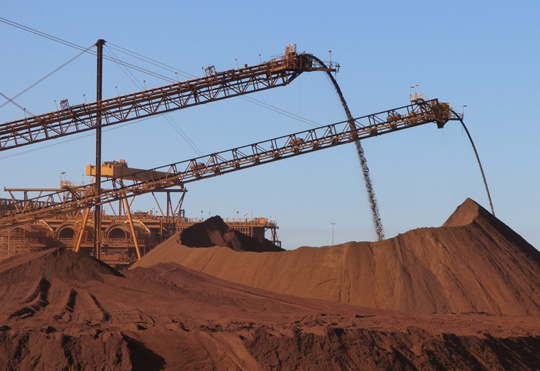
Significant Incident Report No. 251
Actions required
Mine managers are reminded of the importance of maintaining a safe system of work and verifying the competency of the workers responsible for operating plant and mobile equipment on their sites.
Notes:
Overview
Training and competency assessment are integral to the effective implementation of the operation’s safe system of work for isolations. Personnel need to be assessed as competent in the site’s isolation procedures and systems, including permit systems where required, before commencing any work that involves the isolation of hazardous energy sources.
Monitoring, audit and review
A risk-based approach requires monitoring, auditing and review of isolation systems, methods and compliance. An audit schedule should be developed to promote the conduct of these activities.
Safe systems of work
Implement and enforce suitable isolation procedures for plant and machinery.
Undertake a documented risk assessment of all mobile plant in the workplace to identify, assess and control all hazards to which workers are likely to be exposed.
Implement a suitable maintenance system, including periodic inspections by competent persons, to ensure plant are maintained and are in a safe condition.
Training and supervision
Confirm workers, such as operators and workers conducting cleaning and maintenance, are adequately instructed, trained and assessed in the use of plant, including its safety features.
Confirm workers receive adequate supervision in the performance of their duties while operating and maintaining plant.
Document control and record keeping
All documentation associated with the isolation management system should be developed and maintained in accordance with the operation’s document control procedures, legislative requirements and subsidiary guidance material.
To maintain the effectiveness of the internal auditing program and support continuous improvement of the isolation management system, a clear line of documentation ownership and review should be specified and enforced.

Slide 23
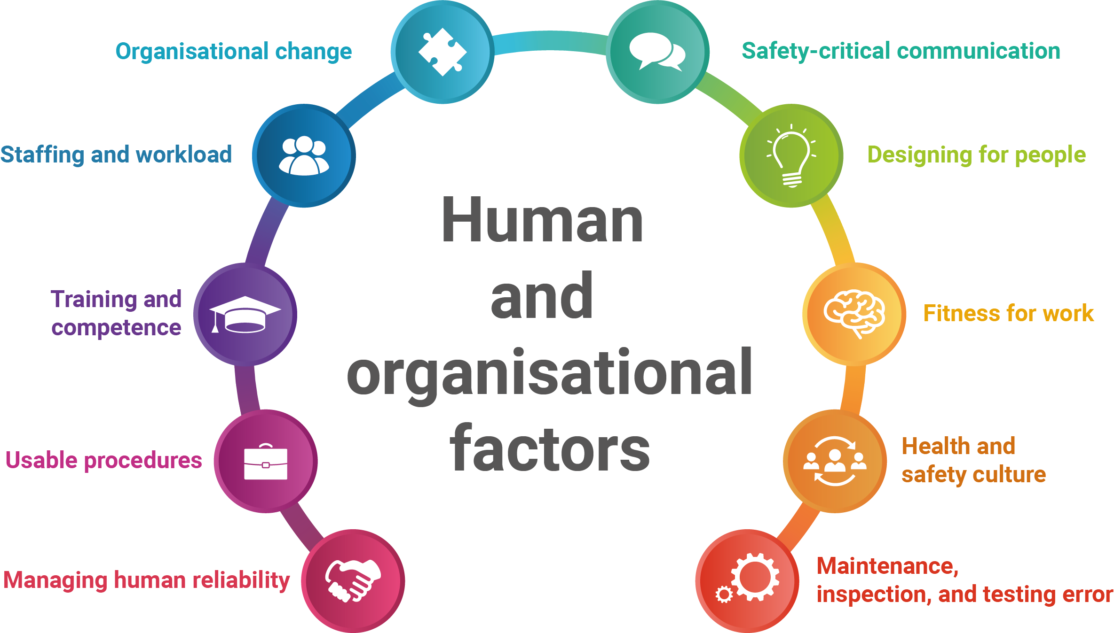
Human and organisational factors
Notes:
Human factors is the study of human capability and behaviour – understanding capability, behaviour and natural limitations means that we can then design work for people instead of expecting people to fit into unreasonable work designs.
Humans make errors – fact.
With this in mind we need to do all we can to increase likelihood of people providing desired performance and also invest in error management for the situations when an error occurs (because it will). Error management means making sure that people are alerted to errors as soon as possible, it is possible to recover from errors, and the result of an error is as small as possible – error mitigation.
This is the Human and Organisational Factors model adopted by the Mines Safety Directorate. 1- Human and organisational factors that most frequently contribute to incidents in WA mining.
Good news is that it is the same as the rest of the world so find some reputable resources and start learning. DMIRS will produce supporting materials in 2019.
Information is on DMIRS website.

Slide 24
Environment
Error prevention
Desired performance
Unintentional
Slips
Attention failures
Plan of action satisfactory, but action deviated from intention in some unintentional way
Individual
Organisation
Job
Lapses
Memory failures
Human performance
Rule based
Misapplication of good rule or application of a bad rule
Mistakes
Knowledge
based
No ready-made solution, new situation tackled by thinking out answer from scratch
Human error
Routine
Habitual deviation from regular practices
Error management
Exceptional
Non-routine infringement dictated by extreme local circumstances
Event
Intentional
Violations
Near Miss
Situational
Non-routine infringement dictated by local circumstances
Acts of sabotage
Notes:
This model exemplifies how multiple factors will influence behaviour and likelihood of desired performance – environment, job, organisational and individual factors.
It is not sufficient to attribute an incident to human error – we need to know
1. What influence/contributed to the human error
2. What type of error it was
Both of these pieces of information assist to address the latent hazards and make actual improvements for future.
Firing a person for being involved in the incident assumes that they are a hazard which makes no sense as ALL humans will make errors and by dismissing them you will lose the key to the usual information about why something actually went wrong.

