Slide 1
Please read this before using presentation
This presentation is based on the findings of investigations by Department of Mines, Industry Regulation and Safety.
Department of Mines, Industry Regulation and Safety(DMIRS) supports and encourages reuse of its information (including data), and endorses use of the Australian Governments Open Access and Licensing Framework (AusGOAL)
This material is licensed under Creative Commons Attribution 4.0 licence. We request that you observe and retain any copyright or related notices that may accompany this material as part of attribution. This is a requirement of Creative Commons Licences.
Please give attribution to Department of Mines, Industry Regulation and Safety, 2017.
For resources, information or clarification, please contact: RSDComms@dmirs.wa.gov.au or visit www.dmirs.wa.gov.au/ResourcesSafety

Slide 2
Investigation learnings for managers and supervisors From fatal and serious injury investigations by the Department

Slide 3
Failures
Investigators almost always find one of the following failures when investigating fatal accidents and serious injuries
Notes:
Investigators follow a routine when conducting an investigation.
They find one of these failures almost every time.

Slide 4
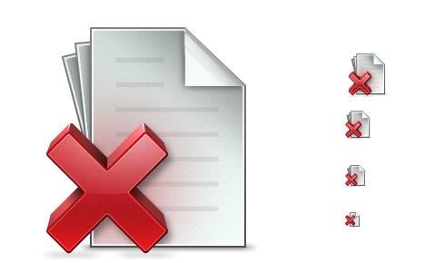
Failure #1
Supervisors let the workers start the job without any work documents
Notes:
No Take 5, SLAM or Step Back
No JHA/JSA/JSEA
No lifting permit, confined space permit, work at heights, etc.

Slide 5
Failure #2
Supervisors have approved the job even though work documents were unsuitable
Notes:
Half filled in, steps missing.
Hazards completely missed.
The wrong controls identified for those hazards that were identified.
No permit when a permit is required.
No reference to the Original Equipment Manufacturer (OEM) manual that had all the necessary safety information in it.

Slide 6
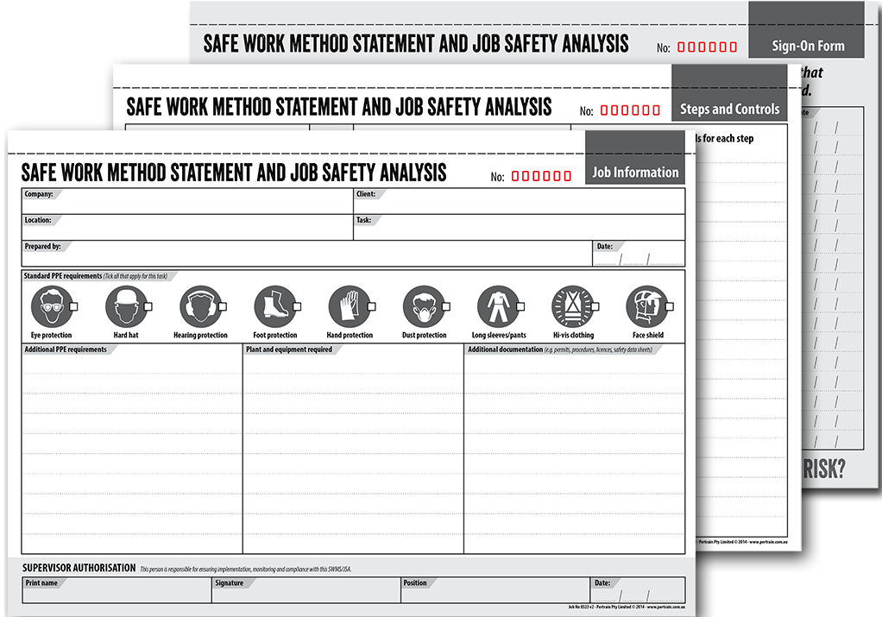
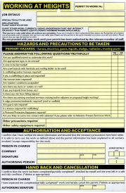
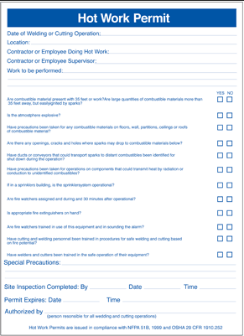
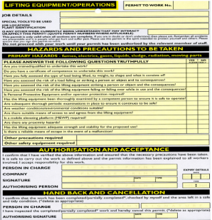
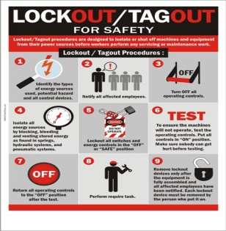
Where do inspectors see this?
Risk management forms like:
JHA
JSEA
Permit forms for high risk work like:
Confined space entry
Hot work
Working at heights
Lifting
Energy isolations forms
Notes:
Investigators always look for the job documents, especially the ones the mining operations safety management system requires workers to use, as well as any the Original Equipment Manufacturer (OEM) may have available.

Slide 7
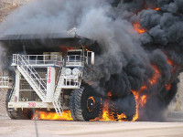
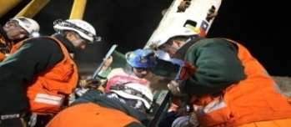
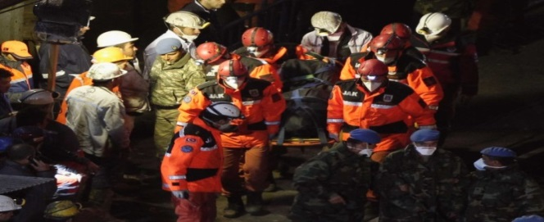
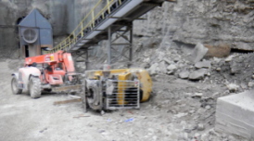
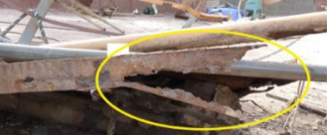
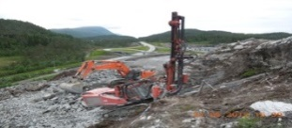
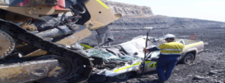
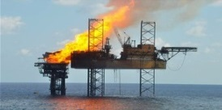
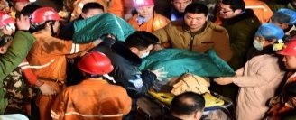
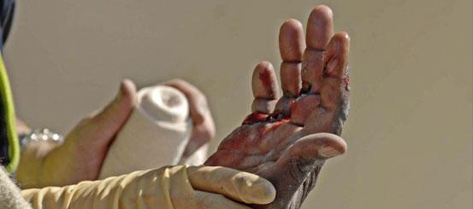
Consequences
When the paperwork either:
Was not done at all, or
Was not done well enough
Hazards known to be present, were not controlled
Workers were injured or killed
Notes:
Investigations haven’t found any brand new hazards recently that no-one hasn’t seen before!
Often the hazards had been identified by the mine in a risk assessment before any accident occurred!
The mine had thought about what controls should be used for those hazards.
None of this was used when the accident happened

Slide 8
Examples
Fatality | A worker was trapped under a belly plate | The work started without any paperwork The mine had the right tool for the job, but it was not thought of
Serious injury | A worker fell from height | Supervisors and workers worked at height without bothering conforming with valid permits
Fatality | Workers dropped a load onto themselves | The supervisor assumed the job paperwork had been done and did not check – in actual fact the paperwork had not been done
Notes:
New supervisor – never seen the job done before and didn’t know about the fatal potential AND didn’t know there was a special tool and it was available.
Everybody knew what was supposed to be done, nobody bothered.
Job went across several shifts, lots of work going on, the supervisor just missed it.

Slide 9
Examples (continued)
Serious injury | A worker used the wrong tool and it failed | Tools were introduced to a job without assessing any hazards and controls
Fatality | A worker was crushed when he accidently moved the machine | The task had changed and they did not reassess any potential new risks
Serious injury | A worker received an electric shock | Electricity was allowed to be introduced to a work area without advising workers within that area
Notes:
The job changed, no-one looked for new hazards, they made it up as they went along.
The job changed, no-one looked for new hazards, they made it up as they went along.
Procedure at the mine for communicating the introduction of power was not followed.

Slide 10
Obligations
Employers are required to:
Manage the mining operation in accordance with their safety management system
Train their managers, supervisors and workers in the parts of the system they will need to use
Ensure the managers, supervisors and workers use the system and take corrective actions when they don’t
Update the safety management system when needed
Notes:
Use safety management system to help manage the mine.
Must ensure personnel know how to use the tools they needed.
Check personnel are using the tools properly – even though there hasn’t been an accident does not mean it is working properly.
Maintain the system up to date.

Slide 11
What needs to change
Supervisors
Don’t let jobs start before you have checked the job paperwork
Don’t sign the job paperwork if you don’t know what the safety steps for the job are!
Find someone who does know
Don’t sign the job paperwork when it’s not suitable
Your crews and your managers are relying on you to close any gaps
Notes:
Ensure workers must know they can’t start work till the job paperwork have signed off by the supervisors.
If a supervisor does not know what are the hazards, they are unable to keep their workers safe. Find someone who knows!
A supervisor is the manager’s representative and should not sign off the job paperwork before works commencement, if the work condition is unsuitable.
The workers and the manager depend on supervisors to find the gaps and fix them!

Slide 12
What needs to change (continued)
Managers
Ensure your supervisors know that accepting unsuitable job paperwork is not right …
job will not commence
Ensure your workers know that without the job paperwork suitably done …
job will not commence
Notes:
Managers must be aware of what the supervisors are signing off on your behalf.
Workers must be aware that any work will not be allowed to commence without the paperwork.

Slide 13
What needs to change (continued)
Mines invest heavily to create a safe system of work
Job management documents are an important part of the system
Use them properly
Notes:
A lot of time and money is invested in Safety Management Systems, Safe Work Procedures, Risk Assessments, creating Permits and so on.
Before a job starts the safety management system has standard steps to follow to control the hazards.
The better they are used, the better the chance the hazards will be controlled.

Slide 14
Assistance from inspectors
During mine inspections, when inspectors find deficient work documentation, the inspector will require the manager to take remedial action
Actions taken will depend on time, place and circumstance
Options for inspectors include:
recording defects
issuing Improvement Notices
issuing Prohibition Notices
commencing an Investigation
Notes:
Inspectors would rather find work documentation being done well.

Slide 15
Last words
Paperwork is not a hard barrier
it is there to help keep people safe
BUT
Notes:
If there was a fatality, will the standard of paperwork at your mine be your best friend, or your worst enemy?

