Slide 1
Please read this before using presentation
This presentation is based on the findings of investigations by Department of Mines, Industry Regulation and Safety.
Department of Mines, Industry Regulation and Safety (DMIRS) supports and encourages reuse of its information (including data), and endorses use of the Australian Governments Open Access and Licensing Framework (AusGOAL)
This material is licensed under Creative Commons Attribution 4.0 licence. We request that you observe and retain any copyright or related notices that may accompany this material as part of attribution. This is a requirement of Creative Commons Licences.
Please give attribution to Department of Mines, Industry Regulation and Safety, 2018.
For resources, information or clarification, please contact: SafetyComms@dmirs.wa.gov.au or visit www.dmirs.wa.gov.au

Slide 2
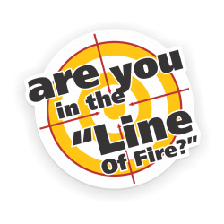
Line of fire hazard recognition
TO CHANGE IMAGE
Right click and select “Change Picture…”
2
Notes:
Line of Fire injuries are a significant proportion of the total injuries reported to DMIRS including the major contributing factor for a number of fatalities.
Workers often unknowingly, put themselves in the Line of Fire
This presentation will discuss many workplace hazards and outlines general principles that can help employees prevent these hazards from serious injuries and deaths.
Featured are several serious incidents that illustrate the consequences of not noticing when we are in harm's way.
Topics include hazards presented by moving machinery, flying debris and projectiles, moving vehicles, contact with stationary hazards and the importance of including Line of Fire hazards in your risk assessment.

Slide 3
What is a 'Line of Fire’ hazard?
Line of Fire is the path an object will travel and create a risk of injury.
‘You are in the line of fire when you are at risk of coming into contact with a force that will, or may hurt you’
3
Notes:
The line separating safety from danger is sometimes quite small.
To avoid crossing that line, we must
Always be aware of the hazards around us
Understand the machines and operations in our work areas; and
Take the time to think about the possible consequences that may result from where we place our bodies or the actions we perform.
When we do this, we can avoid suddenly finding ourselves in the Line of Fire.

Slide 4
Line of fire significant incident reports and bulletins (mining industry)
Switchboard arc flash injury SIR 245
Worker seriously injured by hot caustic solution SIR 233
Suspended load fatality SIR 194
Worker seriously injured by falling jib attachment SIR 222
Bystander struck by component ejected from accumulator SIR 208
Worker crushed by mobile plant - SIR 238
Fitter struck in chest by packing plate released under pressure SIR No 252
Worker injured while unloading poly pipe from vehicles Bulletin 133
Angle grinder injuries Bulletin 136
4
Notes:
A sample of some Significant Incident Reports (SIR) and Bulletins between 2014 to 2016 shows Line of Fire hazards as a contributing factor.

Slide 5
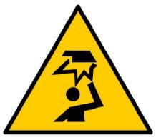
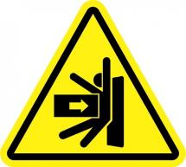
Three mechanisms of injury
Stored energy
Contact with stored energy
Striking hazards
Struck by or striking against an object
Includes falling objects
Crushing hazards
Caught in, on or between an object
5
Notes:
Some of the most common mechanisms of injury relating to line of fire incident.

Slide 6
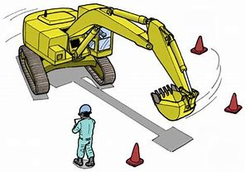
Work activities and equipment involving line of fire
Lifting/hoisting
Moving vehicles/heavy equipment
Hand and power tools
Moving parts
Electrical equipment
Objects with roll potential
Objects with fall potential
Tensioned lines and equipment
6
Notes:
There are a number of work activities and equipment which if not used/done safely can place workers in the “line of fire”. This slide lists some of the more common examples. This is a not an exhaustive list. You should identify the specific line of fire hazard for your specific workplace. Other line of fire hazards include spring loaded devices, regulator/gauge pressurisation, high pressure hydraulic tools etc.
When conducting your risk assessment ask yourself what you can you do to prevent exposure to ‘line of fire’ hazards. Some are suggested below.
Lifting/hoisting controls:
Are exclusion zones in place?
Has rigging gear been inspected?
Have load swing hazards been considered?
Are Tag lines used to ensure there is enough distance between you and the load?
Moving vehicles /heavy equipment controls:
Parking brakes and wheel chocks used?
Does operator have a full view of the working environment?
Barricades/signs in place?
Hand and power tools controls:
Adequate barriers and/or guards in place in case of kickback or unexpected release?
Cut away from your body
Flying debris hazards considered? (grinding, welding, chiselling etc.)
Moving parts controls:
Could equipment rotate unexpectedly?
Is guarding in place?
Electrical equipment control:
Workers outside the arc flash boundary when conducting switching operations?
Objects with roll potential control:
Is adequate bracing/controls in place to prevent objects rolling unexpectedly?
Objects with fall potential controls:
Exclusion zones established under work performed at heights?
Tools secured, kickboards fitted to working platforms?
Tensioned lines control:
All personnel clear of tensioned cables, straps, chains and ropes?

Slide 7
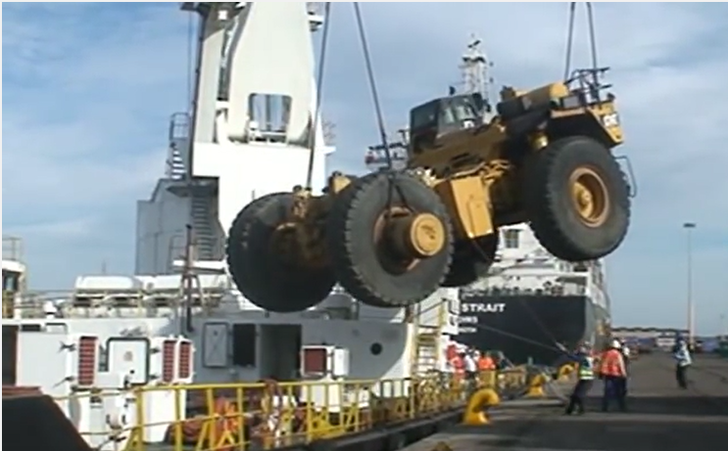
Risk management
Identify ‘Line of Fire’ hazards before you commence a task
Assess the risk
Eliminate the hazard. If not practicable, minimise the hazard using the hierarchy of control.
7
Notes:
It is important that ‘line of fire’ hazards are included in risk assessments conducted at the mine. Failure to identify these and implement suitable controls can result in injury. Ultimately you should eliminate the hazard if practicable. If this is not possible then controls should be in place to minimise the hazard.
An example of some questions to ask for ‘line of fire’ hazards are provided below
Identify the Line of Fire hazards before you commence a task
What objects or plant are a potential line of fire hazard?
What is happening around me that may put me in the line of fire?
Assess the risk
If the line of fire hazard is released, am I likely to be in the line of the fire?
Be aware of where you are or where are you going in relation to the direction of the hazardous energy.
Eliminate the hazard. If not practicable, minimise the hazard using hierarchy of control.
How can I eliminate the line of fire hazard?
eg. Remove the source of the line of fire hazard.
If not practicable, minimise the hazard using the heirarchy of control?
Substitute the line of fire hazard with something safer.
Engineering controls : Implement protection barriers and/or guarding etc.
Isolation: De-energise line of fire hazards through lock out/tag out procedure
Administration controls: Prohibit persons working in the line of fire through adequate supervision.
Implement exclusion zones if line of fire cannot be predicted accurately.
Ensure safe body positioning and position hand and body clear from the line of fire.
PPE: Use adequate PPE such as gloves, hard hats and eye protection
Photo: shows worker in the line of fire due to short tag line. Should the load fall he could be seriously injured or killed.

Slide 8
Final take-aways
Be aware of the constantly changing work environment around you
Identify ‘Line of Fire’ hazards in your risk assessment
Eliminate the need to work in the line of fire where practicable
Document and implement the controls of your risk assessment
Monitor ‘Line of Fire’ hazards through adequate supervision.
8

