Slide 1
Please read this before using presentation
This presentation is based on the content presented at the 2019 Mines Safety Roadshow in October 2019.
Department of Mines, Industry Regulation and Safety (DMIRS) supports and encourages reuse of its information (including data), and endorses use of the Australian Governments Open Access and Licensing Framework (AusGOAL)
This material is licensed under Creative Commons Attribution 4.0 licence. We request that you observe and retain any copyright or related notices that may accompany this material as part of attribution. This is a requirement of Creative Commons Licences.
Please give attribution to Department of Mines, Industry Regulation and Safety, 2019.
For resources, information or clarification, please contact: SafetyComms@dmirs.wa.gov.au or visit www.dmirs.wa.gov.au/ResourcesSafety

Slide 2
2019 Mines Safety Roadshow

Slide 3
Muffling the myths about noise

Slide 4
Notes:
We are aiming to:
Ensure workers go home in the same physical condition that they arrived at work in.
Make sure that what happens at work does not impact detrimentally on workers mental health while they are at work or have a negative impact on their life outside of work.
Make sure that workers are not exposed to hazards today that may not necessarily have a negative impact today but have the potential to ruin their retirement plans – think hearing loss, lung diseases, occupational cancers, impact on fertility, disabling injuries etc.
Exposure to hazardous noise can also result in quickened pulse rates, increased blood pressure, narrowing of blood vessels, nervousness, sleeplessness, and fatigue.
Reference: Work Related Noise Induced Hearing Loss in Australia (April 2006) - https://www.safeworkaustralia.gov.au/system/files/documents/1702/workrelated_noise_induced_hearing.pdf

Slide 5
You’re about to learn…
Some issues with noise
Human / organisational influences and motivators
Muffling myths and stating facts
Case studies
Solution focus – What can we do about it?
Workshop

Slide 6
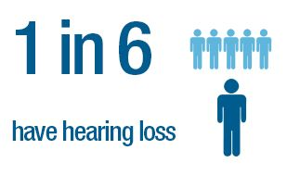
Some issues with noise
Effects of age and noise exposure are additive
Hearing loss can have devastating effects on an individual’s ability to contribute in community activities and can limit relationships/professional opportunities
Risk of hearing impairment in the workplace may also arise through exposure to ototoxins (these include, solvents, fuels, metals, fertilisers, herbicides and pharmaceuticals)
And many more …
6
Notes:
1 in 6 Australians is affected by hearing loss. With an ageing population, [this] is expected to increase to 1 in 4 by 2050
Most common causes of hearing loss are ageing and excessive exposure to loud sounds
Effects of age and noise exposure are additive. Therefore, noise exposure may cause hearing loss in middle age that would not otherwise occur until old age.
Once hearing loss occurs, it can’t be reversed.
It is less well known that a substantial number of medications and common industrial chemicals can also cause hearing loss or exacerbate the effects of noise.
These chemicals are said to be ototoxic (oto = ear, toxic = poisonous).
Source: https://www.safeworkaustralia.gov.au/system/files/documents/1702/occupational_noiseinduced_hearing_loss_australia_2010.pdf
Source: Access Economics, Listen Hear! The economic impact and cost of hearing loss in Australia, (February 2006), p. 5.

Slide 7
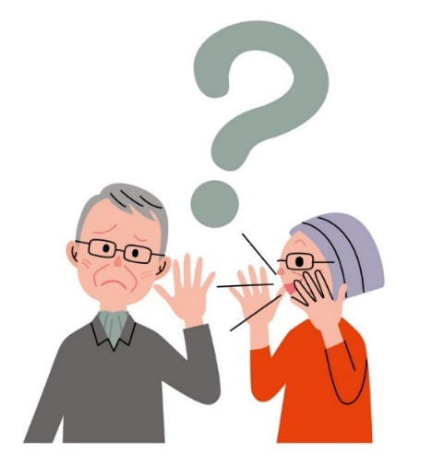
Some issues with noise
As a guide, if you need to raise your voice to communicate with someone about one metre away, the noise is likely to be hazardous to hearing.
Whether the exposure standard of 85 dB(A) averaged over eight hours is exceeded depends on the level of noise involved and how long workers are exposed to it.
Peak noise levels greater than 140 dB(lin) can create almost instant damage to hearing.
Note: The action level for peak noise level,140dB(lin); or for noise exposure 85dB(A) (MSIR r. 7.3.)
Notes:
Generally, NILH is related to:
How loud the sound is (the decibel level),
The amount of time you are exposed to the sound, and
How far away you are from the sound.
Other factors to consider now include exposure to vibration, a persons age and exposure ototoxins.
Peak noise levels greater than 140 dB(Lin) usually occur with impact or explosive noise such as sledge-hammering or a blast. Any exposure above this peak can create instant damage to hearing.
85dB(A) and 140dB(lin) are the two action levels outlined in the Mines Safety and Inspection Regulations 1995.

Slide 8
Wearing hearing protection has given me ear infections.
They are uncomfortable.
I’ll only be in the area for a minute or two.
I’m already deaf, things can’t get any worse. Why should I wear hearing protection?
I can’t hear people speaking to me when I’m wearing earmuffs or ear plugs.
I don’t know how to fit ear plugs properly.
I can’t hear warning signals when wearing them.
Notes:
Do any of these points look familiar?
If they do, it could indicate some opportunities for improvement in your sites hearing conservation program.
I’ll only be in this area for a minute or two
Everyone must wear their hearing protection before entering a hearing protection zone, no matter how long they intend to stay there.
I can’t hear people speaking to me when I’m wearing earmuffs or earplugs
It should be easier to make out speech in a noisy environment, because much of the background noise is screened out.
Chosen for task – beware of under and over-protection issues.
There are also flat response earplugs so that you can still hear all frequencies and, if required, earmuffs that block background noise but allow the sound from human speech to pass through.
Wearing hearing protection has given me ear infections
The wearing hearing protection is unlikely to be the cause of ear infections if good hygiene is adhered to.
This means that hands should be clean when inserting and removing plugs, disposable plugs should be discarded after each use.
Workers who are suffering from an ear infection or are susceptible to infections should wear earmuffs.
Workers should be able to choose which hearing protection is most suitable for them and feedback from workers should be considered in purchasing hearing protection devices.

Slide 9
Human and organisational influences and motivators
9
Notes:
By way of providing an example of why the Department believes the risk management conversation commences on the stage 3 controls, the following slide is a summary of noise exposures across the Industry.
There is a big range in different people’s susceptibility to hearing loss from noise, however research shows that 8-hour average daily noise exposure levels below 75 dB(A) or instantaneous peak noise levels below 130 dB(C) are unlikely to cause hearing loss. With progressively increasing levels, the risk becomes greater*.
The exposure standard for noise at an LAeq,8h of 85 dB(A) and a peak noise level at 140 dB(C), which protects most but not all people. Therefore, workplace noise should be kept lower than the exposure standard for noise if reasonably practicable.
*SWA Managing Noise and preventing hearing loss at work, September 2015 Page 10
Essentially, a worker who is exposed to 85 dB(A) for 8 hours receives the same noise energy as someone exposed to 88 dB(A) for 4 hours, with the balance of the day in a very quiet environment. In both cases the exposure standard is not being exceeded. However, being exposed to 88 dB(A) for more than 4 hours would mean that the standard is exceeded. Similarly, if a worker is using a machine that generates 121 dB(A) then the exposure standard would be exceeded after only 7.2 seconds.
The Department has selected 4 categories of workers (another 6 categories are available, and all show similar trends) to illustrate the point that over the past 10 years (from data supplied by the industry) noise exposures have hardly changed, with workgroups other than management and supervisory consistently exposed above the exposure standard.

Slide 10
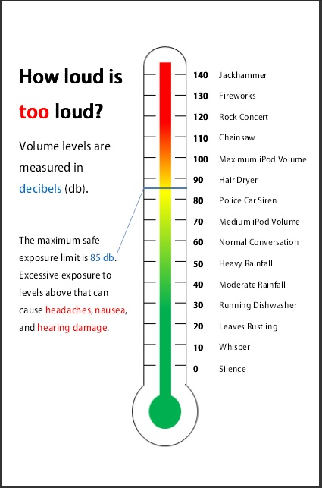
Human and organisational influences and motivators
At Work
Outside of work
Notes:
Not only can noise affect you in the work environment by we also need to be aware of our exposure to noise at home.
The World Health Organisation estimates more than 1 billion young people are in danger of hearing loss from portable audio devices, including smart phones.
it’s important that we consider factors out side of work too.
Source: https://www.who.int/mediacentre/news/releases/2015/ear-care/en/

Slide 11
Organisational influences and motivators
According to a report published by Safe Work Australia (SWA), the strongest barriers include:
relying too much on personal hearing protection
infrequent and improper use of hearing protection
not understanding or considering the potential benefits of effective noise control.
Notes:
Listed here are some barriers some organisations might face when addressing noise in the workplace.
Other important barriers include:
business size (small or medium-sized businesses are less likely than large businesses to have effective noise control)
insufficient knowledge of the effects of loud noise on hearing and hearing loss on quality of life
belief that noise control costs too much
belief that hearing loss is inevitable (‘fatalism’)
belief that hearing loss ‘will not happen to me’ (‘optimism’)
low confidence about being able to do anything about noise (‘self-efficacy’)
high inertia about doing something about noise and hearing loss, and
work cultures that are resistant to change.
Implementing higher levels of controls can lead to benefits such as:
Reduced PPE costs per person
no requirement for audiometry
reduced management hassles (policing etc)
improved working conditions (no PPE)
improved communications
no hearing damage claims
Plus the potential for improved efficiency / productivity.
Source: https://www.safeworkaustralia.gov.au/system/files/documents/1702/occupational_noiseinduced_hearing_loss_australia_2010.pdf

Slide 12
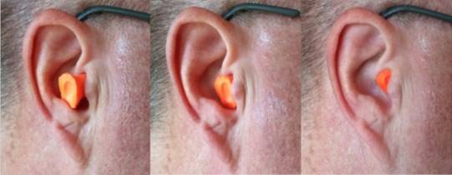
Which ear plug appears correctly fitted?

Slide 13
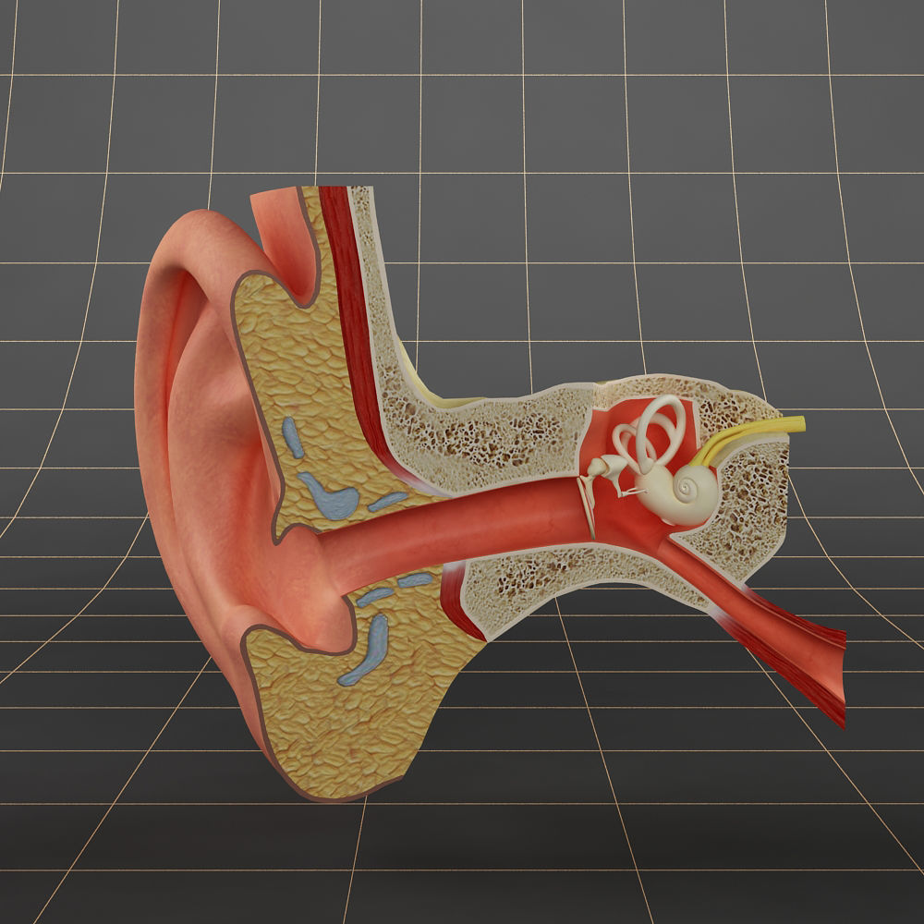
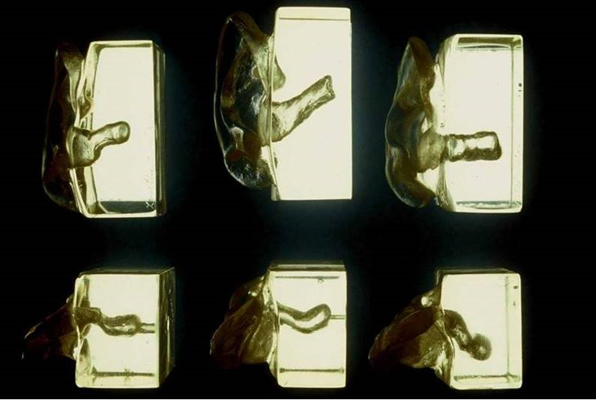
This is the shape of everyone’s ear canal
Notes:
Most ear canals are portrayed as being straight, as you can see in the diagram. However, the reality is much different.
Everyone’s ear canal is different and unique. This is why one type of earplug won’t fit all.
If you choose to wear ear plugs, fit testing is imperative to ensure you’re protected to an adequate standard.
Variety of ear canals picture Source: 3M

Slide 14
Does it make any difference to my noise exposure if there’s a dent or damage to the padding of my ear muffs?
YES
Notes:
To be effective, hearing protection needs to be maintained and kept in good condition.
Dispose of any PPE which is damaged or shows signs of wear and tear.

Slide 15
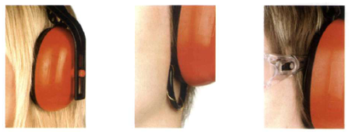
What can you see wrong with these pictures?
Notes:
Ensure the hearing protector tightly seals within the ear canal or against the side of the head.
Hair and clothing should not be in the way.
These things affect the quality of the seal and allows the noise to travel through.
Source: https://www.shponline.co.uk/ppe/is-your-hearing-overprotected

Slide 16
Impact of removing hearing protection
Time removed (in 1 hr) | Maximum 25 dB Protection is reduced to (dB) Class 4
0 min | no reduction
1 min | 17
5 min | 11
10 min | 8
30 min | 3
60 min | 0
Notes:
In order to get full benefit from hearing protection – we must wear it all the time.
If we remove them the protection is substantially reduced.
The following table gives a maximum protection provided for non-continuous use of an ideally fitted 100% efficient hearing protector.
For example, when hearing protection is rated with an attenuation of 25dB, if one takes off his/her hearing protector for 5 minutes in an hour the maximum protection will be reduced to no more than 11dB.
Class 1 – 10-19
Class 2 – 14-17
Class 3 18-21
Class 4 – 22-25
Class 5 – at least 26
Hearing protection must be used ALL THE TIME to get full benefit.
Source: Removal of hearing protectors severely reduces protection. Health and Safety Executive, UK (no date)

Slide 17
The Bigger Picture
Notes:
Video Duration: 4 min 19 sec
Source: https://www.youtube.com/watch?v=LehVFM6UPfg

Slide 18
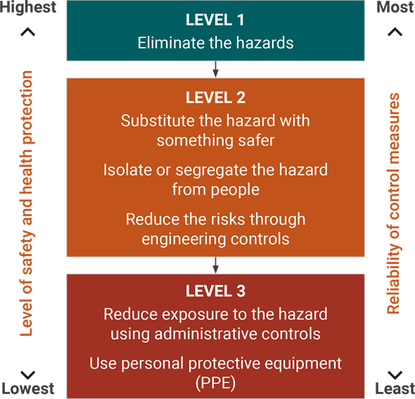
Solution focus – what can we do about it?
Notes:
The preferred solution = eliminate the source of the loud noise.
When this is not possible or practical to eliminate the noise source, minimise exposure using the hierarchy of controls such as:
substitute the noise source with quieter machinery or processes
apply engineering solutions such as vibration dampeners, mufflers, and absorptive panels
isolate the noise source from workers for instance: barriers, apply administrative solutions
When none of the above are reasonably practicable, provide hearing protection.
Hearing protection should be issued to employees:
where extra protection is needed above what has been achieved using noise control;
as a short-term measure while other methods of controlling noise are being developed.
A comprehensive hearing conservation program or noise control program should include strict adherence to the hierarchy of controls as well as assessments of noise exposure and hearing; education with respect to risks, solutions and responsibilities; and training on noise control and personal protection.
A hearing conservation program includes noise assessment, hearing protector selection, employee training and education, audiometric testing, maintenance, inspection, record keeping, and program evaluation.
Equipment and machinery should be well maintained and when purchasing new products enhanced noise control should be considered.
Job rotation to reduce the time exposed is also an effective measure.
Source: Managing Noise and Preventing Hearing Loss at Work – Code of Practice - https://www.safeworkaustralia.gov.au/system/files/documents/1702/managing_noise_preventing_hearing_loss_work.pdf

Slide 19
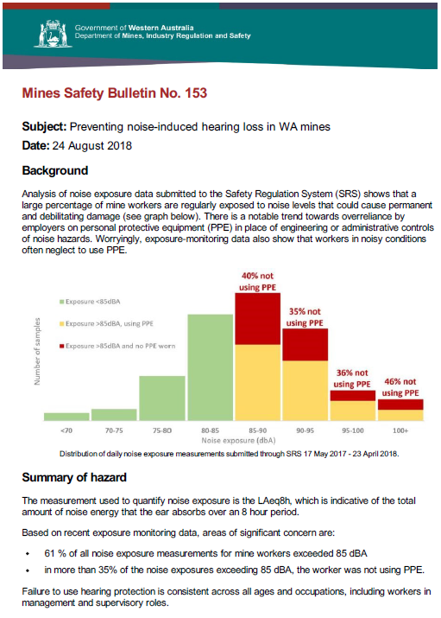
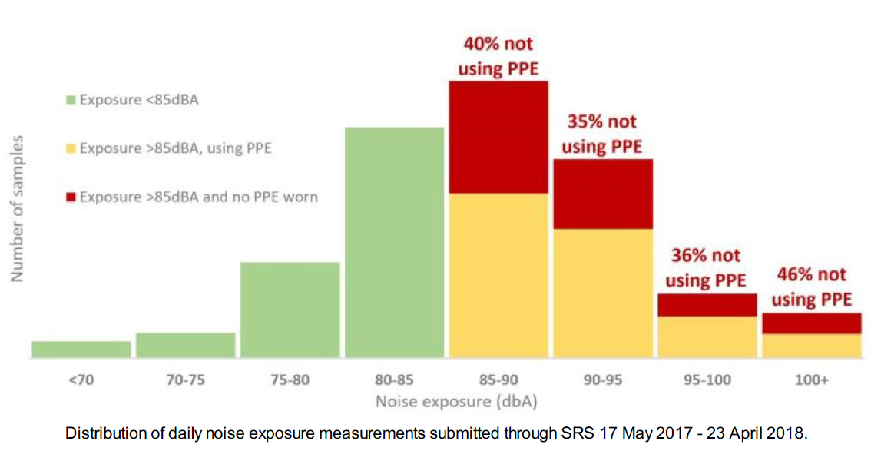
19
Notes:
Based on recent exposure monitoring data, areas of significant concern are:
61 % of all noise exposure measurements for mine workers exceeded 85 dBA
in more than 35% of the noise exposures exceeding 85 dBA, the worker was not using PPE.
Failure to use hearing protection is consistent across all ages and occupations, including workers in management and supervisory roles.
More information is contained in MSB 153 (released 24 August 2018)

Slide 20
Solution focus – What we can do about it
Consult with workers when proposing to make any changes that may affect their health and safety.
Include safety and health representatives at each step of the risk management process.
Prepare a noise report and implement a noise control plan.
Workers must have access to relevant information.
Notes:
Consult with workers when proposing to make any changes that may affect their health and safety, for example when planning to buy new machinery or equipment.
Consult with workers and Health and Safety Representatives (SHREP’s) is required at each step of the risk management process.
By drawing on the experience, knowledge and ideas of your workers you are more likely to identify all hazards and choose effective control measures.
Workers must have access to relevant information such as noise exposure data and potential control options (this information should be contained in the sites noise report and noise control plan).

Slide 21
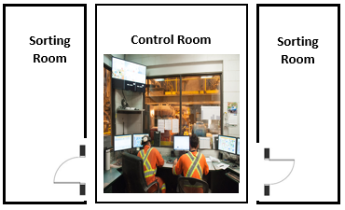
Example 1 – A quieter control room
Situation –
Persons working in control room situated between two sorting rooms, noise exposure in those rooms averaged 90 dB(A).
Action –
noise cancelling glass and sealed doors were installed.
Outcome –
noise is now below the action level of 85 dB(A) in the control room.
21
Notes:
The noise levels are described in decibels (dB)
They can not be added or subtracted in the usual arithmetic way because the dB scale is logarithmic
For example: Two identical noise sources emitting 90 dB(A) produce the combined noise level of 93 dB(A), not 180 dB(A)
3 dB(A) increase corresponds to a doubling of sound energy
10 dB(A) increase corresponds to a 10 times increase of the sound energy
20 dB(A) increase corresponds to a 100 times increase of the sound energy

Slide 22
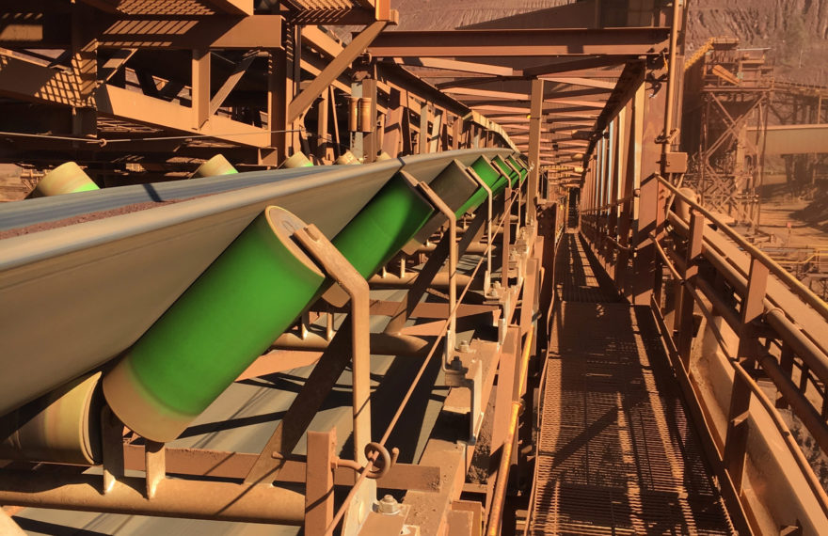
Example 2 – Reducing noise from conveyors
Situation –
A primary source of plant noise stems from conveyor rollers.
Action –
installation of composite shell material up to 70 percent lighter than steel rollers.
Outcome –
Up to 50% less noise volume than traditional steel rollers.
Requires less time and manpower to install and maintain.
Reduced power demand.
22

Slide 23
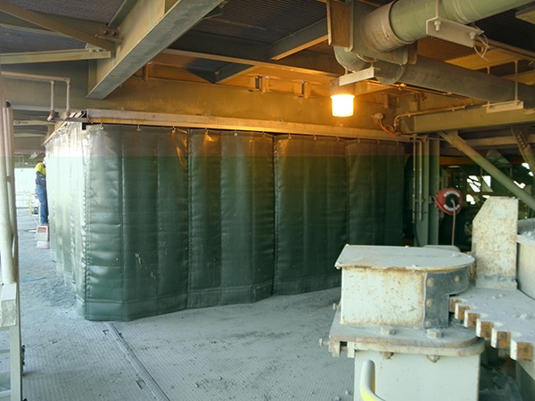
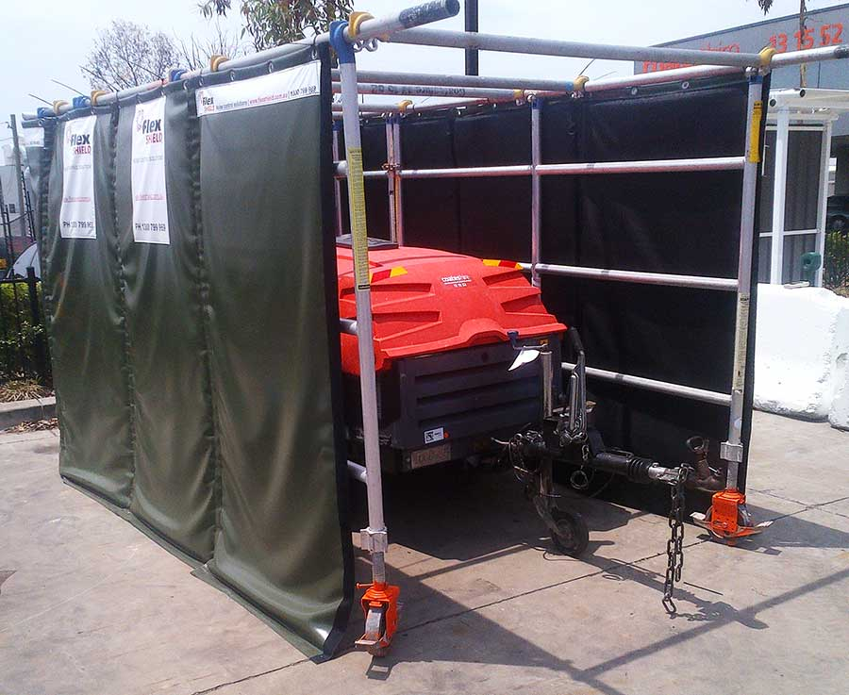
Example 3 – Acoustic screens for noisy equipment
Situation –
High noise levels can be emitted from equipment such as pumps, local ventilation fans or hand-operated tools.
Action –
In some cases, the only practicable alternative is to surround the source with an acoustic screen.
Outcome –
Reduction of noise.
23

Slide 24
Further Information
For further details specific to the WA mining industry regulatory requirements, refer to Part 7, Division 1 of the Mines Safety and Inspection Regulations 1995.
Detailed information for noise control management in new and existing workplaces may be obtained from Part 2: Noise control management of AS/NZS 1269 Occupational noise management.
Management of noise in Western Australian mining operations – Guideline
Mines Safety Bulletin No. 153 - Subject: Preventing noise-induced hearing loss in WA mines
Managing noise and preventing hearing loss at work - Code of Practice
Model Code of Practice: Managing noise and preventing hearing loss at work
Ototoxins

Slide 25
Follow us on social media and sign up for news alerts!
Twitter
@DMIRS_WA
@AndrewChaplyn
LinkedIn at Department of
Mines, Industry Regulation and Safety
Sign up to receive weekly news alerts @ www.dmirs.wa.gov.au
Notes:
Add slide about awards

