Slide 1
Please read this before using presentation
This presentation is based on content presented at the 2015 Exploration Industry Forum in June 2015
The Department of Mines and Petroleum (DMP) supports and encourages reuse of its information (including data), and endorses use of the Australian Governments Open Access and Licensing Framework (AusGOAL)
This material is licensed under Creative Commons Attribution 4.0 licence. We request that you observe and retain any copyright or related notices that may accompany this material as part of attribution. This is a requirement of Creative Commons Licences.
Please give attribution to Department of Mines and Petroleum, 2015.
For resources, information or clarification, please contact: RSDComms@dmp.wa.gov.au or visit ww.dmp.wa.gov.au/ResourcesSafety

Slide 2
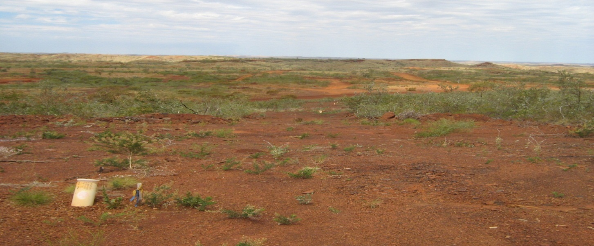
Programme of work (PoW) applications

Slide 3
Overview
Legislative context
Types, tenure and activities approved
Application process
Assessment and approval process
The ‘ins’ and ‘outs’ of PoW applications
DMP approvals snapshot

Slide 4
Legislative context
Mining Act 1978 – requirement that a PoW be lodged in prescribed manner and approved prior to the use of ground disturbing equipment for mineral exploration or prospecting purposes
Failure to obtain or comply with a PoW approval constitutes a breach of tenement condition, potentially rendering that tenement liable to forfeiture or other enforcement action
An approved PoW does not absolve the proponent from obtaining approvals under other legislation e.g. clearing permit, licence to construct bores and extract groundwater, declared rare flora (DRF) permit
Notes:
Requirement to lodge a PoW is imposed as a condition of the tenement
Other enforcement action may include Penalty in Lieu of Forfeiture – requires determination through the Environmental Enforcement Panel and ministerial consent
Other approvals - EP Act clearing permit if not exempt, DoW licences under the RIWI Act, s.18 licence under the Aboriginal Heritage Act. permit to take DRF under Wildlife Conservation Act

Slide 5
Types, tenure and activities approved
Two (2) types of PoWs:
Programme of work – Exploration (PoW-E)
Programme of work – Prospecting (PoW-P)
PoW-E: approves exploration drilling and associated activities including construction of tracks, pads, sumps, camps and core yards. PoW-E approval can also be sought for hydrological and geotechnical investigations
PoW-P: approves prospecting activities including scraping and detecting, costeaning/trenching, dryblowing, small wet alluvial plants and bulk sampling projects
Notes:
Prospecting policy on DMP website provides a more detailed description of the activities which are deemed to be prospecting activities which can be approved via a PoW-P
Prospecting activities to be considered exploration rather than mining need to meet low impact criteria, including a requirement that ground disturbance is kept to a minimum.
PoW-P application requires a commitment that no more than 2ha of ground will remain open at any time

Slide 6
Types, tenure and activities approved
Appropriate tenure must be held and tonnage limits apply as follows:
Exploration Licence: 1,000 tonnes for the life of the tenement
Prospecting Licence: 500 tonnes for the life of the tenement
Notes:
Tenure must be live for a PoW to be approved
Requirement that exploration activities proposed on Miscellaneous Licences are compatible with the purpose for which the tenement was granted.
Exceedance of tonnage limits requires approval from DMP Mineral Titles Division
Tenement holders should record cumulative disturbance on their tenements and use the calculation tool on DMP website to determines whether excess tonnage approval is required. Sumps are not factored in to the calculation as they are mitigating the potential for greater environmental impacts through the discharge of groundwater should it be encountered

Slide 7
Application process
Online lodgement for PoW-Es via the environmental assessment and regulatory system (EARS) – screening checks undertaken by approvals coordinator
Hardcopy lodgement for PoW-Ps acceptable until 1 July 2016
Notes:
PoW may be rejected at the screening stage
Online lodgement is beneficial as the potential for rejection is reduced and applicants have the ability to track the progress of the assessment
PoW-Ps are submitted in hardcopy format to either DMP Perth or Kalgoorlie office

Slide 8
Application process
PoW applications to be accurately completed and accompanied by supporting information as required which may include:
Cover letter – content may comprise of detailed information in relation to the receiving environment, a summary of stakeholder consultation undertaken, status update in relation to other approvals that may be required or description of compliance with tenement conditions
Detailed map include scale bar, legend, grid coordinates, tenement boundaries and labels, proposed drill hole locations and line and track clearing
Letter of consent from all tenement holders including other parties that may have an interest in the tenement
Excess tonnage approval from Mineral Titles Division
Management plans where required
Notes:
Cover letter – proposal may be with a DPaW managed reserve which triggers a requirement to comply with specific tenement conditions e.g. development of a CMP as well as consult with various stakeholders. Cover letter can detail consultation undertaken or provide a status update in relation to other approval requirement
Map to include tenement boundaries and labels, scale bar, GDA grid coordinates, location of proposed activities and disturbance i.e. drill holes, tracks, heritage sites, landforms and topographic features such as watercourses, existing access tracks, reserves, PDWSA’s and other relevant cadastral features
Letter of consent if applicant not the tenement holder
Excess tonnage may not have been approved but pre-approval will expedite the approval process
Management plans – these may include Conservation Management Plan, Radiation Management Plan, Dieback Management Plan or Exploration Environmental Management Plan for proposal in more environmentally sensitive locations

Slide 9
Assessment and approval process
Assessing officer will check for compliance with tenement conditions and undertake database searches in relation to activities proposed. Checks also undertaken for excess tonnage approval, iron ore endorsements and surface rights where required
Further information from the proponent may be requested by the assessing officer once the PoW has been accepted for assessment
Internal and external agency advice may be required depending on location or other environmental aspects of the proposal
Notes:
EO will check various databases including eMits, GeoMap, Tengraph, Minedex, Aboriginal Heritage Inquiry System
Further information from proponent may include details on management strategies for environment impacts, detail on how specific tenement conditions will be complied with, justification of pad sizes or track widths. Stop the clock event with a 10 business day timeframe provided for a response. No response may result in rejection of PoW
Advice may be requested from other agencies including OEPA, DPaW, DoW, Resources Safety Division, Mineral Titles. Stoop the clock event with external agencies afforded 20 business days to respond and a further 5 days should not response be received.

Slide 10
Assessment and approval process
Approval of PoW may be subject to a bond request or additional tenement conditions
PoW approvals are valid for 4 years – post-exploration/ prospecting rehabilitation reports are to be submitted
Extension of PoW or timeframe for completion of rehabilitation can be granted upon request prior to expiry of the PoW
Notes:
Bond request for PoWs would not be common with the introduction of the MRF, however, a provision remains to impose bonds where the rehabilitation risk warrants it
Approval letters sent electronically
Rehabilitation report proformas are attached to the PoW approval letter – submission not a statutory requirement but will be used to demonstrate that rehab obligations have been met and also establishes credibility with the regulator
Extension must be requested prior to the expiry of the PoW

Slide 11
‘Ins’ and ‘outs’ of PoW applications
Examples of issues DMP typically encounters with PoW applications include:
Incomplete application forms
Lack of supporting information
Tenure related issues
Inadequate justification of proposed activities
Poor quality maps
PoW application is not supported by management plans where required
Notes:
Incomplete application forms – not all relevant boxes checked with respect to environmental management and rehab commitments
Lack of supporting information – this may include a detailed cover letter for more complex PoWs, management plans, biological surveys
Tenure related issues – surface rights may not have been grated for proposals over private land, letters of consent may be required, excess tonnage approval may be required, proposed activities are not compatible with underlying tenure, PoW-P applications may involve tenure which is pending
Inadequate justification of proposed activities – pads sizes and track widths may exceed what is considered appropriate for that activity
Poor quality map – lack detail and don’t include features described earlier
No management plans – these should be submitted as required

Slide 12
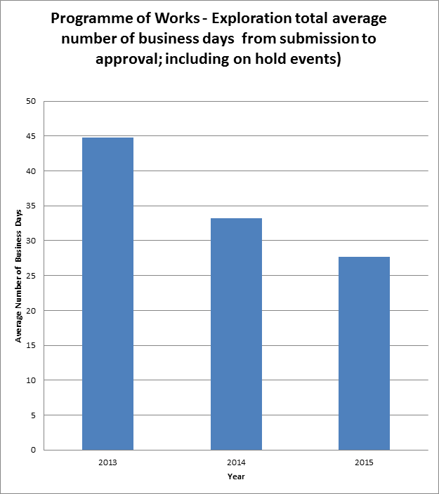
DMP approvals snapshot
Notes:
Graph shows a reduction in overall processing timeframe for PoW-Es only – data is based on average business days from submission to approval and includes the periods applications were on hold
Reduction from 45 business days in 2013 to 28 days for the 2015 year to date
The average number of on hold days during this period has been reduced from 21 to 8 which has been a key contributing factor in the improvement
Other factors includes –
Online lodgement has resulted in a steady improvement in the application quality which has also reduced the need for additional information from proponents
Revision of administrative agreements with other agencies and tightening of referral criteria
Improved industry understanding of the PoW application process and awareness of regulators expectations
Greater retention of staff during this period has resulted in the development of a skilled and competent set of assessing EO’s

Slide 13
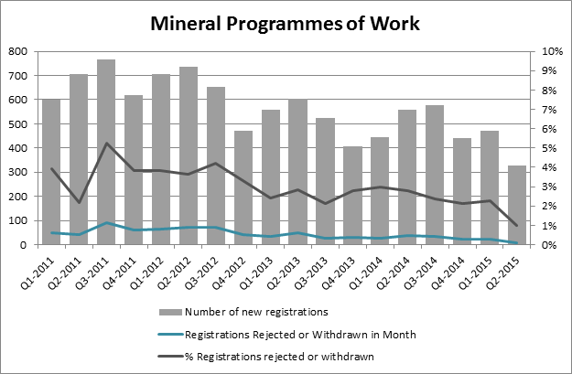
DMP approvals snapshot
Notes:
PoW workload – in excess of 2,000 PoWs received per year. Approximately 85% are PoW-Es and 15% PoW-Ps
Reduction in the % of PoW applications rejected or withdrawn – greatest reduction since the introduction of mandatory online submission for PoW-Es – i.e. reduction from a peak of around 5% in 2011 to between approx. 1-2% in 2015
Greater guidance on PoW application forms and advice from EO’s has resulted in higher quality applications and less rejections in screening or assessment

Slide 14
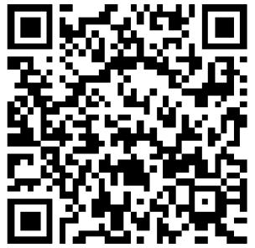
Stay informed!
Subscribe to our email alert service
and receive weekly news about:
recent publications
latest safety alerts
what’s happening at Resources Safety.
Visit www.dmp.wa.gov.au/ResourcesSafety
to sign up

