Slide 1
Please read this before using presentation
The Department of Mines and Petroleum (DMP) supports and encourages reuse of its information (including data), and endorses use of the Australian Governments Open Access and Licensing Framework (AusGOAL)
This material is licensed under Creative Commons Attribution 4.0 licence. We request that you observe and retain any copyright or related notices that may accompany this material as part of attribution. This is a requirement of Creative Commons Licences.
Please give attribution to Department of Mines and Petroleum, 2015.
For resources, information or clarification, please contact:
RSDComms@dmp.wa.gov.au or visit
www.dmp.wa.gov.au/ResourcesSafety

Slide 2
Safe drilling: The journey (part 1)
The past

Slide 3
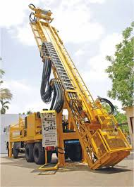
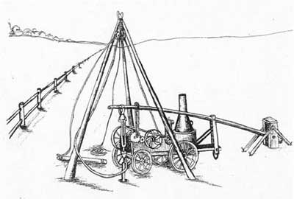
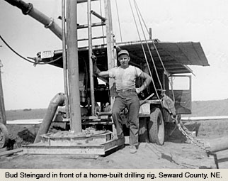
Evolution of drilling
Notes:
Look how far we have come.

Slide 4
What does Resources Safety do?
Resources Safety promotes safety in the mining, dangerous goods and petroleum industries in Western Australia by raising awareness, promoting compliance, using enforcement when necessary and providing specialist advice
Outcome: Responsible exploration and development of mineral and energy resources ensuring community expectations are met

Slide 5
What governs exploration safety and health?
Legislation
Mines Safety and Inspection Act 1994
Mines Safety and Inspection Regulations 1995
Remember
All parts of the Act and regulations apply

Slide 6
What are the objects of the Act?
Promote and secure the safety and health of persons
Assist employers and employees to identify and reduce hazards
Protect employees against risks associated with mining operations
Foster and facilitate cooperation and consultation between employers and employees
Promote contribution from employers and employees to the development of safety legislation
Notes:
These objectives are taken directly from section 3 of the Mines Safety and Inspection Act 1994.

Slide 7
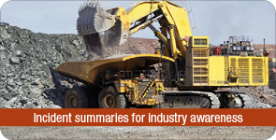
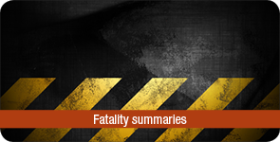
Our commitment
To work with industry to reduce serious accidents and incidents, and provide tangible support in achieving a positive cultural change.

Slide 8
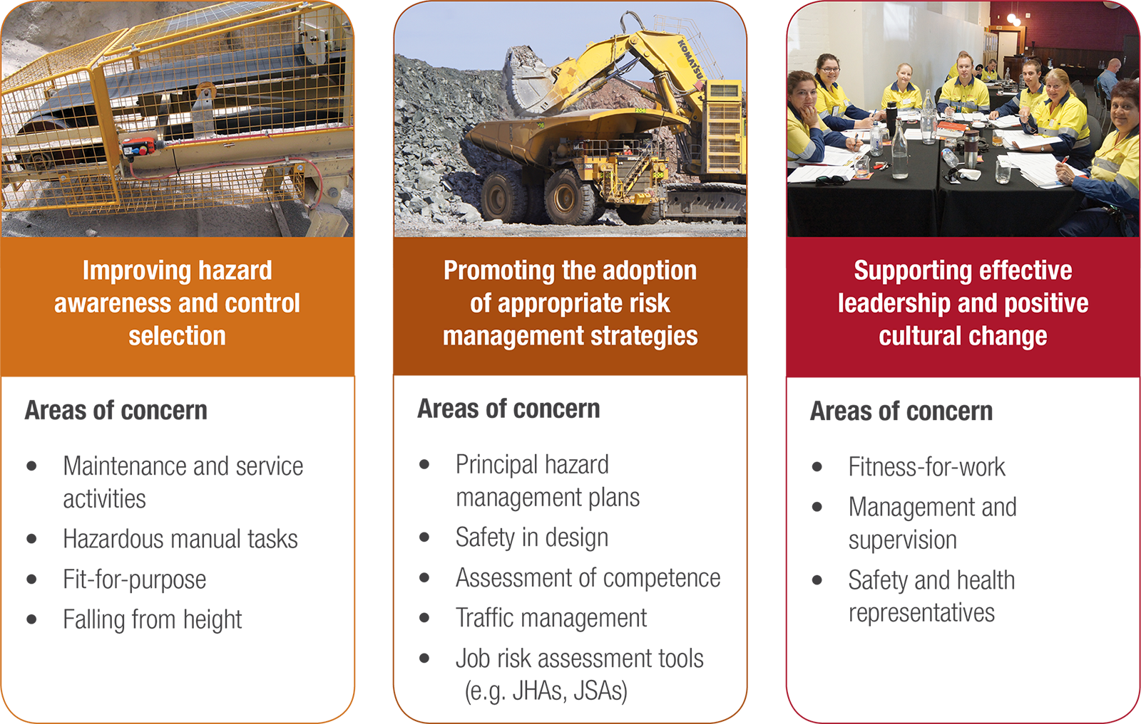
Resources Safety’s focus for mining
Notes:
The Department of Mines and Petroleum’s mines safety priorities specifically relating to the drilling sector.

Slide 9
What are the characteristics of a resilient culture?
Vulnerable | Rule followers | Robust | Enlightened | Resilient
In denial Messengers ‘shot’ Whistleblowers dismissed or discredited Protection of the powerful Information hoarded Responsibility shirked Failure punished or covered up New ideas crushed | Deal ‘by the book’ Conform to rules Target = ‘zero’ Reactive Repair not reform Information neglected Responsibility compartmentalised New ideas = ‘problems’ | Develop risk management capacity Enhance systems Improve suite of performance measures Develop action plans Monitor and review progress Clarify/refine objectives | Active leadership Safety management plan widely known Competent people with experience Accountabilities understood Advanced performance measures Regular reviews Range of emergency responses catered for | Strive for resilience of systems Reform rather than repair Responsibility shared Actively seek new ideas Messengers rewarded Proactive as well as reactive Failures prompt far-reaching inquiries Flexibility of operation Consistent mindset is ‘wariness’
‘in disarray’ pathological | ‘organised’ reactive | ‘credible’ calculative | ‘trusting’ proactive | ‘disciplined’ generative
Sanction | Direct | Encourage | Partner | Champion
Notes:
The safety reform spectrum, available from the Department’s website, lists the attributes of different organisations – with the most prone to failure on the left, and moving across in increasing levels of trust and system development. The row across the bottom shows the ways in which regulators tend to vary their strategies to deal with each organisational type.
All operations should aspire to be RESILIENT. This is the goal of the inspector under the Reform and Development at Resources Safety (RADARS) program.
To strive for resilience of systems you must be able to take a hit and recover (e.g. receive negative feedback and react proactively).
Reform rather than repair. If something goes wrong, or there is a near miss, take the opportunity to really address the issues using the hierarchy of control rather than do a “quick fix”.
Responsibility shared. Every employee on the mine is responsible for safety not just safety representatives, safety advisors and management.
Seek new ideas. Is there a better way of doing what we are doing?
Messengers rewarded with positive feedback and recognition.
Proactive as well as reactive. Use audit findings and consult with the workforce to proactively deal with hazards prior to an event.
Failures prompt far reaching inquiries and do not just blame the operator. What can we do as an organisation?
Flexibility of operation to overcome and resolve issues and deal with change.
Consistent mindset, maintain a state of awareness. Celebrate success and do not rest on your achievements.

Slide 10
What does our history tell us?
Fatal injuries in the Western Australian mining industry 1896 - 2015 (part year to 30 June 2015)
Notes:
This graph shows mining fatalities since records began in 1896.
Overall the trend has been down, despite increasing workforce numbers.
With a gap two days short of two years, the mining industry has proven that zero fatalities in a year is possible.

Slide 11
What does our history tell us?
Fatal injuries in the Western Australian mining industry 1965 - 2015 (part year to 30 June 2015)
2
15 year gap for exploration
1
2
1
1
Number of fatalities
1
1
1
1
1
1
1
1
Notes:
This graph shows mining fatalities in recent history (1965 onwards). Let’s look at this more recent data, specifically fatalities related to mining drilling activity.
On average a drilling employee is fatally injured every 3.57 years. The role of both the Department of Mines and Petroleum and industry is to ensure the current period without fatalities continues (since 2007).
2015 – A fitter was fatally injured when working on a dozer and was crushed by the dozer belly plate.
2007 – A 19 year-old driller's assistant clearing a blockage in the sample hose was struck and fatally injured by the sample hose and a dust deflector box (which detached from the cyclone).
2006 – A 25 year-old driller died as a result of injuries received in an incident at a mine.
2002 – A drill jumbo operator was fatally injured in an accident at a mine.
1995 – A diamond driller operating a track-mounted rotary diamond drill rig became caught between the rotating drill rod and the mast of the drill rig.
1992 – A driller moving the mast of a truck-mounted drill rig to drill angled blast holes was found trapped between the truck and the mast of the rig.
1989 – A worker was fatally injured when their overalls became caught on the rotating steel of a drill jumbo.
1989 – A blockage developed in a suction hose. When a worker attempted to clear the blockage the hose’s clamp broke free and struck his head.
1988 – While moving a drill rig, the pin came out of the boom ram and the boom fell on a worker.
1987 – Drill rods were being disconnected after running them out of the hole. The lower end of a rod freed itself from the joint. The rod swung in an arc and struck a worker on the right arm and the right-side of the body.
1984 – A worker was struck by a high-pressure hose connection which came apart when the coupling failed. The drill rig was being shifted.
1984 – As a drill rod was being uncoupled it swung sideways knocking a worker off the mast. He fell two metres to the ground.
1969 – A drill stabilizer dislodged from a drill rod and fell around 65 feet, striking a worker causing fatal head injuries.
1967 – The malfunction of a "pick-up elevator" caused a drill rod to fall and strike a worker.
1966 – A worker died when a drilling line broke and the travelling block (which was overwound into the crown block) fell and struck the worker.

Slide 12
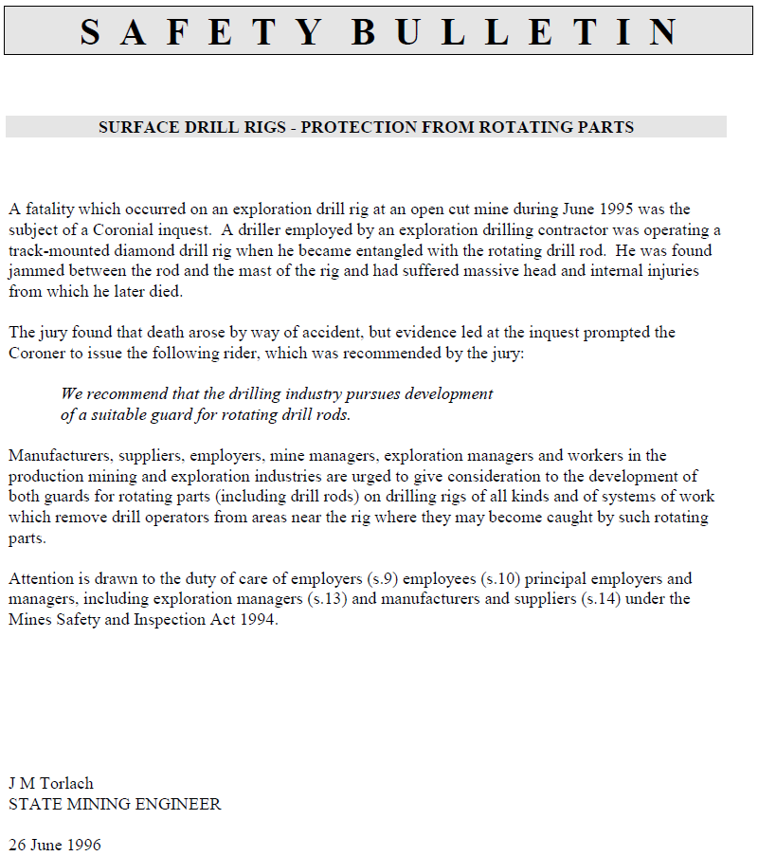
Safety Bulletin No. 21
26 June 1996
Notes:
The Mines Safety Inspection Regulations 1995 clearly outline the requirements for plant safety. Mines Safety Bulletin No. 21 reminds industry of these requirements (e.g. guarding of drill strings and other rotating parts hazards).

Slide 13
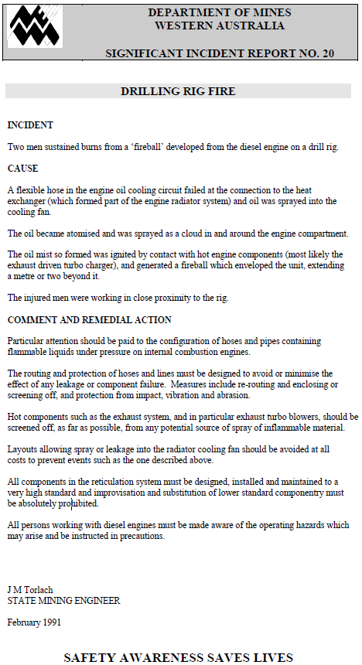
Significant Incident Report No. 20
February 1991
Notes:
Mines Safety Significant Incident Report No. 20 Drilling rig fire was issued in February 1991 to alert industry of the need to ensure competent design of rig systems to prevent the risk of injury by inherent drilling hazards (e.g. hydraulics, compressed air, diesel fuel systems).

Slide 14
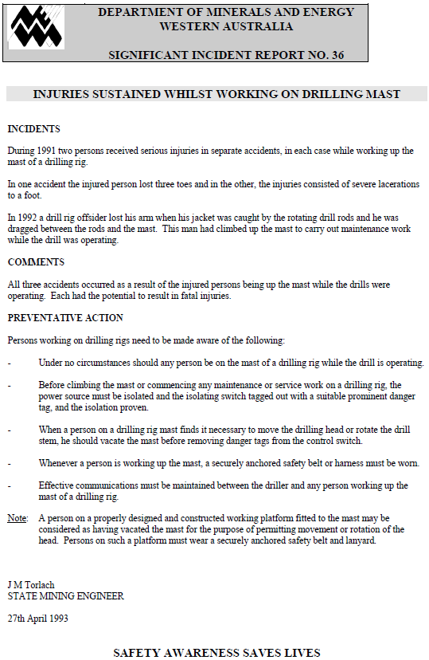
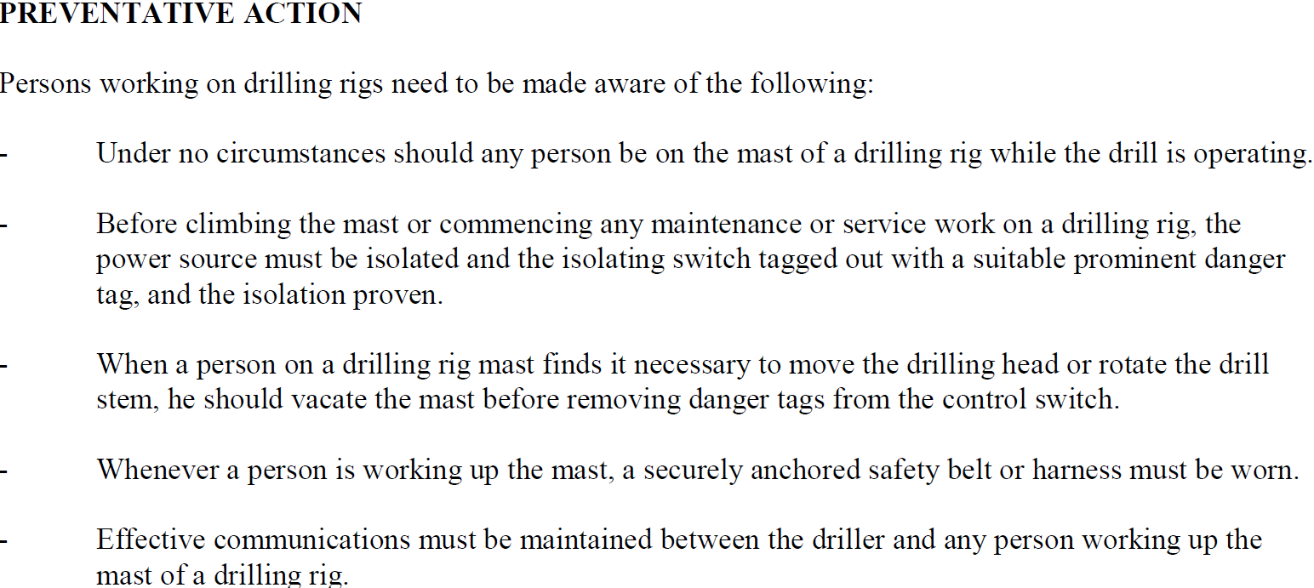
Significant Incident Report No. 36
27 April 1993
Notes:
In 1993, Mines Safety Significant Incident Report No. 21 Injuries sustained whilst working on drilling mast reminded industry of the hazards of working at heights and the need to employ isolation systems.

Slide 15
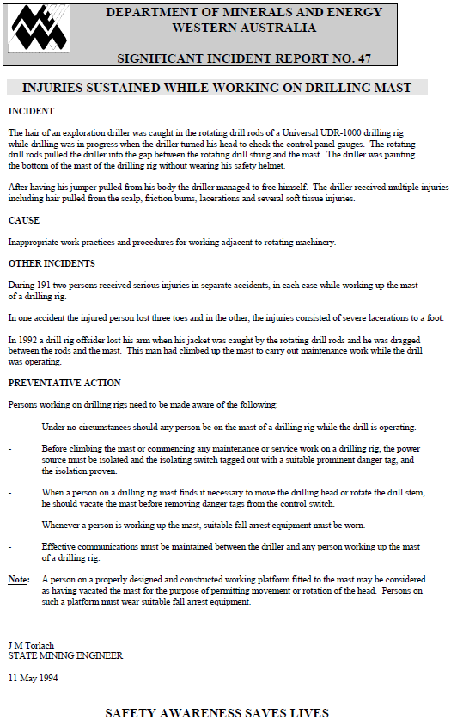
Significant Incident Report No. 47
Notes:
In 1994, Mines Safety Significant Incident Report No. 47 Injuries sustained while working on drilling mast was released following an injury resulting from entanglement in rotating parts.

Slide 16
We are not bulletproof
The human body is extremely fragile.
Where engineers are involved in design this invariably means energies exceed human tolerance.
Therefore uncontrolled interaction with these energies will almost always result in serious injury or death.

Slide 17
Key parts of MSI Act to be aware of
78. Some occurrences at mines to be notified and recorded
(1) The manager must immediately give notice to the district inspector for the region in which the mine is situated of an occurrence to which this section applies, whether or not any bodily injury to any person or damage to property has resulted from the occurrence, and must give to the district inspector such particulars in respect of the occurrence as the inspector may require.
79. Some potentially serious occurrences to be notified
(1) The manager must inform the district inspector for the region in which the mine is situated of any occurrence at the mine which in the manager’s opinion had the potential to cause serious injury or harm to health (other than an occurrence referred to in section 78) although no injury or harm in fact happened.
Notes:
Become familiar with these requirements under the Mines Safety and Inspection Act 1994.

Slide 18
Key parts of MSI regulations to be aware of
3.3. Provision of information — earth disturbing operations
(1) This regulation applies to any exploration operation that involves the disturbance of earth (including drilling, costeaning or trial pit excavation).
(2) For the purposes of section 47(3) of the Act, information relating to any exploration operation to which this regulation applies must, so far as is practicable —
(a) be provided before the exploration operation takes place; and
(b) include details of the location, scope and nature of all such exploration operations (including the intended date of commencement and conclusion of exploration activities) that are proposed during an ensuing 6 or 12 month period (as elected by the exploration manager).
Notes:
All mining operation (e.g. exploration companies) must submit these under the Mines Safety and Inspection Regulations 1995.

Slide 19
Key parts of MSI regulations to be aware of
3.6. Training of persons
(1) An employer must ensure that each employee engaged in exploration operations is provided with such training as is necessary to enable the employee to manage risks associated with the hazards of exploration operations in remote sites, including the lack of infrastructure and support and adverse climatic conditions.
Penalty: See regulation 17.1.
(2) The requirement in subregulation (1) is in addition to the requirements of regulation 4.13.
3.7. Suitable equipment to be provided
An employer must ensure that employees engaged in exploration operations are provided with suitable vehicles and appropriate equipment (including communications and emergency equipment) to engage in that operation.
Penalty: See regulation 17.1.
Notes:
These are the key requirements for an employer to provide training and equipment appropriate for the hazards an employee will be exposed to whilst undertaking exploration work.

Slide 20
Key parts of MSI regulations to be aware of
3.9. Drilling and excavation operations
An employer must ensure that any employee engaged in exploration operations does not engage in drilling or excavation operations unless the employee is adequately trained and competent to do so.
Penalty: See regulation 17.1.
Notes:
Specific requirements for the training and competence of drill crew employees.

Slide 21
Key parts of MSI regulations to be aware of
6.3. Designer to identify hazards associated with plant and to assess risks
A designer must —
(a) identify any hazard associated with plant, during the design process, if the plant is intended for use at a mine; and
(b) assess the risk of exposure of a person to a hazard, if any, identified under paragraph (a).
Penalty: See regulation 17.1.
6.6. Manufacturer to identify hazards and to assess and reduce risks if designer outside jurisdiction
If the designer of plant is not within the jurisdiction of the State, the manufacturer of the plant must carry out the designer’s duties under regulations 6.3 and 6.4.
Penalty: See regulation 17.1.
Notes:
Designers and manufacturers of plant have responsibilities. Ensure they have met their obligations and supplied you with legally compliant plant and equipment.

Slide 22
Key parts of MSI regulations to be aware of
6.17. Employer to identify hazards associated with plant and to assess risks
(1) An employer must identify all reasonably foreseeable hazards associated with plant —
(a) both before and during the introduction of plant at a mine; and
(b) both before and during —
(i) any alteration to the plant;
(ii) any change in the way the plant is used;
(iii) any change in a system of work associated with the plant,
(including, where appropriate, a change in the location of the plant), which is likely to involve a risk of a person being exposed to a hazard; and
(c) that may become apparent as a result of new or further safety or health information relating to the plant or its associated systems of work becoming available to the employer; and
(d) assess the risk of exposure of a person to each hazard, if any, identified.
Penalty: See regulation 17.1.
Notes:
An employer must identify hazards associated with plant, conduct risk assessments, reduce the risks identified, and prevent unsafe use of plant [rr. 6.17, 6.18 and 6.21].
Duty holders should be familiar with the requirements of Part 6 of the Mines Safety and Inspection Regulations 1995 – Safety in using certain types of plant in mines.

Slide 23
Mineral exploration drilling – code of practice
Part 1
Risk management approach
Part 2
Drilling hazards
Part 3
Emergency preparedness
Notes:
The Department of Mines and Petroleum has produced several resources to assist the drilling and exploration industry. The Mineral exploration drilling – code of practice was developed with was designed for ease of use and risk-based approach. It is a practical guide to assist in the development and implementation of safe systems of work for all drilling operations.

Slide 24
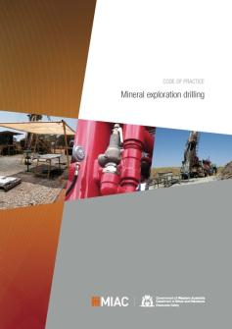
How has the code been developed?
Mineral exploration drilling in remote
locations
Developed with industry input from
various sources
Working and focus groups
2010 and 2011 Exploration Safety Roadshows
Industry comment sought early 2012
ADIA Sundowner March 2012
Designed for ease of use and risk-based approach
Released December 2012
Notes:
The code of practice was developed with industry input.
The code is supported by mineral exploration audits. The audits are structured so that operators can select those aspects relevant to the size and complexity of their operations, and the activities undertaken, and tailor the audit accordingly.
These and other resources can be accessed through the Department of Mines and Petroleum’s website at www.dmp.wa.gov.au/ResourcesSafety and through subscription services.

