Slide 1
Please read this before using presentation
This presentation is based on the findings of investigations by Department of Mines, Industry Regulation and Safety.
Department of Mines, Industry Regulation and Safety(DMIRS) supports and encourages reuse of its information (including data), and endorses use of the Australian Governments Open Access and Licensing Framework (AusGOAL)
This material is licensed under Creative Commons Attribution 4.0 licence. We request that you observe and retain any copyright or related notices that may accompany this material as part of attribution. This is a requirement of Creative Commons Licences.
Please give attribution to Department of Mines, Industry Regulation and Safety, 2017.
For resources, information or clarification, please contact: RSDComms@dmirs.wa.gov.au or visit www.dmirs.wa.gov.au/ResourcesSafety

Slide 2
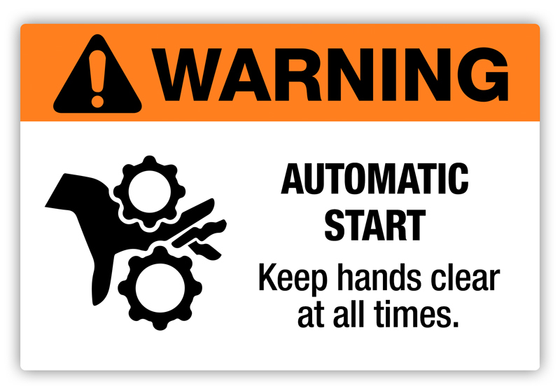
Preventing access to dangerous moving parts and machinery
Notes:
This presentation may be run in conjunction with the Department of Mines, Industry Regulation and Safety ‘Know your hazards’ video series:
Pressing concerns – crushed
Pressing concerns – caught
Pressing concerns - trapped
This presentation covers the statutory obligations mines have to ensure persons are not exposed to hazards from dangerous moving parts of machinery and plant. This presentation concentrates on how to control hazards from machinery and plant through the use of guarding systems.
Records of Notifiable Injuries illustrate particular concerns at the number of workers being injured through exposure to dangerous moving parts of machinery that are not adequately or securely guarded.
Regulations require that every dangerous part of fixed, mobile or hand held plant must as far as practicable, be fenced or guarded. The inclusion of the term “as far as practicable” is not intended to be reason for non-compliance on grounds such as cost but rather to cover situations such as with a circular saw blade, which needs part of its circumference unguarded in order to carry out its function, and to cover the very unlikely possibility that it would not be practicable to guard a particular machine or part thereof.
Guidance as to compliance may be found in the Code of Practice – Safeguarding of Machinery and Plant 2009 and Australian Standard AS4024.

Slide 3
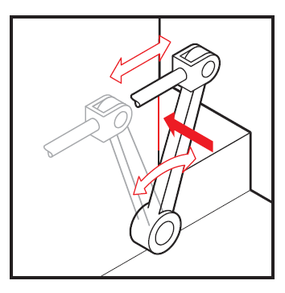
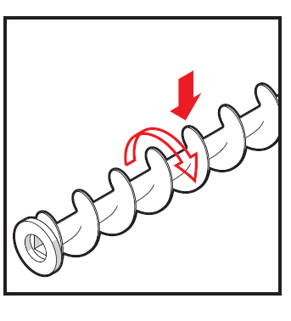
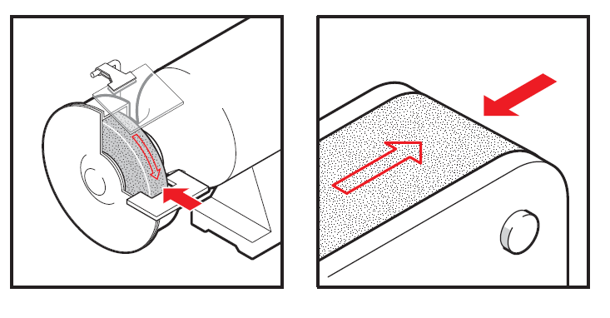
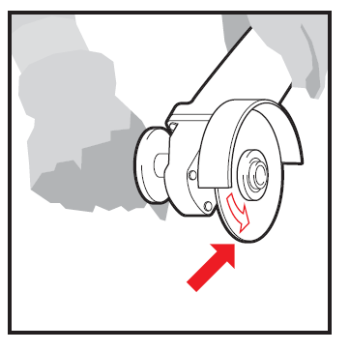
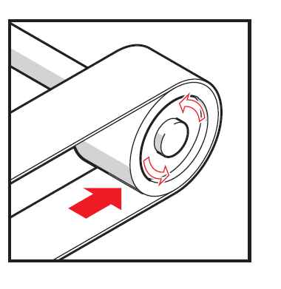
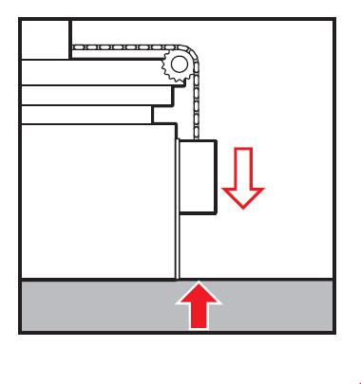
Mechanical hazards
Shearing
Entanglement
Friction and abrasion
Cutting
Drawing in
Crushing
Notes:
There are multiple hazards that persons can be exposed to from plant and machinery. This presentation concentrates on how to control mechanical hazards from energised plant and machinery. Mechanical hazards include:
Shearing – applying power to a slide or knife in order to trim or shear metal or other materials
Entanglement – being caught in machine by loose items such as clothing, gloves, ties, jewellery, long hair etc.
Friction and abrasion – caused by parts operating at high speed
Cutting – rotating, reciprocating or transverse motion that cuts
Drawing in – when part of the body is draw in to a ‘nip point’
Crushing – when part of the body is caught between fixed and moving parts of a machine
Impact – objects that strike the body but do not penetrate it
Stabbing and puncturing – when the human body is penetrated by flying objects or rapidly moving parts of machinery or pieces
Note: solid red arrows – where parts of the body can be injured. White arrows - movement of machine parts.

Slide 4
Serious injuries – lack of guarding
Employee working alone attempted to remove a rock from unguarded return conveyor when both arms were drawn in causing serious crush injuries (SIR 248)
While attempting to remove a rock, an employee was trapped between the moving tamper head and feed tray of a limestone block making machine resulting in multiple injuries (SIR 251)
Notes:
SIR No 248 link – http://www.dmp.wa.gov.au/Documents/Safety/MSH_SIR_248.pdf
SIR No 251 link – http://www.dmp.wa.gov.au/Documents/Safety/MSH_SIR_251.pdf

Slide 5
Serious injuries – lack of guarding (continued)
Employee opened a hatch to remove a bag from an automatic sampler when it activated entrapping his left arm (SIR 205)
An employee trying to dislodge a blockage from discharge outlet of a stemming bucket severed his fingers (later amputated) (SIR 225)
Fatal incident where employee’s head was crushed between motor cable termination box and a moving component of a tripper unit (SIR 186)
Notes:
SIR No 205 – http://www.dmp.wa.gov.au/Documents/Safety/MSH_SIR_205.pdf
SIR No 225 – http://www.dmp.wa.gov.au/Documents/Safety/MS_SIR_225_Worker_seriously_injured_by_moving_parts_in_a_modified_stemming_bucket.pdf
SIR No 186 – http://www.dmp.wa.gov.au/Documents/Safety/MSH_SIR_186.pdf

Slide 6
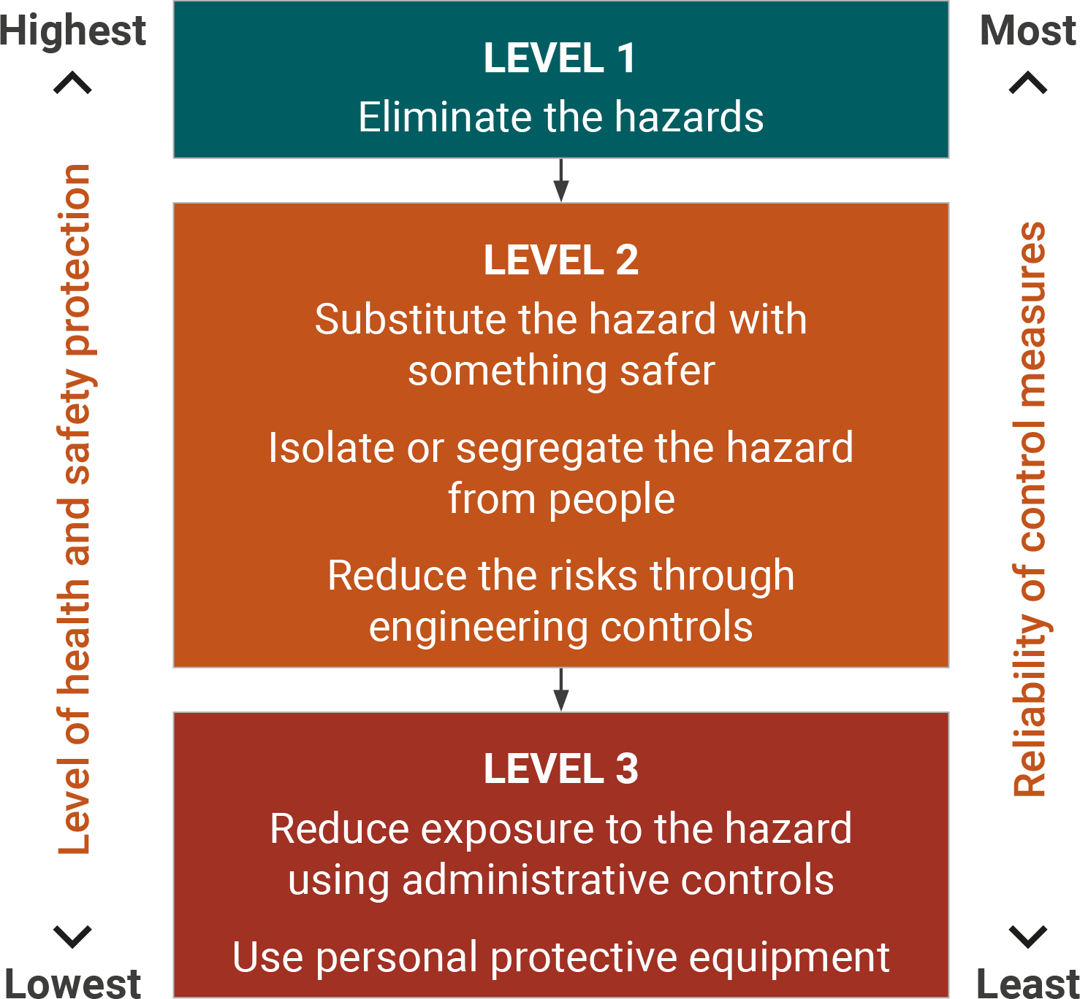
Hierarchy of control – Regulation 4.4 & 6.2
When choosing engineering controls the highest practicable control measure must be implemented. From highest to lowest these are:
Permanent barrier
Interlocked barrier
Fixed barrier (secured by fasteners)
Presence sensing devices
Notes:
Regulation 4.4 (3) any moving machinery at the mine which creates a risk of injury to an employee through inadvertent contact is screened or guarded to prevent such contact.
Regulation 6.2 (f) outlines the hierarchy of control for guarding. Consideration of each higher control measure must be made before a lower form of control is employed unless it is not practicable.
Guarding must be in place where persons can access dangerous moving parts. In practice often engineering controls are applied as a control measure to protect from dangerous moving parts. The most effective controls are permanent guards ranging down to presence sensing devices as the lowest engineering control.
Where it is not practicable to guard machinery, and persons are required to operate or pass in close proximity to dangerous moving parts a safe system of work must be in place to reduce the risk as far as is practicable.

Slide 7
Controls – permanent guards
Most effective guarding type
Welded or incorporated into body of machine
Where no person requires complete or partial access to dangerous area

Slide 8
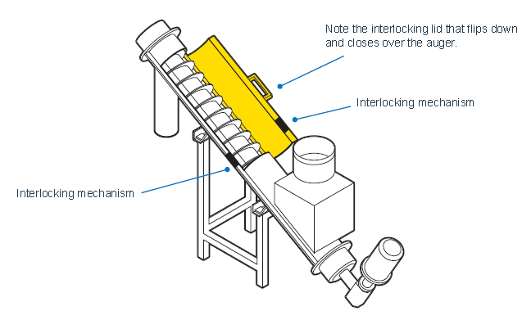
Controls – interlocking guards
Enclosure guards (also called movable guards)
Interconnected with the power and control system of machine (interlock)
Must be designed so any failure does not expose people to danger (‘fail to safe’)
prevents starting of moving parts and / or stops them
Design needs to consider person inside dangerous area when an attempt is made to start machine

Slide 9
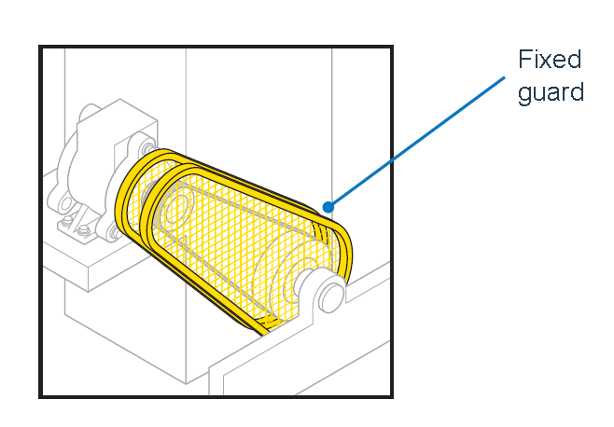
Controls – fixed guards
Should be easy to remove and replace but only with the aid of a special tool (eg. spanner or Allen key)
Wing nuts, wedge inserts etc. which can be operated with fingers or become stuck should not be used
Can be designed with provision for cleaning, maintenance, adjustment and repair

Slide 10
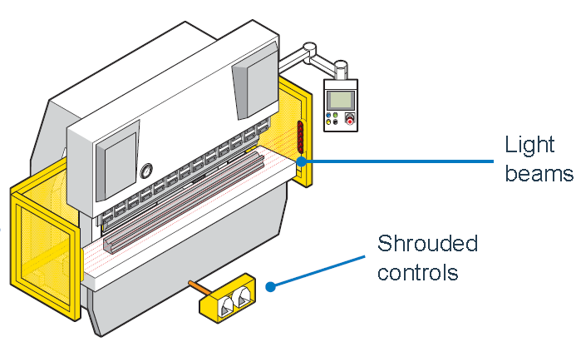
Controls - presence sensing devices
Must operate as intended and stop the machinery when the light beams or sensors are interrupted before person moves to a position where they could be injured
Must be operated and maintained according to manufacturers instructions
Examples - photoelectric curtains, laser scanners and pressure mats

Slide 11
Summary
Ensure chosen fence or guard:
Prevents all access to the dangerous moving parts
Suitable signage to warn of the hazard
Substantial construction – strength & quality materials (AS 4024 design standard)
Constantly maintained
Kept in position and secured while machinery or plant is operated
Plant is effectively de-energised and isolated before any guard is removed
Guards are secured in place before plant is re-energised and operated
Notes:
Final takeaway:
As you walk around your workplace today ask yourself: “Is it practicable to provide a higher level of guarding than that already provided?”

