Slide 1

Please read this before using presentation
This presentation is based on content presented at the Mines Safety Roadshow in October and November 2016
The Department of Mines and Petroleum (DMP) supports and encourages reuse of its information (including data), and endorses use of the Australian Governments Open Access and Licensing Framework (AusGOAL)
This material is licensed under Creative Commons Attribution 4.0 licence. We request that you observe and retain any copyright or related notices that may accompany this material as part of attribution. This is a requirement of Creative Commons Licences
Please give attribution to Department of Mines and Petroleum, 2016
For resources, information or clarification, please contact:
  RSDComms@dmp.wa.gov.au or visit
  www.dmp.wa.gov.au/ResourcesSafety

Slide 2
State-of-play for safety performance in WA

Slide 3
Overview
Recent industry safety performance and trends
Department of Mines and Petroleum (DMP) areas of focus

Slide 4

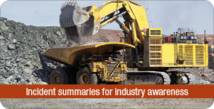
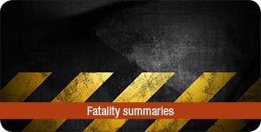
Our commitment
To work with industry to reduce serious accidents and incidents, and provide tangible support in achieving a positive cultural change.
Notes:
Critical concept is DMP working with industry to identify and mitigate problems.

Slide 5
Fatalities since last roadshow
There have been four fatalities:
16 Nov 2015 – Paulsens Gold Mine – Adam Perttula – underground operator died from heat stress
25 Nov 2015 – Alcoa Kwinana – Benjamin White – contract scaffolder fell into digester vessel
19 June 2016 – Channar Open Pit – Lee Buzzard – fitter died from crush injuries when working on drill mast
26 July 2016 – Central Norseman Gold – Lindsay Bridges – contract boilermaker died from crush injuries when a thickener bridge structure they were dismantling collapsed
Notes:
2 fatalities since the roadshow in 2015 brings the total deaths to 6 in 2015!

Slide 6
Trends in performance ?
66 fatalities 2000 - 2016
What happened here?
Notes:
Consider the past 10 years:
Slight positive trend, but still averaging 3 or 4 fatalities each year!
What happened in 2012? Statistical aberration? Why can’t we repeat whatever we were doing “right”?

Slide 7
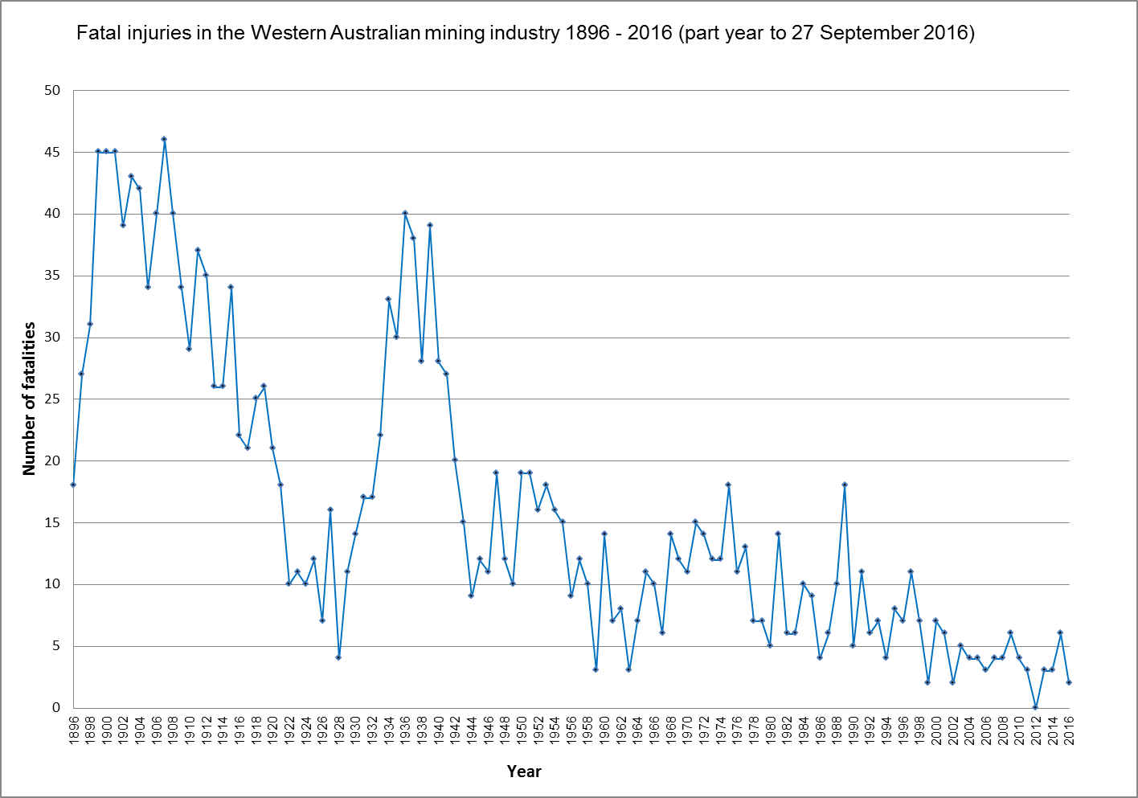
What does history tell us?
1,942 fatalities
Notes:
This graph shows mining fatalities since records began in 1896.
Overall the trend has been down, despite the increasing workforce numbers, but has flattened
Introduction of Legislation has been a driver in improvement (but erratic) – generally through prescription and mandated standards.
1906 Mining Act
1946 Mines Regulation Act
1994 MSIA
Other significant global events (eg war) caused major shift in mining activity and introduced technology.
Let’s recall the more recent data:
2012 - 0
2013 - 3
2014 - 3
2015 - 6
2016 - 2 so far

Slide 8
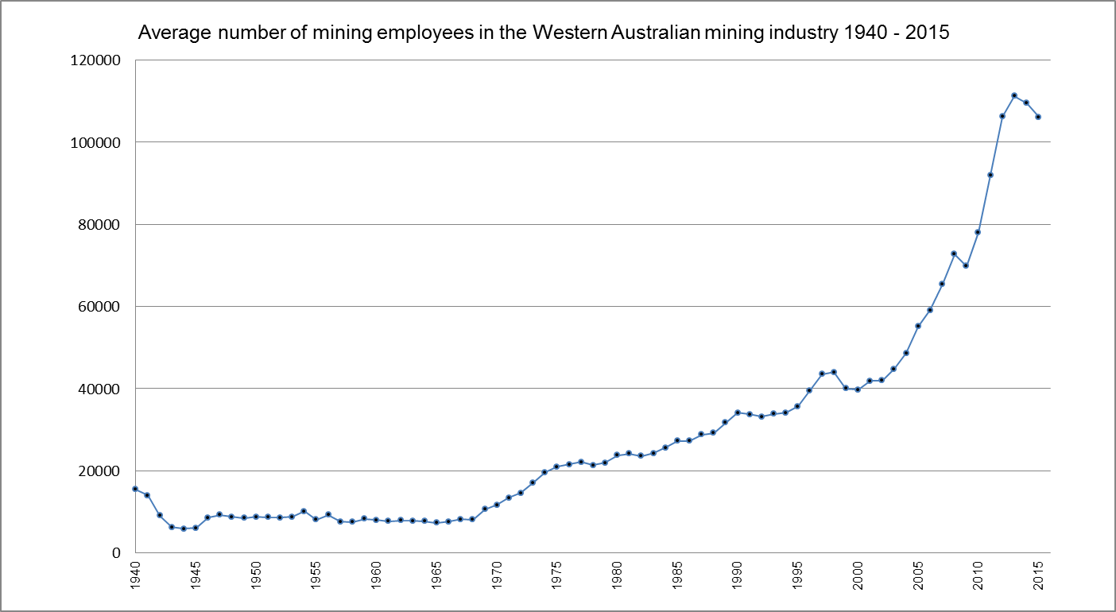
To put this performance in perspective
Notes:
Significant increase in number of employees working within the mining industry since around 1970.
Peak 114,000 + in 2013
Drop-off in past two years due to completion of the new mine construction boom and economic recession within mining industry.

Slide 9
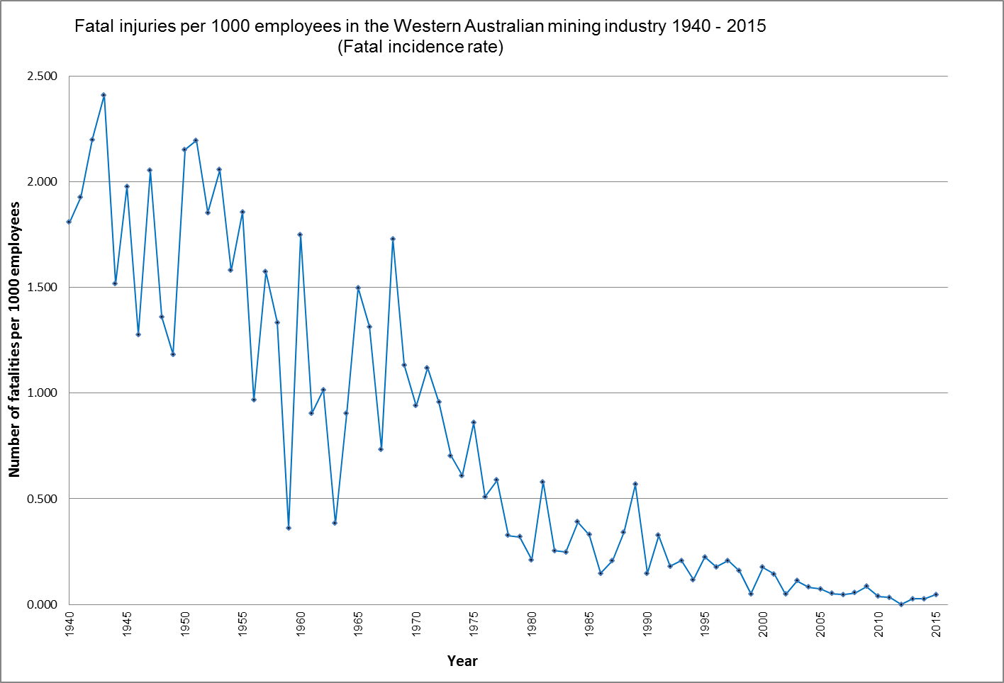
Trends in performance
Notes:
Considerable improvement in safety performance in terms of number of fatalities per 1000 employees since 1940.
More consistent performance is an indicator of greater control over workplace activities and hazards.
Concern for the up-swing in the performance curve since 2012.

Slide 10
So what is causing the
number of fatalities?

Slide 11
Let’s look at the fatalities since 2012
14 Aug 2013: Kurt Williams, electrician at Christmas Creek suffered traumatic head and chest crush injuries when caught between a travelling tripper and structure.
4 Dec 2013: Stephen Hampton, contractor at Telfer Gold mine was crushed when pinned under a tailings discharge pipeline he was installing.
29 Dec 2013: Allen Zuvela, fitter at Christmas Creek was crushed under the cab of a surface miner that fell when rigging gear failed.
15 Feb 2014: Wayne Fowlie, u/g operator at Central Norseman Gold died when crushed under a rockfall.
26 May 2014: Lance Farber, contractor at Bright Star was crushed between the mast and the cab of a forklift whilst attempting to move the forklift.
29 Sept 2014: Colin Whitton, electrician at Worsley Refinery died as a result of being crushed/falling down lift shaft whilst troubleshooting.
20 Jan 2015: Phillip Kitching, fitter at Woodie Woodie was crushed during removal of a dozer belly plate
Notes:
This is a summary of the fatalities since the end of 2012

Slide 12
Let’s look at the fatalities since 2012 cont’d
11 May 2015: Adam Hardaker, u/g operator at Nifty Copper was crushed when struck by a 700kg rock dislodged from a draw point.
15 May 2015: Joshua Martin, u/g operator at Telfer Gold mine was crushed between the EWP basket and the backs during charge-up work.
6 Sept 2015: Hira Rewita, equipment operator at Hanking Gold died as a result of injuries when he fell from the cab of an overturned truck.
16 Nov 2015: Adam Pertulla, u/g operator at Paulsens Gold Mine died as a result of heat stress.
25 Nov 2015: Benjamin White, contract scaffolder at Kwinana refinery died as a result of a 12m fall into a digester vessel.
19 June 2016: Lee Buzzard, fitter at Channar Open Pit was crushed whilst working on a drill rig mast.
26 July 2016: Lindsay Bridges, contract Boilermaker at Central Norseman Gold was crushed when a structure he was working on collapsed onto him.
Notes:
Summary of post-2012 fatalities - continued.

Slide 13
SO WHAT DO WE SEE?

Slide 14
Let’s look at the fatalities since 2012
14 Aug 2013: Kurt Williams, electrician at Christmas Creek suffered traumatic head and chest crush injuries when caught between a travelling tripper and structure.
4 Dec 2013: Stephen Hampton, contractor at Telfer Gold mine was crushed when pinned under a tailings discharge pipeline he was installing.
29 Dec 2013: Allen Zuvela, fitter at Christmas Creek was crushed under the cab of a surface miner that fell when rigging gear failed.
15 Feb 2014: Wayne Fowlie, u/g operator at Central Norseman Gold died when crushed under a rockfall.
26 May 2014: Lance Farber, contractor at Bright Star was crushed between the mast and the cab of a forklift whilst attempting to move the forklift.
29 Sept 2014: Colin Whitton, electrician at Worsley Refinery died as a result of being crushed/falling down lift shaft whilst troubleshooting.
20 Jan 2015: Phillip Kitching, fitter at Woodie Woodie was crushed during removal of a dozer belly plate
Notes:
The highlighted text shows the mechanism of cause-of-death in each event.

Slide 15
Let’s look at the fatalities since 2012 cont’d
11 May 2015: Adam Hardaker, u/g operator at Nifty Copper was crushed
when struck by a 700kg rock dislodged from a draw point.
15 May 2015: Joshua Martin, u/g operator at Telfer Gold mine was crushed
between the EWP basket and the backs during charge-up work.
6 Sept 2015: Hira Rewita, equipment operator at Hanking Gold died as a result of injuries when he fell from the cab of an overturned truck.
16 Nov 2015: Adam Pertulla, u/g operator at Paulsens Gold Mine died as a result of heat stress.
25 Nov 2015: Benjamin White, contract scaffolder at Kwinana refinery died as a result of a 12m fall into a digester vessel.
19 June 2016: Lee Buzzard, fitter at Channar Open Pit was crushed whilst working on a drill rig mast.
26 July 2016: Lindsay Bridges, contract Boilermaker at Central Norseman Gold was crushed when a structure he was working on collapsed onto him.
11 out of the last 14 fatalities are due to crush injuries!
Notes:
This summary highlights the risk of being crushed when working has been the major cause of death within the mining industry since 2012.

Slide 16
Factors in the fatalities since 2012
From investigations, most common contributing factors:
Inadequate hazard awareness – line of fire (12)
Unsafe work method (9)
Unsafe act (8)
Equipment design (7)
Inadequate isolation (4)
Equipment failure (4)
Unsafe workplace conditions (3)
Inadequate warnings (3)
Note: Some investigations are still underway and subject to legal opinion.
Notes:
Analysis of the contributing factors in all fatalities since 2012 shows multiple causes, but failure to recognise or control the hazards that can result in being crushed is the most significant factor.
Generally, improved hazard recognition and job planning is needed to prevent re-occurrences.
Fundamental practice of keeping clear of the line-of-fire of any energy release is an essential safeguard.

Slide 17
Summary of fatality causes – 1970 to 2016
6 fatalities in one event in 1989
Notes:
This table considers the causes of all fatalities since 1970, with a subset of all fatalities in the past 10 years - as an extension of the analysis of events since 2012.
6 employees drowned at Emu mine in 1989 when the underground workings flooded due to heavy rain.
Data shows no fatalities due to electrocution since 2005, being caught in equipment since 1995 and fuming since 1989.
Generally, a positive trend of improvement in all categories, especially when considering the major increase in number of employees working within the mining industry.
Workforce numbers have increased from 10,000 in 1970 to peak of 110,000 in 2013.
Average 1970 – 2016 approx 40,000
Average 2000 – 2016 approx 80,000

Slide 18
Summary of fatalities caused by crush injuries
Current progress
Some improvement – more work to be done
Reasonable improvement – due
mainly to improved ground
support practices
More work needed in area of traffic
management and driving safety
Improvements due mainly to effective
guarding and isolation practices
Notes:
Direct comparison on basis of 50 years to 10 years with focus on causes of crush fatalities.
Industry’s ongoing emphasis on guarding of moving equipment and nip-points has resulted in major improvement in control of hazard of being caught.
Improvements in support of ground in u/g and pit wall stability has diminished the risk of being killed due to falling objects.
More work is needed in preventing vehicle-related incidents and being caught between moving equipment.

Slide 19
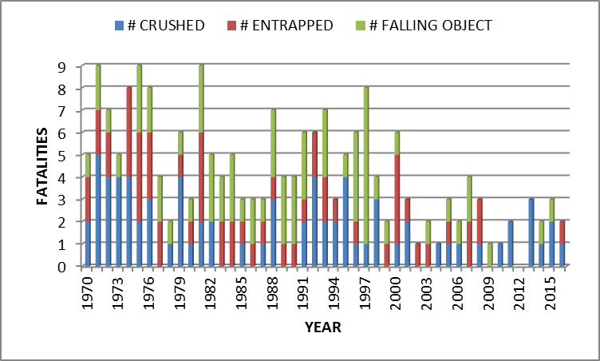
Number of fatalities where cause of death is
crush-type injuries
199 fatalities
Notes:
Entrapment category includes vehicle collisions, structural collapse, major rockfall events and being buried in ore passes – all with a high potential for crushing type injuries.
Combining the entrapment fatalities with crush fatalities provides a more complete picture of the hazards of being placed in a rapidly-diminishing space.
Data shows at least one death due to crush-type injuries has occurred every year since 1970, with the exception of 2012. Total 199 deaths.

Slide 20
Fatalities are not the
only outcome
of these events

Slide 21
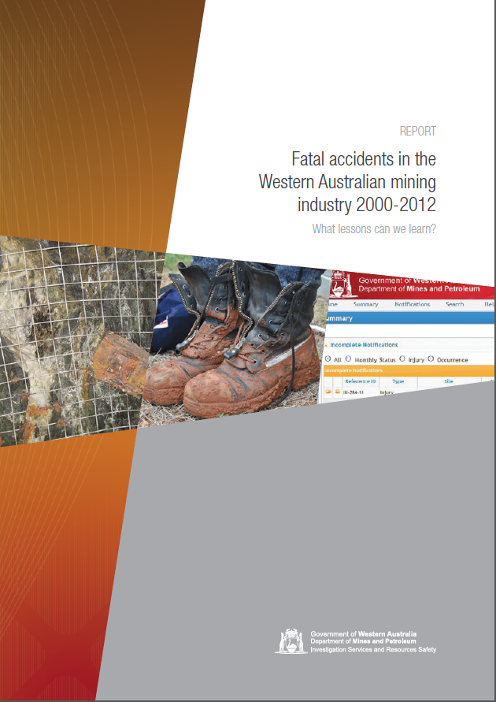
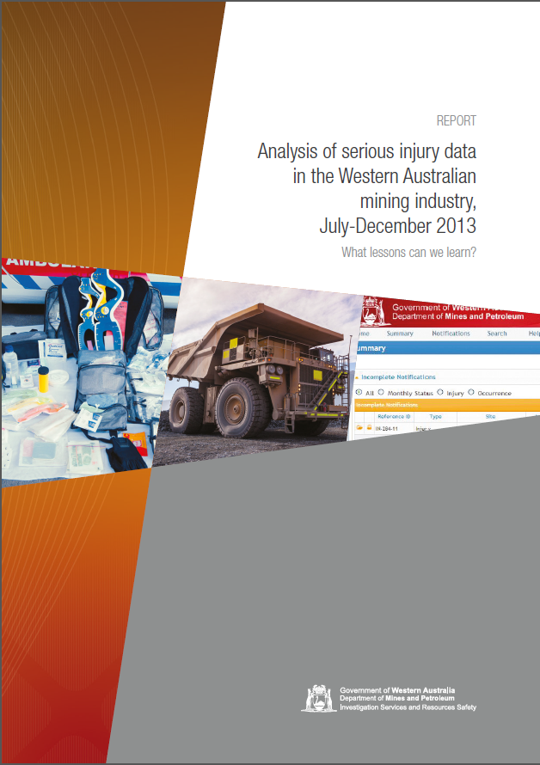
Analysing the data
Fatality review
Serious injury review
Notes:
2 reviews of reported injury data have been undertaken in recent times
Reports are available through the DMP website.
Additional research and analysis is currently underway, with a view to updating these reports.

Slide 22
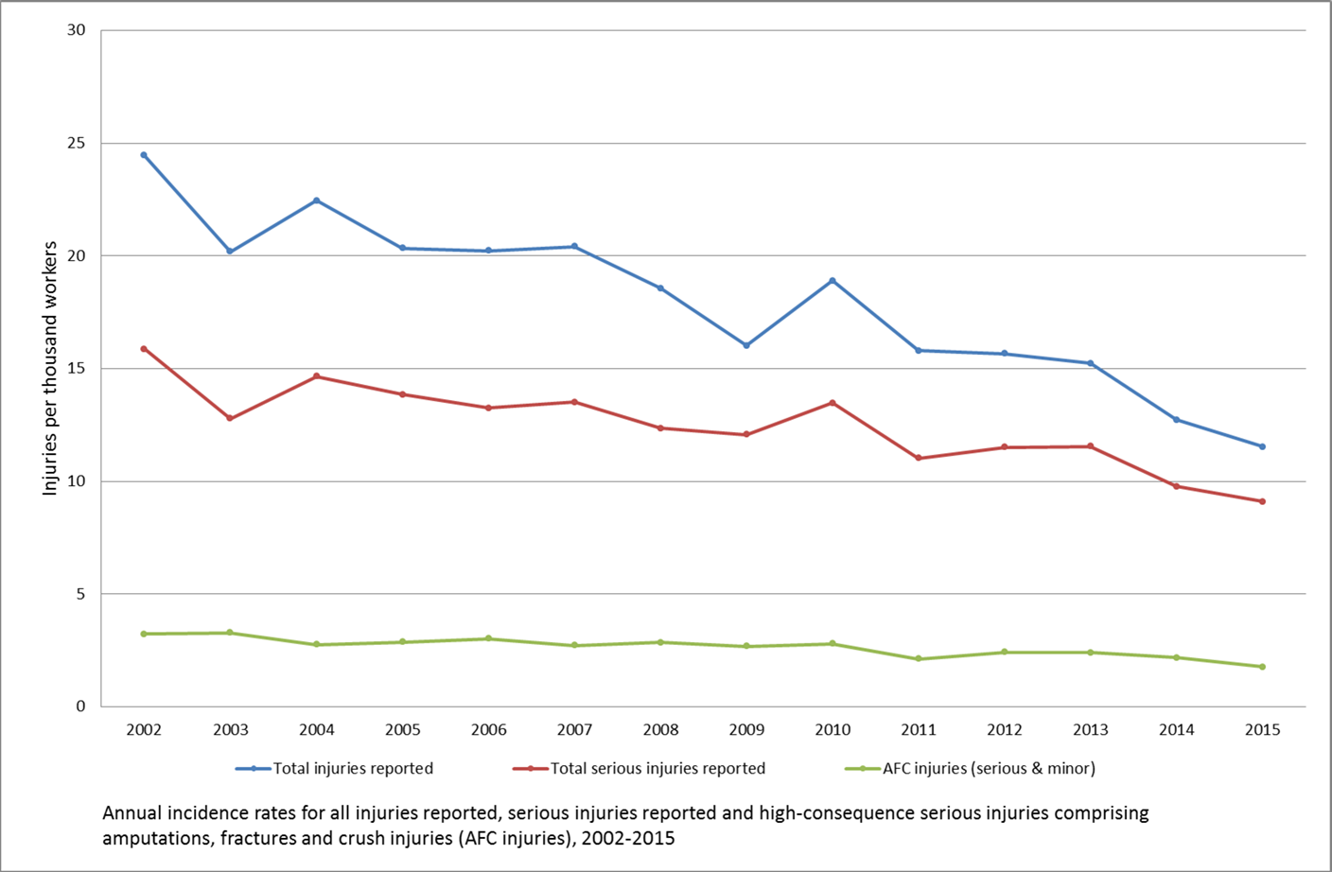
Considering injuries – normalised annual injury rate/1000 FTE employees
217 AFC injuries
Notes:
Total number of injuries reported in any year can be affected by the number of employees in the industry; by expressing data in terms of injuries per 1000 employees allows comparisons between years and trends to be identified.
Graph indicates downward trend in number of injuries, but high-consequence (disabling) injuries is relatively constant.
This tells us that we are making steady in-roads to the number of injuries caused within the workplace, but have need for greater effort to reduce the number of disabling injuries.
These disabling injuries are reflected in the number of workers who bear the signs of substantial injury, or who cannot do the job they used to do, or are unable to work at all, but we must all consider the “hidden” effects of the injury on their lifestyle and family. The following videos give an insight into this aspect of managing workplace safety.

Slide 23
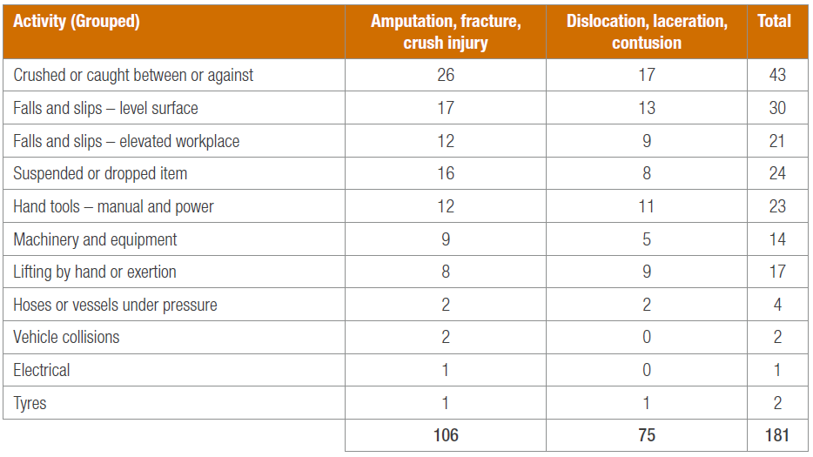
From serious injuries review – July to December 2013
High-consequence serious injuries by nature of injury and work scenario
Fatalities since 2006
(12)
(9)
(6)
(4)
Total 1452 AFC injuries 2006 - 2013
Notes:
Being crushed or caught between = greatest source of injuries
Considering the fatalities since 2006 in BLUE, we see a correlation between the incidence of serious injuries and fatalities – as we expect from high-energy transfer events.

Slide 24
Areas of focus
for DMP
Notes:
To provide direction and best use of resources, the DMP is focussing on the following areas.

Slide 25
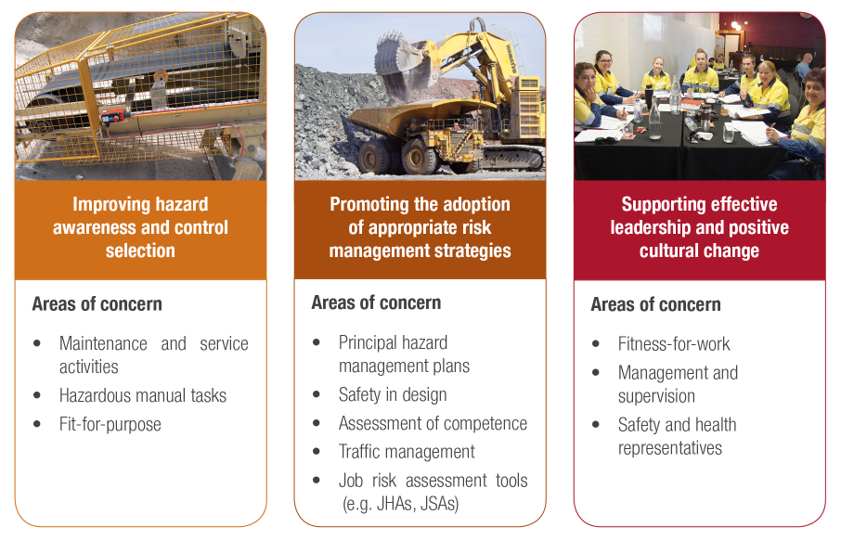
Resources Safety’s focus on mining activities
Maintenance and service activities
Hazardous manual tasks
Fit for purpose
Principal hazard management plans
Safety in design
Assessment of competence
Traffic management
Job risk assessment tools (e.g. JHAs, JSAs)
Fitness for work
Management and supervision
Safety and health representatives
Notes:
Discuss three “pillars” and subset of areas of current concern.
All pillars will be covered in today’s workshops:
Hazardous manual tasks
JHAs
but main focus is on:
Fitness for work – mental wellness and human factors, and
Involvement of Safety and Health Reps in managing workplace safety.
Note that proposed new legislation will have an increased focus on:
Safety and health representatives
Management and supervision
Risk management strategies

Slide 26
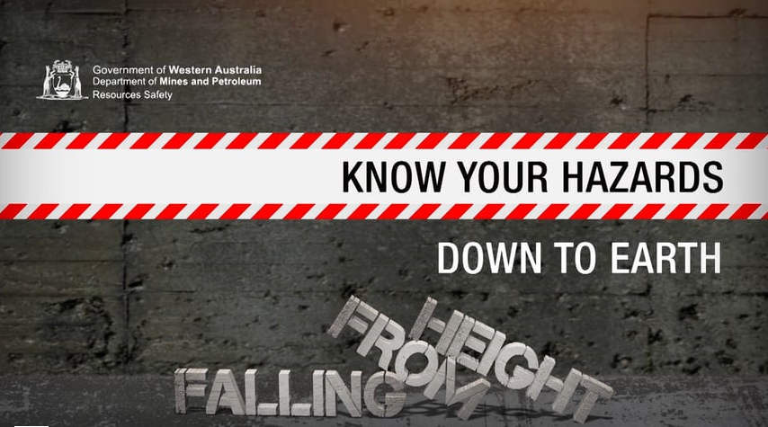
Focus areas: critical activities and hazards
On the basis of ongoing significant events greater focus is needed in areas of:
Crushed between or against
  2016 hazard videos
Falls from height
  2015 hazard videos
Vehicle related
  Loss of control
  Traffic management
Notes:
2016 hazard video series cover crushing, entrapment and caught by hazards:
Similar mechanism of cause
Can have similar outcomes

Slide 27
What else
needs
to be done?
Notes:
Discuss your site’s performance in managing the risk of crush injuries.
Identify areas of concern and any opportunities for improvement.

Slide 28
Summary
Why aren’t we making better decisions?
We appear to be learning from our mistakes, but not quick enough – current trend in fatalities and serious injuries is static
Being crushed is the greatest cause of fatalities and significant injuries
We need to do something different and change our thinking if we are to drive improvements.
Go back to your workplace and compare your site experience in the key contributing areas
Make a difference
Notes:
The hazards related to working in the mining industry have not changed substantially since 1896 and there are numerous repeats of incidents – highlighting our failure to learn from our mistakes.
We need to raise the level of awareness of hazards, improve the management of controls and embed best practices across all workplace activities.

Slide 29



Stay informed
Remember: Subscribe to our weekly email alert service to receive the latest news about what’s happening at Resources Safety
@ www.dmp.wa.gov.au/subscriptions
Follow us on social media:
Twitter
@DMP_WA
LinkedIn at Department of
Mines and Petroleum
Notes:
Subscribe to Resources Safety’s email alert service to receive invitations to provide input as well as the latest news about publications, safety alerts, events and safety reform progress. Safety news alerts are typically sent each Tuesday.
Follow us on LinkedIn to receive the latest resources safety news alerts and job opportunities at DMP.
Follow us on Twitter to stay up-to-date on a variety of the latest department news and information - from major project milestones and upcoming events, to updates regarding industry policies and guidelines.

