Slide 1
Please read this before using presentation
This presentation is based on the content presented at the 2019 Health and Hygiene Forum in June 2019.
Department of Mines, Industry Regulation and Safety (DMIRS) supports and encourages reuse of its information (including data), and endorses use of the Australian Governments Open Access and Licensing Framework (AusGOAL)
This material is licensed under Creative Commons Attribution 4.0 licence. We request that you observe and retain any copyright or related notices that may accompany this material as part of attribution. This is a requirement of Creative Commons Licences.
Please give attribution to Department of Mines, Industry Regulation and Safety, 2019.
For resources, information or clarification, please contact: SafetyComms@dmirs.wa.gov.au or visit www.dmirs.wa.gov.au/ResourcesSafety

Slide 2
2019 Health and hygiene
forum

Slide 3
Trends, trouble spots and success stories: noise

Slide 5
This presentation is about…
What is Noise Induced Hearing Loss (NIHL)?
How big is the problem?
What are some risk factors for NIHL?
Who’s responsible?
How much noise is too much?
What’s the bigger picture?
How can we make a positive difference?
Noise management – how far have we come?
What are your key take-away messages?

Slide 6
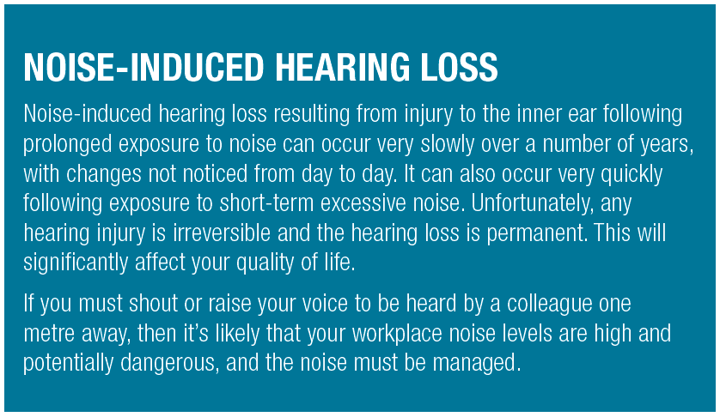
Noise induced hearing loss (NIHL) – How big is the problem?
1 in 6 Australians is affected by hearing loss. With an ageing population, [this] is expected to increase to 1 in 4 by 2050
Most common causes of hearing loss are ageing and excessive exposure to loud sounds
Effects of age and noise exposure are additive. Therefore, noise exposure may cause hearing loss in middle age that would not otherwise occur until old age.
Notes:
NIHL results when the inner ear becomes damaged following short term or long term exposure to excessive noise. It can occur quite quickly or deteriorate over time. Once it has taken effect, the damage is permanent.
As a rule of thumb, if you have to raise your voice to speak to someone a meter away, then the noise level around you has the potential to cause hearing damage, therefore it must be managed.
There are 2 main culprits to hearing loss, excessive noise & aging.
It is worth noting that although our hearing deteriorates over time - we can bring the hearing loss on faster if we expose ourselves to excessive noise.
While interventions such as hearing aids and cochlear implants enhance a person’s ability to communicate, the majority of people with hearing loss (85%) do not have such devices.
Source: Access Economics, Listen Hear! The economic impact and cost of hearing loss in Australia, (February 2006), p. 5.

Slide 7
What is an ototoxin?
Ototoxic chemicals can be divided into two general classes: workplace chemicals and medication. Currently it is thought that more than 750 different groups of chemicals are potentially ototoxic, but only a few of these have been studied in any depth.
Notes:
It is less well known that a substantial number of medications and common industrial chemicals can also cause hearing loss or exacerbate the effects of noise.
These chemicals are said to be ototoxic (oto = ear, toxic = poisonous).
Source: https://www.safeworkaustralia.gov.au/system/files/documents/1702/occupational_noiseinduced_hearing_loss_australia_2010.pdf

Slide 8
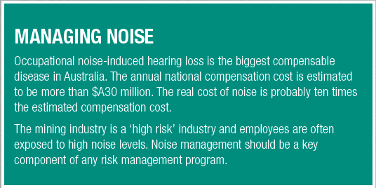
Adding ototoxins
Research projects:
Cigarette smoking has been shown to have potential adverse effects on hearing.
According to new research led by Curtin University;
Almost 1 in 5 Australian working men experienced noise above the recommended occupational limit on their most recent working day.
4 out of 5 workers who exceeded the full noise exposure limit were also likely to be exposed to at least one ototoxic chemical in the workplace.
The Occupational Health team at Edith Cowan University is investigating the relationship between noise exposure and welding fumes to determine if welding fumes could be implicated as an ototoxic agent.
Notes:
Some of the biggest ‘at risk’ industries for NIHL is mining and construction.
Recently, researchers from Curtin university conducted a study that Identified almost 1 in 5 Australian working men were exposed to noise above the occupational limit and about 4 out of 5 these workers were exposed to at least 1 ototoxic chemical. More information and a link to the study can be found here - https://news.curtin.edu.au/media-releases/australian-tradies-exposed-to-excess-noise-levels-at-work-study-finds/
The Occupational Health team is investigating the relationship between noise exposure and welding fumes to determine if welding fumes could be implicated as an ototoxic agent. For more information refer to Edith Cowan University, WA. School of Medical & Health Sciences Contact Dr. Martyn Cross: m.cross@ecu.edu.au or A/Prof. Sue Reed: s.reed@ecu.edu.au
New research in this area is indicating that we need to consider ototoxins if we want to reduced the risk of noise induced hearing loss.

Slide 9
Noise-induced hearing loss risk factors
Noise-induced hearing loss is related to:
How loud the sound is (the decibel level)
The amount of time you are exposed to the sound
How far away you are from the sound.
Notes:
Generally NILH is related to:
How loud the sound is (the decibel level),
The amount of time you are exposed to the sound, and
How far away you are from the sound.
Other factors to consider now include exposure to vibration, a persons age and ototoxins.

Slide 10
Whole person safety
Notes:
This graphic illustrates the importance of ‘whole person safety’.
The effort we put into protecting our hearing, our lungs, joints has a flow on effect to our mental health and overall wellbeing. We need to intervene here (at work) so that we can enjoy our retirement, see our grand children grow, and in the context of noise, we want to be able to hear them.

Slide 11
The Bigger Picture
Notes:
This video illustrates what NIHL can be like.
Source: https://www.youtube.com/watch?v=LehVFM6UPfg

Slide 12
Step 1: Identification
Notes:
In line with good risk management approaches, the first step is to identify the hazards.
Can you identify the noise hazards specific to your workplace?

Slide 13
How can we make a positive difference?
At work
Outside of work
Notes:
We should consider noise exposure both at work and at home.
The World Health Organisation estimates more than 1 billion young people are in danger of hearing loss from portable audio devices, including smart phones. This is just one example of potential excessive noise exposure in the home environment.
If we want to consider the ‘whole person safety’ we need to look at our risk factors both at home and at work – for this presentation we are focusing more on workplace risk factors.

Slide 14
How much noise is too much?
As a guide, if you need to raise your voice to communicate with someone approximately one metre away, the noise is likely to be hazardous to hearing.
Whether the exposure standard of 85 dB(A) averaged over eight hours is exceeded depends on the level of noise involved and how long workers are exposed to it.
Peak noise levels greater than 140 dB(C) usually occur with impact or explosive noise such as sledge-hammering or a gun shot. Any exposure above this peak can create almost instant damage to hearing.

Slide 15
Step 2: Risk analysis & assessment

Slide 16
2018 Noise monitoring data
Agent | Numbers sampled | Number exceeding exposure standard
Noise (LAeq8h) | 4760 | 3330 (69%)
Source: Qlik
Notes:
Of the 4760 noise (LAeq8h) samples submitted to the department, more than 69% were in excess of the exposure standard during 2018.

Slide 17
When should a risk assessment be conducted?
If you have identified any noisy activities that may expose your workers or other people at your workplace to hazardous noise then, unless you can reduce the exposures to below the standard immediately, you should assess the risks by carrying out a noise assessment.
Refer to noise report and noise control plan
Notes:
A noise assessment will help you:
identify which workers are at risk of hearing loss
determine what noise sources and processes are causing that risk
identify if and what kind of noise control measures could be implemented
check the effectiveness of existing control measures.
Noise exposure outside work can be a significant contribution to risk, increasing exposure and reducing recovery time.
Other risk factors including pregnancy, exposure to potentially ototoxic substances and vibration must be considered when assessing
noise exposure risk.

Slide 18
Step 3: Control the risk
Notes:
Apply the hierarchy of controls that you are familiar with.

Slide 19
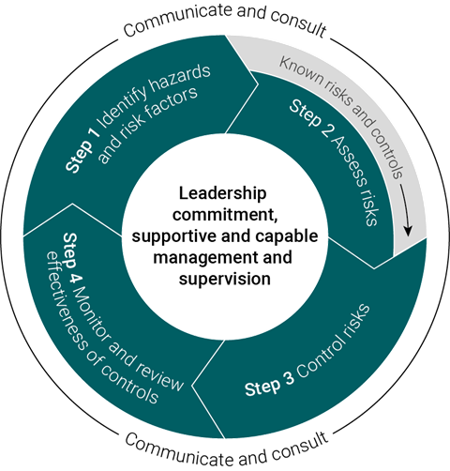
Risk management process
Notes:
We don’t need to design a new system, use the one you have got.
Use your risk management process when managing noise hazards.

Slide 20
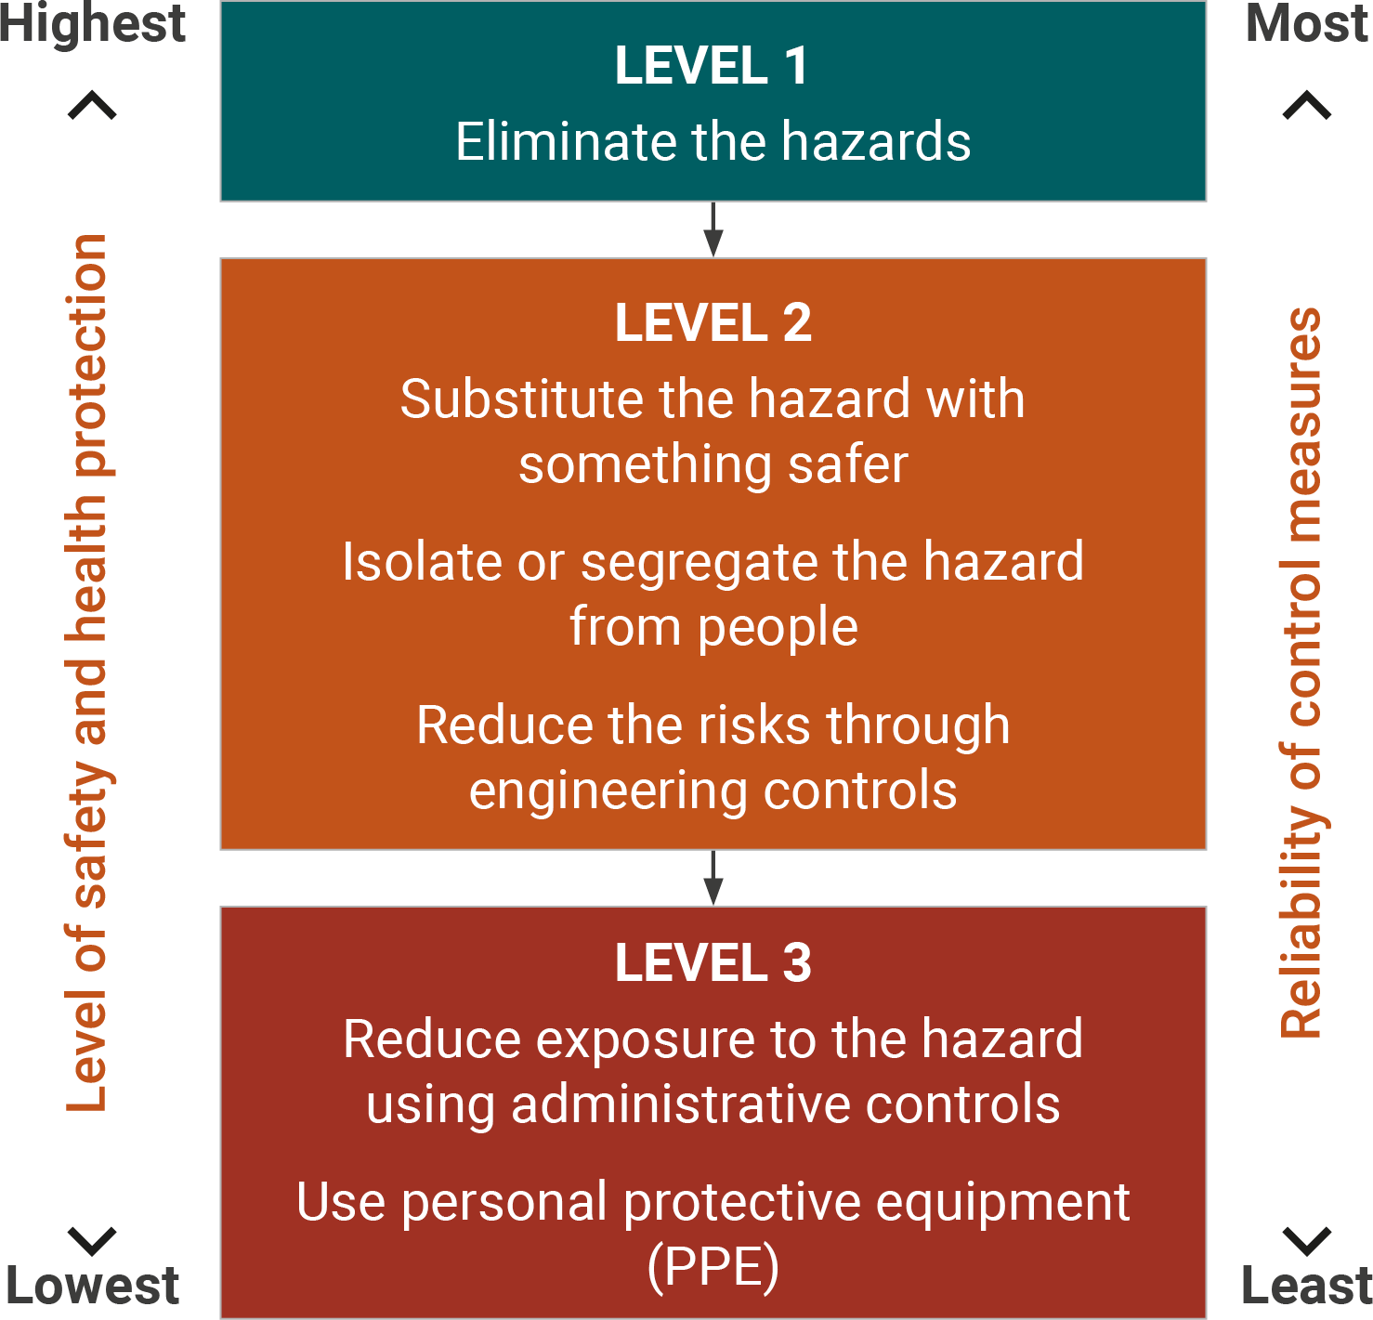
Risk management – Hierarchy of control
Notes:
Mines Safety contend that the risk management “discussion” across the broader industry appears to start at the bottom tier of the hierarchy of control.
When it comes to noise the most effective control measure is to eliminate the source of noise completely, for example by ceasing to use a noisy machine, changing the way work is carried out so hazardous noise is not produced or by not introducing the hazard into the workplace.
If it is not reasonably practicable to eliminate the source of noise, the risk must be minimised so far as is reasonably practicable. This includes ensuring that the noise does not exceed the exposure standard by choosing one or more of the following measures:
substitute the hazard with plant or processes that are quieter
modify plant and processes to reduce the noise using engineering controls
isolate the source of noise from people by using distance, barriers, enclosures and sound-absorbing surfaces.
Industry are reminded (many would be familiar with the hierarchy of control concept) that the level-3 controls are usually straightforward to implement, but are the least effective, and should be viewed, in most instances as short-term fixes to long term issues.
Importantly, for the discussion that follows, when implementing a level-3 control, a conscious decision is made to not address the hazard, rather to control the potential exposure to the hazard. This does not align with the modern safety philosophy of making the workplace suitable for the worker, and not making the worker suitable for the workplace.

Slide 21
Managing the risk
If there is a remaining risk after elimination, substitution, isolation and engineering controls have been considered, it must be minimised so far as is reasonably practicable by implementing administrative controls, and if a risk still remains, then suitable personal protective equipment must be provided and used.
These two types of control measures, when used on their own, tend to be least effective in minimising risks because they rely on human behaviour and supervision.
Notes:
If there is a remaining risk, it must be minimised so far as is reasonably practicable by implementing administrative controls, and if a risk still remains, then suitable personal protective equipment must be provided and used. These two types of control measures, when used on their own, tend to be least effective in minimising risks because they rely on human behaviour.

Slide 22
Declaration questions
Specific regulatory requirements for noise control are described in Part 7, Division 1 of the Mines Safety and Inspection Regulations 1995.
The person has been provided sufficient information and training about the risks associated with noise hazards (MSIR r.7.7)*
The person was supplied hearing protection devices of sufficient rating for the noise exposure to ensure the exposure is below the relevant occupational standard (MSIR r.7.6)*
The person was provided sufficient instruction to ensure that the hearing protection devices were correctly fitted and used (MSIR r.7.7) and assessed as competent to use the personal protective equipment (MSIR r.4.13)*
The person is subject to regular health assessments using recognised techniques to identify any adverse effects from noise exposure (MSIR r.3.27)*
A noise report AND a noise control plan has been prepared and submitted (MSIR r.7.8-11)*
Notes:
Each site should be able to answer each of these questions with a yes, as a minimum.

Slide 23
“But everyone wears hearing protection”
44%
LAeq8h (dBA) ranges (upper limits included)
Notes:
**Before the declaration questions were introduced in SRS**
Mines Safety has had several discussions with industry leaders that have had a recurring theme that ‘noise is difficult to manage’, and therefore the industry actively promotes the use of hearing protection as a first line of protection. Feedback is that compliance with the use of hearing protection is very high.
Data submitted does not support the industry view of compliance. When industry submits data on noise exposures to the Department, the user is asked whether hearing protection was worn during the sampling period.
The grey bars in the graph illustrate the number of samples submitted that reported noise exposures within a 5dBA band. As can be seen from the graph, there are a great deal of samples submitted (>3000) and only 44% of the samples returned exposure readings less than the exposure standard.
Therefore over half of the mining workforce are exposed to levels of noise that may lead to noise induced hearing loss.
Almost half of the samples collected on workers that returned results above the 85dB Action Level reported that the workers did not wear hearing protection.

Slide 24
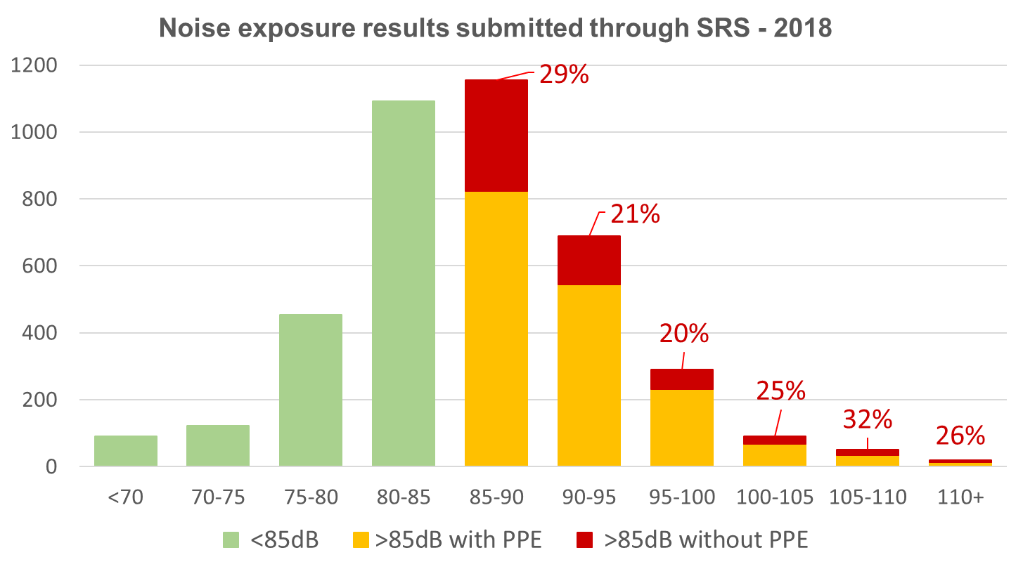
“But everyone wears hearing protection”
Noise exposure results submitted through SRS - 2018
Notes:
**After declaration questions were introduced in SRS**
When we look at rates for the whole 2018 dataset, there appear to be some improvements in the percentages.
More work needs to be done - Training, supervision and audiometric tests are necessary to ensure workers understand that they must use hearing protection when supplied by the employer.

Slide 25
Step 4: Communicate & consult

Slide 26
Noise in the mining industry
Noise report and noise control plan
Safety meetings
Toolbox
Prestart
Hazard reports
Conversations
Secondary impact of other safety hazards
Subject matter experts

Slide 27
Step 5:
Monitoring & review
Notes:
The results of monitoring for noise hazards and risk factors are used:
for verification and validation of controls
to identify learning opportunities for the purpose of continuous improvement
to trigger corrective measures, including early intervention if necessary.

Slide 28
Noise management – How far have we come?
Notes:
By way of providing an example of why the Department believes the risk management conversation commences on the stage 3 controls, the following slides is a summary of noise exposures across the Industry.
There is a big range in different people’s susceptibility to hearing loss from noise, however research shows that 8-hour average daily noise exposure levels below 75 dB(A) or instantaneous peak noise levels below 130 dB(C) are unlikely to cause hearing loss. With progressively increasing levels, the risk becomes greater*. The exposure standard for noise at an LAeq,8h of 85 dB(A) and a peak noise level at 140 dB(C), which protects most but not all people. Therefore, workplace noise should be kept lower than the exposure standard for noise if reasonably practicable.
*SWA Managing Noise and preventing hearing loss at work, September 2015 Page 10
Essentially, a worker who is exposed to 85 dB(A) for 8 hours receives the same noise energy as someone exposed to 88 dB(A) for 4 hours, with the balance of the day in a very quiet environment. In both cases the exposure standard is not being exceeded. However, being exposed to 88 dB(A) for more than 4 hours would mean that the standard is exceeded. Similarly, if a worker is using a machine that generates 121 dB(A) then the exposure standard would be exceeded after only 7.2 seconds.
The Department has selected 4 categories of workers (another 6 categories are available, and all show similar trends) to illustrate the point that over the past 15 years (from data supplied by the industry) noise exposures have scarcely changed, with workgroups other than management and supervisory consistently exposed above the exposure standard.

Slide 29
Analysing workplace data – Making a positive difference
Organisation’s policies and procedures
Buy quiet policies
Changes in work design
Changes to the operating status of the mine (risk profile)
Additional noise report to be prepared
>5 dB or more in the peak noise level
Every 5 years
Requested by inspector
Workers’ compensation claims
Audiometric testing
Incidents and injury records
Work schedules.
Notes:
Examples of making a positive difference and information that can be used to identify opportunities for improvement.

Slide 30
Key take-aways – Snap shot of what we covered…
As a guide, if you need to raise your voice to communicate with someone approximately one metre away, the noise is likely to be hazardous to hearing
How you can make a positive difference at work AND at home
We still have a way to go – with workgroups other than management and supervisory being consistently exposed above the exposure standard
We can’t fix the problem with hearing protection – more level 1 and 2 controls are needed.

Slide 31
Additional resources
Detailed information for noise control management in new and existing workplaces may be obtained from Part 2: Noise control management of AS/NZS 1269 Occupational noise management.
Management of noise in Western Australian mining operations – Guideline
Mines Safety Bulletin No. 153 - Subject: Preventing noise-induced hearing loss in WA mines
Managing noise and preventing hearing loss at work - Code of Practice

Slide 32
DMIRS contacts
1 800 SAFE MINE (1 800 7233 646)
Email: MinesSafety@dmirs.wa.gov.au

Slide 33
Follow us on social media
Twitter
@DMIRS_WA
@AndrewChaplyn
LinkedIn at Department of
Mines, Industry Regulation and Safety
Notes:
Add slide about awards

