Slide 1
Please read this before using presentation
This presentation is based on the content presented at the 2017 Mines Safety Roadshow in October 2017.
Department of Mines, Industry Regulation and Safety(DMIRS) supports and encourages reuse of its information (including data), and endorses use of the Australian Governments Open Access and Licensing Framework (AusGOAL)
This material is licensed under Creative Commons Attribution 4.0 licence. We request that you observe and retain any copyright or related notices that may accompany this material as part of attribution. This is a requirement of Creative Commons Licences.
Please give attribution to Department of Mines, Industry Regulation and Safety, 2017.
For resources, information or clarification, please contact: RSDComms@dmirs.wa.gov.au or visit www.dmirs.wa.gov.au/ResourcesSafety

Slide 2
2017 Mines Safety Roadshow

Slide 3
Setting the scene
Troubling trends and
how to tackle them

Slide 4
Towards 2020 – our commitments
Notes:
Towards 2020 commitments details the goals, focus areas and measures of success for safety and health initiatives undertaken by the regulator.
Progress on these commitments will be reported annually. Examples of progress reporting include online news items, Resources Safety Matters articles, publications, web pages or case studies.
Completed commitments will be archived and be made available to industry online.
(Commitments summary - clockwise)
Modernised legislation – Modernised, consolidated legislation covering mining, petroleum, MHF and geothermal energy;
Human and organisational factors - Routine application of human and organisational factors principles to safety and health management
Mental health and wellbeing - Improved workplace mental health and wellbeing in the resources sector
Safety regulation system (SRS) enhancements - Fully integrated online systems that streamline administration and regulatory functions
Ground control - Improved ground control management
NORM - Improved radiation safety management of naturally occurring radioactive material (NORM)
Risk-based resourcing - Appropriate targeting of compliance and enforcement efforts (right tool, right place, right time)
Nano diesel particulate matter - Increased understanding and control of health impacts of diesel particulate matter (DPM), particularly nano diesel particulate matter (nDPM)
Emergency preparedness - Improved emergency preparedness and safe systems for those working away from readily accessible infrastructure and support services
Traffic management - Improved traffic management practices
Ventilation management - Improved ventilation practices and compliance

Slide 5
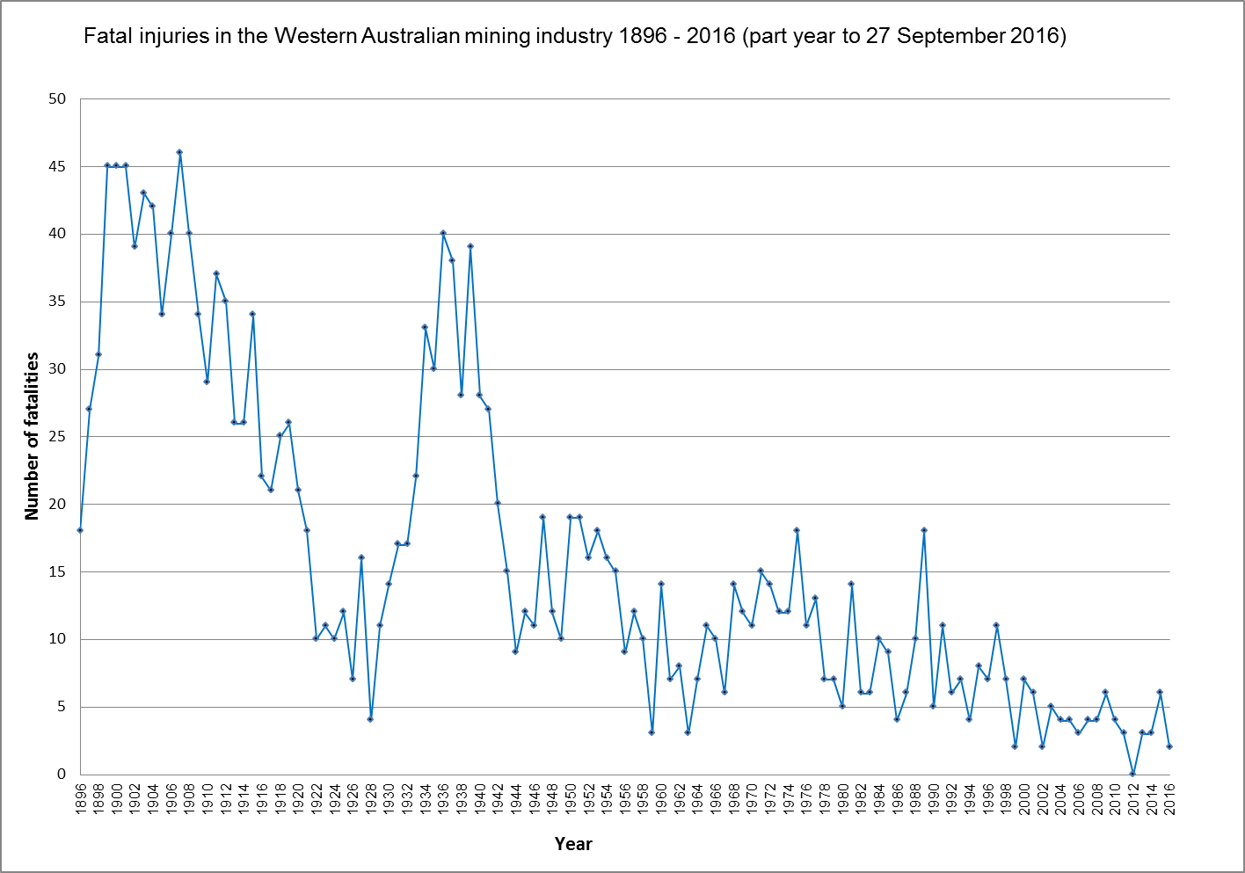
WA mining – historical fatalities
1,942 fatalities
110y average = 16.2
Last 16y average = 4.1

Slide 6
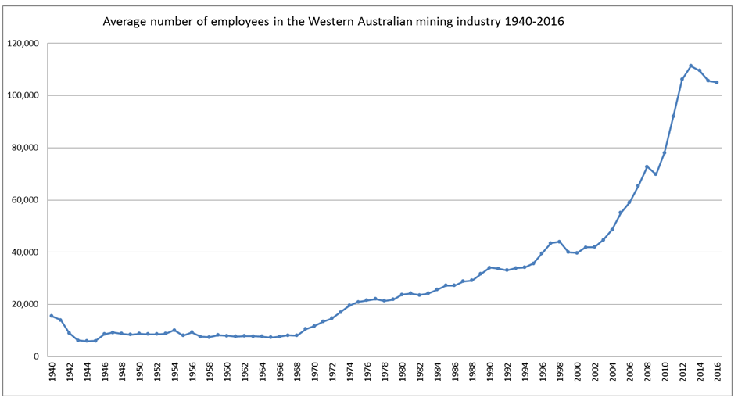
WA mining – historical worker numbers

Slide 7
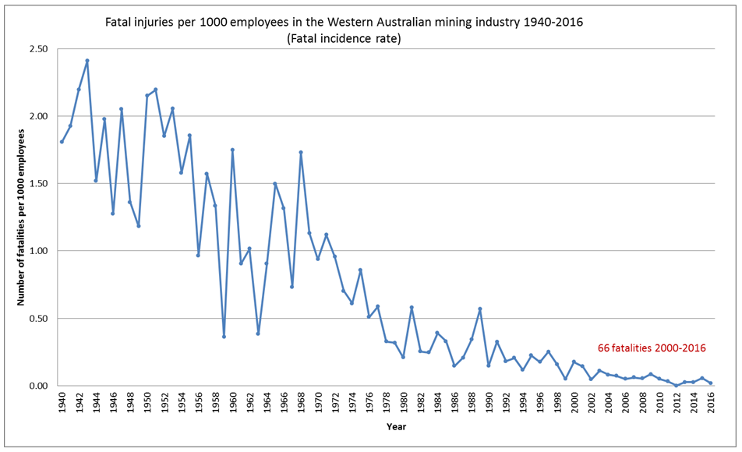
WA mining – fatal incidence rate

Slide 8
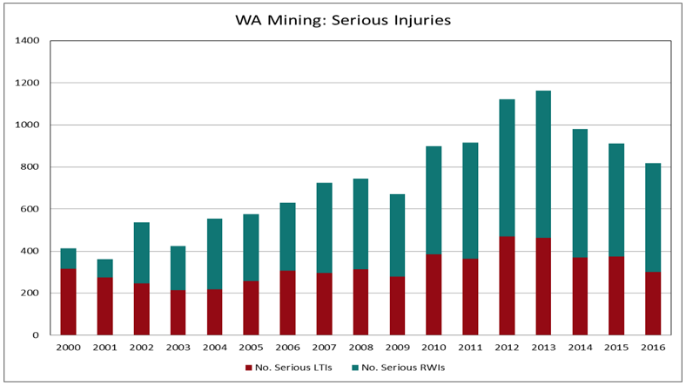
WA mining – serious injuries

Slide 9
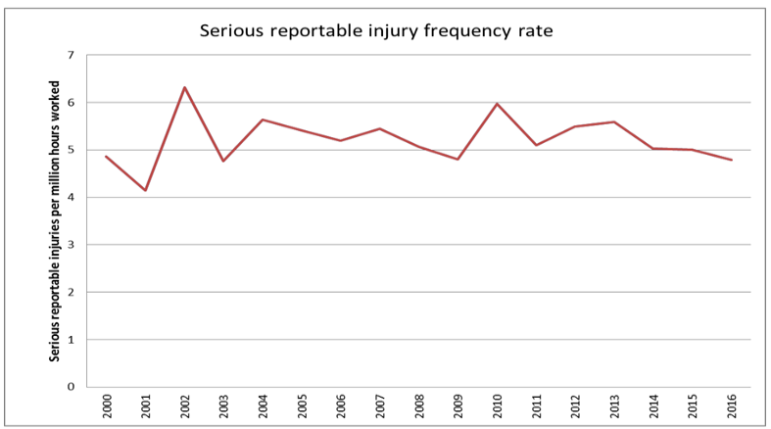
WA mining – serious injury frequency

Slide 10
WA mining – serious injuries (July-Dec 2013)
Activity (Grouped) | Amputation, fracture, crush injury | Dislocation, laceration, contusion | Total
Crushed or caught between or against | 26 | 17 | 43
Falls and slips – level surface | 17 | 13 | 30
Falls and slips – elevated workplace | 12 | 9 | 21
Suspended or dropped item | 16 | 8 | 24
Hand tools manual and power | 12 | 11 | 23
Machinery and equipment | 9 | 5 | 14
Lifting by hand or exertion | 8 | 9 | 4
Hoses or vessels under | 2 | 2 | 4
Vehicles collisions | 2 | 0 | 2
Electrical | 1 | 0 | 1
Tyres | 1 | 1 | 2
 | 106 | 75 | 181

Slide 11
Break out exercise
In your groups:
Nominate a scribe and a spokesperson
Brainstorm and list the WHS issues on your site that you believe need priority attention:
Select the five highest priority issues to report back to the main group

Slide 12
Factors in fatal accidents since 2012
From investigations, most common contributing factors:
inadequate hazard awareness – line of fire (12)
unsafe work method (9)
unsafe act (8)
equipment design (7)
inadequate isolation (4)
equipment failure (4)
unsafe workplace conditions (3)
inadequate warnings (3)
Notes:
Note: Some investigations are still underway and subject to legal opinion.

Slide 13
Multi-national research findings
Major mine hazards have been known for 200+ years
Data since 1992 in 5 countries:
Australia, Britain, Canada, New Zealand and USA
46 fatal or multiple fatality accidents
Engineering, design and maintenance flaws
Failure to heed warning signs
Flaws in risk assessments
Flaws in management systems
Flaws in system auditing
Economic and reward pressures compromising safety
Failures in regulatory oversight
Worker or supervisor concerns that were ignored
Poor worker-management communication and trust
Deficiencies in emergency and rescue procedures
M. Quinlan (2014), Ten Pathways to Death and Disaster: Learning from fatal incidents
in mines and other high hazard workplaces, Federation Press, Sydney

Slide 14
Break out exercise – pathway 1
Engineering, design and maintenance flaws:
What do you think of maintenance activities on your site?
Place an X in the box below the number that best captures your opinion of the current situation at your site

Slide 15
Break out exercise – pathway 2
Failure to heed warning signs:
How often do you think that warning signs are followed on your site?
Place an X in the box below the number that best captures your opinion of the current situation at your site

Slide 16
Break out exercise – pathway 3
Flaws in risk assessment:
Do you know why risk assessments are done, what your role in them is and how to do them?
Place an X in the box below the number that best captures your opinion
of the current situation at your site

Slide 17
Break out exercise – pathway 4
Flaws in management systems:
What do you know about the WHS management system on your site?
Place an X in the box below the number that best captures your opinion of the current situation at your site

Slide 18
Break out exercise – pathway 5
Flaws in system auditing:
Do you know if your WHS management system has been audited?
Place an X in the box below the number that best captures your opinion of the current situation at your site

Slide 19
Break out exercise – pathway 6
Economic and reward pressures compromising safety:
Do you think that production is prioritised before safety on your site?
Place an X in the box below the number that best captures your opinion of the current situation at your site

Slide 20
Break out exercise – pathway 7
Failures in regulatory oversight:
Do you think that the inspectorate visits your site often enough, and have the desired impact?
Place an X in the box below the number that best captures your opinion of the current situation at your site

Slide 21
Break out exercise – pathway 8
Worker or supervisor concerns that were ignored:
If you raise a WHS issue does it get appropriately addressed, and feedback given?
Place an X in the box below the number that best captures your opinion of the current situation at your site

Slide 22
Break out exercise – pathway 9
Poor worker management and trust:
Describe the level of worker-management communication and trust on your site:
Place an X in the box below the number that best captures your opinion of the current situation at your site

Slide 23
Break out exercise – pathway 10
Deficiencies in emergency and rescue procedures:
If an emergency happened on your site, what would the response be:
Place an X in the box below the number that best captures your opinion of the current situation at your site

Slide 24
Setting the scene
Why focus on traffic management?

Slide 25
Fatal accidents – 2000 to 2012 → 52 reports
Falls from height
OEM procedures – fitters in workshops
Run away vehicles
Vehicle rollovers
Vehicles over edges
Vehicle collisions
Electrical contacts
Underground rock falls
Open pit wall failures
Inrush situations
Tyre handling – pressure and gravity
Notes:
Note: Additional 9 fatalities 2013-2015

Slide 26
Traffic management – background
Internationally, road trafﬁc is:
8th leading cause of death globally
leading cause of death for young people
aged 15–29
>1 million people die each year on the world’s roads
In Australia, work-related road crashes account for:
15% of national road deaths
approximately 50% of all occupational fatalities
Many people are killed or seriously injured while travelling to and from work
Source* A guide to applying road safety within a workplace
National Road Safety Partnership Program (NRSPP) website

Slide 27
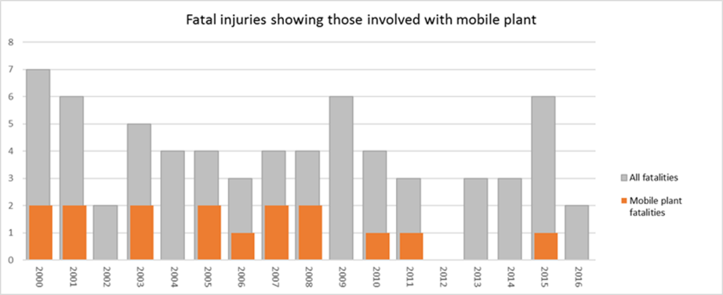
WA mining – fatalities 2000 to 2016
Traffic related incidents accounted for 16 (24%) of all fatalities

Slide 28
WA mining – fatalities 2000 to 2016
Category
Collisions | 5 | 16 fatalities
Over edges | 4
Runaways | 4
Rollovers | 3
Location
Surface | 11
Underground | 5

Slide 29
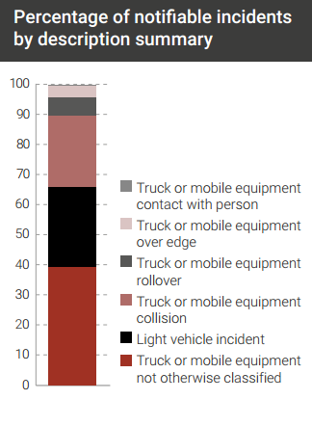
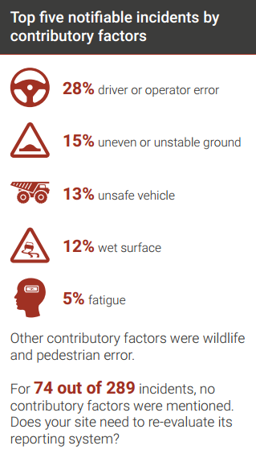
WA mining – September 2017 snapshot

Slide 30
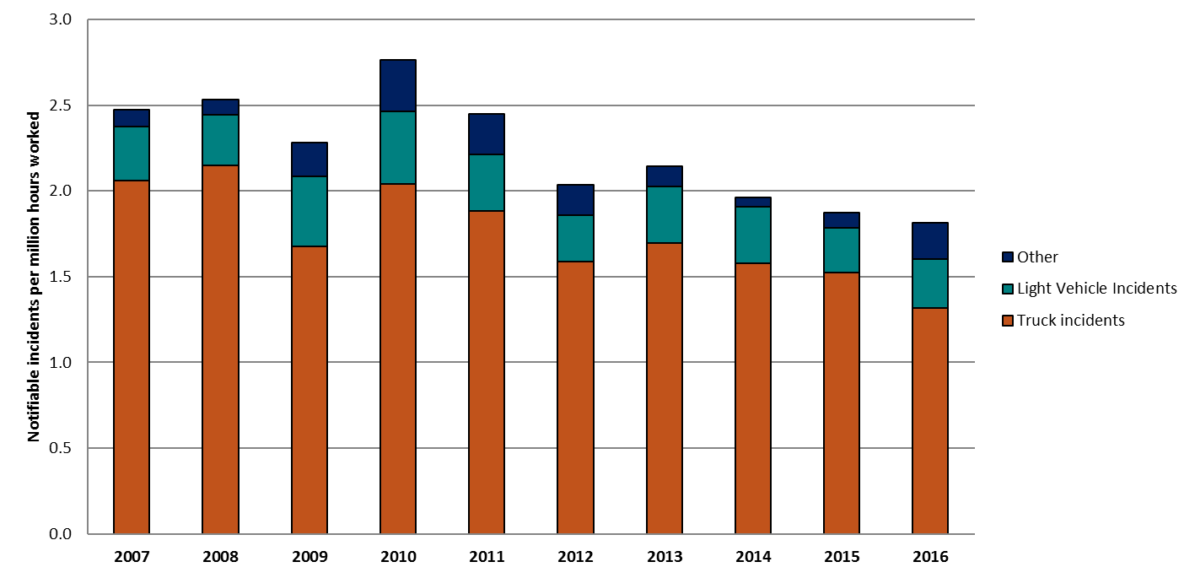
Notifiable incident frequency rates – surface
Average notifiable incidents per year – 328 (~17%)
Notes:
Graph showing number of notifiable incidents involving loss of control for mobile equipment

Slide 31
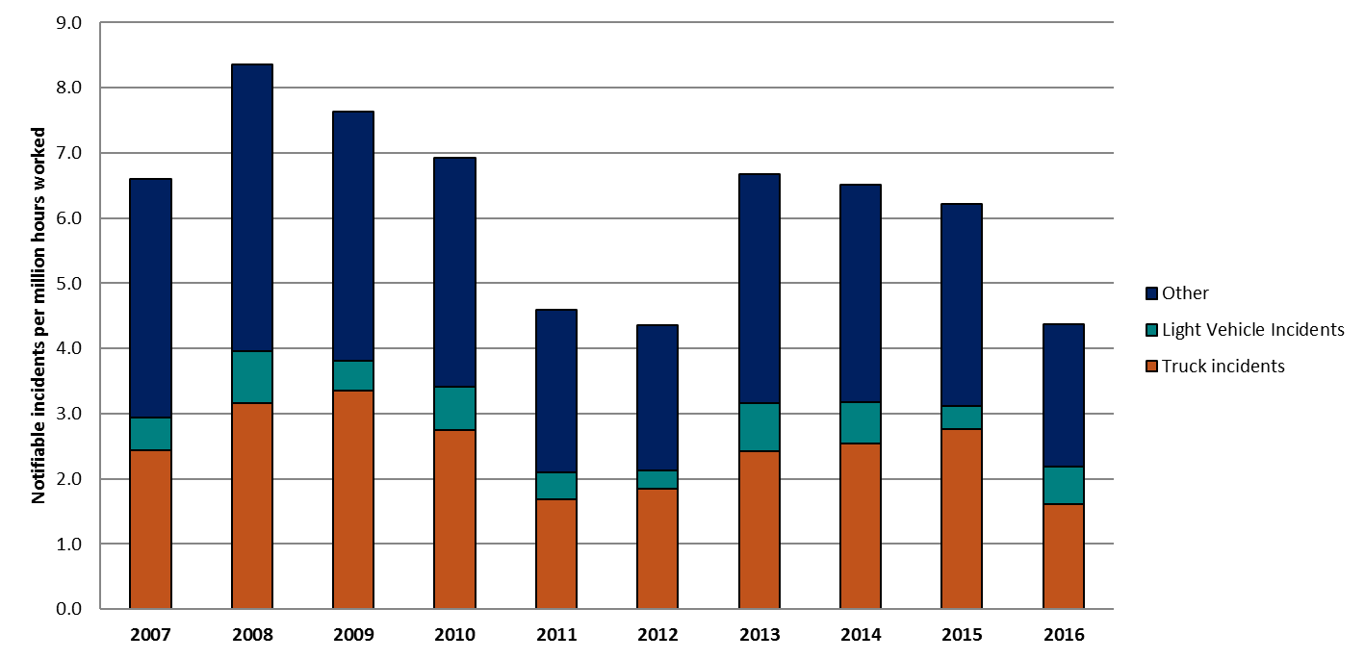
Notifiable incident frequency rates – underground
Average notifiable incidents per year – 104 (~5.4%)
Notes:
Graph showing number of notifiable incidents involving loss of control for mobile equipment

Slide 32
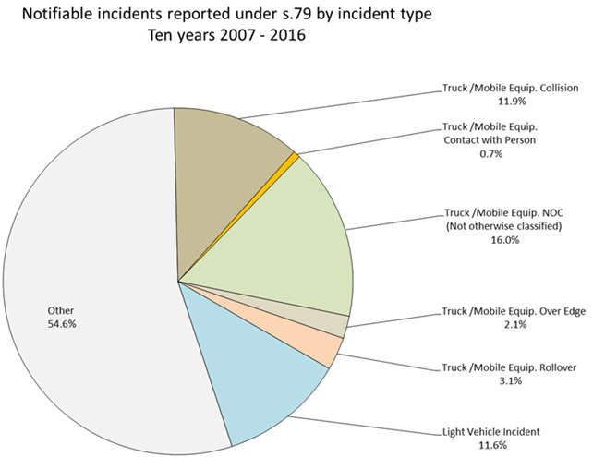
Notifiable incidents reported under s.79
45.4% incidents over the last 10 years involve vehicles
Notes:
Graph showing number of notifiable incidents involving loss of control for mobile equipment

Slide 33
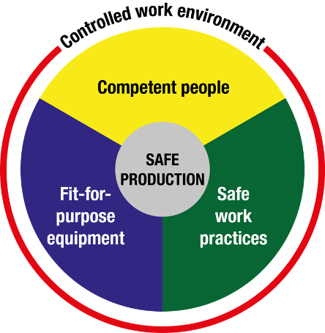
Risk management principles – Nertney wheel
Based on established risk management principles
Safe systems
Safe vehicles
Safe people
Notes:
By the way this is in line with Internationally accepted models of road safety and those of Main roads WA.
Safe System Approach of Main roads WA
Safe System is a philosophy that has been incorporated into our road safety strategy "The Road Towards Zero". The Safe System acknowledges that human error within the transport system is inevitable, and that when it does occur the system makes allowance for these errors so as to minimise the risk of serious injury or death.
The Safe System approach is based on four key cornerstones:
Safer vehicles
Safer speeds
Safer drivers
Safer roads and roadsides

Slide 34
Shaping and sharing the future

Slide 35
A few final reminders
Have you registered to receive the Departments regular updates? www.dmp.wa.gov.au/subscriptions
Check out the videos on our website in November and watch out for the toolbox presentations
Use the outcomes of the traffic management workshop to develop improvements in your TMP:
Enter our annual Safety and Health Resources Sector Awards
Notes:
The Awards are outlined on pages 10 and 11 of the latest edition of the Resources Safety Matters magazine

Slide 36
Awards for Excellence reminder
The Safety and Health Resources Sector Awards recognise individuals, team and companies that have developed a new initiative or an original solution to specific safety and health problems in the workplace
Safety representatives
Systems and people
Engineering

