Slide 1
Please read this before using presentation
This presentation is based on content presented at the Mines Safety Roadshow held in October 2014
It is made available for non-commercial use (e.g. toolbox meetings, OHS discussions) subject to the condition that the PowerPoint file is not altered without permission from Resources Safety
Supporting resources, such as brochures and posters, are available from Resources Safety
For resources, information or clarification, please contact:
  RSDComms@dmp.wa.gov.au
  or visit
  www.dmp.wa.gov.au/ResourcesSafety

Slide 2
What’s happening in mines safety in WA?

Slide 3

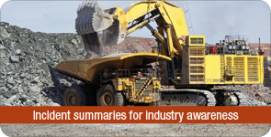
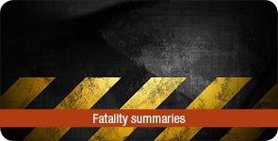
Resources Safety’s commitment
To work with industry to reduce serious accidents and incidents, and provide tangible support in achieving a positive cultural change.
Notes:
This statement from the Department of Mines and Petroleum underpins the regulatory approach taken by the Resources Safety Division.
This presentation provides an update, as at October 2014, about what is happening in:
Resources Safety in terms of the mines inspectorate
industry in terms of safety performance
and discusses how these have influenced the regulator’s focus for the next few years, including what is happening with the legislation.

Slide 4
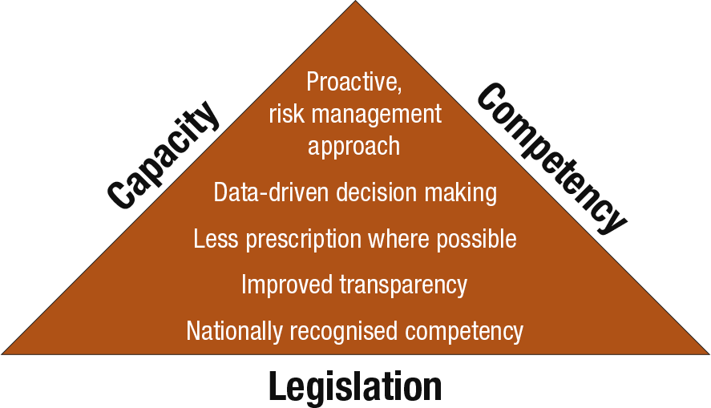
RADARS vision for leading practice regulation
Notes:
Firstly, a quick review of RADARS, which stands for Reform and Development at Resources Safety.
The RADARS initiative was approved in late 2009. It is a long-term strategy focused on improving the way that Resources Safety regulates.
As a safety regulator, Resources Safety needs staff with the capacity and competency to deal with a variety of issues and situations.
There also needs to be a strong legislative foundation upon which to base the risk-based regulatory approach.

Slide 5
5 principles of leading practice safety regulation
Transparency – we have clear rules and processes
Accountability – we explain our performance
Consistency – the same outcome is sought, although our approach may differ depending on the circumstances
Proportionate – our actions are guided by the safety and health risk
Targeted – we focus on the most important safety and health outcomes
Notes:
It is easy to talk about a risk-based approach to safety but, in practice, it requires more of the regulator.
Interpreting whether someone breached prescriptive legislation is usually clear. It’s either yes or no.
Assessing whether someone has identified the hazards, and eliminated or reduced workers’ exposure to them, is another matter.
When interacting with industry, the regulator needs to be:
Transparent – have clear rules and processes
Accountable – explain performance
Consistent – the same outcome is sought, although the approach may differ depending on the circumstances
Proportionate – actions are guided by the safety and health risk
Targeted –focus on the most important safety and health outcomes
The mines inspectorate runs training programs and six-monthly inspector forums to work towards these aims.

Slide 6
Safety legislation reform PHASE 1
Work Health and Safety (WHS)
Mines safety
WHS (Mines) Bill expected to be introduced to Parliament mid-2015
WHS (Mines) regulations to come into effect mid-2016
Supporting codes of practice and guidelines to follow
Notes:
Work Health & Safety Bill for the resources industry
PHASE 1 – MINES SAFETY
Department of Mines and Petroleum, Resources Safety Division, has work well underway to modernise and harmonise safety legislation that regulates the resources sector in Western Australia. Draft bill has gone to Parliamentary Counsel for mining.
New legislation will have a greater focus on risk management and will incorporate the best elements of the National Mines Safety Framework and the model Work Health and Safety legislation processes that have been undertaken over the past few years.
It is expected the new legislation will be in place by mid-2016. There will be transition arrangements in place to accommodate the introduction of and new requirements.

Slide 7
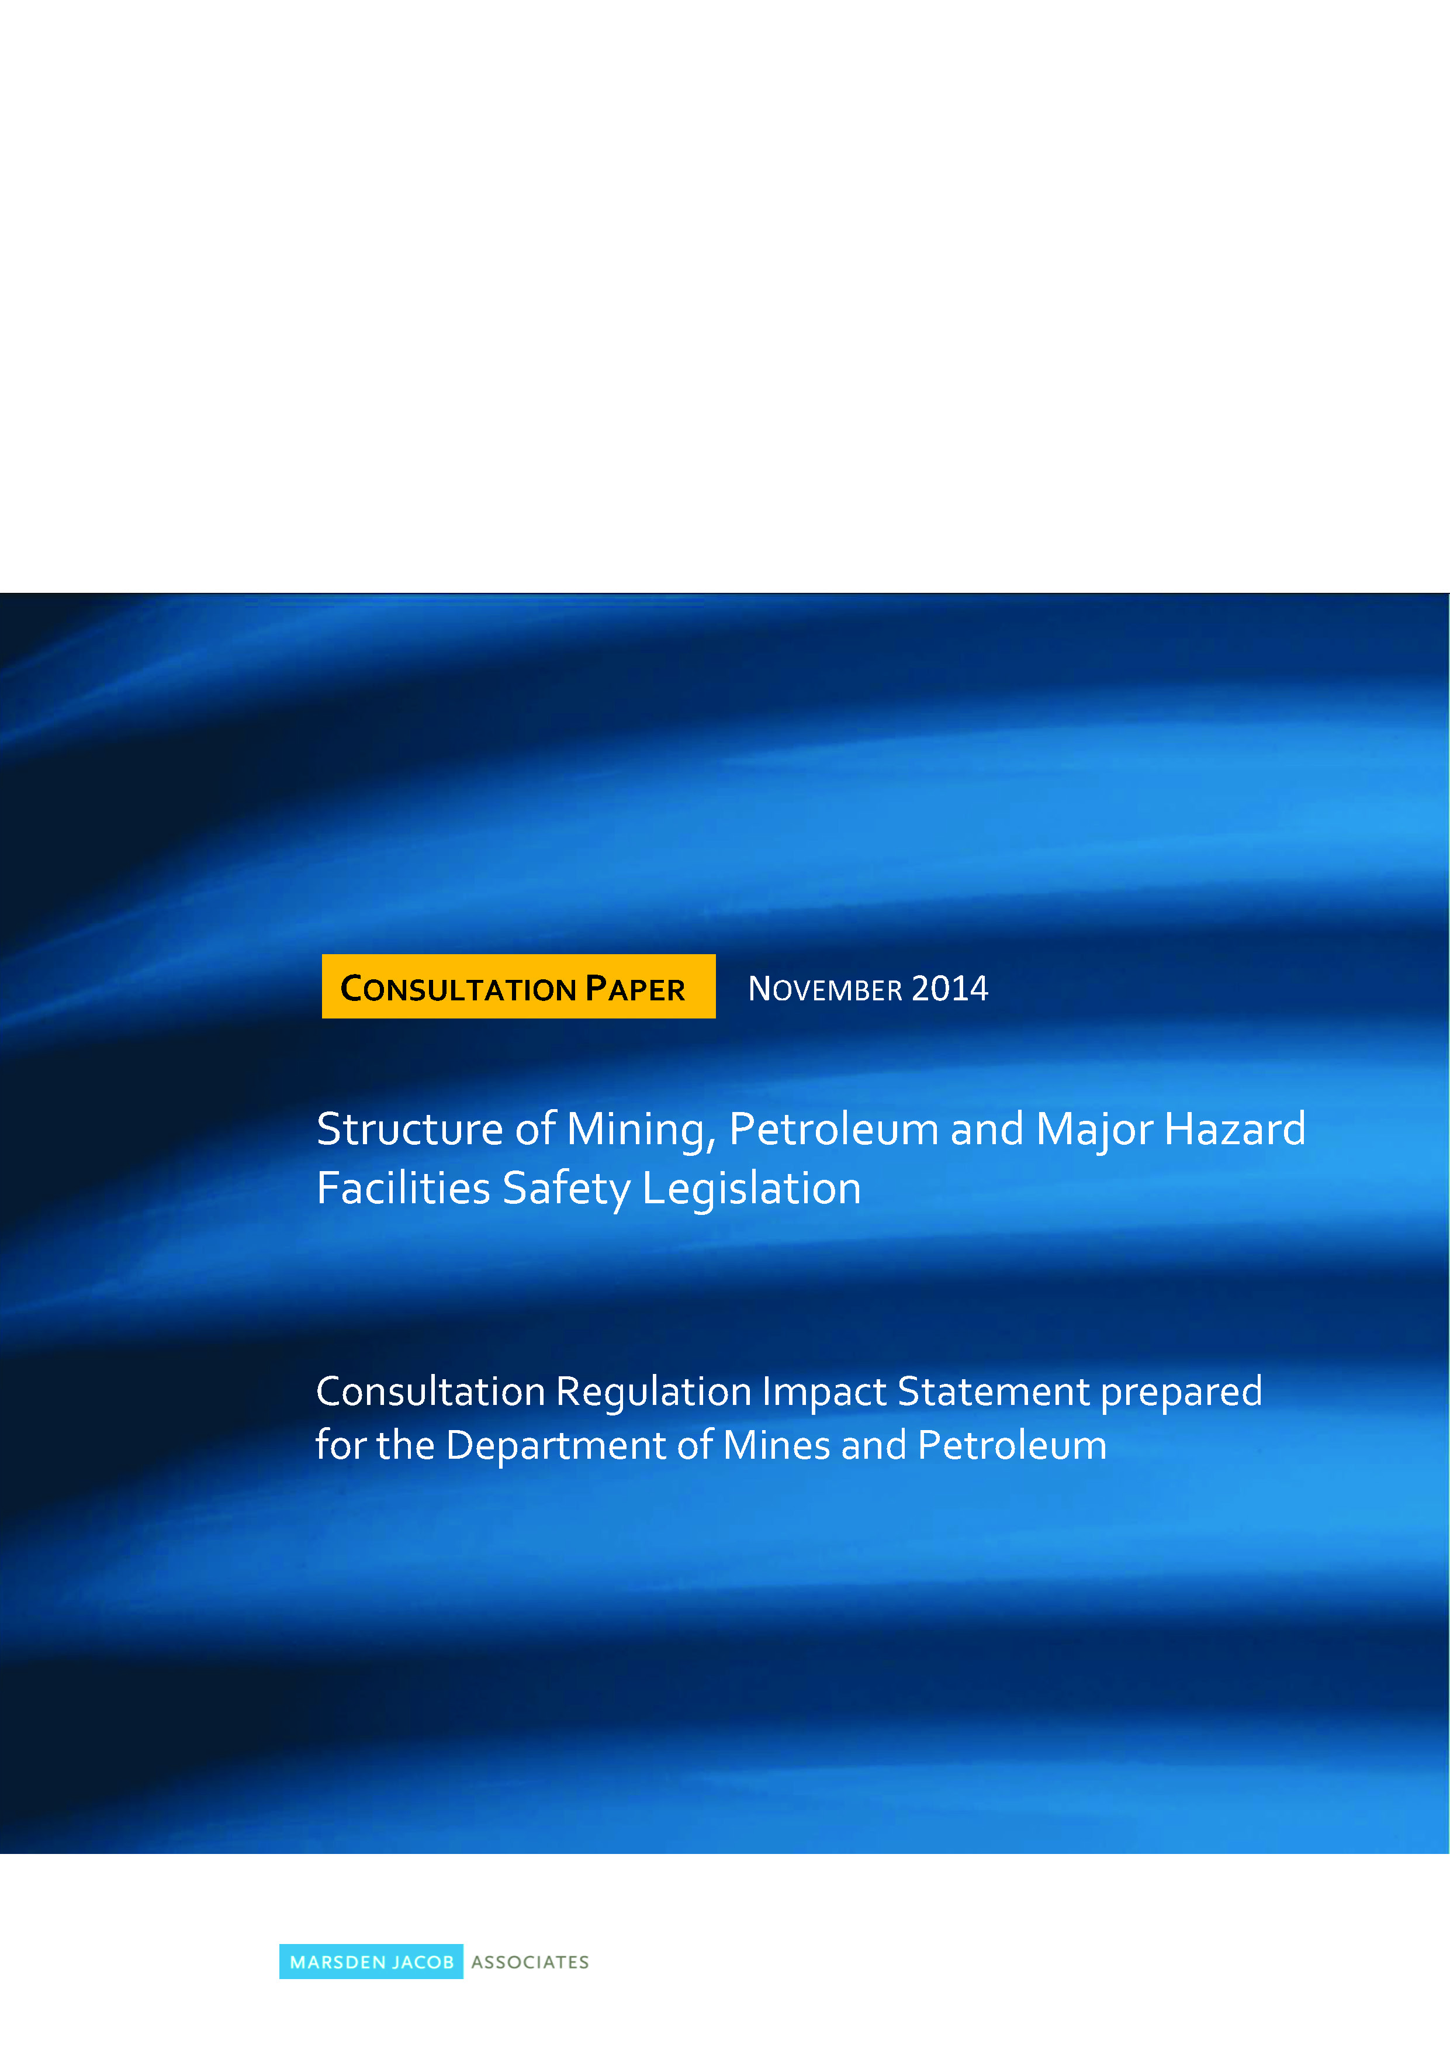
Safety legislation reform PHASE 2
Consultation RIS on 5 options closes 19 December 2014
Minister to consider Decision RIS March 2015
Chosen option implemented 2015-2017
Structural reform of mining, petroleum and MHF safety legislation
Consolidation of resources safety legislation
Information and consultation paper available at www.marsdenjacob.com.au
Notes:
Throughout this process, DMP is consulting through the Ministerial Advisory Panel on Safety Legislation Reform, with industry and the unions to ensure that it receives input into the decision-making process. MAP is tripartite body – industry, unions, government
Minutes from the Ministerial Advisory Panel are available on the DMP website
There will also be an opportunity for industry to comment through the Regulatory Impact Statement (RIS) process.
For Phase 2, the Department is undertaking a RIS on the preferred option for consolidation.
Marsden Jacob Associates is currently undertaking consultation on behalf of the Department of Mines and Petroleum (DMP) in Western Australia. Further information is available from the Marsden Jacob website.
The consultation period closes on 19 December 2014.
Also see Resources Safety’s website and sign up for weekly news alerts for information on how to provide input.

Slide 8
What are the options?
Unified safety Act for mining, petroleum and MHF
Consolidated safety Act for petroleum and MHF; mines safety Act remains separate
Individual mining and petroleum safety specific Acts; MHF safety provisions remain split across two Acts and two regulators
Consolidated safety Act for mining and petroleum; MHF safety provisions remain split across two Acts and two regulators
Maintain the status quo. Work Health and Safety (Mines) Act; safety provisions contained in three separate petroleum Acts and MHF safety provisions remain split across two Acts and two regulators
Notes:
Input is sought on five proposed options to structure the safety aspects of mining, petroleum and Major Hazard Facilities (MHF) legislation.
Options outlined in the Consultation Paper seek to:
* consolidate safety provisions for mining, petroleum and MHF into a single or reduced number of Acts; and
* allow for a single regulator to cover all safety provisions at MHF sites.

Slide 9
Safety legislation reform PHASE 2
Consultation RIS on 5 options closes 19 December 2014
Decision RIS from consultant 31 January 2015
Minister to consider Decision RIS March 2015
Implement chosen option 2015-2017
Consolidation of resources safety legislation
Information and consultation paper available at www.marsdenjacob.com.au
Notes:
The Minister for Mines and Petroleum will consider the Decision RIS report in 2015.
Once it is decided which option will be adopted, work will commence on the legislation with implementation planned for sometime in 2017.
Having set the scene for what is happening in Resources Safety, let’s now review industry’s performance.

Slide 10
Industry’s performance - How are we travelling?
Notes:
This graph shows mining fatalities since records began in 1896.
Overall the trend has been downwards, despite the increasing workforce numbers.
Let us examine the more recent data in detail.

Slide 11
How are we travelling in recent times?
Fatalities in WA mining industry 2000-2014 (part year to 30 September 2014)
Notes:
This graph shows mining fatalities since 2000 to end September 2014.
In the last 15 or so years, there have typically been 3-5 fatalities a year.
Note the peak in 2009. This was one of the drivers for the RADARS strategy.
Although the Western Australian mining industry has a good safety record, there is an industry-wide commitment for everyone to go home safe.
The first challenge is to reduce fatalities to zero. Industry has achieved it once, in 2012. Can it be done again? We sincerely hope so and need to work together to achieve this.

Slide 12
Since the last Mines Safety Roadshow …
Fatalities
4 December 2013 – Telfer TSF, SIR 193
29 December 2013 – Christmas Creek workshop, SIR 194
15 February 2014 – Harlequin underground, SIR 200, MSB 112
26 May 2014 – Brightstar process building, SIR 203
29 September 2014 – Worsley Alumina Refinery, under investigation
Notes:
This slide lists the fatalities between the 2013 and 2014 Mines Safety Roadshows, together with safety alerts related to those incidents.
Visit www.dmp.wa.gov.au/15563.aspx (mining publications) to retrieve copies of the Mines Safety Significant Incident Reports (SIRs) and Mines Safety Bulletins (MSBs).
Telfer tailings storage facility
Mines Safety Significant Incident Report No. 193 Crush injuries sustained from movement of tailings pipe – fatal accident
Christmas Creek heavy equipment maintenance workshop
Mines Safety Significant Incident Report No. 194 Crush injuries sustained from working with a suspended load - fatal accident
Harlequin underground mine, ore drive
Mines Safety Significant Incident Report No. 200 Fall of ground in underground mine - fatal accident
Mines Safety Bulletin No. 112 Quality control issues when installing friction rock stabilisers with airleg drills
Brightstar process building
Mines Safety Significant Incident Report No. 203 Operator crushed by mast of forklift truck - fatal accident
Worsley Alumina Refinery, lift shaft
Still under investigation as at end October 2014. Safety alert to be issued.

Slide 13
Number of serious injuries per million hours worked
Serious LTIFR
Are we closing the gap?
Not yet
Notes:
What about other performance data?
People are still getting hurt. So the second challenge is to reduce the serious injuries frequency rate.
The rate has continued to flatten out, showing little change in 2013-14 compared with the previous two years.
How can we continue the downward trend and close the gap to zero? As for fatalities, we all need to work together and be vigilant.

Slide 14
Nature of serious injuries reported for 2013-14
Number of serious LTIs
Notes:
This graph shows the types of serious injuries reported for 1 July 2013 to 30 June 2014.
Note: For more detailed information on industry’s safety performance, visit www.dmp.wa.gov.au/8004.aspx (mining accidents and incidents)

Slide 15
Location of accident involving serious injury reported for 2013-14
Number of serious LTIs
Notes:
This graph shows where the serious injuries were sustained in 2013-14.
Note: For more detailed information on industry’s safety performance, visit www.dmp.wa.gov.au/8004.aspx (mining accidents and incidents)

Slide 16
Number of disabling (restricted work) injuries per million hours worked
Disabling injury frequency rate
Notes:
We have seen some of the fatal and serious injury data. What about disabling or restricted work injuries?
Disabling injury definition:
Work injury (not LTI) that results in injured person being unable to fully perform his or her ordinary occupation (regular job) any time after the day or shift on which the injury occurred, regardless of whether or not the person is rostered to work, and where alternative or light duties are performed or hours are restricted.
This graph shows there is still some way to go for disabling injuries too.
The surface frequency rate has flattened out.
For the underground environment, there is a smaller workforce, which probably accounts for some of the variability (small change in number of injuries will have larger effect on frequency rate). However, the rate overall is higher than that for the surface.
The message continues to be that we need to work together and be vigilant.

Slide 17
2,376 incidents reported for July 2013 to June 2014
Notes:
The final set of figures presented is for occurrences or incidents that are required to be reported to the Department of Mines and Petroleum under Sections 78 and 79 of the Mines Safety and Inspection Act.
Total incidents reported for 1 July 2013 to 30 June 2014 = 2,376
SOME NOTES
Fires – the most numerous category covers any fire, from small fires extinguished immediately, to bushfires near exploration camps, to vehicle fires that do major damage.
Incidents involving trucks or mobile equipment and light vehicles – these continue to be of concern and a separate toolbox presentation is available on this topic, which was covered at the 2014 Mines Safety Roadshow.
Electrical incidents – although this category also covers static electricity, any electrical incidents are concerning because of their potential impact on the human body.
Presence of gas – as for fire, this covers any presence of gas from the detection of minor amounts of gas (e.g. methane) to significant pockets of gas being encountered during drilling.
Compressed air explosion – the incidents may be small in number but the consequences can be serious.
So we have a lot of information about what has been happening in industry over the past year. What other information do we have to guide us on what we should we focus on to make a difference and move closer to zero harm?

Slide 18
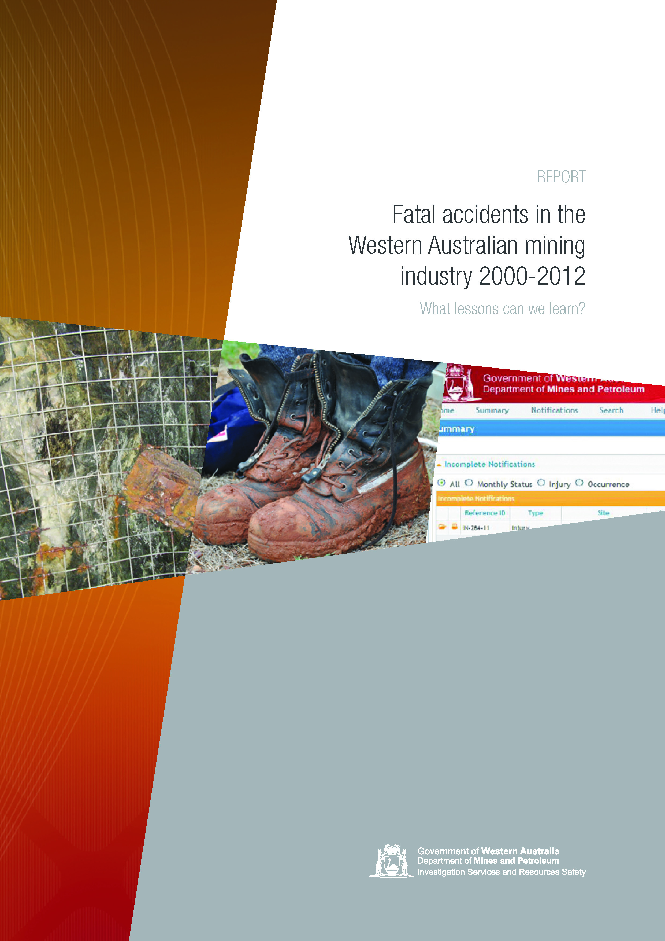
Notes:
In 2013, Resources Safety published a report looking at 13 years of fatalities in the WA mining industry, from 2000 to 2012.
The report and accompanying toolbox presentation are available from the Resources Safety website:
www.dmp.wa.gov.au/8004.aspx#10723
www.dmp.wa.gov.au/8054.aspx#8914
Let us look at some significant findings from the report.

Slide 19
Ten critical factors – multiple fatalities
1. Fall arrest equipment
2. Departure from OEM procedures
3. Run-away vehicles
4. Vehicles over edges
5. Vehicle collisions
6. Electrical contacts
7. Rock falls
8. Pit wall failures
9. Inrush situations
10. Tyre handling
Notes:
These top ten critical factors have been highlighted as they have led to multiple fatalities.
They comprise over three quarters of the total fatalities and involve a number of single-incident repeat situations – apart from the inrush situation – which involved three fatalities in a single event.
Note: See report and separate toolbox presentation if more detailed information is required.

Slide 20
Seeking safety performance improvement
Identification of hazards and critical tasks
Principal hazard management plans
Written work procedures
Involvement of workforce
Training processes – workers and supervisors
Supervision to standards
Site familiarisation and induction
Adequate breaks during the shift
Notes:
What can industry do with this information to improve safety performance?
Identification of hazards and critical tasks (most important) – Everyone needs to understand what hazards they are going to be faced with during the day and what critical tasks everyone does on a day-to-day basis. We need to know what can go wrong and what can kill when doing a particular job.
Principal hazard management plans (PHMPs) – The repetitive failures that we see in the review match the principal hazards identified by the National Mines Safety Framework. All operators need to have knowledge of the hazards on their site that can cause multiple fatalities and repeat fatalities.
Written work procedures – Need to be developed for hazards that have been identified, and modified if the situation changes.
Involvement of workforce – Workers need to know the written work procedures and need to be involved with developing those procedures.
Training processes (workers and supervisors) and supervision to standards – Once the procedures are in place, there needs to be training processes to ensure all employees and supervisors are well trained in the jobs they have to do and have knowledge of the hazards they might face.
Site familiarisation – People need to be conscious of employees entering the industry, they need time to familiarise themselves with what’s going on, the roster cycles and different working environments (this may include a site tour at night, when things look different). They need time to get to know work mates, supervisors and work processes.
Adequate breaks during the shift – This is a long standing issue. We need to be conscious that people cannot sustain focused activities for long periods of time and breaks are needed. The likelihood of someone making an error increases with fatigue and the accompanying lack of concentration.

Slide 21
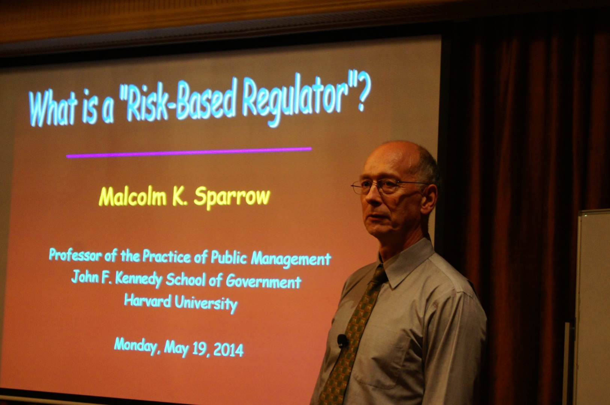
Learning from a world leader
Notes:
When planning its operational and communications strategies, Resources Safety considers the safety performance data, incident reports and results of fatality investigations, as well as other information available through various reporting processes (including mines safety roadshow surveys) and from mines inspectors.
The regulator has also looked to those who can provide guidance on what other regulators are doing so Resources Safety could take on board the lessons learned.
In May 2014, the Department of Mines and Petroleum engaged internationally recognised Professor Malcolm Sparrow from Harvard to run a workshop for Resources Safety on risk-based regulation.
Note: Visit www.hks.harvard.edu/about/faculty-staff-directory/malcolm-sparrow for biographical details and links to Professor Sparrow’s website and CV.

Slide 22
Harm-reduction framework for regulators
Hazard and risk identification
Analysis and design of risk mitigation projects
Implementation
Notes:
Essentially Professor Sparrow talked about the importance of identifying the risks that are significant – they could be high consequence or not controlled, or the hazards may not be recognised.
It is then a matter of analysing the risk to adequately define the problem and what can be done about it, working out who needs to be involved, when it should be done, and how success will be measured.
In workshop sessions, Professor Sparrow helped participants explore the relationship between the regulator and industry, and how Resources Safety might achieve the best outcomes. A regulator also has finite resources and cannot do everything so it is important to target those resources to maximise the ultimate benefits to industry in terms of safety performance.
He talked about regulatory craftsmanship, which involves using a broader range of tools and being organised around specific tasks. Compliance tools should extend far beyond traditional enforcement methods.
NOTE:
Computer graphic – collection and analysis of information to make informed decisions
Toolbox – selected the right approach to most effectively and efficiently achieve the desired outcome

Slide 23
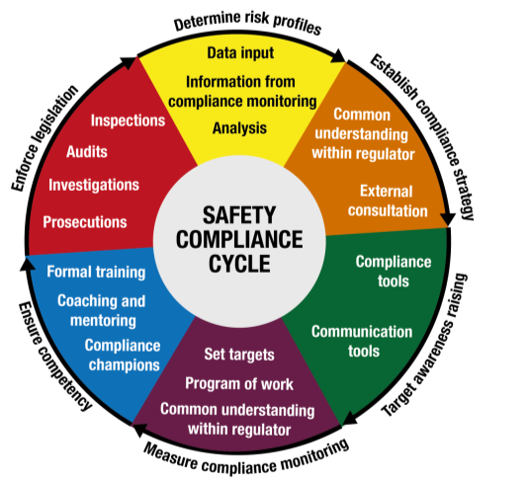
“Bads” versus “Goods” – which approach?
Enforce legislation
Raise awareness, seek compliance
Notes:
For example, will the project focus more on identifying and reducing “bads” (e.g. risks or harms) or defining and promoting “goods” (e.g. moving up the hierarchy of control, promoting safe work practices, raising awareness of unfamiliar hazards).
Note: Roadshows are typically focused on “goods” – raise awareness, seek compliance.

Slide 24
What does Resources Safety do with all this information?
Notes:
All of this information was considered at the Mines Inspectors Forum held in March 2014, and three strategies were identified as being important for industry to improve safety performance.
So what is Resources Safety focusing on for mines safety in 2014-15 and beyond?

Slide 25
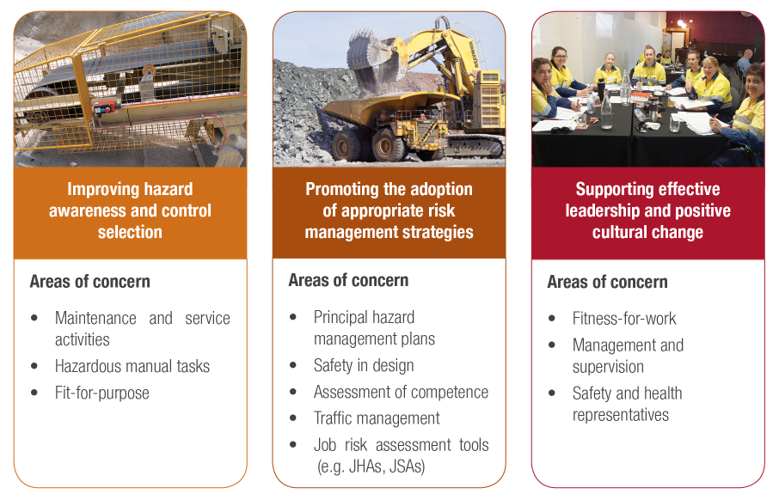
Resources Safety’s focus on mining activities
Maintenance and service activities
Hazardous manual tasks
Fit for purpose
Principal hazard management plans
Safety in design
Assessment of competence
Traffic management
Job risk assessment tools (e.g. JHAs, JSAs)
Fitness for work
Management and supervision
Safety and health representatives
Notes:
Mines safety is focused on three priority areas:
improving hazard awareness and control selection
promoting the adoption of appropriate risk management strategies
supporting effective leadership and positive cultural change
Areas of specific concern are listed. Resources Safety is focusing on these areas in its operational planning.
Note that proposed new Work Health and Safety (Mines) legislation will have an increased focus on:
Safety and health representatives
Management and supervision
Risk management strategies

Slide 26
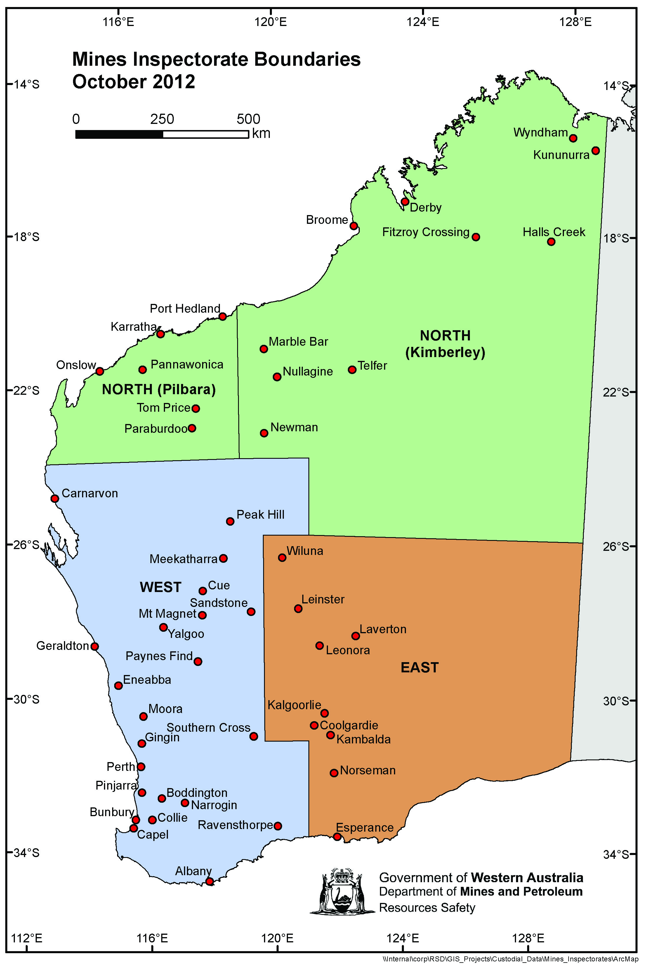
Notes:
Some areas of concern will apply across Western Australia while other strategies will target specific geographic areas or activities to achieve the best outcomes.

Slide 27
Hierarchy of control – reducing exposure to hazards
Elimination
Substitution
Engineering
Isolation/Segregation
Administrative control
PPE
Notes:
In particular, operators are encouraged during the risk management process to apply the hierarchy of control when considering potential control measures.
The higher up the hierarchy of control your solution is, the greater its effectiveness or protection. The graphic in this slide is a slightly different approach to help people visualise what this means and hopefully better remember the levels.
Think of these coloured semi-circles as shields of protection.
ANIMATION – CLICK TO ADD “SHIELDS”
PPE = limited protection – very small shield!
Isolation or segregation = bigger “shield” of protection
Elimination of hazard = no risk, completely shielded
This is the final slide on this topic. The next slide is a call for people to sign up for Resources Safety’s weekly news alerts.

Slide 28

Stay informed!
Subscribe to Resources Safety’s email alert service
and receive weekly news about the latest:
publications
safety alerts
events
invitations to provide comment (e.g. RIS)
Visit www.dmp.wa.gov.au/ResourcesSafety to sign up
Notes:
Subscribing is very easy – Look for the hard hat and envelope icon to go the subscription section. You just need to provide your name and an email address.
This alert service is the fastest way for Resources Safety to keep you informed about what’s happening.
Short cut to subscribe - dmp.us2.list-manage2.com/subscribe?u=cba119dd163867c2e7916c1f3&id=f4197fffaa

