Slide 1
Please read this before using presentation
This presentation is based on content presented at the 2015 Mines Safety Roadshow in October 2015
The Department of Mines and Petroleum (DMP) supports and encourages reuse of its information (including data), and endorses use of the Australian Governments Open Access and Licensing Framework (AusGOAL)
This material is licensed under Creative Commons Attribution 4.0 licence. We request that you observe and retain any copyright or related notices that may accompany this material as part of attribution. This is a requirement of Creative Commons Licences.
Please give attribution to Department of Mines and Petroleum, 2015.
For resources, information or clarification, please contact:
RSDComms@dmp.wa.gov.au or visit
www.dmp.wa.gov.au/ResourcesSafety

Slide 2
What’s happening in industry?

Slide 3
What are we talking about today?
Recurring incidents
WA and rest of Australia
Why aren’t we learning?
Workshop
Notes:
Look at wider scope than Western Australia.
Review Australian mining serious incidents and fatalities.

Slide 4
Review of safety alerts
Review of Mine Safety Bulletins (since February 1990) and Significant Incident Reports (since August 1989)
Multiple entries accidents, incidents and fatalities
Rock falls | 12
Falls | 6
Elevated work platforms (EWPs), cherry pickers | 4
SAFE
EXPLORATION
Notes:
Mine Safety Bulletins are published to let the rest of industry know of potential hazards on their site and assist industry prevent a recurrence.
This simple analysis shows we do not seem to be taking heed of our mistakes.

Slide 5
EWP fatality NSW
SAFE
EXPLORATION
Notes:
May 2014 – NSW.
Highlights the hazards associated with elevated work platforms (EWPs).

Slide 6
EWP serious accident WA
SAFE
EXPLORATION
Notes:
December 2014 – WA.
Serious EWP incidents reported.

Slide 7
EWP fatality WA
SAFE
EXPLORATION
Notes:
May 2015 – WA.
Fatality involving an EWP.
Why aren’t we learning?

Slide 8
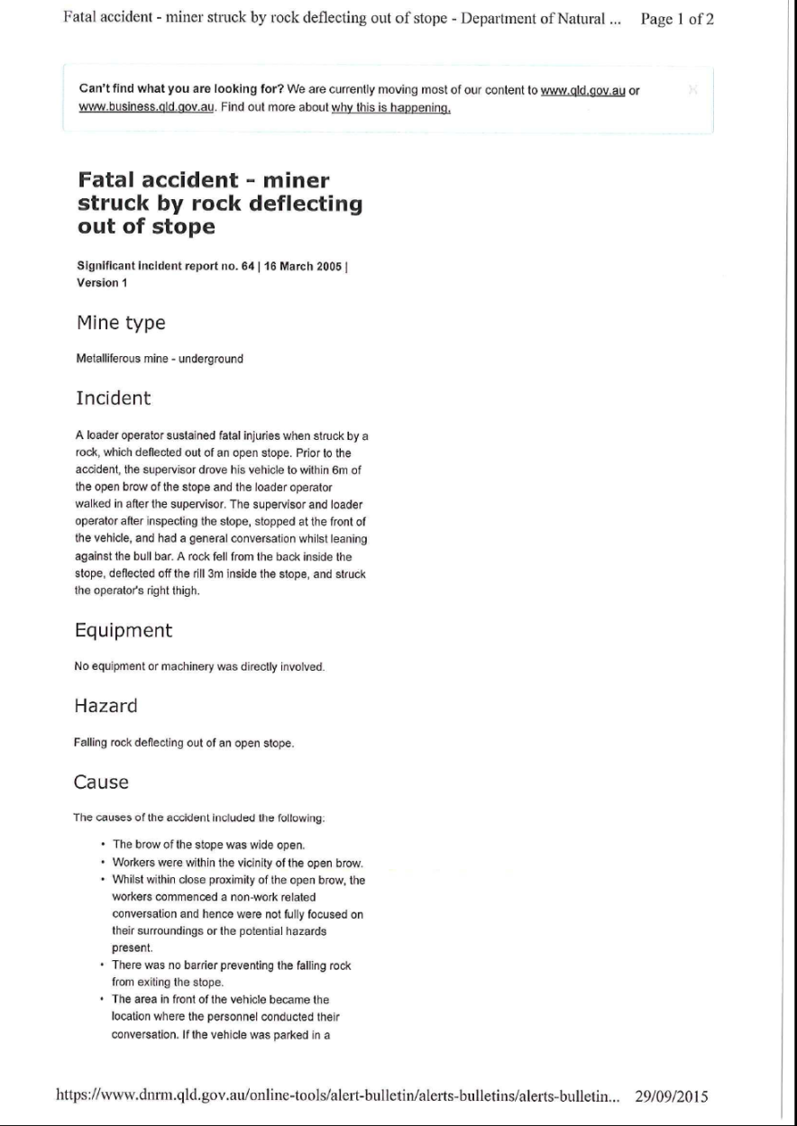
Rockfall fatality QLD
SAFE
EXPLORATION
Notes:
March 2006 – Qld.
Rockfall – rock from stope fatality.

Slide 9
Rockfall fatality SA
SAFE
EXPLORATION
Notes:
Feb 2015 – SA.
Rockfall fatality.

Slide 10
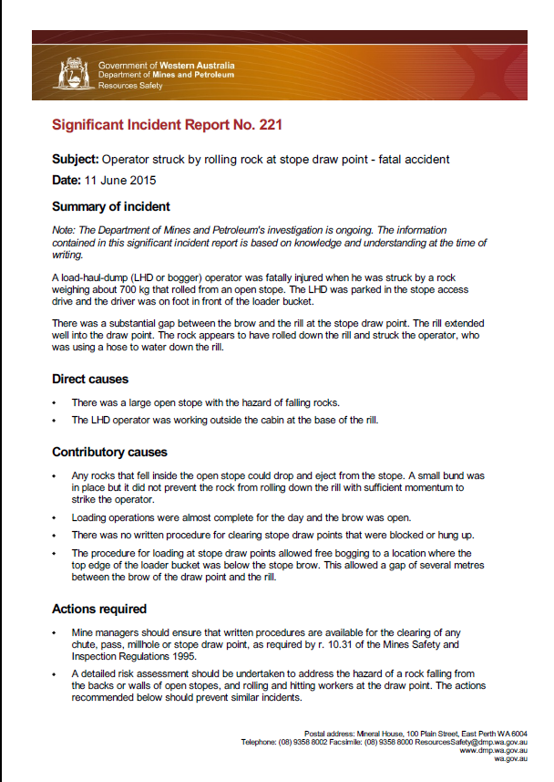
Rockfall fatality WA
SAFE
EXPLORATION
Notes:
June 2015 – WA.
Rockfall from stope fatality.
In the main, mining hazards have not changed. Yet sometimes controls are still inadequate.

Slide 11
Dozer belly plate fatality WA
SAFE
EXPLORATION
Notes:
November 2010 – WA.
Dozer belly plate fatality.

Slide 12
Dozer belly plate fatality WA
SAFE
EXPLORATION
Notes:
February 2015 – WA.
Dozer belly plate fatality – almost identical incident.
What are we learning?

Slide 13
Why aren’t we learning?
Culture?
Is safety culture a barrier?
Is Australian culture an issue?
Hierarchy of control
Why is ~80% administrative and PPE in WA mining?
Why are we not climbing the hierarchy?
Accident and incident investigation and continuous improvement
Adequate resource allocated
Culture (blame person)
Competency of investigators
Closing the loop
SAFE
EXPLORATION
Notes:
Some suggestions:
culture
hierarchy
learnings from our previous incidents and accidents.

Slide 14
Room for improvement
In the main, mining hazards have not changed
Safety culture spectrum
Hierarchy, PPE and administrative
SAFE
EXPLORATION
Notes:
Two main areas for improvement in WA mining from the Department of Mines and Petroleum (DMP) perspective.

Slide 15
Definition of health and safety culture (HSG65)
“The safety culture of an organisation is the product of individual and group values, attitudes, perceptions, competencies and patterns of behaviour that determine commitment to, and the style and proficiency of, an organisation’s health and safety management system.
Organisations with a positive safety culture are characterised by communications founded on mutual trust, by shared perceptions of the importance of safety and by confidence in the efficacy of preventative measures.”
SAFE
EXPLORATION
Notes:
There are many definitions of safety culture, this is one from the United Kingdom’s Health and Safety Executive (HSE).

Slide 16
Definition of health and safety culture (HSG65)
“The safety culture of an organisation is the product of individual and group values, attitudes, perceptions, competencies and patterns of behaviour that determine commitment to, and the style and proficiency of, an organisation’s health and safety management system.
Organisations with a positive safety culture are characterised by communications founded on mutual trust, by shared perceptions of the importance of safety and by confidence in the efficacy of preventative measures.”
SAFE
EXPLORATION
Notes:
Highlight attitudes, group values, perceptions, competencies, mutual trust and communication.

Slide 17
Objects of the Act (MSIA 1994)
(a) to promote, and secure the safety and health of persons engaged in mining operations; and
(b) to assist employers and employees to identify and reduce hazards relating to mines, mining operations, work systems and plant at mines; and
(c) to protect employees against the risks associated with mines, mining operations, work systems at mines, and plant and hazardous substances at mines by eliminating those risks, or imposing effective controls in order to minimize them; and
(d) to foster and facilitate cooperation and consultation between employers and employees, and associations representing employers and employees, and to provide for the participation of those persons and associations in the formulation and implementation of safety and health standards and optimum working practices; and
(e) to provide procedures for employers and employees to contribute to the development and formulation of safety legislation for mines and mining operations and to consult regarding its administration.
SAFE
EXPLORATION
Notes:
Objects of the Mines Safety and Inspection Act (MSIA) 1994.

Slide 18
Objects of the Act (MSIA 1994)
(a) to promote, and secure the safety and health of persons engaged in mining operations; and
(b) to assist employers and employees to identify and reduce hazards relating to mines, mining operations, work systems and plant at mines; and
(c) to protect employees against the risks associated with mines, mining operations, work systems at mines, and plant and hazardous substances at mines by eliminating those risks, or imposing effective controls in order to minimize them; and
(d) to foster and facilitate cooperation and consultation between employers and employees, and associations representing employers and employees, and to provide for the participation of those persons and associations in the formulation and implementation of safety and health standards and optimum working practices; and
(e) to provide procedures for employers and employees to contribute to the development and formulation of safety legislation for mines and mining operations and to consult regarding its administration.
SAFE
EXPLORATION
Notes:
DMP assist in communication.
All in the legislation - safety and health representatives, committees.
Greater emphasis in the new legislation.

Slide 19
Room for Improvement?
SAFE
EXPLORATION
Notes:
Who has seen this? The safety culture spectrum was released in 2007.
There are 5 levels from vulnerable to resilient.
Where do you think WA mining operations sit on the spectrum?

Slide 20
Room for Improvement?
SAFE
EXPLORATION
“Average”
Notes:
Through assessment and opinion of DMP inspectors – WA mining falls under Rule followers with pockets of enlightenment.
How DMP works with sites – relates from sanction to champion.

Slide 21
Hierarchy of control – reducing exposure to hazards
Elimination
Substitution
Engineering
Isolation/Segregation
Administrative control
PPE
Notes:
Who has seen this?
There are 6 levels of control.
PPE = limited protection – very small ‘shield’ of protection!
Isolation or segregation = bigger ‘shield’ of protection.
Elimination of hazard = no risk, completely shielded.

Slide 22
Hierarchy of control – reducing exposure to hazards
Elimination
Substitution
Engineering
Isolation/Segregation
Administrative control
PPE
~80%
Notes:
DMP estimate is that 80% of mining controls in WA are at the bottom two levels – administrative control and PPE.
Room for improvement in culture and hierarchy.
Why aren’t we learning?

