Slide 1

Please read this before using presentation
This presentation is based on the content presented at the 2019 Health and Hygiene Forum in June 2019.
Department of Mines, Industry Regulation and Safety (DMIRS) supports and encourages reuse of its information (including data), and endorses use of the Australian Governments Open Access and Licensing Framework (AusGOAL)
This material is licensed under Creative Commons Attribution 4.0 licence. We request that you observe and retain any copyright or related notices that may accompany this material as part of attribution. This is a requirement of Creative Commons Licences.
Please give attribution to Department of Mines, Industry Regulation and Safety, 2019.
For resources, information or clarification, please contact: SafetyComms@dmirs.wa.gov.au or visit www.dmirs.wa.gov.au/ResourcesSafety

Slide 2
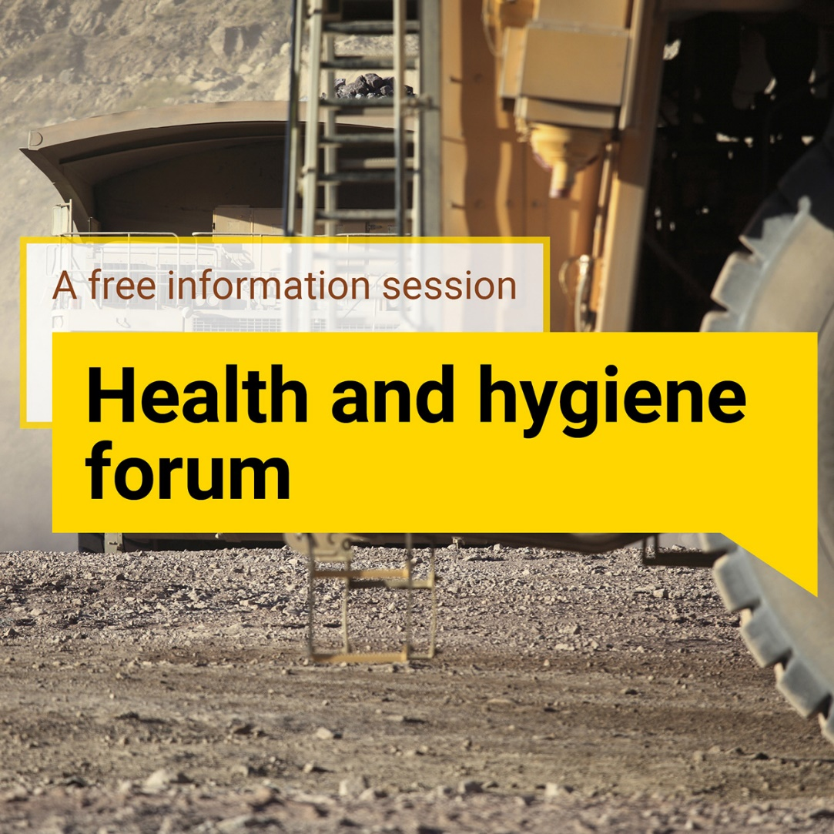
2019 Health and hygiene
forum

Slide 3
Trends, trouble spots and success stories: asbestos and other
fibrous minerals

Slide 4
What we’ll be covering in this session
History of asbestos in WA
Overview of asbestos
A risk-based approach to fibrous mineral management
What our data is telling us
Update from the Regulators
Trouble spots
Success stories
Notes:
This session will cover
brief history of asbestos in Western Australia
An overview of what asbestos is, the different types of fibres and why they’re hazardous.
risk-based approach to managing fibrous minerals including some information from our Guideline and what should be included in a Fibrous Minerals Management Plan.
Health and hygiene sampling data collected through SRS.
Then finish up with some trouble spots and success stories.

Slide 5
A history of Asbestos in Western Australia
100 BC
Late 1800s
1880s
1927
1940
1944
1959
1960
1966
Roman historian identifies slaves grow sick and die when weaving asbestos cloth
industrial revolution, increase in use of asbestos products
First asbestos mine begins operating in Australia – Jones Creek NSW
Asbestosis given it’s name
Mining begins at Wittenoom with the plant opening in 1943
First warning of a problem at Wittenoom
6 cases of lung disease for Wittenoom workers confirmed
Mesothelioma declared a ‘new’ disease
Wittenoom closes
Notes:
Asbestos is not a new hazard, we can see that even as early as 100BC, people working with asbestos were experiencing sickness and dying as a result of their exposure.
100 BC - Roman historian Pliny wrote about the ‘disease of slaves” after noticing that slaves weaving cloth from asbestos were growing sick and dying. This same historian also describes the use of rudimentary respirators made from animals bladders by some of the slave asbestos miners in an attempt to protect themselves from the fibres as they worked.
Then we jump forward to the industrial revolution in the late 1800s which saw the demand for asbestos products sky-rocket. Due to it’s heat, chemical and water resistant properties, it was extremely well suited to being made into insulation for equipment that powered the industrial revolution like engines, boilers and generators. Unfortunately, we later learn that it wasn’t so great for human health.
As the demand for asbestos products increased, so too did the prevalence of lung disease among factory workers and miners. It was British factory inspectors who noted the adverse health effects of asbestos dust working in factories in 1898, referring to the “evil effects” of asbestos dust.
In the years to follow, numerous inquiries launched by law makers and industrial bodies around the world were finding that exposure to asbestos dust was causing illness and premature death. In 1911, Australia introduces new ventilation legislation after a Royal Commission into working conditions in the countries gold mines finds widespread lung disease in workers. This also prompts insurance funds to launch their own investigations and they start pushing back on insurance coverage and increasing premiums for workers in the asbestos industry.
Despite this, asbestos production and use continues and in 1936 crocidolite deposits at Wittenoom are discovered by Lang Hancock. Mining at the site starts in 1940 with the plant opening a couple of years later in 1943. Then the second world war breaks out, and we see the use of crocidolite asbestos from Wittenoom being used to manufacture gas masks in Britain.
Then in 1944, the Western Australian Assistant State Mining Engineer reports on the danger of dust being generated at the Wittenoom mine. Then over the next decade or so, the body of evidence grows showing that miner’s exposure to asbestos fibres at Wittenoom is detrimental to lung health.
This culminates in Dr Jim McNaulty discovering 6 cases of lung damage among Wittenoom workers in 1959. He issues a series of warnings to the mine management and over the next few years, more than 100 cases of lung disease are confirmed for Wittenoom and ex-Wittenoom workers.
Then, in 1966 Wittenoom closes after a highly critical report from the commonwealth Department of Health is published. I’ll touch on Wittenoom in a little bit more detail later in my presentation.
So we know that asbestos is not a new hazard, it’s been around for centuries and it’s something that will continue to remain a hazard for the mining industry.

Slide 6
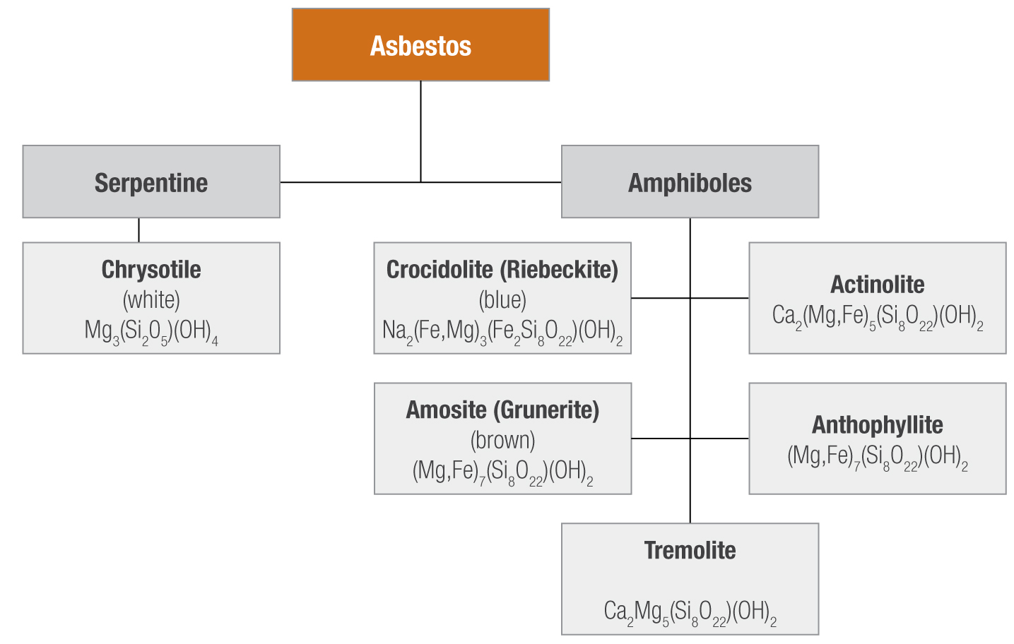
What is it?
Notes:
So what exactly is asbestos?
Asbestos is a commercial term used to describe 6 types of naturally occurring silicate minerals fibres that can be split into two categories; serpentine and amphiboles.
The Serpentine form of asbestos is the mineral Chrysotile, considered to be the least hazardous form of asbestos. Due to its chemical composition in that it does not contain any iron, it is known as ‘white’ asbestos.
All the minerals in the amphibole group, have varying degrees of iron content, giving them different colours (i.e. ‘brown’ and ‘blue’ asbestos).
Crocidolite, also known as ‘blue’ asbestos, is considered to be the most hazardous due to it’s size and needle-like shape. It was Crocidolite that was the mineral being mined at the Wittenoom mine.

Slide 7
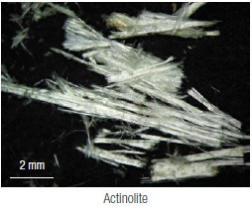
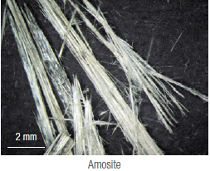
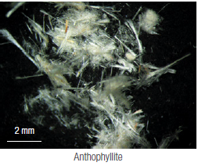
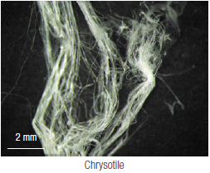
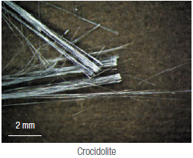
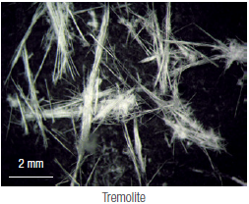
Types of asbestos fibres
Notes:
Here we can see pictures of the different types of asbestiform minerals taken at magnification.
You can see how each type is shaped different to the next. Notice the shape of the crocidolite crystals (bottom middle), and how they’re needle-like in their structure. It’s these thin, needle-like fibres that, at the right size, can penetrate deep into the lungs and cause lung disease. Compare that to the chrysotile fibres to the right which have a much more curved and fluffy shape.
It is for this reason that Amphibole-based Crocidolite is considered to be more hazardous than the serpentine-based mineral Chrysotile.
But, although they look different, they all the similar properties in that they are durable, flexible and heat resistant, with high tensile strength and good binding properties.

Slide 8
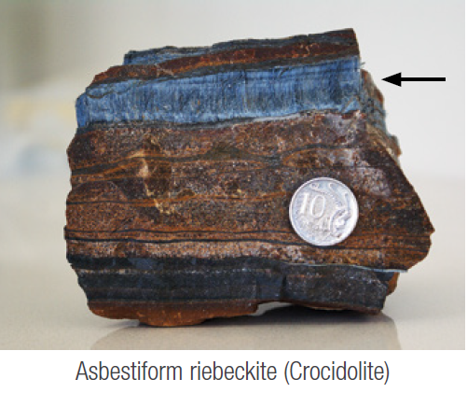
How is it formed?
Parent rock is mafic or ultramafic (igneous)
Disturbance in rock formation (e.g. faulting, slippage)
Heat, pressure, water and minerals from parent rock lead to asbestos crystal formation
Often occurs in “lenses” or bands
(mm – cm).
Notes:
When looking at asbestos, it’ may also be useful to understand how it is formed so we can use this information to get an idea of where we can expect to find it.
Asbestiform minerals are widely distributed throughout the State and can be found in mafic and ultramafic parent rock. This rock forms when molten rock cools and solidifies under the earth’s surface, and under the right conditions, forms asbestos crystals. Sometimes this rock is forced to the earth’s surface through faulting and slipping where the mineral can sometimes weather, changing the mineral’s characteristics. Other times, it’s found in veins that lie deep beneath the Earth’s layers of soil and weathered rock.
You can see from the picture on my slide, a vein of blue asbestos or crocidolite. These veins, also referred to as lenses or bands, are sometimes very small and can be difficult to predict.

Slide 9
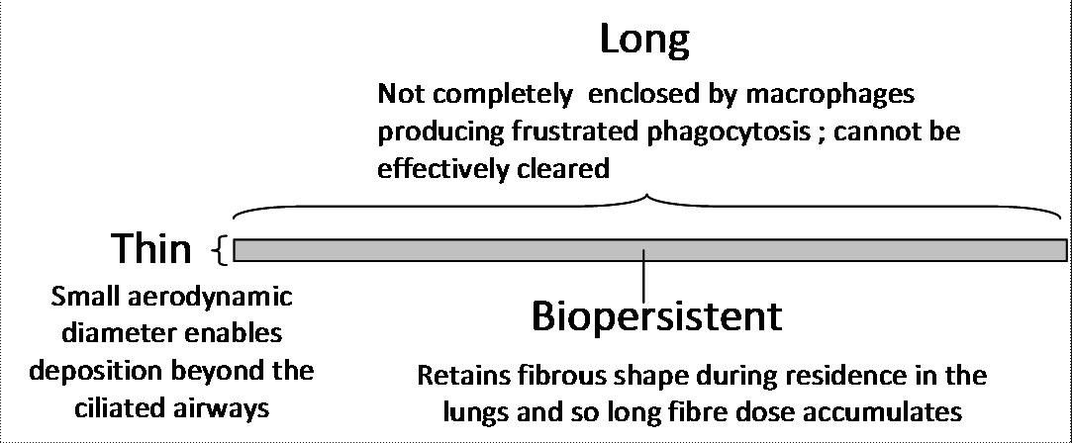
Why is it hazardous?
For fibres to be hazardous they must be:
airborne
respirable
Risk depends on:
concentration of fibres in the air
duration of exposure
type of fibre (serpentine vs amphibole)
morphology (size and shape)
Source: particleandfibretoxicology.biomedcentral.com/articles/10.1186/1743-8977-7-5
Notes:
The fact that there may be asbestos in the geology of the mine, does not straight away mean it is a hazard. Asbestos only becomes a hazard if fibres of a respirable size, become airborne and may be inhaled.
Undisturbed asbestos does not spontaneously emit fibres. The potential for an asbestos mineral to release respirable fibres depends on its physical characteristics and the degree of handling and processing.
The danger from exposure is not immediately obvious because harmful fibres are too small to be seen with the naked eye, and there is often a long latency period between exposure and onset of disease.
How many of you have heard the old ‘one fibre kills’ argument? Well fortunately for all of us, this argument doesn’t stack up. Asbestiform fibres are everywhere in our built environment, mostly from the breakdown of asbestos containing materials like brake-linings and asbestos cement sheeting. But air monitoring in cities indicates that the average person inhales about 1 million fibres every year so clearly this myth is not backed by science.
What we do have to consider when assessing the risk of developing an asbestos-related disease are things like
the concentration of fibres in the air. Historically, asbestos related diseases have been associated with exposures to concentrations of more than 100 times the exposure standard.
The duration of time the worker is exposed these fibres.
The type of fibre.
And their size and shape.
We’ve already seen the shape of crocidolite fibres, with their long, thin, needle-like shape. This shape means that inhaled crocidolite fibres are more likely to penetrate deeper into the lungs, where they are difficult to remove and can cause irritation.
Picture from https://particleandfibretoxicology.biomedcentral.com/articles/10.1186/1743-8977-7-5

Slide 10
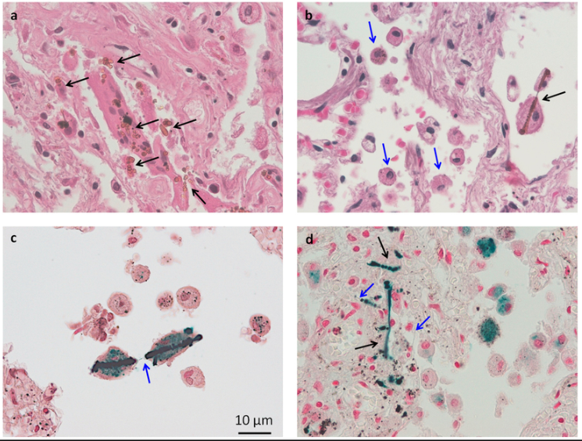
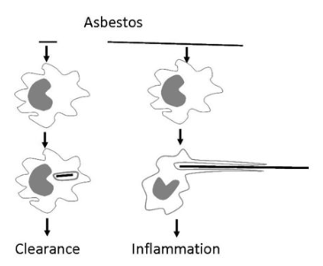
What happens after exposure?
The human body has defence mechanisms which will try and rid fibres from the respiratory system.
Fibres that remain the lungs can cause
Asbestosis | Lung cancer
Mesothelioma | Pleural plaques
Source: www.researchgate.net/figure/Histological-examination-of-human-lung-tissue-with-asbestos-bodies-Panel-a-and-b-are_fig1_235372387
Source: particleandfibretoxicology.biomedcentral.com/articles/10.1186/1743-8977-7-5
Notes:
Fortunately, most of the fibres we inhale are removed from the respiratory system by the body’s natural defence system. The body will expel the larger particles by trapping them in the upper airways, and coughing and sneezing. The smaller particles will be engulfed by scavenger cells called macrophages which work to rid the small particles from the lung.
This defence mechanism works well in many situations, however some fibres of a respirable size can penetrate deep into the lungs, lodging in the lung tissue and causing irritation. This irritation can lead to a number of potential lung diseases like asbestosis, lung cancer, mesothelioma and pleural plaques.
These diseases are caused by the body’s defence mechanisms in an attempt to dissolve the fibres in the lungs. In the case of asbestosis, the lung tissue thickens as macrophages sent to engulf and dissolve the fibres, cannot complete their job. This results in a build-up of a fibrous layer within the lungs, which causes the affected person to have difficulty in breathing. Similarly, lung cancer results when the breakdown of the macrophages and the irritation of the lung tissue results in the mutation of a cell, which then becomes cancer.
We can see this process happening in the pictures on the slide. When the macrophages encounter a short, smaller fibre, they are able to enclose the fibre and clear it from the lungs. However, when there is a long, thin fibre, the macrophage is unable to extend itself to fully enclose the fibre, which results in inflammation.
The picture on the right shows asbestos bodies present in human lung tissue. You can see the black arrows pointing out the asbestos fibres, some of which are engulfed by macrophages. You can see the fibre in slide c is being attacked by 2 macrophage cells, however even together, they are still not able to fully encompass the long, thin asbestos fibre.
____________________________
Figure on the left - The frustrated phagocytosis paradigm as it relates to long and short fibres of asbestos (left) and various forms of carbon nanotubes (right). When confronted by short asbestos fibres or tangled, compact carbon nanotube 'particles' the macrophage can enclose them and clear them. However the macrophage cannot extend itself sufficiently to enclose long asbestos or long nanotubes, resulting in incomplete or frustrated phagocytosis, which leads to inflammation.
Picture from https://particleandfibretoxicology.biomedcentral.com/articles/10.1186/1743-8977-7-5
Figure on the right - Histological examination of human lung tissue with asbestos bodies. Panel (a) and (b) are microphotographs from the histological sections used for the study, stained by hematoxilin and eosin. Diffuse fibrosis and asbestos bodies (black arrows) are evident. In panel (b) there are sparse macrophages (blue arrows) and an asbestos fibre is phagocytated by two macrophages (black arrow). Panel (c) and (d) show tissue sections colored with Perls' staining and positive staining of asbestos bodies (black arrows). Uncoated fibre parts are not stained (blue arrows). In (a), (b), (d) magnification is 40×, while in (c) is 60×.
Picture from https://www.researchgate.net/figure/Histological-examination-of-human-lung-tissue-with-asbestos-bodies-Panel-a-and-b-are_fig1_235372387
https://www.resourcesregulator.nsw.gov.au/__data/assets/pdf_file/0009/825930/Dust-Safety-Info-Booklet-webVersion.pdf – good resource from NSW regulator

Slide 11
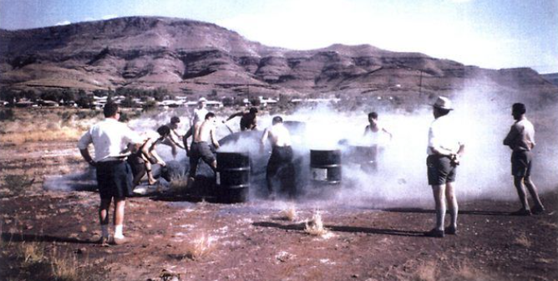

Wittenoom
First case of mesothelioma diagnosed by Dr Jim McNaulty in 1962.
Since then, it is estimated that 2000 deaths have occurred following exposure to asbestos at Wittenoom.
Source: independentaustralia.net/politics/politics-display/blue-murder-at-wittenoom,5376
Source: www.perthnow.com.au/news/wa/when-dust-ends-in-death-how-asbestos-devastated-wittenoom-ng-b88930946z
Notes:
So we know that there’s a relationship between the concentration and type of fibre a worker is exposed to, and the health outcomes for that person. But how much is too much? Well we have an exposure standard that is set at 0.1 f/ml for all fibres meeting the definition of a countable fibre as under regulation 9.33 i.e. an object which has a width of 1 micrometre or less, and is more than 5 micrometre’s long. Provided exposures are below this exposure standard, the risk of a worker contracting an asbestos-related disease is very low, and is definitely much lower than other hazards that exist in the mining industry.
So how does that compare to the exposures at Wittenoom? Well conditions in the mine were not good, with exposures being cited in some cases as up to 6-8 times the allowable level in 1948. The mill and bagging areas were where the highest concentrations of asbestos would be found, with some articles claiming exposures of 600 f/ml for baggers at Wittenoom. The top picture here shows a group of mine workers competing to see how could fill their drum full with blue asbestos tailings first.
But unfortunately it wasn’t just the mine workers who were exposed to the asbestos dust. Blue asbestos was used across the townsite for many other purposes, including for a ‘beach’ at the local swimming hole, children’s sand-pits. It was also used to cover the local racetrack, and footpaths and carparks were made from it.
It’s not surprise then, to learn about the high incidence of mesothelioma cases and other asbestos-related diseases for people who worked at the mine, or lived in the town. Of the 13,000 residents, and 7 thousand mine workers, there has been approximately 2000 deaths attributed to exposure to asbestos at Wittenoom. The two children in the photo are two of these people. They were 4 years old when this photo was taken in 1953, playing in a sandpit made from asbestos tails in Wittenoom. They died from mesothelioma at the ages of 36 and 38.
Thankfully, we know that the exposures seen in today’s mining industry are no where near the levels people were exposed to at Wittenoom. But it can still be a hazard and it must be managed if it is encountered.
Top picture from https://independentaustralia.net/politics/politics-display/blue-murder-at-wittenoom,5376
Bottom picture from https://www.perthnow.com.au/news/wa/when-dust-ends-in-death-how-asbestos-devastated-wittenoom-ng-b88930946z

Slide 12
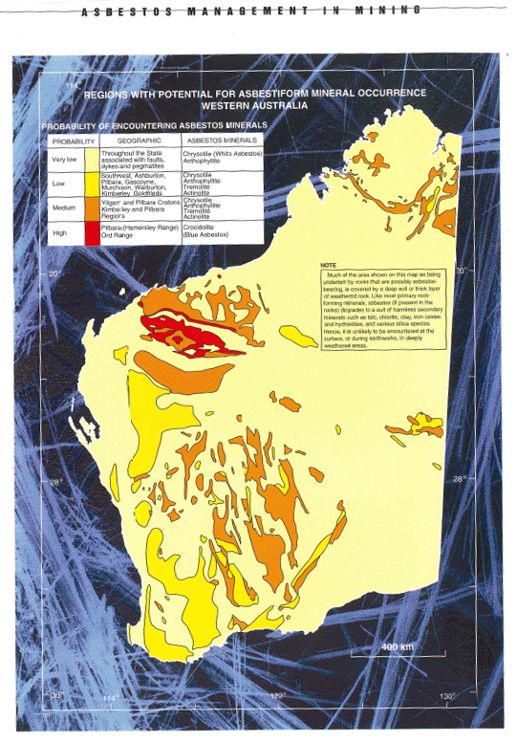
Are fibrous minerals likely to be a hazard at your site?
Use all sources of information available to you including geological data.
But what happens when it’s uncertain whether you will encounter fibrous minerals?
Notes:
So how do you know it’s a hazard at your site?
You might already have some information available to you in the form of geological data like core logging. Our geological survey division used similar information to put this map together. It shows a rough estimation of regions where there is a potential for asbestiform minerals to occur. Regions of mafic and ultra-mafic rock such as the Hamersley Basin where Banded Iron Formations are found, and the greenstone belt where the State’s gold and base metal deposits are located, are associated with a higher chance of encountering asbestiform minerals. You can see these areas highlighted in red on the map.
mafic or ultramafic (rich in iron and magnesium).
map was developed by the Geological Survey division.
Does anyone currently consult with the geology department when looking to determine if asbestos is likely to be encountered? How often do you review this data? Unfortunately, it’s not uncommon to hear that there is no process in place for sharing of information between the geology team and OSH teams. I encourage you to have a look at your own site’s processes, and think about how information from your geology department gets fed across to the OSH team. Are there any gaps?
But sometimes, there is no predictive data or information available, or an vein of asbestos is intersected unexpectedly as often happens in exploration. It’s in these situations that training and education is so important. The drilling crew must be aware of what to look for, and what to do if they suspect fibres have been intersected. It is also very important to ensure that other controls designed to control for dust are in place as this will also reduce the likelihood of fibres becoming airborne.

Slide 13
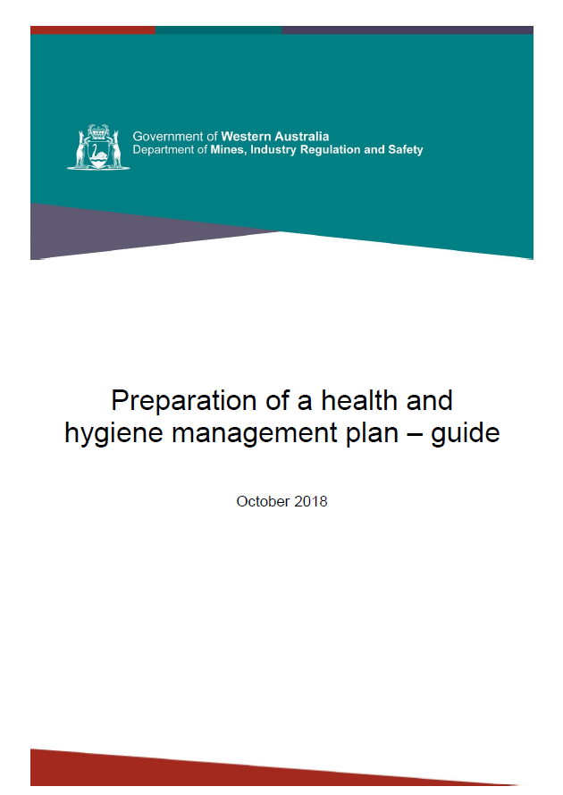
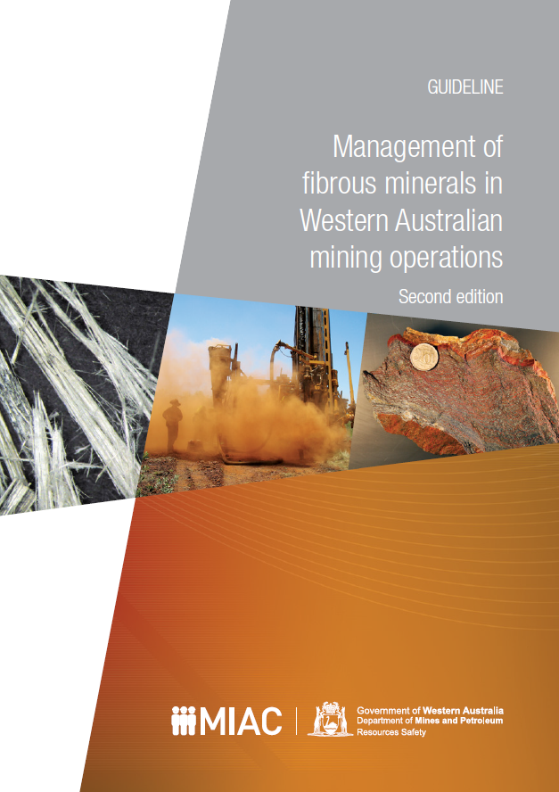
Risk-based approach to managing fibrous minerals
1 July 2019 – all mining operations are required to have a Health and Hygiene Management Plan (HHMP)
Health risk assessment identifies a likelihood of encountering fibrous minerals, you’ll need a FMMP as well.
  See Appendix 3 from the guideline
Notes:
All this information should be feed into the Health and Hygiene Management Plan. If the Health Risk Assessment (HRA) indicates a risk of exposure to fibrous minerals, a fibrous minerals management plan will also be required. Please include this as an attachment when you submit your HHMP to the Department. You can find information on what to cover in your fibrous minerals management plan in appendix three of the Guideline which is available on our website.
An assessment of the risk associated with encountering fibrous minerals should be done at each stage of mining including exploration, construction, mining (surface and underground), processing, shutdown, care and maintenance and rehabilitation activities. If there are any significant changes to the risk profile for the site, a revision of your HHMP should be submitted.
One of the key areas which is often lacking in management plans submitted to DMIRS, is in the verification of controls. If you plan to implement controls to address a particular hazard, you must have a strategy to test whether these controls are effective. It’s no good just assuming everything is working as it should as we know that’s often not the case. Things like audits, regular inspections and health surveillance are things you may want to consider when verifying your controls are working.

Slide 14

Why the focus on fibres?
Rising demand for State’s minerals
Increased probability of encountering fibrous minerals as depths of exploration and mining increases
Poor dust management practices still observed.
Notes:
Fibrous minerals have always been around, but why should fibrous minerals be on our radar? Well I mentioned before that with the increase in demand for the state’s minerals, there is a higher likelihood of encountering fibrous minerals simply because of the amount of earth being accessed, and because the depths of mining and exploration activities continues to grow deeper and deeper.
And although many sites implement good management practices when it comes to fibrous minerals, we are still seeing activities and practices that are concerning to us. But what does our data tell us?

Slide 15
Asbestos exposure data: Average asbestos concentrations
Notes:
Well, when I went through our data, I was actually surprised to see the results. This graph shows the average concentration of asbestos fibres over the last 3 decades. As you can see, these figures tell a good story. The data is trending down, and the averages are well below the exposure standard of 0.1f/ml and even well below the 50% action limit normally applied.
However, note the general slightly upwards trend since 2012.
__________________________
Average concentration of all asbestos samples submitted from 1990 to 2019 (2019 is only partway complete). Concentrations are raw, and have not been adjusted for extended shifts.

Slide 16
Total submitted samples showing concentration above Exposure Standard
Notes:
This graph too, indicates that the exposure to asbestos fibres is well controlled. The results shown in green are a total count of those samples that fall below the exposure standard. As you can see this is the majority of the samples submitted to the Department. The small portion of samples shown here in red, indicate samples with a concentration that exceeded the exposure standard.
Note that the 2019 data is year-to-date, at time of the forum.

Slide 17
Total number of asbestos samples grouped according to % of Exposure Standard
Notes:
And again, the data is telling us that asbestos exposure is well controlled which is great. As you can see, there’s only been 10 samples submitted to us (2018-19) which exceed the exposure standard. The majority of the samples submitted falling below 25% of the exposure standard.

Slide 18
Declaration questions
Sample Number | Question 1 | Question 2 | Question 3 | Question 4 | Question 5 | PPE Worn?
1 | Yes | Yes | Yes | Yes | Yes | No
2 | Yes | Yes | Yes | No | No | No
3 | Yes | Yes | No | Yes | No | No
4 | Yes | Yes | Yes | Yes | Yes | Unavailable
5 | Yes | No | Yes | Yes | Yes | No
6 | Yes | Yes | Yes | Yes | Yes | Unavailable
7 | No | No | No | No | Yes | No
8 | Yes | Yes | Yes | No | Yes | No
9 | Yes | Yes | Yes | No | No | No
10 | Yes | Yes | No | No | Yes | No
 | 9 Yes; 1 No | 8 Yes; 2 No | 7 Yes; 3 No | 5 Yes; 5 No | 7 Yes; 3 No | 8 No; 2 Unspecified
Notes:
As most of you will be aware, we capture our exposure data through SRS. Last year, we added 5 declaration questions which were mandatory for all samples being submitted which exceeded the adjusted exposure standard. Over this time, we’ve only recorded a total of 10 exceedances for asbestos. It’s not a big data set but I thought it was pretty interesting anyway.
Out of those 10 exceedances, 8 of those workers were not wearing PPE, with this information being unavailable for the 2 of these samples. This is in line with what we’re seeing out in industry in terms of PPE compliance, and also what data from other agents like noise is telling us and it also highlights again, why you can’t rely on PPE as a control as we know it’s not reliable.

Slide 19

But…it’s not just about occupational exposure
Individual risk factors also have a role in determining health outcomes
General health status
Smoking
Exposure to ACM in non-occupational
settings, e.g. DIY work
Environmental exposure to asbestos
Pre-existing lung diseases, e.g. COPD.
Notes:
But it’s not just occupational exposure either, there are many other factors that may determine the health outcome for individuals exposed to asbestos.
We know that smokers have a far higher risk of developing lung cancer, but couple this with exposure to asbestos fibres, and there is a synergist effect and their risk of developing a lung-cancer is far higher than if they were just exposed to fibres, or just a smoker.
Interestingly though, there does not appear to be the same synergistic effect for mesothelioma risk. This appears to just come down to exposure to asbestos fibres.
Apart from education and wellness programs run on site, the influence over some of these factors is limited for the employer. So let’s take a look at what can be done in an occupational setting.

Slide 20
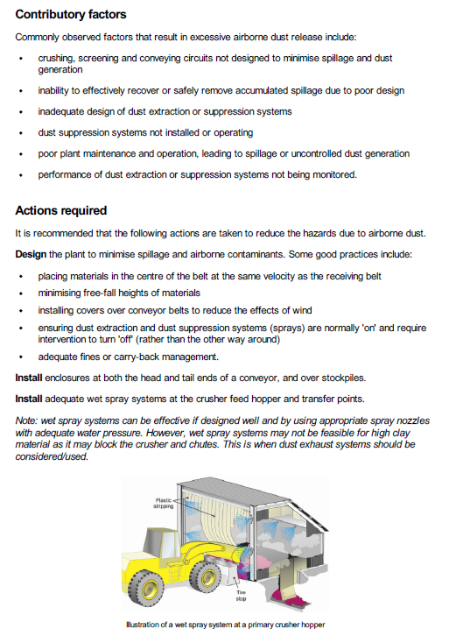
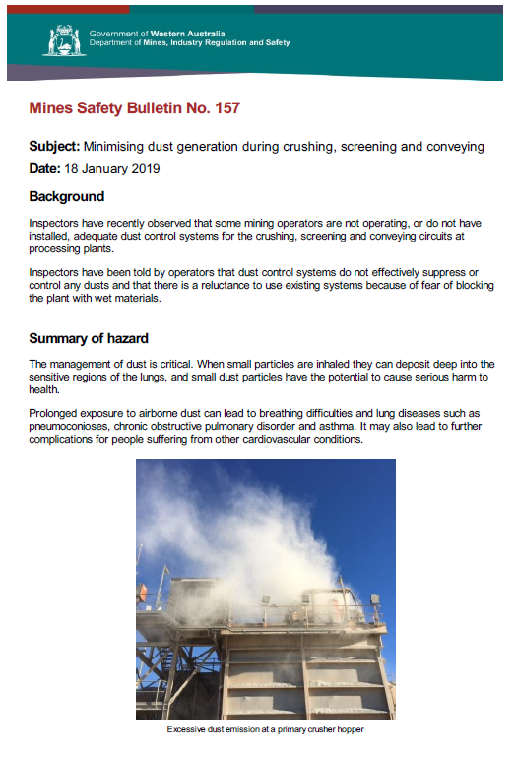
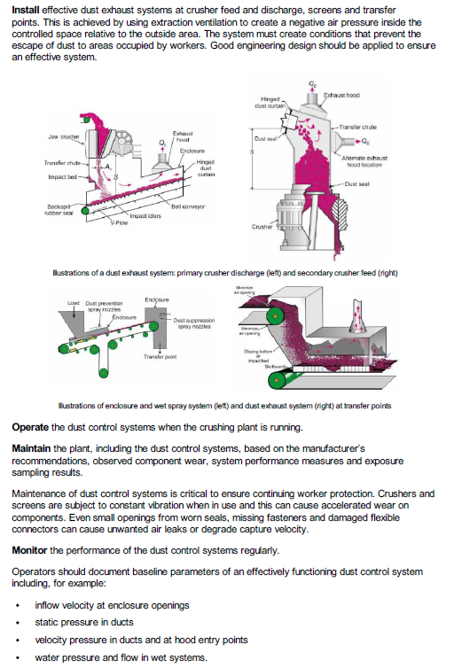
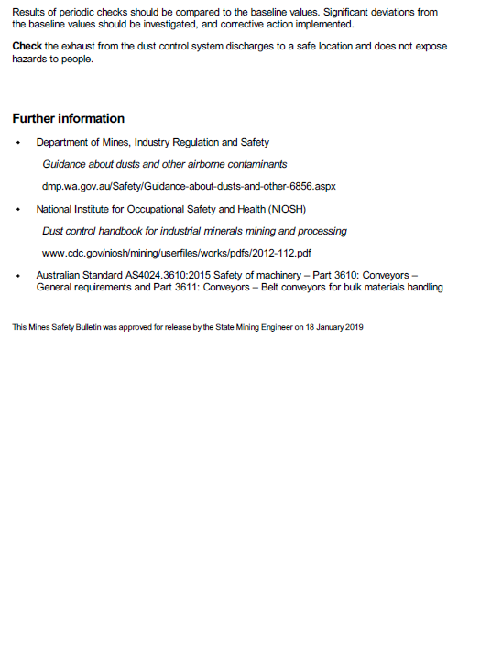
Trouble spots – Dust suppression in process plants
Recommendations made:
Design the plant to minimise spillage
Install enclosures where possible e.g. over stockpiles
Install dust suppression sprays at critical points
Install dust exhaust systems at critical points
Operate the systems when the plant is running
Maintain existing systems
Monitor the performance of installations
Check that the exhaust from systems is located in a suitable area.
Control dust and
you can control airborne fibres
Notes:
When I speak to people on site about asbestos, often their reaction is based on emotion, rather than fact. Take the ‘one fibre kills’ argument I spoke about before for example.
It is important to talk about asbestos to improve overall education and awareness of the hazard, but also remember to bring it back to basics. Often times we see that dust might be well managed in the pit, or in mining areas, however throughout the plant, dust suppression systems are inadequate or simply not working at all. In January, we published Safety Bulletin 157 on this topic, and it outlines some recommendations made based on what we see when we’re out conducting our inspections. These recommendations can be applied generally, and do not only apply to those sites which may encounter fibrous minerals.
As we know, higher level controls are always preferred as they are reliable and can be verified easily. So keeping that in mind, the first recommendation is to design the plant the minimise spillage and airborne contaminants. This can be done through installing covers over conveyors and installing dust suppression systems.
Install enclosures where possible to prevent dust from becoming airborne like over stockpiles.
Install dust sprays systems at critical points in your system, normally this includes any transfer points, and at the crusher feed hopper.
Install dust extraction systems where appropriate, normally at the crusher feeder and discharge points, and at screens and transfer points. This may be particularly critical for those products like clay-based materials where wet sprays may not be feasible.
Make sure to actually operate the dust control systems when the plant is running. Consider the default to have the system running at all times, and have an override for times where the system needs to be turned off.
Maintain the system! This is so important! It’s no good having a system if it’s not maintained properly. All too often I see dust extraction systems with holes in the duct work and vibrating screens with skirts and fasteners ripped letting dust escape into the air.
Monitor the performance of the systems where they are in place. Baseline standards should be set and any deviations should be investigated.
Check the exhaust is located from the system is located in a suitable area, not into the workspace of other workers.
Even if fibres are not present in the dust, it’s still important to control dust levels throughout the plant. I’ve tried to summarise them here, but I encourage you to have a look at the bulletin which can be found on the website.
Safety bulletin 157 – Jan 2019 http://www.dmp.wa.gov.au/Documents/Safety/MSH_SB_157.pdf

Slide 21
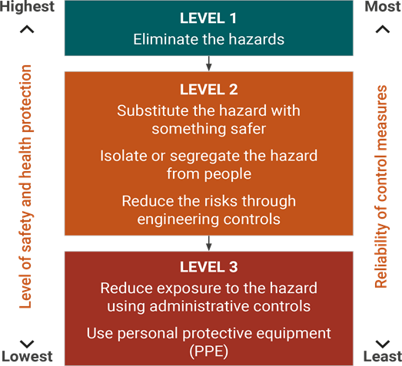
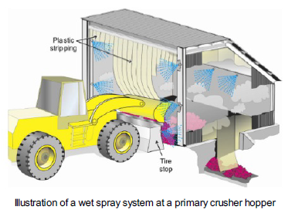
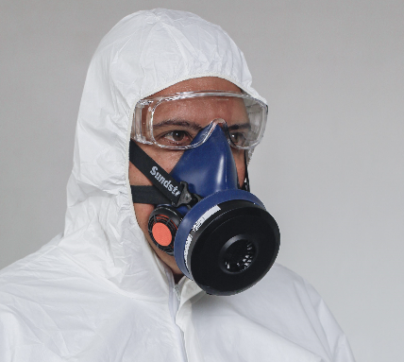
Trouble spots – Relying on lower level controls
Notes:
I’ve already touched on this point, but all too often we see sites relying on PPE to control the risk of exposure to airborne contaminants. We have already seen from the data I presented earlier that PPE is not the answer, and at least half of the inspection I go on, I encounter problems with PPE. It might be that the signage for PPE is no longer visible, it may be that people are not wearing PPE in areas where it’s required, or it may be that what they are wearing is not fitted correctly.
And then, how do you even begin to verify your PPE control works, how do you know, that every time someone is working in a particular area, they are wearing the required PPE and that it’s fitted well. There are some verification methods like task observations and inspections, however you can never be sure that the control will be effective because you’re relying on a human on make sure they follow a procedure.
We’d much rather see controls at the higher levels being implemented on site. These controls are much more reliable, provided they are maintained and used, and offer a higher degree of reliability in controlling the contaminant. I’m not saying that PPE shouldn’t be used at all, but it should be used in conjunction with other higher level controls.

Slide 22
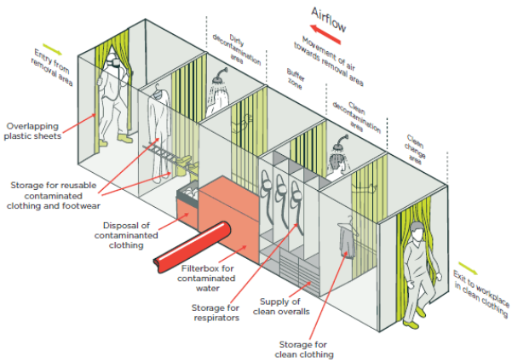
Trouble spots – Decontamination
Have clear expectations on the decontamination process
Have required facilities and equipment available
Source: https://worksafe.govt.nz/topic-and-industry/asbestos/management-and-removal-of-asbestos/
Notes:
Another trouble spot I’ve noticed recently when out in the field is decontamination. On a recent site inspection I went to a site where there was a designated fibrous zone in the pit. Inside this fibrous zone, workers were required to wear respirators and disposable coveralls. When exiting the designated fibrous zone, they were required to drive to a contamination unit and dispose of their contaminated coveralls. This all seemed fine until I noticed a worker who got out of his ute inside the fibrous zone and walked over to the lighting tower set up nearby. I asked the site representative to confirm what the site’s standard was for PPE inside the zone and he told me that workers weren’t required to wear full PPE if they’re not outside the cab of his vehicle for very long. When questioned a little more, he couldn’t really tell me what ‘very long’ meant. It’s for this reason that site standards should be clearly documented and communicated to workers.
I’ve also come across a situation where a site had a decontamination process whereby workers were required to drive to the decontamination unit, strip off their coveralls, then get back into the same vehicle they drove to the decontamination unit it with no process in between to clean or decontaminate the cab of the car in between. Does anyone see the problem with that?
Picture from https://worksafe.govt.nz/topic-and-industry/asbestos/management-and-removal-of-asbestos/

Slide 23
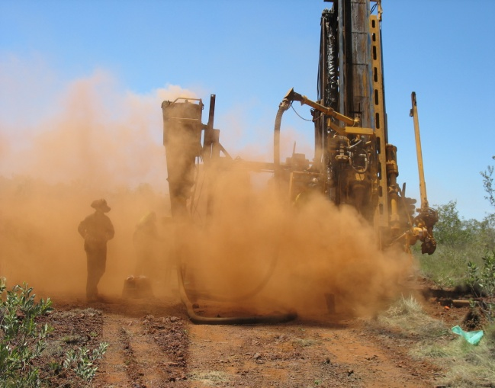
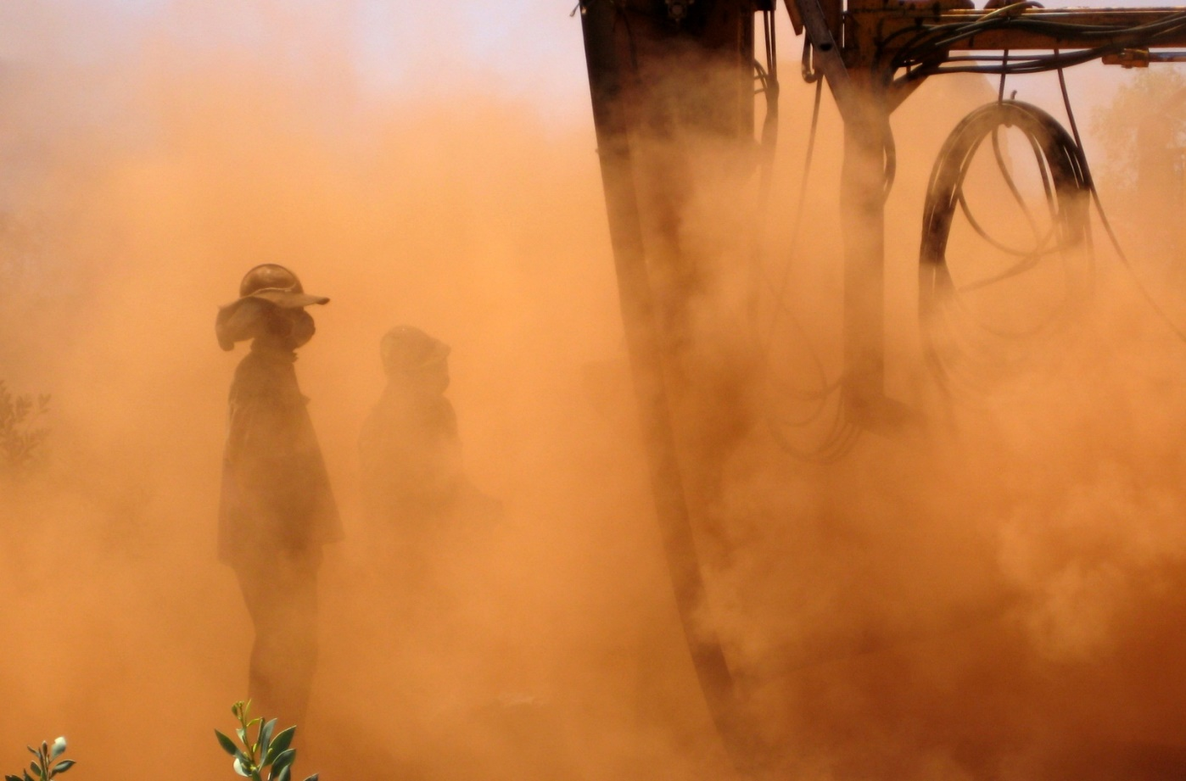
Success stories – Exploration (before)
Notes:
But it’s not all doom and gloom, we have also seen some success stories from our mining industry and we need to celebrate these achievements. One of these achievements has been in the exploration sector. These pictures were taken at an RC drill rig operating in the Pilbara, and as you can see, it’s extremely dusty! You can see the operator in the right-hand picture has his dust mask on… but I’m not sure it would be offering much protection in these conditions.

Slide 24
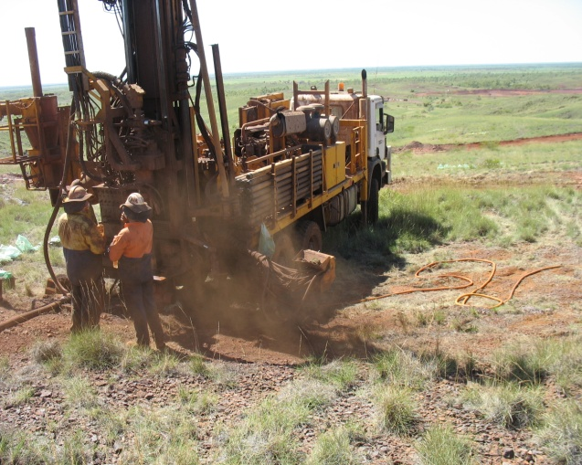
Success stories – Exploration (after)
Control dust = control fibres
Notes:
With the implementation of wet drilling techniques and dust collection systems, exploration drilling is now much less dusty than it has been before. We need to reinforce these controls at every opportunity we get, especially in the exploration sector where exposure to asbestos is often unexpected. But if we concentrate on controlling the dust, we can also limit the exposure to fibres.
Unfortunately, in terms of data, we still don’t have a good picture of what’s happening in the exploration space with samples submitted to SRS for exploration only making up 5% of all the samples we receive.

Slide 25

Success stories – Health monitoring programs
Increase in ongoing health monitoring programs implemented.
More than just pre-employment medicals.
Declaration question:
The person is subject to regular health assessments using recognised techniques to identify any adverse effects (MSIR r.3.27)
Notes:
We’ve already heard from Lindy this morning about the history behind MineHealth and the ongoing requirements for health monitoring. What is encouraging is that more and more sites have been implementing ongoing health monitoring programs for their employees exposed to different types of health hazards including asbestos. Safe Work Australia have a number of guidance sheets on their website which talk about health monitoring for workers exposed to different hazards at work.
This is something we will continue to capture data for through the declaration questions in SRS. We will also be accessing information on these programs through the annual review of the HHMP where sites will be prompted to provide information on what they are doing in this space.

Slide 26
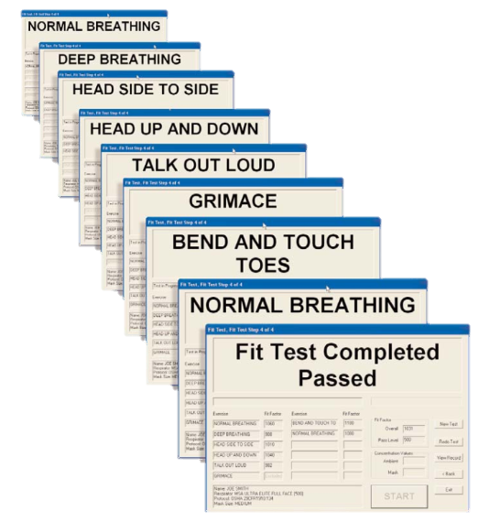

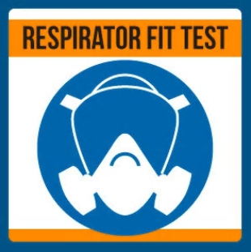
Success stories – Fit testing programs
Notes:
Another positive initiative that I encourage all sites to implement, is a fit testing program. A lot of site’s I’ve visited recently have already implemented programs which fit test employees for both respiratory and hearing protection. Factors like face shape and size, as well as facial hair and the job the person is required to undertake while wearing the PPE are taken into consideration when recommending what type of respirator is appropriate for the wearer. This is a great way to get buy-in from the workforce, improving the likelihood that the right PPE will be worn correctly. This is also a requirement of Australian Standard 1715.

Slide 27
Success stories – Greater visibility of health hazards
Notes:
We’ve also seen the profile of health related hazards increase over the last 2 years or so. This has been driven by the introduction of the HHMP and other guidance material, and the formation of a dedicated health team. In my experience, I’ve seen greater engagement with senior site management on hazards that affect their worker’s health which is very encouraging and puts us in a good position for making improvements in this space.

Slide 28

DMIRS contacts
1 800 SAFE MINE (1 800 7233 646)
Email: MinesSafety@dmirs.wa.gov.au

Slide 29



Follow us on social media
Twitter
@DMIRS_WA
@AndrewChaplyn
LinkedIn at Department of
Mines, Industry Regulation and Safety
Notes:
Add slide about awards

