Slide 1
Please read this before using presentation
This presentation is based on content presented at the 2018 Exploration safety information session in July 2018.
Department of Mines, Industry Regulation and Safety(DMIRS) supports and encourages reuse of its information (including data), and endorses use of the Australian Governments Open Access and Licensing Framework (AusGOAL)
This material is licensed under Creative Commons Attribution 4.0 licence. We request that you observe and retain any copyright or related notices that may accompany this material as part of attribution. This is a requirement of Creative Commons Licences.
Please give attribution to Department of Mines, Industry Regulation and Safety, 2018.
For resources, information or clarification, please contact: SafetyComms@dmirs.wa.gov.au or visit www.dmirs.wa.gov.au/ResourcesSafety

Slide 2
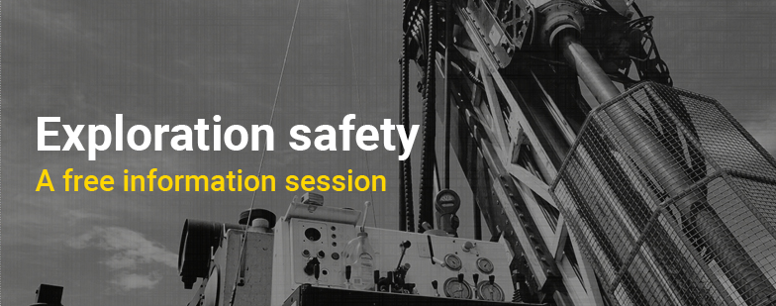
2018 Exploration safety information session

Slide 3
Exploration transition to mining operation

Slide 4
Outline of presentation
Legislation
Exploration and mining operations
Approvals to commence operations
Purpose of a Project Management Plan (PMP)
What triggers a PMP
Information in PMP
Submission of PMP

Slide 5
Legislation
The Mining Act 1978
Mining Regulation 1981
Mines Safety and Inspection Act 1994
Mines Safety and Inspection Regulation 1995
Notes:
The Mining Act 1978 (the Mining Act) and Mining Regulation 1981 outlines the law as it relates to Mining, Mineral Titles, Royalties and Environment.
Mineral titles Division- administers all mineral tenements in Western Australia and maintains title registry systems. This includes State exploration and mining tenement and online mapping system Mineral Titles Online, as well as Tengraph Online – which displays the position of mineral tenements in relation to other land information.
Royalties Division - assesses Mineral resources that are owned by the community and a royalty is a purchase price for the resource. The community expects a fair return for the loss of its non-renewable mineral resources. A key aspect to Western Australia’s low sovereign risk status is its royalty system which provides industry with a straightforward, transparent, stable and predictable arrangement.
Environment Division - assesses mineral, petroleum and geothermal exploration and development applications made within WA. The Environment Division also conducts environmental compliance audits and inspections to ensure approved activities comply with legislation, regulations, policies and approval commitments and conditions.
Mine Safety Division regulates the MSIA and MSIR -
The objects of this Act are —
(a) to promote, and secure the safety and health of persons engaged in mining operations; and to assist employers and employees to identify and reduce hazards relating to mines, and mining operations. To foster and facilitate cooperation and consultation between employers and employees.

Slide 6
Departmental approval process
Program of Work
Mining Act 1978
Mining Proposal
Mining Act 1978
State mining engineer Approval
MSIA 1994
MSIR 1995
MSIA 1994
Notes:
Programmes of work – is submitted when a company or prospector wants to explore for minerals, usually on a small scale
MSIA - An exploration manager must notify the senior inspector in which exploration activities will take place.
Mining proposals – is submitted by a company for a proposed mining operation and accompanied by a mining lease application.
State Mining Engineer approval - A principal employer or manager must procure the approval in writing of the State mining engineer before mining operations are commenced at a mine

Slide 7
The Mining Act 1978
Program of Work Exploration (PoW-E) will be replaced
Programme of Work Spatial (PoW-S)
Mining proposal
Mining proposal for small mining operations
Notes:
The Mining Act 1978 requires a PoW to be lodged
Before ground disturbing equipment is used by the holder of a prospecting or exploration licence, a programme of work (PoW) must be lodged with DMIRS. Once approved, the PoW application becomes a legally binding document which is often imposed as a tenement condition. This document shall contain key details regarding the mining operations to be undertaken
PoW-S was released in March 2017. Exploration and Prospecting proponents can now access relevant, site specific spatial data for their proposed activities which can be adjusted and optimised prior to lodgement. The system also prompts the proponent for location-specific additional information, which otherwise would have been requested by an Environmental Officer during assessment. The overall result is faster application and assessment timeframes.
When a mining proposal is submitted, the Departments environmental officer will assess the mining proposal and make recommendations to Departments Mineral and Titles Services Division (MTSD). The Grant is normally supported if the mining proposal meets acceptable environmental practices. Approval to commence mining may be issued by the Director of the Environment Division but will be conditional upon the tenement being granted.
Mining Proposals for Small Mining Operations
Small mining operations are small scale operations that have a minimal or low impact upon the environment. The level and detail of information required to assess the environmental impact of these operations is much less than that required for a normal mining operation.

Slide 8
Program of Work (POW)
Exploration and prospecting licences have tonnage limits:
Exploration licence – 1000 tonnes
Prospecting licence – 500 tonnes
Complete a Rehabilitation Report
Notes:
When the tonnage limit will be exceeded by the proposed activities, an excess tonnage application must be submitted to Mineral Titles Division (MTD). It is the responsibility of the tenement holder to maintain accurate records of tonnage disturbances on a tenement and to know when an excess tonnage application is required. Tenement holders should note that tonnage disturbance accumulates over the life of the tenement, is applied to a tenement as a whole (rather than the area of the tenement where the disturbance actually occurs) and is not reduced or removed as a result of rehabilitation activities, partial tenement surrender or conversion of tenure.
It is a requirement that all rehabilitation is undertaken within 6 months of completion of ground disturbance activities. It is best practice in rehabilitation reporting to submit both before and after photographs (including a significant landmark) with captions detailing location, date and a brief description of the content of the photograph.
Programme of Work applications increase by 50 per cent since January 2018
The Department of Mines, Industry Regulation and Safety (DMIRS) has seen a 50 per cent increase in Programme of Work (PoW) applications since the start of the year suggesting mineral exploration activity in Western Australia is on the rise.
DMIRS usually receives on average 200 applications each month, and so far this year the average has increased to 300 applications per month.
“In May alone the department received 366 applications, about an 80 per cent increase, which is very encouraging and indicates the buoyant nature of the minerals exploration sector in Western Australia,”
“The increase in PoW applications is placing some pressure on the approval processing targets, and stakeholders may experience a slight delay in processing times.
“the department target is to process 80 per cent of applications received within 30 business days, and currently we are above the target with 83 per cent of applications finalised within the timeline for the April quarter.
“We want to reassure industry that plans are in place to address the additional workload and the department will continue to process in order of the date received to ensure applicants are treated fairly.”

Slide 9
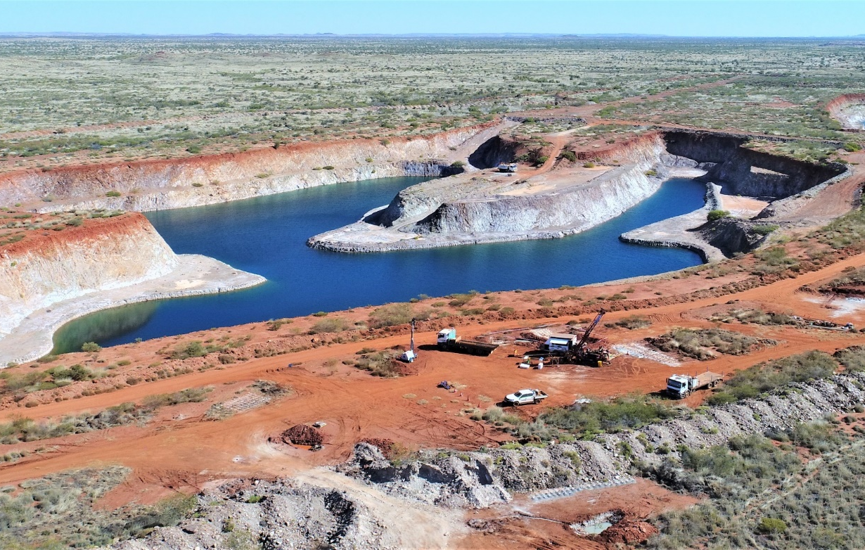
Mines Safety Inspection Act
Terms defined;
Exploration operations
Mining operations
Notes:
Exploration operations - means any exploration activity which is undertaken on a mining tenement, whether offshore or on land, but does not include —
(a) any development work involving underground operations; or
(b) the excavation of any trial pits beyond the extent permitted under the tenement conditions; or
(c) remote sensing activity carried out using airborne or satellite mounted equipment (except for ground based activity in support of such remote sensing activity);
Mining Operations - operations means any method of working by which the earth or any rock structure, coal seam, stone, fluid, or mineral bearing substance is disturbed, removed, washed, sifted, crushed, leached, roasted, floated, distilled, evaporated, smelted, refined, sintered, pelletized, or dealt with for the purpose of obtaining any mineral or rock from it for commercial purposes or for subsequent use in industry, whether it has been previously disturbed or not, and includes —
(a) exploration operations; and
(b) developmental and construction work associated with opening up or operating a mine; and
(c) the removal and disposal of overburden or waste or residues by mechanical or other means and the stacking, depositing, storage, and treatment of any substance considered to contain any mineral; and
(d) the operation of blast furnaces and direct reduction furnaces; and
(e) the operation of privately owned railways to transport ore or other mining products, or to provide related services; and
(ea) the transport of ore or other mining product that takes place on a road that is not a road as defined in the Road Traffic (Administration) Act 2008 section 4; and
(f) the crushing, screening, sorting, stacking, and loading and handling of ore or other mining products at any rail or road terminal or any loading or transhipment points, including seaports; and
(g) the operation of any support facilities on the minesite, including mine administration offices, workshops, and services buildings; and
(h) borefields remote from the minesite but an integral part of the mining operation; and
(i) operations by means of which salt or other evaporites are harvested; and
(j) operations by means of which any mineral is recovered from the sea or sea bed or a natural water supply; and
(k) operation of residential facilities and recreational facilities and the ground used for that purpose, where such facilities are located on a mining tenement and are used solely in connection with mining operations; and
(l) the operation of any project which is for the time being declared by the Governor to be a mining operation under section 6; and
(m) operations undertaken for the environmental rehabilitation of the minesite during production operations and after their completion; and
(n) operations for the care, security and maintenance of a mine and plant at the mine undertaken during any period when production or development operations at the mine are suspended; and
(o) operations undertaken to leave a mine safe to be abandoned,
but does not include the operation of —
(p) steel making plants; or
(q) rolling mills; or
(r) facilities for the manufacture of goods from mining products; or
(s) residential facilities or recreational facilities and the ground used for the purpose where such facilities are not located on a mining tenement and directly associated with mining operations; or
(t) sand, gravel, limestone, or rock excavation carried on by or for any State agency or instrumentality or any local government for the use or disposition by any such agency, instrumentality or local government; or
(u) excavation activities on private land by and for the use of the owner of the land

Slide 10
Management of exploration operations
MSIA 1994: Management of exploration operations
MSIR 1995: Management of mines
Notes:
47. Management of exploration operations MSIA
(1) If exploration operations are carried out on a mining tenement which is held by a person who holds an adjoining mining tenement or mining tenements on one or more of which mining operations are being carried out, the registered manager of the mine at which those mining operations are being carried out may notify in writing the senior inspector responsible for the region of the State in which those exploration operations are being carried out that all such exploration operations are under the control of that registered manager.
(2) If exploration operations at a mine are not under the control of a registered manager because a registered manager is not required under section 33(7) for those operations and, for a mine to which subsection (1) applies, no notice has been given under that subsection, the principal employer must —
(a) notify, without delay and in writing, the senior inspector responsible for the region of the State in which those exploration operations are being carried out of the name and address of the person who is the exploration manager for those operations; and
(b) notify, without delay and in writing, that senior inspector of the name and address of the person who is responsible to the principal employer for the management of all activity in carrying out such exploration operations (and that person may, but need not, be the person notified under paragraph (a) as exploration manager); and
(c) take all reasonable steps to ensure that the exploration operations are carried out in accordance with all applicable provisions under this Act.
(3) An exploration manager must inform the senior inspector for the region of the State in which the exploration operations are to take place of the location, scope, and nature of the exploration operations in accordance with the regulations.
(4) A person notified as being responsible for the management of exploration activity under subsection (2)(b) must take all reasonable steps to liaise effectively with the district inspector for the region where that activity is taking place concerning the location, scope and nature of the exploration operations.
(5) Notwithstanding subsections (1) and (2), in the case of exploration operations carried out by a syndicate or other association of persons in such a way that no person is employed in those operations, no notification under subsection (2) is required, but the members of that entity or partnership or those persons are jointly and severally responsible for the performance of those duties and responsibilities which are —
(a) in the circumstances described in section 47A(1), imposed on exploration managers under this Act;
Part 3 — Management of mines
3.2. Prescribed place at which record book to be kept
For the purposes of section 23(1)(a) of the Act, the prescribed place at which a record book is to be kept in the case of exploration operations is at the principal office in Western Australia of the exploration manager.
3.3. Provision of information — earth disturbing operations
(1) This regulation applies to any exploration operation that involves the disturbance of earth (including drilling, costeaning or trial pit excavation).
(2) For the purposes of section 47(3) of the Act, information relating to any exploration operation to which this regulation applies must, so far as is practicable —
(a) be provided before the exploration operation takes place; and
(b) include details of the location, scope and nature of all such exploration operations (including the intended date of commencement and conclusion of exploration activities) that are proposed during an ensuing 6 or 12 month period (as elected by the exploration manager).
3.4. Provision of information — other operations
(1) This regulation applies to any exploration operation that does not involve the disturbance of earth.
(2) For the purposes of section 47(3) of the Act, information relating to any exploration operation to which this regulation applies must, so far as is practicable —
(a) be provided before the exploration operation takes place; and
(b) include general details of the location, scope and nature of all such exploration operations (including the intended date of commencement and conclusion of exploration activities) that are proposed during an ensuing 12 month period.
3.5. Remedial work
(1) If any exploration operation (including an operation involving the disturbance of earth by drilling, costeaning or trial pit excavation) has been carried out at a site, the district inspector may direct that specified
remedial work be carried out to make the site safe.
(2) The exploration manager for the exploration operation referred to in subregulation (1) must ensure that a direction given under that subregulation is complied with as soon as is practicable.

Slide 11
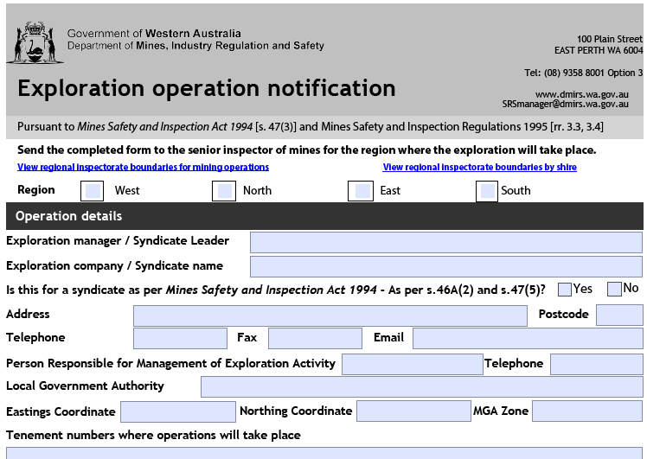
Exploration operation notification

Slide 12
The Mines Safety Inspection legislation
Exploration requirements;
Record book to be kept
Notify Senior Inspector
Remedial work
Notes:
3.2. Prescribed place at which record book to be kept
The prescribed place at which a record book is to be kept in the case of exploration operations is at the principal office in Western Australia of the exploration manager.
46A. Exploration manager, appointment of
An exploration manager must inform the senior inspector for the region of the State in which the exploration operations are to take place of the location, scope, and nature of the exploration operations in accordance with the regulations
3.5. Remedial work
If any exploration operation (including an operation involving the disturbance of earth by drilling, costeaning or trial pit excavation) has been carried out at a site, the district inspector may direct that specified remedial work be carried out to make the site safe.

Slide 13
The Mines Safety Inspection legislation
Exploration requirements;
Entry into a disused mine
Provide adequate supervision, information and training
Electricity in camps
Notes:
3.6. Training of persons
An employer must ensure that each employee engaged in exploration operations is provided with such training as is necessary to enable the employee to manage risks associated with the hazards of exploration operations in remote sites, including the lack of infrastructure and support and adverse climatic conditions.
3.8. Entry into disused mine workings
An employer must ensure that any employee engaged in an exploration operation does not enter any disused mine workings unless the employee is competent to do so and does so in accordance with an established safe procedure.
Duty of care from an Employers, provide supervision and training to be able to perform their work in such a manner that they are not exposed to hazards
5 Electricity in mines 5.2. Notice of intention to install electricity supply Installations and equipment to be in accordance with AS/NZS Standard
Electrical supervisors Duties of electrical supervisor

Slide 14
The Mines Safety Inspection legislation
PMP to be submitted
Approval in writing from the State mining engineer
Commencement of any construction or mining Operations
Notes:
Legal requirement for approval of commencement
Mines safety and Inspection Act 1994 s.42
Mines Safety and Inspection Regulations 1995 r. 3.12 and r. 3.13
Start of site risk management program, i.e. broad assessment of risks
Requires sites to consider control strategies and management systems
Risk controls considered at design stage (hierarchy of control, cost effective)
Possible future legislative focus on risk management and safety management systems
Notification and approval of commencement of mining operations
Principal employer or manager must notify the District Inspector before:
mining operations commence
mining operations recommence after suspension
mining operations are suspended or abandoned
Principal employer or manager must not commence mining operations until approval in writing from the State Mining Engineer
Notification of commencement includes Project Management Plan (PMP)

Slide 15
Purpose of a PMP
Identification of potential major risks
Throughout various stages of the operation’s life cycle
Start of the sites Risk Management program and implementation of Safety Management systems
Notes:
The preparation of a PMP is the basis for the initial identification of potential major risks at the various stages of the operation’s life cycle, from construction to development, production and closure. It is a starting point for developing ongoing strategies to manage those risks.
The PMP should therefore be considered by the principal employer and mine manager as an important tool in their due diligence process to develop an appropriate site-specific occupational health and safety management system
Sites should not regard PMPs only as a legal requirement.
Should be seen as start of sites risk management program and implementation of management systems.
Enable sites to consider hazards, risk and controls early in life cycle. Controls can be more cost effective when incorporated early in life cycle.
Higher order controls can also result, eg engineering, substitution.
Possible new harmonised legislation has greater and more specific focus on risk management and management systems so PMPs consistent with this approach.

Slide 16
An adequate Risk Assessment is vital
Notes:
Assessment of the risks, identifies the hazards and then a TARP Trigger action plan can be developed and implemented to prevent catastrophic event.
The seawall had failed to open up for ocean conditions. This occurred at approximately 1400 after the high tide of 9.5 m. This follows the advice of two earlier slips in the seawall. Immediate actions included, evacuating the pit and cessation of all works in the pit. Engineering expertise were mobilised to site to assess the situation. No further work was conducted in the main pit until a thorough risk assessment had been developed.
No personnel were working in the area. Equipment losses were limited to a few pumps. Minor diesel slicks had being dealt with by deploying containment booms.
Controls implemented to prevent a similar incident could be for Managers and Supervisors in open pit mining operations should check to ensure that the working procedures and operating policies specified in the ground control management plan deal effectively with the following:
Geotechnical monitoring systems are put in place which are capable of effectively monitoring slope movement. The functionality of monitoring systems should be regularly reviewed, as open pit operations are dynamic and subject to change.
The condition of pit edges and berms above and below working horizons should be regularly checked for signs of instability, both local and globally. Signs of impending failure may include cracking and small volume rock failures, as well as bulging or swelling of the face or toe of pit walls. It is important that regular checks are made after blasting and rainfall events. The appearance of groundwater or changes in the flow should be reported, investigated and monitored.
Rigorous enforcement of clearly articulated policies and practices should be undertaken at all levels of the operation. Risks associated with pit wall stability especially in the vicinity of accumulated water should be properly assessed and appropriate controls put in place to ensure the safety of all employees.

Slide 17
An adequate Risk Assessment is vital
Notes:
This is a past events when the risk had not been assessed correctly
Structural Failure of Acid Leach Tank - 14 December 2014 - Investigation
rupture and collapse of a 2 million litre acid leach tank — the tank shell failed due to corrosion damage
Catastrophic structural failures are often rapid events with little warning. There is usually
insufficient time to escape the vicinity.
The consequences (including knock-on effects) of structural failure increase when the contained
energy or resisted load has secondary harming potential, such as when the failure of one
structure (or structural component) causes the failure of others (i.e. a domino effect), or harmful
liquids are released.
Structural failures almost always involve high energies. Even small parts falling from height can
result in a fatality or serious injury.
Responsible persons are reminded of the importance of managing the structural integrity of
structures. Structural integrity and safety rely on good practice throughout a structure’s life cycle

Slide 18
What should trigger a PMP
Treatment of minerals for commercial use as defined in the definition of a mining operation.
Notes:
Major Risks need to be assessed to prevent significant incident:
Injuries from incidents involving conveyors
Between 01 January 2011 and 08 September 2016 there have been 107 reported injuries at mine sites involving conveyors. 79 were serious injuries requiring workers to be away from work for more than two weeks. Of these serious injuries: 16 per cent were the result of contact with the moving parts of the conveyor 16 per cent were crush injuries 14 per cent resulted in fractures.
Significant Incident Report No. 233
Subject: Worker seriously injured by hot caustic solution while cleaning an inline
strainer
Date: 01 December 2015
Summary of incident
During routine maintenance, a process operator was cleaning a screen box (inline filter) connected
to pipework below a thickener tank. He opened the drain valve to verify isolation before undoing four
bolts to open the screen box door. On opening the screen box door, the operator found the screen
full of material. As he pulled the screen out of its housing, a blockage upstream of the screen box
dislodged. The operator was engulfed in 95°C caustic solution, receiving thermal and caustic burns
to his body and face.
An emergency responder found the main isolation valve open.
Direct causes
The main isolation valve was open, so the screen box and associated valves were not isolated.
The process operator was in front of the screen box when the blockage dislodged.
Contributory causes
The isolation of valves was not verified through either a second and independent method of
ensuring all valves were closed, or checking the effectiveness of each isolation point by
separately observing a “change of state”.
The operator mistakenly thought he had closed the main isolation valve but its function was
actually being performed by a blocked pipe.
Excessive scale had built up inside the vessel after scheduled maintenance was delayed.
It was difficult to determine the position of the main isolation valve (i.e. open versus closed).
Operators were not required to lock or tag isolation points for routine work.
Actions required
The following actions are recommended for work involving hazardous substances.
Plant design and modifications
Consider plant design that enables positive and proven isolation methods such as physical
disconnection, single block and bleed and spade, and double block and bleed.
Consider modifying the plant to include facilities for proving an isolation point. Where drain lines
are used, they need to be as close as possible to the isolation to prevent a false verification due
to a line blockage.
Isolations should be as close as possible to the piece of plant being isolated.
Consider installing flushing systems to verify pipework and plant are free of blockages.
Safe systems of work
Implement safe systems of work such that:
safe work procedures are provided for isolations, including the basic principles of lock, tag, try
test and finally test for dead
safe work procedures are updated to capture operational experience to ensure known risks
have adequate controls
vessels are maintained to reduce material or scale build-up inside pipelines, drain lines or
valves, as blockages may falsely indicate isolation
plant and equipment are clearly identifiable to prevent incorrect isolation
gases and liquids are not trapped in sections of plant that do not have adequate pressure or
vacuum protection or thermal relief.
Verifying isolation
An isolation valve may leak and fail to isolate. If the isolation is not verified appropriately, the leak or
failure may not be recognised until the job starts.
When conducting an isolation, prove all isolation points before proceeding with intrusive work.
Each isolation valve should be proved separately by observing a “change of state” between
close-open-close positions after the system has been fully drained. Valves need to experience
full system pressure to ensure they hold.
A “try test” needs to be completed to verify all electrical, hydraulic and instrument air circuits
have been isolated.
The “test for dead” needs to consider all potential hazards, such as residual amounts of
corrosive, toxic or flammable substances, retained pressure, hot condensate and steam. Do not
rely on an unproven or inconclusive isolation. Consider:
extending the isolation boundary
implementing additional controls
deferring the work until a shutdown.

Slide 19
What may trigger a PMP
Any removal of an excess tonnage bulk sample beyond the Mineral Titles standard permitted tonnages.
Notes:
The Environmental Division came across this site (following a complaint).
A Mining Proposal was in place – but only for mining costeans. However the photos indicates that substantial mining is occurring.
Previous mining activities have been undertaken at the site which ceased in the 1980s.
A low impact mining proposal was approved on 9 July 2010 and was for the filling of old costeans and burial of rubbish and also the creation of two new costeans for emerald mining.
It was also noted that the approved mining proposal did not include an alluvial wet plant as part of the activities. An old cement truck is currently being used to process material from the costeaning and a new Programme of Work-Prospecting application should be submitted to ensure that this activity is in accordance with approvals.
The approved low impact mining proposal is for the disposal of rubbish on site and the creation of two additional costeans. The mining proposal approved the disturbance of 0.33 hectares of vegetation. The inspectors captured the areas of
disturbances around the current workings and there is approximately 1.3 hectares of disturbance around the current camp and stockpile area. The mining proposal indicated that the old camp and rubbish on the site would be removed or buried to clean up the area.
The inspectors noted that there is still a camp and a lot of rubbish present on site, most of which looks like it has been there for many years. Rubbish on site needs to be removed and disposed of in an appropriate manner.
The inspectors observed one costean that is actively being excavated. This costean is quite deep at certain points (the inspectors estimate that it would be greater than 10 metres below the surface) and does not contain any barriers to stop people or animals from falling in. There are no egress points and any person or animal that fell in would not be able to walk out. A commitment was made as part of the mining proposal that fauna egress ramps would be provided from excavations to allow for fauna to escape prior to backfilling. Egress ramps need to be created for this costean. The back of an old cement truck is currently being used to process the material being excavated from the costean. It was observed that fines material from the processing was running off into the surrounding vegetation. A sediment trap should be created to capture any material and stop it flowing freely into the environment. It is also noted that on the low impact mining operation form that was approved for this project, it was indicated that an alluvial wet plant would not be part of the proposed activities. Therefore, this processing was not approved by this mining proposal. A Project management Plan needs to be submitted to the State Mining Engineer.

Slide 20
What should trigger a PMP
All underground operations especially if it involves a shaft sink or installation of winding equipment.
Notes:
A complaint regarding underground operation without a PMP and a dodgy winch was followed up by inspectors on Friday 23 March 2018.
A Davit lifting frame and combination of an electric hoist and compressed air hoist arrangement was installed and available to lift a 40 kg load was observed at a underground operation. The underground operation consists of a 12 metre shaft and level development operated by one individual who occasionally has assistance from another individual to operate the surface hoist raising the broken ore in a site manufactured bucket.
Major Risks need to be assessed
Mines Safety Significant Incident Report No. 157
Work platform struck by skip and dislodged into shaft
Incident
At an underground mine, routine non-destructive testing (NDT) of a skip conveyance rope was being conducted from a work platform placed across the skip compartment at the shaft brace. The NDT instrument was located on the platform and installed around the rope. The platform was fabricated from steel and weighed about 900 kg.
While conducting the test, the conveyance was lowered to the bottom of the shaft as per the procedure outlined in the task risk assessment. A decision was made to conduct another test, and the winder driver was instructed to bring the skip to the surface in readiness for another test run.
As the skip was brought to the surface, the rope attachments struck and dislodged the platform, which fell 4 metres into the shaft before coming to rest when it wedged between the skip and shaft furniture.
No injuries and minimal actual damage were sustained. However, had the platform fallen to the bottom of the shaft (1000 m), the consequences could have been more serious, including serious injury to persons and major disruption to winding operations.
Immediate causes and contributory factors
The platform was dislodged into the shaft when it was inadvertently struck by the skip being brought to the surface. The method of securing the platform in place did not prevent it from falling into the shaft.
There was no standard procedure for this routine task. Risks were identified using a task risk assessment process and form.
The risk assessment and change management processes for the task were inadequate — not all risks were identified; the actual task sequence was different to the planned sequence; and not everyone involved in the task signed onto the original task risk assessment. When the task was modified, the task risk assessment was not reviewed and, as a consequence, controls were not put into place to manage the new risks associated with raising the conveyance with the platform covering the shaft brace.
Communication between the personnel conducting the NDT and the winder driver was inadequate. The winder driver was not informed that the platform was still in place, and the skip was raised faster than normal with a platform in position.
Detection and protection systems or devices to alert the winder driver that a platform was installed or to limit hoisting speed were not in place or were inadequate. A closed circuit television (CCTV) monitor showing a view of the shaft brace area was available in the winder room but not easily viewed by the winder driver when operating the winder.
Comments and preventative actions
To avoid a recurrence of this type of incident, the following actions should be implemented.
Ensure formal risk assessment is conducted for tasks involving the use of platforms in and around shafts. The scope of the risk assessment should consider all activities involved in the life cycle of the task, including installation and removal of the platform. The risk assessment team should contain persons involved in the task, including contractors.
When a platform is used in a shaft, it should be secured to prevent it falling into the shaft due to inadvertent contact or other means of failure. A platform should be properly designed, constructed and installed to be fit for purpose and minimise risk of harm to persons, considering operational and environmental factors.
Appropriate detection and protection devices should be considered based on the risk assessment. This may include warning devices when platforms are installed, speed limiting devices and CCTV monitors. Ergonomic factors need to be considered when designing the layout of visual displays and instrumentation.
Rigorous change management procedures and practices need to be established outlining actions to be taken when tasks are modified, including review of risk assessment and required authorisations.
Appropriate documentation must be prepared outlining safe work procedures and controls to manage the risks associated with the task. All personnel involved in the task, including contractors and the winder or hoist driver, need to be properly trained and instructed in the performance of the task.
Communication methods need to be established to ensure that all personnel understand the task and any instructions given during the task, including during an emergency situation. If a stage or any other object is placed in the shaft affecting the winding path, an entry should be made in the winding engine log book maintained under regulation 11.8 of the Mines Safety and Inspection Regulations 1995. Should there be any doubt then personnel should not proceed with the task until clarification is obtained from appropriate personnel or authority.
Adequate supervision is required for such high risk tasks to ensure proper task allocation and instruction, job planning and monitoring of performance.
Where work is undertaken that could result in an object falling into a shaft, precautionary measures and controls should be in place to ensure the safety of persons working below (e.g. at or near shaft plats). These may include physical barriers, warning signage, temporary suspension of man-riding, and consideration of risks and interactions during job planning.

Slide 21
What may trigger a PMP
Any large surface operation where pit walls are formed which pose a wall failure hazard to employees.
Notes:
Major Risks need to be assessed to prevent significant incident:
SIGNIFICANT INCIDENT REPORT NO. 12
SLOPE FAILURE – OPEN PIT MINE
INCIDENT
A slope failure involving an estimated 270,000 tonnes of rock occurred recently in an open pit mine. The slope in which the failure occurred had been extensively cable bolted. The failure buried machinery valued at approximately $400,000 and effectively destroyed the main haul road to the pit. The failure occurred without apparent warning and lasted approximately one minute. Although pit personnel were not injured, a haul pack operator and driller were fortunate to escape injury.
COMMENTS AND RECOMMENDATIONS
The cause of the failure is being investigated but initial indications are that a 'toppling' rather than circular or planar failure mechanism was involved. Pit operators are reminded that evidence of slope instability should be looked for on a routine basis. The most common signs of instability are tension cracks developing around the pit edge, on haul-roads or on berms. Monitoring of the rate of opening of these tension cracks usually gives sufficient warning of a pending slope failure to allow personnel and equipment to be withdrawn from the immediate area. It is strongly recommended that pit edges and berms be thoroughly and routinely inspected twice daily for signs of instability. Monitoring of tension crack widths should be instituted as soon as they are detected and appropriate actions taken to eliminate any risk of injury to personnel should wall failure occur.

Slide 22
Information provided in a PMP
General details of notification
Proposed mining operations overview
Type of mine
Details of proposed operations
Notes:
Name of the Mine. Location Number of tenements – Name of Principle employer – Address – Mining Operations Affected – Date of commencement
Number of persons employed during construction – Operations – Expected duration of mining Operations
Underground – open pit – Treatment plant – Smelter Refinery – Dredge -

Slide 23
Information provided in a PMP
Mine plan
Plan of operations
Emergency preparedness and training details for the mine
Identification of major hazards
Notes:
Open pit operations layout – Underground layout – Access to underground workings
Suitable scale – Mine layout shown – other facilities shown – Tenement boundaries shown – National grid relationship shown – RL datum shown

Slide 24
Submission of a PMP
PMP submission is now done online using the Safety Regulation System (SRS)
Reasonable time should be allowed for the assessment
Target is 30 working days to obtain the State mining engineer's approval
Notes:
The PMP will remain as incomplete until the proponent has submitted. Once submitted the PMP can no longer be amended. The proponent entering the PMP is the only user who can view the PMP
When the PMP is submitted an alert is sent to the inspectors that have been given access to see those alerts. One of these inspectors will take ownership of the PMP (Role of manager)
The manager assigns the assessment to various inspectors depending on the speciality of the assessment required. The inspectors with a role of QA will be available to be selected for the assessment
The QA inspectors approve or reject the assessment
The manager (owner) then accepts or rejects the PMP
The PMP is then accepted or rejected by the SME (State Mining Engineer)

Slide 25
Review process for PMP workflow
PMP entered by industry proponent
PMP assessed by District Inspector and Special inspectors
30 day deadline for approval
If further information requested, ‘Stop the clock’ initiated on 30 day timeline
All info received, PMP recommended for approval
Approval – letter signed by State mining engineer
Notes:
Flow chart outlines steps in MSB review process.
PMP may be assessed by one or several inspectors.
Inspectors ensuring required information is supplied and adequate.
Internal target of 30 working days to review and approved PMPs.
May request further information in which case assessment clock will stop.
Result of review process is recommendation on approval of commencement of operations by SME

Slide 26
Safety Culture Spectrum
Vulnerable | Rule followers | Robust | Enlightened | Resilient
In denial Messengers ‘shot’ Whistleblowers dismissed or discredited Protection of the powerful Information hoarded Responsibility shirked Failure punished or covered up New ideas crushed | Deal ‘by the book’ Conform to rules Target = ‘zero’ Reactive Repair not reform Information neglected Responsibility compartmentalised New ideas = ‘problems’ | Develop risk management capacity Enhance systems Improve suite of performance measures Develop action plans Monitor and review progress Clarify/refine objectives | Active leadership Safety management plan widely known Competent people with experience Accountabilities understood Advanced performance measures Regular reviews Range of emergency responses catered for | Strive for resilience of systems Reform rather than repair Responsibility shared Actively seek new ideas Messengers rewarded Proactive as well as reactive Failures prompt far-reaching inquiries Flexibility of operation Consistent mindset is ‘wariness’
‘in disarray’ pathological | ‘organised’ reactive | ‘credible’ calculative | ‘trusting’ proactive | ‘disciplined’ generative
Sanction | Direct | Encourage | Partner | Champion

