Slide 1

Please read this before using presentation
This presentation is based on the content presented at the 2019 Nano diesel particulate matter (nDPM) in July 2019.
Department of Mines, Industry Regulation and Safety (DMIRS) supports and encourages reuse of its information (including data), and endorses use of the Australian Governments Open Access and Licensing Framework (AusGOAL)
This material is licensed under Creative Commons Attribution 4.0 licence. We request that you observe and retain any copyright or related notices that may accompany this material as part of attribution. This is a requirement of Creative Commons Licences.
Please give attribution to Department of Mines, Industry Regulation and Safety, 2019.
For resources, information or clarification, please contact: SafetyComms@dmirs.wa.gov.au or visit www.dmirs.wa.gov.au/ResourcesSafety

Slide 2

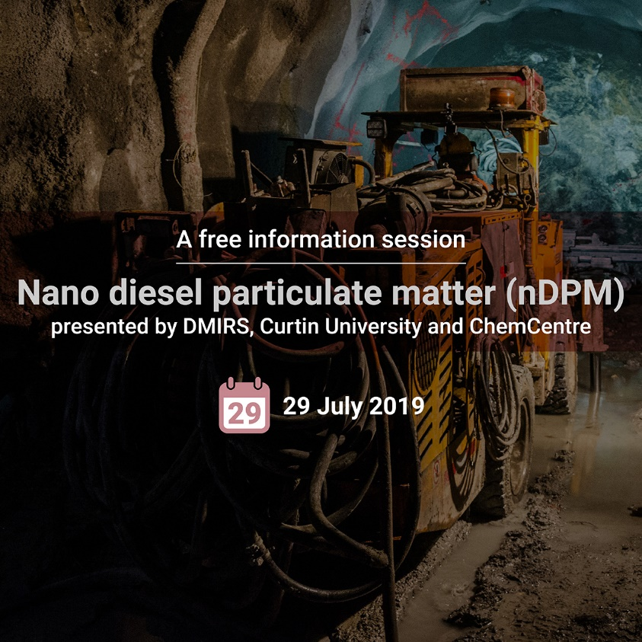
2019 Nano diesel particulate matter (nDPM) Forum

Slide 3


MRIWA Project M495: A Study of
Nano Diesel Particulate Matter (nDPM) Behaviour and Physico-chemical Changes in Underground Hard Rock Mines of Western Australia.
- Part B (Curtin-Led Component)
A/Prof Ben Mullins, Curtin University
DMIRS, 29 July 2019

Slide 4
Aims
The overall aim of this component of the study was to better understand (n)DPM and related emissions and their transport in current and (future) deeper mines.
Via:
a. Stationary Monitoring.
b. Personal Monitoring (input to health study)
c. Computational fluid dynamics study of nDPM transport.
d. Deeper mine (chamber) study

Slide 5
Components of Study
1. In-mine study:
Stationary Monitoring
Mobile Monitoring
Personal Monitoring
2. CFD simulation of key activities/regions in the mine.
3. Simulated (deeper) Mine Experiments – ageing of diesel exhaust and secondary organic aerosol formation
Influence of pressure (up to ~4 km depth)
Influence of ammonia (Ad-Blue and ANFO)

Slide 6
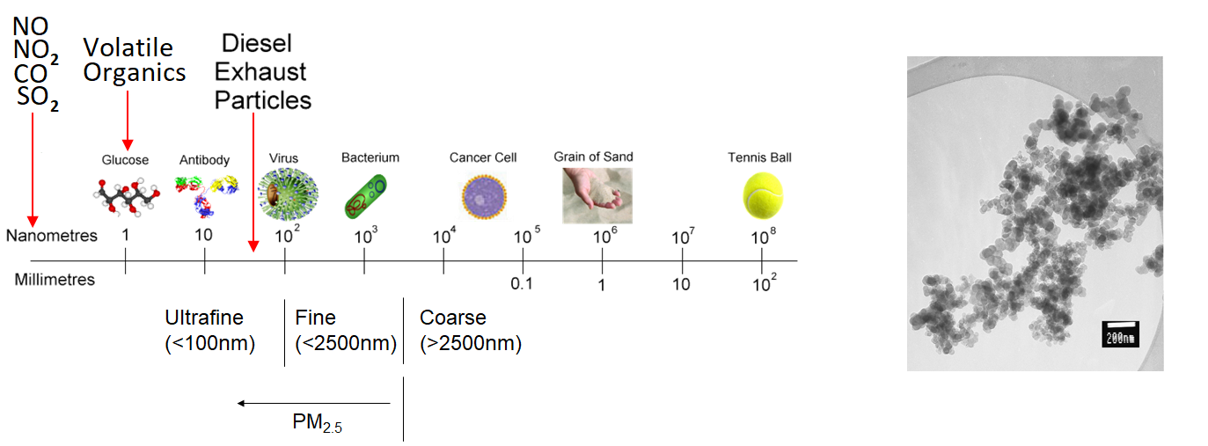
Major components of diesel exhaust

Slide 7
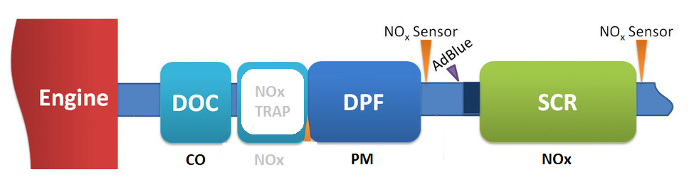
Diesel Emissions Control

Slide 8
Equipment
Stationary (2 setups)
EC - SKC Cyclone/Pump
(nano)Particle Spectrometry – SMPS
Gases – Testo 350
PM_{0.1}-PM₃₂ – PALAS Frog OPC
PAHs – Tenax Tubes & SKC Pump
Personal Monitoring
EC - SKC Cyclone/Pump
Particle Number/Size (& Mass) - DiSCMini
NO₂, SO_{x} and VOCs – Passive Samplers

Slide 9
Stationary Monitoring Results

Slide 10
Mobile Monitoring Results

Slide 11
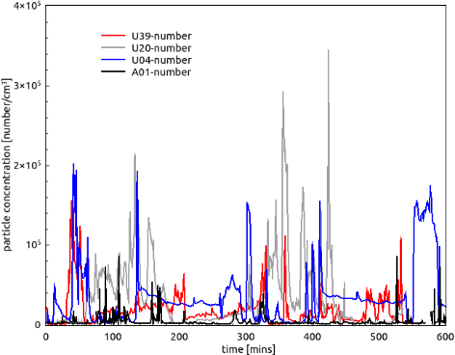
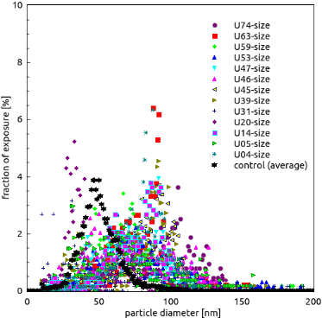
Personal Monitoring Results

Slide 12
Monitoring Results
Both stationary and personal monitoring found a significant agreement between EC and particle number concentration.
Difference in relationship due to resolution between DiSCMini and SMPS.
NO_{x} around 10x higher than NO₂. Passive samplers can only measure NO₂.
Mobile monitoring very useful tool for understanding ventilation performance at current levels of mine activity.

Slide 13
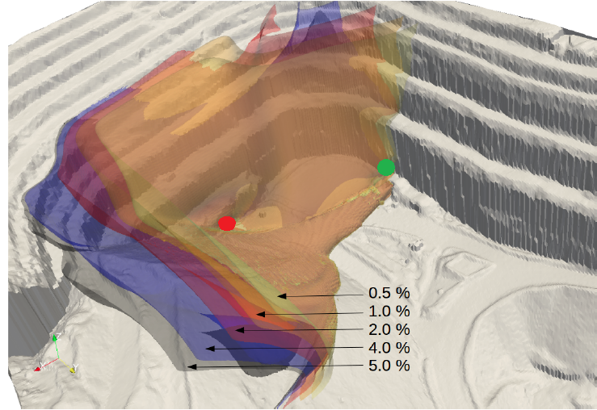
CFD Study Results

Slide 14
CFD Study Results

Slide 15
CFD Study Results

Slide 16
Summary – CFD Results
CFD Appears to be a useful tool to manage DPM as it offers higher resolution than conventional 1D tools (e.g. Ventsim)
Good agreement was found between CFD and average tracer gas measurements
CFD also useful to design portal arrangement

Slide 17
Deeper Mine Study Results
Rationale:
UV and ozone can combine with diesel emissions (above ground) to form “new” nanoparticles.
Ammonia (from AdBlue) can also create new nanoparticles.
These “secondary organic aerosols” can be highly toxic
Amantidas et al. (2014)

Slide 18
Deeper Mine Study
Chamber simulating mine up to 4 km depth.
Findings: Pressure cannot replace Ozone and UV to create new particles. No significant changes to nDPM at pressures <1.4 atm (~4 km depth). OH radicals (or NH₃) needed to create SOA.
Need to ensure no sources of Ozone or UV in the mine (e.g. electric motors or switchgear, lights that emit in UV spectrum).
Residual NH₃ causes SOA formation however levels insignificant in engines without DPF. Benefits of SCR likely outweigh disadvantages.

Slide 19
Summary / Key Findings
Despite significant changes in diesel engine technology, there remains a good agreement between EC and particle number.
Realtime instruments such as the DiSCMini – which “count” nanoparticles (via electrical charges), or high resolution optical particle counters, are useful tools for managing DPM in mines.

Slide 20
Summary / Key Findings (cont.)
NO_{x} monitoring is also a very important management tool.
CFD should be incorporated into ventilation design – at minimum when designing portal location
It is important to ensure that all lighting and electrical equipment in use in the mine does not emit UV.

Slide 21
Acknowledgements
Anglo Gold Ashanti / Sunrise Dam
Barminco
ChemCentre (Silvia Black, Angela Downey)
QUT
Curtin: Abishek Sridhar, Guang Xu, Ping Chang, Ryan Mead-Hunter, Alison Reid, Sam Spearing and many more.
QUT: Reece Brown, Joel Alroe, Zoran Ristovski.

