Slide 1
Please read this before using presentation
This presentation is based on the content presented at the 2019 Registered Managers Forum in August 2019.
Department of Mines, Industry Regulation and Safety (DMIRS) supports and encourages reuse of its information (including data), and endorses use of the Australian Governments Open Access and Licensing Framework (AusGOAL)
This material is licensed under Creative Commons Attribution 4.0 licence. We request that you observe and retain any copyright or related notices that may accompany this material as part of attribution. This is a requirement of Creative Commons Licences.
Please give attribution to Department of Mines, Industry Regulation and Safety, 2019.
For resources, information or clarification, please contact: SafetyComms@dmirs.wa.gov.au or visit www.dmirs.wa.gov.au/ResourcesSafety

Slide 3
Setting the scene

Slide 4
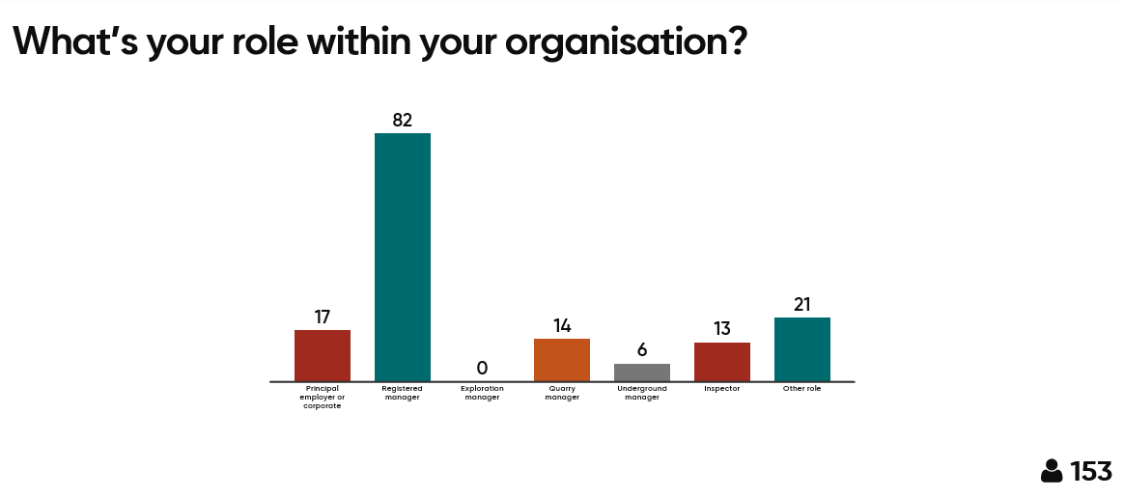
Notes:
Participants were asked to select their position through online polling Mentimeter

Slide 5
Notes:
Participants were asked to select what they hoped to gain from attending the RM forum through online polling Mentimeter

Slide 6
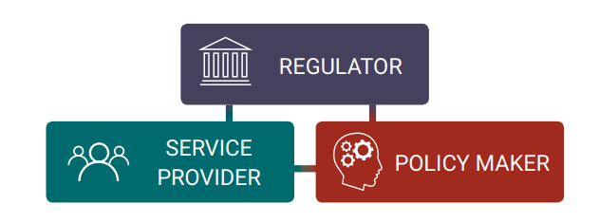
The Department of Mines, Industry Regulation and Safety supports a safe, fair and responsible future for the Western Australian community, industry and resources sector
Our Strategic Plan - Towards 2024, seeks to build on our Strategic Intent approach, by maximising our impact as regulator, service provider and policy maker

Slide 7
The Department of Mines, Industry Regulation and Safety (DMIRS) Safety Regulation Group, is the primary safety regulator for the minerals, petroleum and dangerous goods industries in Western Australia.
Its role is to promote safety and health through:

Slide 8
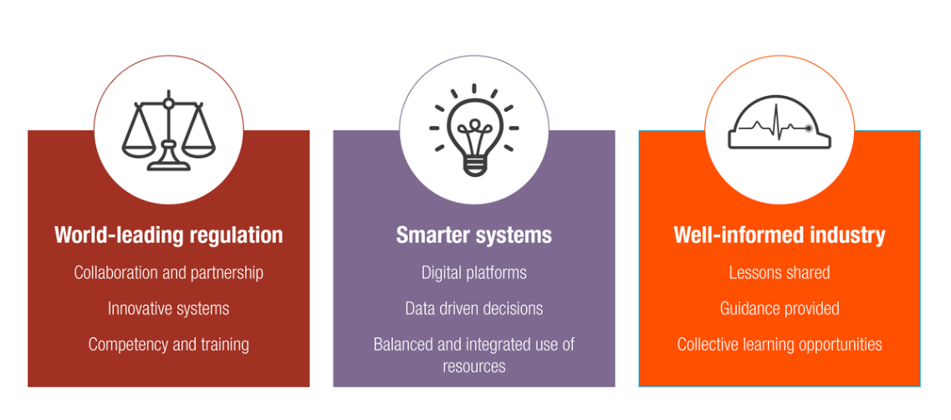
Towards 2020 – goals

Slide 9
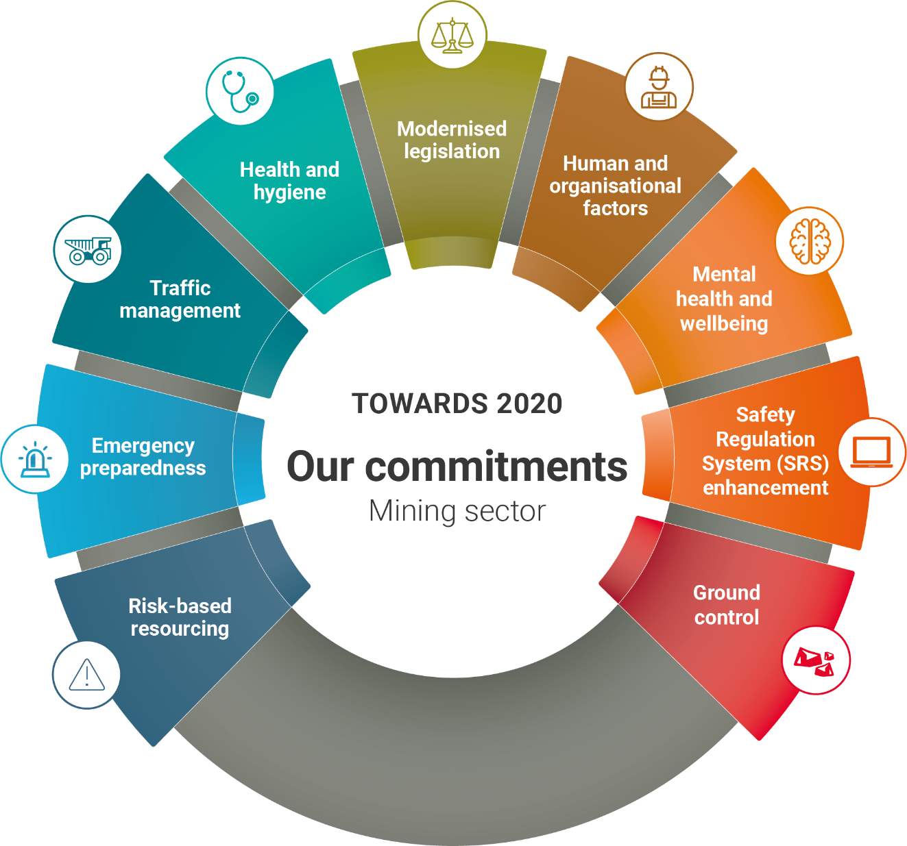
Towards 2020 – our commitments

Slide 10
Modernised legislation
Focus area: Harmonised, amalgamated health and safety legislation covering general industry, mining, dangerous goods, petroleum, major hazard facilities and geothermal energy
Update on progress:
WHS regulations public comment to commence soon
WHS regulations being developed separately for:
General industry – based on model WHS regulations
Mining – based on Core, national mine safety framework and MSIR
Petroleum – based on current sets of regulations.

Slide 11
Safety Regulation System (SRS) enhancements
Focus area: Fully integrated online systems that streamline administration and regulatory functions
Update on progress:
SRS reporting for industry – planned roll-out Q3 2019
Provide reporting function in SRS to allow an overview of operational performance
Benchmarking across commodity (commodity data will be sanitised)
Will only be able to access for site where user has security.
Exemptions – planned roll-out Q4 2019
Exemptions and agreements will be applied for online via SRS
Reminders on upcoming expiry or revocation will be notified electronically through SRS
Exemptions and agreements granted to individual sites will be viewable in SRS . This provides an electronic record.
As part of the project all existing current exemptions and agreements have been loaded into SRS.

Slide 12
Emergency management
Focus area: Improved emergency preparedness and safe systems for those working away from readily accessible infrastructure and support services
Update on progress:
Support emergency response competition (ERC) events in to promote emergency response
Sponsored both surface and underground ERC Kalgoorlie this year
Booth at Perth MERC event in November
DMIRS Inspectors involved in judging scenarios at all events.

Slide 13
Human and organisational factors
Focus area: Industry understand human and organisational factors (HOF) principles and apply to safety and health management
Update on progress:
Develop and promote guidance materials
Online content due for completion Q4 2019.
Training of Inspectors undertaken
2 day awareness program - completed
Four inspectors completed specialist course.

Slide 14
Mental health and wellbeing
Focus area: Improved workplace mental health and wellbeing in the resources sector
Update on progress:
Code of practice – released this year
Mentally healthy workplaces for fly-in fly-out (FIFO) workers in the resources and construction sectors
Develop guidance to support code
Development of Mentally Healthy Workplaces video suite underway
Official launch to industry – Q4 2019.

Slide 15
Health and hygiene
Focus area: Increased attention on chronic exposure to agents that lead to adverse impacts upon health
Update on progress:
Coordinate and fund research into Nano diesel particulate matter (nDPM) behaviour, health impacts and control measures required
nDPM – Project undertaken at Sunrise Dam mine in Oct 2017
Research report released 29 July 2019
nDPM information session held 29 July 2019 – toolbox presentations available online
Presentations at AUSIMM MineVent 2019 conference.
Industry forum
Health and Hygiene Forum held 24 June 2019
Toolbox presentations available online.
Monitoring of noise exposures
Preliminary evaluations of compliance with noise exposures and wearing of hearing protection completed.

Slide 16
Ground control
Focus area: Improved ground control management
Update on progress:
Develop and publish guidance to improve ground control management at mines
Code of practice and guideline to be released shortly.

Slide 17
What you told us last year…
Notes:
Registered Managers in 2018 were asked the question “why aren’t we improving?”

Slide 18
WA Mining Safety statistics – 2018/19 injury statistics by area

Slide 19
WA Mining Safety statistics – Fatalities
Notes:
The fatality chart shows 29 people killed in the last 10 years.

Slide 20
WA Mining safety statistics – Fatalities by type of accident
2013-14 to 2018-19

Slide 21
WA Mining Safety statistics – Serious injuries

Slide 22
WA Mining Safety statistics – 2018/19 Amputations, fractures and crushing (AFC) injuries
That’s 250 people seriously injured!

Slide 24
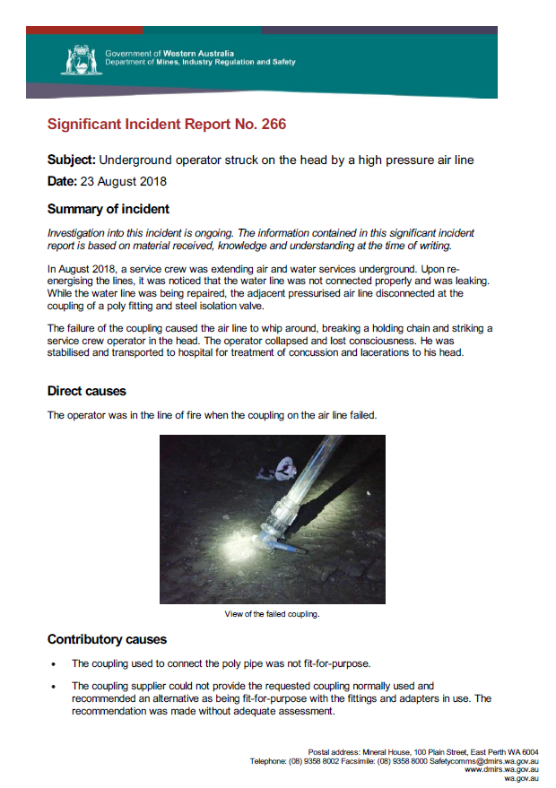
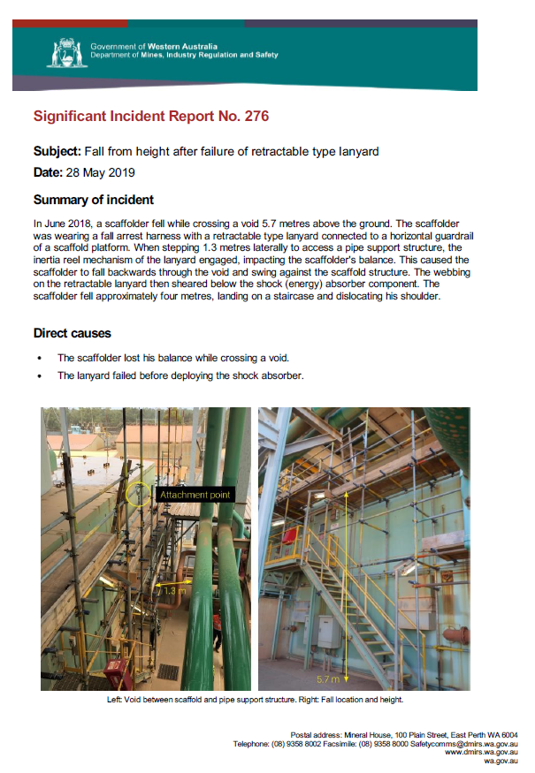
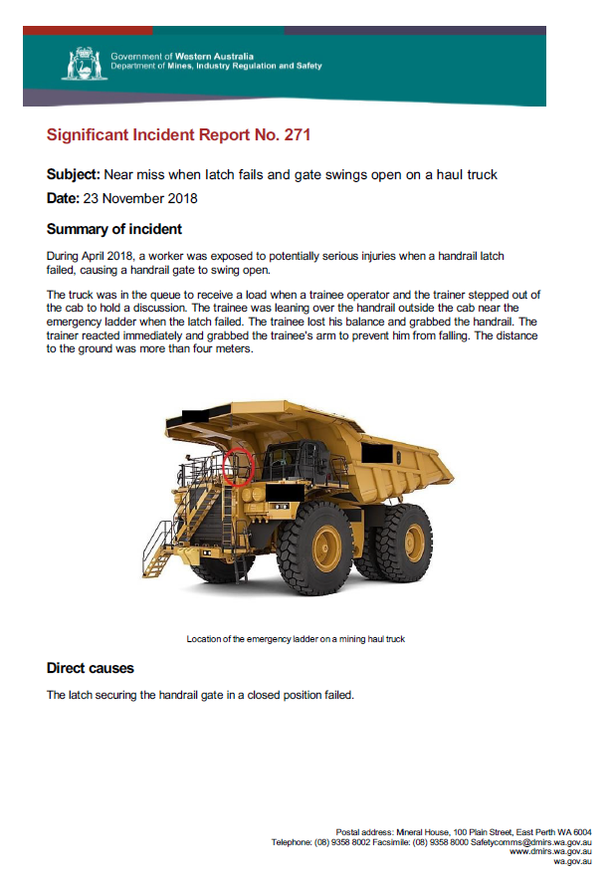
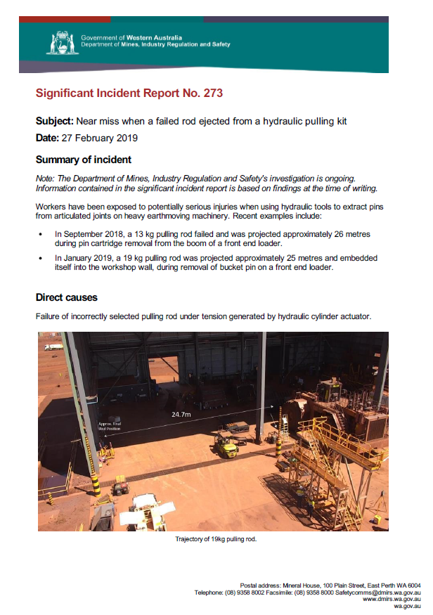
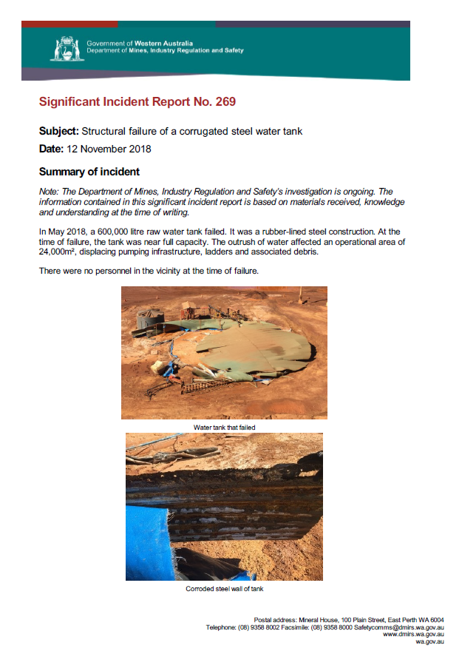
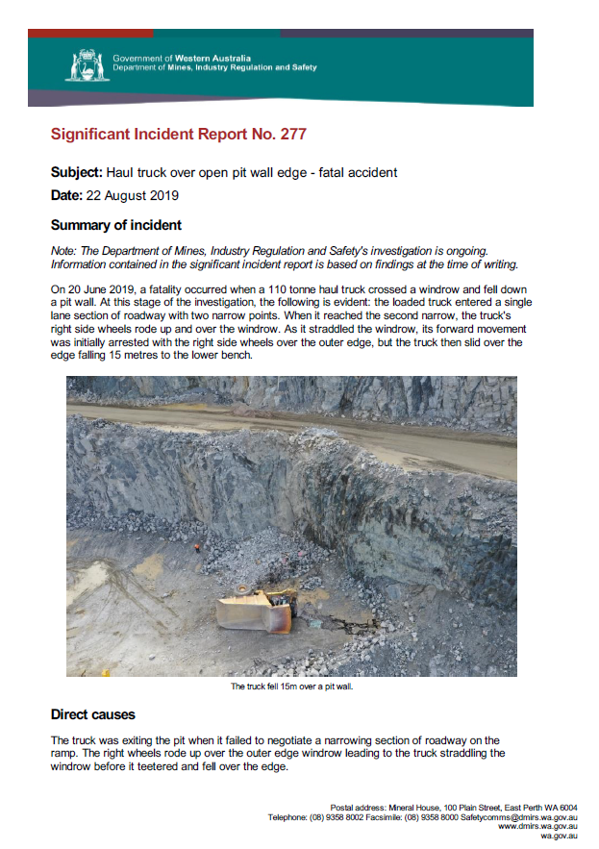
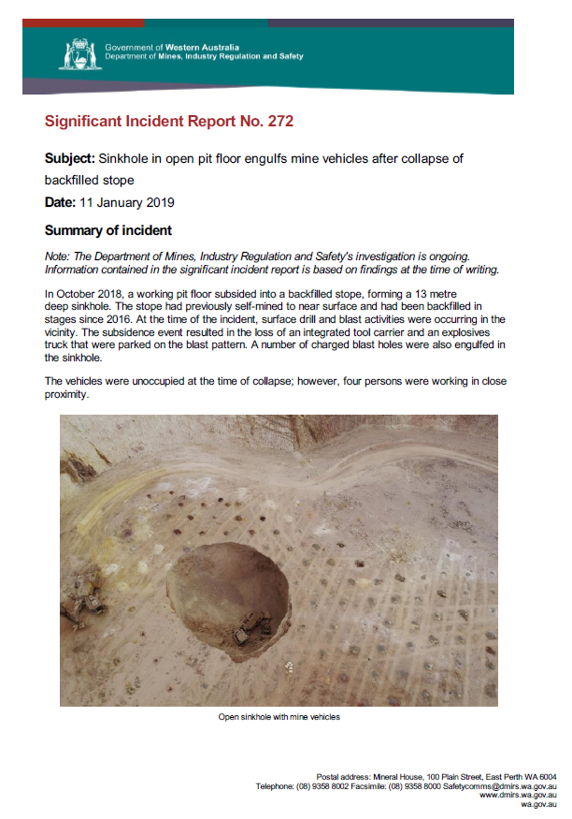
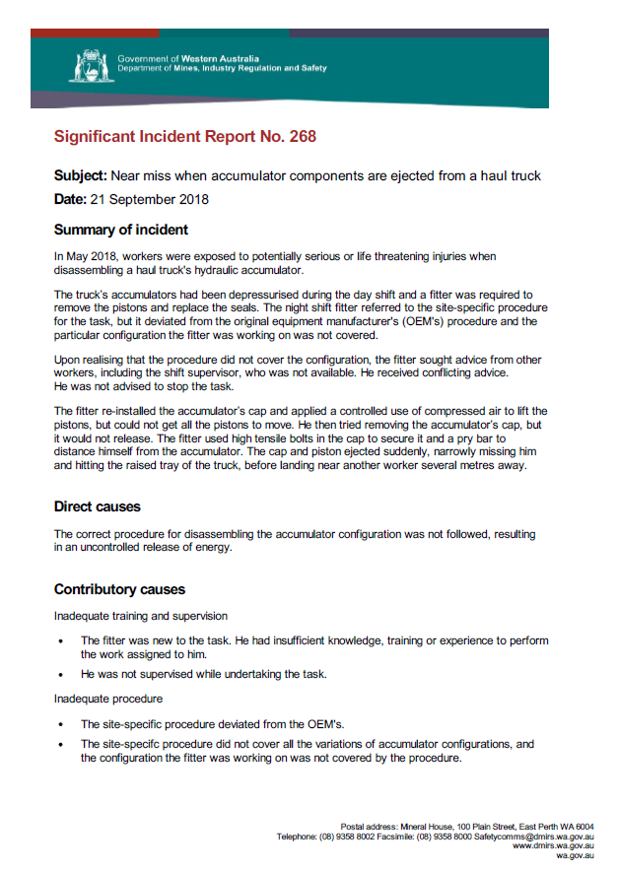
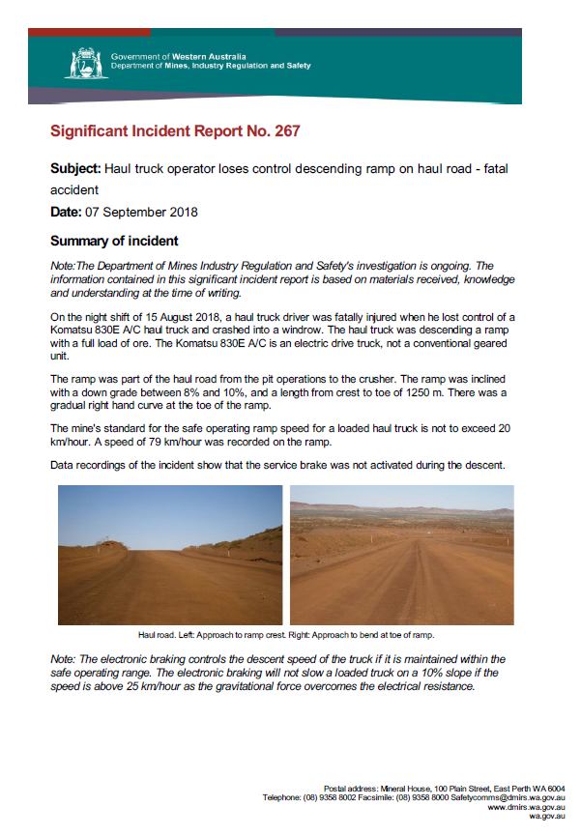
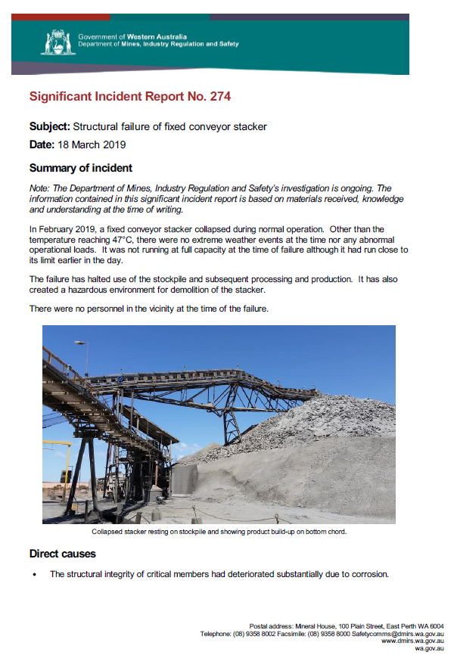
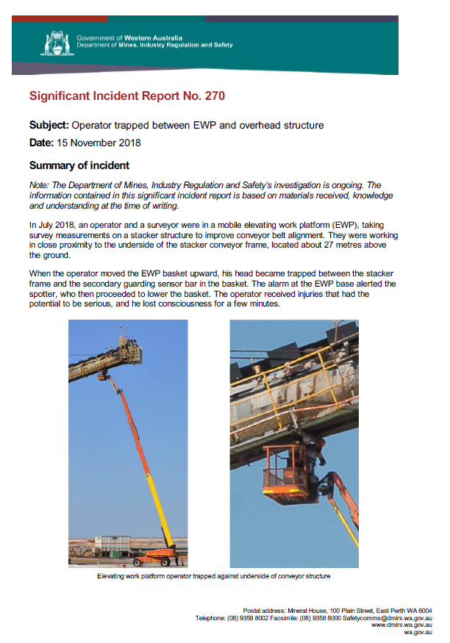
Since the last Registered Managers Forum…
12 Mines Safety Significant Incident Reports (SIRs)
Notes:
12 Mines safety significant incident reports since the 2018 Registered Managers forum

Slide 25
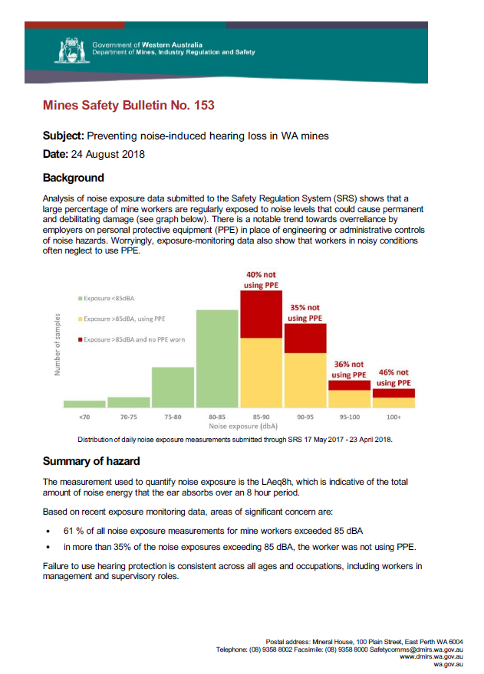
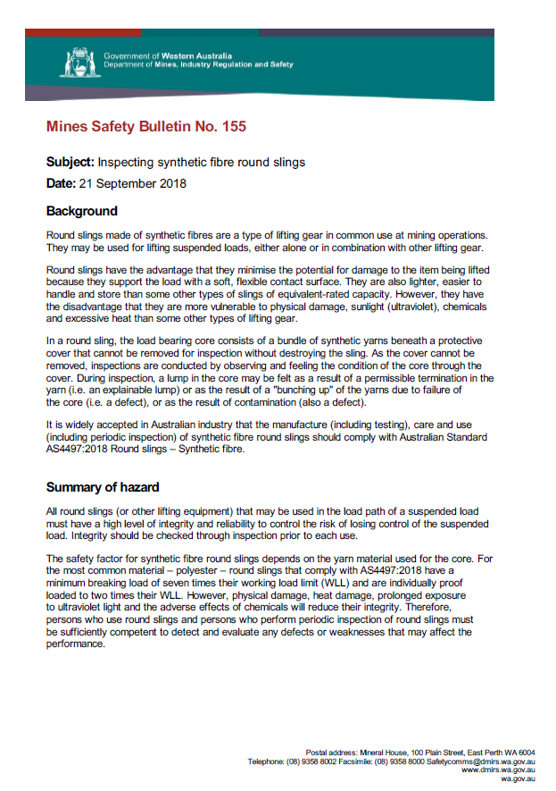
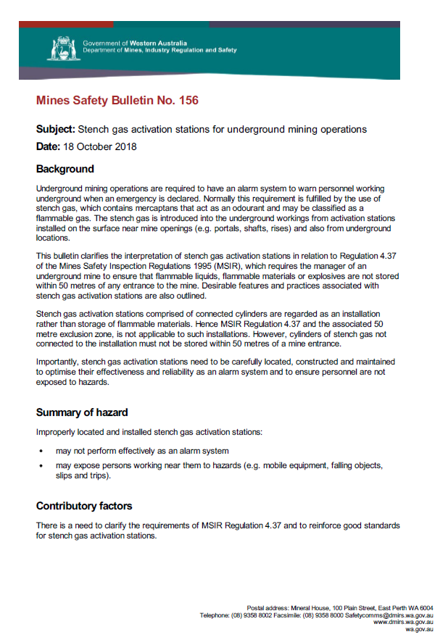
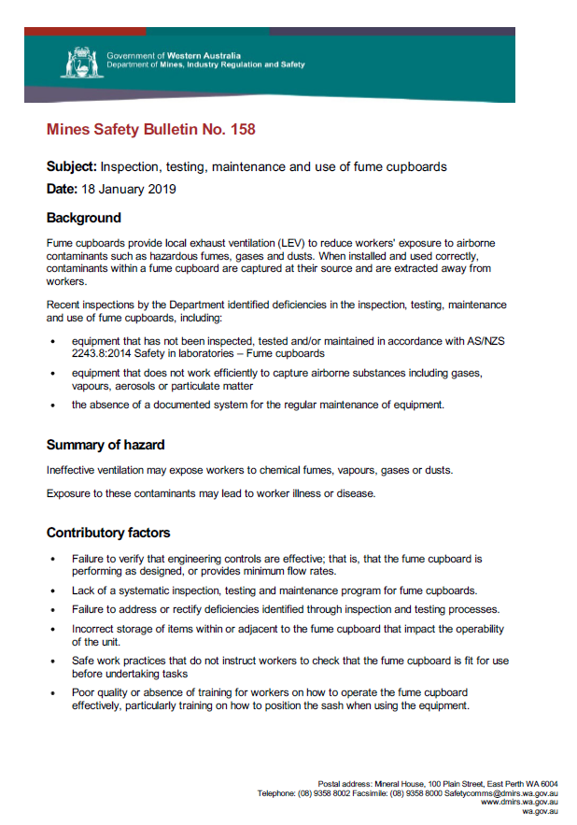
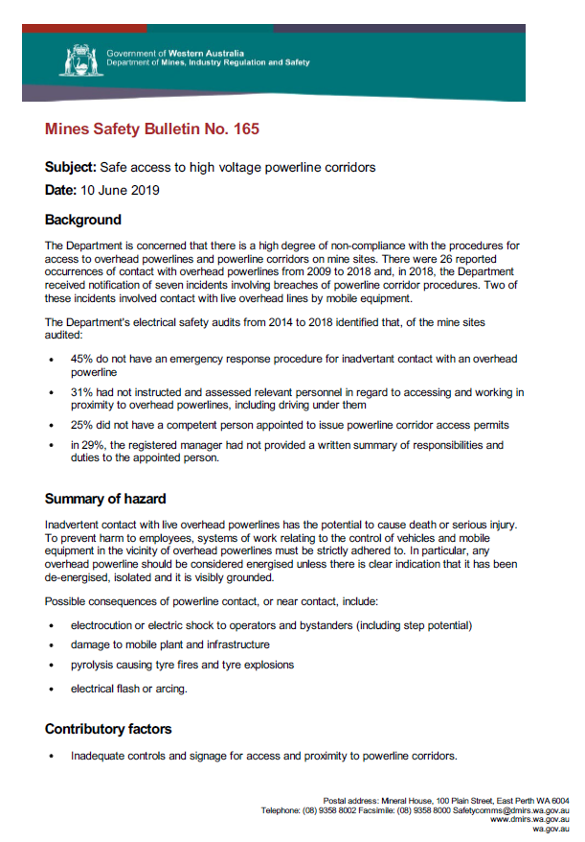
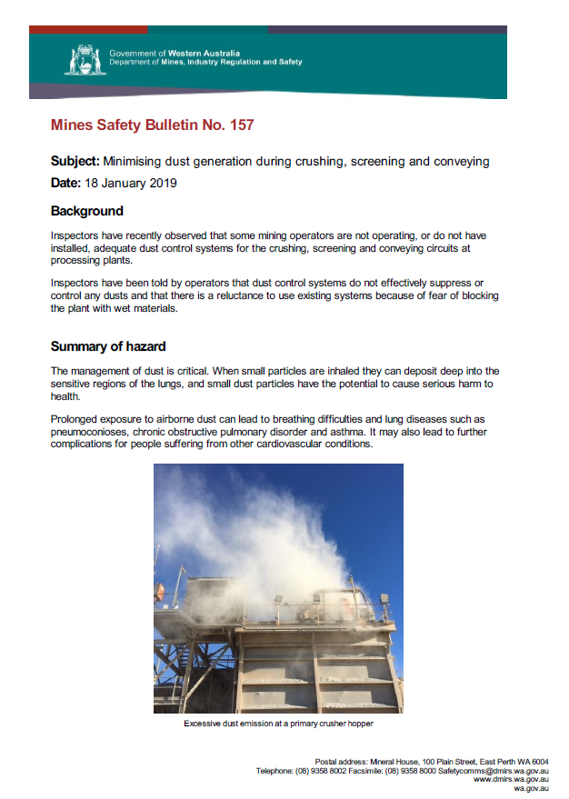
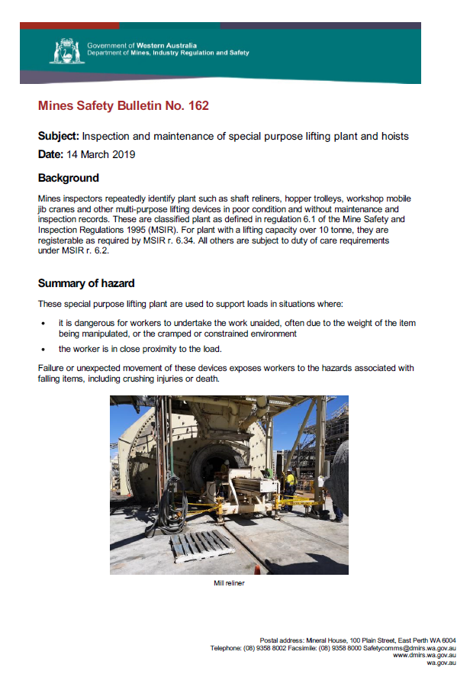
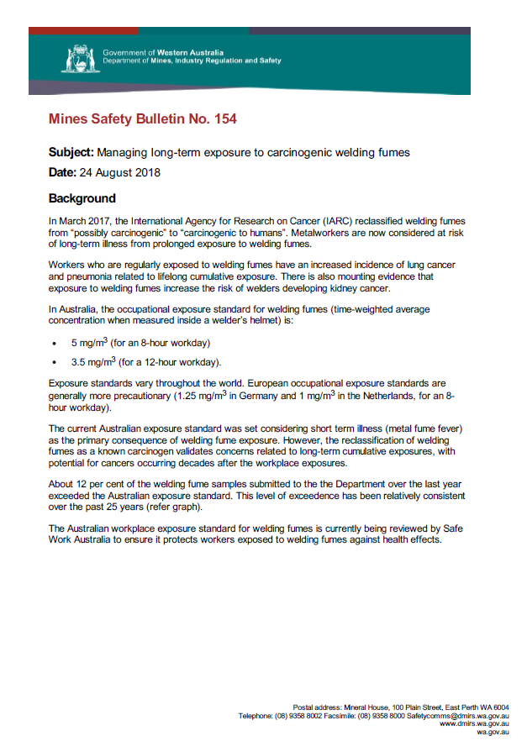
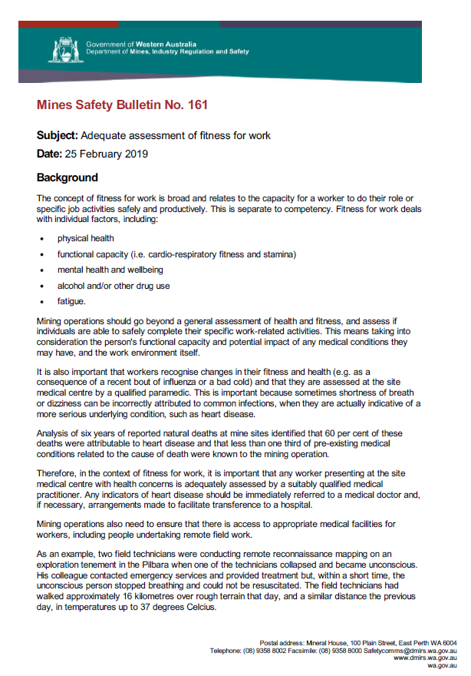
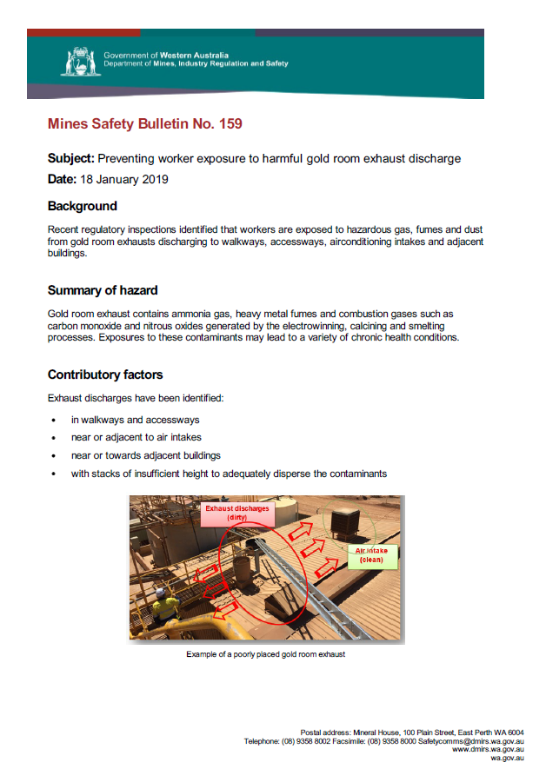
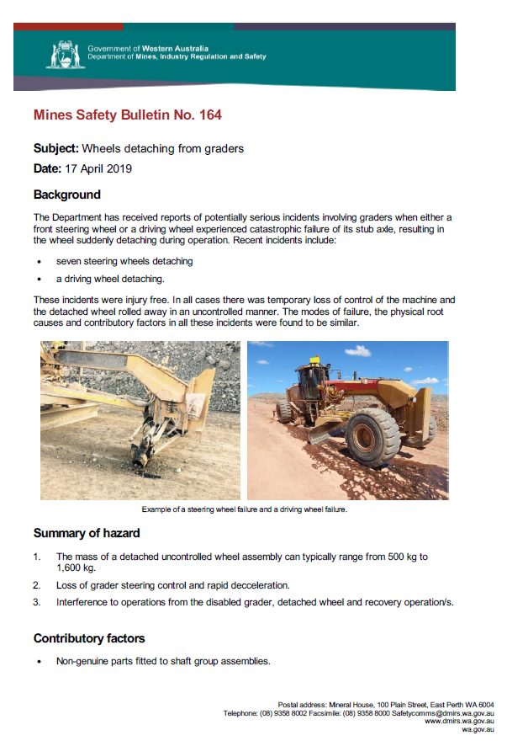
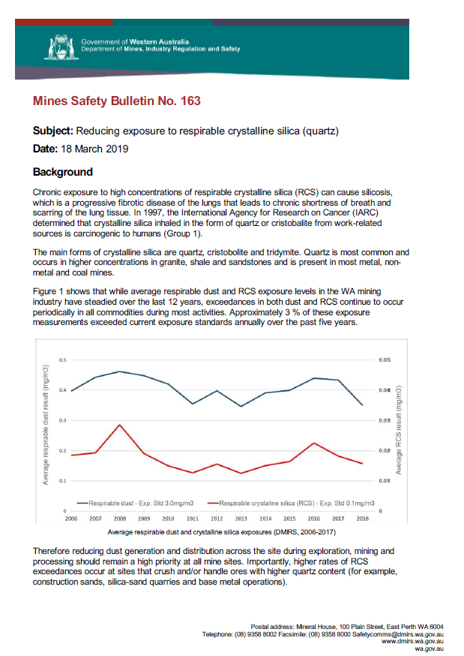
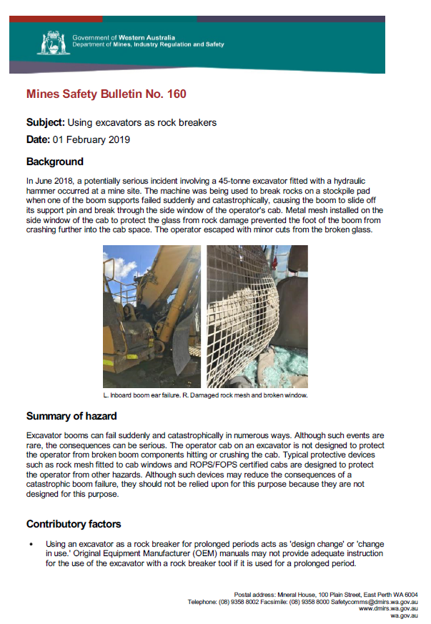
Since the last Registered Managers Forum…
13 Mining Safety Bulletins (MSBs)
Notes:
13 Mines Safety Bulletins since the 2018 Registered Managers forum

Slide 26
Investigations and resulting prosecutions
Notes:
4 other matters in court at the moment, and 16 completed investigations under legal review.

Slide 27
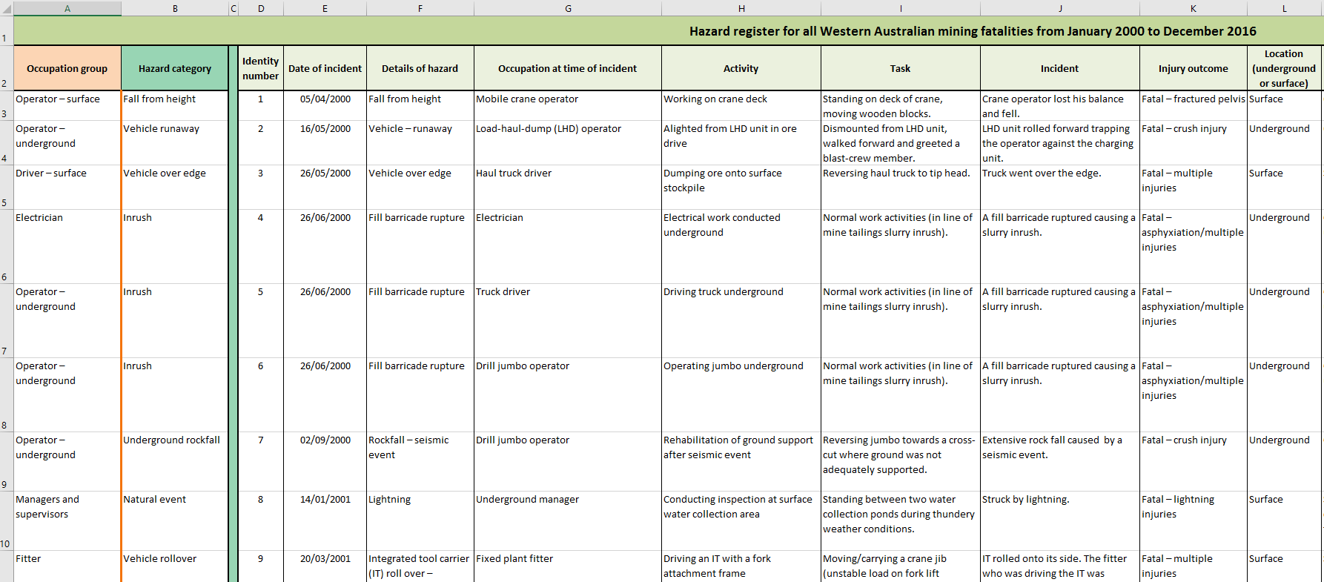
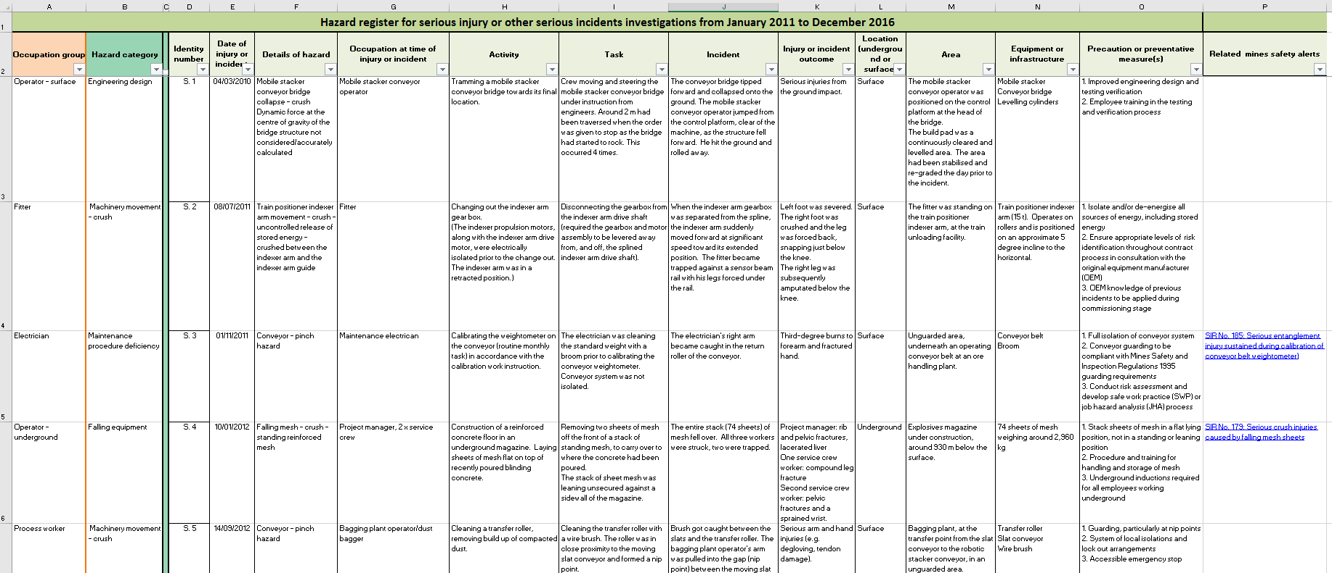
Applying the learnings – Hazard registers
Available at www.dmirs.wa.gov.au
Notes:
We are not finding new ways of hurting

Slide 29
Safe work month
Focus area: A collective effort across the Safety Regulation Group to promote the importance of workplace safety and health. The theme for 2019 is Building healthy and safe workplaces
Update on progress:
Events hosted by Safety Regulation Group Directorates to be held across October. Includes:
Mental Health week
Worksafe workshops and forums
Mines Safety Roadshow
Work Health and Safety Excellence Awards.

Slide 30
Work Health and Safety Excellence Awards
Focus area: The inaugural Work Health and Safety Excellence Awards recognise outstanding solutions and innovations to specific workplace health and safety problems in WA
Update on progress:
WHS Excellences Awards – officially launched by Minister 4 April 2019
Nominations closed 7 June
Judging underway
Ceremony to be held 2 October
Subscribe to our news alerts for tickets.

Slide 31
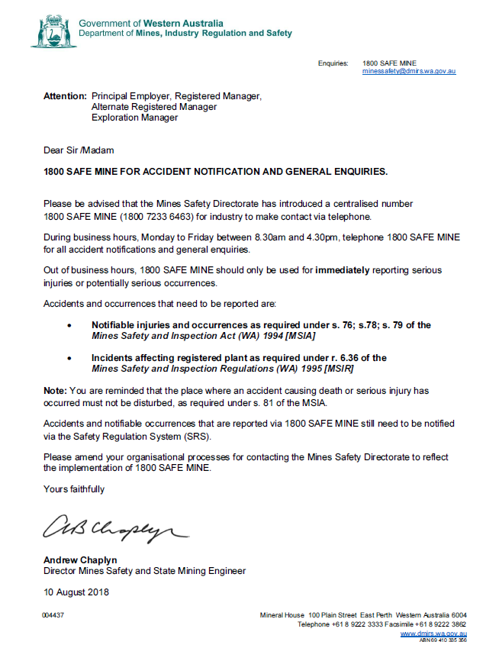
1 800 SAFE MINE

Slide 32
Notes:
85 of the participants at the forum described their take away message from the event

Slide 33
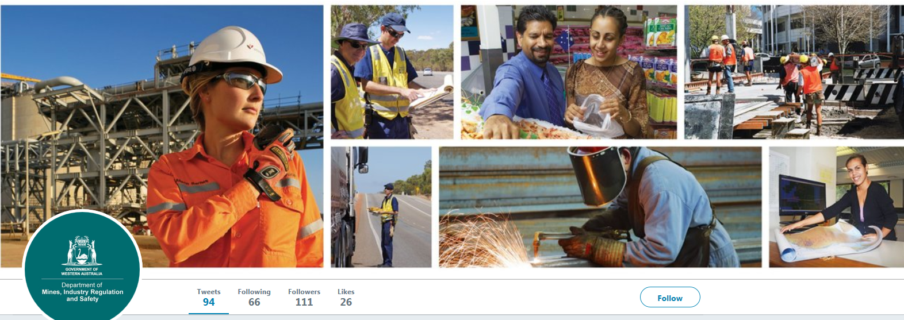
Follow us on social media and sign up for news alerts!
Twitter
@DMIRS_WA
@AndrewChaplyn
LinkedIn at Department of
Mines, Industry Regulation and Safety
Sign up to receive weekly news alerts @ www.dmirs.wa.gov.au
Notes:
Add slide about awards

