Slide 1

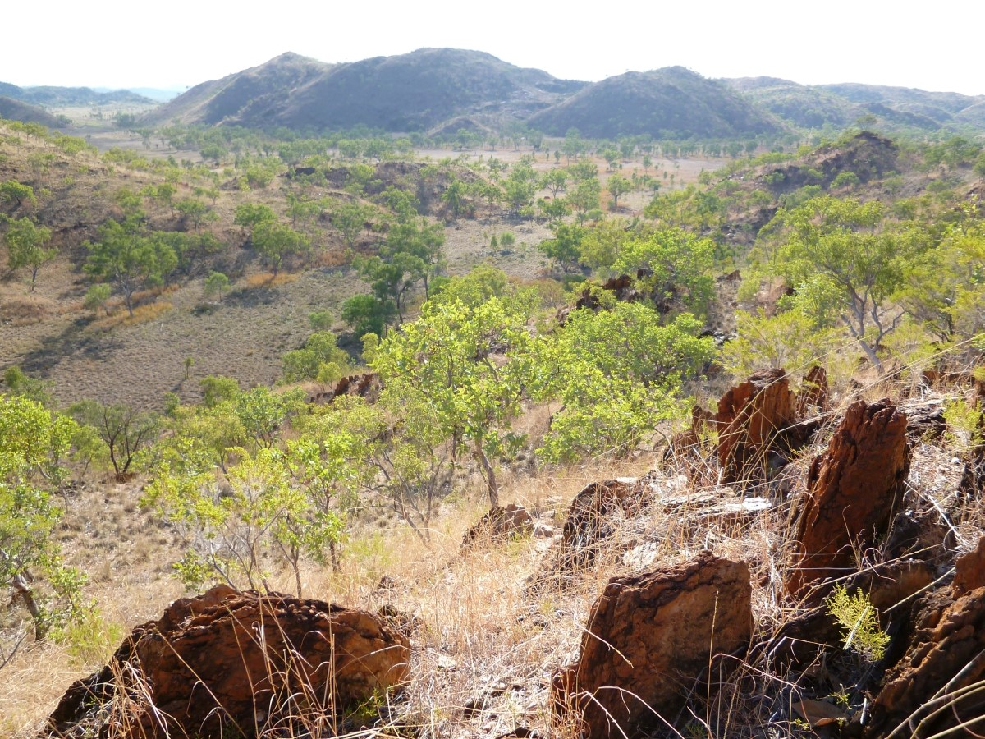
GSWA Open Day 2020
The last gasp of King Leopold: New insights into the evolution of the West Kimberley
Presented by
Imogen Fielding

Slide 2
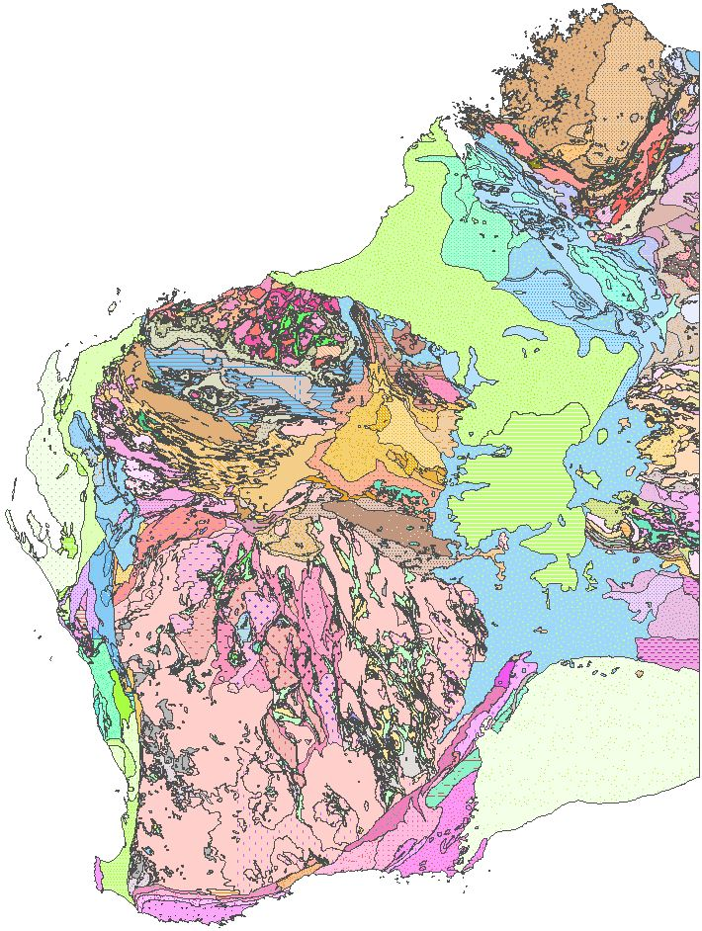
State metamorphic mapping project
External studies (not exhaustive)
Recent (post-2010)
Older (pre-2010) or less robust
Pressure (P)–Temperature (T)–time (t) data
Defining the tectonic evolution of the State
Methods
  P–T estimates
    phase equilibria modelling
    thermobarometry, mineral chemistry
  (t) in situ monazite geochronology
    dating metamorphism and fabric development
GSWA studies
Completed
In progress
Planned

Slide 3
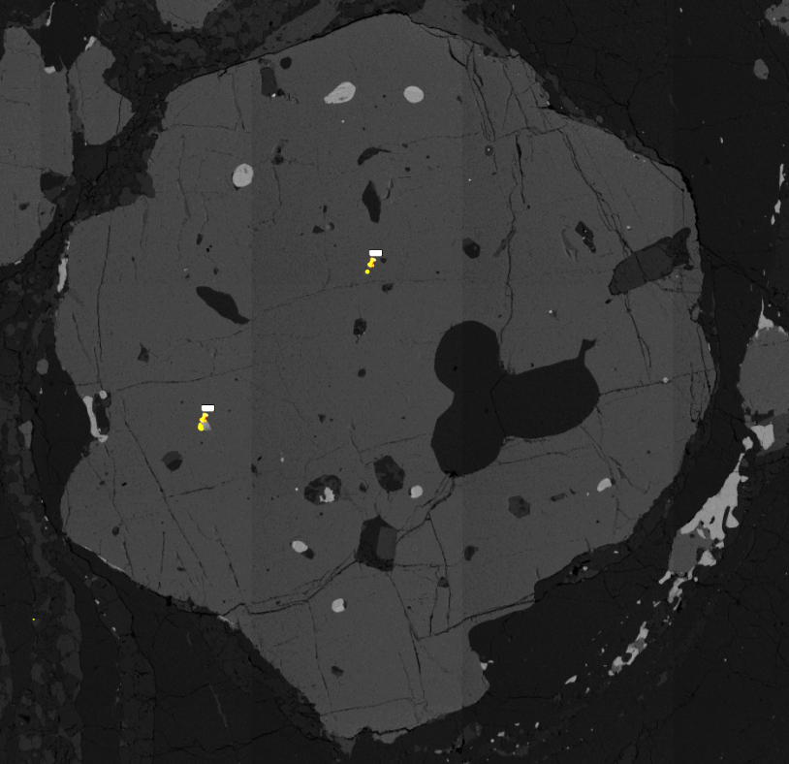
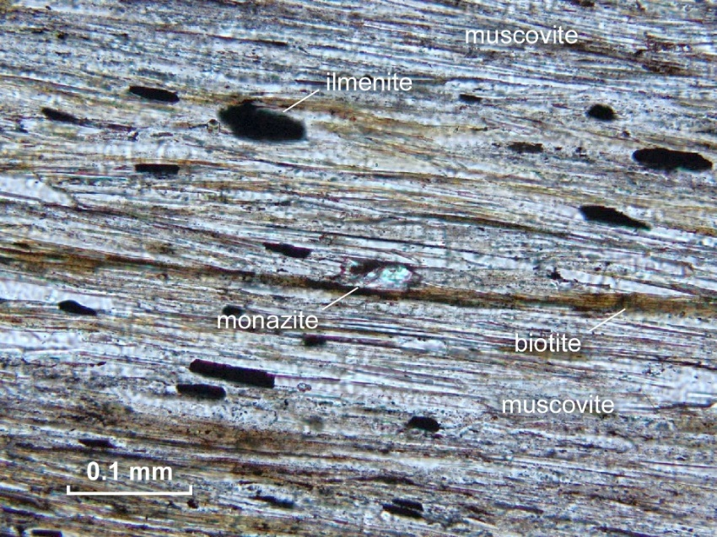
In situ monazite geochronology
In situ analyses
  textural setting preserved
    metamorphism mineral assemblages
    monazite aligned in fabrics
  small grains analysed
Why monazite?
  REE-rich phosphate mineral
  grows during metamorphism and hydrothermal activity
  dissolution–reprecipitation reactions can mean multiple ages preserved
  low common–Pb
Garnet with monazite inclusion

Slide 4
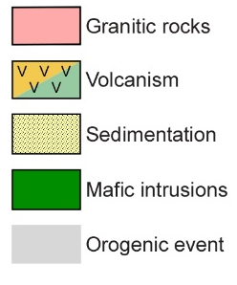
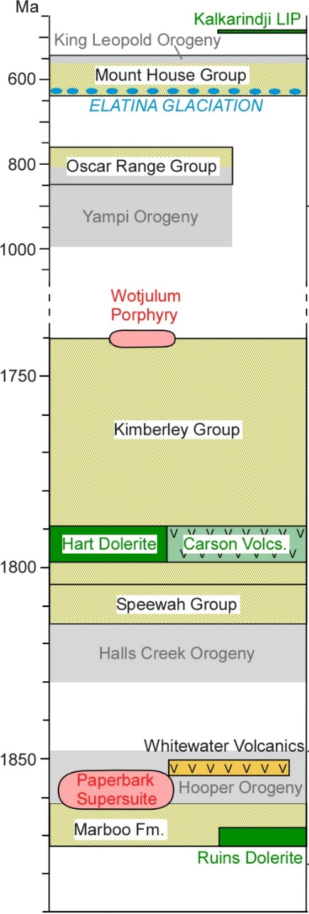
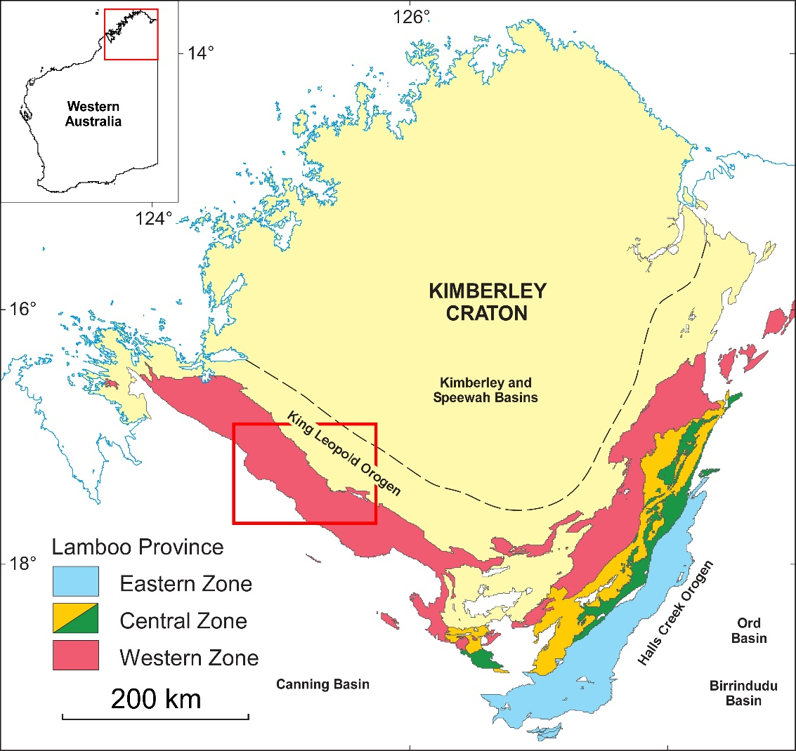
King Leopold Orogen
King Leopold Orogen
Lamboo Province – Western Zone
Paleoproterozoic metasedimentary and igneous rock
4 orogenic events
1870–1850 Ma Hooper Orogeny
1835–1805 Ma Halls Creek Orogeny
1400–1000 Ma Yampi Orogeny
670–510 Ma King Leopold Orogeny

Slide 5
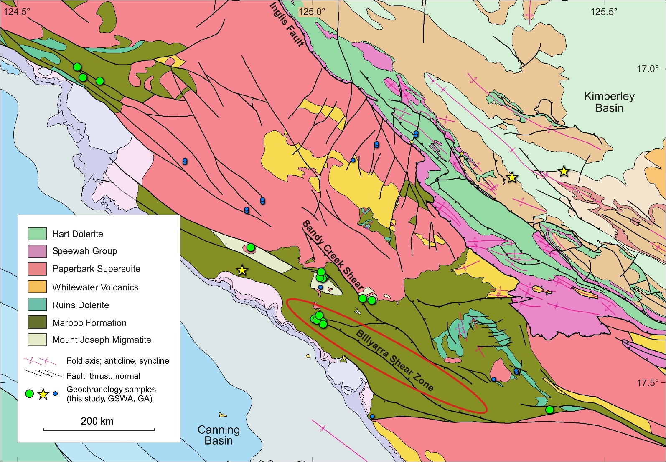

Project aims
P–T–t data for the King Leopold Orogen
Faults thought to have formed during the 1400–1000 Ma Yampi Orogeny

Slide 6
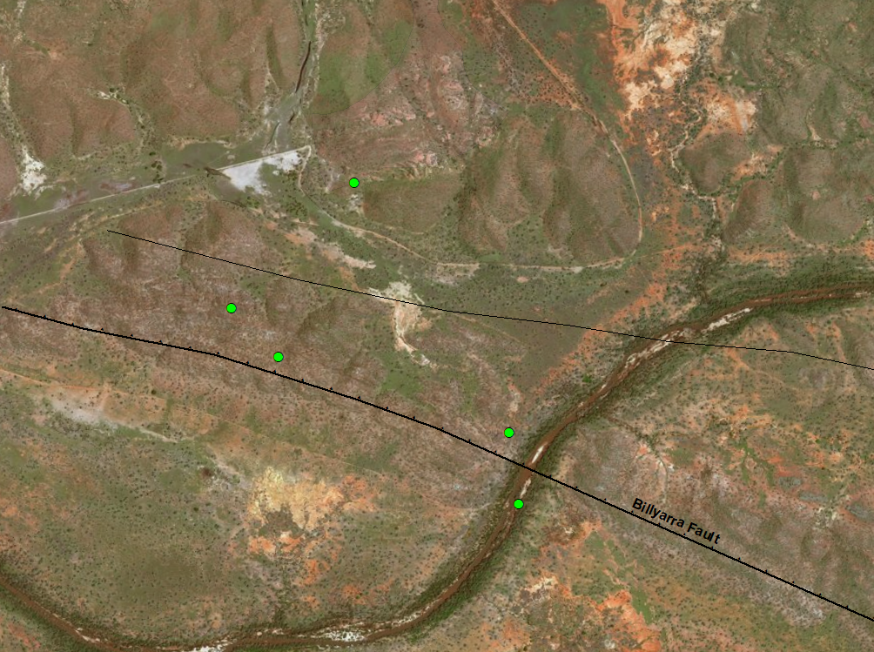
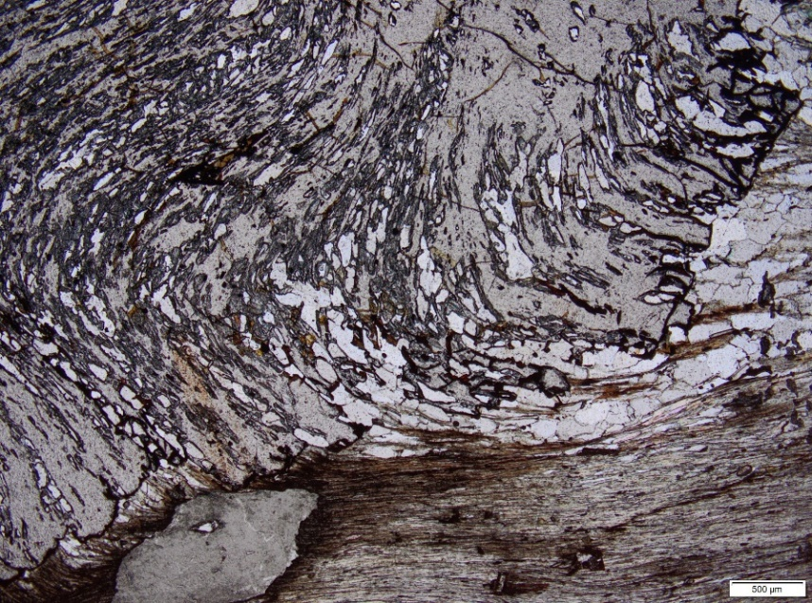
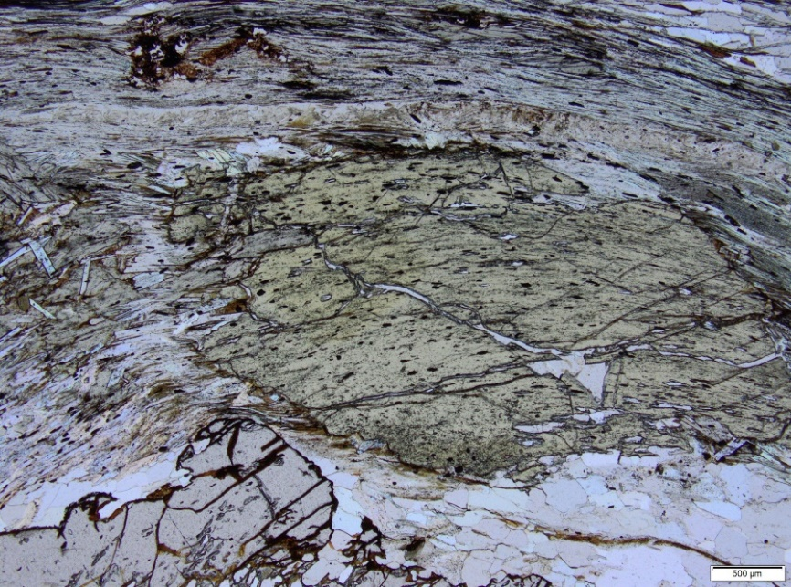
Linking metamorphism and deformation
Garnet–staurolite schist
Foliation defined by muscovite + biotite + quartz
Garnet has helical inclusion trails
Inclusion trails in garnet and staurolite aligned in fabric
210674
biotite/muscovite
Granite
garnet
210673
210664
staurolite
210670
210671
95536
Marboo Formation
1 km
biotite/muscovite
quartz
garnet

Slide 7
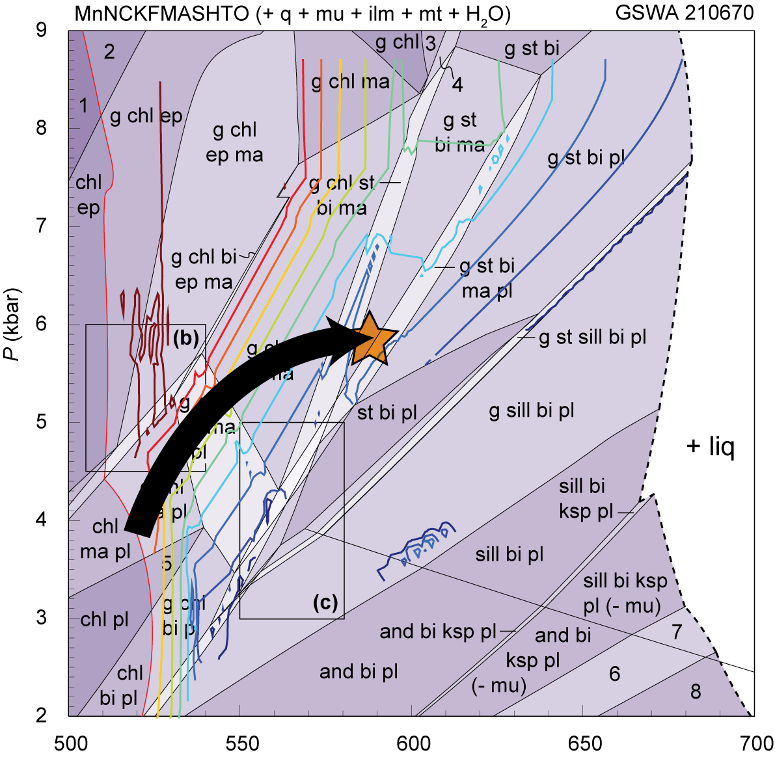
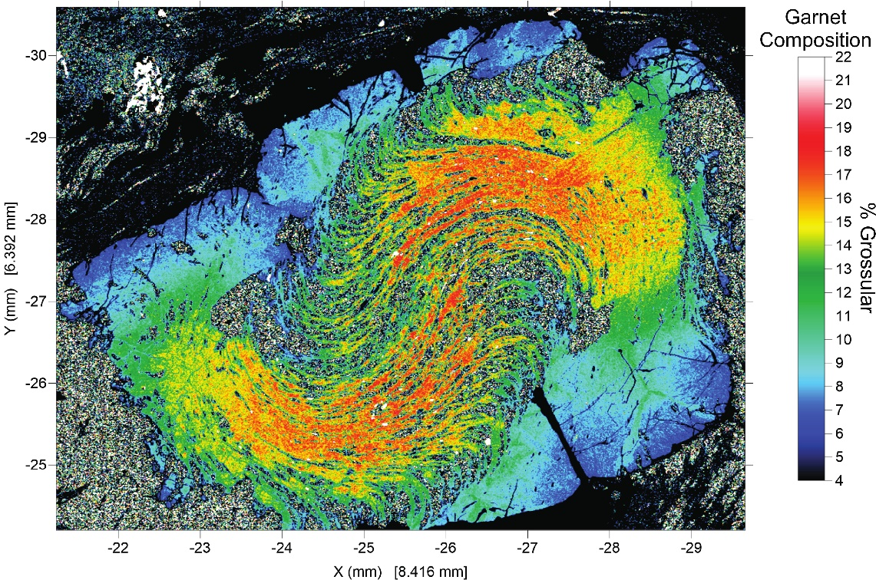
Pressure (P) – temperature (T) estimates
Garnet + staurolite + biotite + muscovite
Peak conditions 580–630°C and
5–6 kbar
Crustal thickening
15
13
Depth (km)
10
T (°C)

Slide 8
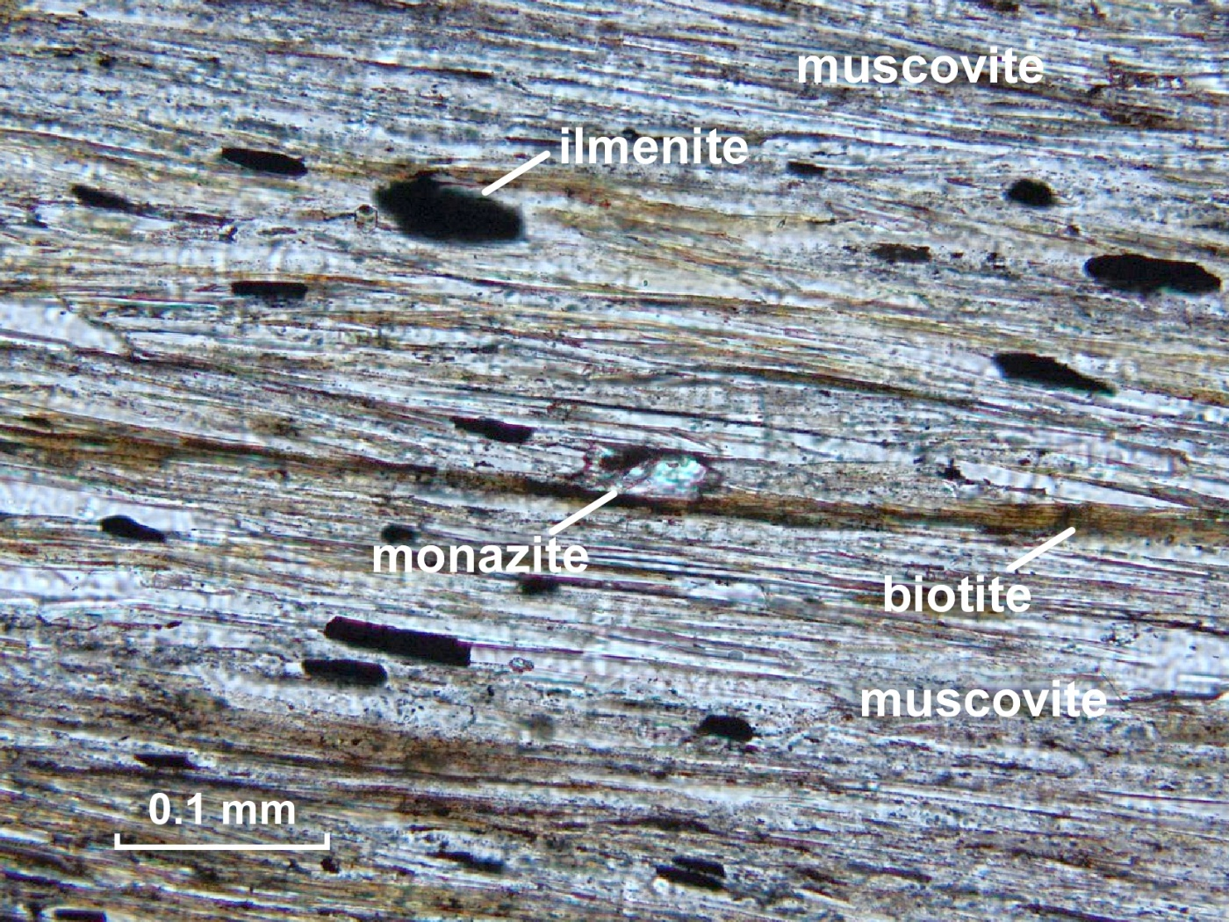
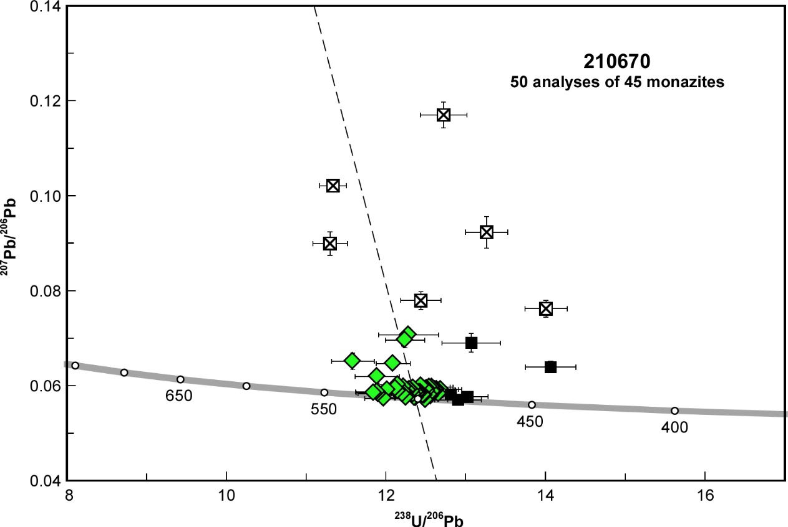
Proximal to Billyarra Shear Zone
Monazite aligned in fabric
502 ± 3 Ma (n = 50; MSWD = 0.94)
502 ± 3 Ma

Slide 9
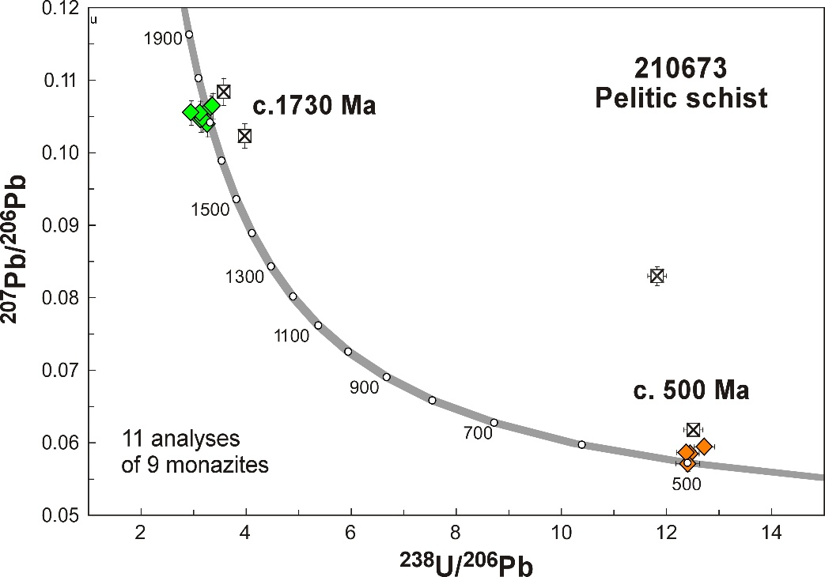
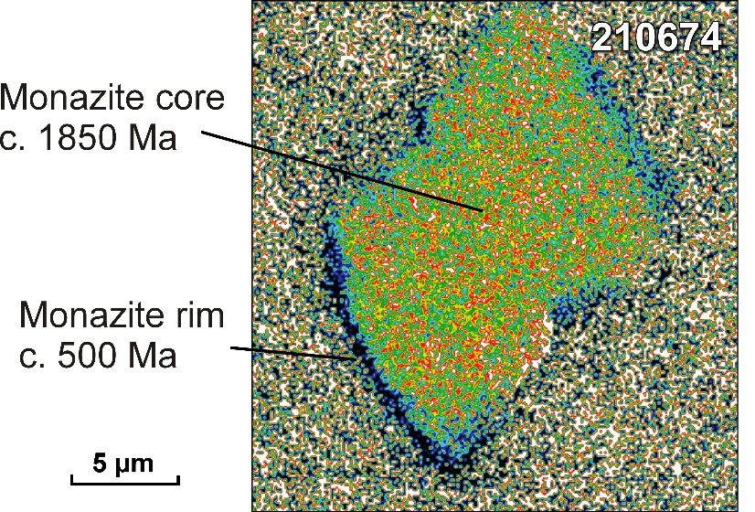
Distal to Billyarra Shear Zone
Preservation of Paleoproterozoic metamorphism
210673 c. 500 and 1730 Ma (preliminary results)
210674 EPMA maps show c. 1850 Ma core and narrow c. 500 Ma rim
210674
Granite
210673
Marboo Formation
505 ± 5 Ma
502 ± 3 Ma
501 ± 3 Ma
c. 500 Ma
1 km

Slide 10
Conclusions
Fault movement previously linked to the 1400–1000 Ma Yampi Orogeny
However:
  geochronology indicates deformation occurred at c. 500 Ma
  accompanied by a significant metamorphic event
    Barrovian-style (regional) metamorphism to a minimum depth of ~13 km
    hydration along active shear zones promotes equilibration during this event
No evidence of the Yampi Orogeny
Extension of the 670–510 Ma King Leopold Orogeny

