Slide 1
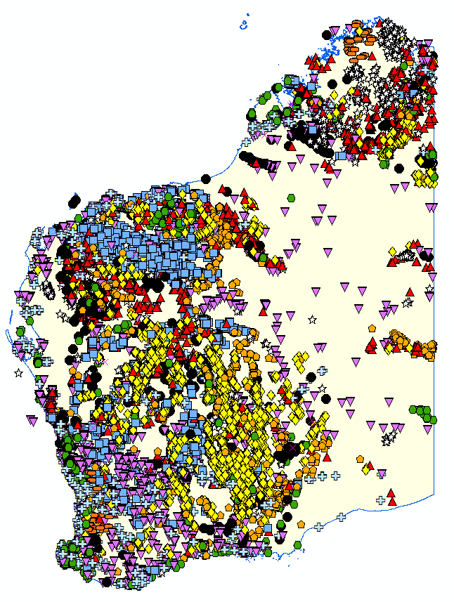
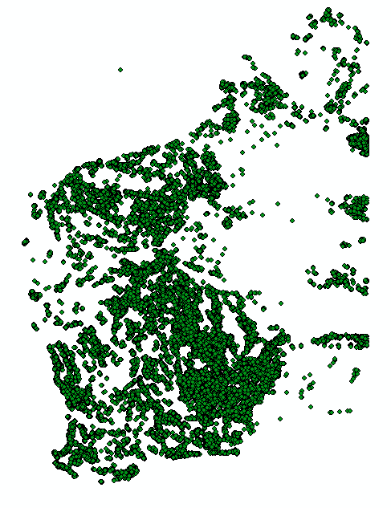
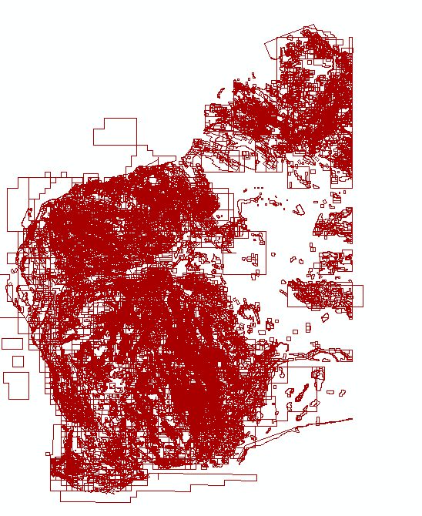
Smart exploration starts with
WA’s rich data endowment
“Where there is Data Smoke, there is Business Fire”*
Activity
points
Drilling data
*Data Driven: Profiting from Your Most Important Business Asset
by T.C. Redman
Reports
Presented by
Nicole Wyche, Felicia Irimies, & Julia Thom
Statutory & Resource Information Branch
Notes:
Data is the lifeblood of the exploration industry, and we are here to show you where to find it. The quote on this slide is from a book called Data Driven – Profiting from your most important business asset. The state of WA has an enormous data asset for your use, and this asset is managed by the SRI branch of the Geological Survey of Western Australia.

Slide 2
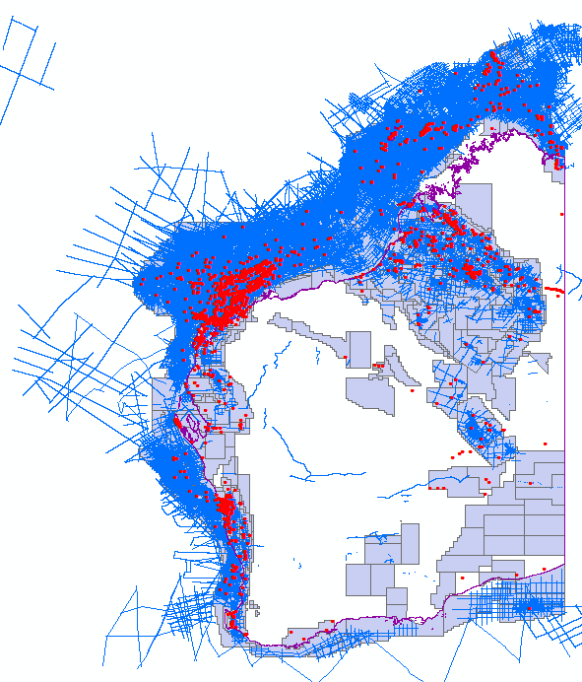
SRI Mission
Data custodians for mineral exploration and mining data, and petroleum exploration data generated in Western Australia
Ensure compliant reporting of company data
Information providers who save you time and money!
Your source of good reporting and data searching advice
Data delivered free of charge using three databases:
Mines & Mineral Deposits database (MINEDEX)
WA Petroleum Information Management System (WAPIMS)
WA Mineral Exploration Reports database (WAMEX)
Petroleum data
Notes:
Our branch has 4 main roles. Most importantly, we are the custodians for all mineral exploration, mining, and petroleum exploration data generated in Western Australia. In accordance with legislation, explorers using our lands must report the data they acquire to us. We ensure that this data is reported in a compliant, consistent and useful way. We are available to help you both submit and access this data. We make our enormous datasets available for everyone’s use, using our three main databases. These are…..

Slide 3
BIG data = BIG value for exploration
Don’t reinvent the wheel – search for existing data first! We have:
106,860 mineral exploration reports from 1957 to today. In 2018 -19, WA mineral exploration expenditure was $1.4 billion (ABS data). At this rate of spending, over the last 20 years the report dataset has grown to a value >$20 billion
Information from 1.7 million drill holes. Estimated value $7,7 billion*
Mineral drill core in the Core Library valued at $86 million*
1 Petabyte (10¹⁵) of petroleum exploration data including:
4385 petroleum boreholes, value >$70 billion
2148 geophysical surveys, value >$6 billion
*cost to drill
Reports
Drilling
$ values AUD
Notes:
Even before you start your exploration or research program, you already have a huge amount of results available to you. We encourage you to start with our datasets, which cover most of the state. That might be all it takes to find something overlooked by others. While we cannot say for sure how many superpits are waiting to be discovered in our databases, we can tell you how much data we have, and also give you an estimate of what the cost to you might be, if you were to collect this data yourself.
We have over 106,000 mineral exploration reports, documenting over 60 years of exploration results. Every year, more that 1.4 billion dollars is spent on exploration in WA, and most of this generates data that is reported to us. If we consider this investment rate over a 20 year period, we can very conservatively value our reports at upwards of 20 billion dollars. Our databases have 1.7 million drill holes and related results. The drilling costs alone for this dataset total almost 8 billion dollars. We have a further 86 million dollars of example drill core from top WA deposits available for viewing in our two Core Libraries.
If anyone feels these are large numbers, these pale in comparison compared to our petroleum exploration datasets. Our current holdings measure at 1 Petabyte of data, including over 70 billion dollars of borehole and geophysical survey data.
When valuing our data holdings, we have used only drilling or sampling costs, meaning the real value of this dataset is higher still. Our wish is that we can transfer as much of this value as possible to your projects.

Slide 4
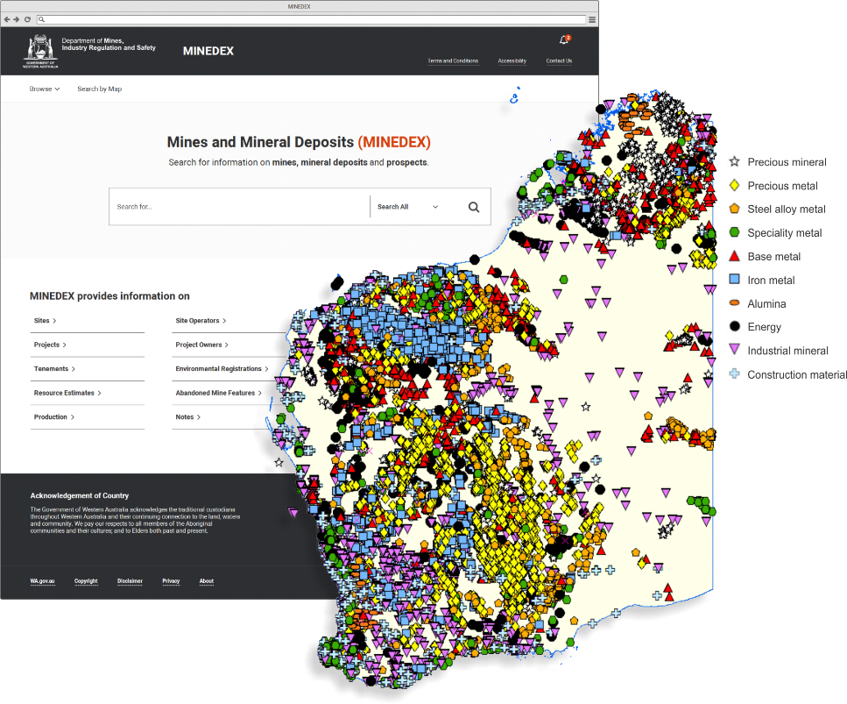
MINEDEX – Mineral activity tracking
Mines & Mineral Deposits database (MINEDEX)
Presented by
Nicole Wyche
Manager – Statutory & Resource Information Branch
Notes:
Next we will take a very brief look at our three databases. If you visit our poster afterwards, we can also demonstrate them live. Of course you can also call us for assistance. My name is NW and I am the Manager of the SRIB. I will start by talking about our MINEDEX database. Explained simply, MINEDEX aims to create a point for every site of mineral industry activity in WA (as you can see on this map), and attach as much information to that point as possible. Like all our databases, MINEDEX is free to use without registration.

Slide 5
MINEDEX
A textual and spatial database of WA mines, mineral occurrences and mining infrastructure
Site locations, operating status and history
Project structure & ownership history
Commodities, resources, production data
Environmental registrations & tenements
Site operators
Spatial locations relative to other datasets
Inventory of Abandoned Mine Sites
Unique site and project identifier codes
Notes:
MINEDEX is both a textual and spatial database. Text searching is available via the MINEDEX web interface. Spatial searching is available via our free GIS application GeoVIEW, and you can link between the two applications.
MINEDEX has information on mines, mineral occurrences and mining infrastructure. As well as site locations, you can find the current operating status of sites, and also the operating history. Sites a grouped into projects which reflect current industry projects. The history of the project, including past and present owners, is also available.
MINEDEX also contains commodity information including resource estimates and production data. You can also see what other datasets (such as map sheets and tenements) cover your point of interest, and view related environmental registration documents (such as mining proposals). MINEDEX also hosts the Abandoned Mine Sites dataset we heard about early today.
An important role of the MINEDEX database is that it creates unique site and project codes for tracking past and present industry activity thoughout our department.

Slide 6
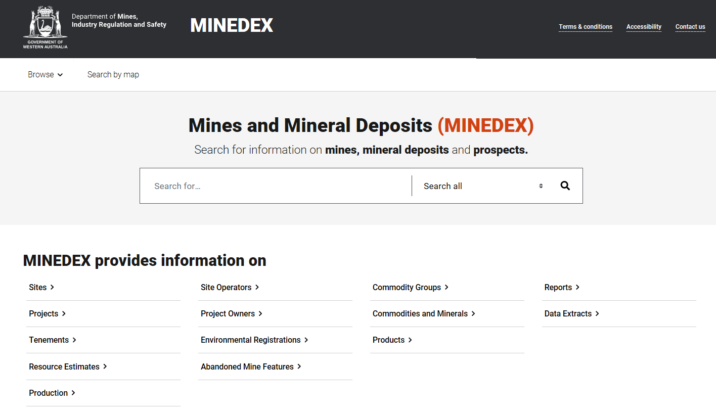
https://minedex.dmirs.wa.gov.au
New MINEDEX released in November 2019, offering:
Comprehensive searching (free text or by subject)
Custom reports
Complete export
Works on tablets and mobile phones
Improved accessibility for users with disabilities

Slide 7
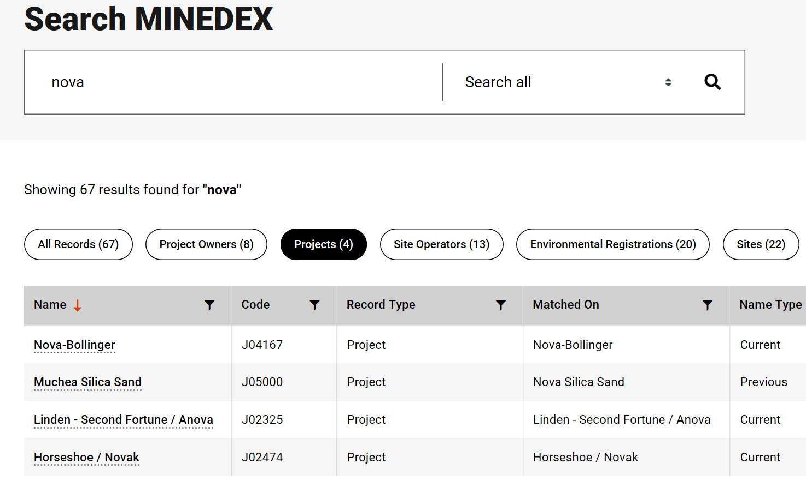
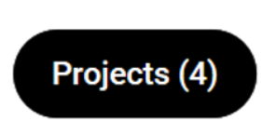
MINEDEX example search
Result by topic
header
click
Notes:
Simple search for Nova
Returns 67 records, and sorts these into topics (for example, there are 4 projects with Nova in the project name)
Clicking any link takes you to more levels of detail.
All grids can be sorted and filtered to help you search, and individual result grids can be exported.

Slide 8
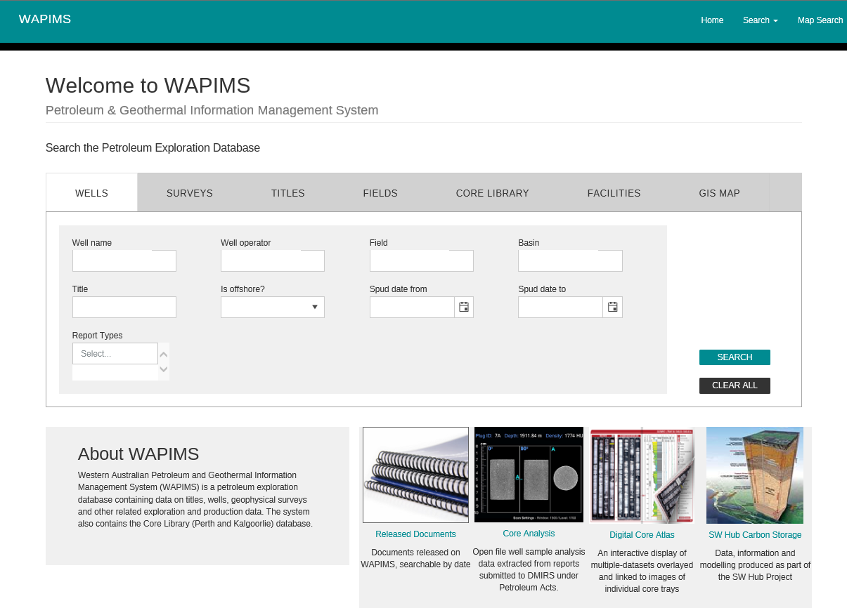
WAPIMS – Petroleum information & data delivery
WA Petroleum Information Management System (WAPIMS)
Presented by
Felicia Irimies
Manager – Petroleum Exploration
Information

Slide 9
https://wapims.dmp.wa.gov.au
WAPIMS holds all petroleum data submitted by companies as required by legislation, including
Wells (reports, logs, samples)
Surveys (field and processed data, reports, observer’s logs)
Titles (Annual Assessment Reports, reprocessing data)
General studies (sample analysis reports and data)
Data extracted from reports: biostratigraphy, formation tops, porosity, etc.
News and information about data releases
Request forms (core and sample loans)
Exporting and online data ordering functions, built-in spatial viewing

Slide 10
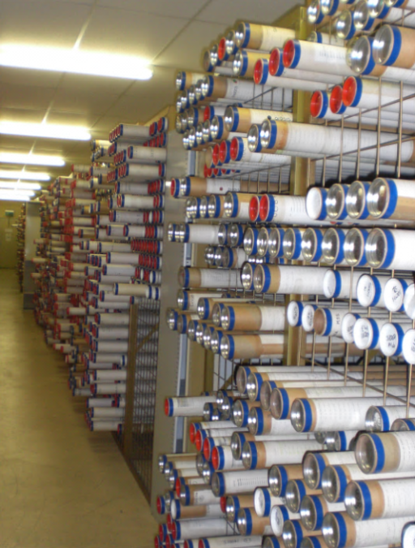
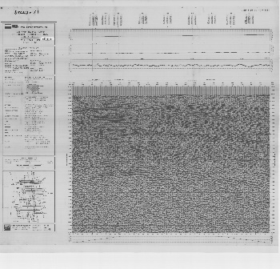
WAPIMS for petroleum data
Petroleum wells and survey data from WA
4385 petroleum boreholes
2148 surveys
Up to 1 Petabyte data (online and offline)
>55,000 core samples were taken from core library for research
>200,000 biostratigraphic and
petrology slides
Transcription programs
paper
image
Petroleum data
seg y

Slide 11
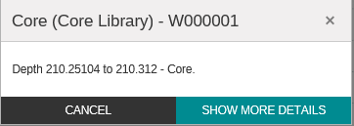
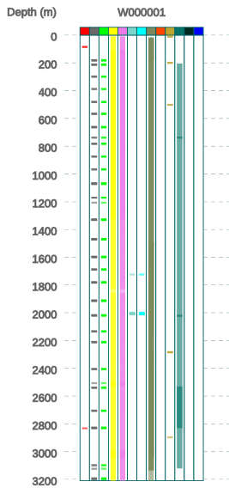
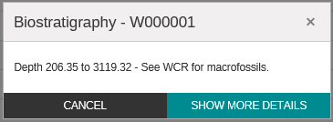
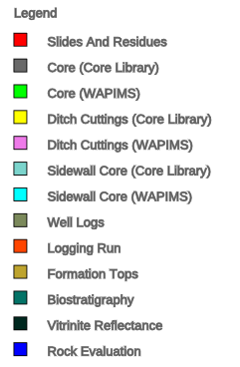
WAPIMS: Coming soon! – data by depth

Slide 12
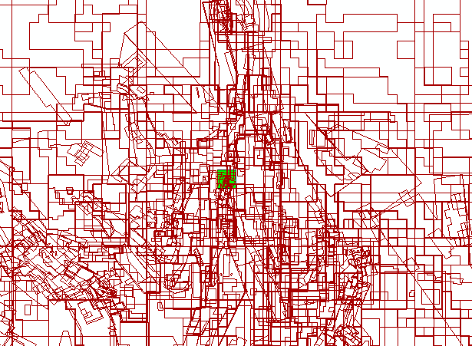
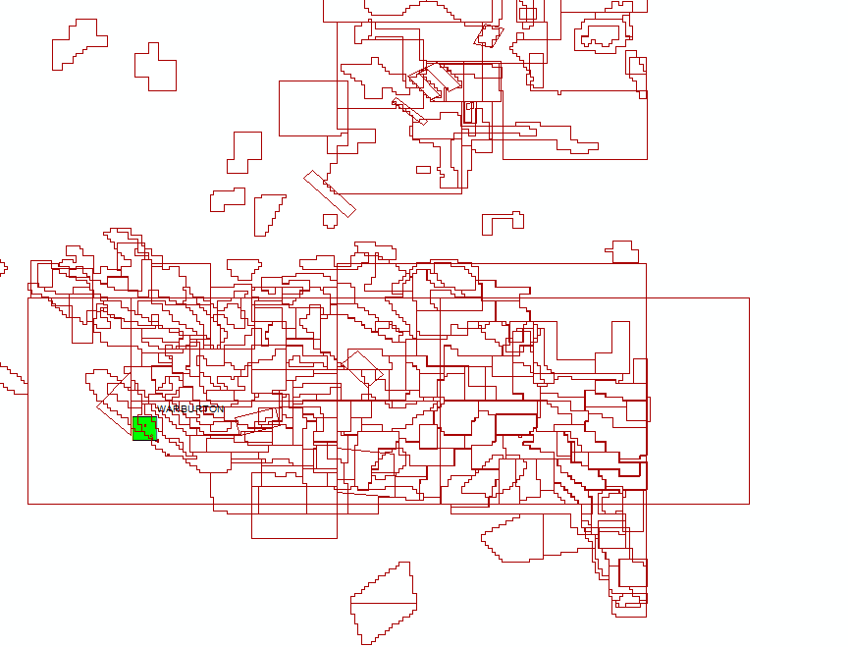
WAMEX – Where exploration starts
WA Mineral Exploration Reports (WAMEX)
Laverton
WA
Presented by
Julia Thom
Manager – Mineral Exploration
Information
Warburton
Available data from almost everywhere

Slide 13
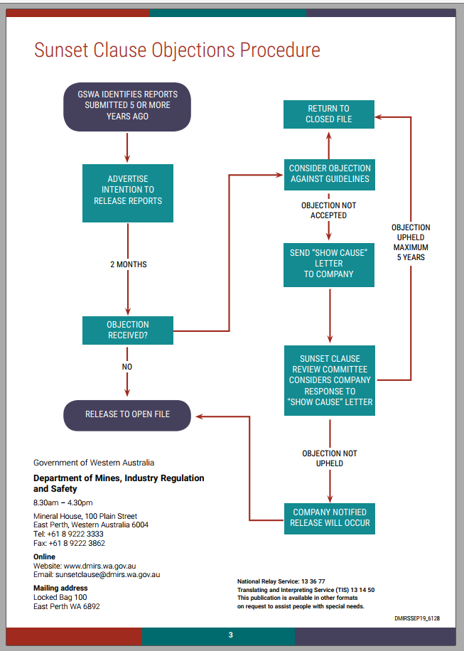
WAMEX – WA’s exploration data mine
WAMEX holds all Mineral Exploration Reports submitted by companies as required by legislation
Data from 1957, mandatory digital reporting since 2006
Reports and data remain confidential for 5 years
106,860 reports (93,815 open file), 90% spatially located
Free GIS searching
Notes:
The reports also include all digital data collected such as drilling and geochemistry, ground geophysical data etc.
Reports remain confidential for 5 years before they are release under the Sunset Clause.
Towards the end of last year we released a policy guideline and process late last year and we are working on having much more of the historical data in our database available to the public.

Slide 14
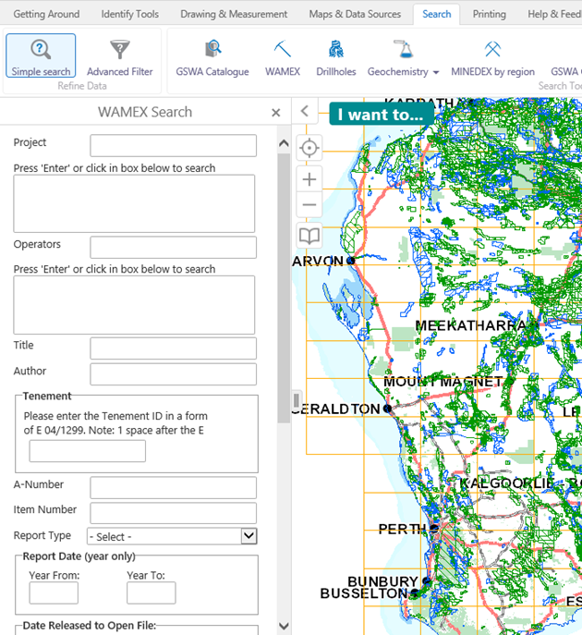
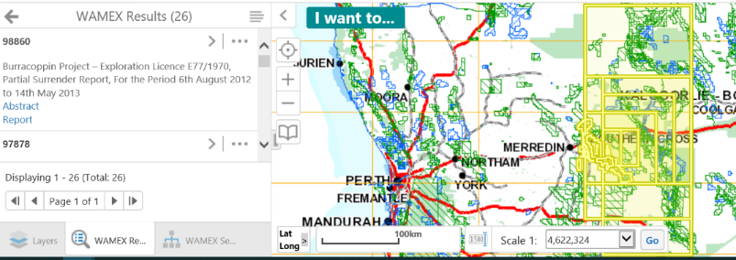
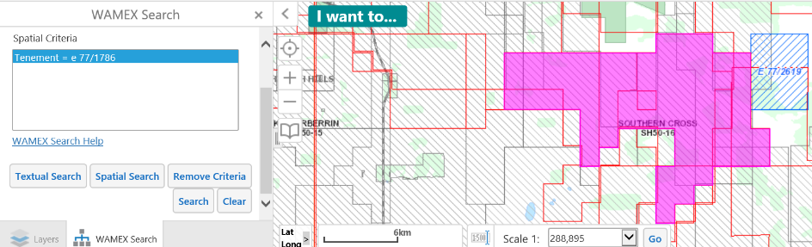
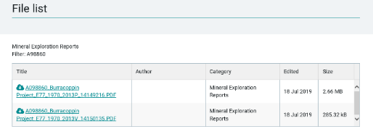
Searching WAMEX – how and why?
HOW
Searching the database is through GeoVIEW
- Textual searching (project name, company name, keyword)
- Spatial searching (current tenement, rectangle, polygon, map sheet)
Notes:
If you would like a demo come and see us and we will show you.
To make it easier you can get a complete set of all the documents and associated data on a 2Tb hard drive. Currently this is just a dump of all the reports in PDF and associated data files.
For the next update of the hard drive I will add the text of the abstracts for each report (better searching for you), including drilling and other statistics as well as an export of tenement numbers associated with each Anumber
Online lodgement allows the text of the report to be stored in the database itself thus making complete text searching possible.

Slide 15
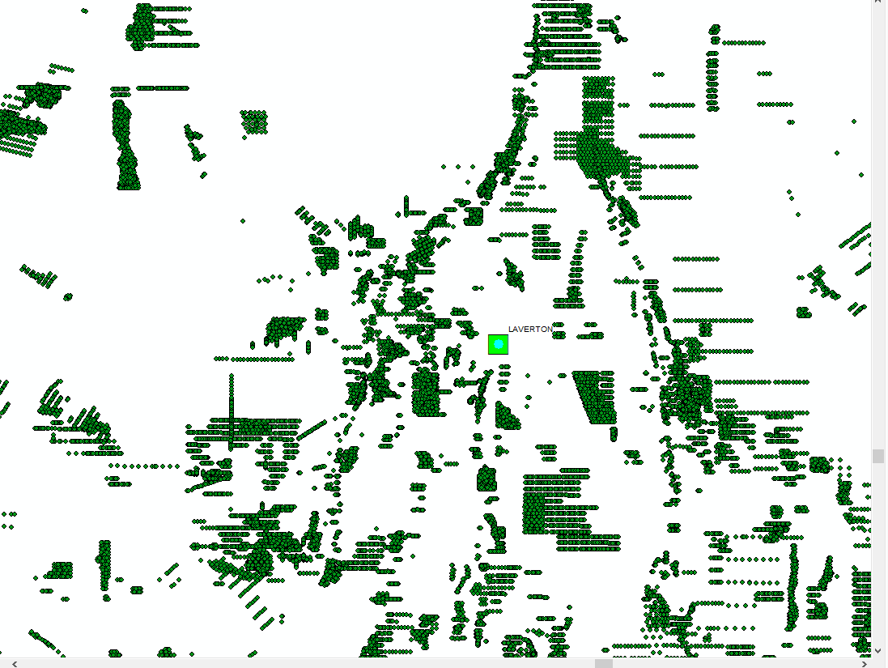
Drillhole & Geochemistry database
Company drill holes, geochemistry and more
1.7 million drill holes already drilled!
Over 10 million surface geochemistry sample assay results
Download geochemical data by tenement (by request)
Complete database available in SQL12 format
WA
Laverton
Notes:
The complete database (drillholes and surface geochemistry) is available on a 32 Gb hard drive. Requires SQL12 to install.

Slide 16
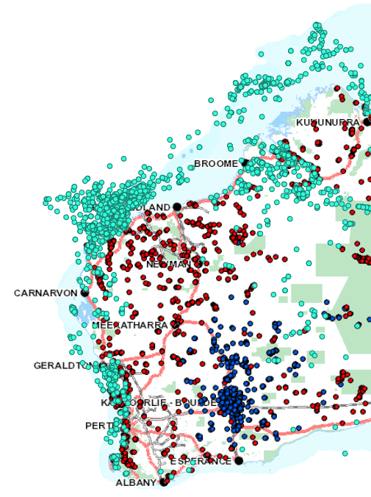
Core Library – mineral and petroleum core
Preserving representative examples of drilled assets
2 locations for mineral core – Perth and Kalgoorlie
690,000 m of mineral core available for viewing
300,000 m of petroleum core available for viewing in Perth
Limited sampling by approval (conditions apply)
Includes rare samples and core from locations that cannot be drilled again
Mineral core in Perth
Mineral core in Kalgoorlie
Petroleum wells
Notes:
Our representative drill core is available for viewing in two core libraries – 1 in Perth and 1 in Kalgoorlie. Petroleum core is held in our Perth Core Library, and mineral core in both locations depending on source area. We hold almost 700,000 m of mineral core and 300,000 of petroleum core. Holdings includes rare samples from areas that cannot be drilled again, and selections of core funded by the Explorations Incentive Scheme.

Slide 17
Training & database information 2020
We offer free training and information sessions. 2020 dates:
Perth
26 March, 9 July, 5 November WAMEX (includes drill holes and geochemistry), MINEDEX
Kalgoorlie
16 April and 29 September GeoMap, GeoVIEW, TENGRAPH Web, WAMEX, MINEDEX, Data & Software Centre, USB products and eBookshop
Go to http://www.dmp.wa.gov.au/Geological-Survey/Training to register

Slide 18
Contact us
MINEDEX minedex@dmirs.wa.gov.au
WAPIMS petdata@dmirs.wa.gov.au
WAMEX wamex.enquiries@dmirs.wa.gov.au
We welcome feedback and suggestions on the management of our state data assets

