Slide 1
World’s oldest regional salt seal in the Amadeus and Officer Basins: implications for subsalt helium and hydrocarbons
Peter Haines

Slide 2
Talk outline
Helium introduction
Helium in hydrocarbon reservoirs
Geological requirements for commercial helium accumulations
Why Western Australia may a good place to explore
Amadeus Basin
Officer Basin
Conclusions

Slide 3
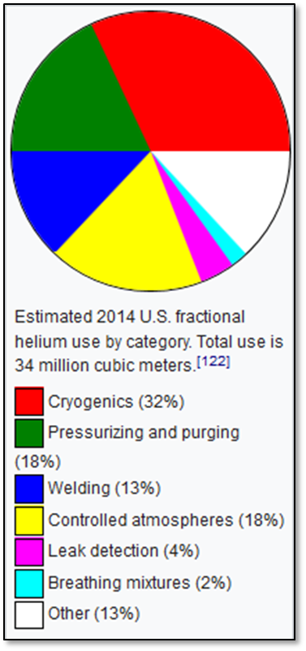
Helium (He)
Helium properties
Second lightest element
Second most abundant element in visible universe
Noble gas / inert
Lowest boiling point (-269˚C)
Very high demand with numerous hi-tech uses
Primordial He mainly found in mantle; crustal He constantly generated by radioactive decay of U and Th (α-particle = He nucleus)
Highly mobile due to inertness and small atom size; most free He in the crust lost into space over geological time

Slide 4
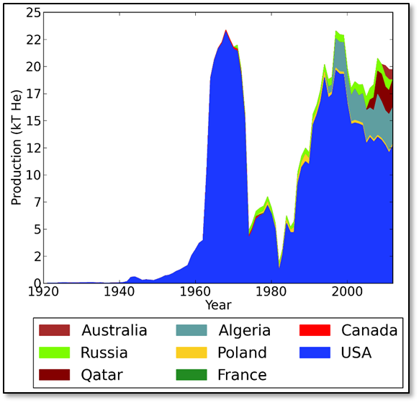
Helium in hydrocarbon reservoirs
Most commercial He a bi-product of hydrocarbon production; separated from waste gas stream (rare He-only wells)
Small concentrations (<<1%) can be economic, depending on infrastructure and markets
High concentrations (>1%) are rare
US first and biggest producer (since 1920s); stockpiled He (National Helium Reserve) in depleted Texas gas field until mid-1990s
Non-US production only significant since 1990s
Australia producing He from Bayu-Undan field offshore Bonaparte Basin since 2010 (~0.1% He at wellhead)

Slide 5
Geological requirements for commercial helium accumulations
A He source: radiogenic U-Th bearing rocks in basement or within a basin
A migration pathway (access to gas phase in pore fluid)
A porous reservoir and trap (same as conventional hydrocarbons)
Excellent seal due to high mobility; best seals are salt (halite, anhydrite)
Lots of time because He generation/accumulation is very slow
Coexisting hydrocarbon source; but a prolific source may reduce He concentration
Therefore for highest He concentration (>1%) look in old basins with marginal hydrocarbon source rocks and intact salt seals over early formed traps (in US most production from Paleozoic fields with late Paleozoic salt seal)

Slide 6
Relevance to WA?
Extensive old basins (Paleozoic, Neoproterozoic, and older)
Radiogenic basement common
Multiple old salt deposits including world’s oldest basin-scale salt deposits (~800 Ma) in Officer and Amadeus basins; possibly extending elsewhere in the Centralian Superbasin
Due to long periods of stability since the Paleozoic the salt has potential to seals traps dating from the Paleozoic or even Neoproterozoic

Slide 7
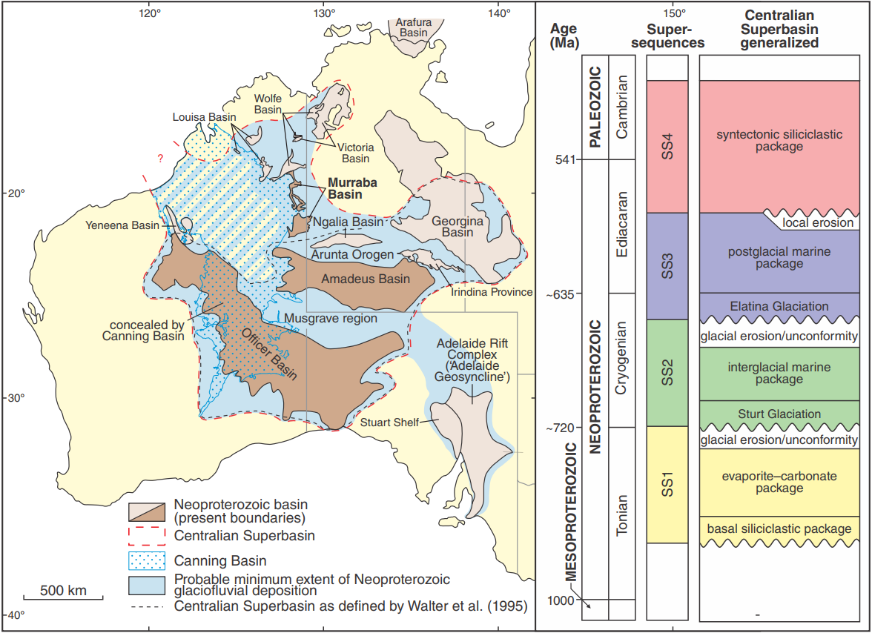
Centralian Superbasin
Modified from Munson 2013
NTGS Spec Pub 5
Centralian Superbasin
(Post mid-Cambrian omitted)
Tectonized Centralian
Superbasin under
Canning Basin
Super-
sequences
Generalized succession
Cambrian
541 Ma
SS4
Syntectonic siliciclastic package
Ediacaran
SS3
Post-glacial marine package
Neoproterozoic
~635 Ma
Elatina (“Marinoan”) Glaciation
glacial erosion / unconformity
Cryogenian
SS2
Inter-glacial marine package
~720 Ma
Sturt (“Sturtian”) Glaciation
glacial erosion / unconformity
Tonian
SS1
Evaporite–carbonate–shale package
Basal siliciclastic package
1000 Ma
Mesoproterozoic

Slide 8
Centralian Superbasin
Modified from Munson 2013
NTGS Spec Pub 5
Centralian Superbasin
(Post mid-Cambrian omitted)
Tectonized Centralian
Superbasin under
Canning Basin
Super-
sequences
Generalized succession
Cambrian
541 Ma
SS4
Syntectonic siliciclastic package
?
?
?
Ediacaran
?
?
SS3
Post-glacial marine package
Neoproterozoic
~635 Ma
Elatina (“Marinoan”) Glaciation
glacial erosion / unconformity
?
?
Cryogenian
?
?
Inter-glacial marine package
?
SS2
?
Sturt (“Sturtian”) Glaciation
~720 Ma
glacial erosion / unconformity
?
Tonian
SS1
Evaporite–carbonate–shale package
Basal siliciclastic package
1000 Ma
Mesoproterozoic
Salt ~800 Ma (halite/anhydrite)

Slide 9
Amadeus – Officer Tonian correlations
Amadeus Basin
WA Officer Basin
~753 Ma volcanics
vvvvvvv
Wallara Formation
upper Buldya Group
Baicalia burra
Stromatolite Assemblage
Browne
Formation
Johnnys Creek Fm
‘upper Browne salt’
Supersequence 1
Buldya Group
Acaciella australica
Stromatolite Assemblage
Bitter Springs Gp
Loves Creek Fm
Woolnough Member
?
Gillen Formation
Tungussia erecta
‘Gillen salt’
‘lower Browne salt’
‘basal Gillen shale’
Lefroy Fm
?
Heavitree Fm,
Dean Qtz, Kulail Sst
Townsend
Quartzite
Reservoir
Hydrocarbon source
Stromatolites
Bitter Sp. Anomaly δ¹³C (~800 Ma)

Slide 10
Centralian Superbasin
Modified from Munson 2013
NTGS Spec Pub 5
Centralian Superbasin
(Post mid-Cambrian omitted)
Tectonized Centralian
Superbasin under
Canning Basin
Super-
sequences
Generalized succession
Cambrian
541 Ma
SS4
Syntectonic siliciclastic package
?
?
?
Ediacaran
?
?
SS3
Post-glacial marine package
GSWA Lancer 1
Dukas 1
Neoproterozoic
~635 Ma
Mt Kitty 1
Magee 1
Elatina (“Marinoan”) Glaciation
Yowalga 3
glacial erosion / unconformity
Kanpa 1A
?
Cryogenian
GSWA Empress 1A
?
?
Mulyawara 1
?
Inter-glacial marine package
?
SS2
Kutjara 1
?
Sturt (“Sturtian”) Glaciation
~720 Ma
glacial erosion / unconformity
?
Tonian
SS1
Evaporite–carbonate–shale package
Basal siliciclastic package
1000 Ma
Mesoproterozoic
Salt ~800 Ma (halite/anhydrite)

Slide 11
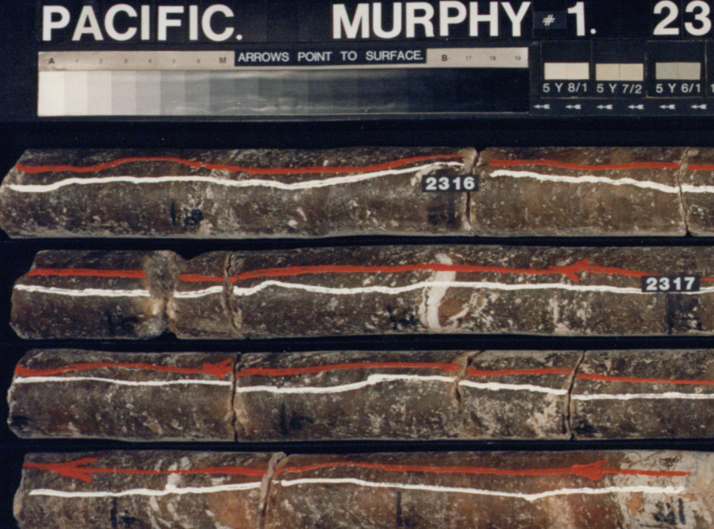
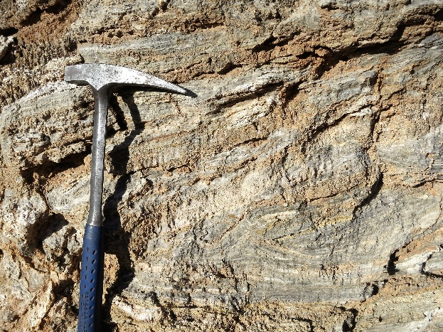
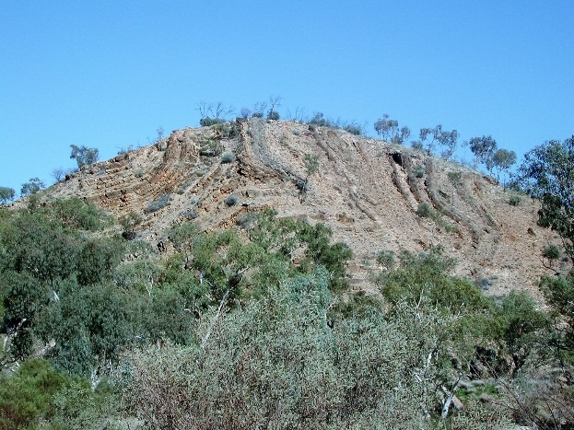
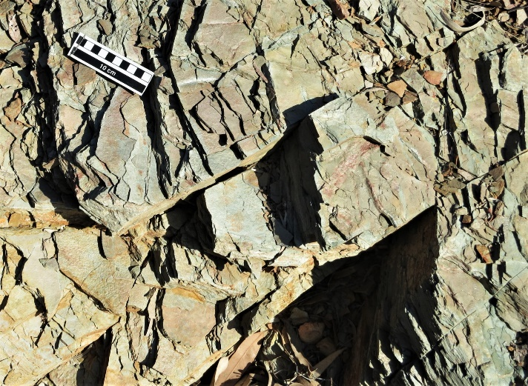
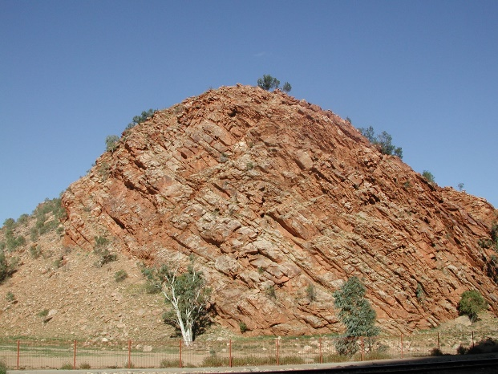
Eastern Amadeus Basin
Centralian Superbasin
Gillen Fm gypsum – Ringwood Dome, NT
Contorted Gillen Fm – Ellery Creek, NT
Gillen Fm salt – Murphy 1 WCR
Lower Gillen Fm shale – NT
Heavitree Fm – Alice Springs, NT
Johnnys Creek Fm
Bitter Sp Gp
Loves Creek Fm
Gillen Formation
salt
lower shale
Heavitree Fm
sandstone
Salt in upper Gillen Formation
Sub-salt black shales in NT drill holes (TOC up to 1.8%: Jarrett et al., 2016) are assumed source of sub-salt gas flows in Magee 1 and Mt Kitty 1

Slide 12
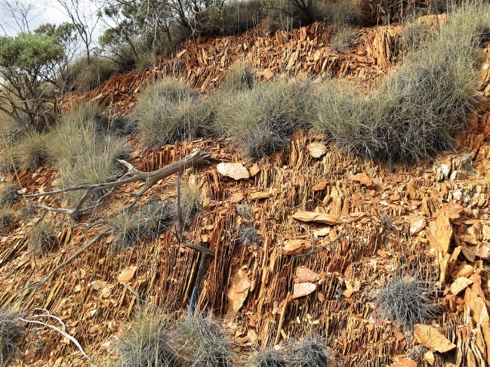
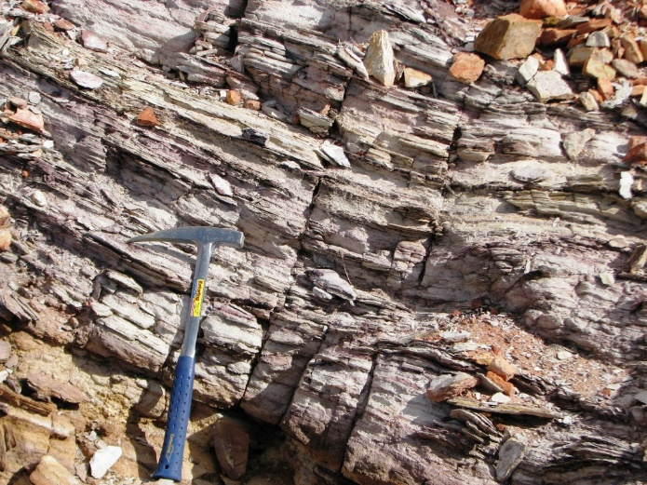
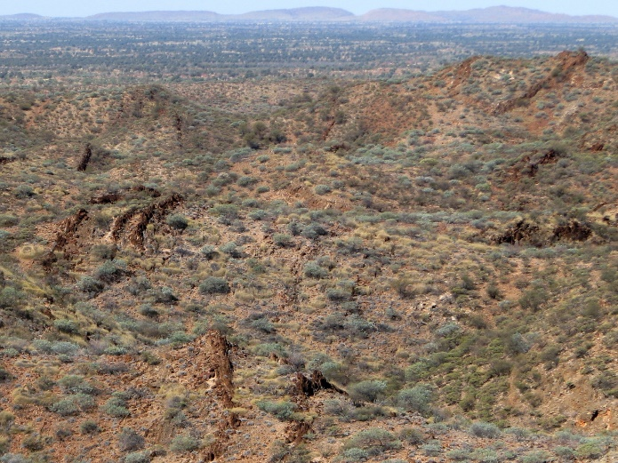
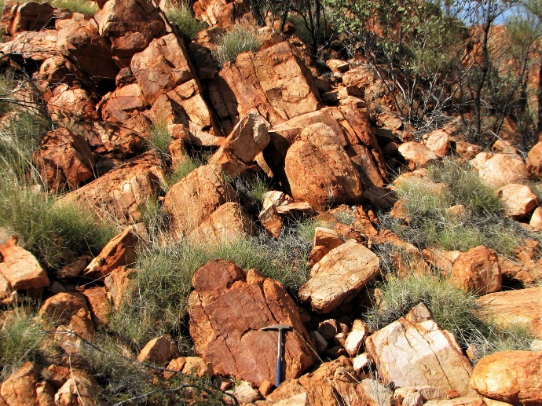
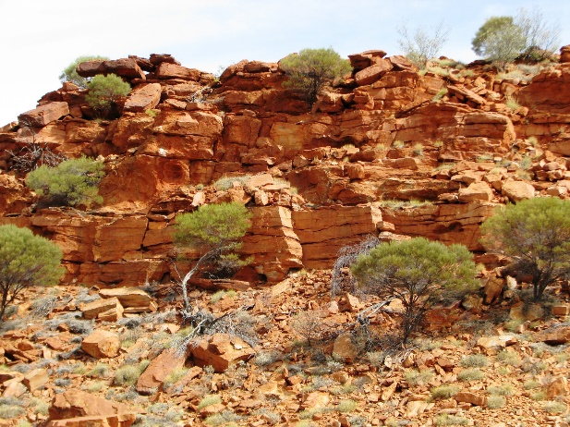
WA Amadeus Basin
Centralian Superbasin
Basal Gillen Fm shale – south
Basal Gillen Fm shale – north
Contorted Bitter Springs Group – Bonython Ra
Dean Quartzite – south
Heavitree Fm – north
Stromatolites allow confident identification of Gillen Fm in WA
Abundant evidence of salt tectonics in WA; no salt at surface but salt seal probably preserved at depth
Lower Gillen Fm shales in southwest much thicker than in east Amadeus
Thick sub-salt reservoir; some outcrops in N are not strongly silicified

Slide 13
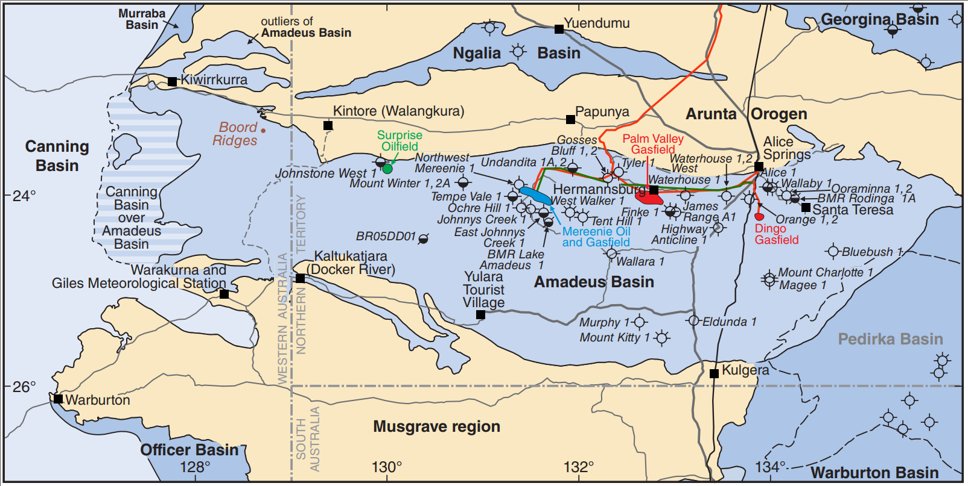
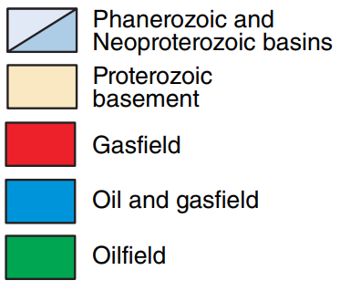
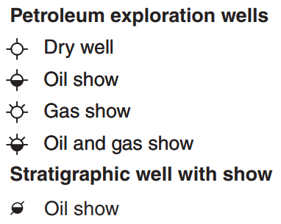
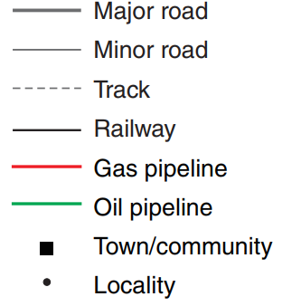
Amadeus Basin
Dukas 1
Santos 2019 (Central Pet ten.)
(Drilling suspended above
inferred reservoir)
Magee 1 (2,696 m)
Pacific Oil & Gas 1992
63.1 Mscfd from 4.5 m sst
Shale 0.5-0.8% TOC
Nitrogen 43.61%
Methane 30.58%
Ethane 5.96% 49.09%
Propane 1.94%
Butane+ 1.66%
Carbon dioxide 0.58%
Hydrogen 0.03%
Argon 0.46%
Helium 6.23%
Mt Kitty 1 (2,295 m)
Santos 2014 (Central Petroleum tenement)
420 Mscfd from weathered/fractured granite
Nitrogen 61%
Methane 13% 18%
Ethane 4%
Hydrogen 11%
Helium 9%

Slide 14
Amadeus Basin
Dukas 1
Santos 2019 (Central Pet ten.)
(Drilling suspended above
inferred reservoir)
Magee 1 (2,696 m)
Pacific Oil & Gas 1992
63.1 Mscfd from 4.5 m sst
Shale 0.5-0.8% TOC
Nitrogen 43.61%
Methane 30.58%
Ethane 5.96% 49.09%
Propane 1.94%
Butane+ 1.66%
Carbon dioxide 0.58%
Hydrogen 0.03%
Argon 0.46%
Helium 6.23%
Prove existence of a subsalt gas-prone hydrocarbon system
Prove integrity of the salt seal
9% He (Mt Kitty 1) close to the upper limit from wells world-wide
Isotope analysis indicates predominantly crustal He source
Concentration of other radiogenic noble gas isotopes indicates trapping and accumulation since Neoproterozoic (McInnes et al, 2017)
Hydrogen content (Mt Kitty 1) possibly “results from either hydrocarbon oxidation or as an abiogenic breakdown product of hydrocarbons in the granite reservoir…” (McInnes et al, 2017)
Both wells uneconomic because of poor reservoir
Mt Kitty 1 (2,295 m)
Santos 2014 (Central Petroleum tenement)
420 Mscfd from weathered/fractured granite
Nitrogen 61%
Methane 13% 18%
Ethane 4%
Hydrogen 11%
Helium 9%

Slide 15
Amadeus Basin
Dukas 1
Santos 2019 (Central Pet ten.)
(Drilling suspended above
inferred reservoir)
Magee 1 (2,696 m)
Pacific Oil & Gas 1992
63.1 Mscfd from 4.5 m sst
Shale 0.5-0.8% TOC
Nitrogen 43.61%
Methane 30.58%
Ethane 5.96% 49.09%
Propane 1.94%
Butane+ 1.66%
Carbon dioxide 0.58%
Hydrogen 0.03%
Argon 0.46%
Helium 6.23%
Too deep
Sub-salt reservoir
and shale thickens
Mt Kitty 1 (2,295 m)
Santos 2014 (Central Petroleum tenement)
420 Mscfd from weathered/fractured granite
Nitrogen 61%
Methane 13% 18%
Ethane 4%
Hydrogen 11%
Helium 9%
No reservoir

Slide 16
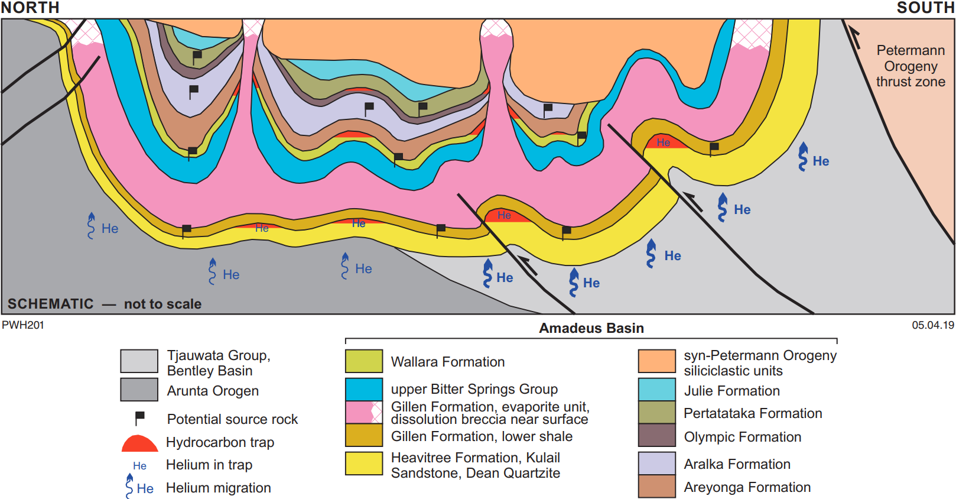
From Haines and Allen, 2019, WABS paper
salt
salt

Slide 17
Centralian Superbasin
Modified from Munson 2013
NTGS Spec Pub 5
Centralian Superbasin
(Post mid-Cambrian omitted)
Tectonized Centralian
Superbasin under
Canning Basin
Super-
sequences
Generalized succession
Cambrian
541 Ma
SS4
Syntectonic siliciclastic package
?
?
?
Ediacaran
?
?
SS3
Post-glacial marine package
GSWA Lancer 1
Dukas 1
Neoproterozoic
~635 Ma
Mt Kitty 1
Magee 1
Elatina (“Marinoan”) Glaciation
Yowalga 3
glacial erosion / unconformity
Kanpa 1A
?
Cryogenian
GSWA Empress 1A
?
?
Mulyawara 1
?
Inter-glacial marine package
?
SS2
Kutjara 1
?
Sturt (“Sturtian”) Glaciation
~720 Ma
glacial erosion / unconformity
?
Tonian
SS1
Evaporite–carbonate–shale package
Basal siliciclastic package
1000 Ma
Mesoproterozoic
Salt ~800 Ma (halite/anhydrite)

Slide 18
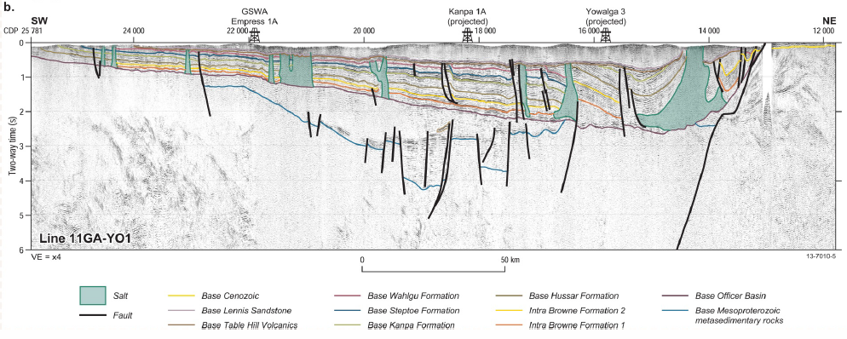
Centralian Superbasin
Modified from Munson 2013
NTGS Spec Pub 5
Tectonized Centralian
Superbasin under
Canning Basin
?
SW
NE
?
?
?
?
GSWA Lancer 1
Dukas 1
Yowalga 3
Mt Kitty 1
Magee 1
Kanpa 1A
?
GSWA Empress 1A
?
?
Mulyawara 1
?
?
Kutjara 1
?
?

Slide 19
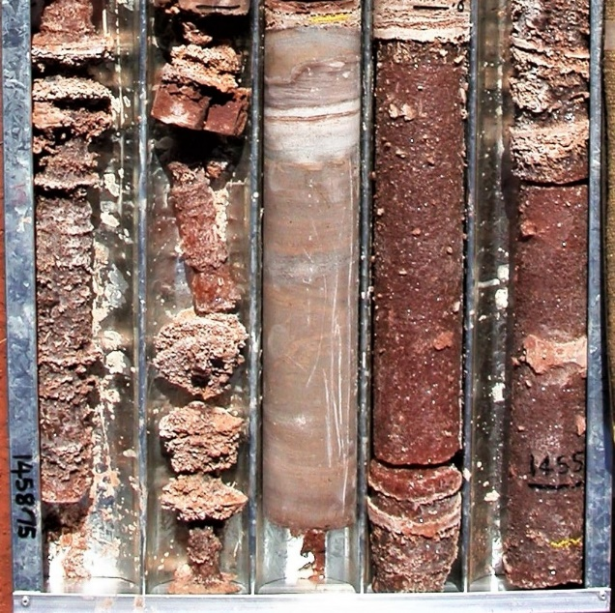
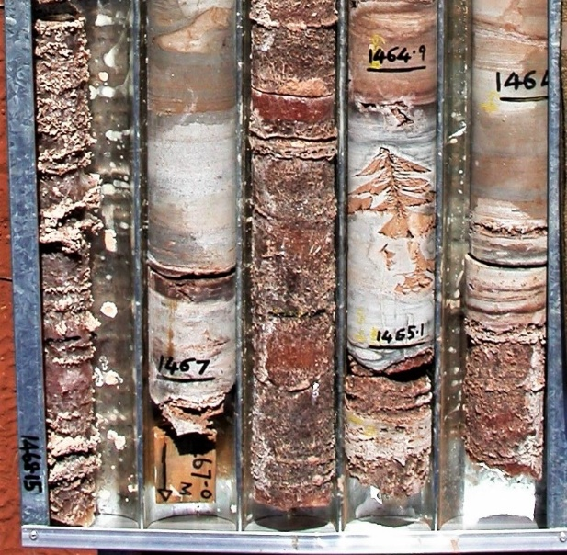
Centralian Superbasin
Western Officer Basin: Browne Formation in GSWA Lancer 1
dolomite
salt

Slide 20
Centralian Superbasin
Western Officer Basin: Browne Formation in GSWA Lancer 1
Limited subsalt exploration
GSWA stratigraphic holes not drilled on identified structural traps, and drilled into thin succession west of basin depocentre where salt unit sits on basement with very little subsalt shale
Exploration wells Kanpa 1A drilled outside subsalt reservoir; Yowalga 3 didn’t reach subsalt reservoir (if present)
Subsalt shale and sandstone reservoir can be inferred farther east (outcrop evidence)
Exploration drilling in SA near WA border (Mulyawara 1, Kutjara 1) prove subsalt shale and sandstone present, and contain numerous but minor gas shows over this stratigraphy

Slide 21
Conclusions
World’s oldest regional salt seal widespread in Amadeus and Officer Basins
Basins overlie radiogenic basement He source
Salt locally overlies thick sandstone reservoir and marginal gas-prone hydrocarbon source rocks
Salt-sealed traps likely formed early (Neoproterozoic & Paleozoic tectonics)
Ingredients thus in place for a world-class He province (challenges are remoteness, and lack of subsurface data)
Trapping of very high He concentration in gas proven in two eastern Amadeus Basin wells (though uncommercial due to poor reservoir)
Considerable opportunities in WA parts of Amadeus and Officer Basins

