Slide 1

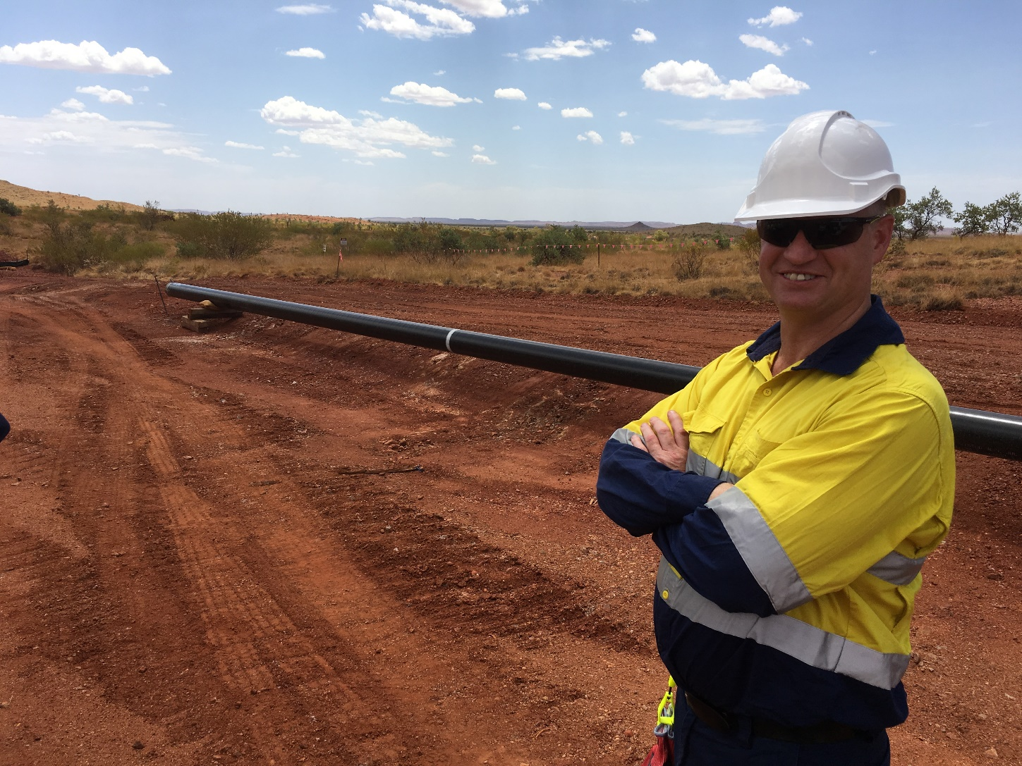
Safety Legislation Update
Presented by
Steve Emery
A/Director Petroleum Safety
and
Dangerous Goods

Slide 2
Background – Safety Legislation Reform
Started with the last State government
Newly elected State government expanded commitments
Application of the Model Work Health and Safety (WHS) legislation but tailored to WA

Slide 3
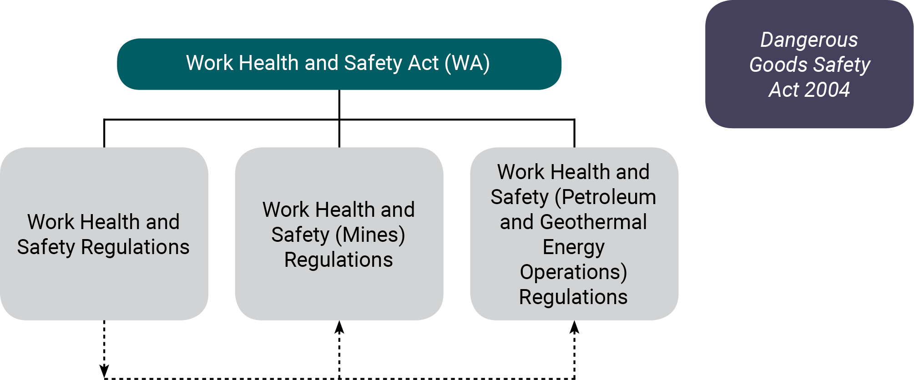
The WHS Act Structure concept
Single Act – 3 sets of WHS regulations
Notes:
Review process

Slide 4
Petroleum Legislation Break Up Concept
Notes:
The Schedules are going to be repealed from the three Acts. We’re not proposing to repeal the three Acts themselves, because they still need to be in place because of Permits, the Adjacent Area, Royalties and so forth.
Those provisions that are in the current Schedules (duty of care and so forth) will be contained in the Work Health and Safety Act. We don’t have any influence over that. This consultation process is not about the Work Health and Safety Act. This consultation that we’re talking about now is about the PAGEO Regulations.
Also, the wording of the provisions of the Work Health and Safety Act is slightly different from the three Schedules.
So why didn’t we do this years ago? Why didn’t we just create one Petroleum Safety Act with one set of regulations? Well, we tried, about twenty years ago. We even got it to the stage of being a bill. Then it stalled. I think that that was because we were trying to maintain alignment between the Western Australian P(SL)A and the Commonwealth P(SL)A, as it was then (it’s the Offshore Petroleum and Greenhouse Gas Storage Act now). Ironically, while the Commonwealth legislation has been evolving constantly, our regulations only came into effect in 2007 and 2010.
So, harmonising with the Work Health Safety legislation is a great opportunity to rationalise these regulations.
But the pertinent regulations that belong to the three Acts will all be merged into one set of regulations – the Petroleum and Geothermal Energy Operations Regulations. They will apply onshore and offshore in the Adjacent Area. They will cover all the PAGEO Operations, including Diving. This is the approach taken by the Commonwealth Legislation. We may as well achieve consistency with them, as well as learning from their mistakes.
And, the duty of care and other provisions in the existing Schedules will be harmonised with the rest of the WHS legislation.
Now Luke will go into more detail about the changes that these proposed regulations will bring.

Slide 5
Rationalisation of 8 sets of regulations into 1 set
Notes:
Now let’s look at some pictures.
Currently, the three Acts that apply to the Petroleum, Geothermal Energy Operations, and gas transmission pipelines are these three Acts.
Each of these three Acts has a number of sets of regulations associated with it. I’ve only shown one set of regulations for each act to keep it simple, but there are other regulations that have to do with things like the environment and reservoir management. We’re not really concerned with those, because this whole project is driven by harmonising with the Work Health Safety Act.
Also, for the P(SL)A there are actually 3 sets of regulations that pertain here, rather than just 1 as I have shown here. Those three are the Management of Safety of Offshore Facilities regulations (for things like rigs), the pipelines regulations, and the diving safety regulations.
The idea that I’m trying to convey with this slide is that we are taking the corresponding, pertinent regulations from the three acts and combing them into one set of regulations, which we will call the PAGEO regulations.
Next, we’ll look at the structure of these Acts and the pertinent regulations in a little more detail. Pretend that these three Acts are actually one Act. That’s what we’ll be looking at on the next slide.

Slide 6
Key changes – The Act
(From the Act)
Duties to the public, not just the workforce
ALARP is now “So Far As Is Reasonably Practicable”
At or Near is now “In The Vicinity Of”
Camp Accommodation is included
Notes:
These changes are required to be reflected in these regulations because they will be in the Work Health and Safety Act. We don’t have any choice over these changes.
(Go through the points)

Slide 7
Proposed Key Changes in the PAGEO Regulations (1)
Application of the Dangerous Goods Safety (Storage and Handling of Non-Explosives) Regulations 2007 to petroleum pipelines
Relates to information and equipment for emergencies
Placarding, accessible manifests, fire-fighting equipment and an Emergency Response Guide submitted to DFES
Provides consistency in case you need help from DFES - strongly recommended by DFES in early consultation
Notes:
Now, this slide and the next slide are about some prescriptive provisions that we are proposing.
This slide has to do with the Dangerous Goods Safety (Storage and Handling of Non-Explosives) Regulations 2007.
Currently, for facilities and operations under the PAGERA and the P(SL)A, those operations are also be subject to the Dangers Goods legislation. However, onshore pipelines under the Petroleum Pipeline Act are exempt from the Dangerous Goods legislation.
We are proposing that we make these arrangements mandatory and prescriptive for onshore pipelines as well.
All of these provisions relate to things that DFES would need to know if there responders are called in to help you in an emergency.
This was very strongly recommended to us by DFES early on in the consultation process.

Slide 8
Proposed Key Changes in the PAGEO Regulations (2)
Chief Inspector Petroleum Safety (CIPS) replaces Minister
Periodic reporting will be required quarterly (not monthly, as is the current case), and will be expanded to include leading indicators
Incident notification is defined under the Act; however, the PAGEO Regulations will define additional industry-specific notifiable incidents
Notes:
This is the last slide in my “key changes” series of slides.
Firstly, we are proposing that a news statutory position is created, called the Chief Inspector Petroleum Safety. This would be functionally the same as is the current case. Currently the legislation is written such that the Minister accepts safety cases and reviews decisions made by the inspector. In reality the Minister actually delegates that power to the Director Petroleum Safety.
Currently the requirements for periodic reporting are for monthly reporting, and they are inconsistent between the three acts. We are proposing that we shift that approach and make their periodic reporting quarterly. Further, we’re proposing to introduce leading indicators that will be more meaningful in terms of process safety, and not so much the lagging indicators like deaths and injuries.
Now finally let me point out that most of the notifiable incidents are covered by the Act. However, in the PAGEO Regulations we need to provide some industry-specific notifiable incidents, such as well kicks, for example.

Slide 9
Important Petroleum and Geothermal Energy Operations Regulations
One set of regulations replaces the existing 8 sets
  Same coverage as original regulations but in one place
The Safety Case approach will be retained
  One kind of safety case for all
Statutory position – Chief Inspector Petroleum Safety
  Accepts safety cases
Registered Operator required for all petroleum and geothermal energy operations
  The Operator will have day-to-day management and control

Slide 10
Relationship to WHS general regulations
Limited application of the general WHS regulations
Representation and Participation – workplace consultation, Health and Safety Representatives, and Safety Committees
General Risk and Workplace Management
Miscellaneous – serious illness, inspector ID cards and stay of decision period
Schedule 10 Prohibited carcinogens, restricted carcinogens and restricted hazardous chemicals
Notes:
This slide has to do with some things that we are proposing to apply from the General WHS Regulations.
Note that these are the kind of prescriptive requirements that are currently in the three sets of OSH regulations. So in other words, we are not proposing arbitrary, prescriptive requirements – they are already there.
Why are we proposing to refer to the General WHS Regulations? Because they are already there, in the WHS Regulations, therefore, there is no need to reproduce them in our regulations.
Also, if there is a shift in philosophy over time, it would be tidier to amend a single set of regulations rather than several sets of regulations.

Slide 11
Centre piece of the Regulations - The Safety Case
Key principle in forming these regulations is to maintain the Safety Case
No fundamental changes
Duty holder identifies hazards and assesses risks
They then identify the most appropriate controls for those risks, and how to manage those controls
A description of these controls is provided in Safety Case
Safety Case is assessed then if ok, accepted by DMIRS
Petroleum Safety audits to accepted Safety Case
Notes:
The safety case approach to these regulations is what I think of as “preventative” legislation, rather than “punitive.” The intention of “preventative” OSH legislation is to encourage the duty holder to take steps to prevent adverse outcomes. “Punitive” legislation is more about setting lots of prescriptive requirements, and then punishing the duty holder if they do not comply.
Our proposal in forming these regulations is to maintain the safety case approach. During our consultation with stakeholders, we have received overwhelming support for this idea. Our industry and the workforce have been working with the safety case approach for several decades. Our industry has benefited from it, and we want to keep it.
(Go through the points)

Slide 12
Something new – the Design Safety Case
Pre FEED opportunity to more formally engage with Petroleum Safety
Intent is to allow:
  Operators to document their Safety in Design principals such as:
    Design Safety Criteria
    Safety Assessment approach
    RAM targets
    Design Life
  DMIRS to identify to operators potential safety issues during design phase rather than after “as built”
NOT mandatory nor formally accepted by DMIRS

Slide 13
Transitional provisions
They will be either in the Act or in the PAGEO Regulations
Existing Safety Cases in force will remain in force until their “expiry date”
Safety Cases submitted before the PAGEO Regulations come into force will be assessed under the old regulations
Other new provisions may come into effect 6-12 months
Notes:
We’re getting close to the end now.
Let’s look at the Transitional Provisions that we’re proposing
(Go through the points.)
For other new provisions (point to the last bullet point) such as application of the Dangerous Goods Safety (Storage and Handling of Non-Explosive) Regulations to pipelines, we would imagine that Parliamentary Counsel would recommend 6-12 months. But that’s part of the consultation process, so you have your opportunity to have your say in your submission.

Slide 14
Where are we now?
The Act
  Drafting Instructions completed
  Act being drafted by Parliamentary Counsel’s Office
  Expected to be in Parliament before end of year
  Won’t receive Royal Assent until Regulations are done
The Regulations
  Drafting instructions have been developed
  Released for Public Consultation
  Expected to be presented to Parliament mid/end next year
Commitment by Government to have Act and Regulations in Parliament by end of next year

Slide 15
The Regulations – Public Consultation
Drafting Instructions out now for consultation
Series of public presentations around WA
On the website
Feedback closes 26 November
Actively seeking feedback and suggestions to improve the drafting instructions

Slide 16
Contact Details
DMIRS website - www.dmirs.wa.gov.au/WHSregsreview
Contact:
  Email: WHSreform@dmirs.wa.gov.au

