Slide 1
Please read this before using presentation
This presentation is based on content presented at the Exploration Safety Roadshow held in March 2014
It is made available for non-commercial use (e.g. toolbox meetings, OHS discussions) subject to the condition that the PowerPoint file is not altered without permission from Resources Safety
Supporting resources, such as brochures and posters, are available from Resources Safety
For resources, information or clarification, please contact:
RSDComms@dmp.wa.gov.au
or visit
www.dmp.wa.gov.au/ResourcesSafety

Slide 2
Importance of auditing

Slide 3
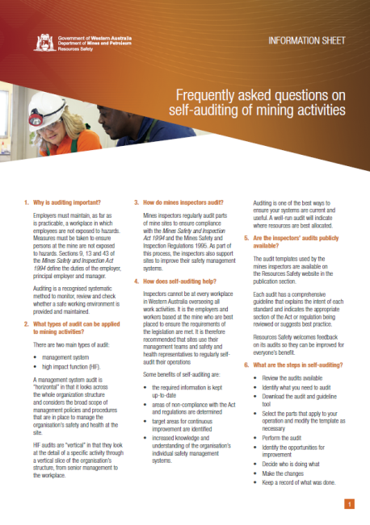
What is the role and benefit of an audit?
One of the best ways to ensure your systems are current and useful.
If well-run, indicates where best to allocate resources.
Some benefits of self-auditing:
required information is kept up-to-date
areas of non-compliance with legislation are determined
target areas for continuous improvement are identified
increased knowledge and understanding of organisation’s safety management systems
Notes:
Auditing:
Identifies holes in your system, both in the documentation and system implementation
Assists in identifying hazards and ensuring controls are in place
Ensures required information is kept up-to-date and document controlled
Identifies areas of non-compliance with legislation
Creates a positive cycle of continuous improvement
Increases employee knowledge and understanding of the organisation’s systems
Improves management’s awareness of potential weaknesses/problems

Slide 4
Resources Safety’s audits are no secret
All audit templates and guidelines are available online
Opportunities to participate in content reviews or pilot runs
Site representatives encouraged to accompany inspectors during audit
Notes:
All audits used by the mines inspectors are available from the Resources Safety publications section of the DMP website.
From time to time, opportunities arise to participate in reviews of content or pilot runs.
Inspectors often request Safety and Health Representatives or other site representatives to assist while they undertake a site audit. The exchange of information can be two ways.

Slide 5
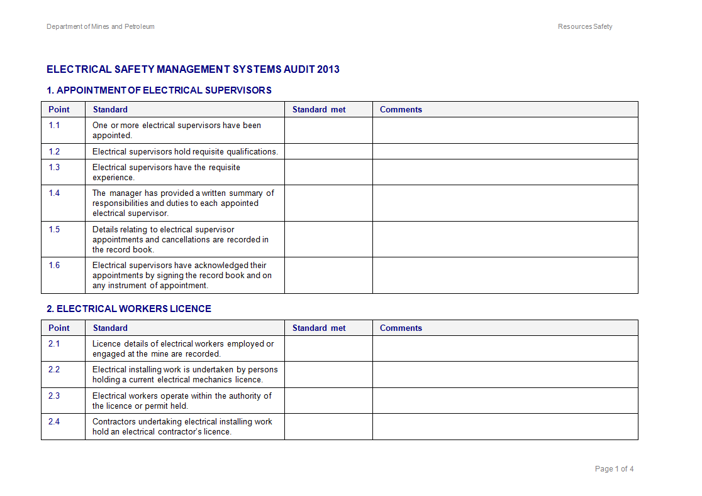
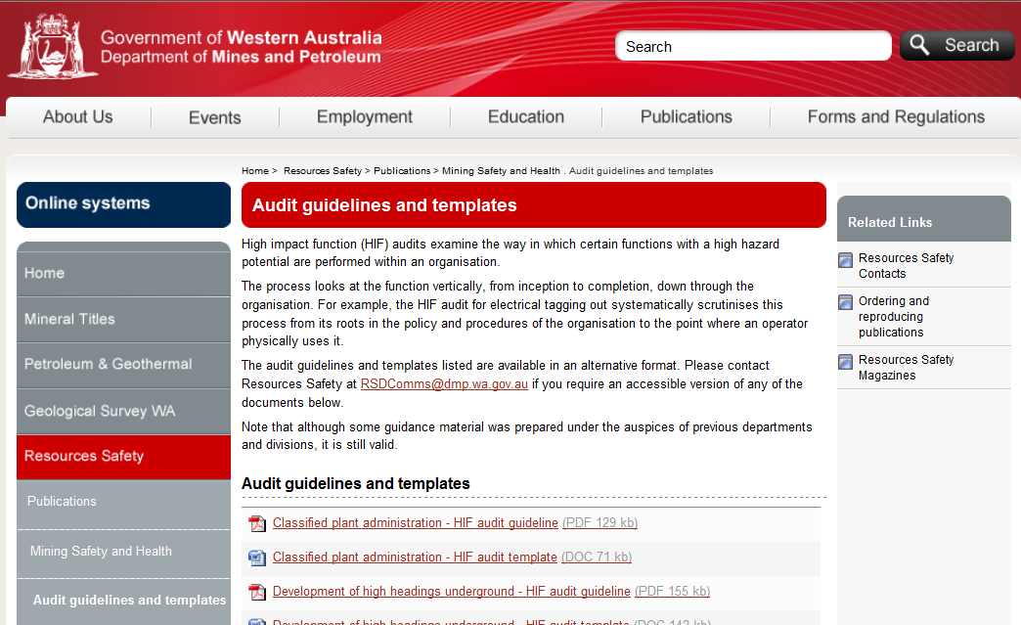
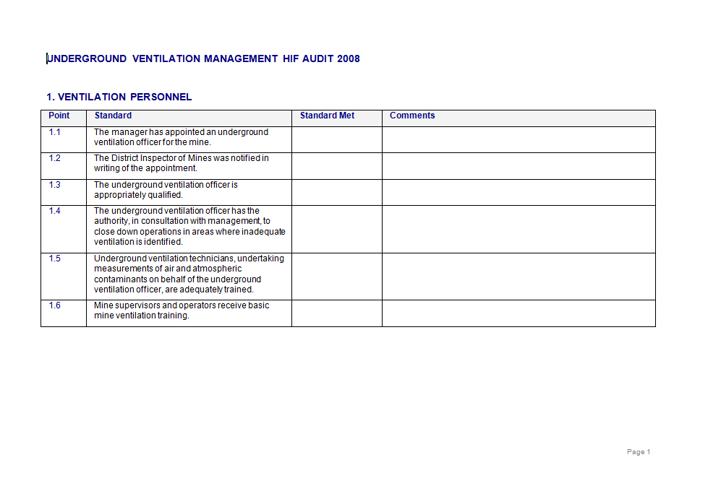
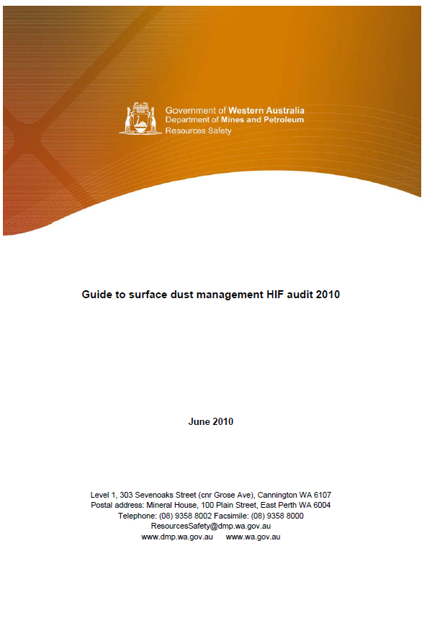
Our audits are available publicly
www.dmp.wa.gov.au/ResourcesSafety
Notes:
Here’s a list of some audits that might interest you:
Resources Safety audits cover areas such as:
mineral exploration
surface dust management
electrical safety management systems
emergency preparedness
manual tasks
noise
traffic management
classified plant and administration
fixed plant
workshops
geotechnical considerations
management systems for small mines
Go to the publications area on the website to download them http://www.dmp.wa.gov.au/15565.aspx

Slide 6
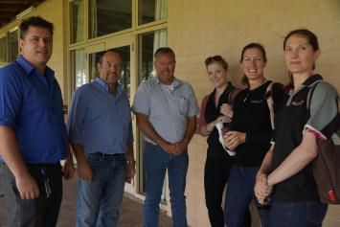
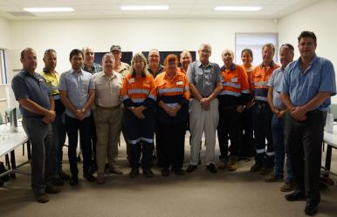
How was the exploration audit developed?
Extensive industry consultation
Complements the code of practice
Notes:
Two industry feedback sessions held in Perth and Kalgoorlie in November 2012. Communicated via Resources Safety weekly news alerts and the DMP events page
Event hosted by ADIA – Australian Drilling Industry Association
Consultation with AMEC – Association of Mining and Exploration Companies
Finalised audit tools available on DMP website for industry use in January 2013

Slide 7
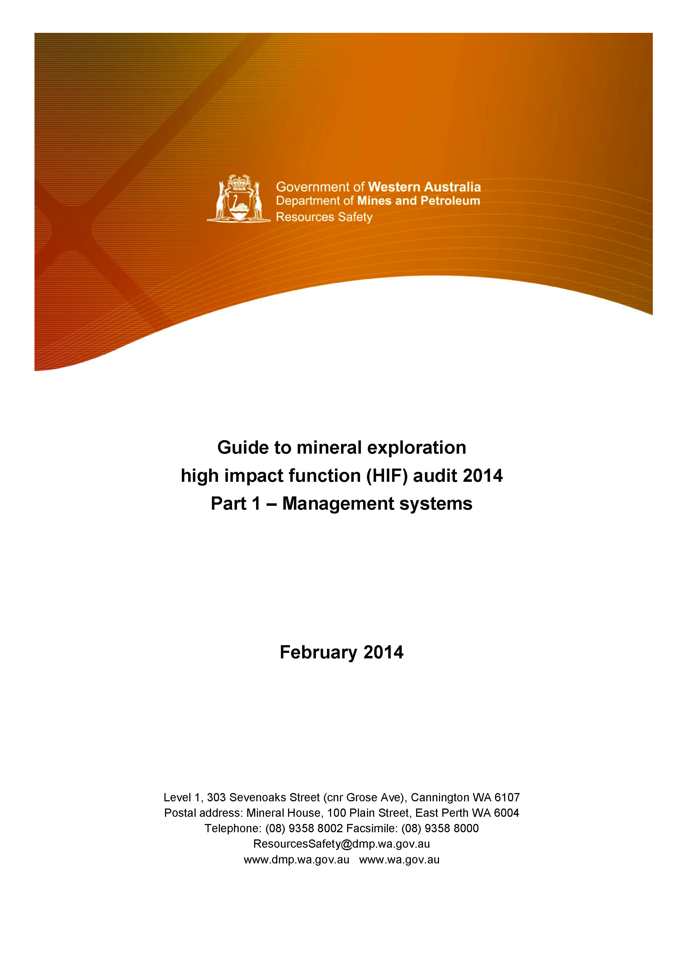
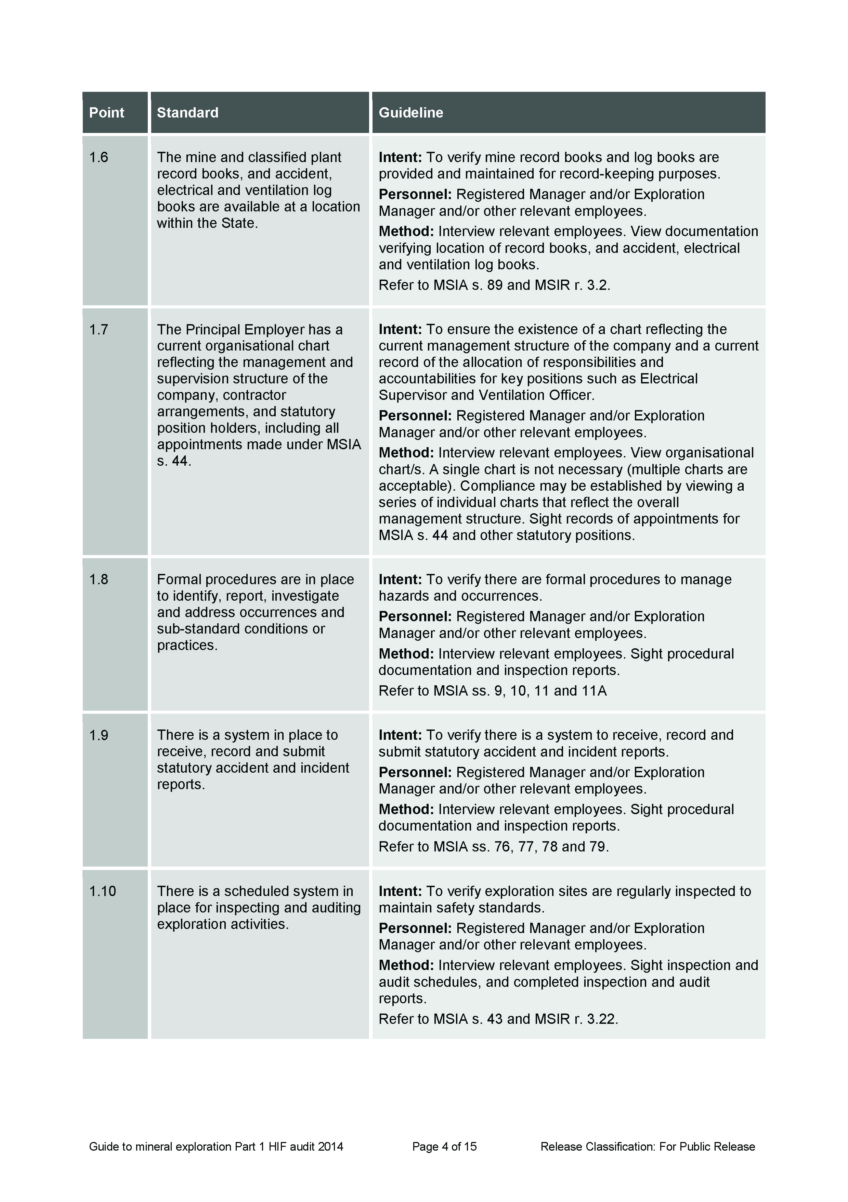
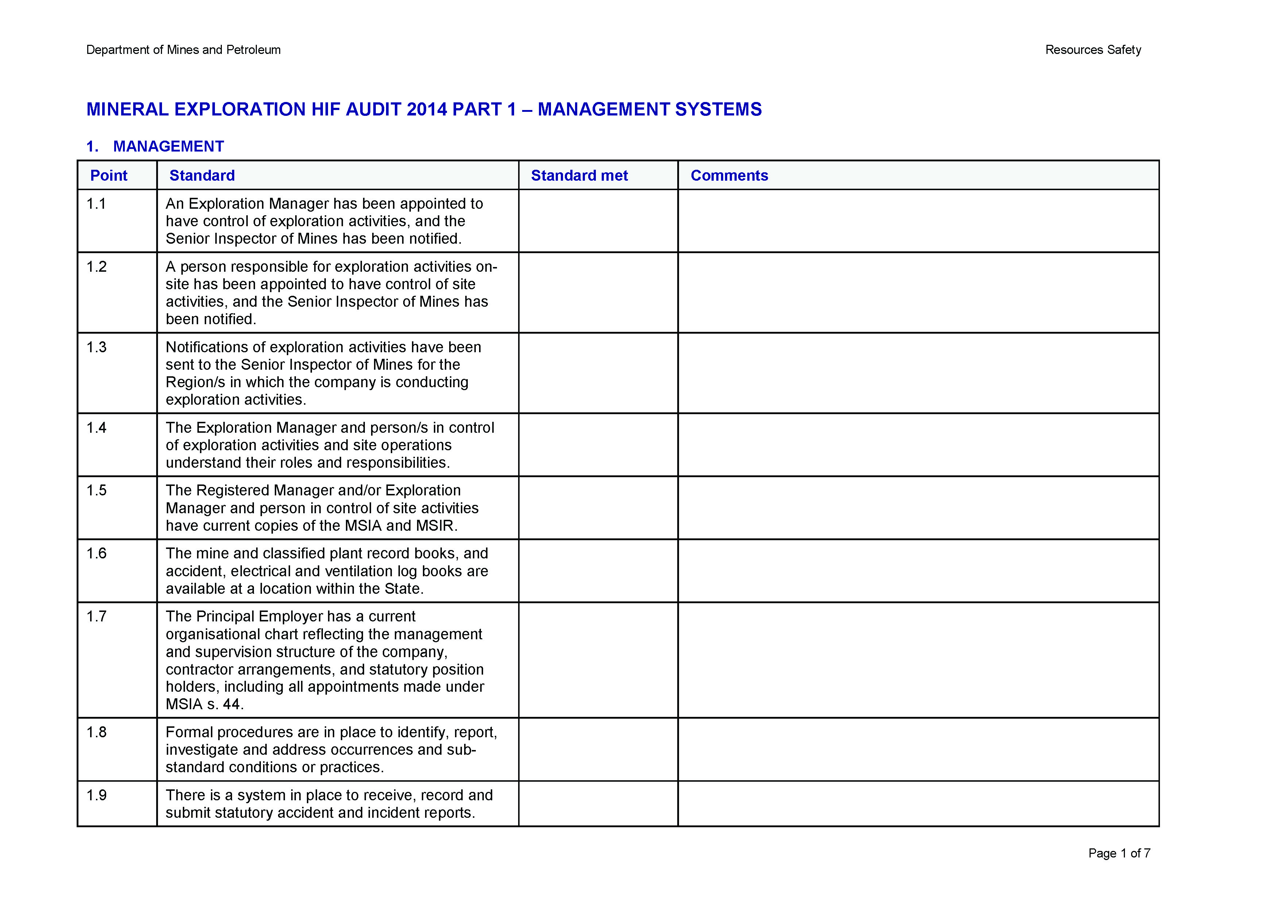
What is the exploration audit tool?
Audit template
Guideline

Slide 8
How is the exploration audit structured?
Part 1
Management systems
Part 2
Site operations
Part 3
Drilling and other field activities
Notes:
Important to note that audit is not just for drilling activities.
Other field activities could include mapping, sampling, surveying, gridline preparation, costeaning, drilling and downhole logging.

Slide 9
What have we found?
Last 13 audits conducted by DMP mines inspectors identified common areas of non-compliances including:
Not all statutory appointments had been made (e.g. Ventilation Officer, Electrical Supervisor)
Appointed responsibilities and duties were not understood in many cases
Supervisors did not have access to accurate training records
Workers were not trained and assessed as competent for their assigned tasks, plant or equipment
No system for training and maintenance of emergency communication and response equipment

Slide 10
Findings from DMP review of fatal accidents 2000-12
Identification of hazards and critical tasks
Principal hazard management plans
Written work procedures
Involvement of workers
Training processes – workers and supervisors
Supervision to standards
Site familiarisation and induction
Adequate breaks during the shift
Notes:
Presented at the 2013 Mines Safety Roadshow. If you are interested in further information from this presentation visit the toolbox presentation section on the website at http://www.dmp.wa.gov.au/8054.aspx
Proposed areas for improvement. What can industry do with this information to improve safety performance?
Identification of hazards and critical tasks (most important) – Everyone needs to understand what hazards they will be faced with during the day and what are the critical tasks everyone does on a day-to-day basis. We need to know what can go wrong and what can kill when doing a particular job.
Principal hazard management plans (PHMPs) – The repetitive failures that we see in the review match the principal hazards identified by the National Mines Safety Framework. All operators need to have knowledge of the hazards on their site that can cause multiple or repeat single fatalities.
Written work procedures – Need to be developed for hazards that have been identified, and modified if the situation changes.
Involvement of employees – Employees need to know the written work procedures and need to be involved with developing those procedures.
Training processes (employees and supervisors) and supervision to standards – Once the procedures are in place, there needs to be training processes to support. This will to ensure all employees and supervisors are well trained in the jobs they have to do and have knowledge of the hazards they might face.
Site familiarisation – People need to be conscious of employees entering the industry. They need time to familiarise themselves with what’s going on, the roster cycles and different working environments (this may include a site tour at night, when things look different). They need time to get to know work mates, supervisors and work processes.
Adequate breaks during the shift – The need for breaks during shift is a long standing issue. We need to be conscious that people cannot sustain focused activities for long periods of time and breaks are needed. The likelihood of someone making an error increases with fatigue and lack of concentration. As a minimum, the site’s fatigue management plan should be reviewed in regard to the problem times identified by the review around 3am, 11am, 4pm and 11pm. What sort of breaks might be required?

